Slide 1
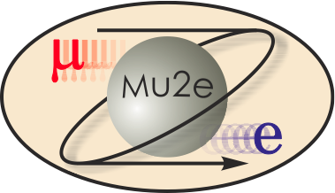
Mu2e CD-2/3b CRV Electronics
Sten Hansen
CRV FE Electronics Level 3
10/21/2014

Slide 2
Experience
36 years at Fermilab
In the last couple of years:
Warm side electronics for CDMS
Beam position monitor system for the Linac
Beam Intensity monitor for the SeaQuest experiment
Wire chamber TDC system for test beam facility

Slide 3
Organization
WBS 475.8 Cosmic Ray Veto
Craig Dukes / Virginia
Julie Whitmore / Fermilab (Deputy)
475.8.1 Project Management
Craig Dukes / Virginia
CAM: Dukes
475.8.5 Photodetectors
Julie Whitmore / Fermilab
CAM: Whitmore
475.8.2 Mechanical Design
Craig Dukes / Virginia
CAM: Dukes
475.8.6 Electronics
Sten Hansen / Fermilab
CAM: Dukes → Whitmore
475.8.3 Scintillator Extrusions
Anna Pla-Dalmau / Fermilab
CAM: Pla-Dalmau
475.8.7 Module Fabrication
Craig Group / Fermilab & Virginia
CAM: Group
475.8.4 Fibers
Yuri Oksuzian / Virginia
CAM: Dukes
475.8.8 Detector Assembly & Installation
Jim Fagan / Fermilab
CAM: Dukes

Slide 4
Requirements
The requirements for the Cosmic Ray Veto are described in detail in Mu2e-doc-944.
Fundamental (detector independent) requirements:
To reduce the conversion-like background from cosmic rays to less than 0.1 events over the course of the run
To provide a cosmic-ray trigger primitive to the DAQ
Not to contribute more than 10% experiment dead time accurate timing
Not to use more than 20% of the DAQ bandwidth

Slide 5
Design
There are three board types in the system:
A counter mother board (CMB) which holds four SiPMs, two flasher LEDs, flash gate switches and a temperature sensor.
A front-end board (FEB) which digitizes the signals from 64 SiPMs.
A readout Controller (ROC) which gathers data from and supplies power to 24 front-end boards over Cat-5 cables. Interfaces to the DAQ/timing/control system.

Slide 6
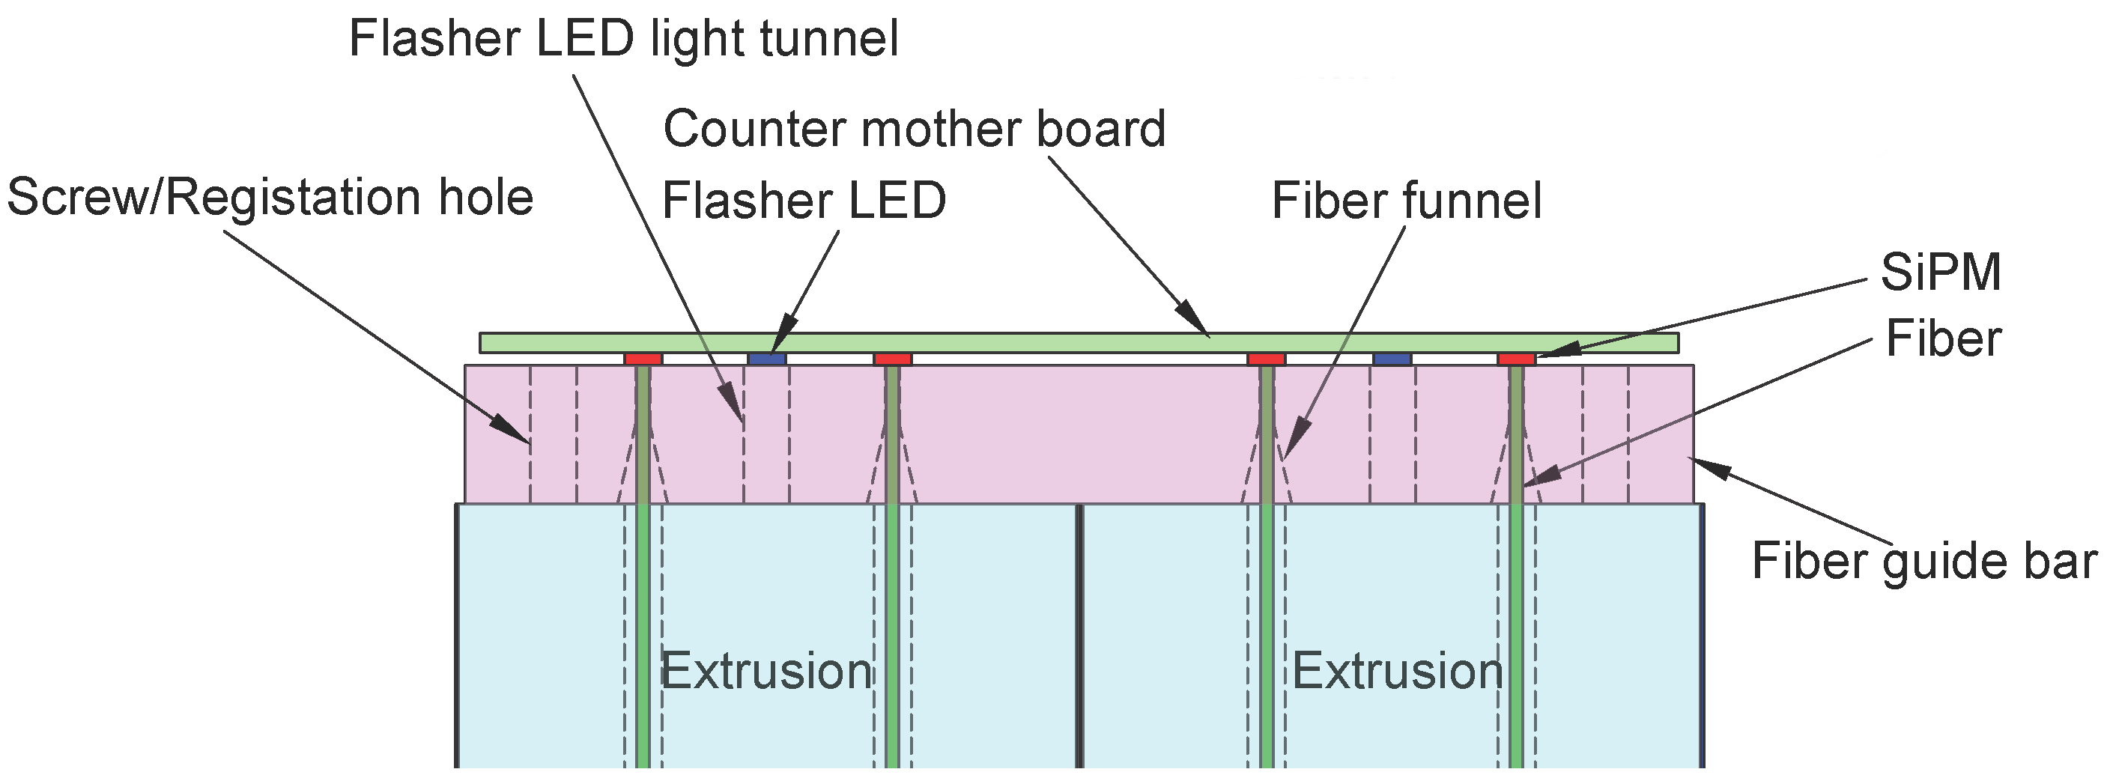
Design
Extrusion Arrangement :
Counter motherboard:
HDMI connector omitted

Slide 7
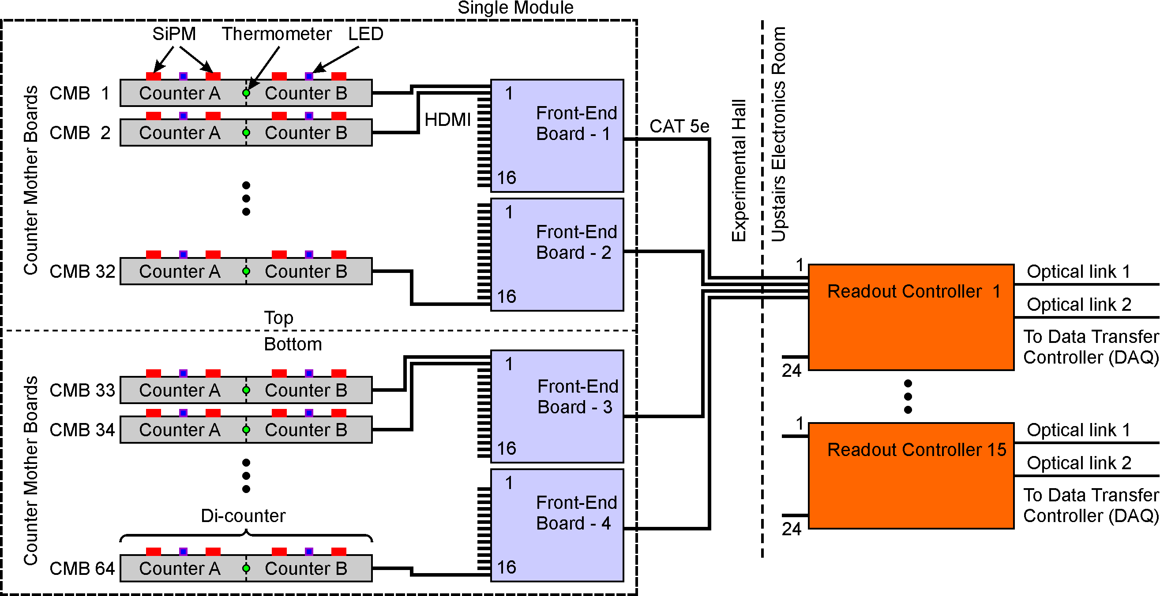
Design
Diagram showing interconnection of all three board types:

Slide 8
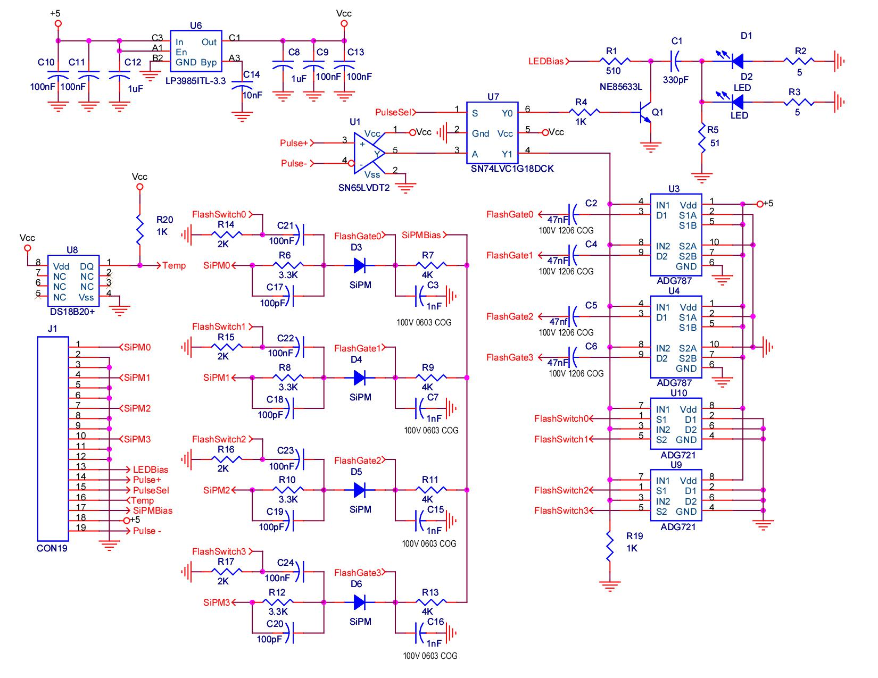
Design
The CMB schematic

Slide 9
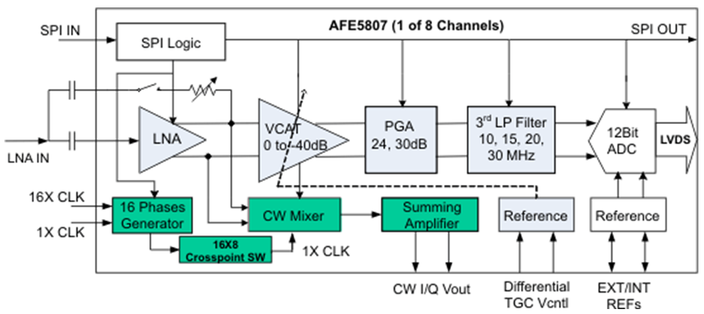
Design
The core of the readout is a commercial ultrasound imaging chip:
Eight channels of: low noise preamp, variable gain amp,
programmable gain amp, programmable low pass filter,
80msps 12 bit ADC. $8 per channel, 120mW per channel.
Adjust gain such that 1p.e. = 10 ADC counts.

Slide 10
Design
Flash gate simulation
Full Scale
LNA Voltage Clamp not simulated, ultrasound imaging requires fast over range recovery

Slide 11
Design
Simulation of an 11 p.e. SiPM signal showing tail cancellation:

Slide 12
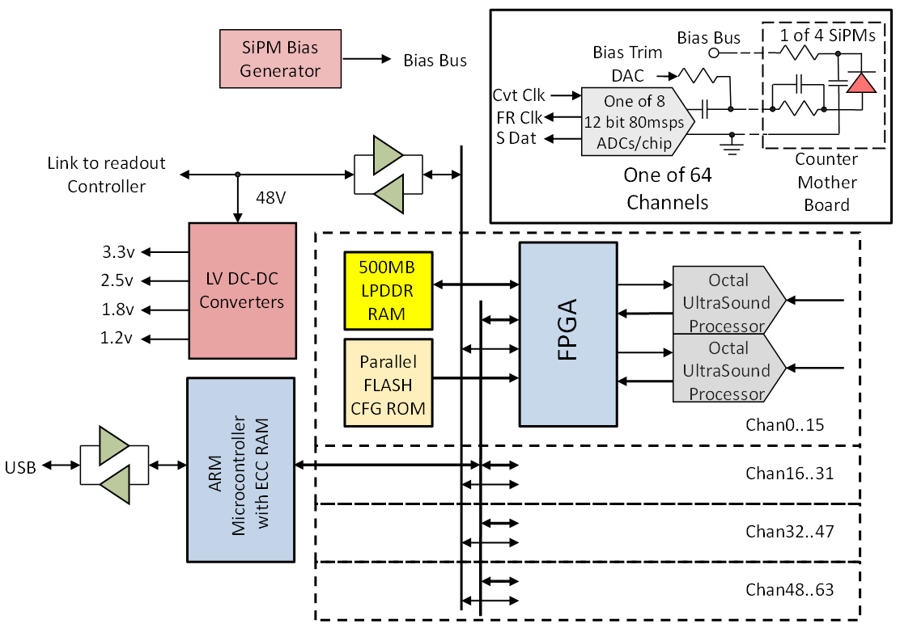
Design
Front end board block diagram:

Slide 13
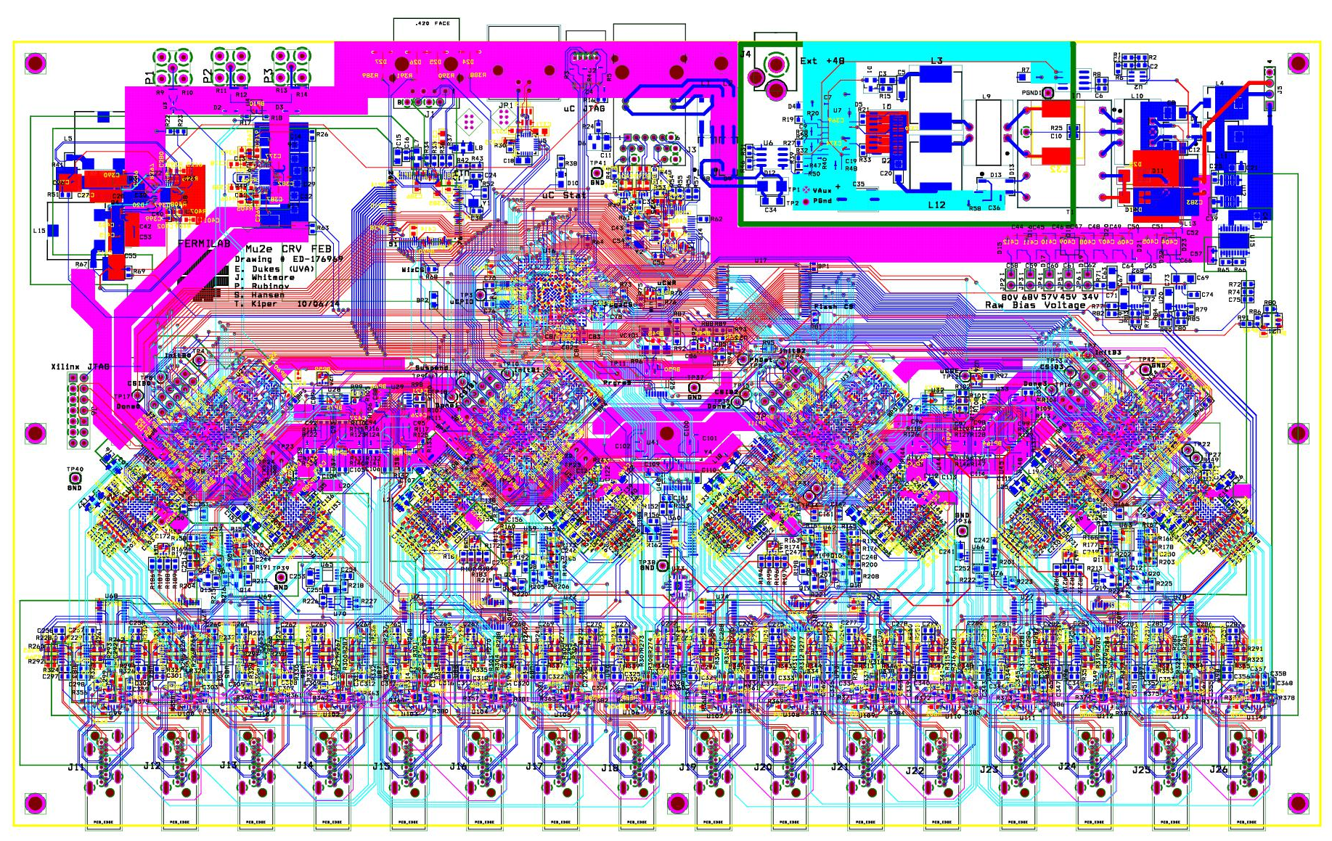
Design
Plot of the FEB layout:

Slide 14
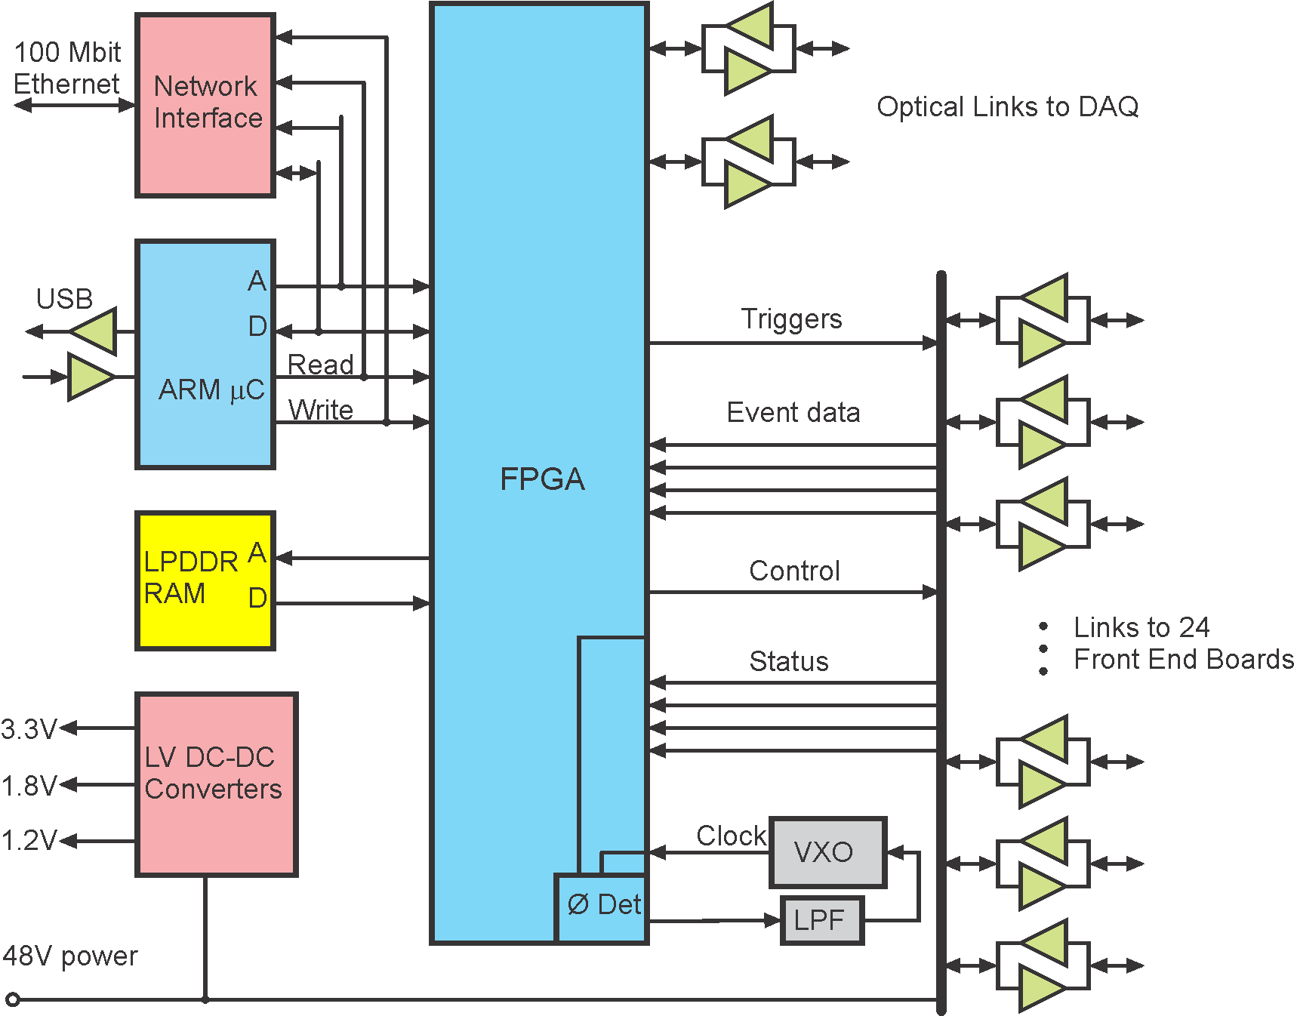
Design
Controller
block diagram:

Slide 15
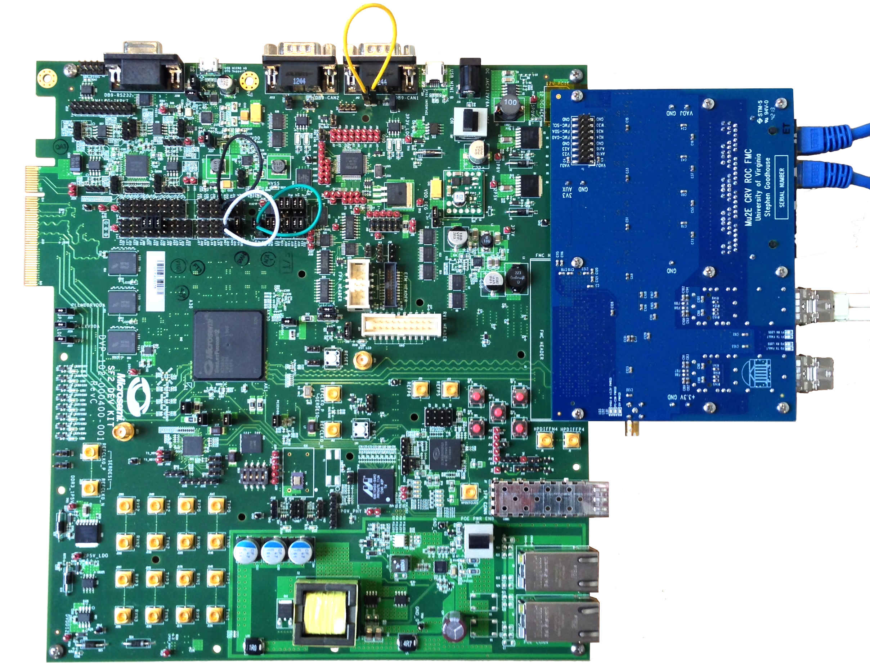
Design
Controller development platform (FPGA evaluation board + FEB adapter):

Slide 16
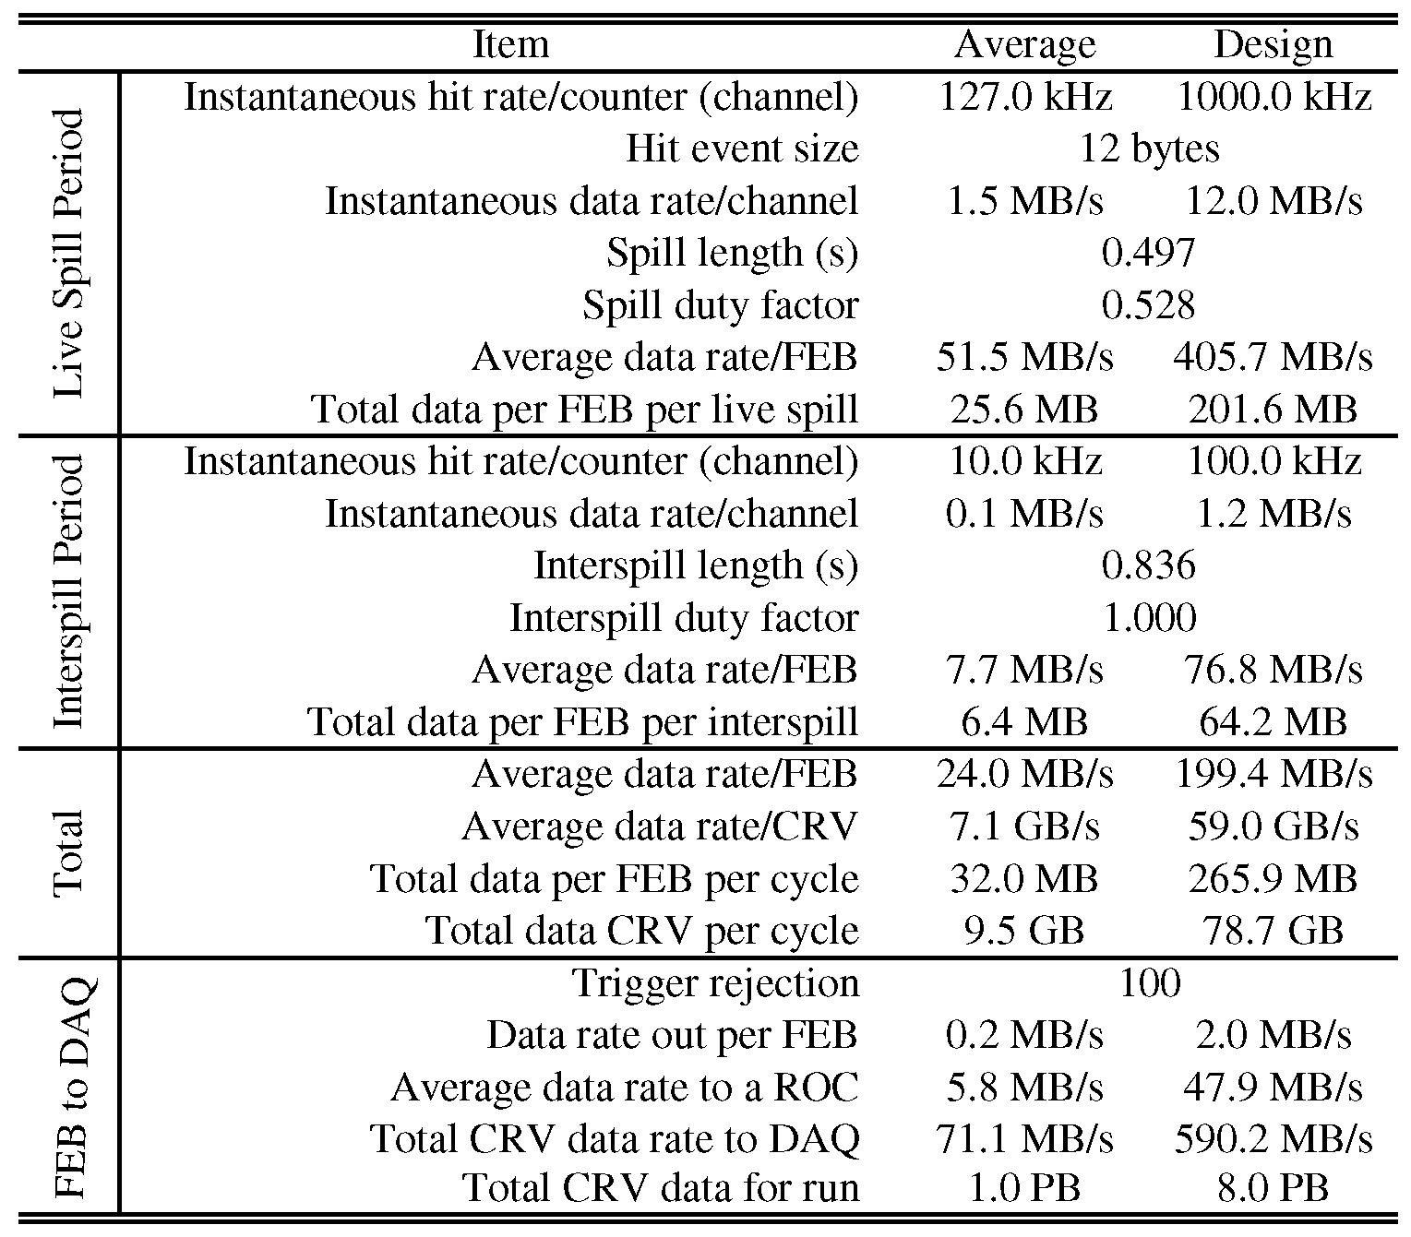
Design
Rate Estimates:
10 MB/s Links
FEB to Controller
200 MB/s Links
Controller to DAQ

Slide 17
Integration and Interfaces
Internal
Schematics, documents posted on UVA server
Weekly CRV meetings
External
Drawings, documents specifying system interfaces posted on Docdb
DAQ meetings
Electrical integration meetings

Slide 18
Changes Since CD-1
Background rates have gone up >10x
Signal tail cancellation implemented to improve double pulse resolution
Flash gate implemented
Channel count has increased 33%
1E10 Neutrons/cm2 total dose. Damage is not an issue, SEUs are.
Single event upset mitigation required
100mT ambient field
Magnetic field tolerance required
Controllers are to be placed in the electronics room to avoid magnetic field and radiation dose

Slide 19
Value Engineering since CD-1
Change from self triggering to externally triggered. All data analysis beyond zero-suppression and trigger primitive is done offline. Reduces FPGA programming labor, reduces data rate

Slide 20
Performance
We will use the ADC data to track SiPM gain variations based on single p.e. signals during the interspill in order to apply a known energy threshold during the spill.
An 80 msps ADC can resolve adjacent pulses down to ~40ns. There is no efficiency loss if two pulses are counted as one, but the time accuracy suffers. Time resolution degrades as pulse separation goes below 60ns.

Slide 21
Performance
We will use the ADC data to track SiPM gain variations based on single p.e. signals during the interspill in order to apply a known energy threshold during the spill.
For a typical muon track we expect timing accuracy of 5ns.
An 80 msps ADC can resolve adjacent pulses down to ~40ns. There is no efficiency loss if two pulses are counted as one, but the time accuracy suffers. Time resolution degrades as pulse separation goes below 60ns.

Slide 22
Quality Assurance
Extensive testing regime
Prototype FEB
Test for single event upsets
Test magnetic field tolerance
Rate testing in a beam
Stability testing with cosmic rays.
Test link to DAQ
Pre-production prototype FEB
Incorporate changes based on results from above
Build test fixture, write test software

Slide 23
Risks
There are no major risks.
Risk of increased channel count has been actualized.

Slide 24
ES&H
There are no special concerns with the CRV electronics
There will be moderate voltages (<100V) present for biasing the photo detectors. Stored energy values are in the milli-Joule range. Moderate power levels (700W) in the controllers.

Slide 25
Cost Table
 | Base Cost (AY K$)
 | M&S | Labor | Total | Uncertainty (on remaining budget) | % Contingency (on remaining budget) | Total Cost
475.8.1 Project Management | 267 | 178 | 445 | 75 | 21% | 520
475.8.2 Mechanical Design | 135 | 3 | 138 | 24 | 38% | 162
475.8.3 Scintillator extrusions | 567 | 462 | 1,029 | 209 | 25% | 1,238
475.8.4 Fibers | 462 |  | 462 | 106 | 24% | 568
475.8.5 Photodetectors (SiPMs) | 464 | 305 | 769 | 190 | 41% | 959
475.8.6 Electronics | 1,314 | 407 | 1,720 | 511 | 33% | 2,231
475.8.7 Module Fabrication | 1,482 | 8 | 1,490 | 466 | 35% | 1,956
475.8.8 Detector assembly and installation | 127 | 81 | 208 | 64 | 35% | 273
475.8.9 Conceptual Design/R&D | 258 | 252 | 511 |  | 0% | 511
475.8.99 Risk Based Contingency |  |  |  | 318 | - | 318
Grand Total | 5,077 | 1,696 | 6,773 | 1,963 | 38% | 8,735

Slide 26
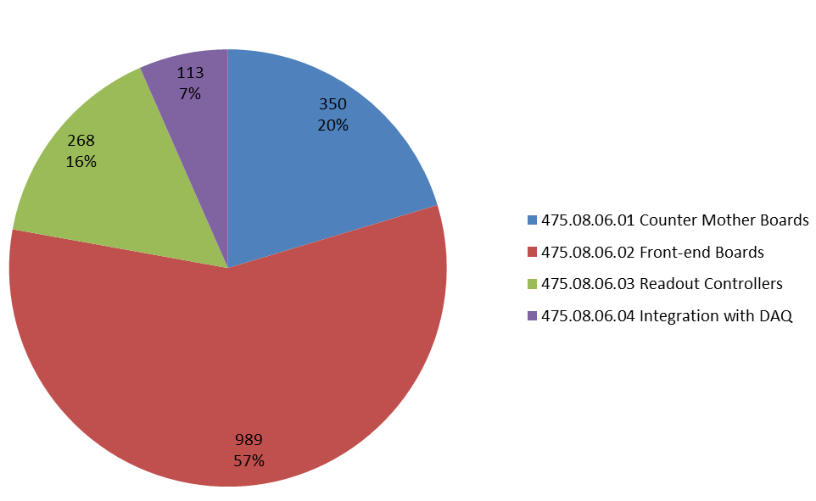
Cost Breakdown
475.08.06 Cosmic Ray Veto Electronics
AY K$

Slide 27
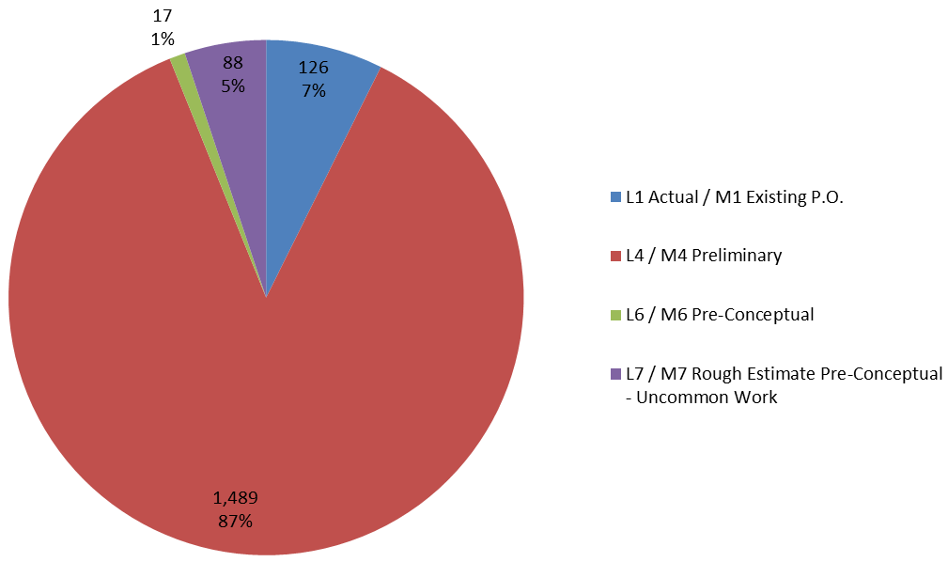
Quality of Estimate
475.08.06 Cosmic Ray Veto Electronics
AY K$

Slide 28
Labor Resources by Discipline

Slide 29
Milestones
47508.6.1.1025 | T5 - Prototype counter motherboards tested
47508.6.3.001025 | T5 - Prototype readout controllers tested
47508.6.2.001035 | T5 - Prototype front-end board tested
47508.6.1.1045 | T5 - Pre-production counter motherboards tested
47508.6.2.001065 | T5 - Pre-production front-end board tested
47508.6.3.001055 | T5 - Pre-production readout controllers tested
47508.6.2.001150 | T5 - Front end boards completed
47508.6.4.001045 | T5 - Pre-production electronics integrated with DAQ
47508.6.3.001080 | T4 - Readout Controllers Completed
47508.6.1.1060 | T5 - Production counter motherboards tested

Slide 30
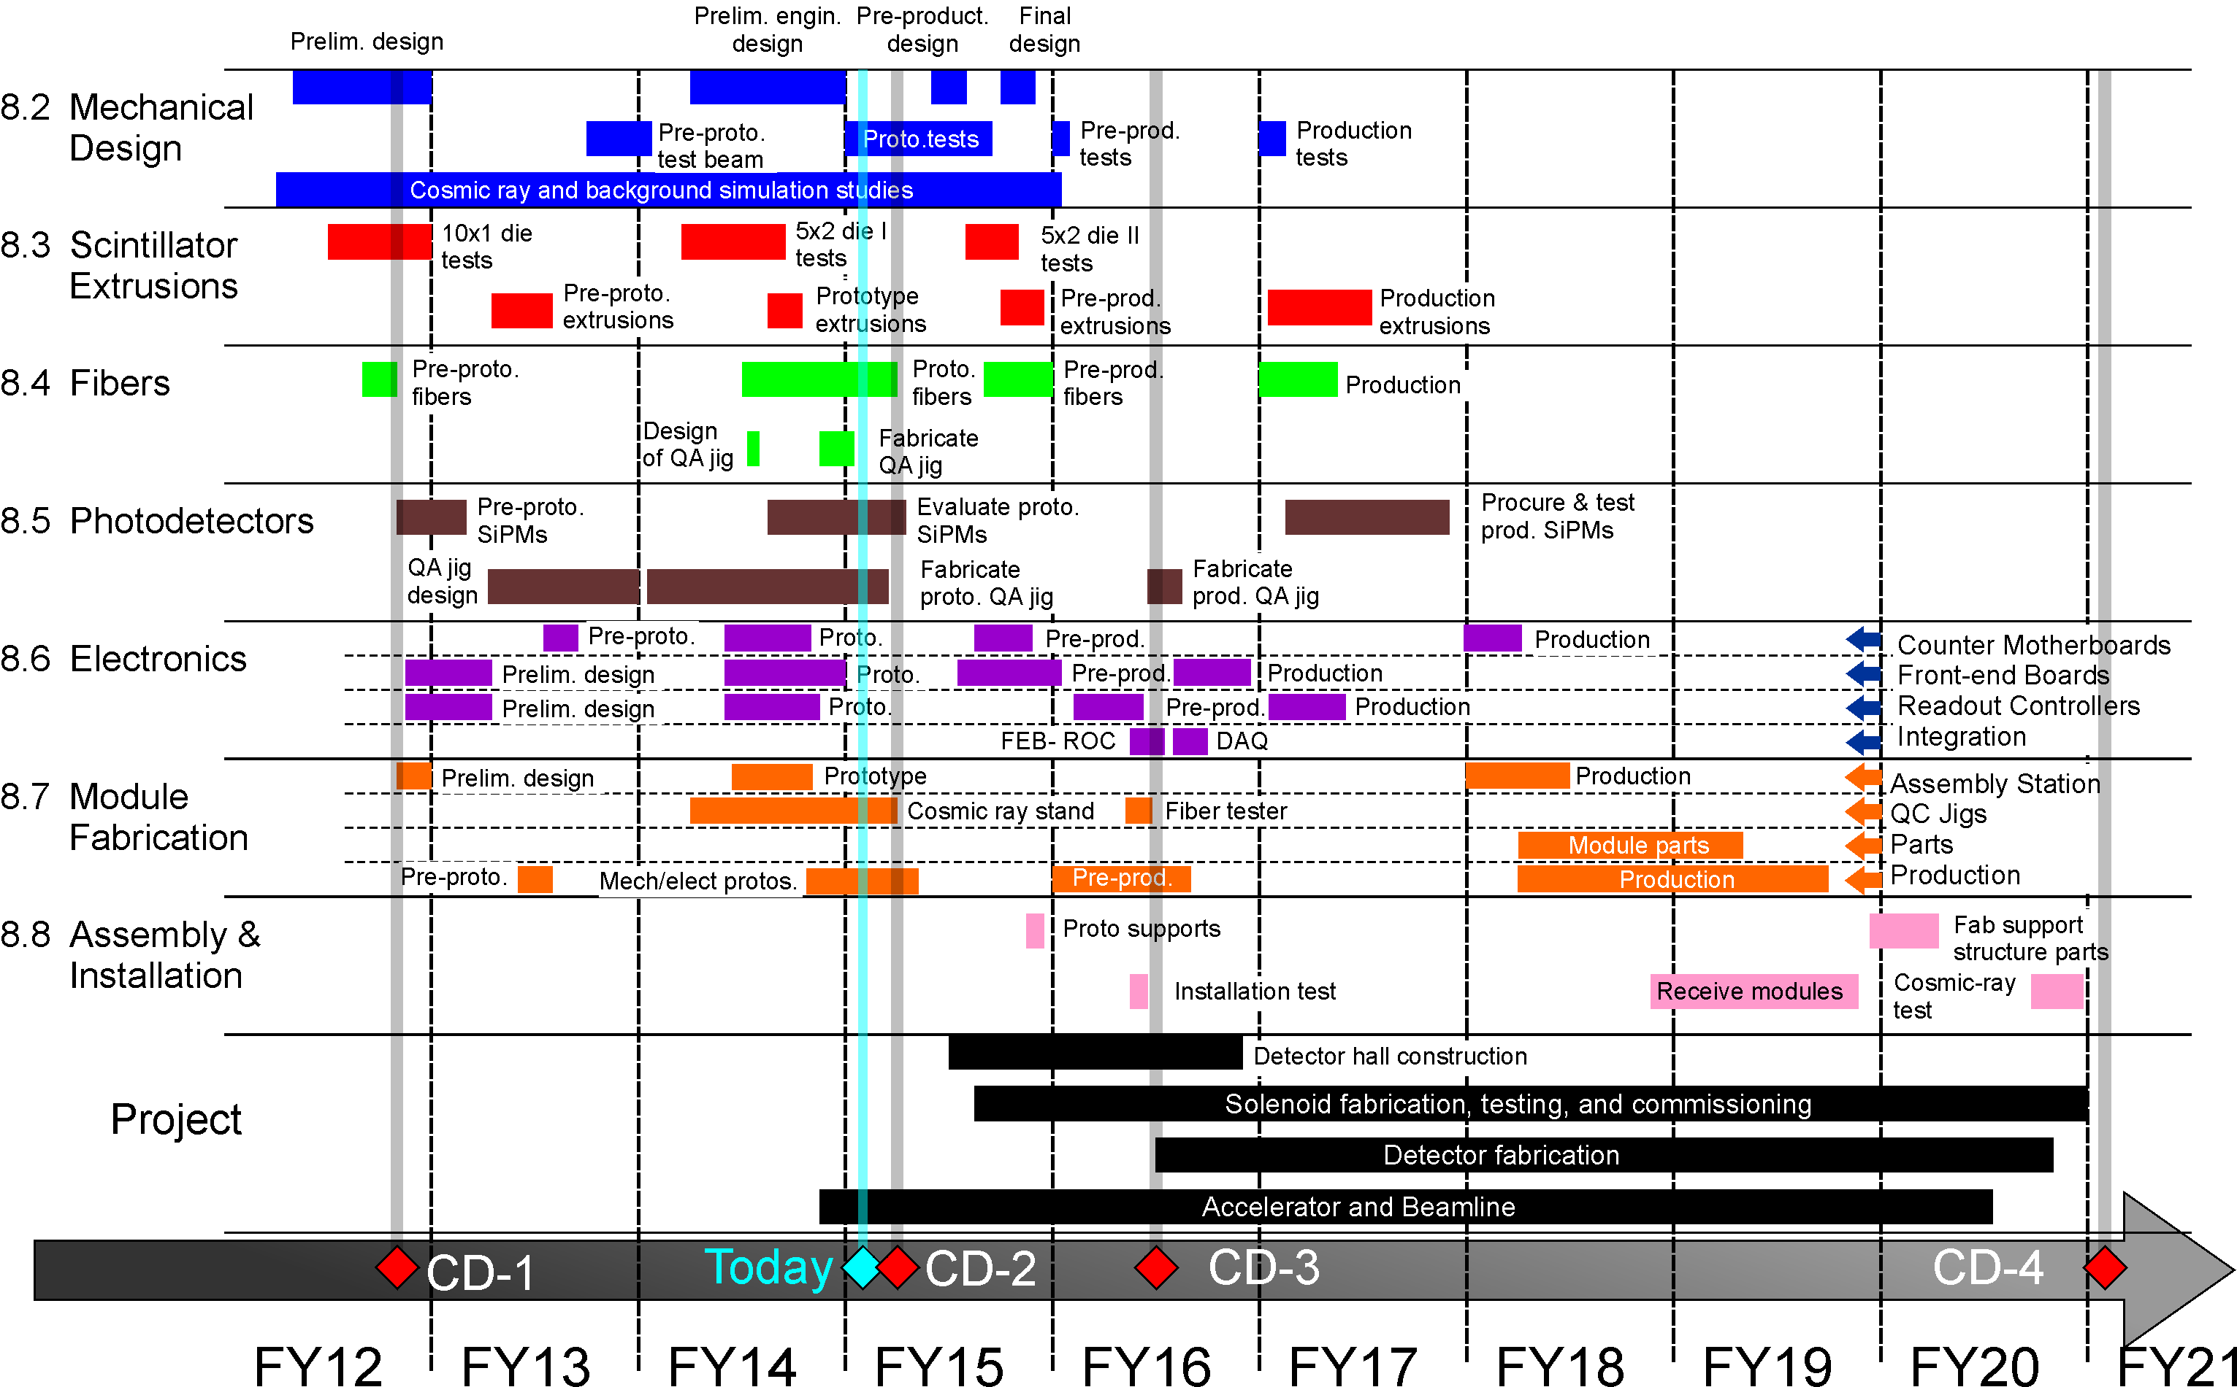
Schedule

Slide 31
Summary
The electronics is commercial off the shelf
The design is derived from previous successful projects
We have begun design and fabrication of the first prototypes.
We will test performance in a magnetic field and under radiation exposure

