Slide 1
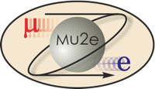
Mu2e CD-2/3b Review
8.5 CRV Photodetectors
Julie Whitmore
Mu2e CRV Deputy L2 & Photodetectors L3
10/21/2014

Slide 2
CRV Photodetector Team
Julie Whitmore – CAM and L3 Manager
    Fermilab scientist for over 20 years.
    L2 Manager: CMS HCAL Maintenance & Operations
    L3 Manager: CMS HCAL FE Elec, CMS HCAL Upgrade FE Elec
    Technical: KTeV CsI Calo and CMS HCAL FE Electronics
Paul Rubinov
    Fermilab Eng Phys for over 15yrs. Mu2e CRV since 2009.
    Technical: over 13yrs photodetector experience, D0 fiber tracker, Minerva FE Elec, SiPM experience from Proton Computed Tomography (PCT), SiPM readout for Fermilab test beam
Vishnu Zutshi
    Assoc Prof NIU.
    Technical: SiPMs for PCT and LC Hadron Shower Imager.
Yuri Oksuzian (see CRV Fiber L3 talk)

Slide 3
Outline
Organizational Breakdown
Scope & Deliverables
Requirements
Design
Improvements Since CD-1
Value Engineering Since CD-1
Performance
Remaining Work Before CD-3
Quality Assurance
ES&H Issues
Interfaces
Risks & Opportunities
Costs
Schedule
Milestones
Summary

Slide 4
Organization
WBS 475.8 Cosmic Ray Veto
Craig Dukes / Virginia
Julie Whitmore / Fermilab (Deputy)
475.8.1 Project Management
Craig Dukes / Virginia
CAM: Dukes
475.8.5 Photodetectors
Julie Whitmore / Fermilab
CAM: Whitmore
475.8.2 Mechanical Design
Craig Dukes / Virginia
CAM: Dukes
475.8.6 Electronics
Sten Hansen / Fermilab
CAM: Dukes → Whitmore
475.8.3 Scintillator Extrusions
Anna Pla-Dalmau / Fermilab
CAM: Pla-Dalmau
475.8.7 Module Fabrication
Craig Group / Fermilab & Virginia
CAM: Group
475.8.4 Fibers
Yuri Oksuzian / Virginia
CAM: Dukes
475.8.8 Detector Assembly & Installation
Jim Fagan / Fermilab
CAM: Dukes

Slide 5
Scope
WBS 8.5 Photodetectors
Julie Whitmore / Fermilab
8.5.1 Photodetector Procurement
This task covers all aspects of the selection and evaluation of prototype photodetectors, and the procurement and testing of the production photodetectors.
8.5.2 Photodetector Quality Assurance Design & Fabrication
This task covers: (1) specifying the requirements for the photodetectors, including those required of the manufacturer, (2) determining the parameters to be tested upon receiving the photodetectors, (3) designing the test stand for photodetector testing, and (4) fabricating the test stand.
8.5.1
Identify SiPM device(s) that meets requirements (Rad & Longevity testing)
Procure Devices
Characterization/Testing
Value engineering
8.5.2
Fabricate QA tester for large scale testing
Test critical parameters to validate vendor batches
Value engineering

Slide 6
Scope & Deliverables
A. Technical Objective
This task covers the selection, evaluation, procurement, and testing of the photodetectors for the cosmic ray veto scintillation counters.
B. Scope of Work Statement
The scope of work includes:
1. The selection and evaluation of prototype photodetectors, and the procurement and
testing of the production photodetectors.
2. Quality assurance design and fabrication, including: (1) specifying the requirements for
the photodetector parameters, including those required of the manufacturer, (2) determining the parameters to be tested upon receiving the photodetectors, (3) designing the test stand for photodetector testing, and (4) fabricating the test stand.
C. Deliverables
Deliverables include:
1. A photodetector test stand.
2. Photodetectors for prototype counters and modules.
3. Photodetectors for production modules.

Slide 7
SiPM Requirements
The photodetector must operate in a magnetic field of 0.1T.
Nominal photosensitive size must be greater than the 1.4mm diameter fiber size with a minimum additional 0.25mm to allow for easy alignment to the fiber.
Device must have a PDE at least as high as 100μm device (Hamamatsu S10362-11-100P) used in test beam (>30%).
SiPM must have a gain of >10⁵.
The number of pixels must be sufficient to cover a dynamic range up to 200 PE with a well understood response.
The device must operate after exposure to 1×10¹⁰ n/cm² @1 MeV neq. S/N for single photoelectron must be distinguishable in order to maintain the in-situ calibration of the devices. Any degradation after 3yrs of operation must not compromise the efficiency requirement of the CRV.
SiPM must produce an intrinsic dark current hit rate <50kHz (3PE threshold). Any after-pulsing must not cause excessive detector deadtime.
The device must be packaged in a small form factor/low profile package that allows tight direct coupling of the SiPM to the fiber.

Slide 8
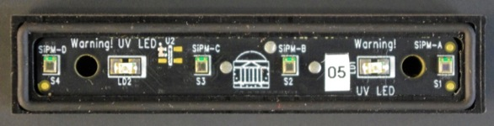
SiPMs in the CRV
Counter Mother Board (surface)
SiPM
Counter Motherboard
5,152 counters, each with 2 fibers
Each counter read out on both ends (with exception of those in the TS region)
18,944 photodetectors: SiPMs (read out both ends, except CRV-U and CRV-T, CRV-cryo)
Surface mount SiPMs large enough to mate to 1.4mm diameter fiber.
1 Counter motherboard per di-counter.
SiPMs must couple tightly to the 4 fibers on the di-counter without mechanical damage to the SiPMs.
Alignment of the SiPMs must be maintained during reflow soldering
  “Oversized” SiPMs that self-register during reflow or by using template
Gasket hood over motherboard to maintain light-tightness

Slide 9
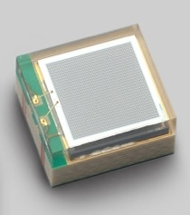
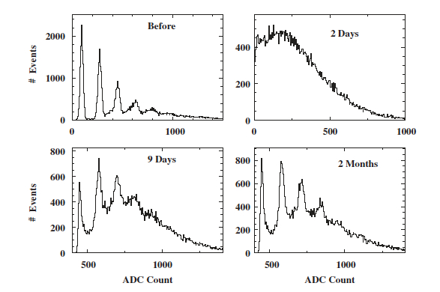
Radiation Damage
Sufficient Shielding is needed to mitigate radiation damage to CRV electronics.
Single PE
Nakamura, NimA 610 (2009), 110-113
Integrated flux to SiPMs is required to be kept below 1x10¹⁰ n/cm² .
(1 MeV neutron equivalent)
SiPM – Irradiated with 2x10¹⁰ n/cm². Dark count before and after irradiation,
And after 2 days, 9 days, and 2 months of annealing.

Slide 10
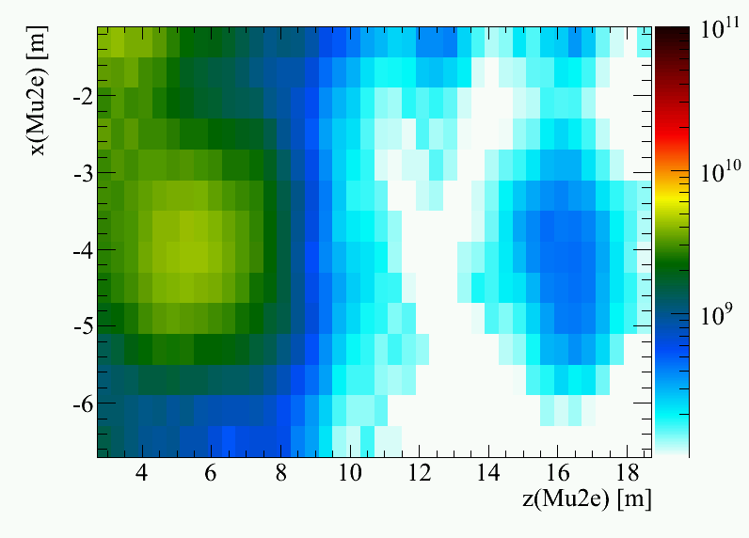
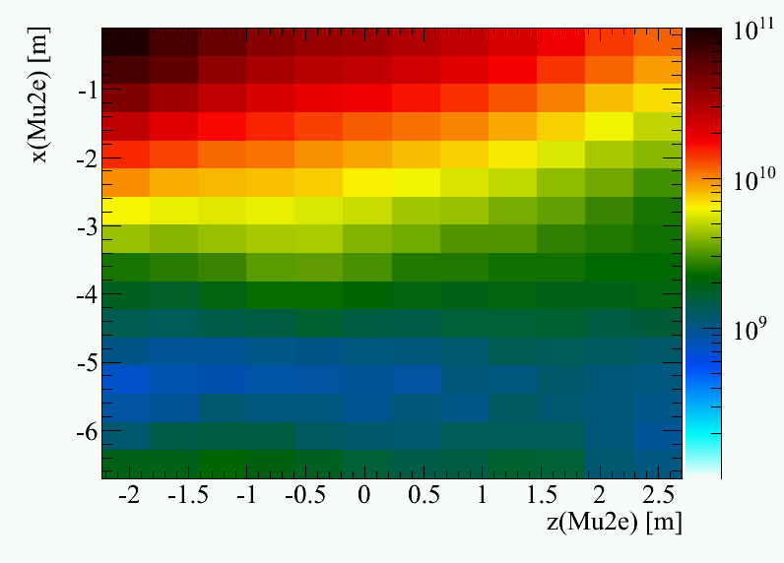
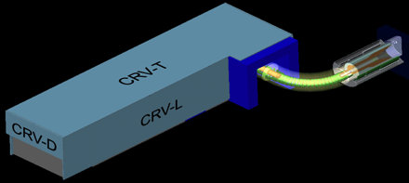
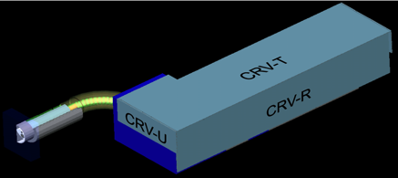
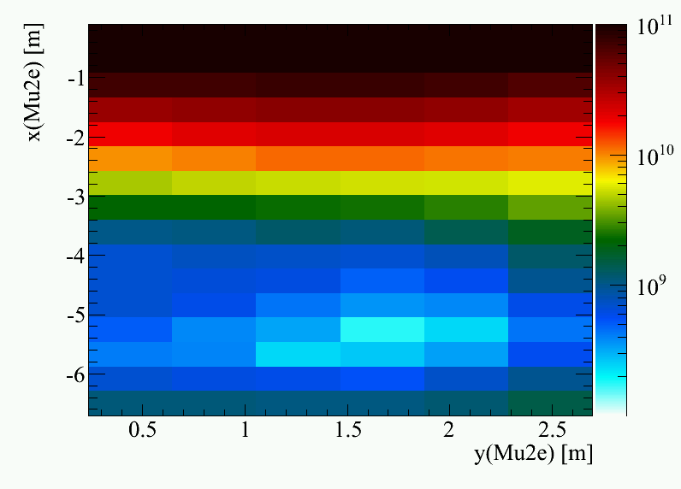
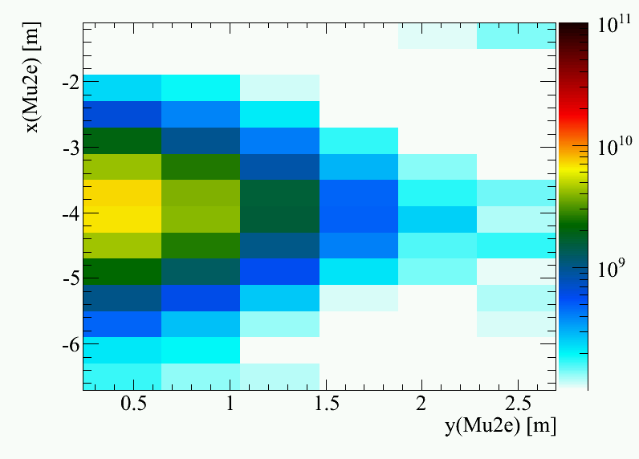
Simulations: Neutron Radiation Damage
Fold rates and spectrum into 1 MeV equivalent damage curve
Note: No timing cut used! No devices used in these regions
DS Top
TS Top
SiPM damage must stay below limit 10¹⁰ n/cm2
Upstream region a problem
Red = 10¹⁰ n/cm2
Black = 10¹¹ n/cm2
Upstream
Downstream

Slide 11
SiPM Operation Plan
Operational model similar to T2K (T2K has ~60,000 devices operating for 3 years).
  No temperature stabilization for SiPMs in T2K
    No special temperature control for SiPM beyond standard building HVAC.
  Monitor single PE peak to track gain. Periodically adjust operating voltage (period to be determined) to align single PE across CRV.
    Correct bias voltage for temperature changes and changes due to radiation.
  Monitor dark count rate. PE spectrum, temperature, SiPM response (via LED flasher system).
  Ability to measure I-V curve in-situ (not during operation).
  Ability to monitor cosmic ray spectrum in modules.

Slide 12
Improvements since CD-1
No significant changes to Mu2e photodetector requirements
  Better understanding of our backgrounds and required light yield
Significant improvements in SiPMs since CD-1 review
  More vendors are developing lower noise, higher PDE devices that are intrinsically more radiation hard
Device decisions
  Surface mount devices, 2mm x 2mm COTS SiPM, quality assurance sampling (10% testing of production devices)

Slide 13
Value Engineering since CD-1 (1)
Benefited from US CMS SiPM R&D with vendors
  Multiple vendors fabricating radiation hard SiPMs
    Improved performance (PDE and noise), wider dynamic range, lower cost
    Quite likely current commercially available SiPMs will meet our requirements
Benefited from T2K Experience
  T2K has operated 60,000 devices for several years.
    Extensively characterized SiPMs
      Key parameters to measure are understood.
        Mu2e only needs to test a subsample of devices.
      Operational experience applicable to Mu2e (with one exception…)
    T2K SiPMs are not in a radiation zone → device characteristics are stable over time.
      Mu2e will need to carefully monitor device characteristics during running to ensure stability of CRV efficiency

Slide 14
Value Engineering since CD-1 (2)
Benefited from NIU/FNAL/Delhi Proton Computed Tomography (pCT) Scanner Project
  Developed test procedures and infrastructure for pCT project (3000 SiPMs)
  Mu2e NIU and FNAL experimenters involved in pCT project
    SiPM expertise: FNAL Eng Phys (Paul Rubinov), NIU physicists and students
    Experienced in handling large number of devices
    Mu2e will leverage pCT software and hardware development

Slide 15
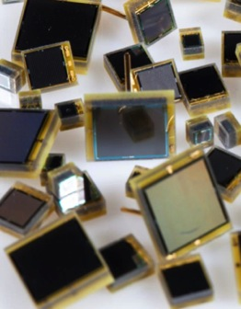
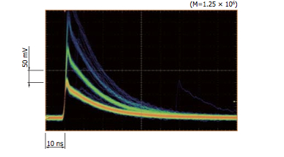
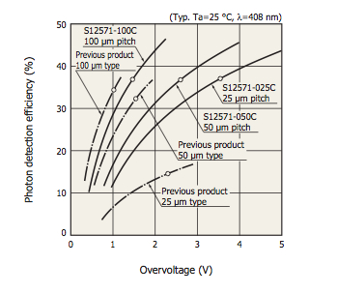
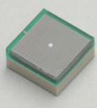
SiPM Procurement
Improved Afterpulsing
PDE: New vs Old
TSV-Thinner epoxy
coating than SMD
(100 μm vs 300 μm)
Rapid improvements to device processes
    Higher PDE
    Better process allows for higher over-voltage operation
    Lower x-talk and after-pulsing
    Better temperature coefficient
Many vendors with new candidate devices
    Hamamatsu and KETEK have 2mm x 2mm COTS SiPMs
      Hamamatsu has Through Silicon Via (TSV) and surface mount packaging. KETEK will have TSV by end of 2014.
    FBK/AdvanSiD has new SiPM with trenching (custom size available)
    SENSL will have TSV late 2014 (custom size available)

Slide 16
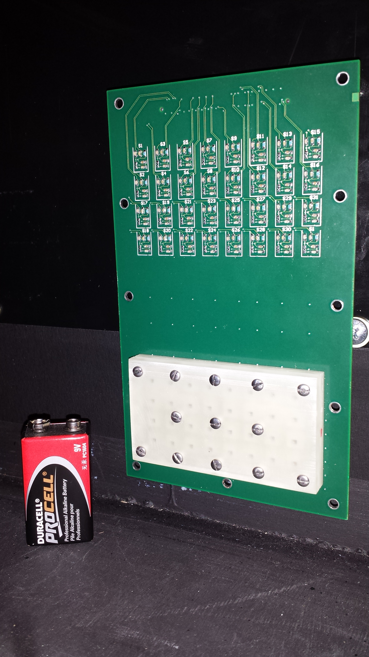
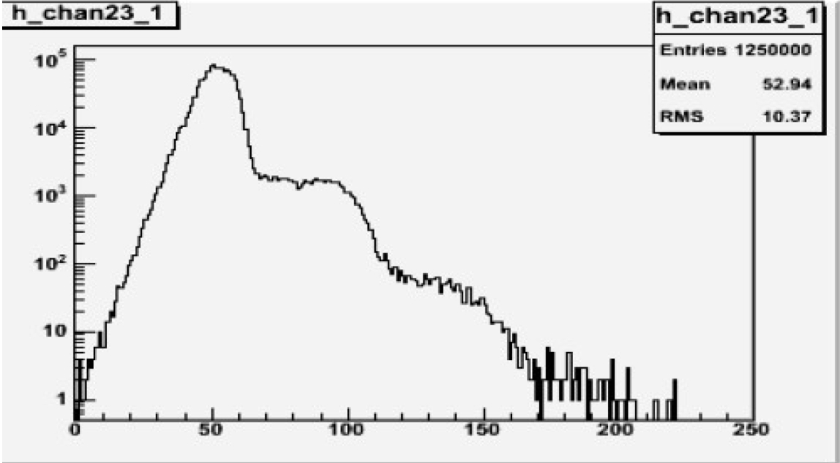
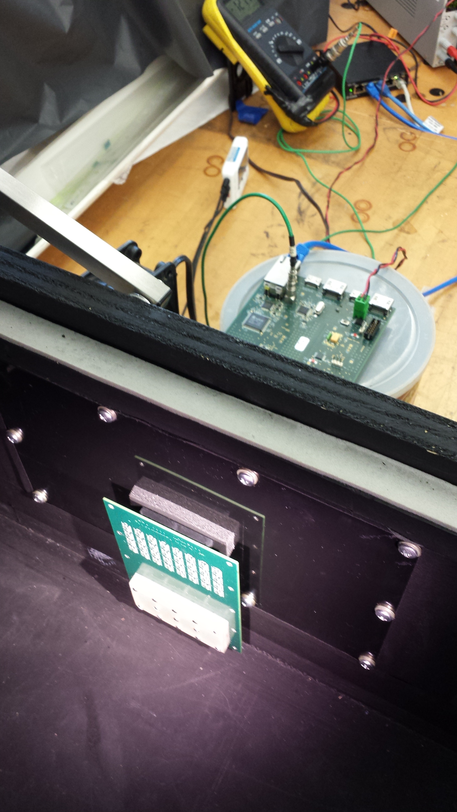
SiPM Characterization
SiPM Adapter board
SiPM characterization before/after irradiation/longevity testing (@NIU)
  Measure device parameters:
    I-V curve, waveform
  Derived parameters:
    V_{BR}, Vbias, Dark current/count
    rate, gain, xtalk, etc.
SiPM Adapter
Board in Dark Box

Slide 17
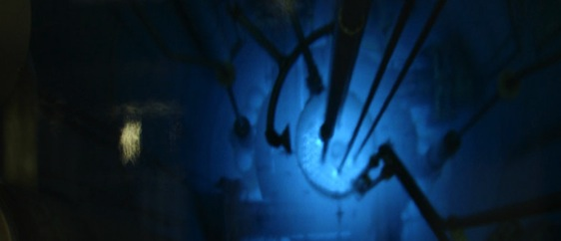
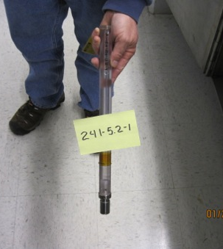
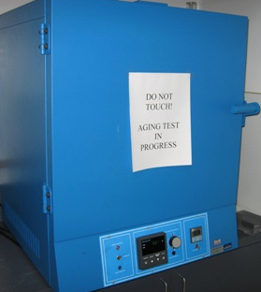
SiPM Radiation & Longevity Testing
Radiation Qualification
  Reactor neutrons
    UC Davis reactor (Energy 1-10 MeV)
    U of Florida reactor (thermal neutrons)
    Sources (Fermilab)
      AmBe
        Energy - 2-10 MeV
        2.1E5 n/s
      Cf-252
        Energy - 2 MeV
        2.7E4 n/s
Accelerated Aging Test
  Arrhenius equation
    Counter Motherboard temperature: ~25 ºC
    Mu2e running (3 yrs) + commissioning (1yr)
  Device oven test:
    70 ºC for 64.5 days
Reactor
Oven for
Accelerated Aging
Sources

Slide 18
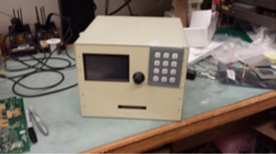
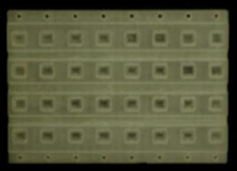
SiPM QA Tester
QA Testing
  Need to test many devices in parallel
    Testing design for I-V tester with a simple scheme for providing bias
  Need to do both I-V and pulse mode testing on a small number of devices
    Longevity/Radiation testing for batch validation

Slide 19
I-V Curve from QA Tester

Slide 20
Remaining work before CD-3
Device selection
  Identify candidate SiPMs and validate they meet requirements
    SiPM characterization (dark count rate, V_{BR}, gain, temp dependence, etc.)
    Radiation and Longevity Testing
    Determine whether COTS SiPM will work. If not, custom size device will be needed.
    We don’t expect any surprises since these devices will be relatively mature (1-2yrs old) by the time of production purchase
Finish prototype QA Tester
  3d printed device holder must be designed/fabricated to match the specific SiPM being tested.

Slide 21
Quality Assurance
Mu2e needs to validate quality of the SiPMs
  Learn from T2K experience (T2K INGRID – 18,000 devices)
    T2K extensively tested all devices at various temps
      Found only a few key parameters were needed for operation (dark count, V_{BR}, temp dependence of gain)
        Need to track properties in-situ (monitor single PE, dark count, gain)
      Temperature dependence is specific to the process
        Need to test a few to fully characterize
  Plans for QA testing of SiPMs
    Test a small subset (10%) of SiPMs to validate the vendor batches
    Destructive Radiation and Longevity tests on a smaller subset of devices (.5%)

Slide 22
ES&H
SiPM operation
  SiPM operating voltages vary by vendor (KETEK ~ 30V, Hamamatsu ~ 80V, etc.)
  Operation of SiPMs will follow Fermilab ES&H Manual (FESHM) standards for electrical equipment operation.
QA SiPM testing jig
  Hazards are minimum (Soldering, epoxy, etc.)

Slide 23
Interfaces & Integration
Internal
  CRV photodetector interfaces to the fibers and FE Electronics
    SiPM size must match fiber with sufficient tolerance for alignment
    FE electronics: Bias voltages & dynamic range are understood and documented. Counter motherboard design documented.
External
  SiPM interfaces with muon beamline shielding: Radiation must be <1E10 n/cm².
  Photodetector dark count rate impacts DAQ
  Building temperature variations affect photodetector response
Interfaces
  DocDB # 1551
  Participation in the weekly CRV meetings.
  Participation in DAQ & Integration meetings

Slide 24
Risks
Risk ID | Docdb# | Type | Title | Date | Probability | Point Estimate (cost k$) | Point Estimate (prob) | Expectation Value (cost k$)
VETO-158 | 4257 | Threat | Custom SiPM size is needed | FY15 | Low | $50 | 20% | $10
Dark count rate in COTS 2mm x 2mm SiPM too high → Smaller SiPM required (e.g. 1.6mm diameter active area)
  Strategy: measure performance on prototype counters
  Low cost risk ($50k). No serious schedule impact.
  No technical risk.

Slide 25
Cost Table
Cosmic Ray Veto 475.08 Cost in AY k$
 | Base Cost (AY K$)
 | M&S | Labor | Total | Uncertainty (on remaining budget) | % Contingency (on remaining budget) | Total Cost
475.8.1 Project Management | 267 | 178 | 445 | 75 | 21% | 520
475.8.2 Mechanical Design | 135 | 3 | 138 | 24 | 38% | 162
475.8.3 Scintillator extrusions | 567 | 462 | 1,029 | 209 | 25% | 1,238
475.8.4 Fibers | 462 |  | 462 | 106 | 24% | 568
475.8.5 Photodetectors (SiPMs) | 464 | 305 | 769 | 190 | 41% | 959
475.8.6 Electronics | 1,314 | 407 | 1,720 | 511 | 33% | 2,231
475.8.7 Module Fabrication | 1,482 | 8 | 1,490 | 466 | 35% | 1,956
475.8.8 Detector assembly and installation | 127 | 81 | 208 | 64 | 35% | 273
475.8.9 Conceptual Design/R&D | 258 | 252 | 511 |  | 0% | 511
475.8.99 Risk Based Contingency |  |  |  | 318 | - | 318
Grand Total | 5,077 | 1,696 | 6,773 | 1,963 | 38% | 8,735

Slide 26
Cost Table
Silicon Photomultiplier (SiPM) 475.08.05
 | Base Cost (AY K$)
 | M&S | Labor | Total | Uncertainty (on remaining budget) | % Contingency (on remaining budget) | Total Cost
8.05.01 Photodetectors (SiPMs) procurement | 409 | 36 | 445 | 148 | 36% | 593
8.05.02 Photodetectors (SiPMs) quality assurance design | 56 | 269 | 325 | 42 | 80% | 367
Grand Total | 464 | 305 | 769 | 190 | 41% | 959
Labor in table is Fermilab Labor only

Slide 27
Cost Breakdown
Base cost in AY k$
Base cost in AY k$

Slide 28
Quality of Estimate
Base Cost in AY k$
Base Cost in AY k$

Slide 29
Labor Resources by FY
475.08.05 Silicon Photomultipliers (SiPMs)

Slide 30
Labor & Material Resources by FY
475.08.05 Silicon Photomultipliers (SiPMs)

Slide 31
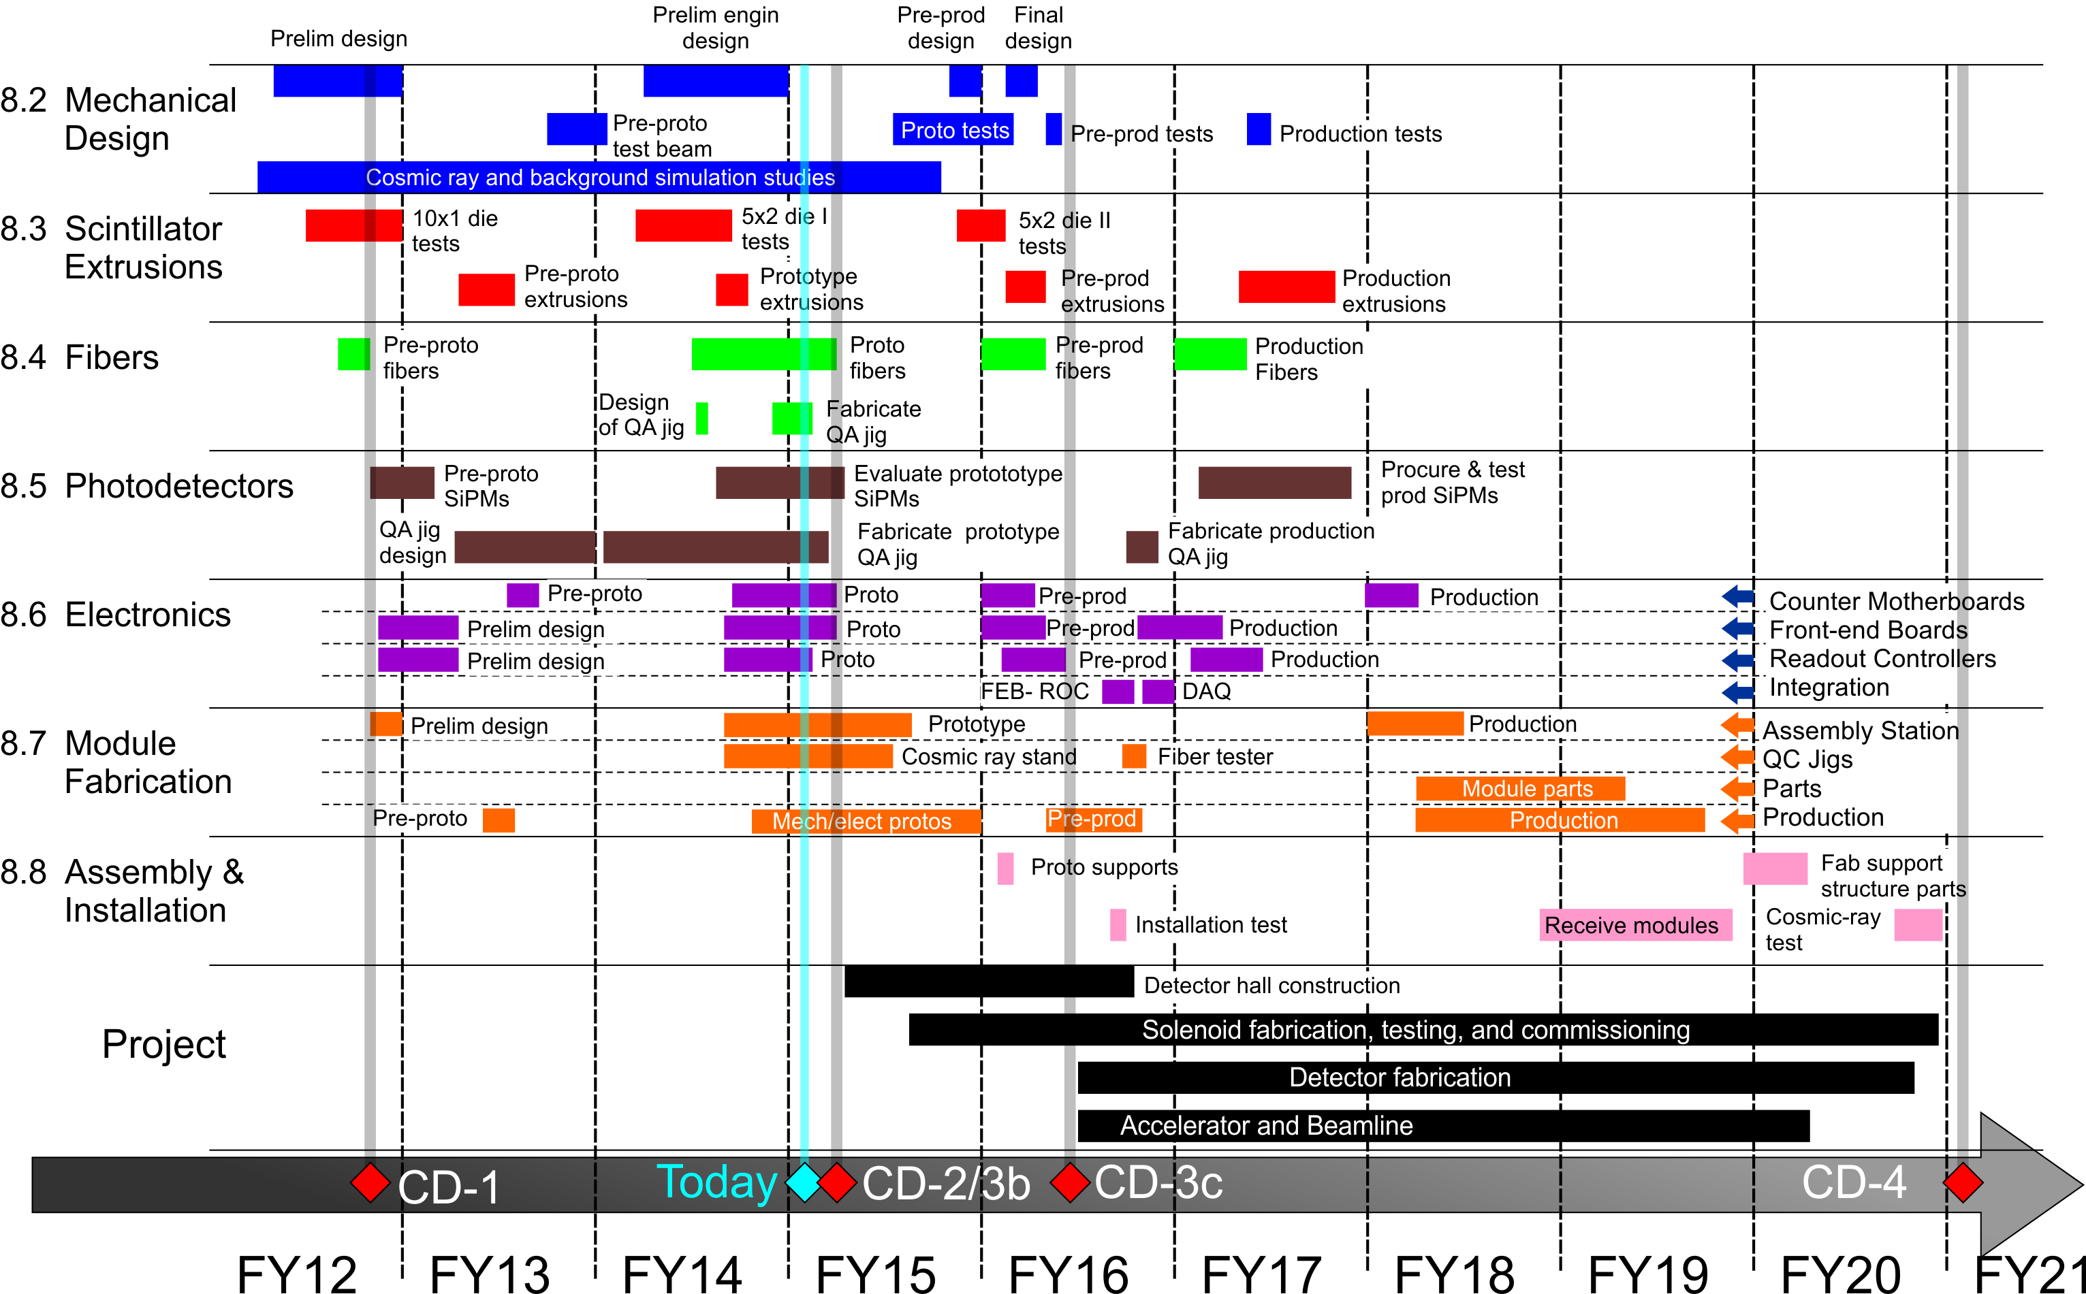
CRV Schedule

Slide 32
Schedule
Silicon Photomultiplier (SiPM) 475.08.05
CD-2
CD-3
Fabricate QA Prototype Tester
Fabricate QA Darkbox
Order Prototype Photodetector
Evaluate
Rad & Longevity Test
T5 -Photodetector Selected
Write Specs for Photodetctor
Fabricate QA Production Tester
PO Production Photodetectors
Procure Prod Photodetectors
Eval Subsample Prod Photodetectors
Rad&Long Test Subsample Prod Photodetectors
T5 – Accept 100% SiPMs for Production modules
Ship SiPMs to Counter Motherboard Factory
FY14 FY15 FY16 FY17

Slide 33
Milestones
Photodetectors 475.08.05

Slide 34
Summary
Overall requirements are well understood
SiPM requirements can be achieved with commercially available devices
  May need custom mask to reduce active area and assoc. dark count noise, but SiPM process will be from standard catalog
  Prototype devices have been ordered (some are in hand)
    Radiation and Longevity qualification testing to begin in Fall 2014
    Prototype counters should be available for study in Winter 2014
  QA prototype tester fabrication is complete
    Hardware is fabricated and testing software is being developed.
SiPM cost and schedule are well understood.
  SiPM development is not on the critical path.

Slide 35
Backup Slides

Slide 36
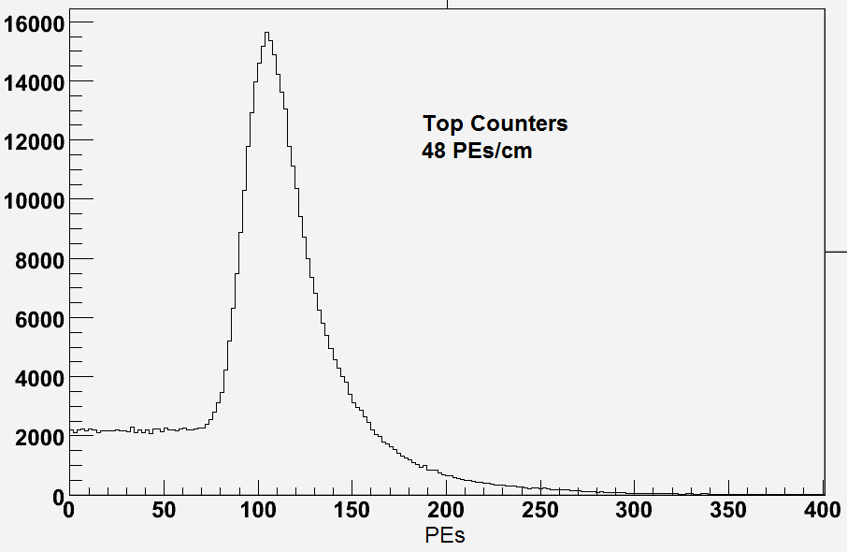
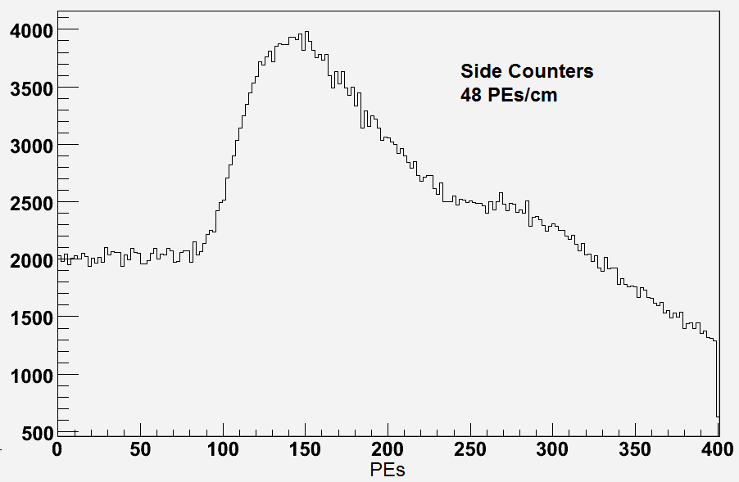
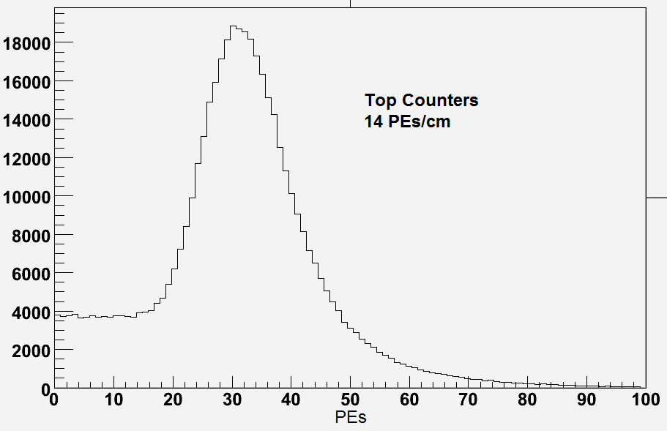
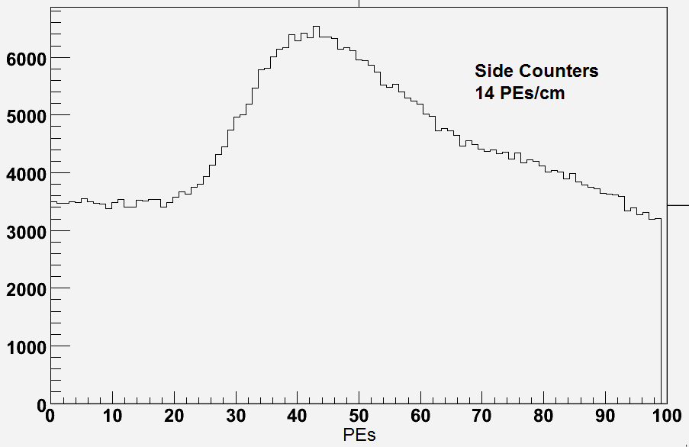
Monitoring SiPM Calibration
Top Counters
Side Counters
48 PE/cm
48 PE/cm
14 PE/cm
14 PE/cm
Monitor SiPMs via muon distributions.
Device dynamic range: up to 200 PE

Slide 37
SiPM IV Curve
From NIU Test Stand – SiPM IV Curve

Slide 38
SiPM Spectrum
From NIU Test Stand - SiPM Spectrum

Slide 39
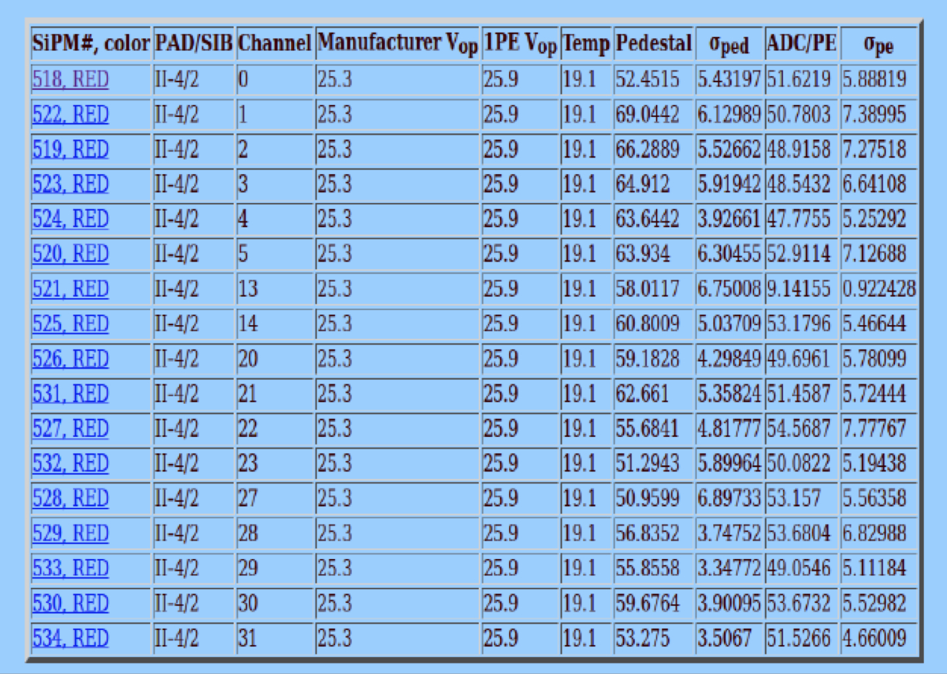
SiPM Characterization DB
From NIU Test Stand - SiPM Characterization DB

