Slide 1
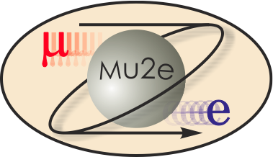
Mu2e CD-2/3b Review 8.3 CRV Scintillator Extrusions
Anna Pla-Dalmau
Mu2e CRV Scintillator Extrusions L3
10/21/2014

Slide 2
CRV Scintillator Extrusion Team
Anna Pla-Dalmau:
CRV Scintillator Extrusion L3 Manager
Fermilab – Scintillation Detector Development Group Leader (1997) – Applied Scientist – Chemist
Manager FNAL-NICADD Extrusion Line Facility since its start in 2003
L2 Manager for Scintillator for MINERvA
Prepared extruded scintillator for T2K, Double Chooz, Belle II, JLAB, Pierre Auger-AMIGA.
James Wish:
Extrusion Line Operation
Janina Gielata and Wanda Newby:
Extrusion Line Operation Assistance and Quality Control

Slide 3
Organizational Breakdown
WBS 475.8 Cosmic Ray Veto
Craig Dukes / Virginia
Julie Whitmore / Fermilab (Deputy)
475.8.1 Project Management
Craig Dukes / Virginia
CAM: Dukes
475.8.5 Photodetectors
Julie Whitmore / Fermilab
CAM: Whitmore
475.8.2 Mechanical Design
Craig Dukes / Virginia
CAM: Dukes
475.8.6 Electronics
Sten Hansen / Fermilab
CAM: Dukes → Whitmore
475.8.3 Scintillator Extrusions
Anna Pla-Dalmau / Fermilab
CAM: Pla-Dalmau
475.8.7 Module Fabrication
Craig Group / Fermilab & Virginia
CAM: Group
475.8.4 Fibers
Yuri Oksuzian / Virginia
CAM: Dukes
475.8.8 Detector Assembly & Installation
Jim Fagan / Fermilab
CAM: Dukes

Slide 4
Scope
WBS 8.3 Scintillator Extrusions
Anna Pla-Dalmau / Fermilab
8.3.1 Die Design and Procurement
This task covers the design of the die needed for the production of the scintillation counters, its procurement and testing through the fabrication of prototype extrusions. We assume that two dies will be needed: a prototype and a production die.
8.3.2 Scintillator Extrusion Production
This task covers the procurement of the scintillator extrusions for prototype tests, pre-production tests, and production of the cosmic ray veto. It includes: (1) the procurement of the materials, (2) the fabrication of the extrusions, (3) the quality assurance, and (4) the shipping of the extrusions to the module factory.

Slide 5
Requirements
Extrude plastic scintillator for Cosmic Ray Veto – FNAL/NICADD Extrusion Line Facility:
Blue emitting plastic scintillator:
Polystyrene - DOW STYRON 665 W
Dopants - 1% PPO + 0.03% POPOP – Curtiss Labs.
15% TiO₂ in polystyrene coating (0.25 mm)
Cross-section – 5 cm x 2 cm with 2 holes for WLS fibers
Amount – 20 metric tones

Slide 6
Design

Slide 7
Changes since CD-1
The cross-section of the scintillator bar has changed:
From CD-1: 10 cm x 1 cm with 4 holes
To CD-2 : 5 cm x 2 cm with 2 holes

Slide 8
Value Engineering since CD-1
Performed extrusion, mechanical and test-beam tests with an existing die of cross-section 4 cm x 2 cm with 3 holes and adapted to produce strips with just 2 holes.
Worked with coating manufacturer to keep the cost/quality of TiO₂/PS coating unchanged.

Slide 9
Performance
Extruded a 5 cm x 2 cm profile with 2 fairly round and consistent holes.
Improved TiO₂/PS coating thickness uniformity
New TiO₂/PS coating with better extrudability in a wide part

Slide 10
Remaining work before CD-3
Reduce gaps between bars:
Address concavity of top and bottom surfaces
Minimize round corners

Slide 11
Integration and Interfaces
INTEGRATION:
Attend weekly CRV meeting
INTERFACES for 47508.3:
47508.2 Counter Design (predecessor)
47508.7 Module Fabrication (successor)

Slide 12
Quality Assurance
Perform QC on extruded scintillator strip
Check light yield with radioactive source on test samples
Check dimensions on test samples
Document Quality Control process
QA: Check purity of raw materials – PS and dopants
Configuration Management:
Use labels with barcodes for strips and test samples
Create a database of dimensions and light yield scanning the labels on the test samples
Document deliveries and usage of raw materials

Slide 13
Risks / Opportunities
Risks:
VETO-156: Control size and shape of fiber holes
Size and shape of fiber holes may not match drawing specifications depending on extrusion operating parameters based on die manufactured.
Opportunities:
VETO-163: Go to a wider extrusion to:
Increase tolerances on the module layer offset distance
Reduce numbers of fibers, SiPMs, extrusions, and electronics channels

Slide 14
ES&H
Follow established safety procedures at Fermilab
Follow established extrusion procedures at Fermilab

Slide 15
Cost Table
 | Base Cost (AY K$)
 | M&S | Labor | Total | Uncertainty (on remaining budget) | % Contingency (on remaining budget) | Total Cost
8.03.01 Die design and procurement | 158 | 77 | 234 | 37 | 36% | 271
8.03.02 Scintillator extrusion production | 410 | 385 | 795 | 172 | 24% | 967
Grand Total | 567 | 462 | 1,029 | 209 | 25% | 1,238

Slide 16
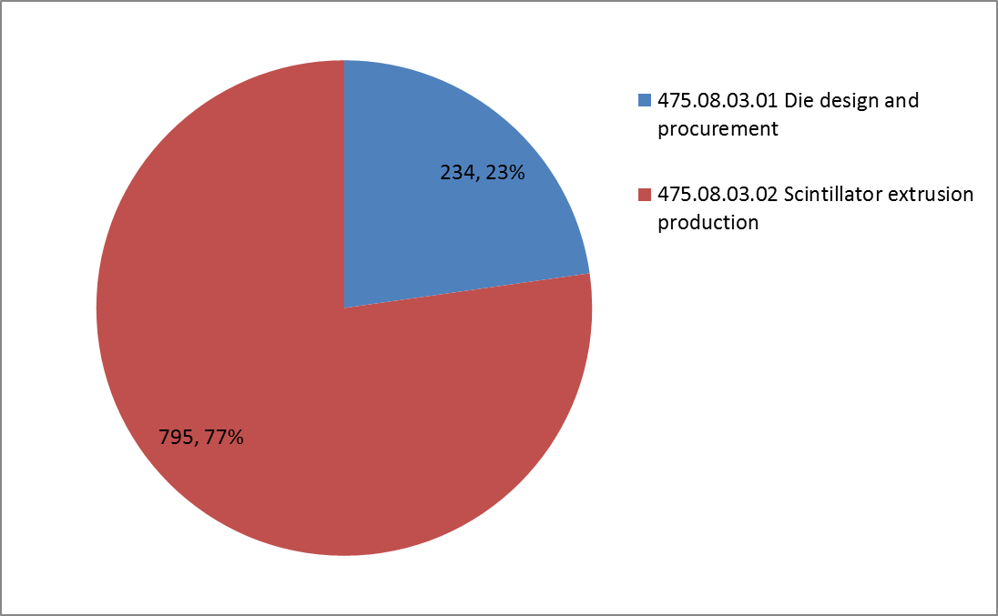
Cost Breakdown
Base Cost in AY K$

Slide 17
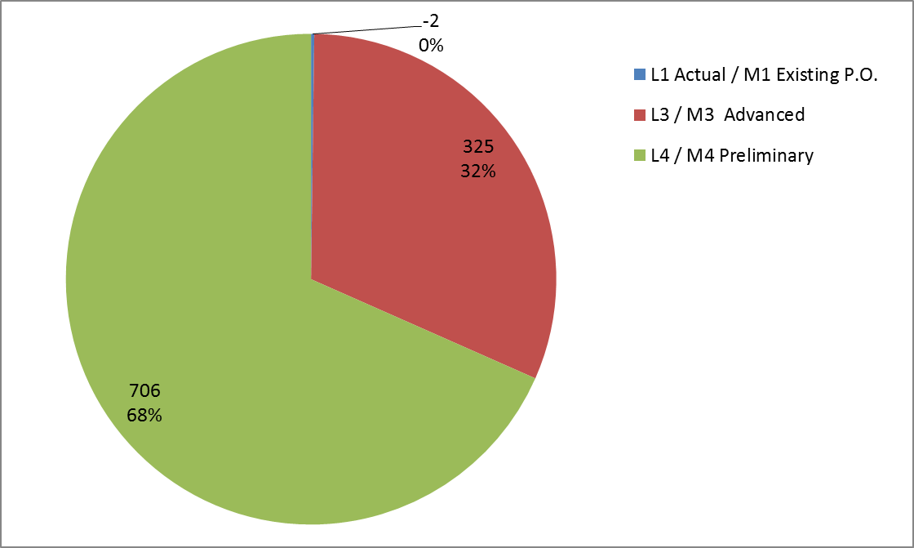
Quality of Estimate
Base Cost in AY K$

Slide 18
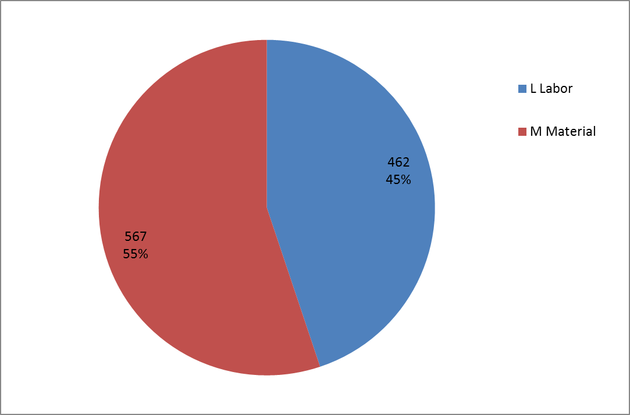
Resource Type
Base Cost in AY K$

Slide 19
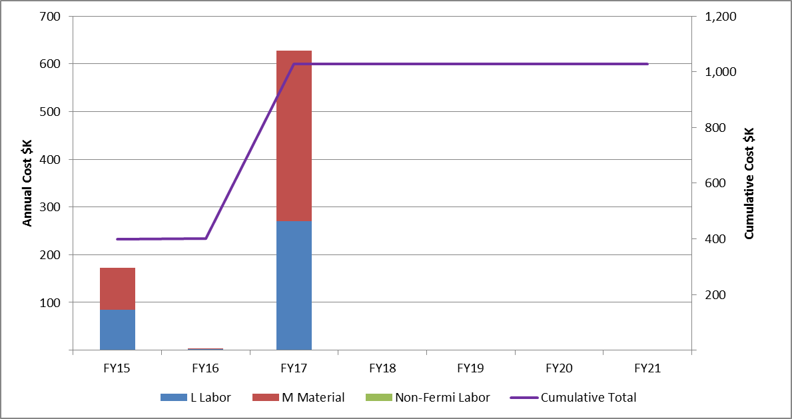
Resources by FY
Base Cost in AY K$

Slide 20
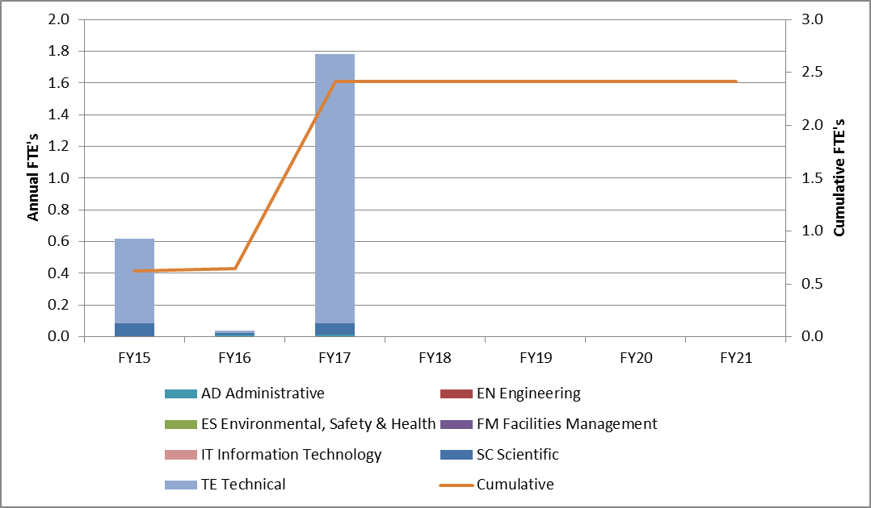
Labor Resources by FY

Slide 21
Major Milestones
Aug 2015: Final die design approved
Jul 2016: PO issued for materials for production extrusions fabrication
Feb 2017: Production extrusions complete

Slide 22
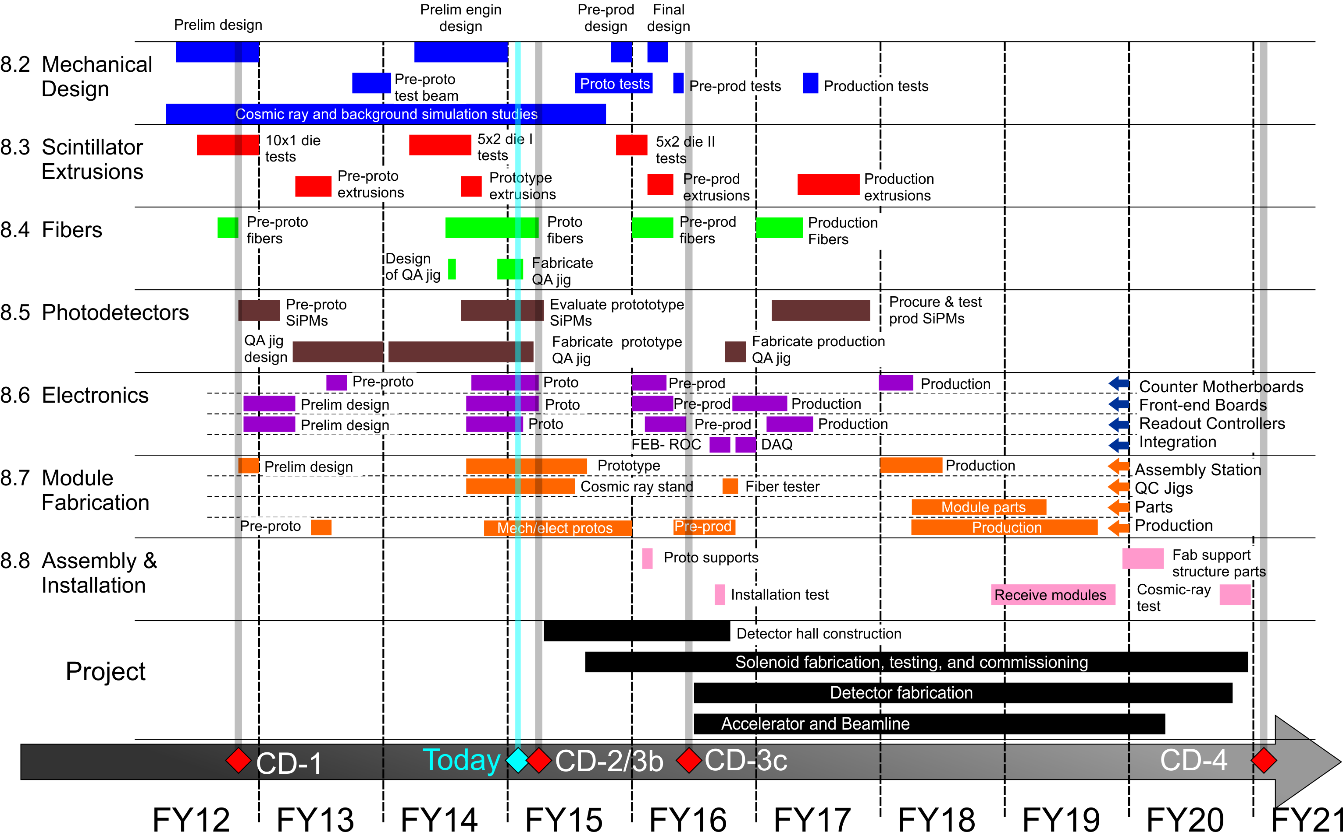
Schedule

Slide 23
Summary
FNAL/NICADD Extrusion Line Facility with co-extruder to deliver the white reflective coating has been in operation since 2005.
Mu2e CRV Die for “5 cm x 2 cm – 2 holes” strip has been tested:
About 500 m of extruded scintillator bars were sent last June to the University of Virginia for testing.

