Slide 1
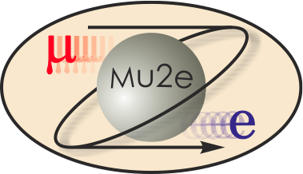
Mu2e External Beamline Cost & Schedule 475.02.07
CD-2 Review
Dean Still
L3 Manager
10/22/2014

Slide 2
Organizational Breakdown
WBS 475.02.07
External Beamline
D. Still
WBS 7.2
External Beamline Magnet Power Supplies
S. Hays
J. Budlong
WBS 7.3
External Beamline Mechanical and Vacuum Systems
R. LeBeau
M. Ball
WBS 7.7
External Beamline Implementation
(Installation)
C. Gattuso
WBS 7.4
External Beamline Diag. Absorber
A. Deshpande
WBS 7.6
External Beamline Technical Documentation and Oversight
D. Still
WBS 7.1
External Beamline Magnets
R. Reilly
C. Ader
WBS 7.5
External Beamline Optics
E. Gianfelice
(Design Only)

Slide 3
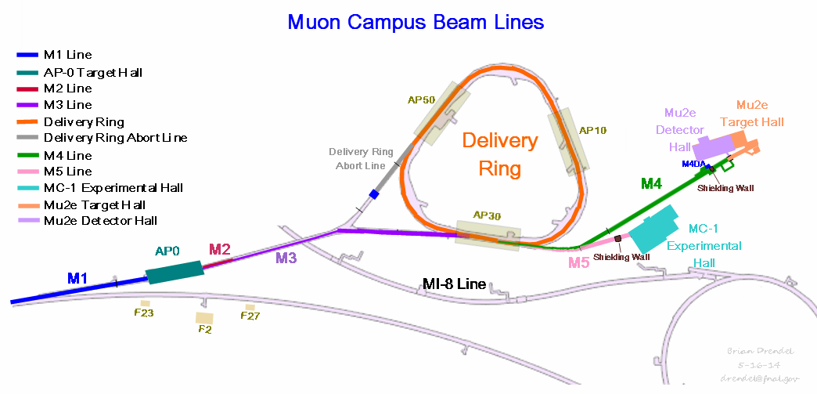
WBS 475.02.07 External Beamline Scope
The Mu2e external beamline includes transport of protons at 8Gev resonantly extracted from the Delivery Ring for normal operation. (Single turn extraction for an initial tune up and commissioning to the diagnostic absorber)
Technical details were presents in talk External Beamline Design by E. Prebys .
Beamline shares the upstream part of the beamline with g-2.
Installation includes elements in the M4 beamline, AP30 , MC-1 and Mu2e service buildings.
Many components and hardware will be reused and repurposed from the Antiproton source as a cost savings & value engineering.

Slide 4
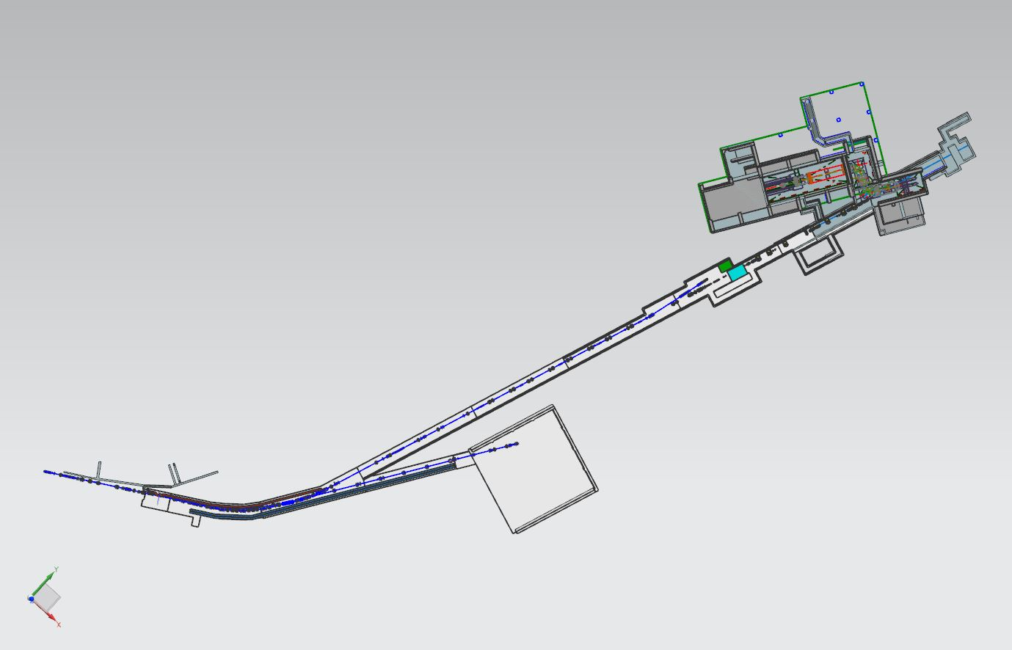
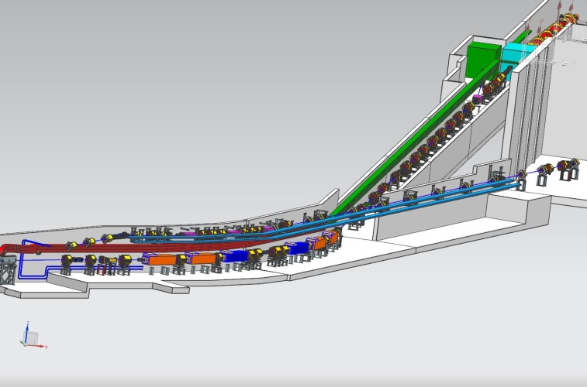
Mu2e Section of the M4 Beamline
The beamline is broken into 4 distinct sections for beam function & installation.
Part of the M4 beamline is shared with g-2. Split is at 908. Mu2e will be responsible for on the cost of installation of the M4 beamline from 908 to 952.
Installation will includes all magnets, magnet supports , main & trim power supplies, vacuum system & controls, LCW and compressed air for tunnel and Mu2e building as well as two beam stops.
The schedules have pushed together so that g-2 running will overlap Mu2e installation 2017 - 2019
Extinction & Diagnostic Absorber Section
Common Section
Final Focus Section
HBend Section
Diagnostic Absorber
Mu2e M4 Beamline
G-2 M5
Beamline
908 Vertical Split for mu2e & g-2

Slide 5
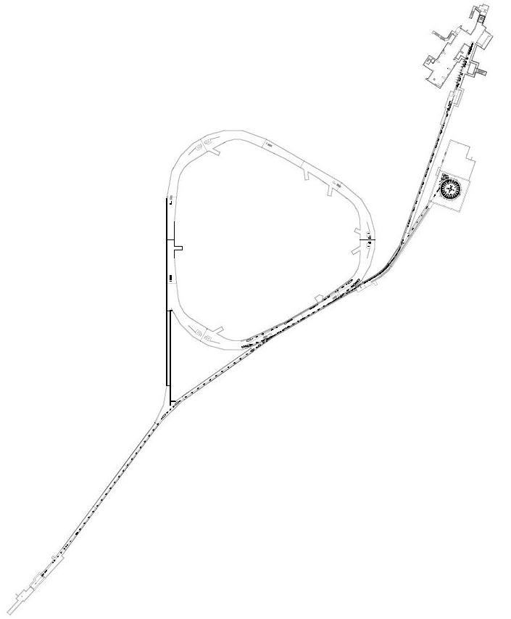
General Installation
Temporary Shield Wall for Installation.
Installed before g-2 runs.
M4 Beamline is broken into 3 sections for installation: (Majority of components for M4 will be repurposed from the Antiproton Source.)
HBend 908 to 920 (Shield wall) 26 Elements, 24% of length
Extinction & Diagnostic Absorber 920 to 945. 58 Elements, 57% of length
Final Focus 945 to 952. 19 Elements, 19% of length.
M4 DA Hatch
6 CDA
AP1 Line
Recycler 700
SQC MSF
Magnets in Former Pbars transferred through new tunnel or M4 DA hatch
Installation of HBend and transporting magnets from Accumulator will occur during shutdowns after g-2 running.

Slide 6
Summary of Installed Components
M4 Magnetic Element
Vacuum
New Main & Trim Power Supply
Row Labels | Needed
New: | 879
5.5" to 4' beam tube reducer | 20
Beamtube, large, special, transitional | 20
Fittings: | 21
Flange Gaskets: | 150
Flanges: | 99
Gauges: | 14
KF40 | 10
Stands: | 28
Valves: | 17
Beamtube, 4" round, laser welded, 316L SS (ft) | 400
Beamtube, 6" round, laser welded, 316L SS (ft) | 100
Repurposed: | 250
Gauges: | 14
Ion Pumps: | 18
Rough Pumps: | 4
Stands: | 47
Valves: | 16
Windows: | 3
Bellows: | 48
Beamtube, 5-1/2" round, 316L SS (ft) | 100
Grand Total | 1129
Row Labels | Count of Location
Fabricated: | 1
MDC | 1
Refurbished: | 6
CDA | 6
Repurposed: | 69
3Q120 | 2
LQC | 4
LQD | 2
NDA | 11
SDF | 2
SDFW | 4
SQA | 20
SQB | 7
SQC | 5
SQD | 5
SQE | 2
VDPA | 5
Grand Total | 76
Row Labels | Count of P.S. CIRCUIT
AP30: | 8
SCR | 1
SWITCH MODE | 7
MC-1: | 20
SCR | 1
SWITCH MODE | 19
Trim power supply (repurposed) | 15
Mu2e Bld.: | 10
SCR | 1
SWITCH MODE | 9
Grand Total | 38
Fabricate 1 beam stop
Modify 1 beam stop
All LCW & Compressed Air Systems are new
Magnet Supports
Row Labels | Count of Magnet
new motorized | 3
new stand and adjustors | 26
repurposed adjustors with height modification | 47
New Instrumentation stand | 24
Grand Total | 100

Slide 7
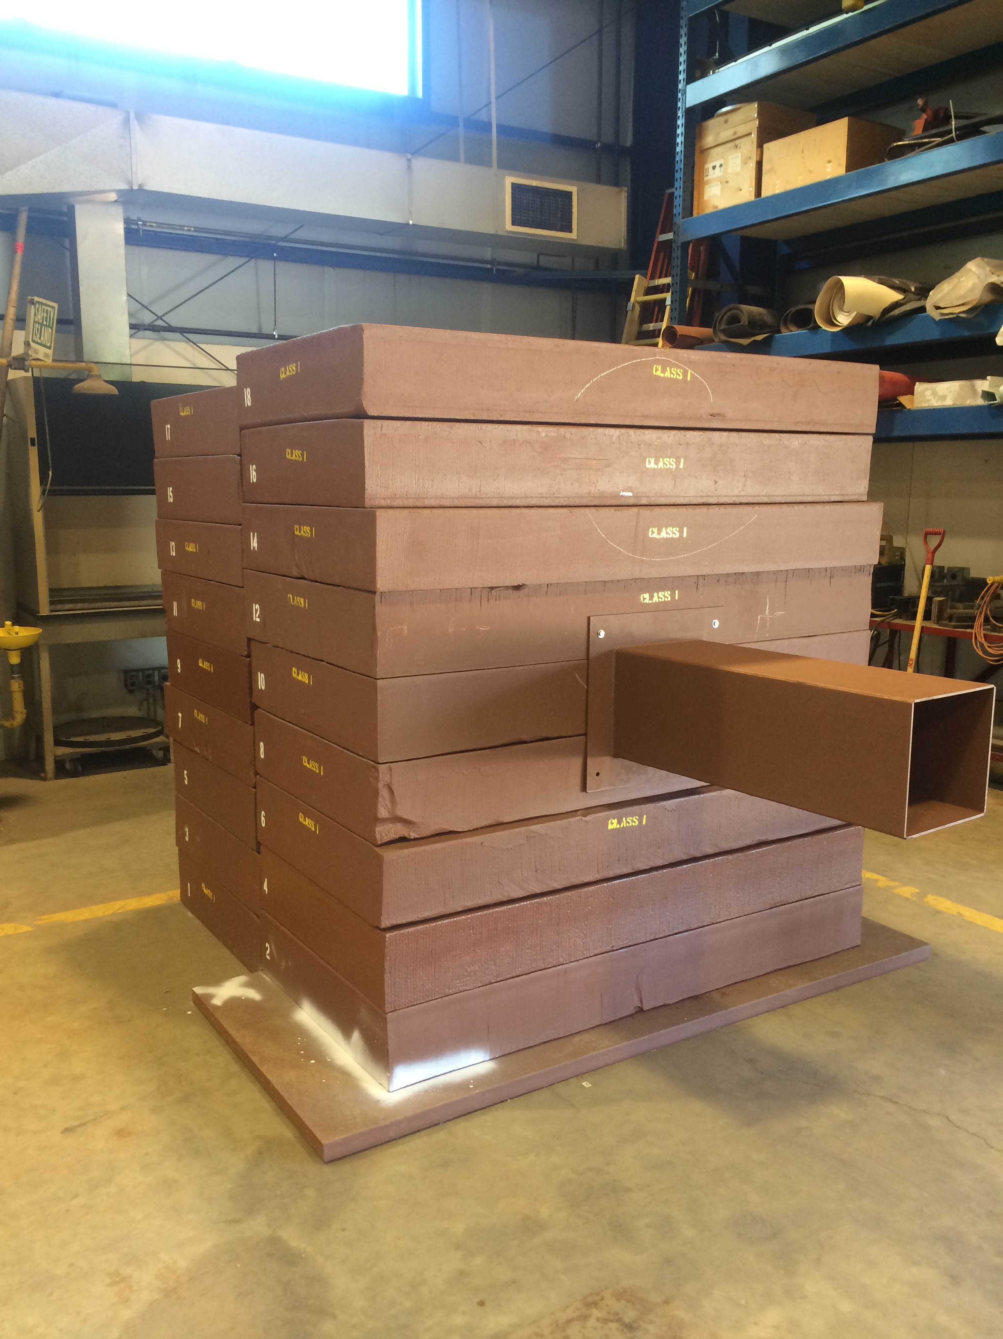
M4 Diagnostic Absorber & GPP
The M4 Diagnostic Absorber was designed on External Beamline WBS 475.02.07.04 .
The steel for the absorber has been and cut , prepared, assembled and will be installed in the tunnel walls surrounded by concreate. The for installation has been transferred for Mu2e project to the tunnel GPP.
The absorber is complete and ready for GPP installation.
Assembled M4 Diagnostic
Absorber waiting to be installed
on the tunnel GPP.

Slide 8
Quality Assurance
All installation work in the M4 beamline has high engineering oversight and coordination in order to ensure quality to design. C. Gattuso is installation coordinator for all Muon Campus Work.
A Component Tagging system has been put in place to keep track of components and ensure quality control of work that needs to be complete for individual components.
Utilize standard adherence to the Fermilab Engineering Manual.
There is a good history of operating experience with similar of repurposed devices of purchasing quality components to ensure quality and predetermined performance. There is Mechanical Engineering QA summary document of practices, policy and procedures in Mu2e-doc-4646.
There is an adequate testing period after installation is complete and built into the schedule to confirm systems can operate at designed performance. (power supply, vacuum, LCW)

Slide 9
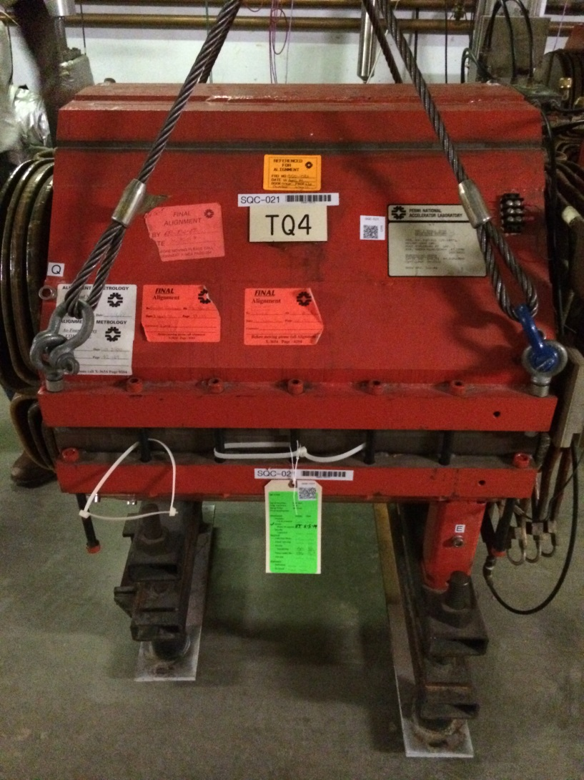
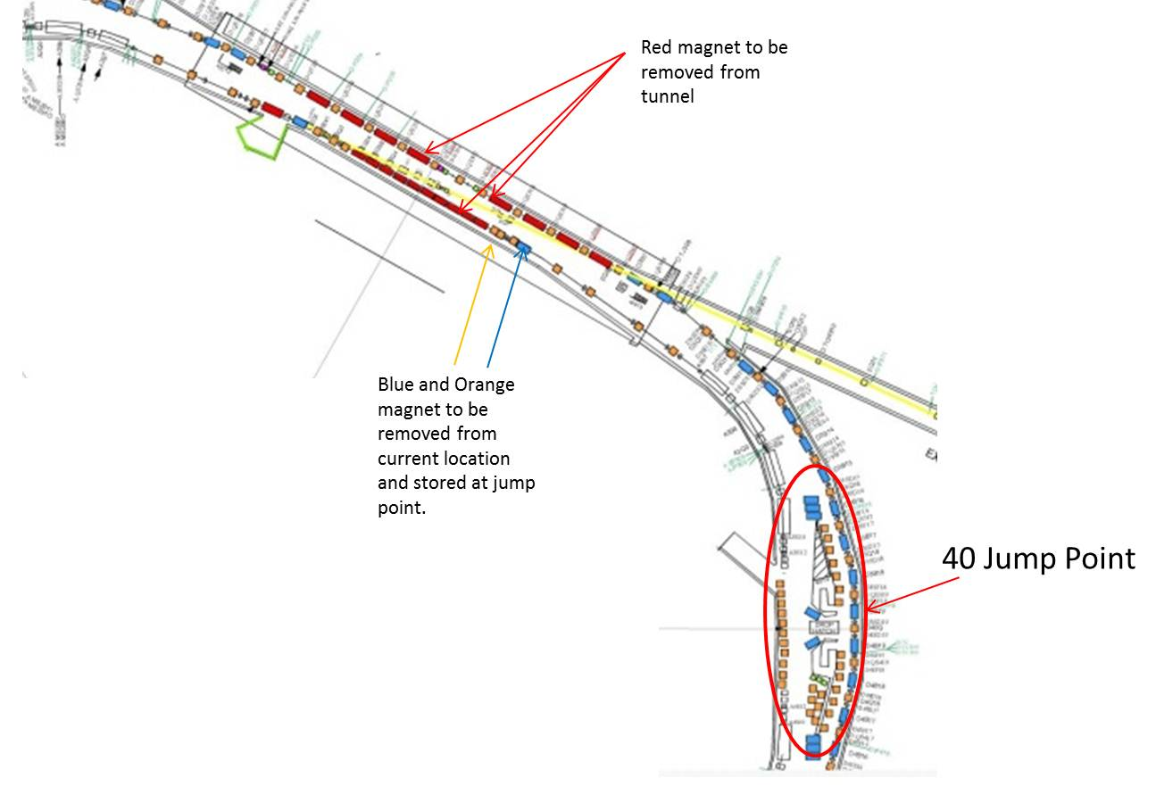
Quality Assurance – Tagging
QR Codes
Electronic coding system to keep track of the status of each magnet
Red: Components to be removed from tunnel
  Storage or
  Rad waste
Blue: Components to removed from current location
and installed back to their original location.
  Magnet in the Delivery ring 30 section for
  example
Green: Components to be removed from current
location and store at its jump point prior to being
re-installed elsewhere
  Magnets being moved from the Accumulator to
  the M2/M3 or M4/M5 lines

Slide 10
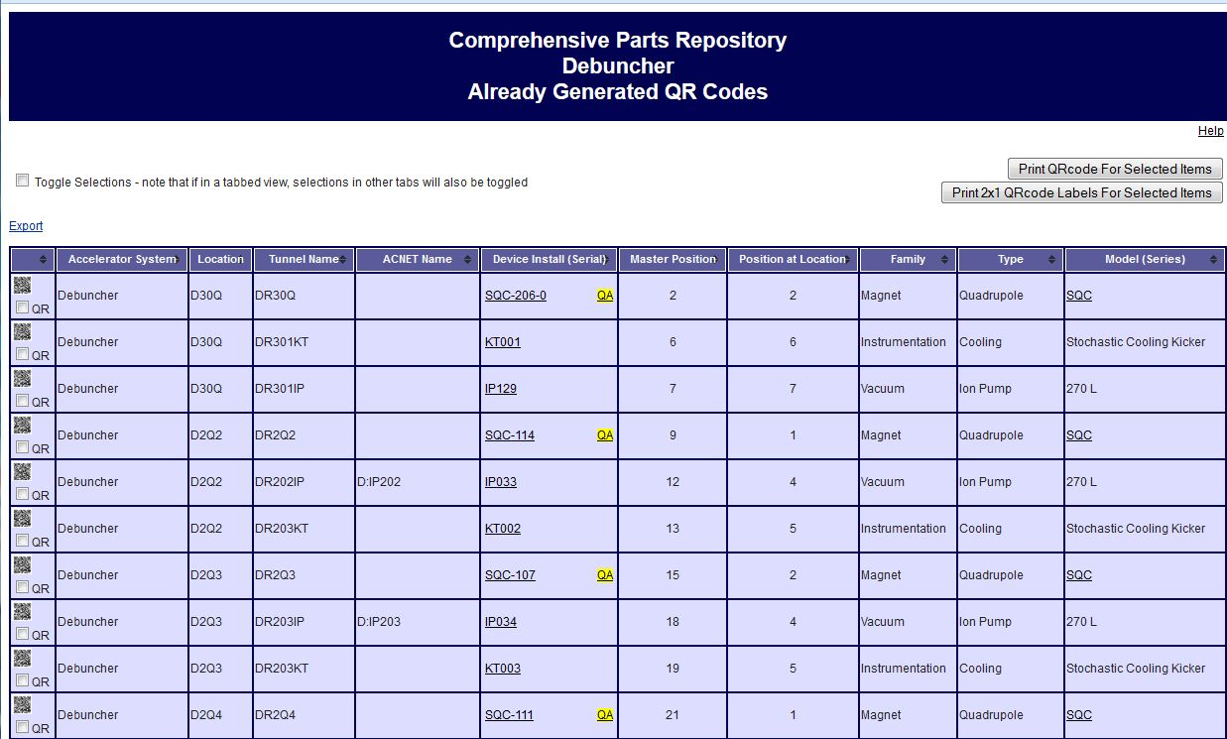
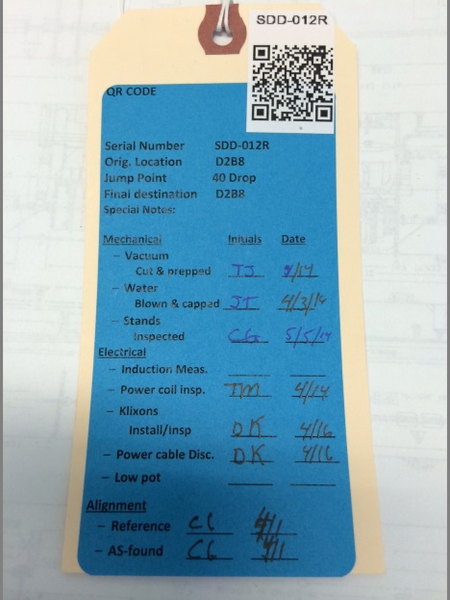
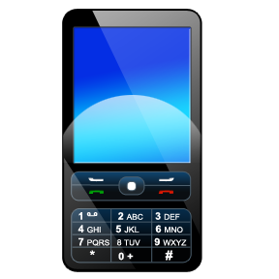
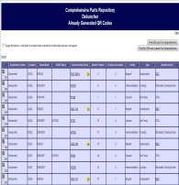
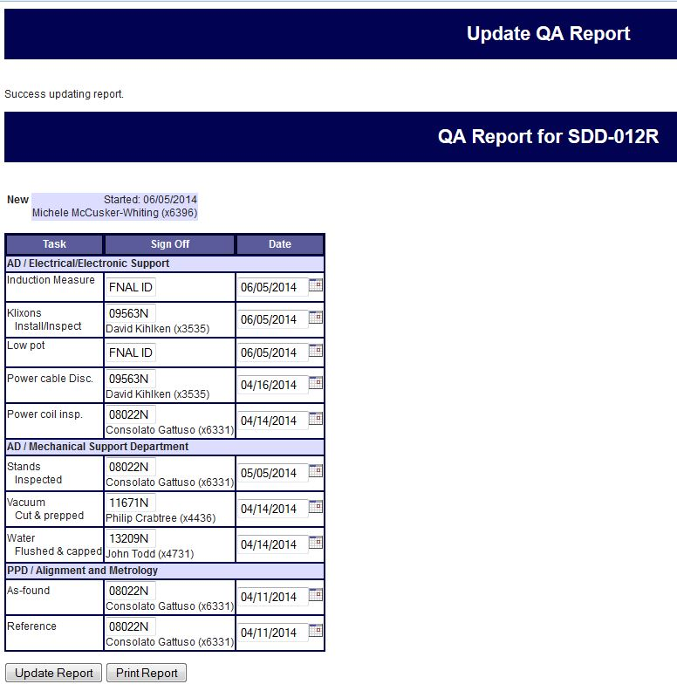
QA – Component Tagging (2)
QA tag for SDD-012R in the 30 straight section located on magnet
Cellphone app
Information added via phone app that reads the QR code, which then allows user to update and populate the entries
Each magnet type has a custom setup
Individual fields then can be populated and updated via this interface

Slide 11
Risks
Registry contains 2 risks:
ACCEL-200 - Mu2e-doc-4589 : Additional power supply circuits needed for modified optics for the change in the extinction section due to extinction design change.
  High probability with up to $400K cost impact
ACCEL-201 - Mu2e-doc-4590: Additional magnet needed to be fabricated for modified optics for the change in the extinction section due to extinction design change.
  Moderate probability with $200K cost impact.
Registry contains 1 risk removed where a Threat is Avoided:
ACCEL-033 Mu2e-doc-3832: Inability to stage magnets in the Accumulator enclosure during g-2 operation
Registry contains 1 opportunity:
  ACCEL-202 - Mu2e-doc-4591: Replace current MDC magnet for diagnostic absorber line with an existing SDC magnet.
    Moderate probability with $110K cost impact.

Slide 12
ES&H
Laboratory safety practices will be observed for all work, including the handling and installation of magnets, vacuum systems, power supplies and other accelerator components.
Job hazard analyses will be performed for installation and other appropriate work.
The new tunnel enclosure will conform to standards for radiation safety including prompt dose, residual dose, air activation and ground water activation. These hazards are addressed in the Hazard Analysis Report Mu2e-doc-4229.
Installation Coordinator will ensure work is properly coordinated to avoid conflicts

Slide 13
Cost Distribution by L4
Final Design Costs
Base Cost by L4 (AY $k)
Installation
WBS Breakout of Implementation | Direct M&S | B A C | Estimate Uncertainty | Total | Average Contingency on remaining budget
475.02.07 Power Supply | 1,286,200 | 2,537,885 | 698,597 | 3,236,484 | 28%
475.02.07 Magnets | 278,400 | 1,843,114 | 547,534 | 2,390,650 | 30%
475.02.07 LCW & Compressed Air | 162,700 | 596,180 | 178,855 | 775,038 | 30%
475.02.07 Vacuum | 131,400 | 458,437 | 137,530 | 595,968 | 30%
475.02.07 Magnet Supports & Beam Stops | 104,700 | 159,688 | 50,488 | 210,176 | 31%
475.02.07 Optics | 0 | 28,406 | 8,522 | 36,927 | 30%
Total | 1,963,400 | 5,623,710 | 1,621,526 | 7,245,243 | 30%
(Installation)

Slide 14
Cost Distribution by Resource Type
Base Cost (AY $k)
Welder
Rigger
Iron Worker
Pipefitter
Materials
&
TM electricians
FNAL Labor

Slide 15
Quality of Estimate
Base Cost by Estimate Type (AY $k)
100% of cost is at the Preliminary Design level or better .

Slide 16
Labor Resources
FTEs by Discipline

Slide 17
Labor / Material Breakdown
Base Cost by Estimate Type (AY $k)

Slide 18
Cost Table
Base Cost (AY K$)
 | M&S | Labor | Total | Estimate Uncertainty (on remaining budget) | % Contingency (on remaining budget) | Total Cost
475.02.07.01 External Beamline Magnets |  | 238 | 238 | 42 | 30% | 280
475.02.07.02 External Beamline Magnet Power Supplies |  | 198 | 198 | 22 | 30% | 220
475.02.07.03 External Beamline Mechanical & Vacuum Systems |  | 373 | 373 | 36 | 33% | 409
475.02.07.04 External Beamline Diagnostic Absorber | 26 | 65 | 91 |  | 0% | 91
475.02.07.05 External Beamline Optics |  | 199 | 199 | 38 | 32% | 237
475.02.07.06 Oversight and Technical Documentation |  | 517 | 517 | 70 | 22% | 587
475.02.07.07 Implementation | 3,387 | 2,237 | 5,624 | 1,622 | 29% | 7,245
Grand Total | 3,412 | 3,827 | 7,240 | 1,830 | 29% | 9,069

Slide 19
M4 External Beamline from CD2 Dir. Review
At the CD2 Directors Review in July there was a comment in the Cost and Schedule section – “There is a mismatch between some BOEs and P6. This is recognized and the path forward is under discussion. For example, the accelerator management team stated there is $1-2M more in the BOEs for the magnets and power supplies than s shown in the schedule”
http://www.fnal.gov/directorate/OPMO/Projects/Mu2e/DirRev/2014/20140708/FINAL_Closeout_Presentation_Mu2e_2014_07_08.pdf
Since July 2014, a “ground up” reevaluation of the M4 external beamline cost has been completed. Reevaluation cost $9.1M from $7.2M.
That reevaluation of the cost was presented to the Mu2e Accelerator Management for changes.
An Accelerator Division Independent cost review of M4 External Beamline was conducted on Sept 8-12, 2014.
Internal Review Final Report can be found in Mu2e-doc-4511 (link on review website)

Slide 20
Major Milestones
Activity ID | Activity Name | Start | Finish | Milestone Tier
47502.07.001010 | T5 - Mu2e External Beamline Preliminary Design Complete |  | 1-May-14 | T5
47502.07.001200 | TX5 - FY15 Maintenance Shutdown (Accelerator Complex) | 08-Sep-15* |  | T5
47502.07.001050 | TX4 - M4 External Beamline Enclosure Complete (by GPP) |  | 30-Sep-15 | T4
47502.07.001020 | T5 - Mu2e External Beamline Final Design Complete |  | 6-Nov-15 | T5
47502.07.001030 | T5 - DOE CD-3 Accelerator Beam Line Mini-Review Approval | 24-Feb-16 |  | T5
47502.07.01.004025 | T5 - Start External Beamline Magnet Stand Procurement & Fabrication | 3-Oct-16 |  | T5
47502.07.07.002500 | T5 - Start of MDC Dipole Fabrication | 3-Oct-16 |  | T5
47502.07.07.004070 | T5 - Start of External Beamline Power Supply Procurement | 3-Oct-16 |  | T5
47502.07.07.002630 | T5 - Start External Beamline Magnet Fixed Stand Assembly and Installation | 31-Oct-16 |  | T5
47502.07.07.004180 | T5 - External Beamline Power Supply Fabrication and Installation Start | 29-Mar-17 |  | T5
47502.07.1240 | TX5 - FY17 Maintenance Shutdown (Accelerator Complex) | 5-Sep-17 |  | T5
47502.07.07.004230 | T5 - External Beamline Mechanical & Vacuum Procurement Start | 2-Oct-17 |  | T5
47502.07.07.003060 | T5 - Start External Beamline Ext. & M4DA section Installation | 31-Oct-17 |  | T5
47502.07.07.004220 | T5 - External Beamline Power Supply Installation Complete |  | 12-Dec-17 | T5
47502.07.07.004345 | T5 - External Beamline Ext. & M4DA section Instalation Complete |  | 14-Sep-18 | T5
47502.07.07.004330 | T5 - Start External Beamline HBend Installation | 17-Sep-18 |  | T5
47502.07.07.002530 | T5 - Start CDA Dipole Magnet Refurbishment | 1-Oct-18 |  | T5
47502.07.07.004320 | T5 - External Beamline HBend Installation Complete |  | 14-Jan-19 | T5
47502.07.07.002700 | T5 - Start External Beamline Final Focus Installation | 30-Jan-19 |  | T5
47502.07.07.002560 | T5 - External Beamline Final Focus Installation Complete |  | 26-Mar-19 | T5
47502.07.001240 | T5 - Mu2e External Beamline Installation and Close-out Complete |  | 25-Nov-19 | T5
47502.07.001230 | T5 - Mu2e External Beamline ready for beam to diagnostic absorber |  | 29-Jan-20 | T5

Slide 21
Schedule – External Beamline
Final Design Complete
PS Arrives @ Mu2e Bldg
CD-2/3b
CD-3c
Beam to Diagnostic Absorber
M4 Enclosure
BO
Shutdown
‘16
g-2 Beam Operations
Shutdown
‘14
Shutdown
‘15
Magnet Removal & Fabrication & Refurbish
5 VDPA Removal RR
MCD Fabrication
6 CDA Refurb
Install ESS
Commission Res. Extr.
Magnet & Support Installation
Remove Hbend dipoles
Extinction & M4DA Section Installation
Internal Beamline
Review
Hbend Section Installation
Procure fixed & motorized stands & assemble
Final Focus Section Installation
LCW
Procure and Install LCW & CA Systems
Vacuum
Prep Ion, tube & components
Procure Parts
Install Ext&DA
Install Hbend
Install FF
Power Supply
Procure , assemble & install main and Trim Power Supplies
Misc
Survey network
Final Alignment
Close up tunnel
Commissioning with single turn Beam
Q3 | Q4 | Q1 | Q2 | Q3 | Q4 | Q1 | Q2 | Q3 | Q4 | Q1 | Q2 | Q3 | Q4 | Q1 | Q2 | Q3 | Q4 | Q1 | Q2 | Q3 | Q4 | Q1 | Q2 | Q3 | Q4 | Q1 | Q2 | Q3 | Q4 | Q1 | Q2 | Q3 | Q4
FY14 FY15 FY16 FY17 FY18 FY19 FY20 FY21
Notes:
Notes:
ESS Installation depicted here is not what is in the P6 schedule. P6 does not account for the fact that the beamline must be commissioned with single turn extracted beam before the ESS can be installed.
The ESS replaces a Delivery Ring extraction kicker module. Therefore, ESS installation precludes further single turn extracted beam to the M4 beamline.
HRS installation takes 10 days (box on schedule is over-sized)
Target installation is off-project and estimated to occur in Dec. 2021.
Beam commissioning is off-project

Slide 22
Summary
The design of the beamline is at a preliminary or better design stage.
The installation schedule is at a preliminary design that has considerations to funding and lab resources.
The M4 beamline is divided into three sections to allow for installation during g-2 operation.
Installation of the beamline has allowed for the priority to commission beam the M4 diagnostic absorber.
The cost of the M4 external beamline is $9.1M
The External Beamline L4 is ready to baseline.

