Slide 1
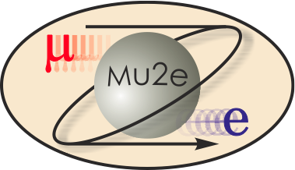
Mu2e CD-2 Review: Instrumentation & Controls
Brian Drendel
L3 Project Manager
10/22/2014

Slide 2
WBS 475.02.03 Instrumentation and Controls
Technical Objective
The technical objective is to design and fabricate the equipment for the accelerator controls and instrumentation upgrades required for beam delivery to Mu2e. This includes implementing system that:
Provide Accelerator controls in the Muon Campus for Mu2e specific controls needs.
Provide Accelerator controls connectivity to the Mu2e Building and M4 beam line.
Provide instrumentation capable of measuring beam intensities, profiles and losses in the M4 beam line.
Provide instrumentation capable of measuring the Delivery Ring tune and Delivery Ring beam intensity.

Slide 3
Standard Specifications: Accelerator Controls
Ethernet (Controls & General): Communicating with controls system and the outside world.
Experiment data: > 1GB/s pipeline between Mu2e and FCC.
Camac/HRM: Communication with ACNET controls.
Timing Links: TCLK timing for devices.
Beam Synch: RF synched timing for devices.
Permit Loop: Permit for Delivery Ring beam abort.
FIRUS: Fire and Utility system for building monitoring.
Safety System: Interlocks and safety system for Mu2e and M4 enclosure.
SEWs: Site Emergency Warning system.
Radmux: Collects data from connected radiation monitors throughout the accelerator areas, beam line areas, and test areas at the Laboratory
Phone: Hard-lined phone connection to building.
Notes:
Camac and Links:
The existing accelerator service buildings will continue to use the legacy controls infrastructure that is currently in place. These service buildings include all of the Main Injector service buildings, as well as F0, F1, F2, F23, F27, AP0, AP10, AP30 and AP50. Future Muon Campus service buildings, including MC-1 and Mu2e, will be upgraded to a more modern controls infrastructure which will be discussed later in this document.
Computer Automated Measurement and Control (CAMAC) crates exist in each service building and communicate with the control system through a VME style front-end computer over a 10MHz serial link as shown in Figure 1. Both digital and analog status and control of many accelerator devices occur through the CAMAC front ends. There should be no need to install additional CAMAC crates, as there is excess capacity in most of the existing crates. An inventory of existing CAMAC crates in the Muon Department service buildings shows that about 25% of the slots are unoccupied and could be used for additional CAMAC cards [1]. In addition, further slots have become available that were used to interfaces devices that became obsolete with the retirement of Collider Run II operations. It is anticipated that there will be ample CAMAC crate coverage for Mu2e operation in the existing Muon Department service buildings, and very few crates will need to be added or moved.
There are serial links that are distributed through and between the service buildings, via the accelerator enclosures, that provide the necessary communications paths for CAMAC as well as other necessary signals such as clock signals, the beam permit loop and the Fire and Utilities System (FIRUS). Controls serial links can be run over multimode fiber optic cable or copper Heliax cable. Most Muon Department links that run through accelerator enclosures are run over Heliax which should function normally in the radiation environment expected for Mu2e operations.
Accelerator device timing that does not require synchronization to the RF buckets will remain on the existing 10MHz Tevatron Clock (TCLK) system. The existing TCLK infrastructure will remain in existing service buildings and new TCLK link feeds will be run via multimode fiber optic cable from the Mac Room to the Mu2e Experimental Hall.
Figure 1: Legacy CAMAC crates interfacing VME front ends via serial links provide both analog and digital status and control of accelerator devices and will continue to be used in existing Muon Department Service Buildings [2]. Drawing courtesy of the AD Operations Controls RookieBook [4].
Accelerator device timing for devices that require synchronization to the RF buckets will continue to be handled through the Beam Synch Clocks; however, a few changes will be required to maintain functionality. The F0, F1 and F2 service buildings will need both 53MHz Main Injector beam synch (MIBS) for SY120 operations and 2.5MHz Recycler beam synch (RRBS) for g-2 and Mu2e operations. These buildings already support multiple beam synch clocks, so the addition of RRBS will require minimal effort. An obsolete 53MHz Tevatron beam synch (TVBS) feed in the MI60 control room will be replaced with a 2.5MHz RRBS feed to provide the necessary functionality. The remaining Muon Department service buildings currently use 53MHz MIBS, but will require 2.5MHz RRBS for g-2 and Mu2e operations. This functionality can be obtained by replacing the MIBS feed at F0 with RRBS and using the existing infrastructure. Further upgrades and cable pulls will only be required if it is later determined that both MIBS and RRBS are required in these service buildings. New beam synch feeds to the g-2 and Mu2e service building will be run via multimode fiber optic cable from the Mac Room.
The Delivery Ring permit loop provides a means of inhibiting incoming beam when there is a problem with the beam delivery system. The Pbar beam permit infrastructure will be used in the existing buildings. The CAMAC 201 and 479 cards, which provide the 50MHz abort loop signal and monitor timing, will need to be moved from the MAC Room to AP50 to accommodate the addition of the abort kicker at AP50. Existing CAMAC 200 modules in each CAMAC crate can accommodate up to eight abort inputs each. If additional abort inputs are required, spare CAMAC 200 modules will be repurposed from the Tevatron and will only require an EPROM or PAL change to bring into operation. The permit loop will be extended to the MC-1 and Mu2e service buildings via multimode fiber optic cable from the Mac Room. CAMAC will not be available in the MC-1 and Mu2e Experimental Halls, so the abort permit signal for these buildings will be extended via an additional cable pull to the AP30 service building.
Permit scenarios are being developed to support necessary operational scenarios. We will need the capability of running beam to the Delivery Ring dump when Mu2e and g-2 are down, and running to either experiment while the other is down.
Hot-Link Rack Monitor
New controls installations in the Mu2e Experimental Hall will use Hot-Link Rack Monitors (HRM’s) in place of CAMAC. A HRM runs on a VME platform that communicates with the control system over Ethernet as shown in Figure 2. Unlike CAMAC, no external serial link is required, minimizing the need for cable pulls between buildings. Each HRM installation provides 64 analog inputs channels, 8 analog output channels, 8 TCLK timer channels and 8 bytes of digital I/O. This incorporates the features of multiple CAMAC cards into a single-compact chassis. Like CAMAC, when additional functionality or controls channels are needed, additional units can be added. Two HRMs will be installed in both MC-1 and Mu2e Experimental Halls and should provide ample controls coverage for both accelerator and experimental devices.
Figure 2: A Hot-Link Rack Monitor is a flexible data acquisition system composed of a remote unit and a PCI Mezzanine card that resides in a VME crate. Each HRM provides provides sixty four 16 bit analog input channels, 8 analog output channels, 8 TCLK timer channels and 8 bytes of digital I/O. HRM’s will eventually replace all of the functionality of CAMAC [5].
Ethernet:
Many modern devices have some form of Ethernet user interface. In addition, many devices and remote front ends use Ethernet to interface the control system instead of using the traditional CAMAC. The results are an increasing demand on the Controls Ethernet. Figure 3 is a map of the Muon Controls network. All of the current Muon Ring service buildings have Gigabit fiber optic connections from the cross-gallery computer room to Cisco network switches centrally located in each service building. These will provide ample network bandwidth and connections after the reconfiguration for g-2 and Mu2e operations. A central Ethernet switch that fans out to the other Muon Department buildings is currently located in AP10, but will need to be moved to AP30 as will be discussed later in this document [9].
Figure 3: Controls Ethernet to the Muon Department Service Buildings should be adequate for Mu2e operations. The central switch at AP10 will be moved to AP30. Legacy networks at AP0, F23 and F27 have limited bandwidth and connectivity, but should be sufficient for Mu2e operations.
Ethernet connects between the Muon Rings service buildings via multimode fiber optic cable paths that traverse the Rings enclosure on the Accumulator side. This will be upgraded to single mode fiber optic cable in order to support the rerouting of the site emergency warning system as well as provide a more robust fiber infrastructure for the higher radiation levels anticipated for Mu2e operations.
Most beam line service buildings have gigabit fiber connected to centrally located network switches that provide ample network bandwidth and connections. AP0, F23, and F27 are the only three buildings that do not have this functionality. AP0 runs off a 10Mbps hub that connects to 10Base5 “Thicknet” that runs through the Transport and Rings enclosures back to AP10, while F23 and F27 run off 802.11b wireless from MI60. Both are 10 Mbps shared networks with limited bandwidth and connectivity. It is anticipated that the network in these three buildings will be sufficient for Mu2e operations.
Restoring Controls Connectivity:
Civil construction of the M4 and M5 beams line enclosures will result in the removal of the underground controls communication duct that provides the connectivity between the Accelerator Controls NETwork (ACNET) and the Muon Campus [8]. Included in this communication duct is the fiber optic cable that provides Ethernet connectivity as well as 18 Heliax cables that provide the controls serial links and other signals including the Fire and Utility System (FIRUS) [10]. These cables currently connect from this communications duct to the center of the D20 location in the Rings enclosure, and travel through cable trays on the Delivery Ring side to the AP10 service building. After removal of the communications duct, FESS will construct new communications ducts from the existing manholes. These communications ducts will go directly to AP30, MC-1 and Mu2e service buildings without going through accelerator enclosures. See Figure 4 for drawings of the current and future controls connectivity paths.
Restoring Connectivity:
When the Heliax and fiber optic cables are cut during the above mentioned communications duct removal, controls connectivity will be lost. The base plan for restoring both Ethernet and controls link connectivity is to pull new fiber optic cable from the cross gallery to the manhole outside of Booster Tower West and on to AP30 via the new communications duct. As a result of the new fiber pull, the Ethernet and controls links will fanout from AP30 instead of AP10. This will require some additional controls hardware configuration and labor. Efforts will be made to minimize the disruption by pulling the fiber and staging the new hardware at AP30 before the communication duct is cut. This is especially important for FIRUS which is necessary for monitoring building protection [10].
2012 Muon Campus Controls
Future Muon Campus Controls
Figure 4: Muon campus controls paths. During construction of the M4 and M5 beam lines, the communications duct that provides controls connectivity to the Muon Campus will be interrupted. A new communications duct will be built to restore controls connectivity to the Muon Service Buildings. New controls will be established to the MC-1 and Mu2e Experimental Halls.
Single-mode fiber will be needed for the Ethernet and FIRUS connectivity and multimode fiber will be needed for the controls serial links. Bundles of 96 pair single mode and 36 pair multi-mode fiber optic cable will be run to AP30. This provides the necessary connectivity in a minimal amount of space. Similar fiber bundles will also be pulled to MC1 and Mu2e.
Establish Connectivity to Mu2e:
New fiber optic cable will be pulled from the MAC Room to the Mu2e Experimental Hall. Single-mode fiber is needed for Ethernet and FIRUS and multimode fiber is needed for the timing links and the abort permit loop. Bundles of 96 pair single mode and 36 pair multi-mode fiber optic cable will be run to Mu2e. The fiber pulls will provide ample connectivity for all Ethernet and controls signals for both the accelerator and experiment. The Mu2e experiment anticipates requiring network rates approaching 100MB/sec during production data taking which can be handled easily with the proposed infrastructure.
Radmux
The Multiplexed Radiation Monitoring Data Collection System (MUX) is operated by the ES&H / Radiation Protection / Instrumentation Team. The MUX system is used to collect data from connected radiation monitors throughout the accelerator areas, beam line areas, and test areas at the Laboratory. The system provides an interface between the radiation monitors and the hardware network; provides real-time data for its various users; logs the raw data; and processes the data into formatted reports for users and for archive purposes. Additionally the archived data serves as the legal record of radiation levels though out the laboratory [2]. Radmux connectivity will be restored to the existing moun buildings and established to the Mu2e Experimental Hall via new cable pulls [12].
Phone
Phone connections to the existing Muon service buildings will be reestablished by splicing into the 400 pair cable in the MI-8 communications duct. A new section of 100 pair cable will be run from the splice, via a new communications duct path established by the Delivery Ring AIP to the AP30 service building.
Phone connections to the Mu2e Experimental Hall will be established by splicing into 400 conductor pair phone line in the CMH33 Manhole and running new 100 conductor pair phone line to the MC-1 and Mu2e Experimental Halls [13].
Site Emergency Warning System
The Site Emergency Warning System (SEW) currently runs to the Muon Rings buildings over the CATV system. When the communications duct is cut, the CATV system will not be reestablished to the Muon Rings buildings. Instead, the SEWs will be run over single mode fiber optic cable to AP30 and then through the Muon Rings enclosure to AP10, where a connection will be made to the existing system. The fiber will fusion spliced to make one continuous fiber path all of the way to AP10.
No cabling infrastructure will be needed for the SEWS in the Mu2e and MC-1 service buildings. A paging system will be internal to each building and will be tied to a radio receiver (called a TAR) which receives the SEWS radio broadcast system. The messages will be broadcast over the paging system [14].

Slide 4
Controls Design
This WBS covers provides the connectivity of all of the controls signals on the previous slide to Mu2e.
This includes everything up to any front end device in the Mu2e service building.
Controls needs specific to any given system are included in the costing for that system.
Software formerly handled in the Operations Preparation WBS for CD-1 have been moved to operations since they will not be required until after project completion.
Any special software needs for specific systems that are needed before project closeout are covered in the costing for that system.
Controls cable pulls and terminations have been moved to conventional construction BoE 475.03.04.05 to coordinate controls infrastructure availability with Mu2e building beneficial occupancy.

Slide 5
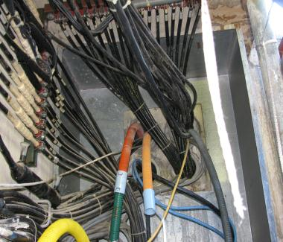
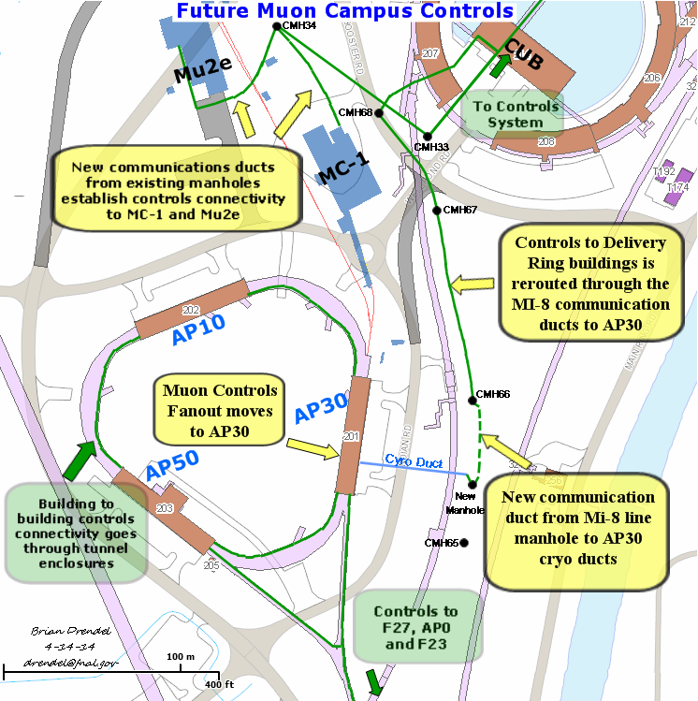
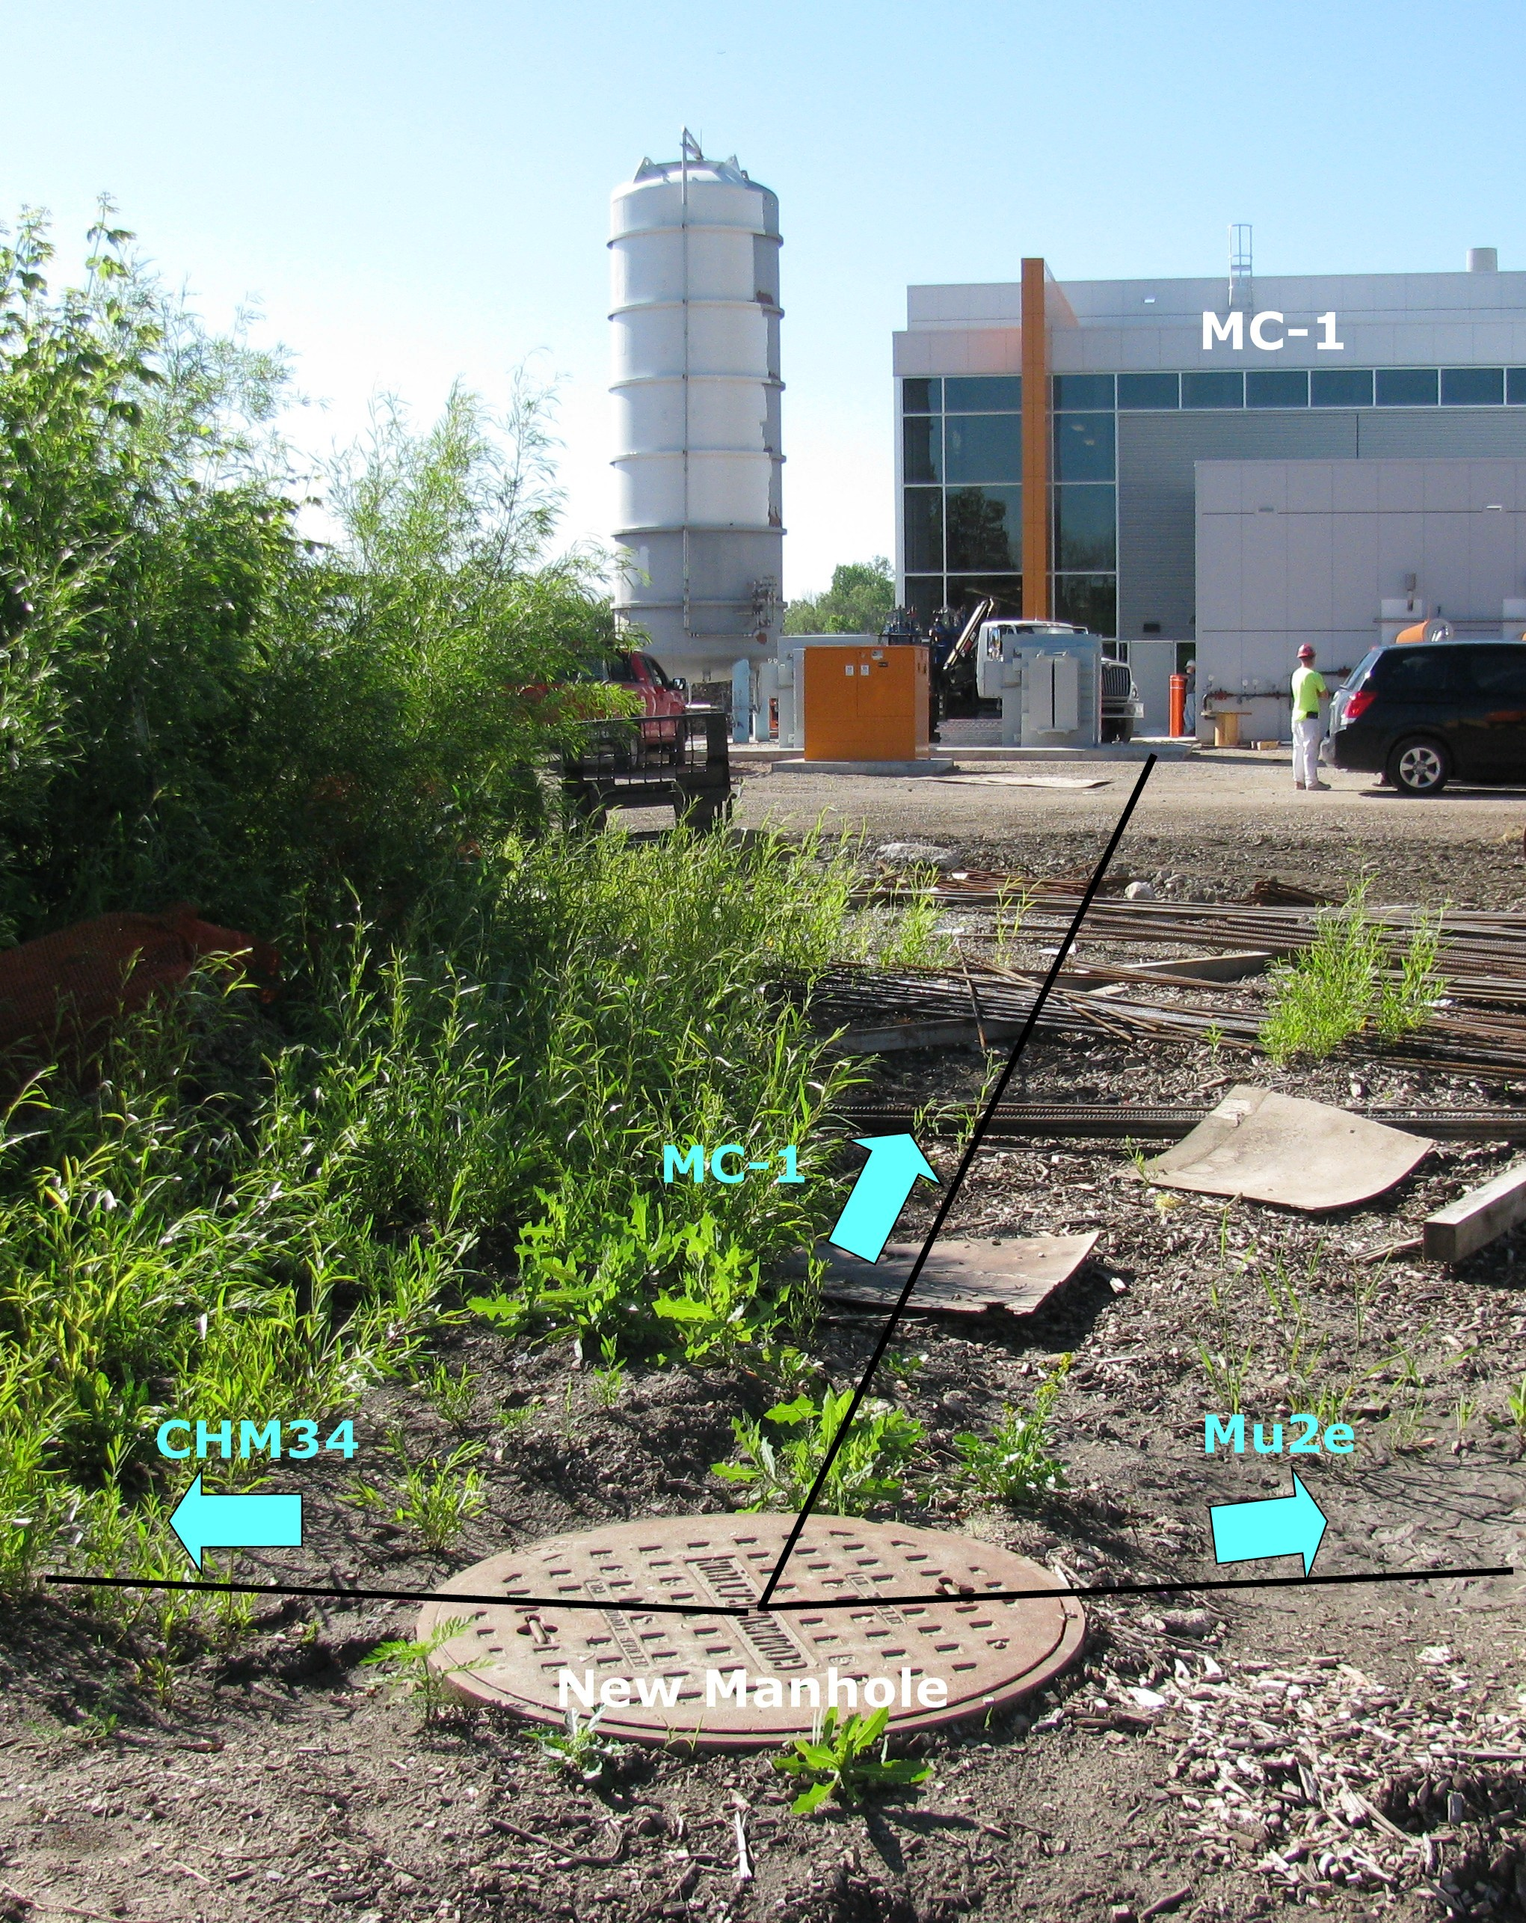
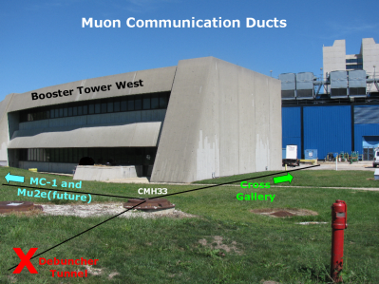
Controls Scope
New controls and communications connectivity will be established from the cross gallery to the Mu2e service building.
96 pair bundle of single mode fiber.
36 pair bundle of multi-mode fiber
Various multi-conductor copper cable.

Slide 6
Mu2e Instrumentation Scope
Delivery Ring Protons (1E12 -> 2E10)
Intensity: DCCT
Tune: Schottky
Extraction Line (2E7 slice every 1.69usec)
Intensity: Ion Chambers
Position/Profile: Multiwires
Losses: BLMs

Slide 7
Instrumentation Scope
Instrumentation is funded by five different sources as shown below. The focus of this talk are the items covered under my Mu2e WBS.
Category | Instrumentation Type | Funding Source
Beam Lines (P1, P2, M1 and M3) | Toroid | Beam Line AIP
 | Beam Position Monitor | Beam Line AIP
 | Beam Loss Monitors | Beam Line AIP, RR AIP
 | Profile Monitors | Beam Line AIP, RR AIP
Delivery Ring | DCCT | Mu2e Project
 | Beam Position Monitor | Delivery Ring AIP
 | Beam Loss Monitor | Delivery Ring AIP
 | Tune Measurement System | Mu2e Project
Abort Line | Toroid/Ion Chamber | g-2 Project
 | Profile Monitor | g-2 Project
 | Beam Loss Monitors | Delivery Ring AIP
Extraction Line (M4 line) | Ion Chamber | Mu2e Project
 | Profile Monitor | Mu2e Project
 | Beam Loss Monitor | Mu2e Project
Notes:
The costing for some Transport and Delivery Ring Instrumentation will be covered in the Delivery Rings AIP.
Transport
Toroids: Existing beam line toroids will be used to measure beam intensities in the beam lines with minimal amount of maintenance performed on the electronics.
Beam Position Monitors (BPMs): Existing BPMs will need small modifications to be used for beam position feedback and orbit control.
Beam Loss Monitors (BLMs): Existing beam loss monitor will be upgraded by repurposing unused BLM electronics and hardware from the Tevatron.
Secondary Emission Monitors (SEMs): Existing SEM electronics will be upgraded to provide beam profile information.
Delivery Ring
Beam Position Monitors (BPMs): BPM electronics will be upgraded with unused electronics from the Recycler to measure the beam orbit.
Beam Loss Monitors (BLMs): BLM system will be used to measure beam loss points. It will be upgraded with unused ion chambers and electronics from the Tevatron.

Slide 8
Requirements: Instrumentation
Instrumentation designed to measure proton beam based on the Proton Beam Requirements Mu2e-doc-1105.
 | Beam Line | Delivery Ring | Abort Line | Extraction
Beam Line Names | P1 Stub, P1, P2, M1, and M3 | Delivery Ring | Abort Line | M4
Particles | Protons | Protons | Protons | Protons
Momentum (GeV/c) | 8.88626 | 8.88626 | 8.88626 | 8.88626
# of Particles | 1E12 | 1E12 -> 2E10 slow spill over 54msec | 2E10 at the end of every cycle or up to 1E12 when beam permit is pulled. | Slices of 2E7 every 1.695usec totaling 1E12 over the 56msec slow spill cycle.
Bunch Length | 120nsec | 120 nsec | 120 nsec | 120 nsec
Transverse Emittance (mm-mrad) | 15pi | 19pi | 40pi | 40pi
Beam Line Length | ~975m | 505m | 72m | 244m

Slide 9
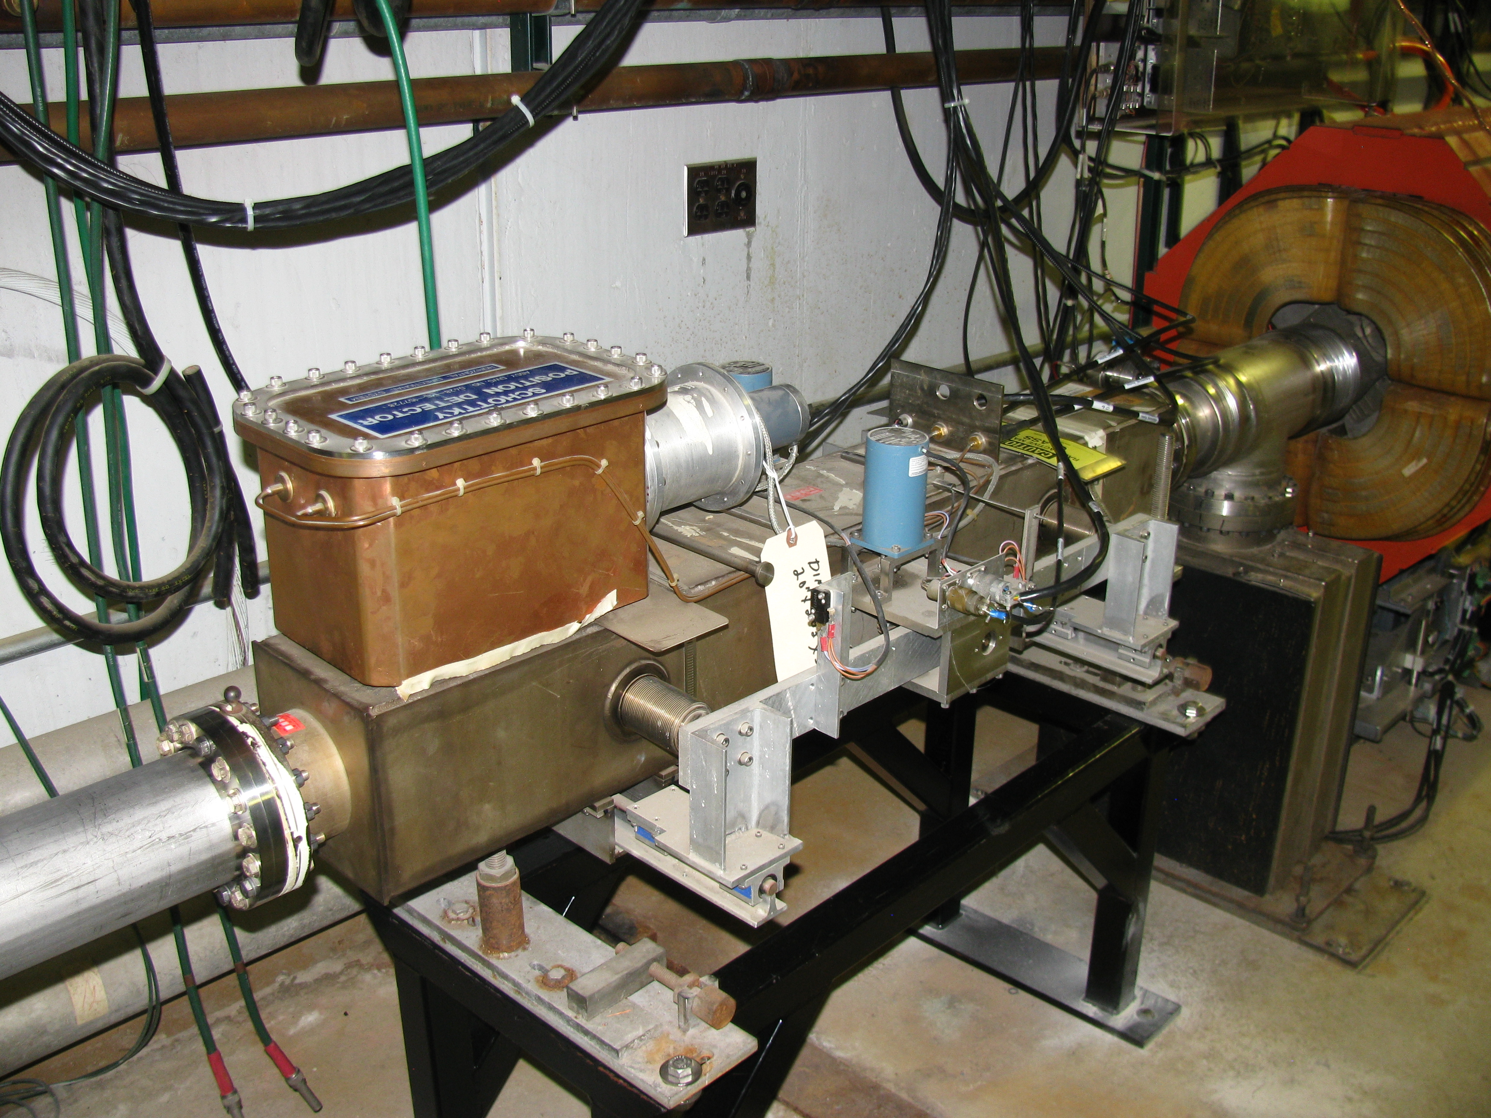
Delivery Ring Instrumentation Design
Measurement | Device | Beam Line | Specific Location
Intensity | DCCT | Delivery Ring | Between D1Q2 and D1Q3
Horizontal Tune | Schottky | Delivery Ring | Between D5Q3 and D5Q4
Vertical Tune | Schottky | Delivery Ring | Between D5Q2 and D5Q3
Notes:
Delivery Ring Instrumentation
Primary proton beam will circulate in the Delivery Ring as it is slow spilled to the M4 line over a time of 56 msec. Like with the beam transport lines, most of the instrumentation needed for operation of the Mu2e Delivery Ring already exists, but needs to be modified or upgraded to accommodate the faster cycle times. The existing DC current transformer (DCCT) will be used to monitor beam intensity through the slow spill cycle. Beam position monitors (BPMs) and beam loss monitors (BLMs) will be used to monitor the positions and losses in the line. Both systems will need significant hardware and electronics modifications to work under Mu2e operational conditions; however, much of the needed equipment can be repurposed from unused collider equipment. To regulate and optimize the Debuncher resonant extraction process a Delivery Ring tune measurement scheme will be required. Schottky Detector hardware and electronics will be recycled from the Tevatron to make this system.
Instrumentation locations were chosen by the beam lines optics expert in order to tune-up the line.
NOT COVERED because they are funded somewhere else:
Beam Position Monitors (BPM)
The primary system to measure the beam orbit in the storage rings will be based on a set of beam position monitors (BPM), distributed along the rings. The existing split-plate BPM pick-ups are suitable for Mu2e operation and will not require modifications.
The BPM read-out hardware is based on an analog differential receiver-filter module for analog signal conditioning, and a digital signal processing system, reusing the Echotek 8-channel 80MSPS digital down converter and other VME hardware from the Recycler BPMs. This system provides beam position and intensity measurements with a dynamic range of 55 dB and an orbit measurement resolution of ±10 microns. The position measurements can be performed on 2.5 MHz bunched beam, as well as on a 53 MHz bunched Booster batch. Data buffers are maintained for each of the acquisition events and support flash, closed orbit and turn-by-turn measurements. A calibration system provides automatic gain correction of the BPM signal path. The software will need to be modified to handle specific events and data acquisition for the Mu2e operation [7].
Beam Loss Monitors
The beam loss monitors (BLMs) are used to locate and measure beam losses in the storage rings. Although there is already a BLM system in place in the Debuncher, it will require significant upgrades for Mu2e operation. The existing photomultiplier tubes will be too sensitive for the expected Mu2e radiation environment, so they will be replaced by ion chambers repurposed from the Tevatron. The electronics have to be re-designed to accommodate the fast cycle time planned for Mu2e. The system will provide a sample-and-hold acquisition technology on individual beam pulses [4].
Abort Line Instrumentation:
Leftover primary proton beam from each spill from the Delivery Ring, as well as Delivery Ring beam that remains when the beam permit goes away, will be sent to the Delivery Ring abort located in the former AP2 line. Like with the beam transport lines, most of the instrumentation needed for operation of the Abort Line already exists, but needs to be modified or upgraded to accommodate the faster cycle times. An existing Toroid and Ion Chamber will be used to monitor beam intensity in the abort line. Beam position monitors (BPMs) and beam loss monitors (BLMs) will be used to monitor the positions and losses in the line. Both systems will need significant hardware and electronics modifications to work under Mu2e operational conditions; however, much of the needed equipment can be repurposed from unused collider equipment. Beam profiles will be measured by using two existing SEMs.

Slide 10
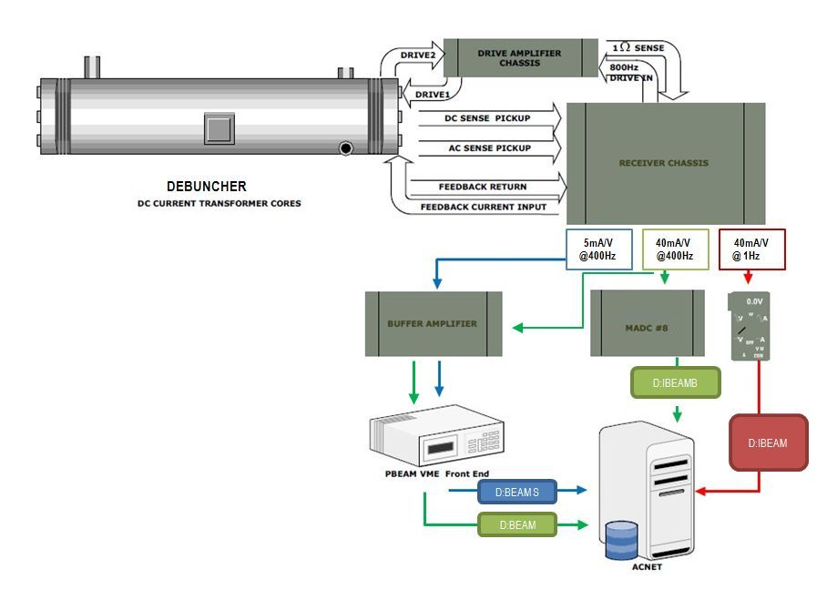
Delivery Ring Instrumentation: DCCT
Delivery Ring DCCT hardware repurposed.
Analog conditioning and VME electronics modified for Mu2e operation.
The system has an accuracy of one part in 10⁵ over the range of 1 x 10¹⁰ to 2 x 10¹² particles with a noise floor of 2 x 10⁹.
The Accumulator unit will become a working spare.
Notes:
Beam Intensity Monitors (DCCT)
A DC current transformer (DCCT) is a device used to measure the quantity of circulating beam with high precision. D:BEAM will become the beam intensity read back for the Delivery Ring. The Accumulator DCCT becomes a spare [2] [6]. Both systems have a full-scale range of 400mA (400e10). Measurements have shown nonlinear errors approaching ~2% for DC currents greater than 200mA. To maximize linearity, calibration procedure focus on doing a least square fit between 0-200mA. The system has an accuracy of one part in 10⁵ over the range of 1 x 10¹⁰ to 2 x 10¹² particles with a noise floor of 2 x 10⁹.
The existing tunnel device in the Delivery Ring can be reused, after applying some modifications. The Delivery Ring DCCT will not require any specific changes to the physical detector, but will need its analog conditioning and VME electronics modified for Mu2e operation. The Accumulator unit will become a working spare.
The pickups consist of two sets of supermalloy tape-wound toroidal cores with laminations, which act to reduce eddy currents. Beam goes through the hole of the donut and acts as a single turn on both toroid sets. The beam sensing electronics are attached to wire windings on each of the toroid sets. One set of cores (T1 & T2) is driven into saturation with 800Hz sinusoidal drive signal. Passing beam induces net magnetic flux on this set of cores, and a second harmonic of the drive signal is detected in the sense winding. The electronics processes this signal and produces an equal and opposite current that minimizes the harmonic and thus keeps the net toroid flux at zero. The second set of cores (T3) is not driven into saturations and follows classical transformer theory. This signal detected processed by the electronics to extend the bandwidth of the entire system. The combination of the resulting signal from processing each sense winding produces the complete feedback signal.
As shown in 6, the receiver chassis provides 3 different sets of analog outputs. Each has a different voltage range and bandwidth, based on modification in the receiver electronics. In order to best measure both the injected and leftover Delivery Ring beam, the following configurations were chosen.
1 Hz bandwidth with 40 mA/V scale. This output is routed to a Keithley digital voltmeter (DVM) located in a rack in the AP10 control room. The Keithley DVM is a GPIB device that talks to the control system through the AP1001 front end, resulting in the D:IBEAM readback that updates once per second with a scale in the mA particle range. Due to the slow 1 Hz sample rate, D:IBEAM is not useful to measure Mu2e slow extracted beam, but will be used for circulating beam studies, diagnostic studies, or calibrations. Maintaining this device also will provide backward compatibility to other intensity algorithms running on AP1001.
400Hz bandwidth with 40 mA/V scale. This output will simultaneously provide 2 readback devices in the control system. One device, D:IBEAMB, is processed through an MADC, using the standard CAMAC 190 card communicating through the Pbar CAMAC front end. At a 720Hz update rate, this 12bit readback effectively provides 40 samples of beam intensity measurements in the mA particle range over the 56msec spill. Although this device would allow us to measure the injected beam and beam through the slow spill cycle, D:IBEAMB is primarily intended for diagnostic purposes. In addition, this output will provide a second device, D:BEAM, which output is sampled by a VME front end after conditioned thru a buffer amplifier (see later description of PBEAM). D:BEAM is intended to be primary measurement of the injected beam and the beam through the slow spill cycle.
400Hz bandwidth with 5 mA/V scale. This output, D:IBEAMV will drive a buffer amplifier, whose output is sampled by a VME front end (see later description of PBEAM). This intensity readback in the uA range will provide the best measurement the leftover beam after slow spill has finished.
The DCCT noise levels are essentially the same in these outputs. The noise of the Debuncher DCCT is about 1.4uA rms for both the 5 and 40mA/V outputs (square root of the sum of the squares from 1 to 58Hz). The Accumulator measures 2.2uA rms.
PBEAM is a VME front end located in AP10. The front end includes a five-slot VME crate with a Motorola MVME-2401 controller. An ICS-110BL-8B provides 4 differential 24 bit ADC channels delivering 18 bits of accuracy. A PMC-UCD provides TCLK and allows ACNET channels that track beam intensity measured on event. (MDAT can also be supported if desired.) Originally, it instrumented such that a single input to the digitizer was from each pbar DCCT systems (i.e. one for Debuncher and another for Accumulator). Since the Accumulator now becomes a spare system, the VME front end will be modified so that both inputs to the digitizer will be from one DCCT system (i.e. Debuncher). One channel will be feed from the 40mA/V receiver chassis output, while the other from 5mA/V. A conditioning amplifier would be used for filtering and to provide a differential inputs to the ADC. The Debuncher signals would be filtered, amplified and driven differentially to the ADC about 50 feet away, located above the Accumulator DCCT. The digitizer oversamples the 400 Hz DCCT outputs at 720 Hz and can provide readbacks with a resolution on the order of a sliding average of twelve 720 Hz samples. Digital signal processing will allow us to measure the injected beam and beam through the slow spill cycle as well as measure the leftover beam after slow spill has finished. The proposed digitizer has the dynamic range to measure the full 400mA range while providing ½ uA rms resolution. Processing the signals digitally will also improve accuracy. The DCCT’s provide between 1 and 2 uA rms provided the 60Hz harmonics are removed.
PBEAM was designed to provide stable readback that is fast enough to sample Delivery Ring beam at various times during the slow spill cycle. D:BEAM is the Delivery Ring Beam Current or main intensity device and is used to derive other arrayed data. PBEAM also provides two other sets of devices that records beam measurements on event. One type is called the fixed-event devices. These will be labeled as D: BEAMXX, where XX is the TCLK reset event. Fixed-event devices will be an array device, containing up to 6 devices. Another time of device is a variable-triggered-event device. It is also an arrayed device, which will be labeled as D:BEAMx. This deivce contains 10 elements, and x will represent the index. Each element will have a settable TCLK event and delay, measured in seconds. The TCLK event is set via the “Timer Reference” selection on a parameter page. The delay is the D/A setting and the intensity readback is the A/D reading.

Slide 11
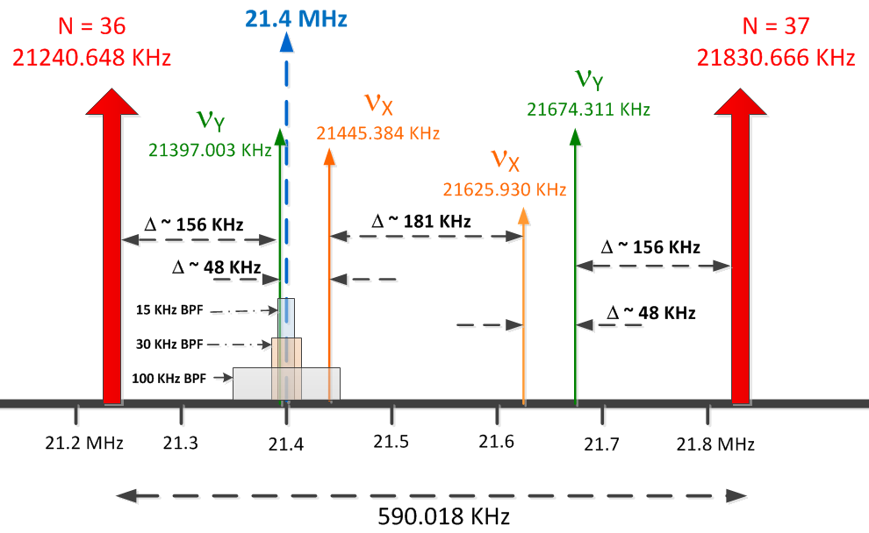
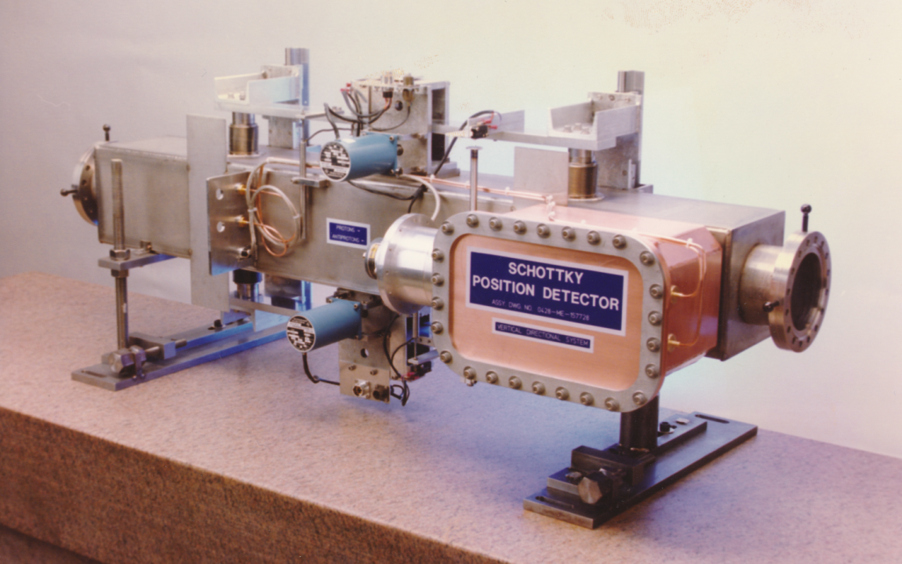
Delivery Ring Instrumentation: Tune Measurement
Repurpose Tevatron 21.4MHz Schottky which has an acceptable aperture.
Down convert from 36th/37th harmonics to 1st harmonic (0 to 590 KHz)
Use 24-bit ADC to sample signal
2 to 4 MHz sampling
100 db dynamic range
Use digital signal processing to produce tunes
Tunes to ±0.001 at 590 Hz
Tunes to ± 0.0001 with averaging over many spills
Notes:
Delivery Ring Tune Measurement
The Delivery Ring is a resonant extraction machine that will require a tune measurement system. The delivery ring tune measurement system will need to measure the average tune and the tune spectrum through the entire 56 ms resonant extraction cycle. These tune measurements will have a resolution of 0.001 at 600 Hz and 0.0001 using averaging. In addition to measuring tune, the system will measure transverse emittance using information from the tune spectrum.
The delivery ring tune measurements will consist of two parts, (1) a Schottky detector system and (2) a direct diode detection base-band Q (3D BBQ) measurement. Both systems have the advantage of being non-destructive to the beam. While the Schottky system has the additional advantage that it can measure transverse emittance, it has the challenge of achieving the desired accuracy at an adequately fast update rate. Averaging of the 3D BBQ system will alleviate this problem.
The Schottky detector system consists of 21.4 MHz resonant pickups taken from the decommissioned Tevatron accelerator as well as its receiver electronics [11]. The 21.4 MHz resonant pickups are two separate horizontal and vertical units with one meter long copper electrodes with stepper motor driven adjustable aperture. Figure 9 shows the vertical pickup unit with attached 21.4 MHz resonator. The Schottky system will measure the tune spectrum and transverse emittance.
A period of beam studies will be required to optimize the Schottky detectors for Delivery Ring operation. Optimal tune measurement will require selection of appropriate band pass filters (BPFs). A block diagram of the electronics setup is shown in Figure 10. Both upper and lower sidebands for the horizontal and vertical tunes fall far enough away from the revolution harmonics to allow valid tune measurements with appropriately chosen band pass filters.
Filter out revolution harmonics
Down convert from 36th/37th harmonics to 1st harmonic (0 to 590 KHz)
Use 24-bit ADC to sample signal
2 to 4 MHz sampling
100 db dynamic range
Use digital signal processing to produce tunes
0.001 tunes at 590 Hz
0.0001 tunes with averaging over many spills
Beam Parameters:
Peak intensity: 1e12 protons
Beam energy: 8 GeV
Bunch structure: Single 2.5 MHz bunch
Nominal bunch length: 40 ns
Bunch base width: 200 ns
Resonant slow-spill extraction over 58 ms
30e6 protons extracted per turn
Tune Parameters:
Nominal tunes
ν_{x} = 9.653
ν_{y} = 9.735
Buncher revolution freq: 590.018 KHz
Measurement Requirements:
Measure tune and transverse emittance
Measure tune throughout slow-spill
Tune resolution:
0.0001 (with averaging)
0.001 @ 600 Hz

Slide 12
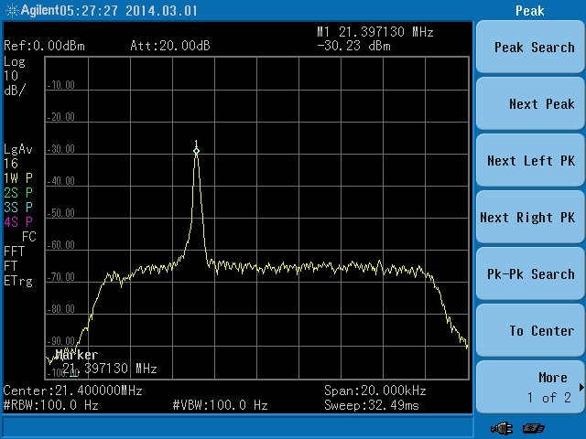
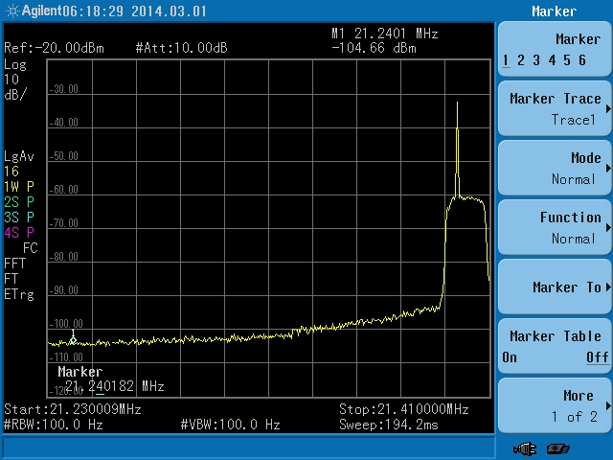
Performance: Schottky Tune Measurement
5.3e10 protons in Debuncher
21.397130 MHz is equal to a vertical tune of 0.7348
Pbar Schottky tune was 0.7348
Performance was sufficient to continue with Schottky tune measurement system.

Slide 13
Extraction Beamline Instrumentation Design
Name | Device | Beam Line | Specific Location
MW900 | Multiwire | M4 | Immediately downstream of c-magnet
IC901 | Ion Chamber | M4 | Immediately upstream of V901
MW903 | Multiwire | M4 | Immediately upstream of Q904
MW908 | Multiwire | M4 | Immediately downstream of Q908
MW910 | Multiwire | M4 | Immediately upstream of H910
MW914 | Multiwire | M4 | Immediately downstream of Q914
MW918 | Multiwire | M4 | Immediately downstream of H918
MW928A/B | Multiwire | M4 | *Each side of extinction collimator at 928
MW932A/B | Multiwire | M4 | *Each side of extinction collimator at 932
MW921A/B | Multiwire | M4 | Each side of AC Dipole
MW936A/B | Multiwire | M4 | *Each side of extinction collimator at 936
IC938 | Ion Chamber | M4 | Immediately upstream of Q939
MW945A/B | Multiwire | M4 | *Each side of shielding wall near the Diagnostic Absorber
MW947 | Multiwire | M4 | Immediately downstream of Q947
MW950 | Multiwire | M4 | Immediately downstreamof IC950
IC950 | Ion Chamber | M4 | Immediately downstream of Q950
MW952 | Multiwire | M4 | Immediately downatream of HT952
*Two profile monitors used on either side of the collimators only for commissioning and later moved to other locations.
Notes:
M4 Line Instrumentation:
Slow extracted proton beam from the Delivery Ring will traverse the newly constructed M4 line before arriving at the Mu2e target. Instrumentation hardware and electronics will be recycled from other areas. The instantaneous intensity of the slow spill beam is too small to be measured with Toroids, so retractable ion chambers will be constructed to measure the beam intensity. A Beam Loss Monitor (BLM) system based on the hardware and electronics that exist in the P1 and P2 line will be implemented to help maintain good transmission efficiency in the beam lines. Secondary Emission Monitors (SEMs) and Segmented Ion Wire Chambers (SWICs) will provide beam profiles in both transverse planes.
Instrumentation locations were chosen by the beam lines optics expert in order to tune-up the line. 16 profile monitors.

Slide 14
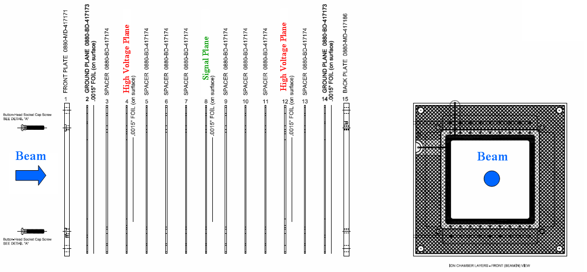
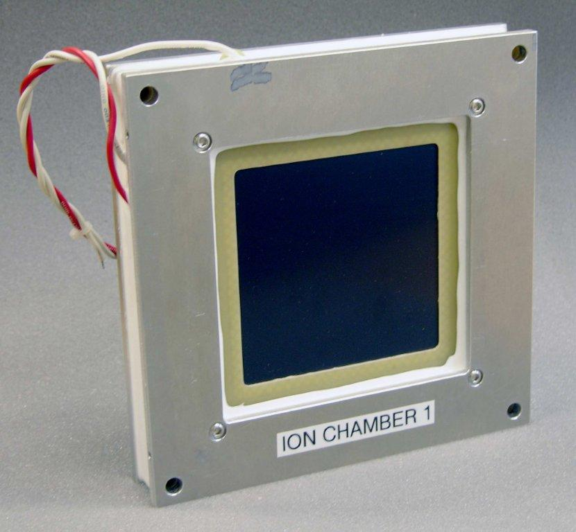
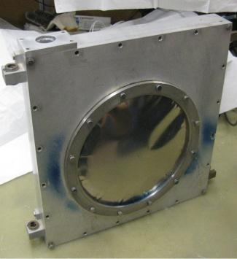
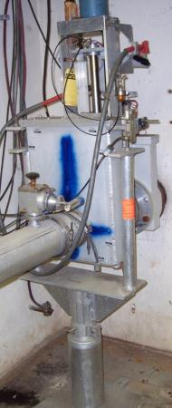
Extraction Instrumentation: Ion Chambers
Anti-vacuum Box
Ion
Chamber
Bayonet
Can
Ion chamber uses prototype FNAL design.
The ion chamber to fit in existing anti-vacuum box.
The anti-vacuum boxes will be installed inside of bayonet vacuum vessels that are being repurposed from Switchyard
The bayonet type drive slides the ion chamber linearly into and out of the beam with a screw drive system.
The detector linear drive shaft is housed in a collapsible bellows that seals it from atmosphere.
Notes:
Ion Chambers:
Ion chambers will be the primary intensity measurement device in the M4 line. Each ion chamber will consist of 3 signal foils interleaved between 4 bias foils, each spaced 1/8” apart. The foils are sealed in an aluminum chamber 10 inches in diameter by 4.5 inches long continuously purged with an 80% argon - 20% carbon dioxide gas mix. The standard ion chamber is shown in Figure 13. Protons passing through ArCO₂ gas generate 96 e/ion pairs or about 1.6 x 10⁻¹⁷ charges/cm which equals about 1.6 picocoulomb for 10E5 p [5].
Two ion chambers will be installed in the M4 line and one in the Diagnostic Absorber line. Since the ion chamber vessel contains ArCO₂ gas, it must be separated from beam tube vacuum. The ion chamber in the diagnostic absorber line will be installed in a gap in the beam line with one 0.003” titanium vacuum window on each side of the ion chamber.
The ion chambers in the M4 line will not be installed in the above described manner because the beam going through both M4 line ion chambers and vacuum windows would result in excessive coulomb scattering during high intensity operations [14]. The solution is to make the ion chamber retractable much like what will be discussed in more detail in the Segmented Wire Ion Chamber section below. The two titanium vacuum windows would be installed on the outside of each ion chamber cylinder, called the anti-vacuum chamber, to provide a barrier between the gas and vacuum. The entire anti-vacuum chamber would be mounted inside of a vacuum can that is common to beam tube vacuum. The ion chamber will be on a motorized drive that would allow it to be taken in or out of the path of beam.
, the gas filled PWCs must be isolated from beam tube vacuum. The PWCs will be packaged in an anti-vacuum box. An anti-vacuum box is a sturdy machined aluminum shell with a .003 inch thick titanium foil window mounted on each side for the beam to pass through. The anti-vacuum box allows the detector to be mounted in a beam line vacuum chamber while the PWC inside the box remains at atmospheric pressure. There is a vacuum tight duct attached to the box in which the gas tubing, signal and high voltage cables are routed in order to get them to atmosphere outside the vacuum chamber.
To save engineering and assembly costs, the anti-vacuum boxes will be installed inside of bayonet vacuum vessels that are being repurposed from Switchyard. The bayonet type drive slides the PWC linearly into and out of the beam with a screw drive system. Bayonet drives use a 72 RPM Superior Electric Slo-Syn AC synchronous stepping motor coupled through a set of gears to a pair of screw drive shafts. The detector linear drive shaft is housed in a collapsible bellows that seals it from atmosphere. Figure 1.62 shows PWC assembly, the anti-vacuum box and the bayonet vacuum can. The same configuration is being used for the earlier mentioned retractable ion chambers. In that case, the PWC assembly is modified by exchanging the two wireplanes with a single foil signal plane and adding spacers such that the ion chamber version is exactly the same dimensions as the PWC.

Slide 15
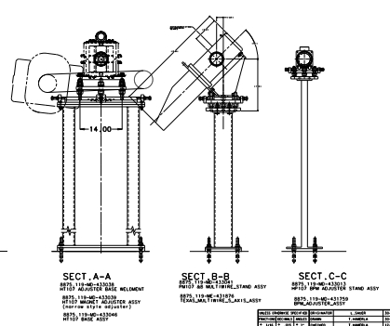
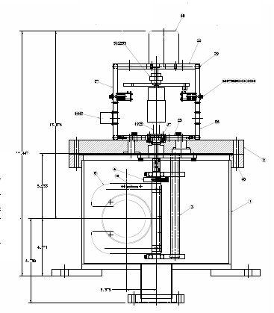
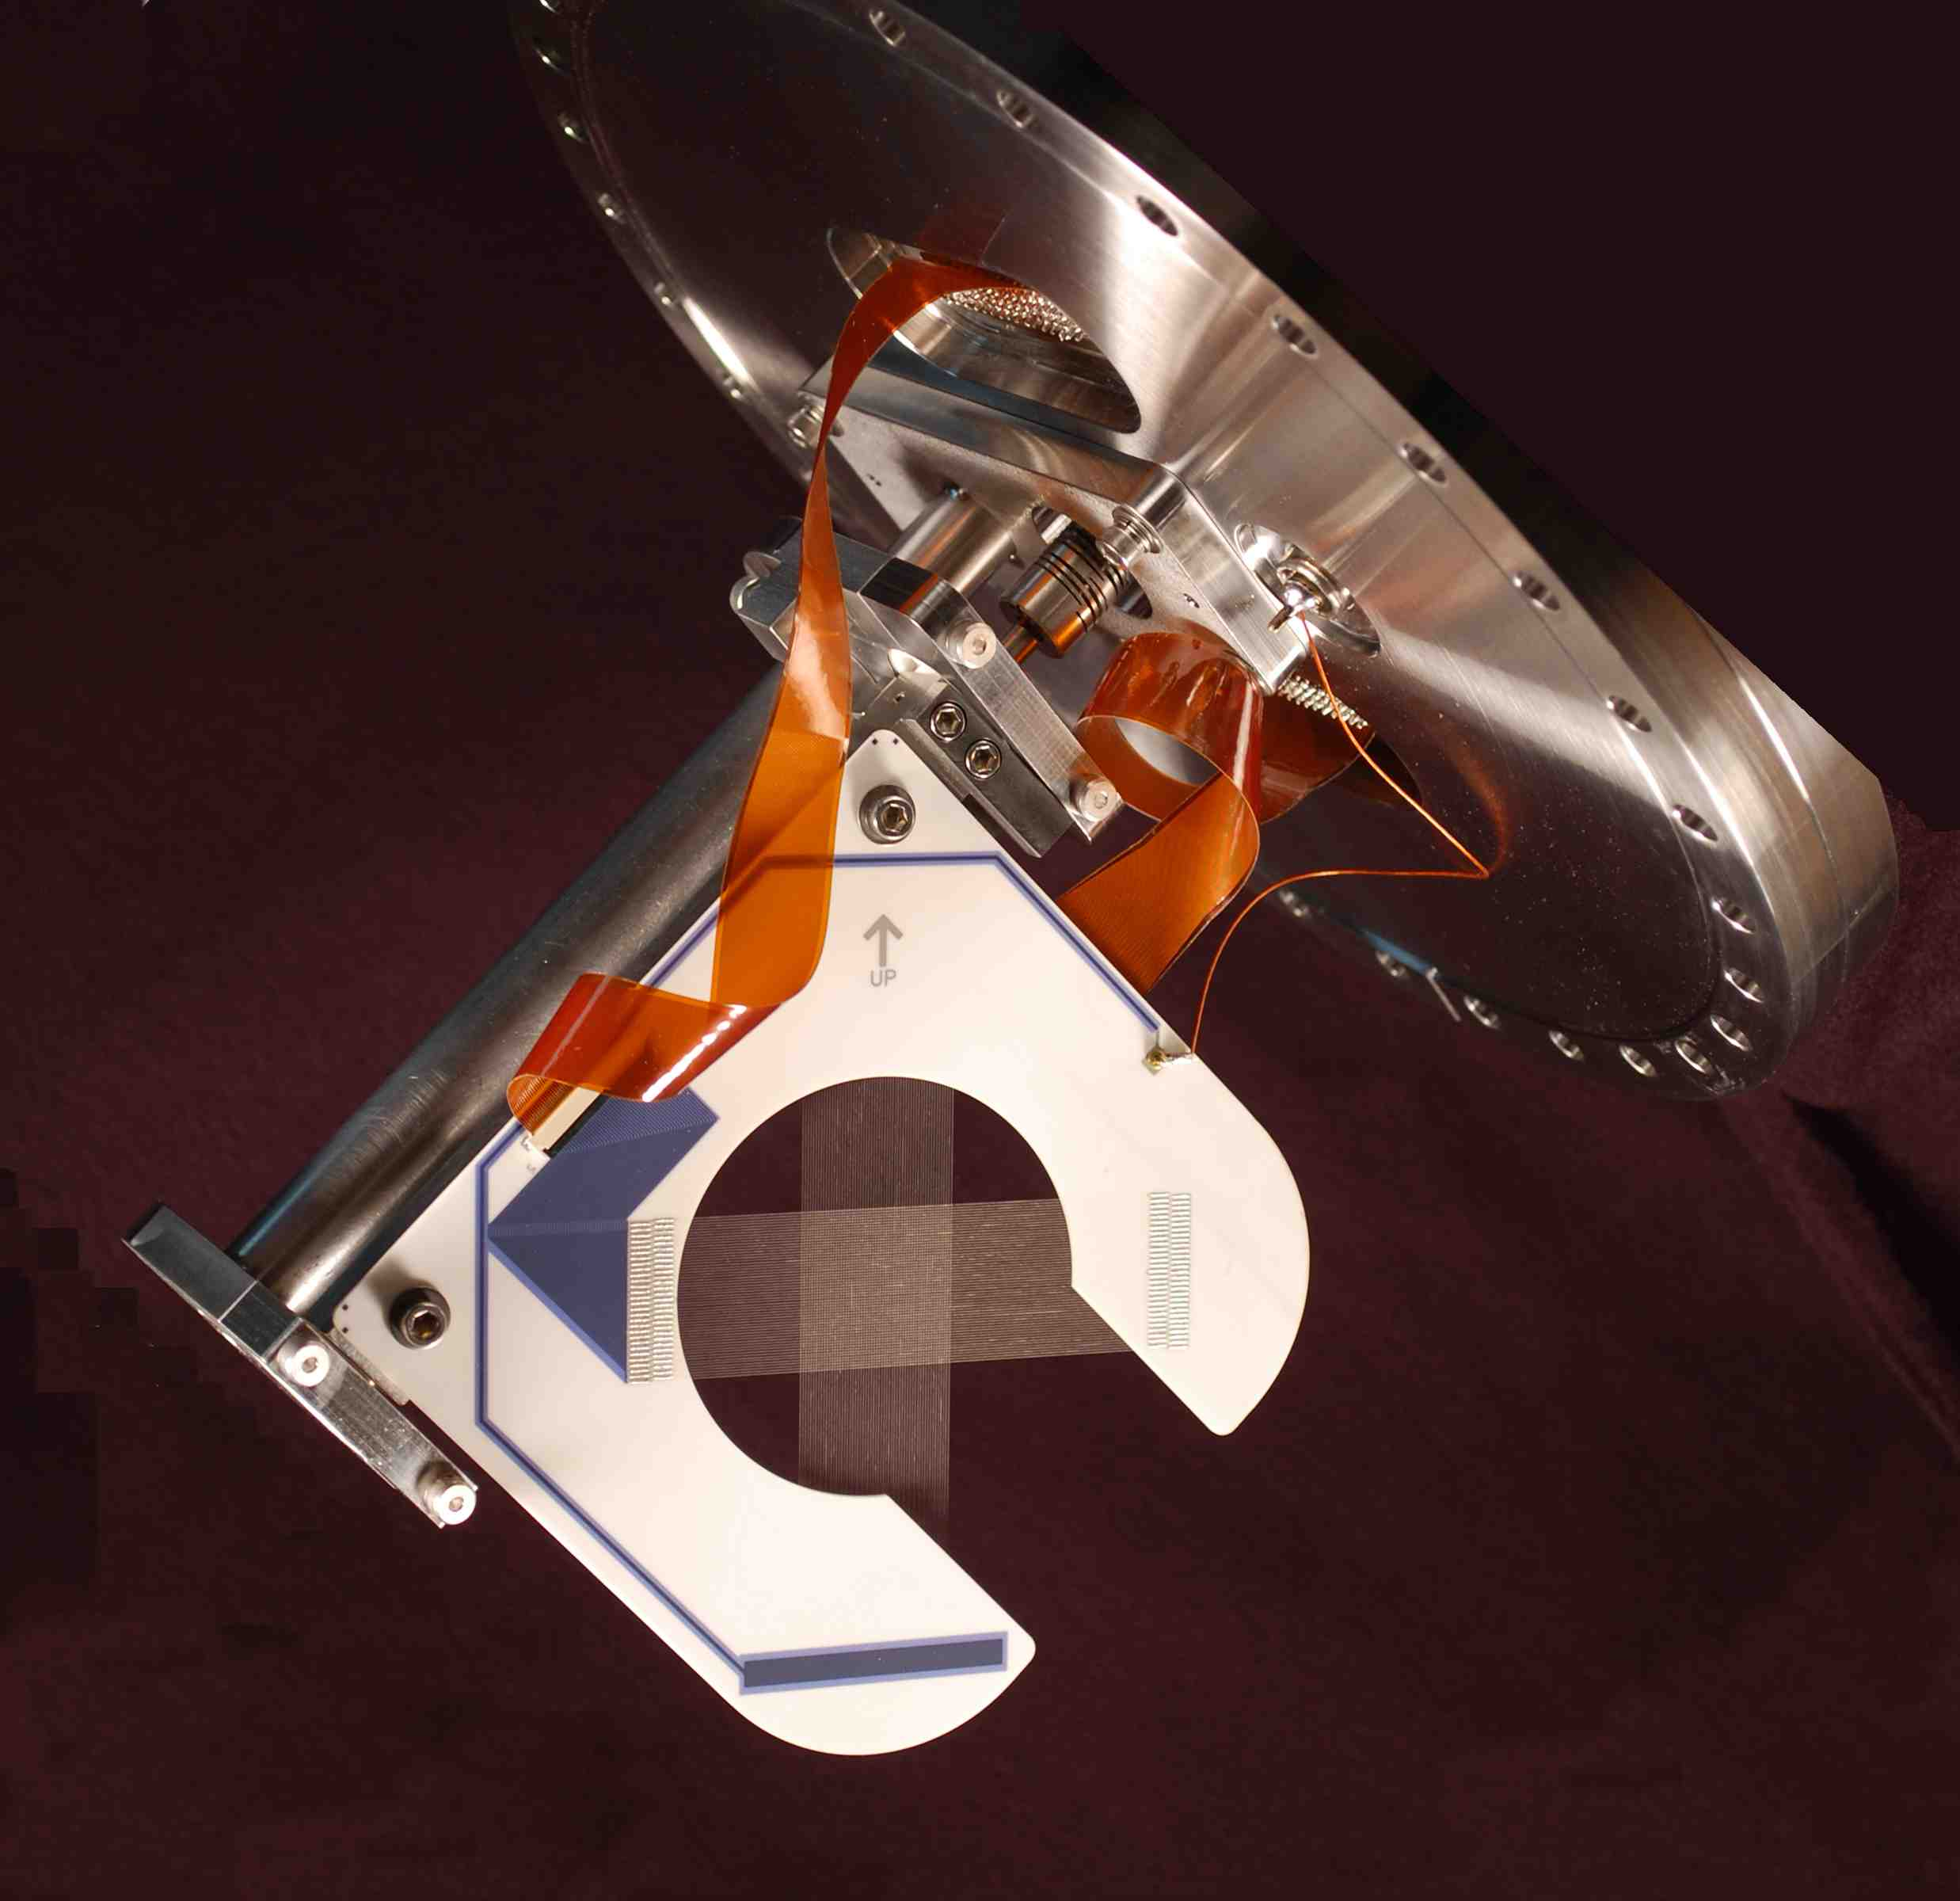
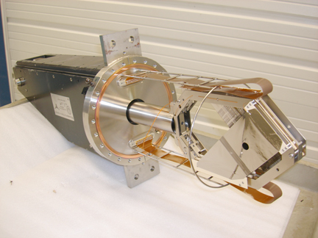
Extraction Instrumentation: Multiwires
NuMI multiwire design used with a gap in the ceramic that allows the wires to be moved into and out of the beam while beam is running.
New vacuum cans will be constructed based on the NuMI design.
11 available Texas Multiwire cans will be repurposed.
Notes:
The Numi multiwire assembly is drawn and filed, dwg no. 488880.
We want these at a 45 degree angle, in which case we would use the Numi PM108 stand 433041 with revised beam elevation off the floor. So just one new drawing needed.
Cost estimate 10-15k for the device and 2k for the stand
Using Texas can we can also use the PM108 stand with revised height (same new dwg as above). We should also make an assembly dwg of the device.
Cost estimate 3k for the device and 1.5k for the stand using old Texas mountings from Numi (I hope we haven't thrown them out).
We found the switchyard bayonet can drawings. There are some revisions, and one new drawing for a spacer for the PWC. I don't know yet what new parts will be needed for the retractable ion chambers. Cost estimate $500 per PWC.
These costs are all machine shop work per device. Tech and drafting time estimates not included.

Slide 16
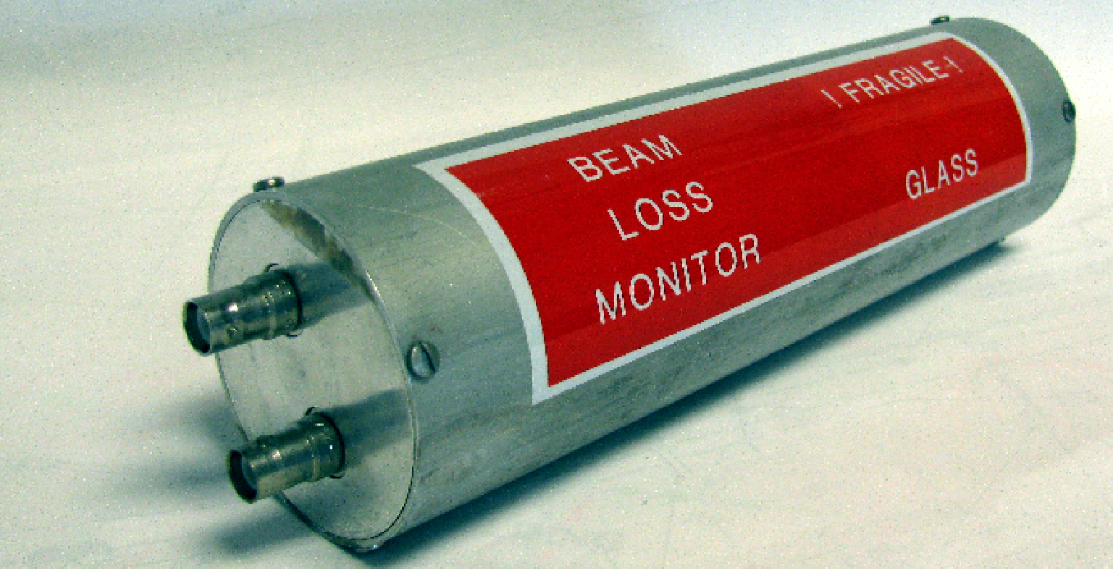
Extraction Instrumentation: BLMs
The M4 Line Beam Loss Monitor (BLM) system has been designed to measure a 0.2% localized loss with microsecond integration.
This will allow seeing losses develop inside of an individual slow spill.
30 BLMs will be placed at key locations along the 245m beam line.
This system design is identical to the existing Main Injector, P1, P2, M1 and M3 line BLM systems.
There is not a sufficient pool of spare hardware and electronics so new parts will need to be purchased and constructed to build the system.
Notes:
BLMs:
The M4 Line Beam Loss Monitor (BLM) system has been designed to measure a 0.2% localized loss with microsecond integration. This will allow seeing losses develop inside of an individual slow spill. 20 BLMs will be placed at key locations along the 245m beam line. This system design is identical to the existing Main Injector, P1, P2, M1 and M3 line BLM systems. There is not a sufficient pool of spare hardware and electronics so new parts will need to be purchased and constructed to build the system.
BLM chassis will be implemented at AP30 and the Mu2e Experimental Hall. Each chassis support 12 BLMs units. The system uses ion chamber loss monitors originally designed for the Tevatron. The ion chambers high voltage supply is contained within the BLM Chassis. It is capable of supplying 2500 volts at 500 uAmps. The High Voltage is set to 2000 volts during chassis testing and no further adjustment is required as the Ion Chamber has a flat high voltage to gain response. An Abort Demand signal is produced by feeding the analog "or" of the 12 daughter card outputs to a voltage comparator circuit. The comparator reference level is set by adjusting a rear panel pot. The daughter card can be set up to operate as a Set-Reset integrator, a fast amplifier or as a Log Amplifier (fig 1). The Integrator has a full scale range of either .14 rad or .014 rad dependent upon which branch is used. The fast amp has a rise and fall time of 1 uSec and a full scale range of .014 rad. The Log Amp has a 6 Decade dynamic range allowing loss readings from .001 rad/second to 1000 rads/second (Fig.2). One and only one of these signals can be jumper configured to provide the output to the MADC. The Daughter Card also has a track and hold circuit that can be inserted in the signal path before outputting to the MADC. The Start Track and Start Hold triggers are provided by a Camac 377 card. A timing card within the BLM Chassis fans out these triggers to the 12 Daughter cards. The Start Track signal also resets the integrator circuit when the daughter card is configured as an integrator.
Beamline Log Amp:
Max rise time 1 mSec
Max fall time 300 mSec
Minimum detectable loss .1 R/Sec
Saturation level 1000 R/Sec
The MM4 Line Beam Loss Monitor system will utilizes 20 Ion Chambers distributed at appropriate tunnel locations It requires two BLM Chassis to service these channels, one at AP30 and one at the Mu2e Experimental Hall. There is also a Camac 377 timing card at each building to provide the Start Track and Start Hold triggers.
The daughter cards are set up to function as a Log amp with a track and hold output. The daughter card outputs are feed into an MADC. From there they can be read from a parameter page, Fast Time plotted, or displayed graphically via console application program.
M4 Line BLMs
Asing for 20 loss monitors
Log amp system
2 chassis - one at mu2e and one at AP30 - support up to 24 loss monitor.
From controls need
Reset timer
Hold timer
1 MADC channel for each loss monitors
Switchyard scarfed up all ion chambers.
Need to build chassis also.
24 channels $33K M&S
Labor - 100 hours of technician time. 2.5 weeks - at least….probably more...
No engineering required
Red hv chain - (MI run is 2000' so no problem)
Each loss monitor green RG58 signal cable.
P1, P2, AP1, AP3 - everything is the same….
Ar sealed. Glass tube inside metal chamber is sealed.

Slide 17
Changes since CD-1
Controls
Pull additional fiber optic channels to the Mu2e service building to cover necessary signals and future expansion.
Additional items covered in Value Engineering Slide.
Instrumentation
Covered in Value Engineering Slide.
Two additional multiwires, one just upstream of the target and one just downstream of the target were added to my scope.

Slide 18
Value Engineering since CD-1
Controls
Splice into nearby existing phone lines to save on costly cable pulls and/or VOIP installations.
Instrumentation
Tune Measurement
Repurpose Tevatron Schottky detectors for our tune measurement system.
M4 Line Profile Monitors
Changed type of profile monitor in the M4 line to save on labor and refurbishment costs
Use ANU multiwire design for M4 line multiwires.
Repurpose Texas Multiwire vacuum cans for our M4 line multiwires
Reduced amount of external beamline instrumentation by allowing for the early use of final focus section instrumentation for commissioning the extinction section.
Retractable Ion Chambers
Repurpose Switchyard Bayonet vacuum cans for ion chambers.
Modify PWC design to fit ion chamber.
M4 Line beam loss monitors.
Use log amp system for BLM electronics. No engineering time required.

Slide 19
Organizational Breakdown
WBS 2.3
Instrumentation and Controls
B. Drendel (AD/Muon) L3 and CAM
WBS 2.3.2
Delivery Ring Instrumentation
B. Drendel (AD/Muon)
WBS 2.3.3
Extraction Beamline Instrumentation
B. Drendel (AD/Muon)
WBS 2.3.4
Technical Documentation
B. Drendel (AD/Muon)
WBS 2.3.1
Mu2e Controls
B. Drendel (AD/Muon)
WBS 2.3.1.1 Transport & Delivery Ring Controls G. Brown (AD/Controls) D. McArthur (AD/Controls)
WBS 2.3.1.2 Mu2e Controls G. Brown (AD/Controls) D. McArthur (AD/Controls)
WBS 2.3.3.1 Profile Monitors
G. Tassotto (AD/Inst) D. Schoo (AD/Inst)
WBS 2.3.3.2 Beam Loss Monitors Randy Thurman-Keup (AD/Inst) J. Seraphin (AD/Inst) A. Saewert (*AD/Inst)
WBS 2.3.2.1 DCCT A. Ibrahim (AD/Inst)
WBS 2.3.2.2 Tune Measurement V. Scarpine (AD/Inst) B. Fellenz (AD/Inst)

Slide 20
Quality Assurance: Controls
Use of Government Lab and Project QA Standards
Fermilab Engineering Manual http://www.fnal.gov/directorate/documents/FNAL_Engineering_Manual.pdf
Fermilab’s Integrated Quality Assurance Program https://esh-docdb.fnal.gov:440/cgi-bin/RetrieveFile?docid=2469
Mu2e Quality Management Plan http://mu2e-docdb.fnal.gov:8080/cgi-bin/ShowDocument?docid=677.
Mechanical Engineering QA practices, policy and procedures http://mu2e-docdb.fnal.gov:8080/cgi-bin/ShowDocument?docid=4646
Quality Assurance for Controls
All innerduct and cable pulls will be completed by contract electricians under the direction of Accelerator Division management.
Fiber optic terminations will be completed by contract electricians, safety system cable terminations will be managed by FNAL ES&H personnel, and phone cable termination will be managed by Business services section, telecommunications department.
All controls links, FIRUS configuration and network connections work will be managed by Accelerator Division Controls Department personnel.
All parts are expected to be procured by FNAL personnel and inspected before being installed. Final testing and calibration of controls devices will be performed by FNAL technical staff before locating equipment in the service buildings.
Quality Assurance for Instrumentation
Repurposing, design, upgrading, building and commissioning of M4 line instrumentation will be completed by qualified Accelerator Division Instrumentation and Controls Department Engineers and Technicians under the direction of Instrumentation and Muon Department management.
All necessary parts will be procured by FNAL personnel and inspected by qualified Instrumentation engineers or technicians prior to installation.
Final testing of instrumentation devices will be performed by FNAL technical staff before devices are installed.
Controls checkout and beam commissioning of each device will be completed by qualified Instrumentation, Controls and Muon Department technical staff.

Slide 21
Risks
ACCEL-015 Injection Damper Required for Delivery Ring
Orbit control in the beam lines may not adequately control trajectory and may lead to excessive emittance dilution.
Note: Delivery Ring injection will be made to work for g-2 before the need for Mu2e.
Threat: $240K
Mitigation: If beam studies indicate instabilities of injected beam into the Delivery Ring, an injection damper system will be developed.
ACCEL-140 Proton Beam not available for FY’13 beam studies
Beam studies in the Delivery Ring are scheduled in order to understand and address various technical concerns associated with the delivery of beam to Mu2e. These beam studies can only be performed when the Lab is operating the accelerator system.
Threat Retired: Beam studies were completed.

Slide 22
ES&H
Tunnel Enclosures and Service Buildings
Electrical hazards from exposed bus work and high voltage connectors.
Mechanical hazards (sharp edges, protruding fixtures)
Radiation hazards
Potentially lethal doses during beam operation
Residual radioactivity after beam operations
Radioactive surface and air contamination
Laboratory ES&H
Instrumentation and controls systems will all be implemented within the guidelines documented in the Fermilab Environment, Safety and Health Manual (FESHM) which can be found online at http://esh.fnal.gov/xms/FESHM.
Laboratory safety practices will be observed for all work.
Job hazard analyses will be performed for installation and other appropriate work.
Mu2e ES&H
All hazards in this WBS are covered in the Mu2e Hazard Analysis Report document Mu2e-doc-675 (http://mu2e-docdb.fnal.gov:8080/cgi-bin/ShowDocument?docid=675).

Slide 23
Cost Distribution by L4
Base Cost by L4 (AY $k)
Extraction Beamline Instrumentation is the cost driver due to construction of Multiwires, Ion Chambers and BLM systems.

Slide 24
Cost Distribution by Resource Type
Base Cost (AY $k)
Extraction Beamline Instrumentation is the cost driver due to the labor costs associated with the construction of Multiwires, Ion Chambers and BLM systems.

Slide 25
Quality of Estimate
Base Cost by Estimate Type (AY$k)
100% of estimates are at the preliminary level or better. Most of the preliminary estimates will be at the advanced level by the time of the DoE CD-3 review.

Slide 26
Labor Resources
FTEs by Discipline
Implementation of most of the cost driving instrumentation was moved to FY’18 to meet the DOE funding profile.

Slide 27
Labor and Material Breakdown
Implementation of most of the cost driving instrumentation was moved to FY’18 to meet the DOE funding profile.

Slide 28
Cost Table
WBS 2.3 Instrumentation and Controls
Base Cost (AY K$)
 | M&S | Labor | Total | Estimate Uncertainty (on remaining budget) | % Contingency on (on remaining budget) | Total Cost
475.02.03.01 Mu2e Accelerator Controls | 45 | 115 | 160 | 26 | 21% | 186
475.02.03.02 Delivery Ring Instrumentation | 46 | 277 | 323 | 52 | 29% | 375
475.02.03.03 Extraction Beamline Instrumentation | 563 | 671 | 1,235 | 310 | 26% | 1,545
475.02.03.04 Technical Documentation |  | 507 | 507 | 94 | 27% | 601
Grand Total | 655 | 1,571 | 2,225 | 482 | 26% | 2,708
Total project cost plus contingency is $2.7M with 26% contingency on remaining budget. Extraction beam line instrumentation is the cost driver and the largest contingency is on the Delivery Ring instrumentation.

Slide 29
Major Milestones
Activity Name | Start | Finish | Milestone Tier
T5 - External Beamline Instrumentation Design Complete |  | 13-Oct-15 | T5
T5 - Final Design of Profile and Intensity Monitors Complete |  | 13-Oct-15 | T5
T5 - Instrumentation & Controls CD-3c Approval Granted |  | 23-Feb-16 | T5
T5 - Mu2e Experimental Hall Controls Complete |  | 20-May-16 | T5
T5 - Abort Controls Complete |  | 1-Jun-16 | T5
T5 - Transport and Delivery Ring Controls Complete |  | 1-Jun-16 | T5
T5 - Controls Implementation Complete |  | 2-Jun-16 | T5
T5 - Delivery Ring DCCT Complete |  | 3-Feb-17 | T5
T5 - Start M4 beamline Profile and Intensity Monitor Procurements | 2-Oct-17 |  | T5
T5 - Start M4 Beamline BLM Procurements | 2-Oct-17 |  | T5
T5 - Start M4 Beamline BLM Assembly and Installation | 21-Nov-17 |  | T5
T5 - M4 Beamline BLM Procurements Complete |  | 30-Nov-17 | T5
T5 - Start of M4 Beamline Ion Chamber and Multiwire Assembly | 11-Jan-18 |  | T5
T5 - Ion Chamber Assembly Complete |  | 26-Mar-18 | T5
T5 - External Beamline BLM Installation Complete |  | 6-Apr-18 | T5
T5 - BBQ Tune Measurement System Complete |  | 10-Apr-18 | T5
T5 - Delivery Ring Instrumentation Complete |  | 8-May-18 | T5
T5 - Schottky Tune Measurement System Complete |  | 8-May-18 | T5
T5 - Delivery Ring Tune Measurement Systems Complete |  | 8-May-18 | T5
T5 - Multiwire Assembly Complete |  | 14-Jun-18 | T5
T5 - Instrumentation & Controls Implementation Complete |  | 4-Sep-18 | T5
T5 - Instrumentation & Controls ready to run beam to the diagnostic absorber |  | 4-Sep-18 | T5
T5 - Instrumentation Implementation Complete |  | 4-Sep-18 | T5
T5 - External Beamline Instrumentation Complete |  | 4-Sep-18 | T5
T5 - Multiwire and Ion Chamber Installation Complete |  | 4-Sep-18 | T5

Slide 30
Schedule
CD-2/3b
CD-3c
Beam to Diagnostic Absorber
CD-4
M4 Enclosure
BO
Commission Res. Extr.
External (M4) Beamline Design
External (M4) Beamline Implementation
Controls Design
BL Ctls Implementation
Mu2e Building Controls Implementation
Instrumentation Design
DCCT Implementation
DR Tune Implementation
M4 Profile Monitor Implementation
M4 BLM Implementation
g-2 Beam Operations
Commissioning with single turn Beam
Q3 | Q4 | Q1 | Q2 | Q3 | Q4 | Q1 | Q2 | Q3 | Q4 | Q1 | Q2 | Q3 | Q4 | Q1 | Q2 | Q3 | Q4 | Q1 | Q2 | Q3 | Q4 | Q1 | Q2 | Q3 | Q4 | Q1 | Q2 | Q3 | Q4 | Q1 | Q2 | Q3 | Q4
FY14 FY15 FY16 FY17 FY18 FY19 FY20 FY21
Notes:
Notes:
ESS Installation depicted here is not what is in the P6 schedule. P6 does not account for the fact that the beamline must be commissioned with single turn extracted beam before the ESS can be installed.
The ESS replaces a Delivery Ring extraction kicker module. Therefore, ESS installation precludes further single turn extracted beam to the M4 beamline.
HRS installation takes 10 days (box on schedule is over-sized)
Target installation is off-project and estimated to occur in Dec. 2021.
Beam commissioning is off-project

Slide 31
Summary
The technical objective is to design and fabricate the equipment for the accelerator controls and instrumentation upgrades required for beam delivery to Mu2e.
Controls:
Controls will provide all of the necessary communications links and infrastructure to connect the Mu2e experimental hall with the existing Accelerator Division controls systems.
Instrumentation:
Instrumentation for the Delivery Ring will consist of an intensity measuring DCCT and tune measurement system.
Other Delivery Ring instrumentation are funded from other sources.
Instrumentation for the Extraction Beamline will consist of intensity measuring retractable ion chambers, position measuring multiwires loss measuring beam loss monitors.
Instrumentation for beamlines upstream of the Delivery Ring are covered by other sources.
Preliminary design is complete and we are ready to baseline our schedule.

Slide 32
Mu2e Delivery Ring Tune Measurements
Beam Parameters:
Peak intensity: 1e12 protons
Beam energy: 8 GeV
Bunch structure: Single 2.5 MHz bunch
Nominal bunch length: 40 ns
Bunch base width: 200 ns
Resonant slow-spill extraction over 58 ms
30e6 protons extracted per turn
Tune Parameters:
Nominal tunes
ν_{x} = 9.653
ν_{y} = 9.735
Buncher revolution freq: 590.018 KHz
Measurement Requirements:
Measure tune and transverse emittance
Measure tune throughout slow-spill
Tune resolution:
0.0001 (with averaging)
0.001 @ 600 Hz

Slide 33
Proposed Mu2E Schottky System
Filter out revolution harmonics
Down convert from 36th/37th harmonics to 1st harmonic (0 to 590 KHz)
Use 24-bit ADC to sample signal
2 to 4 MHz sampling
100 db dynamic range
Use digital signal processing to produce tunes
0.001 tunes at 590 Hz
0.0001 tunes with averaging over many spills

Slide 34
WBS 475.02.03 Instrumentation and Controls
Technical Objective
The technical objective is to design and fabricate the equipment for the accelerator controls and instrumentation upgrades required for beam delivery to Mu2e.
Scope of Work Statement
Design and implementation of required controls systems upgrades for beam transport to the Delivery Ring including Delivery Ring Abort controls, External (M4) beamline control system, instrumentation upgrades, instrumentation for the External (M4) beamline.
Deliverables
Upgraded control system for beam transport to the Delivery Ring, Delivery Ring abort controls, External (M4) beamline control system, Delivery Ring instrumentation upgrades (DC beam current and tune measurement instrumentation), External (M4) beamline instrumentation (beam profile, loss, and intensity monitoring).
Relationships/Interfaces to other WBS Elements/Inputs
Installation of M4 beamline controls and instrumentation requires beneficial occupancy of the M4 beamline enclosure (Beamline Enclosure GPP), the MC-1 building (MC-1 Building GPP), and the Mu2e building (475.03 Mu2e Conventional Construction).
Assumptions
The existing Muon Campus controls infrastructure will remains in place and will continue to function.
Restoring controls connectivity to the Delivery Ring service buildings after the extraction tunnel construction will be successfully completed prior to Mu2e operations and funded through the Delivery Ring AIP.
Controls and Instrumentation items reserved in the Mu2e MOU for re-used components will be functional and remain available at the time of Mu2e implementation.

