Slide 1
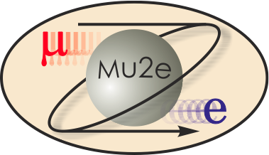
Mu2e Accelerator Systems
Steve Werkema
Mu2e Accelerator Level 2 Manager
10/21/2014

Slide 2
Accelerator L2 Management Team
Steve Werkema – L2 Manager
Projects Involvement:
Mu2e L2 manager since Fall of 2010; prior to that was in charge of Antiproton Source upgrades for Mu2e
Collider Run II Accelerator upgrades L2 manager for Antiproton Source aperture improvements
Deputy Head of Muon Department since its formation. Before that was Deputy Head of the Antiproton Source Department
Vladimir Nagaslaev – Deputy L2 Manager
Accelerator physicist in AD/Muon Department
Involved in Mu2e project since 2009
Also Level 3 manager for Resonant extraction
Mike Campbell – Accelerator Project Engineer
Senior Mechanical Engineer in AD/Mech. Suppt. Department
Engineer in charge of proton target remote handling

Slide 3
Overview

Slide 4
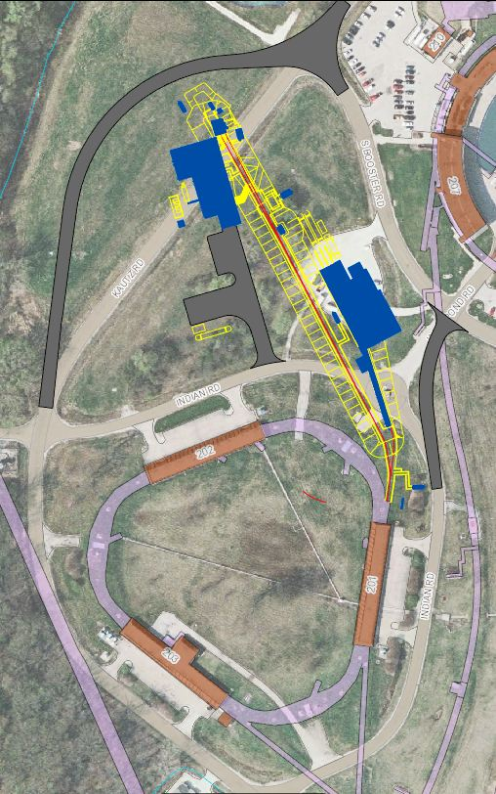
Scope Overview
×
475.02.08.03 Extinction Monitor
475.02.09 Target Station
Mu2e
Bldg
475.02.07 External (M4) Beamline
MC-1
Bldg
475.02.08.02 Extinction
475.02.03 Instrumentation & Controls
475.02.04 Radiation Safety
Everywhere
Delivery Ring
475.02.05 Resonant Extraction
475.02.06 Delivery Ring RF
Notes:
Note: Kautz Road will not be routed around the Mu2e building – hence the big red X.

Slide 5
Mu2e Accelerator Systems Organization
475.2
Accelerator Systems
S. Werkema (FNAL)
475.2.1 Project Management
L3 – S. Werkema
CAM - S. Werkema
475.2.3 Instrumentation & Controls
L3 – B. Drendel
CAM - B. Drendel
475.2.4 Radiation Safety
L3 – T. Leveling
CAM - T. Leveling
475.2.5 Resonant Extraction
L3 – V. Nagaslaev
CAM – V. Nagaslaev
475.2.6 Delivery Ring RF
L3 – J. Dey
CAM – J. Dey
475.2.7 External Beamline
L3 – D. Still
CAM – D. Still
475.2.8 Extinction
L3 – E. Prebys
CAM – E. Prebys
475.2.9 Target Station
L3 – R. Coleman
CAM – R. Coleman

Slide 6
Requirements – Design – Performance

Slide 7
Requirements Overview
The Mu2e Accelerator Upgrades are governed by eight requirements documents
Science Driven Requirements Mu2e-doc-4381
Proton Beam Requirements Mu2e-doc-1105
Beam Extinction Requirements Mu2e-doc-1175
Extinction Monitor Requirements Mu2e-doc-894
Production Target Requirements Mu2e-doc-887
Heat and Radiation Shield (HRS) Requirements Mu2e-doc-1092
Proton Absorber Requirements Mu2e-doc-948
Protection Collimator Requirements Mu2e-doc-2897
All of these documents are available on the review web site.
Notes:
A brief overview of the requirements and how the project meets the requirements is given in what follows. More in-depth coverage will be provided in the relevant breakout session talks.
The Science Driven requirements that are relevant to the Accelerator Upgrades are included in the Proton Beam Requirements, the Beam Extinction Requirements, and the Extinction Monitor Requirements

Slide 8
Proton Beam Requirements
^{[1]} This is the Delivery Ring revolution period.
^{[2]} Assumes a round beam
[SJW1]This number has changed
[SJW2]This number has changed
Parameter | Design Value | Requirement | Unit
Total protons on target | 3.6×10²⁰ | 3.6×10²⁰ | protons
Time between beam pulses | 1695 | > 864 | nsec
Maximum variation in pulse separation | < 1 | 10 | nsec
Spill duration | 54 | > 20 | msec
Beamline Transmission Window | 230 | 250 | nsec
Transmission Window Jitter (rms) | 5 | <10 | nsec
Out-of-time extinction factor | 10⁻¹⁰ | ≤ 10⁻¹⁰
Average proton intensity per pulse | 3.1×10⁷ | < 5.0×10⁷ | protons/ pulse
Maximum Pulse to Pulse intensity variation | 50 | 50 | %
Target rms spot size | 1 | 0.5 – 1.5 | mm
Target rms beam divergence | 0.5 | < 4.0 | mrad
Time Structure
Intensity
Beam
Size
Notes:
The time structure requirements are generally for the reduction of prompt backgrounds in the Mu2e detector.
The intensity requirements optimize Mu2e detector performance.
The beam size requirements optimize muon yield and preclude excessive energy density in the proton target.

Slide 9
Proton Beam & Extinction Requirements
Two successive proton pulses on the Mu2e target (out of 32,000 per spill)
(Jitter applies to pulse separation and transmission window timing)
(Requirement: <50 Mp/pulse)
Notes:
Holdoff time is the time required for primary proton induced background particles to decay or be lost by interaction with muon beamline materials. Holdoff time is determined by physics and may not be what is shown here.
Therefore, the measurement window is decreased as the proton pulse width is increased. The measurement window ends at the leading edge of the next proton pulse.

Slide 10
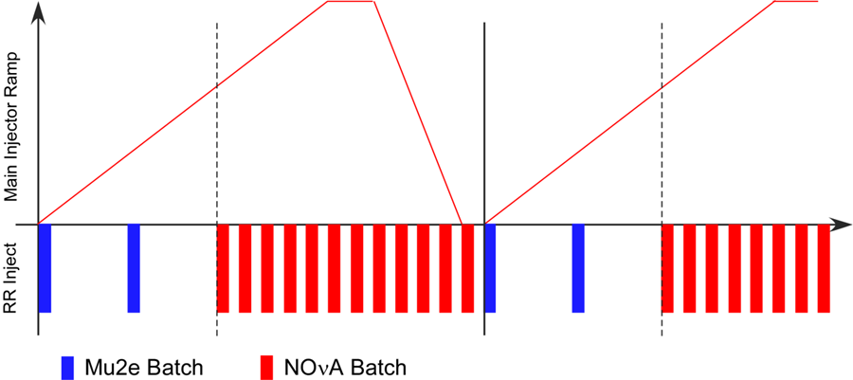
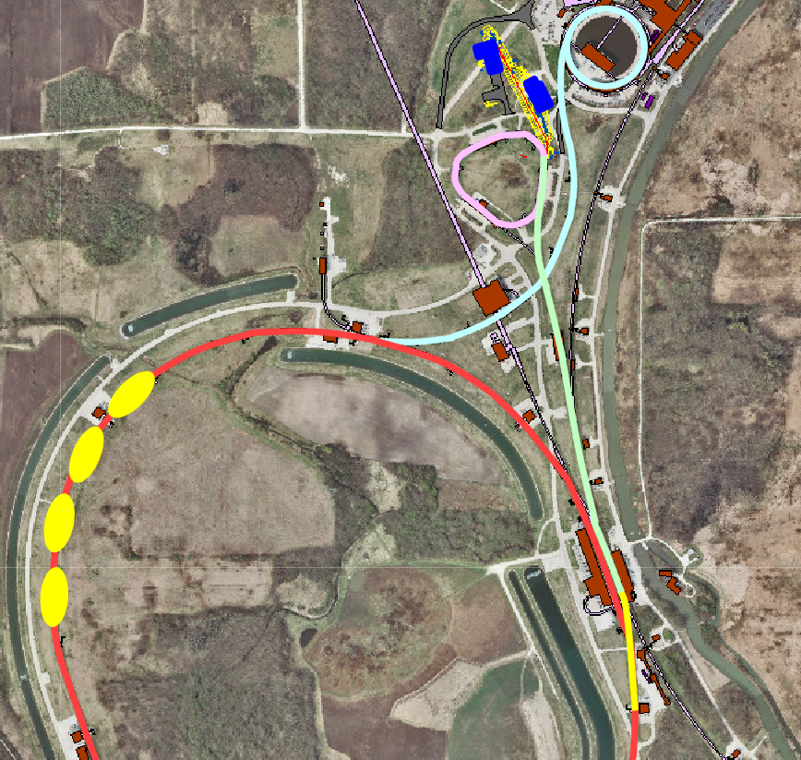
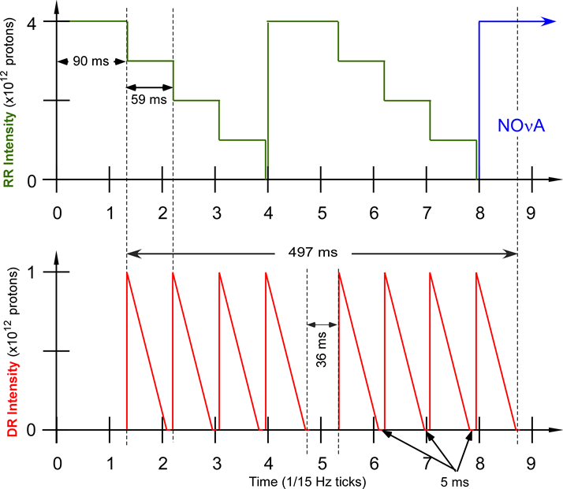
Design – Proton Beam Delivery to Mu2e
Mu2e
Each spill is a train of ~32,000 narrow proton pulses separated by the Delivery Ring revolution period.
Booster
M4
Delivery
Ring
MI-8 Line
Recycler Ring
M1-M2-M3
Notes:
The muons for the Mu2e experiment come from the interaction of a primary proton beam with a tungsten target in the Mu2e experimental hall. The protons that meet the requirements of the experiment are derived thusly:
- A single batch (4 Tp) of 8 GeV KE protons are transported to the Recycler Ring via the MI-8 Line.
- The proton batch is rebunched in the Recycler with a 2.5 MHz RF system into 4 narrow bunches that occupy 1/7th of the Recycler circumference.
- These bunches are extracted, one-at-a-time, from the Recycler and transported to the Delivery Ring.
- The single bunch circulating in the Delivery Ring is resonantly extracted over approximately 54 msec to the Mu2e proton target forming a train of bunches spaced in time by 1.695 micro-sec (Delivery Ring T_{rev}).
- These proton bunches are transported to the proton target via the M4 Beamline.
- During transport from the Delivery Ring to the target the beam pulse passes through an extinction section containing a fast ac dipole magnet that removes the unwanted beam between pulses.
- This process is repeated twice for every 1.333 sec MI ramp cycle in the part of the cycle during which NOvA beam is being accelerated in the Main Injector.

Slide 11
Design – Extinction
Upstream
Extinction
< 10⁻⁴
Downstream
Extinction
< 10⁻¹⁰
The AC Dipole excitation is a superposition of three harmonics: 300 kHz, 900 kHz, and 4.5 MHz.
Notes:
Note: there are two competing constraints on the AC dipole excitation:
Efficient transmission of in-time beam (99.7%)
Kick all out-of-time beam into collimator and only the collimator – that is why the out-of-time part of the waveform must be flattened.
The lattice functions for this section of the beamline is included in the backup slides.

Slide 12
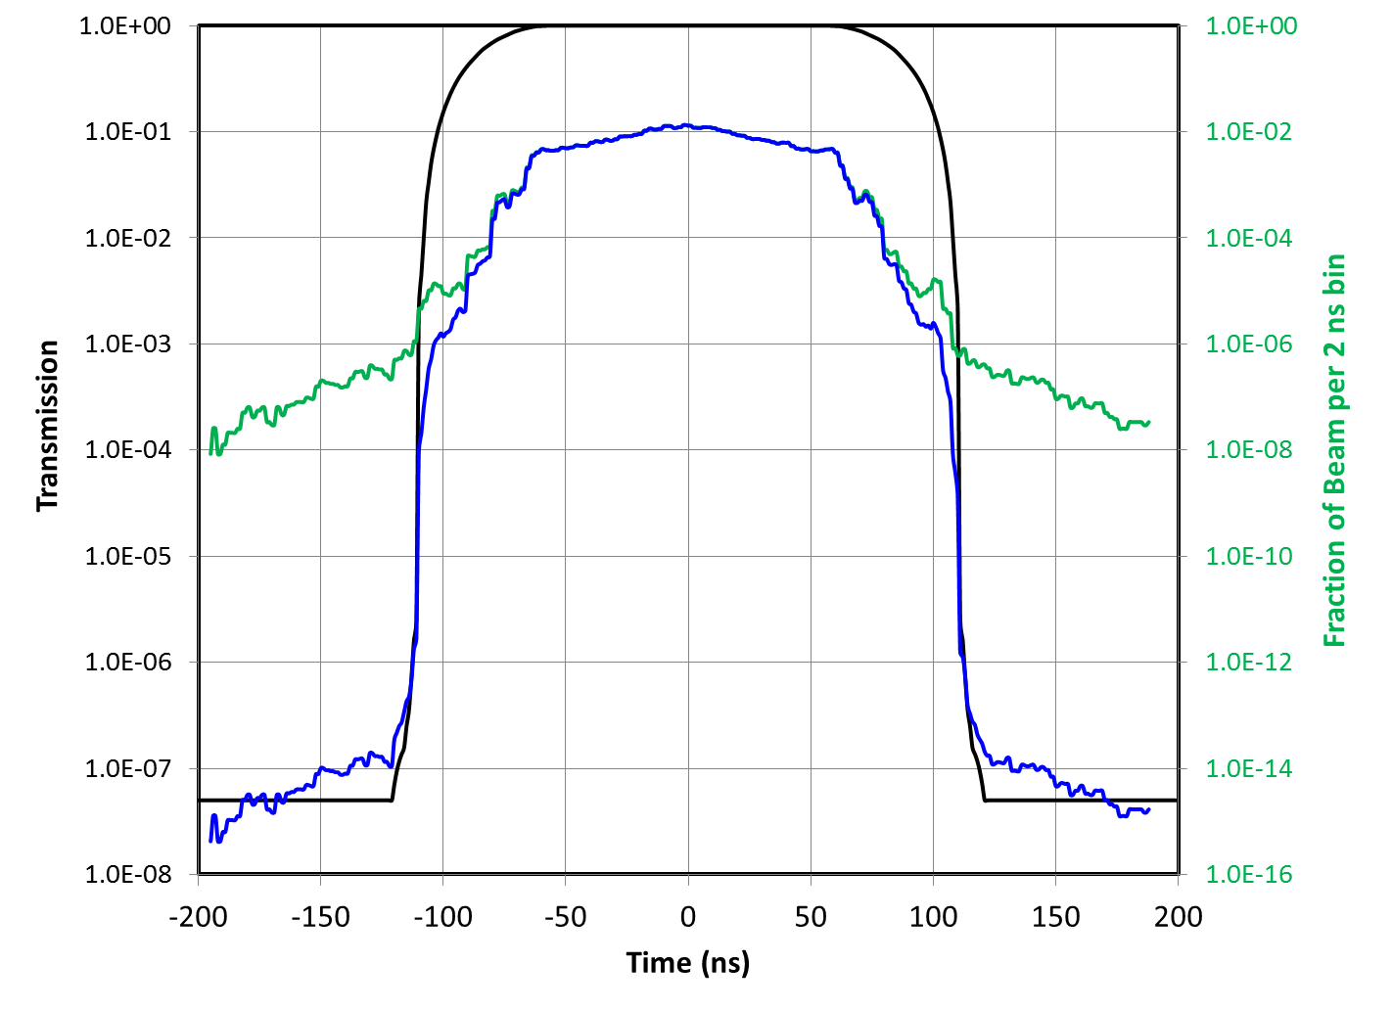
Extinction Performance
Two Models:
Beam time distribution from ESME longitudinal tracking model in the Delivery Ring.
G4Beamline tracking model of extinction section of the M4 beamline.
Results:
Upstream extinction: 1.6×10⁻⁵
In-time beam transmission: 99.7%
Downstream extinction: 8×10^{-13†}
Extinction Requirement: 1×10⁻¹⁰
† This number assumes that there is no contribution from long transverse tails.
Extinction Transmission
Average Delivery Ring Distribution
Average Distribution on Target
Upstream
Down-stream

Slide 13
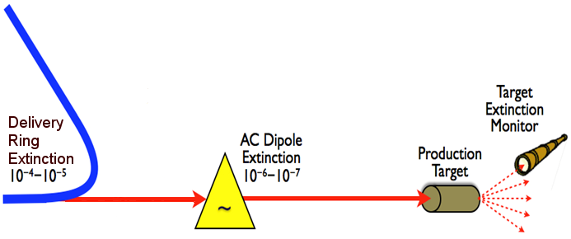
Extinction Monitor Requirements
Specification | Value
Extinction sensitivity (90% CL) | 10⁻¹⁰
Integration time | ~3 hr (6×10¹⁶ POT)
Timing Resolution (rms) | <10 nsec
Dead Time | <10 nsec
Rate Dependent error over dynamic range | <10%
Access Time | 4 hrs
Rad Hardness (max POT) | 4×10²⁰ POT
Notes:
Note: 3 hour integration time assumes design beam power (6 Tp/sec -- ~8 kW)

Slide 14
Mu2e Extinction Monitor
Magnet Room
Spectrometer
Magnet
Detector Room
Upstream
Collimator
Downstream
Collimator
Muon ID
Filter
Magnet
Triggers and
Pixel Planes
Proton Beam
Dump
The target extinction monitor design is a momentum-selecting filter consisting of collimators and a permanent dipole magnet, a magnetic spectrometer, and a range stack.
Notes:
The filter is designed to select a small number of charged particles of momentum ~ 4.2 GeV/c and shield detectors from unwanted interaction products
Spectrometer magnet and detectors measure in-time and out-of-time rates with equal efficiency
The range stack will help establish the muon content of both in-time and out-of-time beams.
Principle of operation is to build up a statistical picture of the in-time and out-of-time particle distributions over the course of ~3 hours at design beam intensity.
At 10⁻¹⁰ extinction, for every 6x10¹⁶ POT (~3 hours at design intensity), about 5 tracks will appear in the pixel planes.

Slide 15
Target Station Requirements
Target Station Layout
There are four requirements documents governing target station components.
Target
Heat & Radiation Shield (HRS)
Proton Absorber (breakout talk)
Protection Collimator (breakout talk)
PS
Notes:
For the sake of time, the Proton Absorber and Protection Collimator requirements will not be covered in this talk (see backup slides and/or Rick Coleman’s breakout talk).

Slide 16
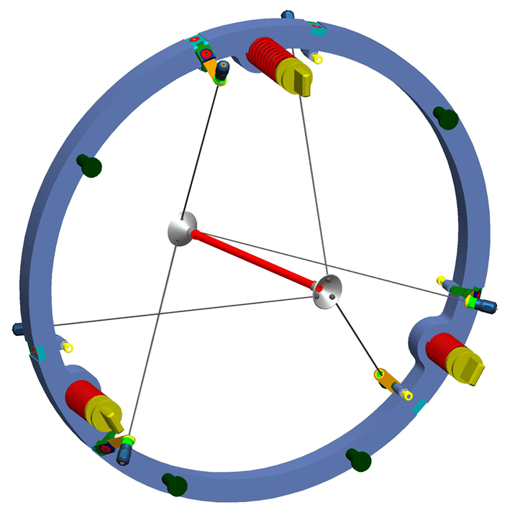
Production Target General Requirements
The target requirements document gives qualitative and quantitative specifications. Here are the general properties that the Mu2e proton target must possess.
Maximize pion yield
High Z, high density
Compact geometry to minimize reabsorption
Mechanically stable, low mass target support structure
lifetime > 1 year in high radiation, high temperature environment
High melting point
Corrosion resistant
High emissivity (lower operating temp.)
Robust support structure
Replaceability
Remote target handling system
Target support structure/target handling system must allow removal of spent target and precise positioning of replacement target
Mu2e proton target design
Tungsten Rod: 16 cm (long) × 6 mm (diameter)
Radiatively cooled
Peak Operating temp.: ~1700℃
Resides in PS vacuum ~10⁻⁵ torr
Notes:
Target Positioning Requirements are included in the backup slides

Slide 17
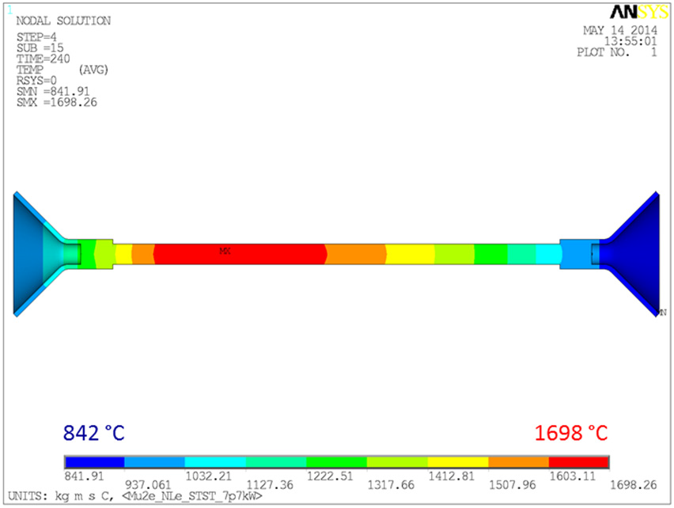
Target Performance
Target performance is assessed by modeling and by materials testing
Steady-state target temperature distribution Vacuum test chamber at RAL
STFC RAL completed numerous ANSYS and Fluka simulations for thermal and mechanical stress and mechanical stability
Completed 4 years equivalent design pulsing on vacuum test stand at RAL to assess mechanical durability (stress and fatigue)
Ready to begin tests of corrosion effects as a function of vacuum
STFC RAL Reports are posted on the review web site
Notes:
The man making the optical pyrometer measurement in the picture at the right is Roger Bennett – RAL Physicist.

Slide 18
HRS Requirements Overview
Limit Production Solenoid (PS) thermal exposure from heat radiated from target to acceptable levels
Limit radiation dose and radiation damage to the Production Solenoid superconducting coils to acceptable levels
Limit heat and radiation exposure of Transport Solenoid (TS) to acceptable levels
Constraints on HRS design:
PS field quality
Quench induced eddy currents
Muon yield
Target
PS Coils
Proton Beam Pipe
Water
Water
HRS Bronze Pieces
HRS Design:
Lines the inside of the PS cryostat
Isolated from muon beamline vacuum
~37 tons of bronze, stainless steel, and water
Notes:
The purpose of the HRS is to protect the PS from the heat and radiation produced by the proton target when 8 kW/8 GeV protons are targeted.
NOTE: TS1 coils are not drawn.

Slide 19
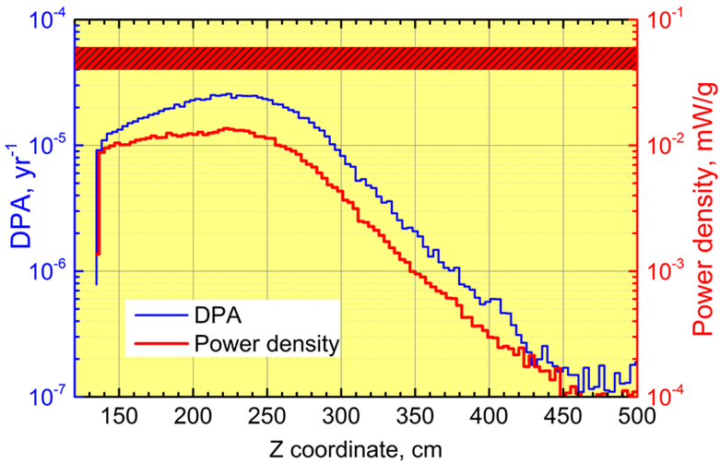
HRS Performance
DPA Requirement:
< 4-6×10⁻⁵ DPA/yr
Power Density Requirement:
< 30 μW/g
MARS Simulation:
Peak DPA and Power Density in the PS coils as a function of position along PS axis.
Target is at z = 300 cm.

Slide 20
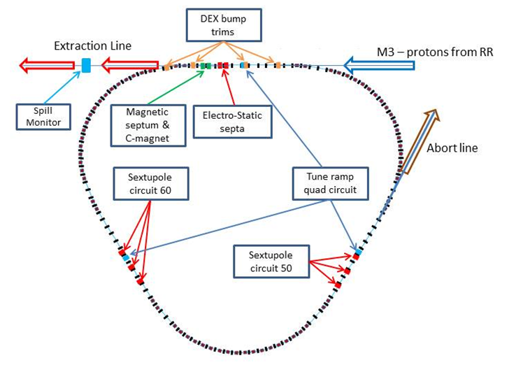
Resonant Extraction Design and Performance
The Mu2e project will install a Resonant Extraction System in the Delivery Ring.
Two Electro-static septum modules
Two families of harmonic sextupole magnets (6 magnets total)
Three horizontal tune ramp quadrupole magnets
RF-knockout based spill feedback and control
Spill monitoring
Parameter | Value
Spill duration | 54 msec
Number of spills in a supercycle | 8
Integrated spill intensity | 10¹² protons
Number of protons extracted per pulse (turn) | 3×10⁷
Time between pulses | 1.695 μsec
Reset time between spills | 5 msec
Spill rate variations | < 50%
Extraction time duty factor | 32%
Notes:
The Extraction time duty factor is the ratio of spill time to the total cycle time = 8 * 54 msec / 1333 msec

Slide 21
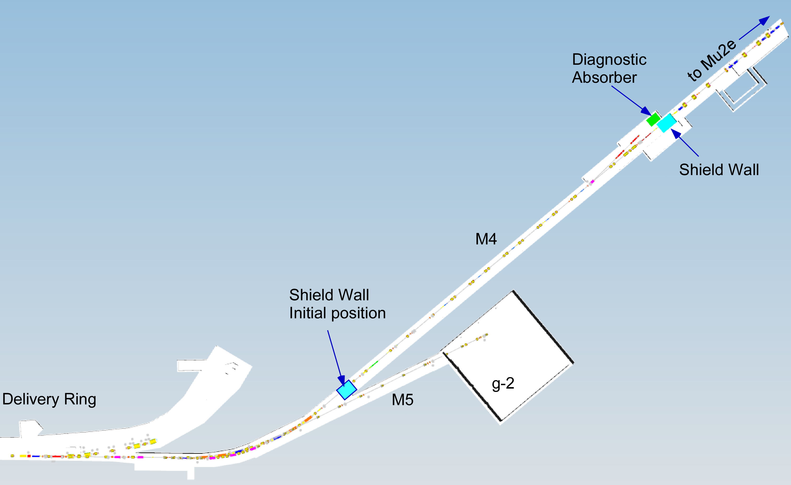
External Beamline
Mu2e External (M4) Beamline scope:
Design, procurement, fabrication and installation of the M4 beamline downstream of V907
M4 beamline includes:
Extinction insert
Diagnostic Absorber
Final Focus
Transport beam from Delivery Ring to Proton Target
Extinction
Diagnostic Absorber for beam commissioning & tuning
Final focus and beam position control on target
Extinction Section
V907
M4-M5 split
Notes:
The Mu2e project installs the M4 beamline from the V907 split through the final focus section

Slide 22
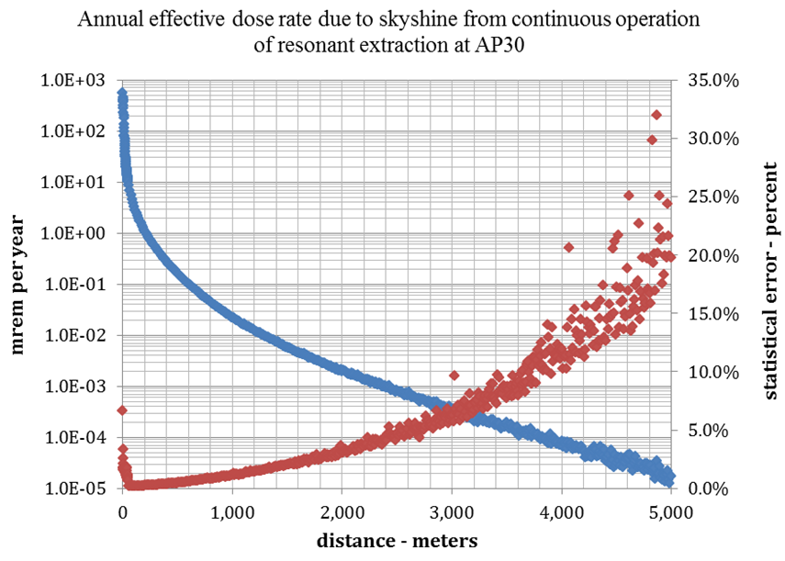
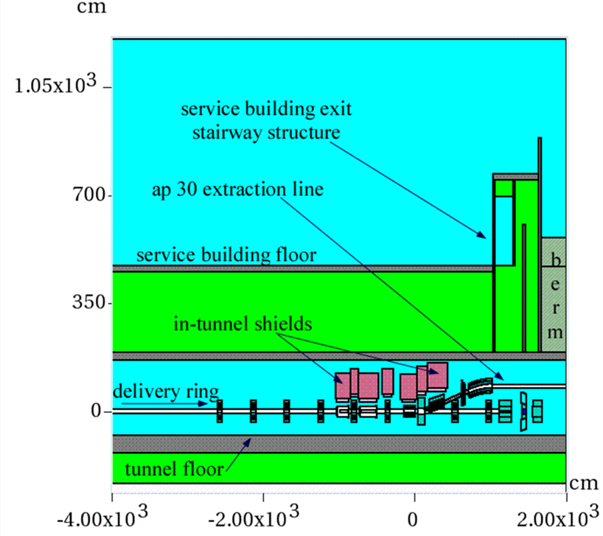
Radiation Safety Design and Performance
The basic components of the Mu2e Accelerator Radiation Safety Upgrades are:
Supplemental shielding of known loss points
Total Loss Monitor (TLM) system of interlocked detectors to preclude unacceptable dose rates outside of beam enclosures
Wilson Hall
Extensive MARS modeling of beam losses during Mu2e operation has shown that the Mu2e Radiation System prevents unacceptable external radiation dose rates
Notes:
Note: Blue diamonds are dose rate in mrem/yr, red diamonds are the statistical error on the dose rate (secondary axis).

Slide 23
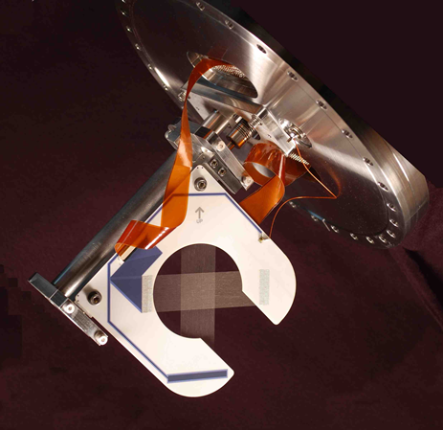
Other Accelerator Systems
Also included in the Mu2e Accelerator Upgrades are:
Accelerator Controls and Instrumentation
M4 beamline controls and instrumentation
Delivery Ring Abort controls
Delivery Ring beam intensity and tune measurement instrumentation
2.4 MHz Delivery Ring RF System
Design and Modeling
Low level RF system
RF Cavity and High Level amplification
provided by the Recycler AIP
MW
wire plane
2.4 MHz
RF Cavity
Notes:
Details of these systems are available in the breakout talks and in the TDR

Slide 24
Improvements Since CD-1

Slide 25
Improvements since CD-1
Resonant Extraction
Septum Plane Downselect: Foils chosen over wires
Extraction Resonance Downselect: 3rd integer resonance selected over 2nd integer
Radiation Safety
Received active shielding waiver (allows use of interlocked detectors)
Received preliminary approval for the use of TLMs
Received approval of the Mu2e preliminary shielding assessment
Target Station
HRS redesign:
CD-1 Design All Bronze located inside the muon beamline vacuum
CD-2 Design Bronze, Stainless Steel, and water; located outside of the muon beamline vacuum
Target remote handling system re-design
Notes:
Note: Radiation Safety approval documentation is available on the review web site.

Slide 26
Improvements since CD-1 (Continued)
Extinction
Removed “internal” extinction (not necessary to meet extinction requirements)
Changed from two AC dipole harmonics to three (ensures that far out-of-time particles end up in the collimator and not in anything else)
Beamline extinction section configuration change:
CD-1 Design: AC-Dipole followed by 5 collimators
CD-2 Design: 2 Hor. Collimators → AC Dipole → Hor. Collimator
Removed upstream extinction monitor
Extinction Monitor design downselect: Extinction Monitor design selection by the Mu2e collaboration and the Mu2e project
External Beamline
Changed extraction to the diagnostic absorber from vertical to horizontal
Lattice changes to accommodate reconfiguration of the extinction section
Notes:
Internal extinction was conceived as a momentum collimator in a high dispersion region of the Delivery Ring that would eliminate particles with high longitudinal amplitude.

Slide 27
Value Engineering since CD-1
Significant value engineering changes prior to CD-1
Reduced amount of external beamline instrumentation by allowing for the early use of final focus section instrumentation for commissioning the extinction section
New extinction section configuration uses two fewer collimators
Elimination of upstream extinction monitoring
Acquisition of most of target materials testing equipment from off-project sources (RAL)
Lowered HRS costs by removing material at downstream (TS) end

Slide 28
Risks
Quality Assurance
ES&H
Integration

Slide 29
Risks
22 Accelerator Risks in Risk Register
All risks mitigated to the extent possible
8 Threats
4 High
3 Medium
1 Low
2 Opportunities
12 Retired Risks
Detailed mitigation plans for all risks are documented in risk forms in the Mu2e doc DB and are linked from the Risk Register (docdb column)
All risks are understood and under control
Details on specific risks will be provided in the breakout session

Slide 30
Quality Assurance
Mu2e Accelerator Upgrades Quality Assurance involves all of the following:
Use of Governing Lab and Project QA Standards
Fermilab Quality Assurance Manual (QAM)
Fermilab Engineering Manual
Mu2e Quality Management Plan (Mu2e-doc-677)
Design Verification and Validation
Reviews
Magnet status tracking
Prototype testing
Beam testing
Procurement & Fabrication Acceptance testing
Notes:
More specific QA measures will be given in the breakout talks for each sub-system.

Slide 31
ES&H
Accelerator beam enclosures
Electrical hazards from exposed bus work.
Mechanical hazards (sharp edges, protruding fixtures)
Radiation hazards
Potentially lethal doses during beam operation
Residual radioactivity after beam operations
Radioactive surface and air contamination
Above ground hazards
Radiation dose rates in excess of continuous occupancy limits during beam operation in Muon Campus service buildings, on or near associated Muon Campus beamline berms, and in the vicinity of the Mu2e proton target and the associated proton beam absorber.
Radiation safety is a significant part of the Mu2e Project – it is a level 3 sub-project of Mu2e Accelerator Upgrades.
These hazards are all discussed in the Mu2e Hazard Analysis Report (Mu2e-doc-675).

Slide 32
Integration and Interfaces
Mu2e Accelerator Systems Interfaces:
External interfaces to the Solenoids, Muon Beamline, Conventional Construction, the g-2 project, and the Muon Campus AIPs
Internal interfaces
Instrumentation & Controls ↔ Resonant Extraction, External Beamline
Radiation Safety ↔ Resonant Extraction, External Beamline, Target Station
Resonant Extraction ↔ External Beamline
External Beamline ↔ Extinction, Target Station
Internal and external interfaces identified and described in the Accelerator Interface document, available on Review site (Mu2e-doc-1529).
Interface Management:
Meetings: Weekly Target Station Meetings, Bi-weekly integration and Accelerator L3 meetings
Formal sign-off between owners of all external interfaces as part of final design requirements.
Interfaces understood and under control.

Slide 33
Cost & Schedule

Slide 34
Cost Distribution by L3
Base Cost by L3
(AY $k)

Slide 35
Cost Distribution by Resource Type
Base Cost
(AY $k)
Notes:
Note: STFC RAL and Bartoszek Engineering labor appear as M&S on this graph.

Slide 36
Quality of Estimate
Base Cost by Estimate Type
(AY $k)
Contingency Rules are in Mu2e-doc-459
(available on the review web site)
99.6% of estimates of Preliminary Design quality or better

Slide 37
Labor Resources

Slide 38
Labor and M&S by FY

Slide 39
Cost Table
WBS 2 Accelerator
Costs are fully burdened in AY $k
 | Base Cost (AY K$)
 | M&S | Labor | Total | Estimate Uncertainty (on remaining budget) | % Contingency (on remaining budget) | Total Cost
475.02.01 Accelerator Project Management | 74 | 3,494 | 3,568 | 360 | 15% | 3,928
475.02.03 Instrumentation and Controls | 655 | 1,571 | 2,225 | 482 | 26% | 2,708
475.02.04 Radiation Safety Improvements | 986 | 1,034 | 2,021 | 497 | 29% | 2,517
475.02.05 Resonant Extraction System | 1,638 | 3,889 | 5,527 | 1,616 | 35% | 7,143
475.02.06 Delivery Ring RF System | 114 | 1,692 | 1,806 | 389 | 25% | 2,195
475.02.07 External Beamline | 3,412 | 3,827 | 7,240 | 1,830 | 29% | 9,069
475.02.08 Extinction Systems | 1,374 | 1,653 | 3,027 | 740 | 33% | 3,767
475.02.09 Target Station | 5,863 | 4,483 | 10,346 | 2,706 | 32% | 13,053
475.02.10 Accelerator Conceptual Design/R&D | 660 | 4,386 | 5,045 |  | n/a | 5,045
475.02.99 Risk Based Contingency |  |  |  | 814 |  | 814
Grand Total | 14,776 | 26,030 | 40,806 | 9,433 | 33% | 50,239
Notes:
Cost drivers highlighted in pink

Slide 40
Major Milestones
Activity ID | Milestone Name | Milestone Date
47502.01.02.001020 | T5 - Preliminary Design Tasks Complete | 6/9/2014
47502.01.03.000130 | TX2 - Beamline Enclosure Beneficial Occupancy | 9/30/2015
47502.01.02.001045 | T5 - Accelerator Final Design Complete | 11/6/2015
47502.01.03.000020 | T2 - M4 Enclosure Ready for Installation during g-2 beam operations | 2/28/2017
47502.03.001050 | T5 - Instrumentation & Controls Implementation Complete | 9/4/2018
47502.05.02.001315 | T5 - Resonant Extraction Electro-Static Septum Assembly Complete | 7/11/2019
47502.05.001060 | T5 - Resonant Extraction System Implementation & Close-out Complete | 9/13/2019
47502.07.001240 | T5 - Mu2e External Beamline Installation and Close-out Complete | 11/25/2019
47502.06.001020 | T5 - Delivery Ring RF Implementation and Closeout Complete | 12/2/2019
47502.01.03.000100 | T4 - Ready to Run Single Turn Extraction Beam to the Diagnostic Absorber | 1/29/2020
47502.04.001080 | T3 - Radiation Safety Improvements Complete | 4/21/2020
47502.01.03.000120 | T4 - Beam Established to Diagnostic Absorber for Objective KPP | 4/22/2020
47502.09.001070 | T4 - Target Station Complete | 7/16/2020
47502.08.001100 | T5 - Mu2e Extinction Systems Installation and Close-out Complete | 9/21/2020
47502.01.03.001100 | T4 - Implementation Tasks Complete (Ready for Verification that Key Performance Criteria are met) | 9/21/2020
Total of 268 milestones in the Mu2e Accelerator Upgrades schedule

Slide 41
Schedule
PS Arrives @ Mu2e Bldg
CD-2/3b
CD-3c
Beam to Diagnostic Absorber
CD-4
M4 Enclosure
BO
Resonant Extraction Design
Fabrication & Installation of Resonant Extr. Magnets, Power Supplies, & Electronics
Fabricate ESS
Install ESS
Commission Res. Extr.
External (M4) Beamline Design
Extinction & M4DA Section Installation
Hbend Section Installation
Final Focus Section Installation
Target Station Design
Target Fabrication
HRS Procurement & Fabrication
HRS Installation
Extinction Design
AC Dipole, Pwr Supply & Collimator Procurement, Fabrication & Install
Extinction Monitor Procurement, Assembly & Install
Instrumentation & Controls Design
Instrumentation & Controls Implementation
Radiation Safety Design
Radiation Safety Procurements, Fabrication & Installation
Delivery Ring RF Design
Delivery Ring RF Procurements, Fabrication & Installation
Beam Operations:
g-2 Beam Operations
M4 Commissioning with single turn Beam
Q3 | Q4 | Q1 | Q2 | Q3 | Q4 | Q1 | Q2 | Q3 | Q4 | Q1 | Q2 | Q3 | Q4 | Q1 | Q2 | Q3 | Q4 | Q1 | Q2 | Q3 | Q4 | Q1 | Q2 | Q3 | Q4 | Q1 | Q2 | Q3 | Q4 | Q1 | Q2 | Q3 | Q4
FY14 FY15 FY16 FY17 FY18 FY19 FY20 FY21
Notes:
Notes:
No Muon Campus beam between Spring 2014 and Winter 2017
ESS Installation depicted here is not what is in the P6 schedule. P6 does not account for the fact that the beamline must be commissioned with single turn extracted beam before the ESS can be installed.
The ESS replaces a Delivery Ring extraction kicker module. Therefore, ESS installation precludes further single turn extracted beam to the M4 beamline.
HRS installation takes 10 days (box on schedule is over-sized)
Target installation is off-project and estimated to occur in Dec. 2021.
Beam commissioning is off-project

Slide 42
Summary
The Design of the Mu2e Accelerator Systems meets the requirements set by the governing requirements documents
Cost estimates for the Accelerator Systems are complete
99.6% of the cost is understood at the Preliminary Design level or better
Risks are understood, are mitigated to the extent possible, and are under control
All Interfaces are identified and defined
Resource needs are understood
ES&H has been embedded into all aspects of the project
Responded to all recommendations from previous reviews
Accelerator Systems are ready for CD-2

Slide 43
Backup Slides

Slide 44
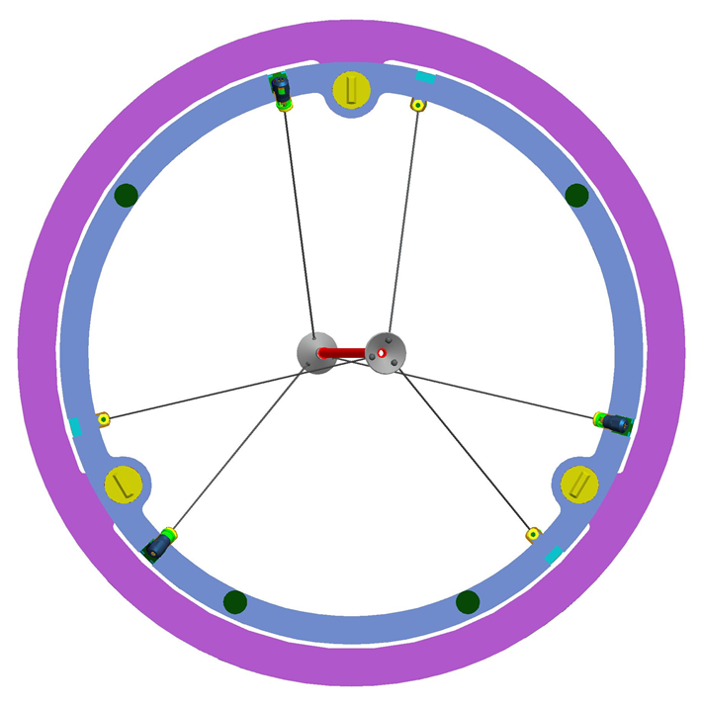
Proton Target Positioning Requirements
Target dimension tolerances
Target Length = 16 cm ±2 mm
Target Radius = 3 mm ±0.1 mm
Alignment of target with respect to PS/HRS
Replacement target positioning repeatability: ±0.25 mm
Transverse placement w/resp. to PS axis: ±5 mm
Longitudinal placement along PS axis: ±10 mm
Alignment of target with respect to the proton beam:
Transverse beam positioning requirement: ±0.5 mm
Horizontal and vertical angle alignment: ±0.2°
Nominal target and support structure and HRS inner wall viewed along the solenoid axis, looking in the proton beam direction.
The target is centered vertically in the HRS.
The target points horizontally off-axis by 14° (toward proton beam left) relative to the support ring in order to be properly aligned with the beam

Slide 45
PS Heat and Radiation Shield General Requirements
Production Solenoid Heat and Radiation protection
Limit the continuous power delivered to the cold mass
Limit the local heat load allowed anywhere within the superconducting coils
Limit the maximum local radiation dose to the superconductor epoxy over the lifetime of the experiment
Limit the damage to the superconductor’s aluminum stabilizer and copper matrix
Production Solenoid field quality should not be degraded by materials used in the HRS
Production Solenoid forces during a quench should be minimized by the choice of HRS materials, if possible. The HRS electrical resistivity must be high to limit forces from eddy currents during a quench.
Transport Solenoid (TS1 coils) Heat and Radiation protection (see #1 above)
HRS thermal cooling system should limit the temperature on the surface of HRS. The inner surface holds the target support. The outer surface is adjacent to the PS cryostat and in contact in a few locations.
The HRS must also be adaptable to the design of a remote handling system for the pion production target.
Muon Yield should not be reduced significantly by the inner bore size of the HRS.
An acceptable shield design must avoid any line-of-sight cracks between components that point from the target to the inner cryostat wall and thus the magnet coils.
Notes:
The bulk of the HRS Requirements document expands, in detail, the specific, quantitative requirements that result from these general requirements.

Slide 46
PS Heat and Radiation Protection Requirements
 | Dynamic Heat Load [Watts] | Peak Power Density [μW/g] | Max. Lifetime Radiation Dose [MGy] | Peak DPA/yr [10⁻⁵]
Specification | < 100 | 30 | 7* | 4 to 6†
Estimated HRS Performance | 24 | 13 | 5.2 | 2.4
* 7 MGy is a conservative limit on coil epoxy exposure, 10% of shear modulus lost due to radiation damage.
† This is the DPA damage per year from which RRR degrades to 100. After this RRR reduction we must warm-up and anneal.
Definitions:
DPA = Displacements per Atom (unit of radiation damage)
$RRR=\frac{ρ_{300°K}}{ρ_{4.5°K}}\text{= }\underline{R}\text{esidual}\underline{ R}\text{esistivity} \underline{R}\text{atio}$ (want to be < 100)

Slide 47
Proton Beam Absorber Requirements
Purpose: The proton beam absorber stops non-interacting primary beam and secondary particles downstream of the proton target.
Proton Absorber parameters for various beam conditions:
 | Primary Beam | Diagnostic Beam | Accident Condition
Beam Power | 8 kW (on target) | 0.8 kW | 8 kW
Total No. of Protons | 8×10²⁰* | 2×10¹⁹ | 2×10¹⁹
Duration of beam | Long Periods | Long Periods | < 10 min
Other Requirements:
Absorber shielding sufficient to protect extinction monitor equipment from prompt radiation
Absorber will include an albedo trap to protect PS hall equipment from secondary neutrons from absorber
Sufficiently well shielded to protect workers in adjacent spaces from residual beam-off radiation
Ground water and air activation less than FRCM limits
* Note: this is more than twice the required number of POT for physics running

Slide 48
Protection Collimator Requirements
Purpose: prevent any interaction of primary proton beam with the HRS, PS cryostat, or PS coils that could result in significant thermal energy deposition or radiation damage.
Requirements:
The Protection Collimator must be able to absorb full design beam power for at least 50 msec*
The Protection Collimator must be able to continuously dissipate the energy deposited by the absorption of beam halo particles during normal operation
The Protection Collimator inside diameter must be less than 80 mm (for elimination of extinction monitor backgrounds)
Must be able to move out of the beam for target scans
Must be constructed of non-magnetic materials (due to proximity to PS and TS)
*The TLM radiation safety system will remove the beam permit in less than 50 msec if all of the beam is being lost in this device

Slide 49
M4 Beamline Extinction Section Optics

