Slide 1
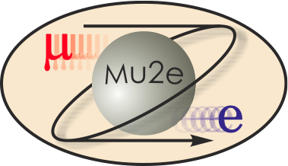
Mu2e Tracker
Aseet Mukherjee
Tracker L2 Manager
21 Oct 14

Slide 2
Tracker Team
Aseet Mukherjee – L2 Manager
  Started work at Fermilab in 1986 working on CDF’s Run-I tracker (CTC), a ~3m×3m cylindrical drift chamber.
  Co-leader with Bob Wagner for construction of CDF’s Run-II tracker (COT), a ~3m×3m cylindrical drift chamber.
  Worked on pattern recognition and fitting software for CTC; slow controls, calibration, monitoring, and maintenance for both trackers.
Bob Wagner – Deputy Manager
  Worked on design and construction of CTC
  Co-leader for construction of COT.
  Leader for construction of vertex drift chamber (VTX) for CDF Run-I
  Worked on calibration, monitoring, and maintenance of all three drift chambers.

Slide 3
Organization
475.6
Tracker
A. Mukherjee (FNAL)
475.6.1 Project Management
L3: A. Mukherjee
CAM: A. Mukherjee
475.6.4 Front End Electronics
L3: V. Rusu (FNAL)
CAM: V. Rusu (FNAL)
475.6.2 Straws
L3: C. Wang (Duke)
CAM: R. Wagner (FNAL)
475.6.5 Infrastructure
L3: A. Mukherjee
CAM: A. Mukherjee
475.6.3 Straw Assemblies
L3: M. Corcoran (Rice)
CAM: R. Wagner (FNAL)
475.6.6 Installation
L3: A. Mukherjee
CAM: A. Mukherjee

Slide 4
Requirements
 | Mu2e Document
Science Driven Requirements | 4381
Requirements for the mu2e Tracker Front End Electronics | 3879
Tracker Requirements Document | 732

Slide 5
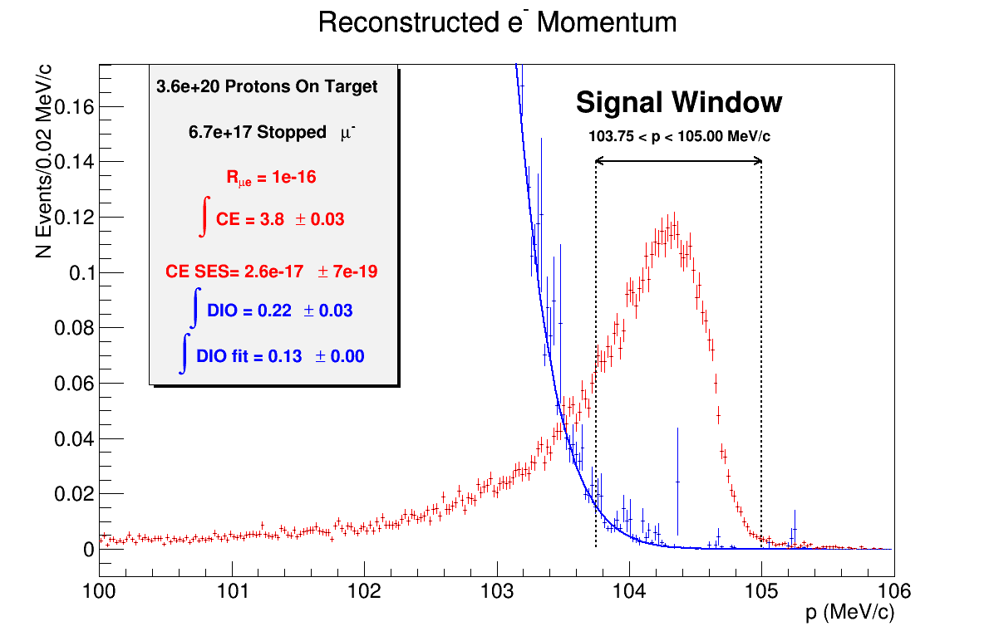
Requirements
Blind to low energy background electrons
Adequate resolution
Efficient for signal
r<380mm
“No” mass (vacuum)
380<r<700mm
Low mass detector
r>700mm
Support structure
For:
3.6·10²⁰ POT
6.7·10¹⁷ μ⁻ stops
R_{μe} = 10⁻¹⁶
Signal yield = 3.5 evt
DIO yield = 0.20 evt

Slide 6
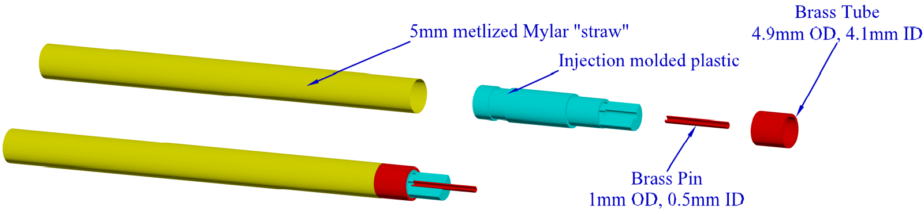
Straw Tubes: 475.06.02 $1,697K
L3: C. Wang (Duke)
CAM: R. Wagner (FNAL)
5 mm OD metalized Mylar® straws, 15µm wall
  Mylar for higher yield and modulus (compared to Kapton)
  Aluminum on inner and outer surface
  Gold on inner surface
25 µm gold plated tungsten sense wire

Slide 7
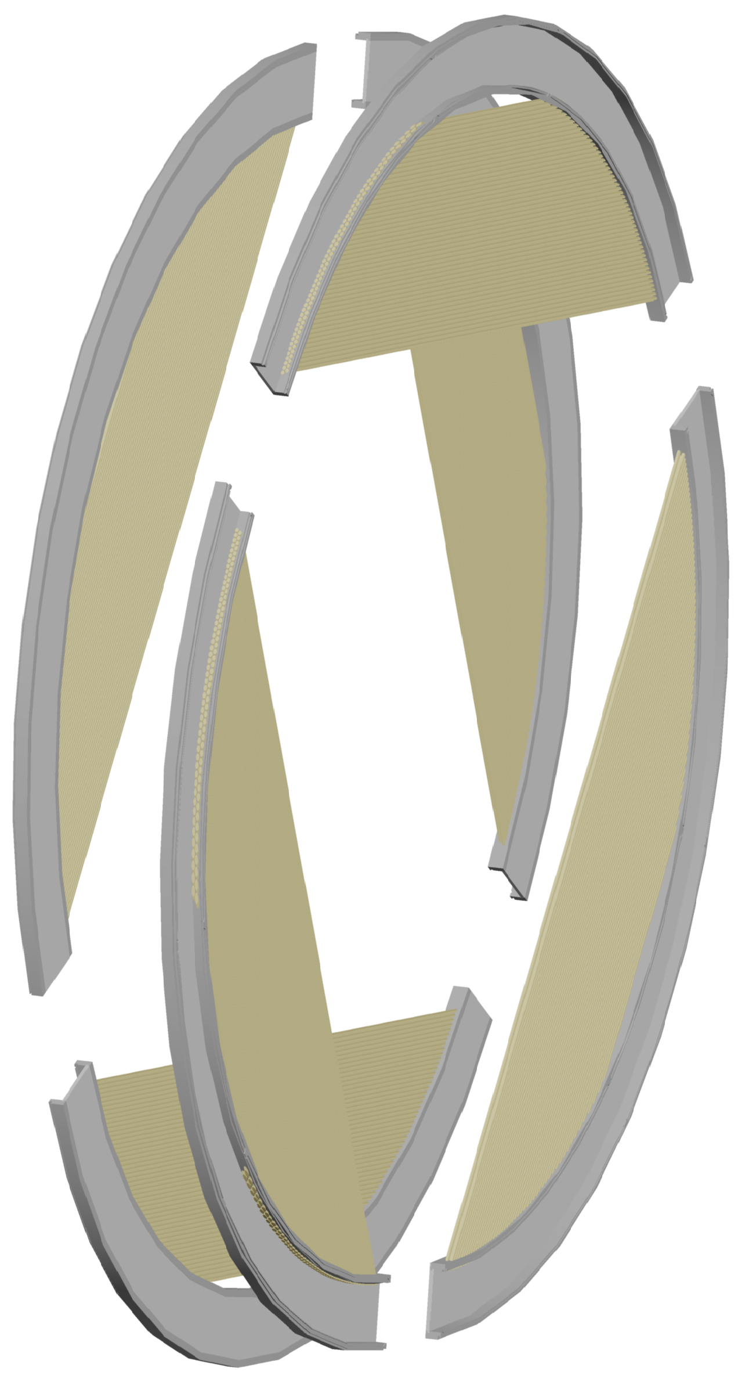
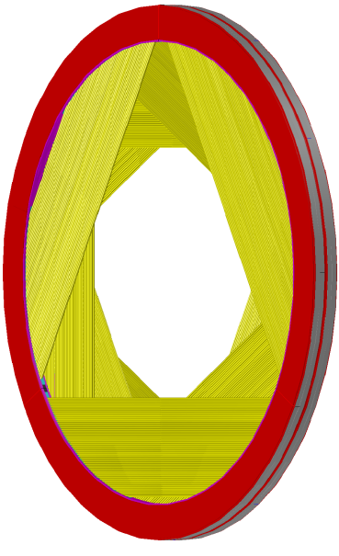
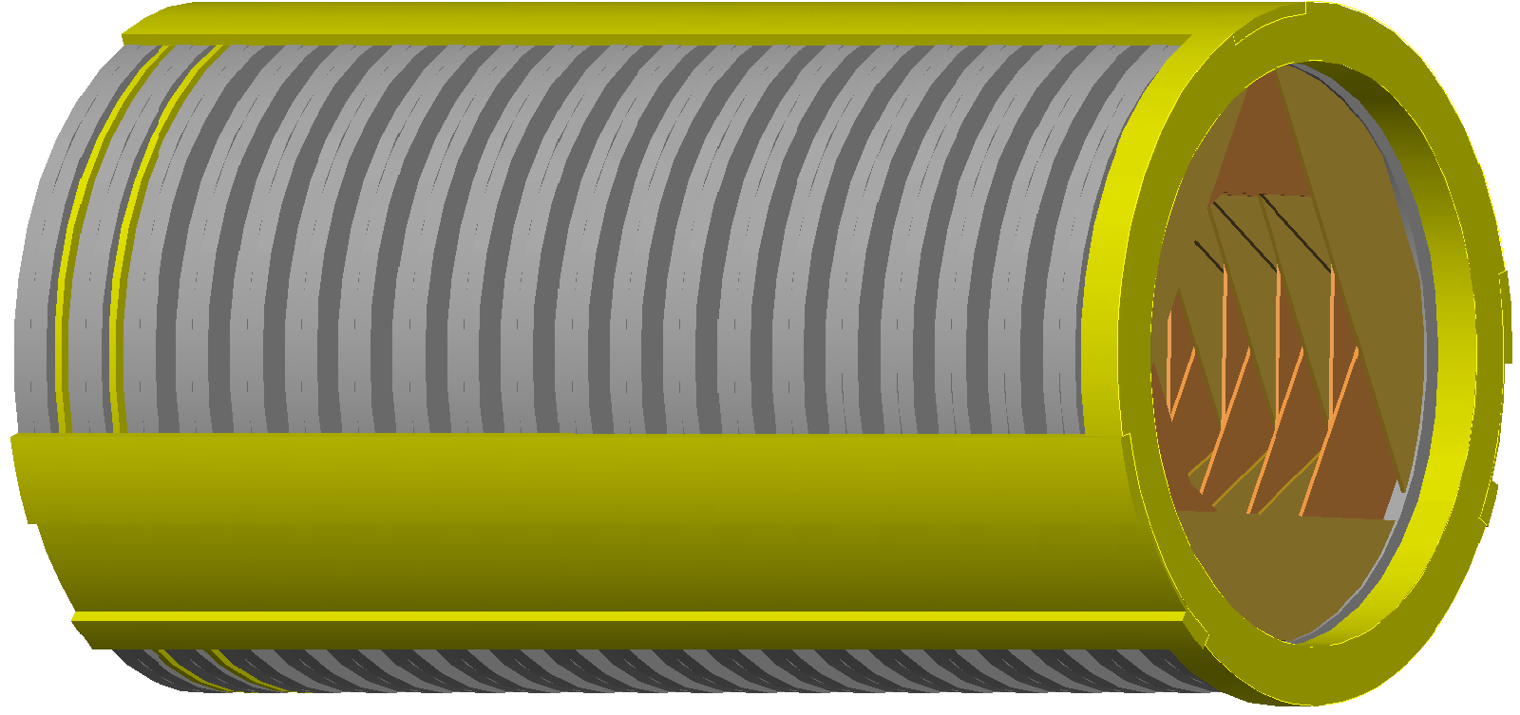
Straw Assemblies: 475.06.03 $5,012K
L3: M. Corcoran (Rice) CAM: R. Wagner (FNAL)
96 straws form a panel (120°arc)
6 panels form a self supporting ring called a plane
Two planes, with a small gap, form a station
12 rotations, pattern set to optimize stereo reconstruction
18 stations form the tracker

Slide 8
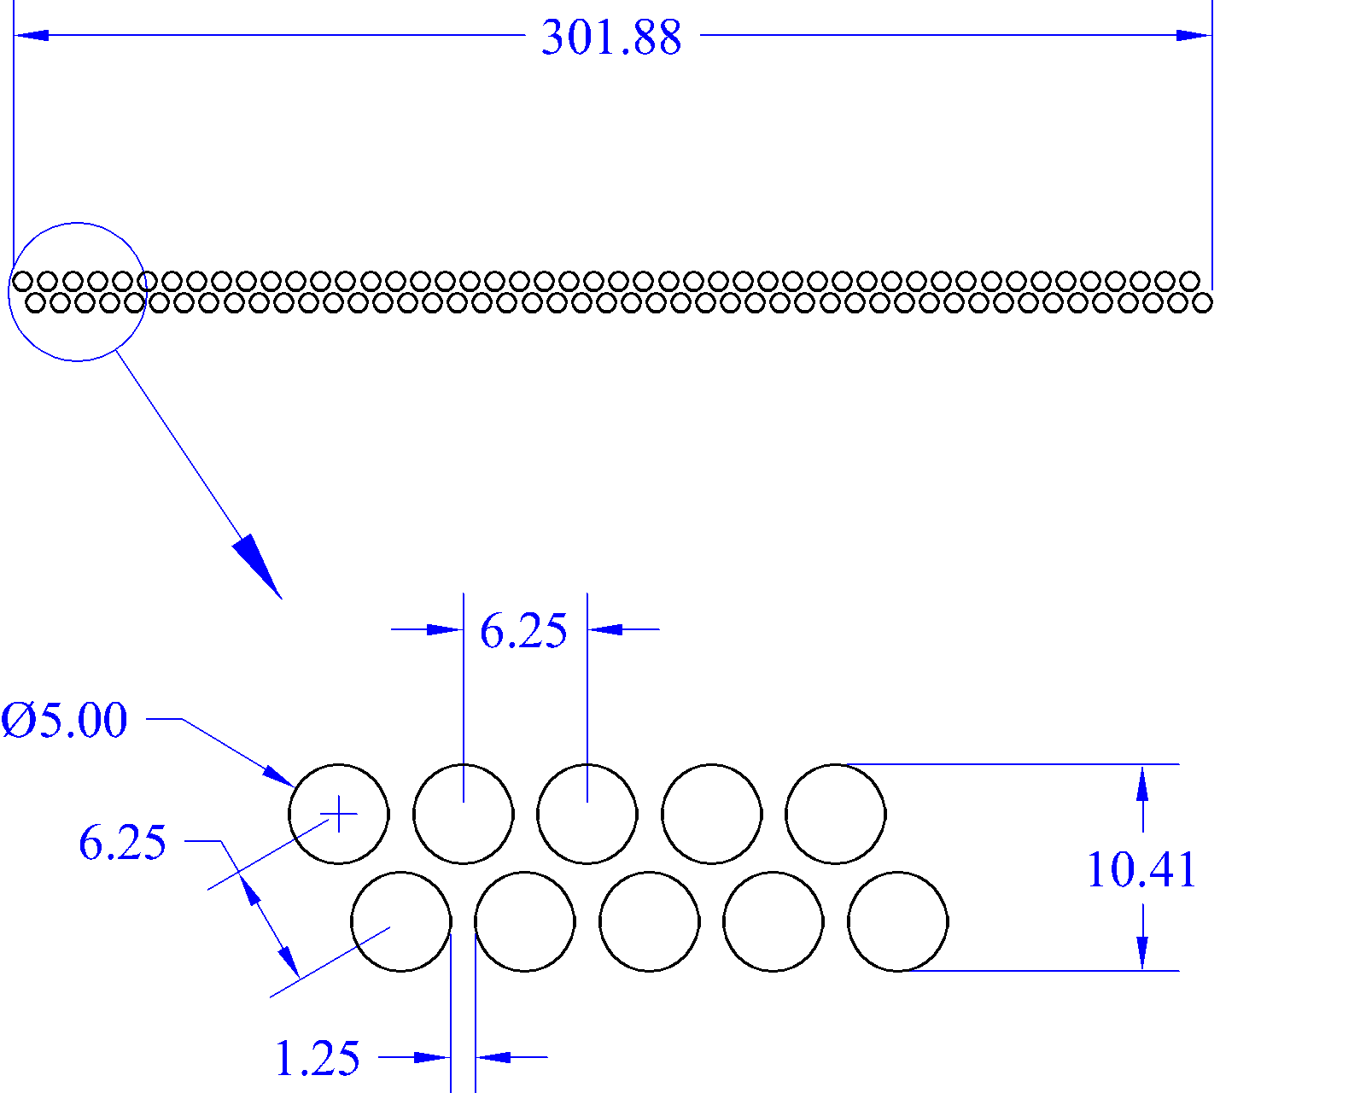
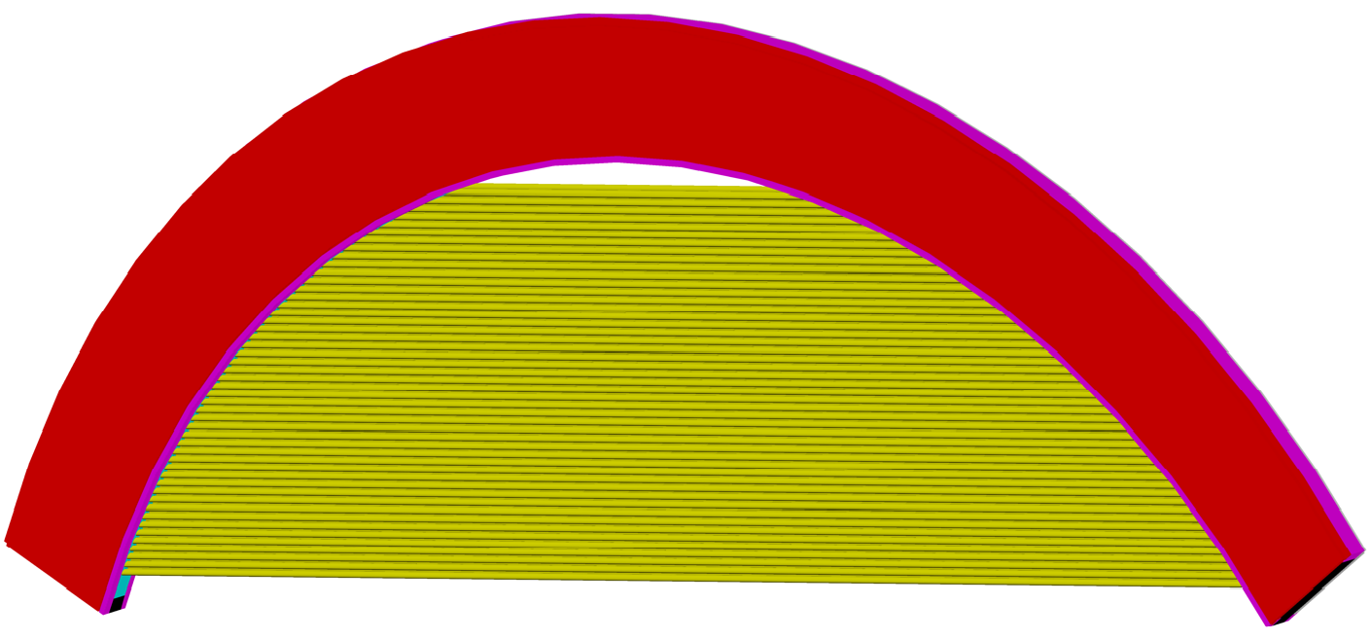
Panel
96 straws of varying length form a panel
  Staggered pattern to improve efficiency and resolve left/right ambiguity
  Gap between straws to allow for expansion when operating in vacuum
Panel frame encloses front end electronics

Slide 9
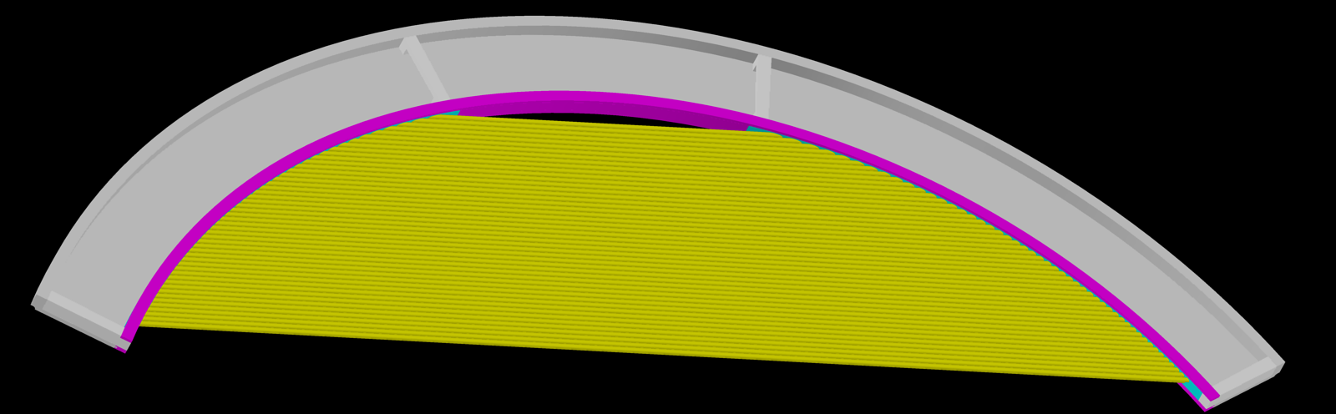
Gas Manifold
Changed since CD1 (was all metal)
3D printed plastic with holes for straws: cyan. 2 pieces
Stainless steel reinforcement: magenta. 3 pieces
Everything else aluminum: grey. 6 pieces
Panel with covers removed

Slide 10
Front End Electronics: 475.06.04 $2,910k
L3 & CAM: V. Rusu (FNAL)
Preamp
TDC
PCB transmission line
Straw
DAQ
Readout Controller
Output Control & Buffer
TDC
∑
Preamp
ADC
Discrete
Commercial Analog ICs
FPGA
FPGA

Slide 11
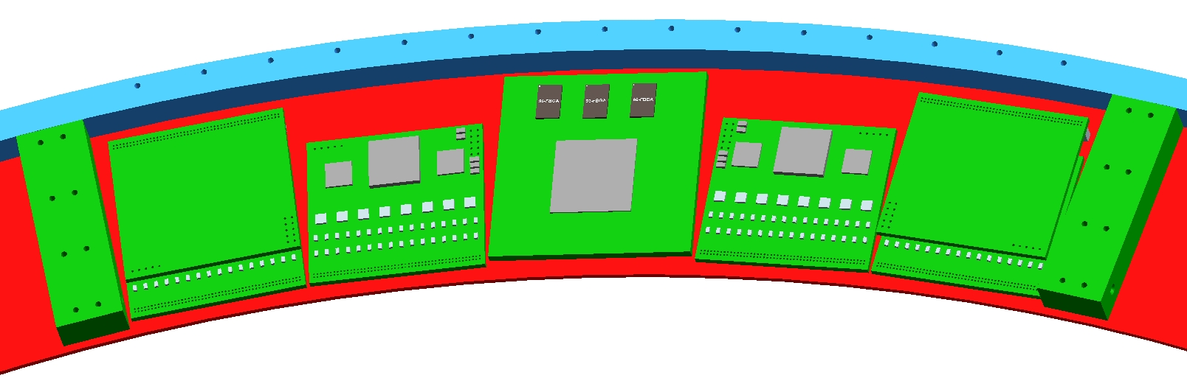
Digitizers
Change since CD1: All commercial, off the shelf parts
Tight fit, but it does fit
Design complete
(subject to value engineering as new parts become available)
Quotes for parts, boards, assembly
Digitizers and ROC
(inner ring suppressed)
Edge view of digitizer boards with overlapping

Slide 12
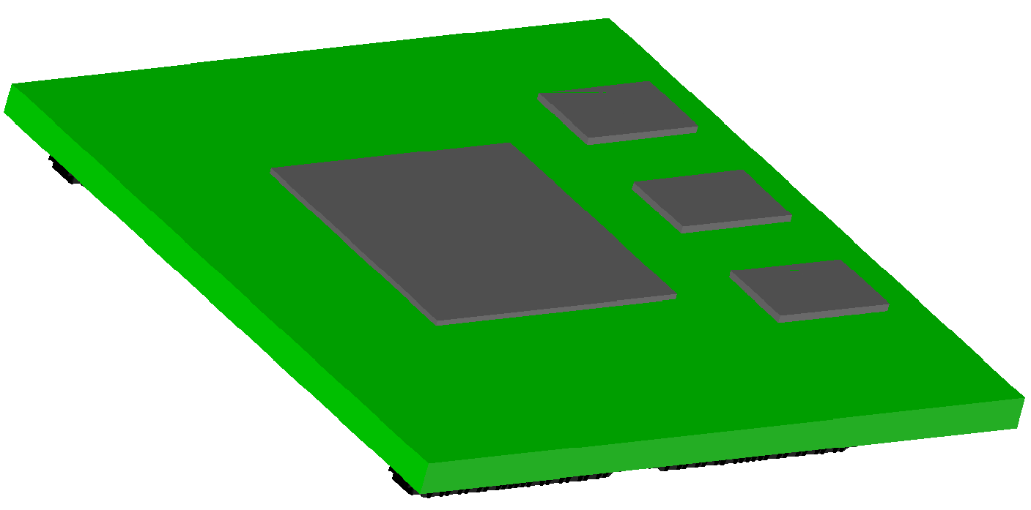
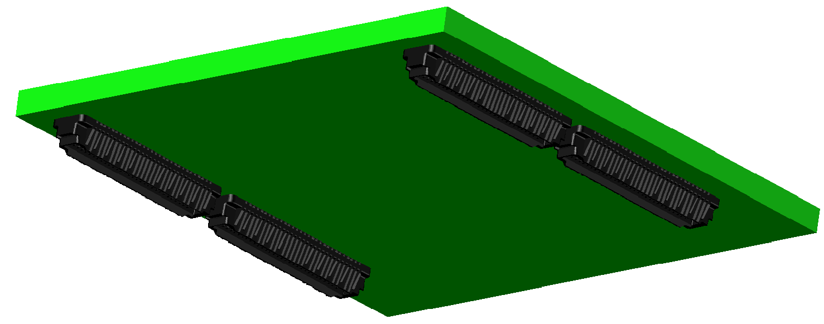
Readout Controller
Work is being done by Fermilab and U. of Houston
Preliminary designs exist.
  1st iteration: Over-size boards with many test features
  Next iteration: Reduce size. Conceptual layout exists
Memory
FPGA
MB Connectors

Slide 13
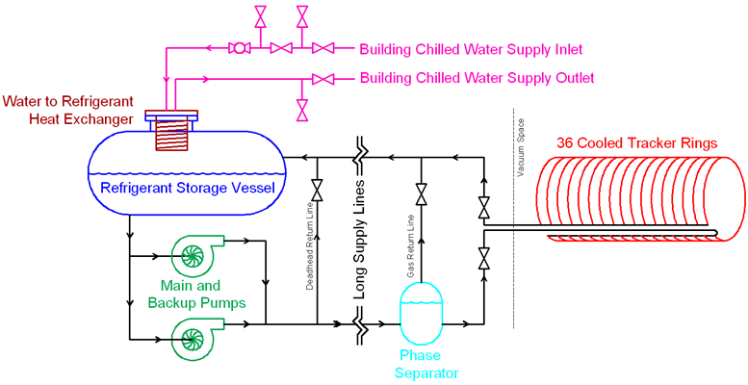
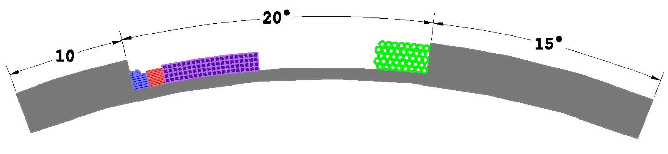
Infrastructure: 475.06.05 $1,293K
L3 & CAM: A. Mukherjee (FNAL)
Utilities run along support beams
Cooling runs around each plane
High Voltage
Communication
Power
Gas

Slide 14
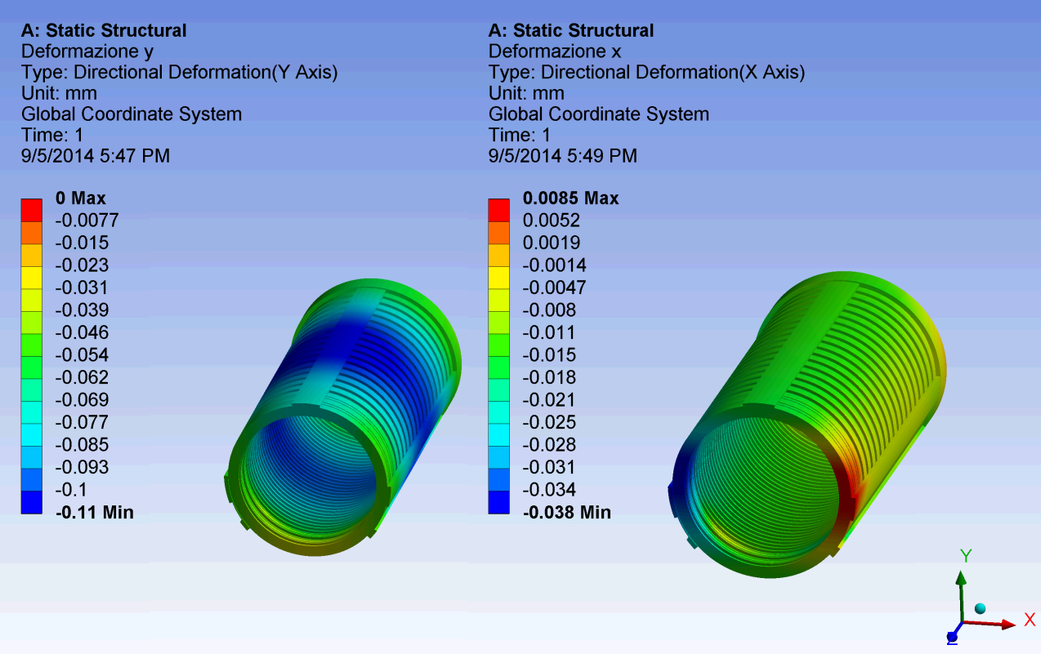
Support Structure
Preliminary design complete
All aluminum gives acceptable deflection
(were considering stainless steel at CD1)
~110μm sag

Slide 15
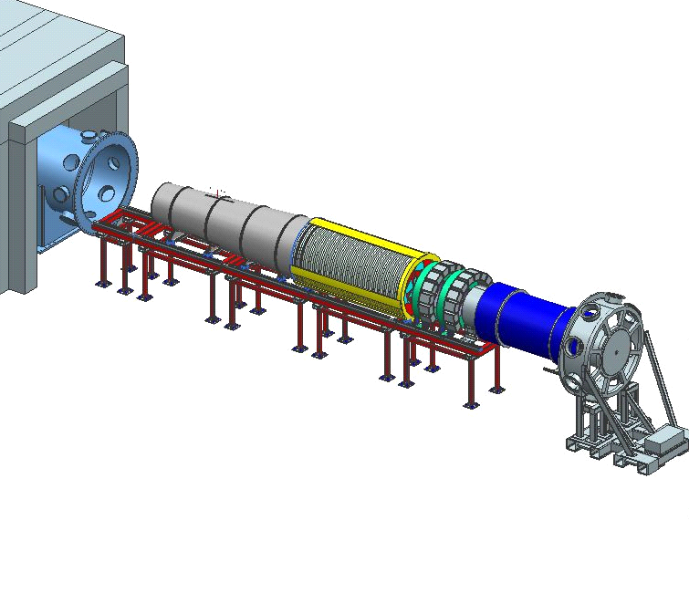
Installation: 475.06.06 $106K
L3 & CAM: A. Mukherjee (FNAL)
Work with muon beamline (475.05) to install detector on rails
Post-installation
optical survey
Route cables through DS
Test connections
Proton
Absorber
Calorimeter
Tracker
Muon Beam
Stop
Detector
Solenoid
External Rail
System
Instrumention
Feedthrough Bulkhead
Notes:
Add picture(s)

Slide 16
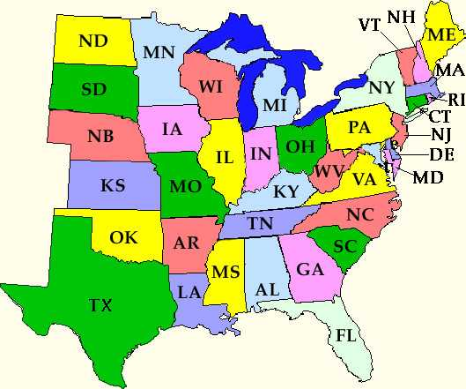
Parts Flow
U. Minnesota
PPG wind straws
York Straw ends
Vacuum feedthroughs
Vacuum test straws
U. Mn Straw QC
Cut and terminate straws
Rice, U. H. assemble panels
Panel QC
Duke Work with PPG
Locate wires (x-ray)
Fermilab Assemble planes Assemble tracker
York
PPG
Duke
Straws
Termination
Vacuum Feedthrus
Panels
Vender Oversight
Rice
U. Houston

Slide 17
Improvements Since CD-1
Composite gas manifold using 3D printing technology
  Lower cost than drilling holes in metal
  Insulating… don’t need to add Kapton sleeves
  Special features can be added at no added cost
    Simplify preamp connection
    Build in epoxy application features
Digitizers with all off-the-shelf parts
All-aluminum support structure
More details in breakout talks

Slide 18
Integration and Interfaces
External Interfaces
Internal Interfaces
  Straws ↔ FEE, Straw Assemblies
  FEE, Straw Assemblies ↔ Infrastructure
  Straw Assemblies, Infrastructure ↔ Installation
Documented in docdb-1562 and 3545
Participation in bi-weekly integration meetings
Formal sign-off between owners of all external interfaces as part of final design requirements
Interfaces understood and under control.
  Muon Beamline
  Conventional Construction
  Calorimeter
  DAQ

Slide 19
Quality Assurance
Straw material tested by supplier for conductivity and adhesion of metal to Mylar®
100% testing of straws for leak rate and electrical conductivity before being assembled into panels
Tension measurement of straws and wires during panel assembly and before panels are assembled into planes
X-ray scan of wire positions within panel
Vacuum testing of panels before assembly into planes
Work in progress on database, bar coding, etc.

Slide 20
Risks and Opportunities
10 current risks in risk registry
  8 threats, all mitigated to the extent possible
    2 Very Low probability
    4 Low probability
    2 Medium probability
  2 opportunities
    1 Medium probability
    1 High probability
Detailed mitigation plans documented and linked from Risk Register (docdb-4320)
All risks understood and under control

Slide 21
ES&H
X-ray machine at Duke
  Procedures in place from ATLAS TRT construction
Gas (Ar:CO2) is non-flammable and non-toxic. Tracker volume less than one compressed gas cylinder.
Radioactive sources are widely used at Fermilab. All applicable saftey rules will be followed.
High voltage is moderate by Fermilab standards:
1500V, <1mA and ~10mJ stored energy on any one line
Power is from 48V supplies which have passive (limited capacity) and active (monitor and trip) current limit
No unusual toxic or hazardous materials used
  Extensive experience with epoxy at all participating institutions

Slide 22
Cost Table
 | Base Cost (AY K$) |  |  | Estimate Uncertainty (on remaining costs) | % Contingency on ETC | Total Cost
 | M&S | Labor | Total
475.06 Tracker
475.06.01 Tracker Project Management | 28 | 1,779 | 1,807 | 250 | 20% | 2,057
475.06.02 Straws | 1,200 | 69 | 1,268 | 429 | 38% | 1,697
475.06.03 Straw Assemblies | 2,708 | 811 | 3,519 | 1,493 | 47% | 5,012
475.06.04 Tracker Front End Electronics | 1,676 | 591 | 2,267 | 643 | 32% | 2,910
475.06.05 Tracker Infrastructure | 374 | 567 | 941 | 352 | 38% | 1,293
475.06.06 Detector Assembly & Installation |  | 70 | 69 | 37 | 53% | 106
475.06.07 Tracker Conceptual Design/R&D | 999 | 654 | 1,653 |  |  | 1,653
475.06.99 Risk Based Contingency |  |  |  | 556 | - | 556
Grand Total | 6,983 | 4,540 | 11,523 | 3,760 | 44% | 15,283

Slide 23
Cost Breakdown
Base Cost AY K$

Slide 24
Quality of Estimate
Base Cost AY K$

Slide 25
Labor & Material by FY
Base Cost AY K$

Slide 26
Labor Resources by FY
FTEs by Discipline

Slide 27
Milestones
L4 and L5 with corrections that were not noticed in time for this review
7/20/15 Single Panel Prototype Evaluation Complete (formerly said “Plane”)
10/1/16 Single Plane Prototype Evaluation Complete
6/5/17 Production Straws ready for assembly
6/13/17 LV power supplies received
7/13/17 Production preamps tested
10/30/17 All panels complete and tested
5/23/18 Straw Assemblies Complete
7/6/18 LV System installed
7/20/18 Cooling system installed and tested
7/24/18 Gas System Installed and Tested
8/31/18 HV system installed
2/25/19 Electronic Installation Complete
2/25/19 Implementation Tasks Complete
(Ready for Verification that Key Performance Criteria are met)
4/10/20 Ready for Cosmic Ray Test
10/15/20 Ready for Operations

Slide 28
Schedule
Pre-production
Production
Final Assembly
L5 Milestone
L4 Milestone
CD-3a
CD-3c
CD-2/3b
CD-4
Single Panel
KPPs Satisfied
Single Plane
Straws
Panels
Front End Electronics
Planes
Preamps
Install Cabling, Electronics
Readout Controller
Tracker Move and Install
Digitizer
Cosmic Ray Test
FY14 FY15 FY16 FY17 FY18 FY19 FY20 FY21

Slide 29
Critical Path
Panel Design, Assemble, Test
Single Plane Construction & Test
Single plane Evaluation Complete
Straw Production
Panel Production
Install electronics in panels
All Panels Complete
Tracker Assembly
Post-move
tests
KPPs Satisfied
Q3 | Q4 | Q1 | Q2 | Q3 | Q4 | Q1 | Q2 | Q3 | Q4 | Q1 | Q2 | Q3 | Q4 | Q1 | Q2 | Q3 | Q4 | Q1 | Q2 | Q3 | Q4 | Q1 | Q2 | Q3 | Q4 | Q1 | Q2 | Q3 | Q4 | Q1 | Q2 | Q3 | Q4
FY14 FY15 FY16 FY17 FY18 FY19 FY20 FY21

Slide 30
Summary
Design satisfies requirements:
resolution, efficiency, and reliability
Cost estimates complete
  99% is at Conceptual or higher
  57% is at Preliminary or higher
  Risks are understood and mitigated to the extent possible
Interfaces have been identified and defined
Needed resources identified, within Fermilab and from collaborating institutions
ES&H incorporated into the plans
Tracker is ready for CD-2

