Slide 1
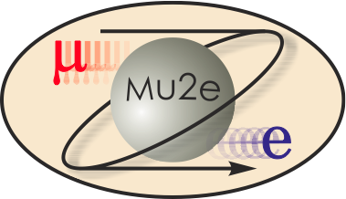
Mu2e Conventional Construction WBS 3.0
T. Lackowski
L2 Manager
10/21/2014

Slide 2
Conventional Construction Fermi Team
Tom Lackowski- L2 Manager
36 years experience; 30 years at Fermilab, State of Illinois Licensed Architect, State of Illinois Licensed Structural Engineer, Project Management Professional (PMP).
Field of Expertise Years @ Fermi
Ron Jedziniak Design Coordination 42/18
Chuck Federowicz* Civil/Environmental 38/30
Steve Dixon* Architect 31/23
Tom Lackowski* Structural 38/30
Emil Huedem* Mechanical 29/23
Randy Wielgos* Electrical 28/5
Jim Niehoff Fire Protection / Detection 25/22
Tim Trout* Construction Coordinator 37/12
* Denotes Professional License

Slide 3
Current Status
Following the CD-1 recommendations:
Preliminary and final design has been completed.
AE (Architect/Engineering) team continuity maintained by minimizing the duration between preliminary and final design.
Taking advantage of the recent aggressive construction market conditions, the Mu2e Conventional Facilities package has:
Issued RFP (Request For Proposal);
Eight proposals received (apparent successful proposer 4% under engineers estimate)
Evaluation board made subcontractor selection based on technical (60%) and price (40%).
Prepared to start construction once authorization is received.
CD-3b is needed to keep building off the critical path.

Slide 4
Integration and Interfaces
Conventional construction has coordinated the internal interfaces between conventional disciplines.
There are external interfaces with all of the other subprojects.
Internal and external interfaces identified and described in Conventional Construction Interface document (approved); available on review site Mu2e-doc-1537.
Subprojects participated in weekly conventional design development meetings.
Participation in bi-weekly integration meetings.
Weekly Tech Board meetings.
Formal sign-off between owners of all external interfaces.
Interfaces understood and under control.

Slide 5
Requirements and Interfaces
The Conventional Construction will produce a facility that satisfies the physical and environmental needs of the other sub-projects.
The requirements and interfaces were developed via a series of meetings that included stakeholders from the other sub-projects.
The requirements were translated into drawings which formed the basis for the A&E, Middough Inc., to produce the contract documents.
The project team reviewed drawings at 30%, 60%, 90% and 100%. The 90% review was also issued as a Lab Wide Comment and Compliance Review.
Conform to applicable environmental and organizational standards.
Life safety code (NFPA 101), IBC Building Code, DOE Guiding Principles, Fermi standards and requirements.
Requirements document Mu2e-doc-1088, approved.

Slide 6
Requirements translate to:
Space Requirements
Mu2e Conventional Facilities Square Footages:
Grade Level 12,600 Square Feet
Grade level divided into a high bay with two 30 ton cranes and a side bay to house support equipment.
Detector Level 9,640 Square Feet
Building square footage increased 27% since CD-1 (from 17,500 SF to 22,240 SF).
Mechanical
HVAC ~300KW HVAC load (about 50% process load) ~88KW CHW for detector cooling, vacuum pump, and electronic racks. (30% margin on CHW to building)
ODH Ventilation: 7000 cfm each for the PS and DS areas & 6300 cfm for solenoid power supply room.

Slide 7
Requirements translate to:
Electrical
Mu2e Conventional Facilities
1,500 KVA for solenoid and beam line power supplies (20% margin)
750 KVA house power (10% margin, upgradable to 1500KVA)
The Delivery Rings Upgrade(AP-30)
Beamline power supplies located in AP-30 require a new 1200 Amp. distribution panel with new secondary from the primary transformer.
Cost Distribution by Trade

Slide 8
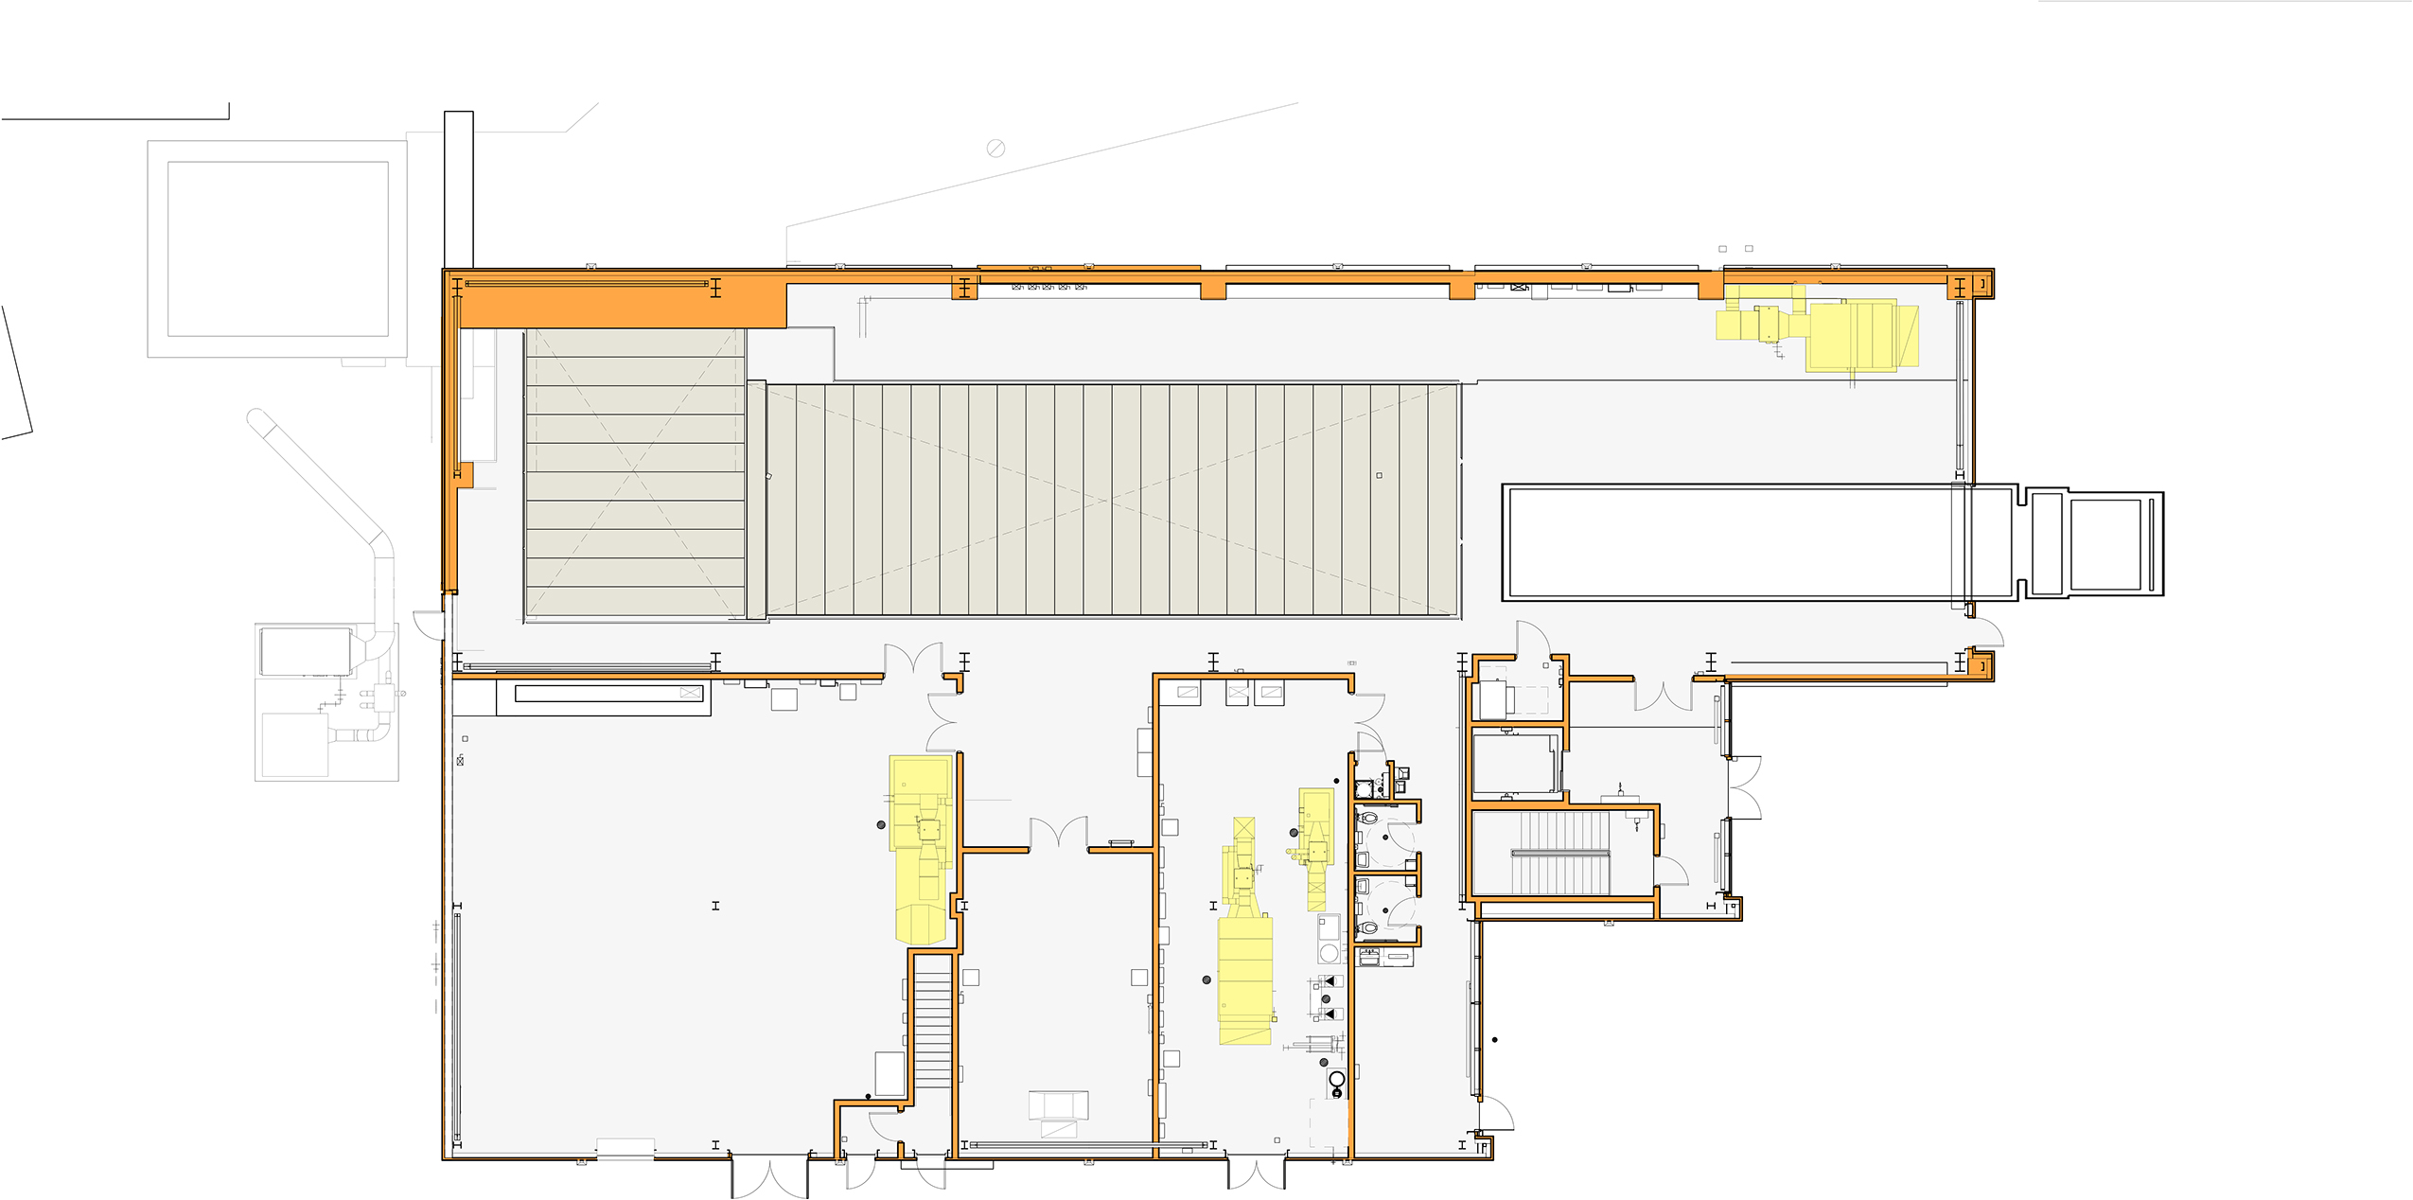
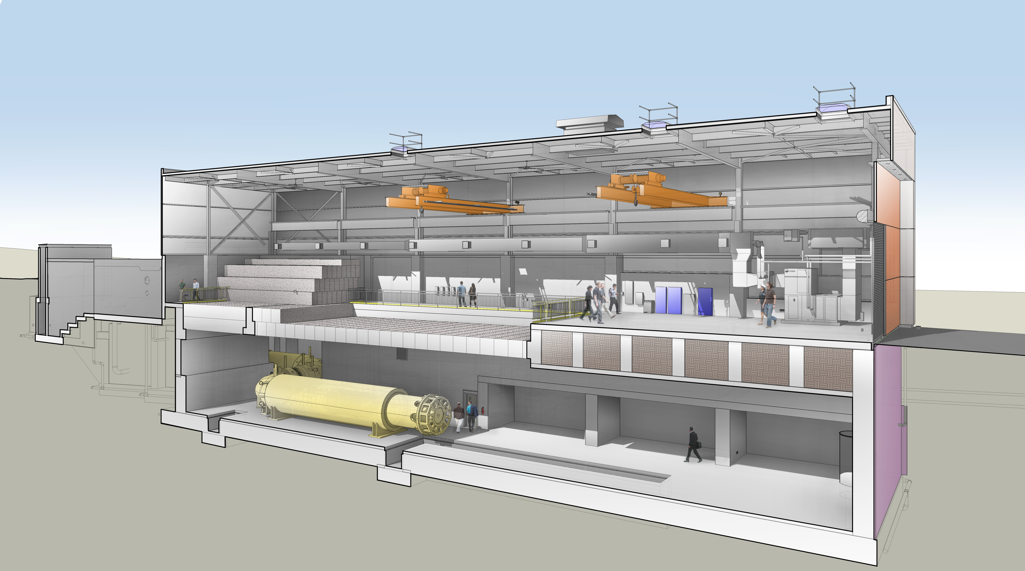
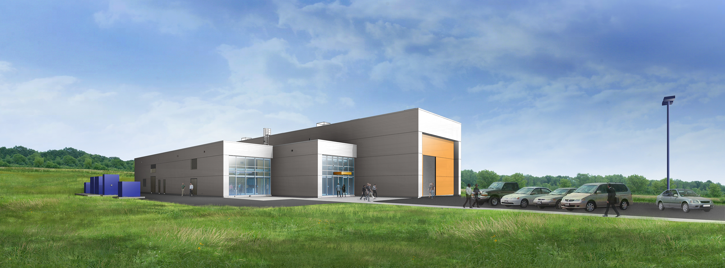
Design - Mu2e Conventional Facilities
Grade Level Plan
Lower Level Plan

Slide 9
Design- Mu2e Conventional Facilities
Roof
2- 30 Ton Overhead Bridge Cranes
Crane Runway
Solenoid Power Supply Room
DAQ Room
Mech. & Elec. Room
PS Hatch
Toilets and Planning Room
Entry
Remote Handling Hatch
Grade Level
TS Hatch
Truck Bay
DS Hatch
PS
DS
TS
Extinction Monitor Enclosure
Primary Beam Absorber
Remote Handling
Lower Level
Detector Support Area
8 GeV Beamline Enclosure
Exit Stair

Slide 10
Improvements since CD-1
Requirements and the interfaces between the Conventional and other subprojects have matured.
Received final beam lattice; Solenoid installation and support requirements defined; Cooling and power loads are well established.
Physical space requirements analyzed and adjusted for each phase of technical equipment installation and operation.
Project Manager has put the Conventional Construction under change control.
Independent Cost Estimate (ICE) completed, .4% delta on work to go.
A&E selected, final contract drawings developed, issued for RFP, proposals received and evaluated; contracts drafted and are under review.

Slide 11
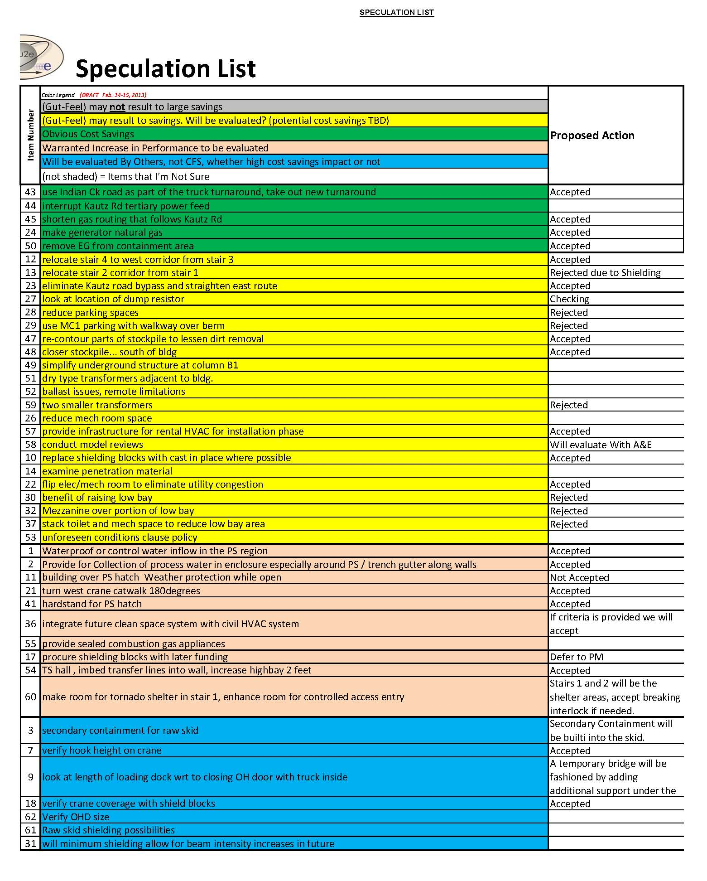
Value Engineering since CD-1
Held Feb 14th and 15^{th,} 2014
Based on U.S. Army Corp of Engineers Methodology
20 participants including the A&E discipline leads.
Speculation list contained 62 items; 20 have been accepted.
Items with major value impact
Eliminated Kautz Rd bypass
Reduced number of stairs tower
Increased crane hook height

Slide 12
Performance
High Performance Sustainable Building Compliance; DOE Guiding Principles.
Meet all applicable building codes and material standards.
Meet Fermilab Design Standards.
Addendum A / Exhibit A defines the sub-contractor’s performance expectation for ES&H, Quality, training, communication, schedule and acceptance.
The Technical Specifications define the performance requirements for each material and product incorporated into the design.

Slide 13
Organization
475.3
Conventional Construction
T. Lackowski (FNAL)
475.03.04 Construction
T. Lackowski*
CAM – T. Lackowski
475.03.01 Conceptual Design
T. Lackowski *
CAM – T. Lackowski
475.03.02 Preliminary/ Final Design
T. Lackowski *
CAM – T. Lackowski
475.03.04.01
Mu2e Conventional Facilities
475.03.04.02
Delivery Ring Upgrade
475.03.03 Construction Phase Oversight
T. Lackowski *
CAM – T. Lackowski
475.03.04.03
Procured Items
475.03.05 Project Close
T. Lackowski *
CAM – T. Lackowski
475.03.04.04 Absorber Fabrication
L3 / CAM – R. Coleman
* Project Team
Design Coordinator – R. Jedziniak; Civil – C. Federowicz;
Architectural – Steve Dixon; Structural – T. Lackowski;
Mechanical - E. Huedem; Electical – R. Wielgos;
Construction Coordinator. - R. Foutch; Construction Safety Consultant – Environmental Resource Management
Consulting A&E - Middough Inc.; Consulting Life Safety Eng.- AON; Commissioning - Primera
475.03.04.05 Building Controls
L3 / CAM – B. Drendel

Slide 14
Quality Assurance
Quality Assurance Program for the Mu2e Project, Mu2e Doc 677.
FNAL Engineering Manual
FESS Engineering Policies and Procedures
FESS Engineering Design Guides
FESS Engineering Cad Standards Manual
Document Review Procedures
AE Handbook
Addendum A and Exhibit A define requirements for Subcontractor’s QC program.
Middough Inc. Quality Control Plan
Technical specifications define quality of installed products.
Construction Coordinator is the first line of QA during Construction.
L2 / Construction Manager has overall responsibility for QA.

Slide 15
ES&H
Construction safety expectations are communicated in the Exhibit A.
flows down the essence of the applicable chapters of FESHM.
requires conformance to OSHA 1926.
requires Hazard Analysis approach.
The Addendum to Exhibit A
Defines subcontractor’s oversight requirements.
On site Project Manager, Site Superintendent and Safety Representative.
Requires the corporate safety person be involved during preparatory meetings, make bi-monthly walk through and assist in any investigations.
Defines Fermilab specific training requirements.
Fermilab will use a consultant ES&H professional to augment its Construction Coordinator.

Slide 16
ES&H
NEPA approved, and CX issued at beginning of CD-1.
Mu2e is included in the Muon Campus IEPA SWPPP, approved.
Domestic Water Permit to Construct is approved, Application for Operating Permit will be completed prior to placing new piping into service.
Sanitary Sewer Permit is not required.
The project’s goal is to have a safe work place with zero incidences. This will be achieved by aggressive compliance to the existing, robust, integrated safety management (ISM) systems for construction that exist at Fermilab.

Slide 17
Risks
Project level risks; One opportunity and three threats risks have been mitigated.
The two construction cost risks have been retired or accepted with receipt of proposals.
“Significant injury or death associated with Mu2e construction/assembly” transferred to Project Manager; but Conventional Construction maintains a significant ownership in this risk.
Need for a parallel electrical feeder from Master Sub Station to campus, transferred to Muon Campus.
Of the 35 lower level subproject risks;
14 are Accepted
17 have been retired
4 transferred

Slide 18
Cost Table
 | Base Cost (AY K$)
 | M&S | Labor | Total | Estimate Uncertainty (on remaining budget) | % Contingency on (on remaining budget) | Total Cost
475.03.01 Conv.Constr. Conceptual Design | 221 | 316 | 537 |  | 100% | 537
475.03.02 Conv.Constr. Preliminary/Final Design | 1,413 | 842 | 2,255 | 114 | 76% | 2,370
475.03.03 Conv.Constr. Construction Phase Oversight | 517 | 1,968 | 2,485 | 505 | 20% | 2,990
475.03.04 Construction | 15,369 | 232 | 15,600 | 2,769 | 18% | 18,369
475.03.05 Conv.Constr. Project Close | 156 | 212 | 367 | 73 | 20% | 441
475.03.99 Risk Based Contingency |  |  |  | -637 | - | -637
Grand Total | 17,675 | 3,570 | 21,245 | 2,825 | 15% | 24,070

Slide 19
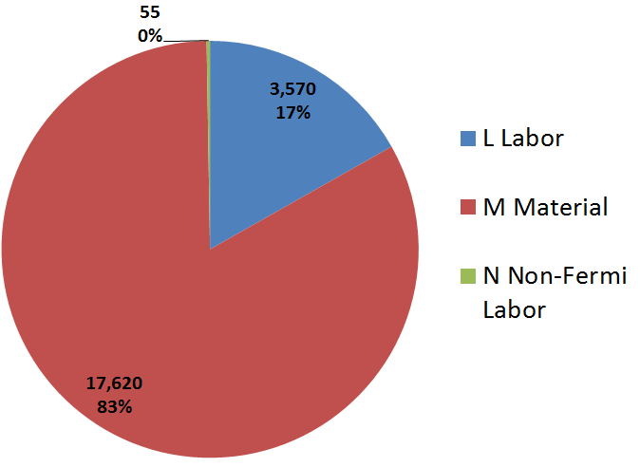
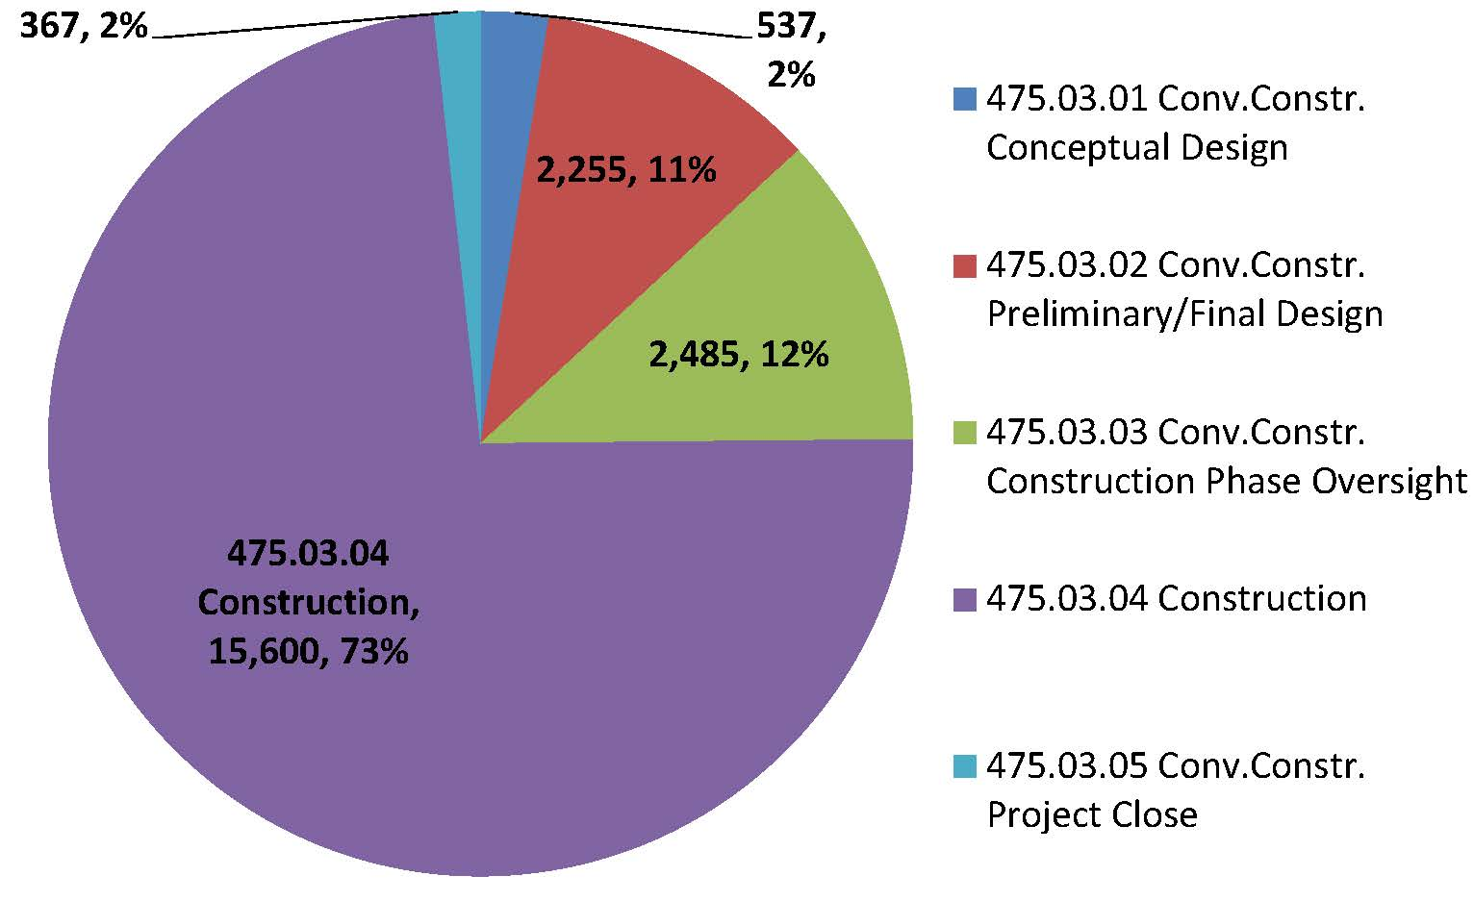
Cost Breakdown
Resource Type AY K$

Slide 20
Quality of Estimate
AY K$

Slide 21
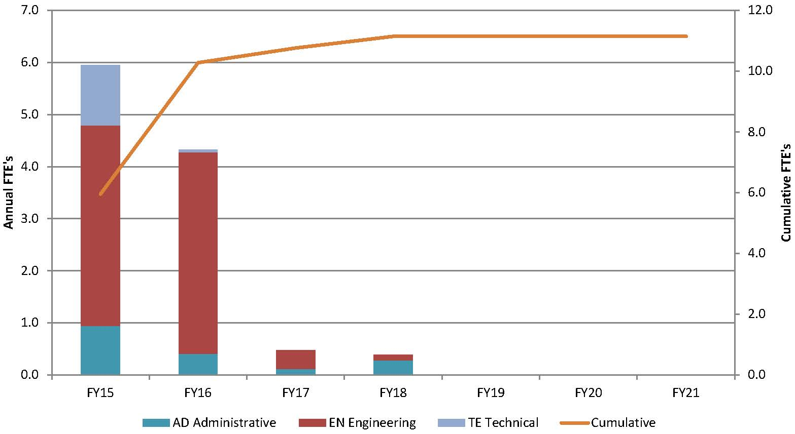
Labor Resources by FY
FESS Engineering provides the Construction Management and Coordination with in-house personnel.

Slide 22
Labor and M&S by FY

Slide 23
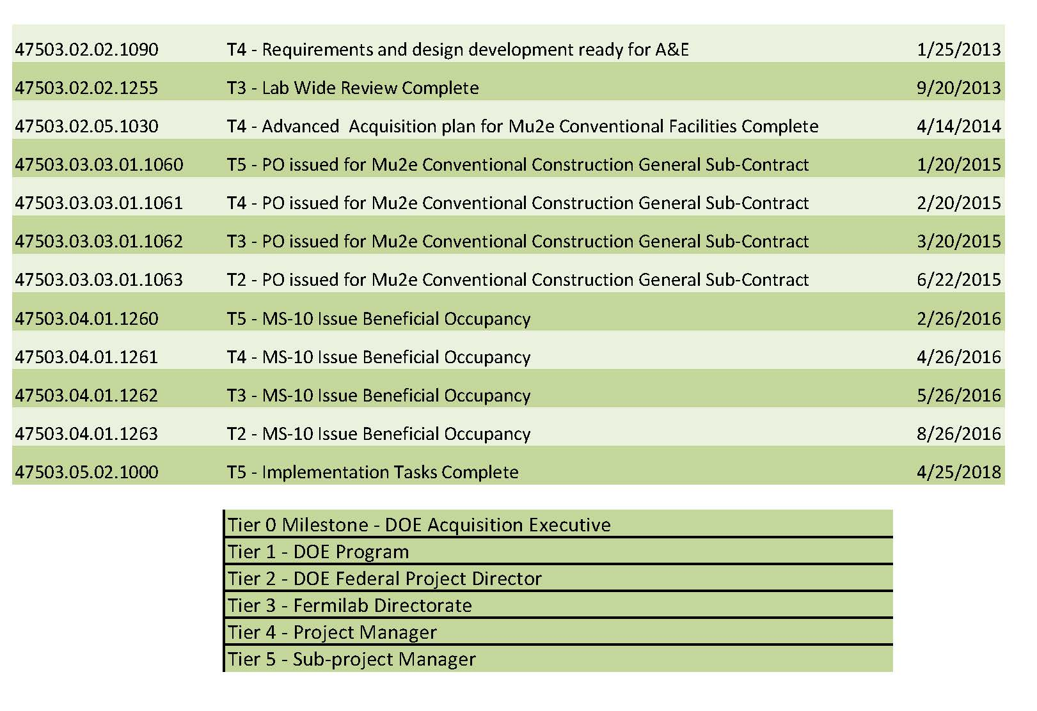
Major Milestones

Slide 24
Schedule
CD-3a
CD-3c
CD-2/3b
CD-4
Fabricate and QA Superconductor
KPPs Satisfied
Solenoid Design/Prototypes
Solenoid Fabrication and QA
Solenoid Infrastructure
Delivery Ring Upgrades
Mu2e Conventional Facilities
Procure Concrete Shield Blocks
Notice to Proceed
Base Slab Complete
Solenoid Installation and Commissioning
Concrete Complete to Grade
Building Weather Tight
Beneficial Occupancy
Detector Prototypes and Construction
Cosmic Ray System Test
Accelerator Commissioning (off Project)
Accelerator and Beamline Construction
Q3 | Q4 | Q1 | Q2 | Q3 | Q4 | Q1 | Q2 | Q3 | Q4 | Q1 | Q2 | Q3 | Q4 | Q1 | Q2 | Q3 | Q4 | Q1 | Q2 | Q3 | Q4 | Q1 | Q2 | Q3 | Q4 | Q1 | Q2 | Q3 | Q4 | Q1 | Q2 | Q3 | Q4
FY14 FY15 FY16 FY17 FY18 FY19 FY20 FY21

Slide 25
Summary
We have a final design that fully satisfies the requirements.
Costs, scope, and schedule through CD-4 are understood.
ICE was within .4% of engineers estimate for remaining work.
The Mu2e Conventional Facilities subcontract has proposals in hand at 4% below engineers estimate.
The remaining construction packages have substantially complete contract documents.
Interfaces are identified and defined.
Resource needs understood and individuals identified.
ES&H embedded into all aspects of the Project.
Responded to all recommendations from previous reviews.
Conventional Construction is ready for CD-2 and CD-3b.

