Slide 1
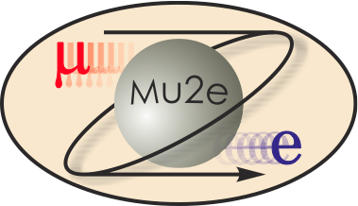

CD-2 Review: Mu2e Calorimeter
Stefano Miscetti
LNF INFN, Italy
Calorimeter L2 Manager
10/21/2014

Slide 2
Calorimeter Team leaders
Stefano Miscetti - L2 Manager, LNF
  10 years experience in operating the CDF Hadron calorimeter
  20+ years experience in construction and operation of KLOE calorimeter. KLOE-2 Technical Manager 2006-2013 → Experience in crystal calorimeters.
  L2 manager of Mu2e calorimeter since 2009.
David Hitlin – Deputy L2 Manager, Caltech
  40+ years experience in calorimetry. Responsible for design and construction of Liquid Argon calorimeter for Mark-II and SLD and BaBar crystal calorimeter.
  Spokeperson of E92, MarkII, MarkIII and BaBar experiments.
  L2 deputy of Mu2e calorimeter since 2011.
Ren Yuan Zhu – Crystal expert, Caltech
  30+ years experience in crystal testing, crystal calorimetry and calibration.
  Worldwide recognized as crystal and calorimeter expert (PDG).
  Responsible of crystal laboratory of Caltech.

Slide 3



Calorimeter Team Organization
475.7
Calorimeter
L2: S. Miscetti (LNF)
Deputy: D. Hitlin (Caltech)
475.7.1 Project Management
L3 – S. Miscetti – (LNF)
CAM – D. Hitlin
475.7.2 Crystals
L3 – D. Hitlin (Caltech)
CAM - D. Hitlin
475.7.3 Mechanics
L3 – F. Happacher (LNF)
475.7.4 Photosensors
L3 – I. Sarra (LNF)
CAM – D. Hitlin
475.7.5 Digitizer
L3 – F. Spinella (Pisa)
CAM – D. Hitlin
475.7.6 Calibration
L3 – F. Porter (Caltech)
CAM – D. Hitlin
475.7.7 Frontend electronics and power
L3 – G. Corradi (LNF)
475.7.8 Assembly and Installation
L3 – A. Saputi (LNF)
CAM – D. Hitlin
MoU agreement in progress between INFN and JINR.
DOE/INFN sharing proposed

Slide 4
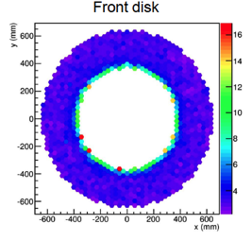
Requirements
The calorimeter requirements are described in DOCDB-864
The calorimeter, EMC, should:
Provide information that, in combination with information from the tracker, can distinguish electrons from muons and pions;
Provide a clean, independent, software trigger, based on energy deposition;
Have large acceptance for signal electrons;
Provide a “seed" to improve track pattern recognition.
Function in the unique mu2e environment:
Sustain a Ionization Dose of < 12 krad/year per crystal
and a fluence of ≈10¹² n/cm²/year
Work in a B field of 1 Tesla
Work in a high rate environment
(from 5-12% occupancy @ 1 MeV threshold)

Slide 5
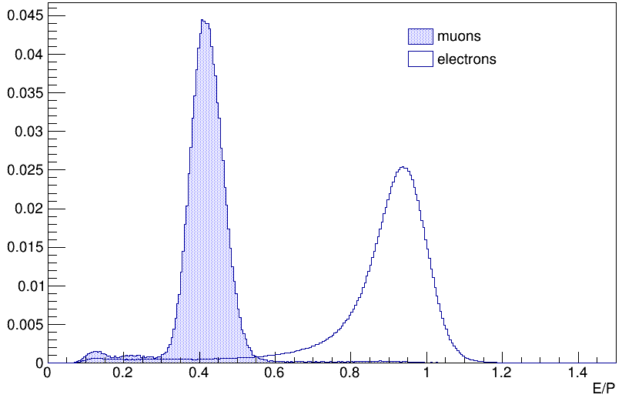
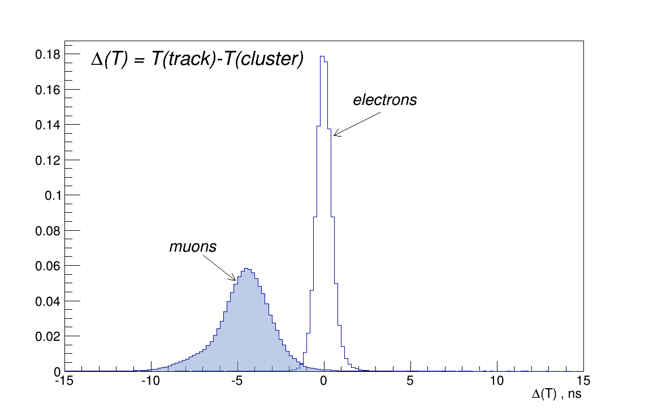
Requirements.1 – PID mu/e
Simulation shows that, after
full Track Selection 1 muon that cannot be vetoed by the CRV is reconstructed as a CE.
Need to keep the background
of these muons faking electrons negligible (below 0.01 events)
→ muon rejection of 200 while keeping highest possible efficiency
Rejection/efficiency evaluated with a log-likelihood based on Eclu/P and ΔT = T_{trk}-T_{clu}.
Toy MC adds gaussian spread on calorimeter energy and timing response
→ Energy res. 5% and time res. < 500 ps look as a reasonable choice.

Slide 6
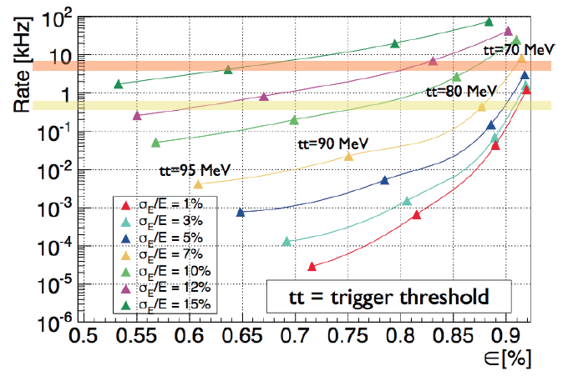
Requirements.2 – trigger
Fast and track-independent
HLT selection based on EMC
cluster reconstruction.
Reduce storage rate to 2 kHz (5 PB/year) .
Toy MC suggests a
calorimeter with < 7%
energy resolution.
These constraints translate to calorimeter specifications of:
98% acceptance for CE tracks, O(5%) energy resolution
O(1 cm) position resolution and a time resolution < 0.5 ns.

Slide 7
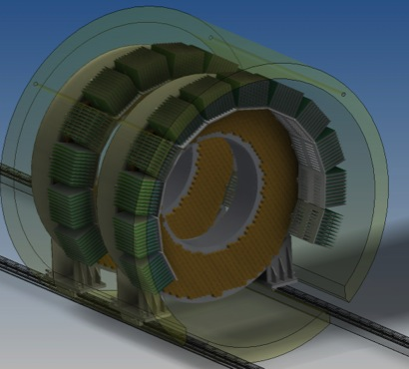
Calorimeter Layout
The Calorimeter consists of two disks with 1650 BaF₂ hexagonal crystals:
R_{inner} = 351 mm, R_{outer}=660 mm, depth = 10 X₀ (200 mm)
The distance between disks is optimized at ½ wavelength ( 70 cm)
Each crystal is readout by two
large area APD’s (9x9 mm²) (3300 total)
Analog FEE and digitial electronics are located in near-by electronics crates
Radioactive source and laser systems provide absolute calibration as well as fast and reliable monitoring capability

Slide 8
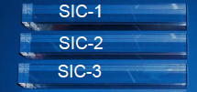
475.07.02: crystals
Barium Fluoride (BaF₂)
Radiation hard, non-hygroscopic
very fast (220 nm) scintillating light
Larger slow component at 300 nm. should be suppress for high rate capability
Photo-sensor should have extended UV sensitivity and be “solar”-blind
Crystal dimension: hexagonal faces of 33 mm across flats, 200 mm length (10 X₀)
 | BaF₂
Density (g/cm³) | 4.89
Radiation length (cm) | 2.03
Moliere Radius (cm) | 3.10
Interaction length (cm) | 30.7
dE/dX (MeV/cm) | 6.52
Refractive index | 1.50
Peak luminescence (nm) | 220 (300)
Decay time (ns) | 1 (650)
Light yield (rel. to NaI) | 5% (42%)
Variation with temperature | 0.1% (-1.29)% / °C
Breakout talk: R.Y.Zhu

Slide 9
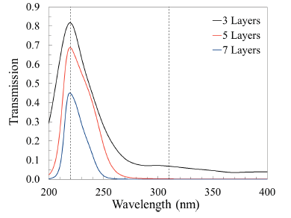
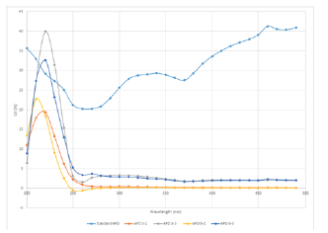
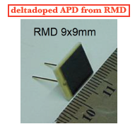
475.07.04: photo-sensors
A Caltech/JPL/RMD consortium has been formed to develop a Large area RMD APD into a delta-doped super-lattice APD with high Q.E. @ 220 nm incorporating also an Atomic Layer Deposition antireflection filter to reduce efficiency for wavelength > 300 nm.
Tests on few prototypes with ALD applied proved that “solar” blindness works
60% QE @ 220 nm
~ 0.1 % QE @ 300 nm
capacitance ~ 60 pF
(1/5 of Ham S8664)
HV ~ 1800 V
Operation Gain ~ 500
Decay time ~ 25 ns.
Breakout talk:
D.Hitlin

Slide 10
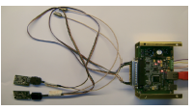
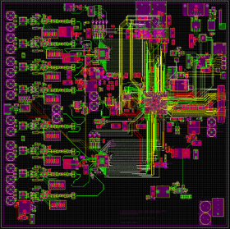
Calorimeter FEE & Readout
FEE is a discrete chips connected to the photo-sensor: V preamp & Local V-bias regulator.
16 FEE channels driven by an ARM-controller to generate/distribute Vbias, Low Voltages
50 FEE channels and 5 ARM controllers produced by INFN- Frascati for test beam array.
New development in progress to adapt this
FEE to the BaF₂ crystals.
Digitizer board with 32 channels
12 bit resolution, 200 msps, Smart Fusion-2 FPGA.
5 prototypes 8 channels under
construction at University of Illinois
Design of final digitizer under
way as a joint project between
INFN Pisa and University of Illinois.
Breakout talks:
G.Corradi/G.Pezzullo

Slide 11
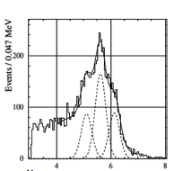
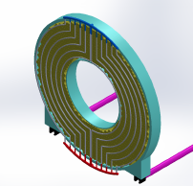
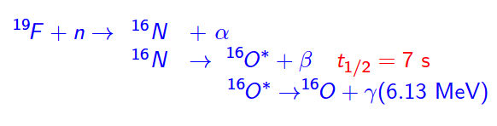
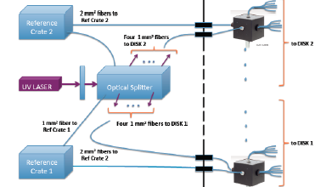
475.07.06 Calibration system
Based on BABAR scheme & salvage of
their components
Neutrons from a Deuterium-Tritium (DT) generator adjacent to the Detector irradiate a fluorine rich fluid (Fluorinert).
The activated liquid is piped to the front face of the disks.
Few per mil energy scale in
few minutes. Linearity.
Final experiment scale (E/P) is set using DIO’s.
E_{γ} (MeV)
Laser system adapted from CMS calibration system.
UV light to monitor continuously the variation of
the photosensor gain (in-kind INFN)
Breakout talk:
F.Porter

Slide 12
Improvements since CD-1
Two significant improvements happened since CD-1:
Geometry has been modified from Vanes to Disks
→ (+) Larger acceptance
→ (+) Identical response and acceptance for electrons and positrons
→ (+) Easier mechanics
→ (-) More background on the crystals
→ (+) Better shielding for photo-sensors
Baseline crystal has been changed from LYSO to BaF₂
→ (+) BaF₂ Is less expensive than LYSO (its cost increases x 2.5 since CD-1) but it still matches requirements.
→ (+) The BaF₂ is faster, it could be used for Mu2e-II sustaining a x10
increase in the rate.

Slide 13
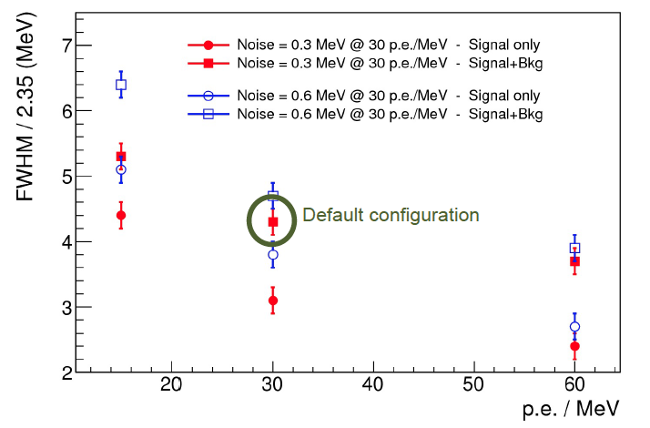
Performance: Energy resolution
Breakout talk:
B.Echenard
L.Y.=30 pe/MeV from crystal measurement with PMT scaled by APD area and Q.E (1.3%)
Electronics noise of 300 keV by scaling down measurement for LYSO and RMD/
Hamamatsu APD properties → adds another relevant term to the resolution (1.3%).
2% leakage and albedo
Pileup contributes additional 3 % to the total resolution.

Slide 14
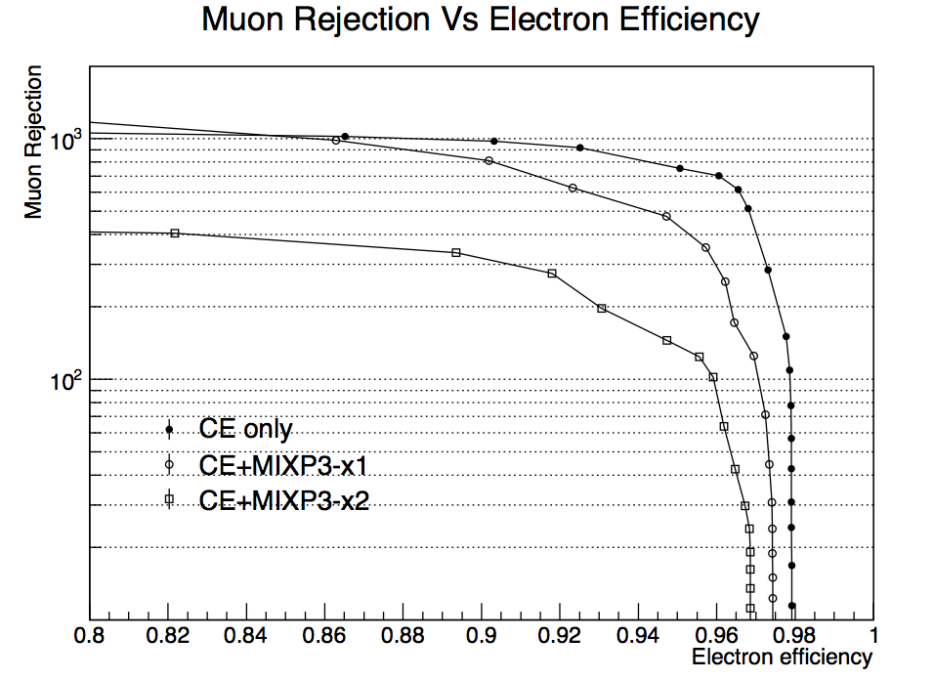
Performance: PID (muon vs electrons)
Full simulation with
pileup background included.
Pre-selection based
on track to cluster matching (space & time).
PID is based on LogLikelihood with E/P and ΔT
Signal only
Signal X 1 accidental occupancy
Signal x 2 accidental occupancy
For a muon rejection of 200 → Electron ID efficiency is 98%
Adding pre-selection cuts → Total PID efficiency is > 93%
with twice the exp. background

Slide 15
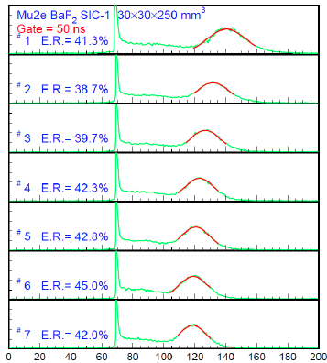
Quality Assurance
QA stations for crystals and photo-sensors exist in INFN and Caltech.
Crystal stations are being modified to adapt to the BaF₂ deep UV emission. Feedback with vendor ensure meeting specifications.
Test longitudinal transmittance, light yield
response to a ²²Na source and measurement
of longitudinal uniformity for all crystals
Measurement of gain, I-leakage and
their dependence on Vbias for each photo-sensor;
Bench test planned for the FEE
and Digitizer systems.
Burn in test for HV system

Slide 16
Integration and Interfaces
The Calorimeter has external interfaces to the Muon Beamline, Conventional Construction, DAQ and the tracking system.
Internal interfaces between mechanics and crystals, FEE and calibration systems …
Internal and external interfaces identified and described in Calorimeter Interface document, available on Review site (docdb # 2195).
Participation in bi-weekly integration meetings.
Formal sign-off between owners of all external interfaces as part of final design requirements.
Interfaces understood and under control.

Slide 17
Risks
3 Calorimeter risks in risk registry
  All risks mitigated to the extent possible
  3 threats
    2 high
    1 low
    0 retired risks
Detailed mitigation plans for all risks, documented in risk forms on docdb and linked from Risk Register (docdb 4320)
All risks understood and under control.
Details in breakout session.

Slide 18
ES&H
Calorimeter has standard detector related issues that are common at Fermilab
  Electrical hazards from both High and Low voltage.
  Mechanical hazards (calorimeter is heavy)
  Toxic materials
    Epoxy may be used to assemble calorimeter (attach APDs).
  Activated Fluorinert with a neutron generator used as Source system.
    Operation of the source in a remote control in a no access condition
    Shielding and interlock the neutron generator
    Compute the maximum exposure in case of a fluid leak
    Used in BaBar @ SLAC.
  Lasers used as part of a flasher system.
    Laser will be enclosed.
These hazards are discussed in the Mu2 Hazard Analysis document
(Mu2e-doc-675).

Slide 19
Calorimeter DOE Cost Table
 | Base Cost (AY K$)
 | M&S | Labor | Total | Estimate Uncertainty (on remaining budget) | % Contingency on (on remaining budget) | Total Cost
475.07 Calorimeter
475.07.01 Calorimeter Project Management | 262 | 7 | 269 | 31 | 21% | 300
475.07.02 Crystals | 2.557 | 54 | 2.612 | 433 | 17% | 3.045
475.07.03 Mechanical Support | 162 |  | 162 | 32 | 20% | 195
475.07.04 Photosensors | 748 |  | 748 | 302 | 47% | 1.050
475.07.05 Digitizer and Front End Electronics | 108 |  | 108 |  | 0% | 108
475.07.06 Calibration Systems | 660 | 58 | 718 | 206 | 37% | 923
475.07.07 Calorimeter Power |  | 4 | 4 | 1 | 30% | 5
475.07.08 Calorimeter Installation | 47 | 260 | 308 | 108 | 35% | 416
475.07.99 Risk Based Contingency |  |  |  | 51 | - | 51
Grand Total | 4.544 | 383 | 4.928 | 1.164 | 26% | 6.092
It assumes INFN pays 1/3 of Crystals, ½ of Photosensors and provide
In-kind the Laser system, the mechanics, and all FEE/Digitizer electronics

Slide 20
DOE Calorimeter Cost Breakdown
BASE COST in AY$K

Slide 21
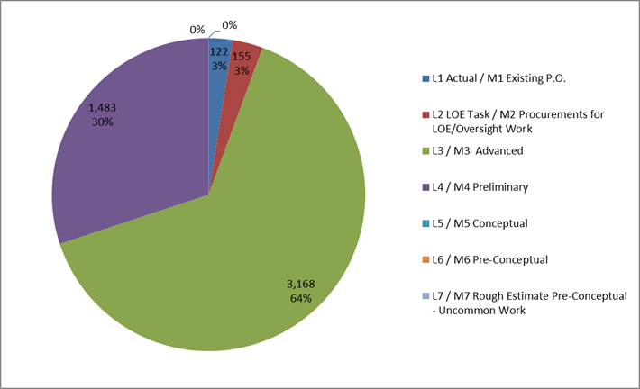
Quality of Estimate
Sum of Value
Estimate Type | Total
L1 Actual / M1 Existing P.O. | 122
L2 LOE Task | 155
L3 / M3 Advanced | 3.168
L4 / M4 Preliminary | 1.483
100% of estimate
are at, or better than,
the preliminary level

Slide 22
DOE Labor Resources by FY
Labor peaks in 2015 to get final design and pre-production ready
Second labor peak in 2018 due to QC and assembly

Slide 23
Major Calorimeter Milestones
47507.2.001783 Technology choice for crystals/photosensors 4 May 2015
47507.5.001401 INFN delivers final FEE design 22 Oct. 2015
47507.2.001980 DOE Reviews production crystal contract 9 Jun. 2016
47507.2.011986 PO issued for production crystals 3 Jan. 2017
47507.4.000700 PO issued for production photo-sensors 29 Mar. 2017
47507.6.001510 PO issued for source system material 4 Aug. 2017
47507.4.000790 QC of all photo-sensors complete 10 Aug. 2018
47507.5.001522 INFN delivers FEE electronics 23 May 2018
47507.2.092161 Survey of production crystals complete 13 Mar 2019
47507.8.002410 Ready for cosmic ray system test 28 May 2020

Slide 24
Calorimeter schedule
CD-1
CD-2
TC
CD3
KPP4
Preliminary Design
Final Design
Production
Installation
Crystal/APD QC stations design
QC Station + test of first crystals
Pre
Prod
Crys
Fabrication of all Crystals
test beam
Proto Modules
QC all Crystals
Pre
Prod
APDs
Fabrication of all APDs
QC Station + test of first APD
QC all APDs
Disk Assembly
CRT
Design/assembly proto
Preliminary
Design
Final Mech. drawings
Support for Crystals and FEE Disk1
Support for Crystals and FEE Disk2
FEE/HV design prototypes
Adapt to new photosensor
FEE
DIGI
final design
FEE/LV/HV
Preprod
FEE/LV/HV
production
WF Digi design prototypes
WF Digi preprod
WF Digi
production
Design
proto Source
Assembly
proto Source
Calibration source
final design
Assembly final source
Design+assembly proto LASER
Final Design LASER
Assembly ffinal flasher
FY12 FY13 FY14 FY15 FY16 FY17 FY18 FY19 FY20

Slide 25
Summary
The Calorimeter has a Baseline design ( BaF₂ crystals in disk geometry readout with “solar-blind” APDs) that fully satisfies requirements.
The Calorimeter cost estimates are completed:
→ 100 % of the cost understood at a preliminary design level or higher;
→ Risks are understood, mitigated to the extent possible and are under control;
Interfaces are identified and defined;
Resource needs understood. Responsibility are divided between US and Italian groups: discussions on INFN funding are well advanced.
ES&H embedded into all aspects of the Project;
Responded to all recommendations from previous reviews.
Calorimeter is ready for CD-2.

Slide 26
Additional Material

Slide 27
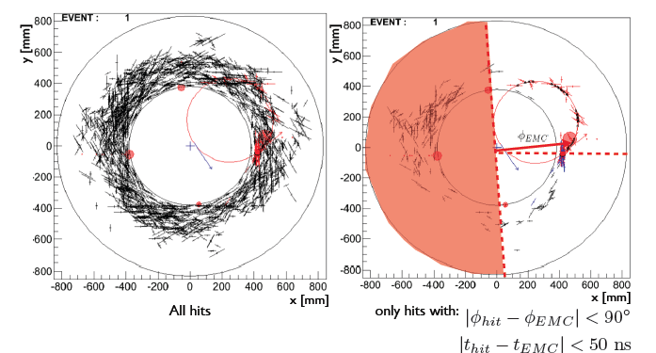
Requirements.2 – assisting the tracker
Pattern recognition of tracks improves when requiring “Straw” hits in time (50 ns window) and space connected with the most energetic cluster.
Calorimeter assisted tracking increases of +12% the overall signal reconstruction efficiency and provides stability as a function of background rate.

Slide 28
INFN Calorimeter proposed Scope
The INFN Mu2e group submitted to INFN CSN1 (National Scientific Committee 1: HEP experiments at particle accelerators) a proposal which envisages the commitment of the group to take responsibility for the following four items of the calorimeter project:
1) Design, procurement and assembly of the mechanical support
2) Design, procurement and assembly of the FEE
3) Design, procurement and assembly of the waveform digitizer
4) Design, procurement and assembly of the laser calibration system
In addition, the group also proposed to contribute on the core investment with a share of 50% of the photosensors and 1/3 of the crystals.
CSN1 expressed support to the first four commitments listed above
A decision on the investment level for crystals and photosensors is deferred, pending the outcome of the Technology Choice Review (TCR) for the calorimeter, currently scheduled for May 2015
The INFN financial commitment will be scrutinized by the INFN Technical-Scientific Committee (CTS) , whose review of the proposal should start on June 2015, after the Mu2e TCR, with an expected decision taken by October/November 2015 (in time for CD-3)

Slide 29
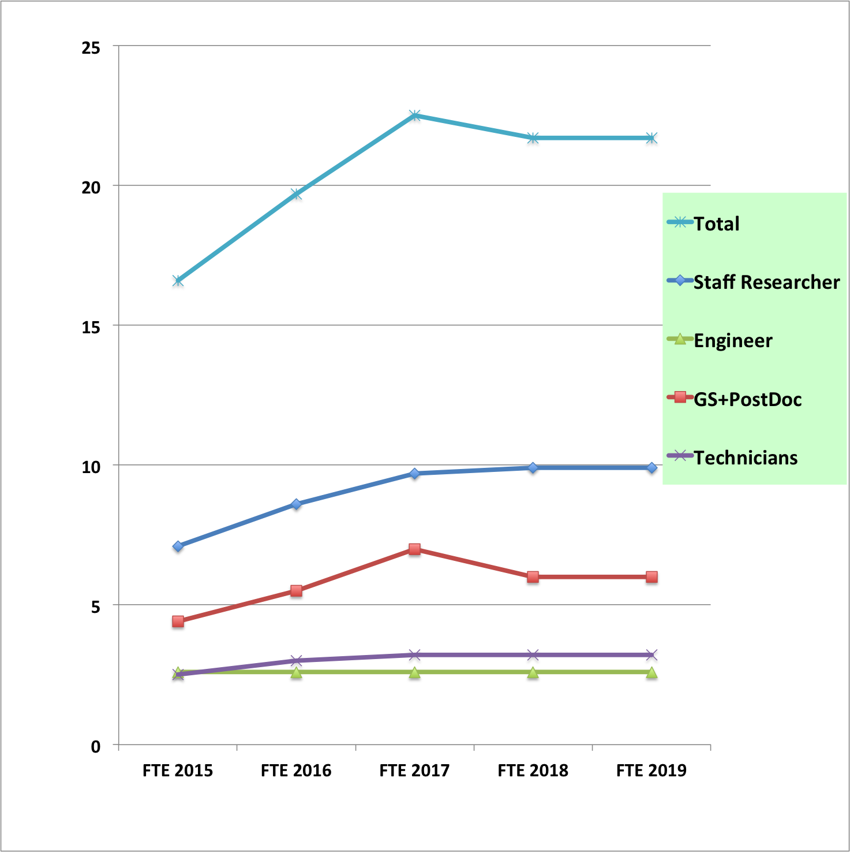
INFN expected Labor resources by year
INFN Mu2e group plans to contribute on labor for all the INFN supported items.
The group plans also to constribute to the installation.
The expected profile of INFN FTE vs year is shown in the attached figure.
Note: INFN FY starts on January 1st

Slide 30
Labor/Material spending profile

Slide 31
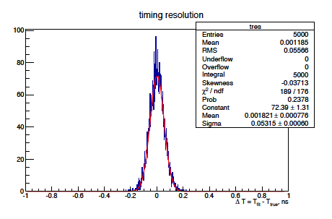
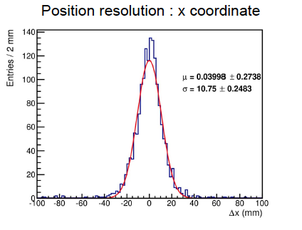
BaF₂ Performance: Timing & space resolution
Electronic noise contribution to T-Res
estimated by simulating & fitting the signal shape with noise → 50 ps.
Contribution of pulse shape stability
and trigger jitter expected to be small.
Shower time fluctuation < L/v_light
(1 ns/sqrt(12) ) should be < 280 ps.
Calorimeter Cluster centroid
(log weighted) at shower max.

Slide 32
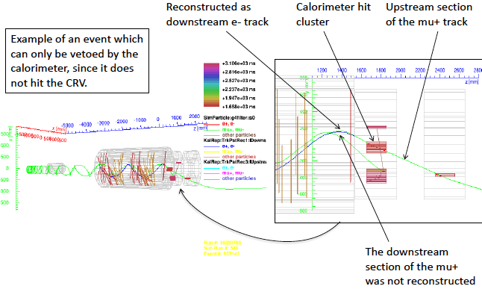
Requirements – PID
-- Simulation of CR events faking electrons carried out by the CRV group → 9 events Not Vetoed : (6 mu-, downstream) (3 mu+,upstream)
-- Applying the CutC selection → they correspond to 1.1 events

Slide 33
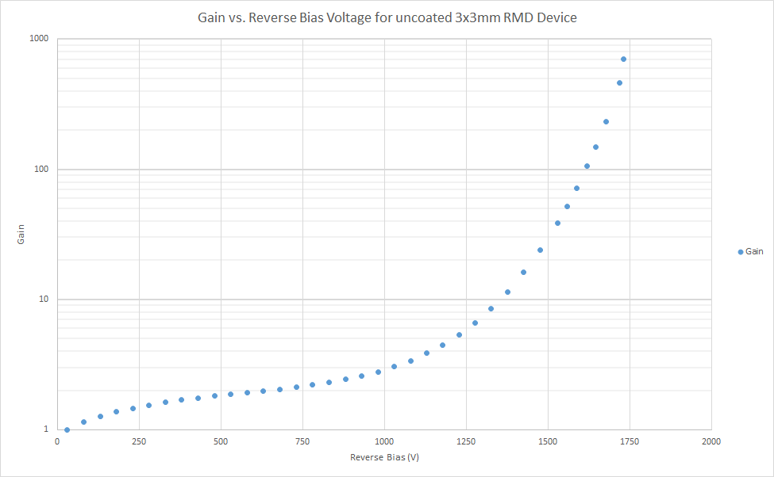
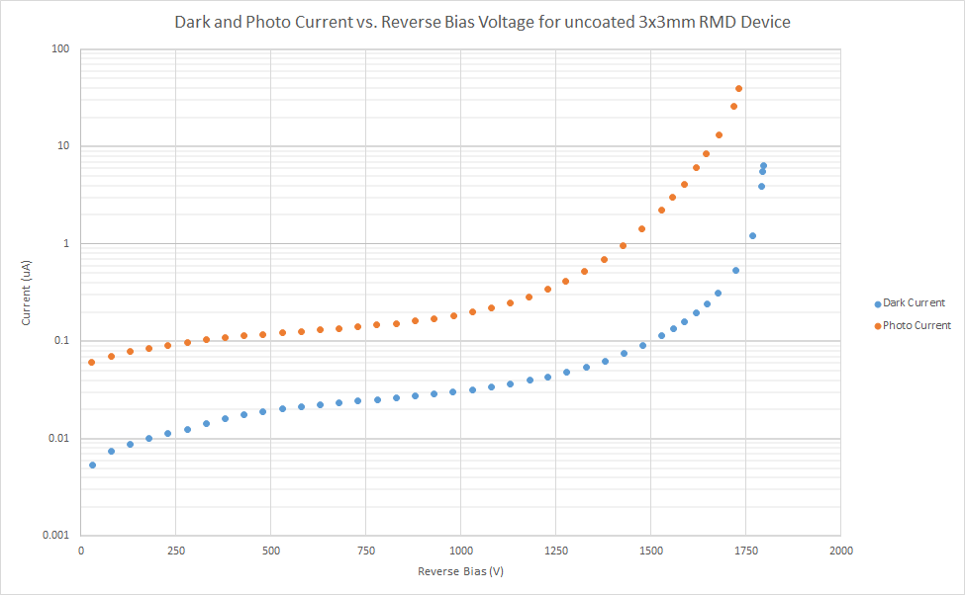
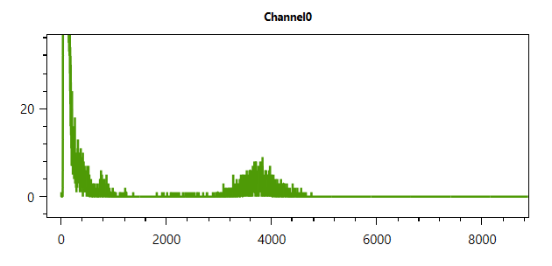
APD RMD/JPL Caltech status: 1 (3x3 mm²)

Slide 34
Remaining work before CD-3
BaF₂ crystals perform as expected (light yield with PMT ~ 100-160 pe/MeV), however RMD/JPL APD RMD to be produced to show matching their design specifications. First prototypes (3x3 mm²) give positive indications.
→ Modification of FEE to adapt to RMD/JPL APD under way.
To be completed for beginning 2015.
Internal Technology Choice review to be held middle 2015 to test
baseline option and compare with backup solution (pure CsI and MPPC).
Mockup of smaller size Disk to test mechanics and mounting scheme.
Adapt QA stations/Laser to final crystal and photo-sensors

Slide 35
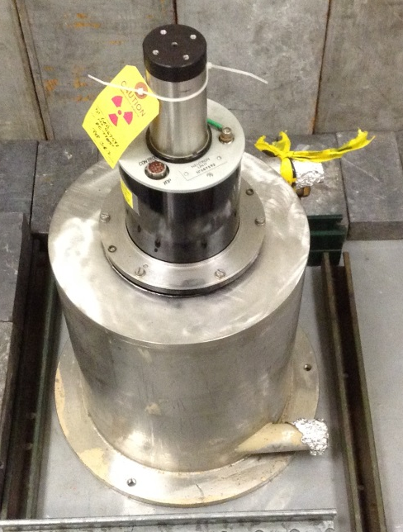
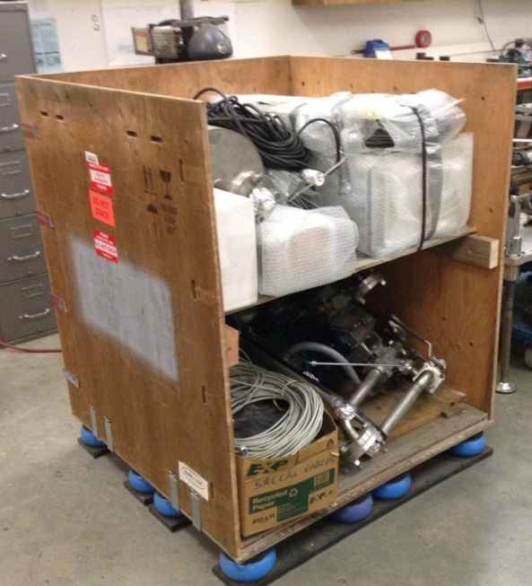
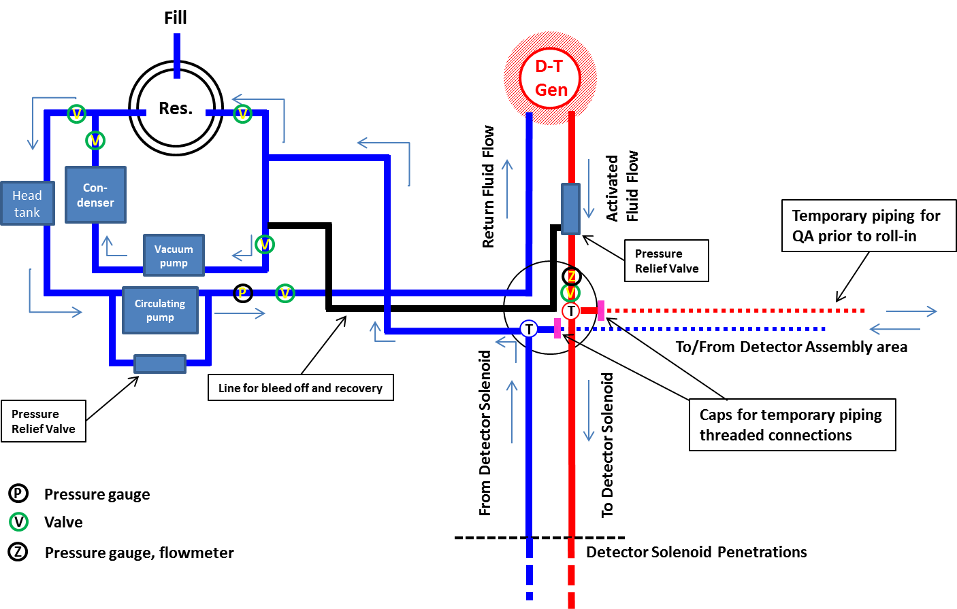
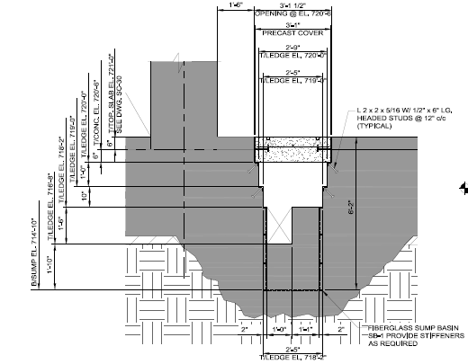
Mu2e Ecal Source Calibration
Ecal absolute energy calibration with a source of known-energy, known-path photons allows monitoring for changes in crystal gain and measurements of noise in energy units, along with an initial set of calorimeter gain settings prior to first beam
Mu2e Ecal source calibration system is based on a similar system salvaged from SLAC/BaBar
Salvage items were delivered to Caltech about two weeks ago for refurbishment and development into the system to be deployed at FNAL
Support for the source calib system has recently been integrated into the detector hall design and work begun to integrate with Ecal mechanics

Slide 36
Risks
CAL-108, INFN cannot deliver full in-kind scope
→ parallel path of approval being followed. Solid R&D contribution established.
→6th July 2014, CSN1 approved INFN participation in Mu2e, acknowledge strong
physics case and relevant contribution to the Detector.
CAL-148, Cannot develop UV-extended solid state photodetectors
that is blind to longer wavelengths
→ Active R&D being followed → Blindness have been proven
→ work on backup solution followed by INFN (CsI+MPPC)
CAL-170 , US/Russia relations could impact the purchase of the
calibration system DT generator in FY2017/2018
→ It is reasonable to expect that normal commercial relation
will be re-established on that time scale.
→ There is (a more expensive) US vendor.

