Slide 1
Mu2e CD-2 Review
Mark Bowden
TDAQ L2 Manager
10/21/2014

Slide 2
TDAQ Team
Mark Bowden – L2 Manager, L3 Manager (System Design & Test)
31 years
Kurt Biery – L3 Manager (Data Acquisition), Department Head - Scientific Computing Division, Real-time Systems Engineering
16 years
Ryan Rivera – L3 Manager (Data Processing, Controls & Networking), Group Leader - Real-time Systems Engineering, Detector Electronics
11 years
Greg Deuerling, Rick Kwarciany, Ron Rechenmacher, Mike Wang

Slide 3
Requirements
Requirements for the DAQ are described in mu2e-docdb 1150.
Collect and assemble data from the Tracker (~13 GBytes/sec) and Calorimeter (~8 GBytes/sec) for online analysis.
Provide online filtering to reduce data Tracker & Calorimeter data volume by ≥ 99%.
Combine with data from CRV, Extinction and Target Monitors for transfer to offline storage.

Slide 4
Requirements
Provide global timing synchronization
Provide fast and slow control networks
Provide connections to offline storage and site networking
Provide control room/operator interfaces

Slide 5
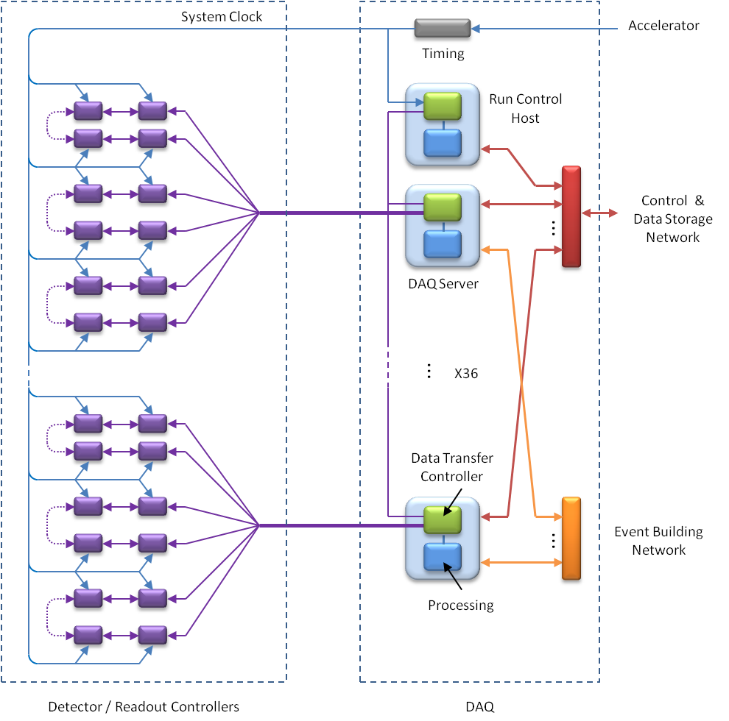
Design
architecture supports both streaming (Tracker, Calorimeter) and triggered (CRV) readout
DAQ Servers handle data readout, event building and processing
bidirectional front-end interface for fast control and readout
large front-end buffers for uniform data transfer
all commercial DAQ hardware
scalable… 1 GByte/sec per DAQ server

Slide 6
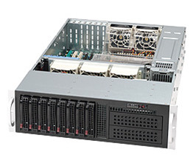
Design
Commercial (off-the-shelf) hardware
DAQ server
- 3U rack-mount computer
- integrated DAQ and online processing
Data Transfer Controller (DTC)
PCIe card with FPGA, memory,
and 8-port SFP+ optical interface
- 1 GByte/sec readout bandwidth
Event Building network
48 port 10G Ethernet switch

Slide 7
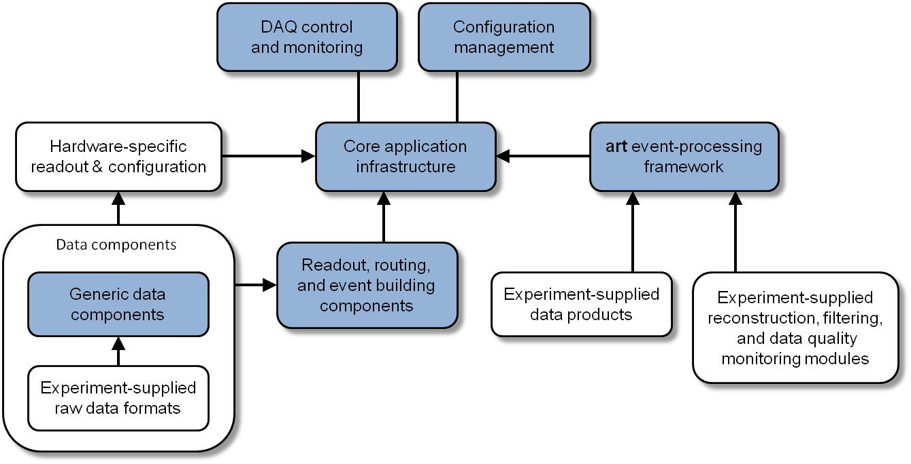
Design
Software based on art and artdaq
(a common DAQ & Online Processing framework developed for Mu2e and other current/future experiments)

Slide 8
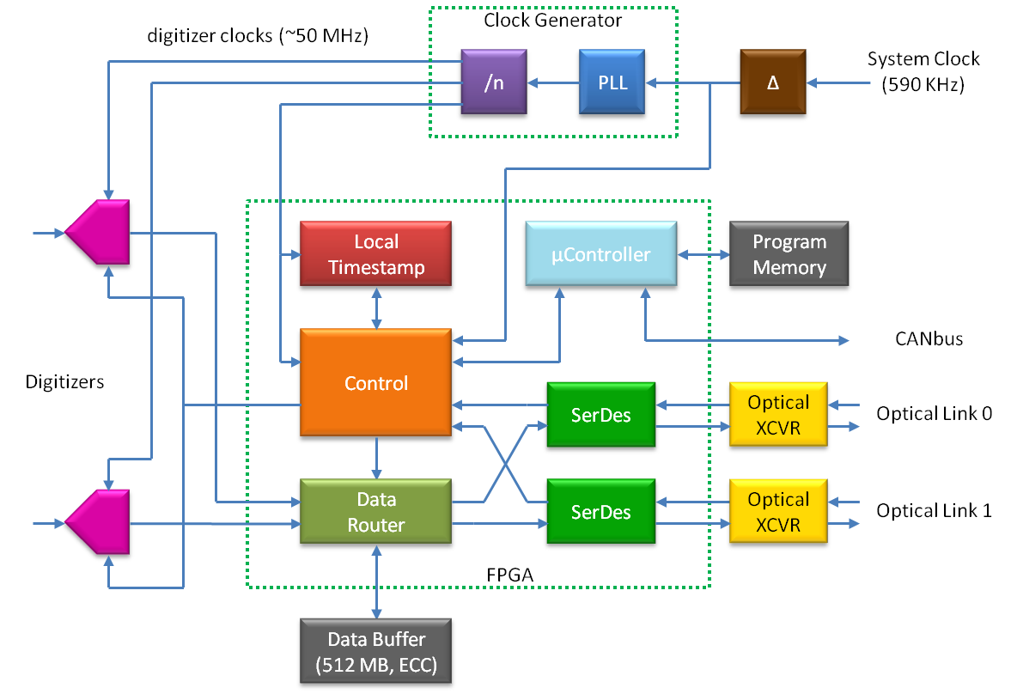
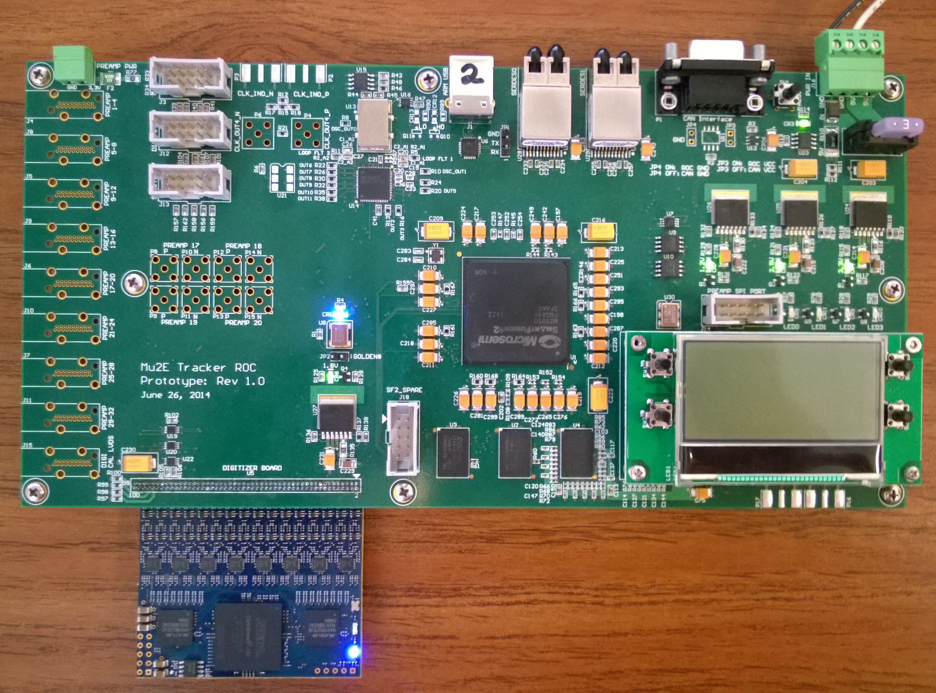
Design
Detector Readout Controllers
interface firmware & protocols
prototype development

Slide 9
Design
Several algorithmic and compiler optimizations were applied to the reference Tracking filter to achieve a speedup of almost 30X.
Optimization stage for MakeStereoHits | Compiler | Execution Time (ms)
 |  | Xeon (speedup) | Xeon Phi (speedup)
Reference | gcc 4.4.7 | 132 | -
Modified algorithm | gcc 4.4.7 | 6.67 (19.8x) | -
Modified algorithm | icc 14.0.1 | 2.04 (3.33x) | -
Additional optimizations | icc 14.0.1 | 1.88 (1.08x) | 30.4
Optimization stage for FlagBkgHits | Compiler | Execution Time (ms)
 |  | Xeon (speedup) | Xeon Phi (speedup)
Reference | gcc 4.4.7 | 14.2 | -
Reference | icc 14.0.1 | 8.03 (1.77x) | 123
Optimizations (mem align/layout) | icc 14.0.1 | 5.01 (1.60x) | 37.7 (3.26x)
Optimizations (single precision) | icc 14.0.1 | 3.37 (1.49x) | 24 (1.57x)
Note : Speedup factors in parentheses are relative to previous stage

Slide 10
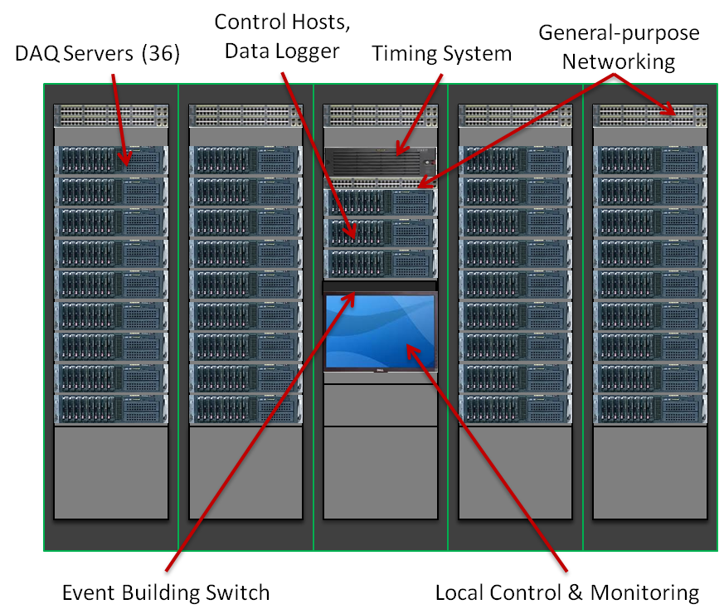
Design

Slide 11
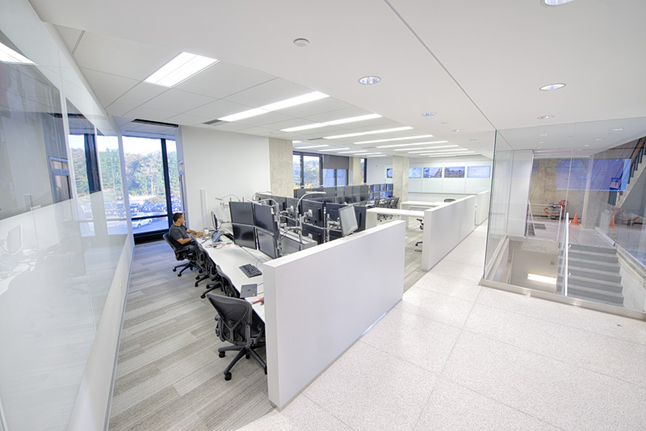
Design
Mu2e Remote Control Room - Wilson Hall, 1st floor West
(shared use - LBNF, MicroBooNE, MINERvA, MiniBooNE, MINOS, Muon g-2, Mu2e, NOvA)

Slide 12
Integration and Interfaces
DAQ has external interfaces to the Detectors (control/timing, data), Accelerator (timing), other subsystems (slow controls), and site networking.
Internal interfaces between servers, timing system and general-purpose networking.
Internal and external interfaces identified and described in DAQ Interface document (docdb #1520).
Participation in Electronics and Detector integration meetings.
Formal sign-off between owners of all external interfaces as part of final design requirements.
Interfaces understood and under control.

Slide 13
Improvements since CD-1
better data rate estimates due to improved background simulations
switch to a triggered CRV readout to accommodate higher background rates and lower thresholds (CRV data not needed for online analysis)
rejection rate reduced from 99.8% to 99.0% to allow independent Calorimeter filters

Slide 14
Value Engineering since CD-1
reduction in number of DAQ servers (48 → 36) to optimize front-end configuration, use higher performance servers

Slide 15
Performance
Tests have been performed on the primary DAQ interfaces -
digitizer to readout controller (LVDS), readout controller to data transfer controller (optical link), and data transfer controller to DAQ server (PCIe) to verify bandwidth requirements
Optimized version of the online Tracker filter meets processing requirement

Slide 16
Organizational Breakdown
475.9
Trigger & DAQ
M. Bowden (FNAL)
475.9.1 Project Management
L3 – M. Bowden
CAM – M. Bowden
475.9.3 Data Acquisition
L3 – K. Biery
CAM – K. Biery
475.9.2 System Design & Test
L3 – M. Bowden
CAM – M. Bowden
475.9.4 Data Processing
L3 – R. Rivera
CAM – R. Rivera
475.9.5 Controls & Networking
L3 – R. Rivera
CAM – R. Rivera

Slide 17
Quality Assurance
DAQ system can be tested to a high level of confidence using simulated data, prior to Cosmic Ray test
Full DAQ system is a scaled version of the Pilot system
In-situ testing - diagnostic features include monitoring of data link bit-error rate and optical power levels, memory and processor tests using large simulated data sets

Slide 18
Risks
7 DAQ risks in risk registry
All risks mitigated to the extent possible
3 threats
0 high
3 low / medium
4 opportunities
Detailed mitigation plans for all risks, documented in risk forms on docdb and linked from Risk Register (docdb #4320)
All risks understood and under control.
Details in breakout session.

Slide 19
ES&H
ES&H issues are minimal
High voltage (208 VAC, no exposed connections)
Class 1 lasers (eye safe)
no issues with radiation or magnetic field

Slide 20
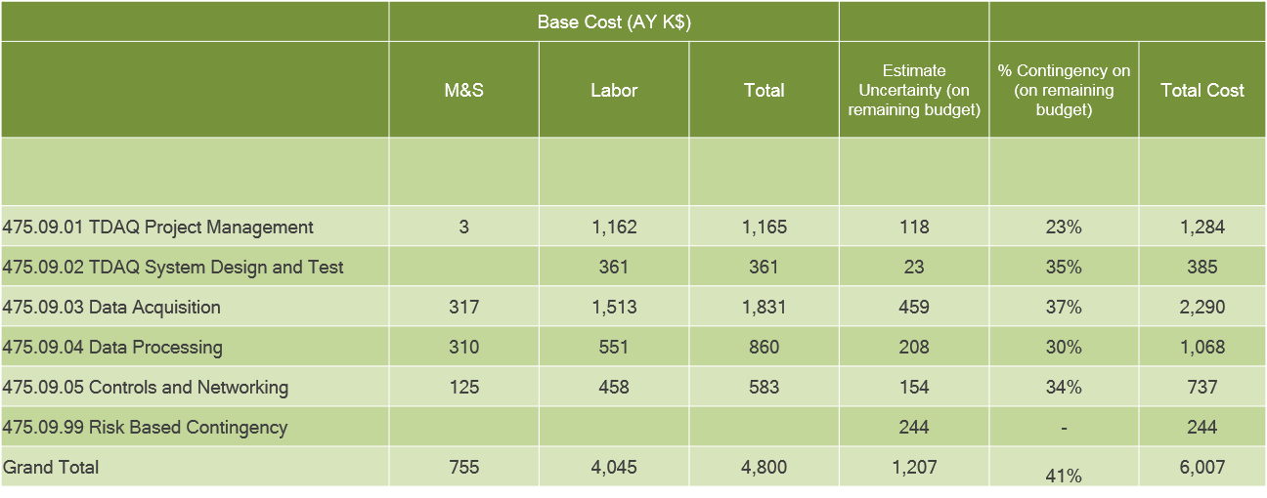
Cost Table
WBS 9 Trigger & DAQ
Costs are fully burdened in AY $k

Slide 21
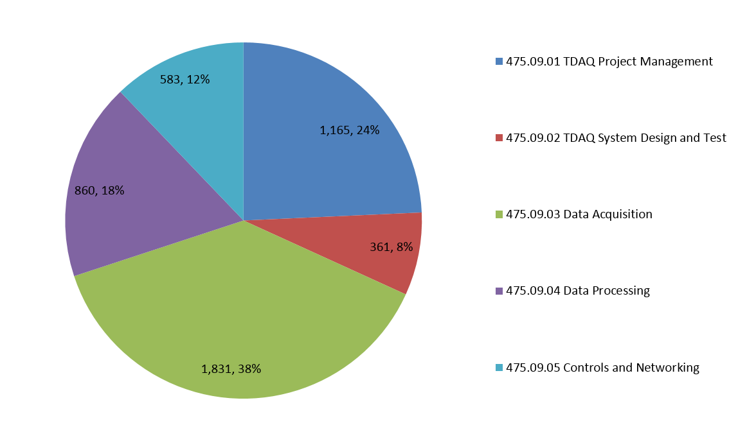
Cost Breakdown

Slide 22
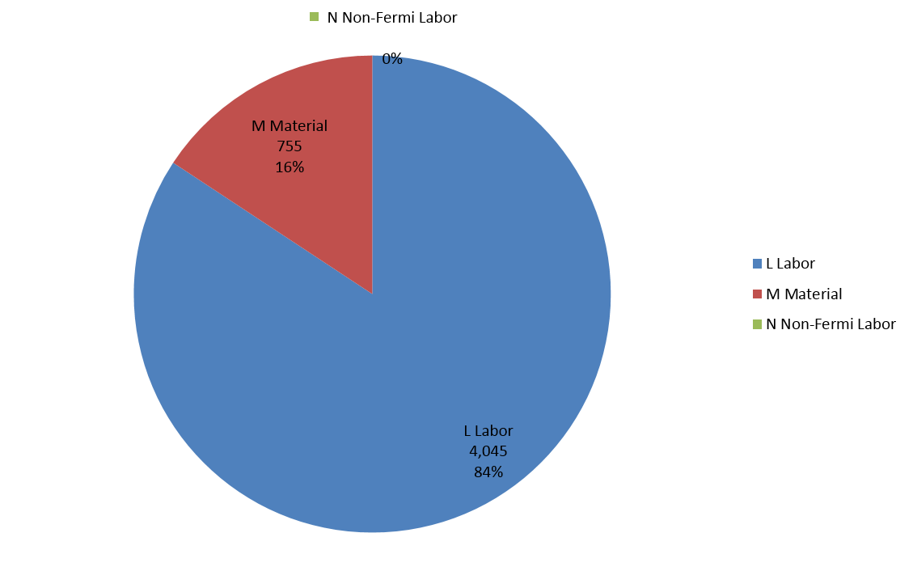
Cost Breakdown

Slide 23
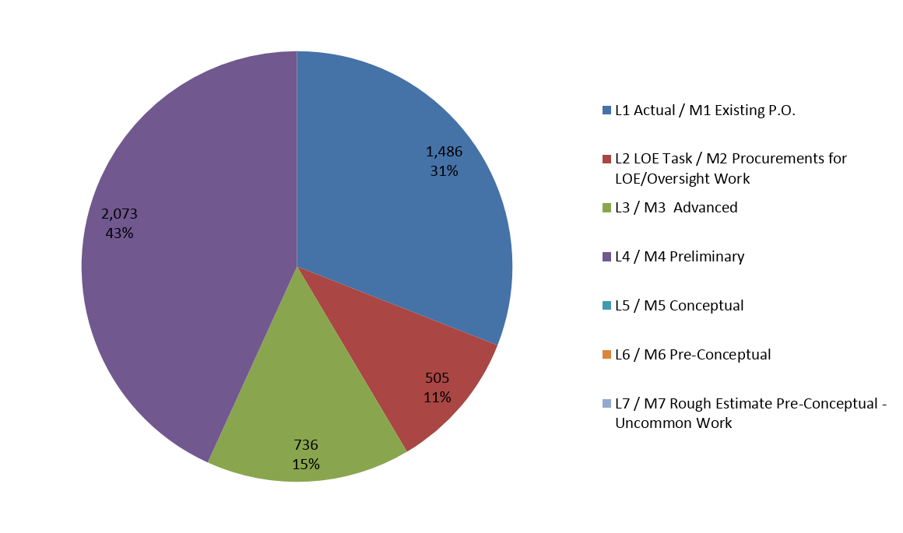
Quality of Estimate

Slide 24
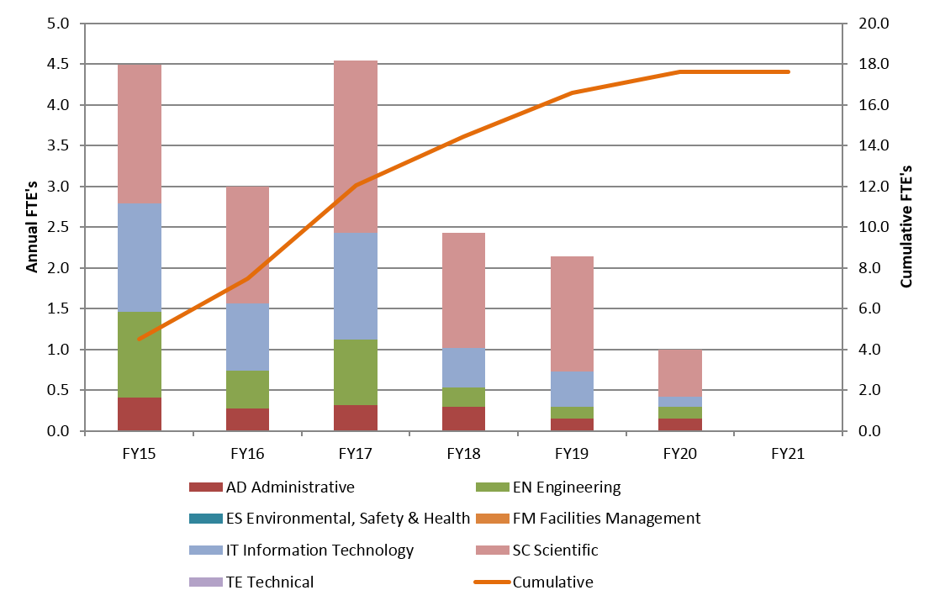
Resources by FY

Slide 25
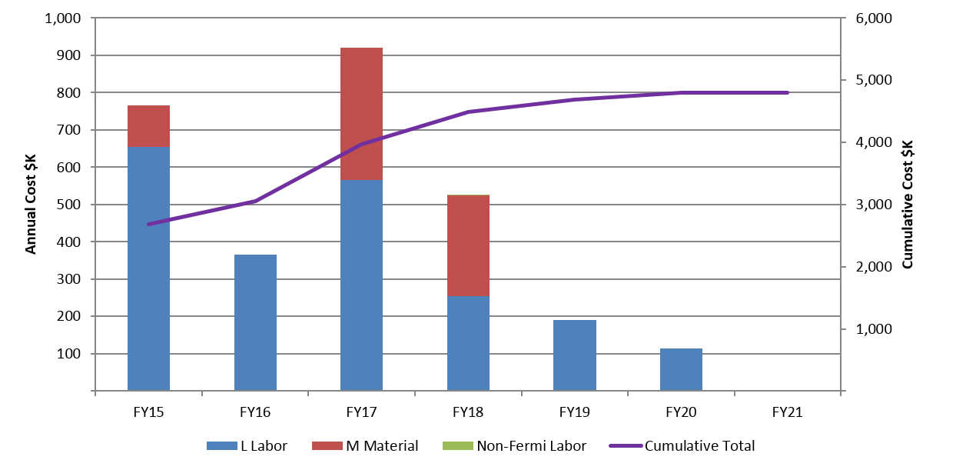
Resources by FY

Slide 26
Major Milestones
Completion of Pilot System development for Data Acquisition, Data Processing, and Controls and Networking tasks (July 2015)
Completion of Production System development for Data Acquisition, Data Processing, and Controls and Networking tasks (January 2020)
last two years are optimization & debug at reduced level of effort
Cosmic Ray Test (final integration with detectors and full readout test) (June 2020)

Slide 27
Schedule
CD-3a
CD-3c
CD-2/3b
CD-4
Data Acquisition
Pilot System
Data Acquisition
Production System
KPPs Satisfied
Data Processing
Pilot System
Data Processing
Production System
Controls & Network
Pilot System
Controls & Networking
Production System
Optimization & Debug
Detector Hall Construction
DAQ, Controls, Networking Purchases
Computer
Purchases
Detector Prototypes and Construction
Cosmic Ray System Test
Accelerator and Beamline Construction
Accelerator Commissioning (off Project)
Q3 | Q4 | Q1 | Q2 | Q3 | Q4 | Q1 | Q2 | Q3 | Q4 | Q1 | Q2 | Q3 | Q4 | Q1 | Q2 | Q3 | Q4 | Q1 | Q2 | Q3 | Q4 | Q1 | Q2 | Q3 | Q4 | Q1 | Q2 | Q3 | Q4 | Q1 | Q2 | Q3 | Q4
FY14 FY15 FY16 FY17 FY18 FY19 FY20 FY21

Slide 28
Summary
We have a design that fully satisfies the requirements
Cost estimates for the DAQ are complete
100% of the cost understood at the Preliminary Design level or higher
Risks are understood, mitigated to the extent possible and are under control.
All interfaces are identified and defined
Resource needs understood
ES&H embedded into all aspects of the Project
Responded to all recommendations from previous reviews
DAQ is ready for CD-2

