Slide 1
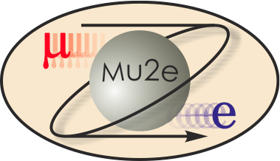
Mu2e Cosmic Ray Veto
8.1 Project Management
E. Craig Dukes
Level 3 Manager
October 21, 2014

Slide 2
Organizational Breakdown
WBS 475.8 Cosmic Ray Veto
Craig Dukes / Virginia
Julie Whitmore / Fermilab (Deputy)
475.8.1 Project Management
Craig Dukes / Virginia
CAM: Dukes
475.8.5 Photodetectors
Julie Whitmore / Fermilab
CAM: Whitmore
475.8.2 Mechanical Design
Craig Dukes / Virginia
CAM: Dukes
475.8.6 Electronics
Sten Hansen / Fermilab
CAM: Dukes → Whitmore
475.8.3 Scintillator Extrusions
Anna Pla-Dalmau / Fermilab
CAM: Pla-Dalmau
475.8.7 Module Fabrication
Craig Group / Fermilab & Virginia
CAM: Group
475.8.4 Fibers
Yuri Oksuzian / Virginia
CAM: Dukes
475.8.8 Detector Assembly & Installation
Jim Fagan / Fermilab
CAM: Dukes

Slide 3
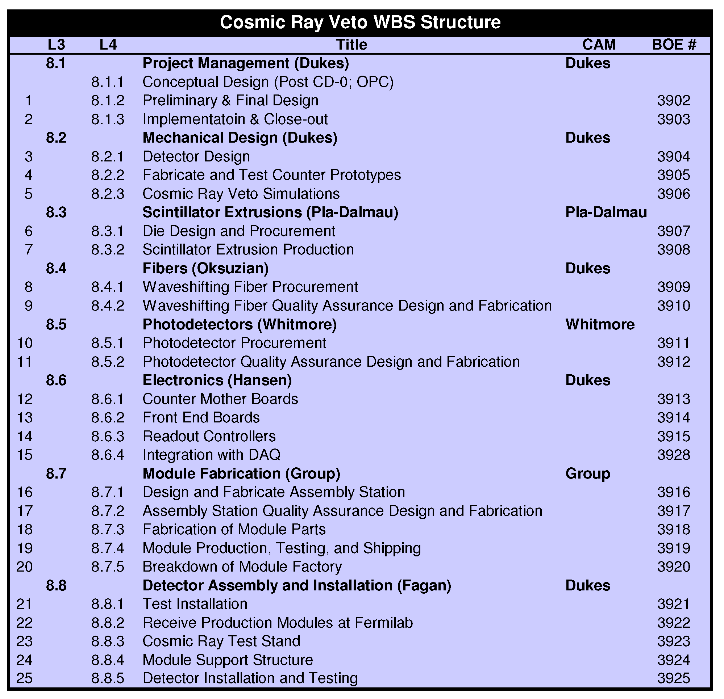
Organizational Breakdown

Slide 4
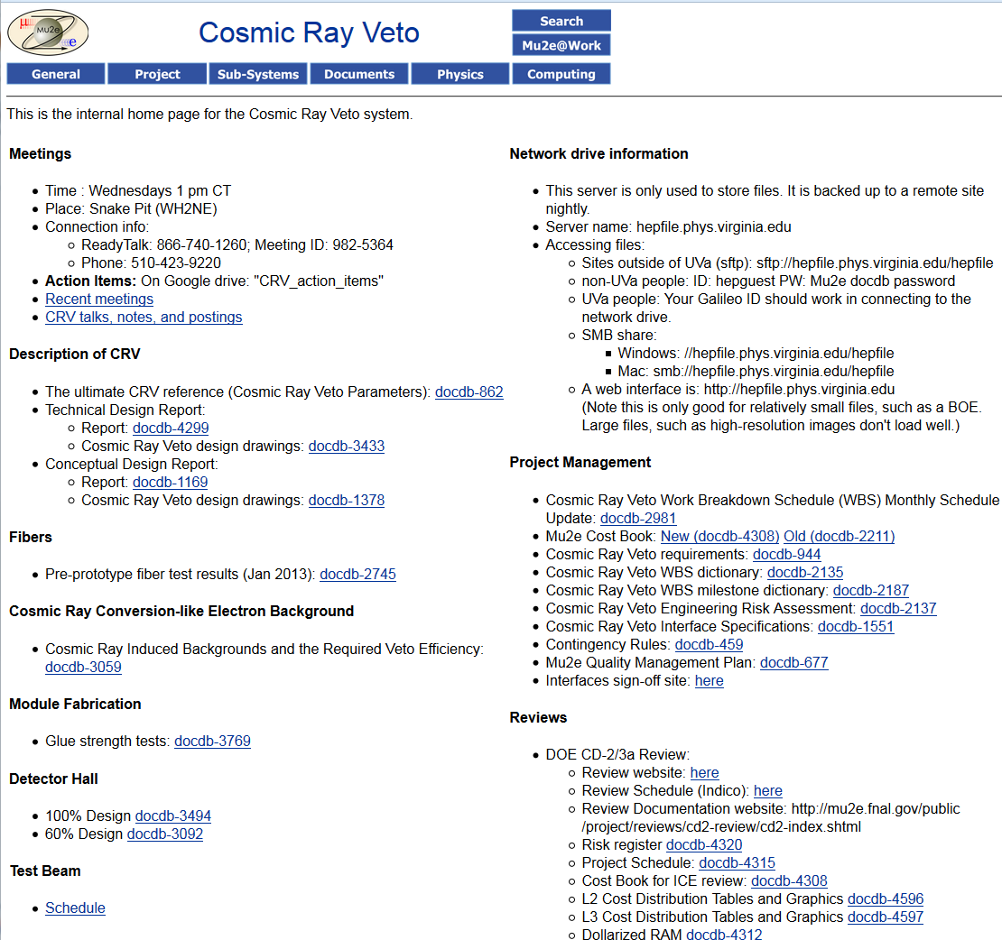
How Do We Share Information?
Weekly CRV meetings
Meeting talks, memos, permanent repository: Mu2e docdb
Temporary repository: Network drive hosted at UVa with web interface
CRV webpage has important links
Google doc on Google Drive for action items

Slide 5
A Few Notes
Spares are off-project.
  Put into 475.10
  This sometimes leads to curious gaps between activities that should be contiguous in the Gantt chart
Installation off project (WBS 8.8.5)
475.8.9 is where OPC costs have been rolled up
Baseline start date is May 1, 2014
You may find apparent differences between BOEs and WBS (P6)
  Most should be due to the fact that when SOWs (To UVa for example) are executed, hours are converted to $ in P6.
Labor to non-Fermilab institutions shows up at M&S
Two major resources:
  TDR (docdb-4299)
  crv_parameters.xlsx (docdb-862): has every important number

Slide 6
Design: External Review
We had a day-long external review of: (1) design, (2) photodetectors, (3) electronics, and (4) module fabrication.
Reviewers: Jim Freeman (Fermilab), Karen Kephart (Fermilab), Iouri Musienko (Notre Dame), Dave Pushka (Fermilab), and Sergey Los (Fermilab).
Findings are written up in docdb-4250.
No major issues with either design and plan.

Slide 7
Plan for CD2
Slide shown at DOE CD-1 Review
Simulations
  Refine the cosmic-ray background simulation to: (1) model changes in the detector hall design, (2) incorporate improvements in the tracking algorithm, and (3) speed it up to allow determine the required position dependence of the CRV efficiency.
  Refine and complete the neutron background rate estimates
Complete preliminary counter and module design
Fabricate prototype extrusions
  Measure their flatness and curvature (“banana”) to determine gap size
Fabricate prototype counters:
  Measure their photoelectron yield
  Measure their neutron efficiency
Evaluate SiPMs
Fabricate prototype front-end electronics boards
Module fabrication
  Fabricate a mockup module to test and optimize fabrication procedures
  Fabricate and test working module with electronics: “vertical slice test”
QA/QC: determine procedures, procure free equipment, and design fabrication and testing equipment
Value management
Done
Done
Done
Done
Postponed: no longer critical
First round done: new models ordered
Underway: awaited new rate estimate
Done
Postponed
Advanced
Always

Slide 8
R&D Plan
Critical parameter in meeting the efficiency requirement is the light yield
A test beam run in fall of 2013 showed that the light yield with pre-prototype counters was insufficient
A test beam run is scheduled in early 2015 to measure the light yield with what should be the final extrusions, fibers, SiPMs, and electronics
Radiation tests of SiPMs and electronics are planned
Neutron response test is planned
Full-size module to be fabricated and shipped to Fermilab for mounting test
Two electronics tests modules to be fabricated; one for Fermilab
There is another round of pre-prototyping that is in the schedule
Simulations:
  Working on full simulation of detector response in framework, validating our model with test-beam data
  Once model is complete we will redo the neutron/gamma rates
  Conversion background simulation will continue with goal of 10X live time

Slide 9
Pre-CD-3 Tasks
Simulations:
  Verification non-factorized simulations in software framework to confirm work done on rates and radiation levels by the Neutron Working Group.
  Complete the conversion-like electron background simulations: the goal is to simulate targeted areas with at least 10X the expected flux.
Design: produce final engineering design.
Requirements: fabricate and measure PE yield at the Fermilab Meson Test Beam Facility of counter prototypes using baseline fiber, SiPMs, and extrusions. Use results to select the fiber size.
SiPMs: perform radiation and longevity tests; select vender.
Electronics: produce and test prototype counter motherboards, front-end boards and readout controllers.
Module fabrication: make a large mechanical prototype module, two small electronics test modules, two large side modules.
Detector installation: test mounting scheme for side modules.

Slide 10
Risks & Opportunities
There are no major cost or schedule risks
More sophisticated simulations indicate higher rates
  Risk: low
  Mitigation: more shielding in targeted areas
Photoelectron yield too low / too high
  Risk/Opportunity: low/moderate
  Mitigation: tune fiber diameter
Fiber vender goes out of business
  Risk: low
  Mitigation: order fiber asap; use larger diameter inferior fibers
Simulations indicate that more CRV coverage needed
  Risk: moderate
  Mitigation: fabricate several extra modules

Slide 11
8.1 Project Management Activities
Project planning.
Scheduling.
Costing.
Integration and maintenance of the fabrication databases
Miscellaneous management activities.
Travel to Fermilab for the L2 head of the cosmic ray veto group.
Partial support for L3 managers.
Resources are generally assigned as level of effort.

Slide 12
Reviews and Recommendations

Slide 13
Director’s Independent Design Review
Date: May 3-5, 2011
Reviewers: Jeff Nelson, Julie Whitmore, Rainer Novotny
Recommendations:
As full-statistics background simulations and light yield data become available both for cosmic ray backgrounds in the experiment and for backgrounds in the veto system (e.g. from neutrons), continue to revise the design in anticipation of the next design phase.
This has been done, and the design is quite a bit different now.

Slide 14
Director’s CD-1 Review
Date: April 3-5, 2012
Reviewers: Rafe Schindler
Recommendations:
Funding should be made available in a timely way to complete the necessary R&D work toward CD-2.
Adopt a more significant preproduction phase (e.g. 5-10%) after the indicated R&D program that would allow for validation of the construction staffing model, production-tooling, quality control and production throughput.
Develop a resource-leveled schedule that ensures better continuity of the task’s technical staff throughout the R&D, production and testing.
Complete the neutron background simulations, which will inform the final optical design prior to CD-2.
These have all been implemented.

Slide 15
DOE CD-1 Review
Date: June 5-7, 2012
Reviewers: Steve Kettell, Douglas Bryman, Rik Yoshida
Recommendations:
Consider possible experiments to measure the production of 105 MeV delta rays from cosmic muons to validate the simulation used for the background estimate.
We did not have the resources to mount such an experiment. However, a comparison was made between Geant4 and theory which shows excellent agreement. At JLab the Kaon Aerogel Detector is being fabricated. High energy delta rays (p > 2.1 MeV/c) will fire the Cerenkov detector, producing a background. They will measure the rate of delta production and compare it to Geant4.

Slide 16
Director’s Independent Design and CD-2/3 Review
Date: July 8-10, 2014
Reviewers: RIch Talaga
Recommendations:
Production of a suitable number of spare modules supported by Project funding should be considered.
We will fabricate 9 spare modules in addition to prototype and pre-production modules. They will be fabricated at the same time: only the funding source will be different.

Slide 17
Independent Cost Review
Date: August 26, 2014
ICE Team Review. The majority of the costs for this WBS element are in fabrication of module parts, and module production, testing, and shipping. The fabrication sub-element is over 90% procurement, and these M&S costs are supported by current vendor quotes from a known supplier. The production sub-element uses the parts acquired in the fabrication activity to assemble the module. The estimate is very explicit describing the number of modules needed; the epoxy and other consumables needed to build the modules; the rental space required to assemble the modules; the average cost for rental space in Charlottesville, Virginia; specs and pricing for shipping containers to transport the modules from University of Virginia to Fermilab; and freight quotes.
The BOE, assumptions, and backup are reasonable for this WBS element. The level of detail is very good.

Slide 18
Reply to Review Charge

Slide 19
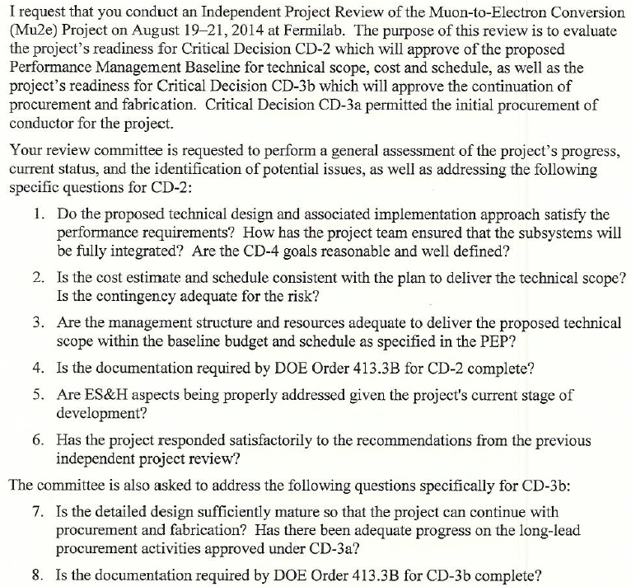
Review Charge

Slide 20
Charge # 1
Do the proposed technical design and associated implantation approach satisfy the performance requirements? How has the project team ensured that the subsystems will be fully integrated? Are the CD-4 goals reasonable and well defined.
  The design is well understood and much effort has been expended to insure that it meets the requirements, a plan is in place to measure that the requirements are met.
  Requirements and Interface documents have been approved by stakeholders.
  The following link take you to the Fermi Project Management Policies and procedures. http://www.fnal.gov/directorate/OPMO/PolProc/home.htm

Slide 21
Charge #2
Is the cost estimate and schedule consistent with the plan to deliver the technical scope? Is contingency adequate for the risk?
  Independent Cost REview (ICE): “The BOE, assumptions, and backup are reasonable for this WBS element. The level of detail is very good.”
  Estimates for the Cosmic Ray Veto are complete: 91% of cost understood at the Preliminary Design level or higher, with most estimates based on very similar systems, with the same personnel, that have recently been built at Fermilab.
  Contingency of 38% is adequate at this stage of the project.
  Risks are minor and understood, mitigated where possible.

Slide 22
Charge #3
Are the management structure and resources adequate to deliver the proposed technical scope within the baseline budget and schedule as specified in the PEP?
  From the sub-project management level the PM has communicated the need to stay within the cost and schedule baseline. The tools and personnel to monitor and analyze the work status exists.

Slide 23
Charge #4
Is the documentation structure by DOE Order 413.3b for CD-2 complete?
  While many of the documents have been completed by the Level One project manager WBS 475.08 has:
    Contributed to a number of the documents such as the: TDR, BOEs, Requirements, WBS Dictionary, WBS Milestone Dictionary, Engineering Risk Assessment, Interface Specifications, Quality Management Plan.
    Have read, not memorized, all of the management documents such a PEP, PMP, and Acquisition Strategy. Know where to find what I need to manage my subproject.
  Addressed and completed those items unique to my sub-project.

Slide 24
Charge #5
Are ES&H aspects being addressed given the project’s current stage of development?
  ES&H was considered and addressed in the design.
    Electrical hazards
    Life safety
    Proper handling and use of toxic materials
  Extensive documentation
    Project: Mu2e Hazard Analysis document (Mu2e-doc-675)
    Cosmic Ray Veto: Quality Assurance and Safety Program for the Cosmic Ray Veto Module Factory (Mu2e-doc-4150)

Slide 25
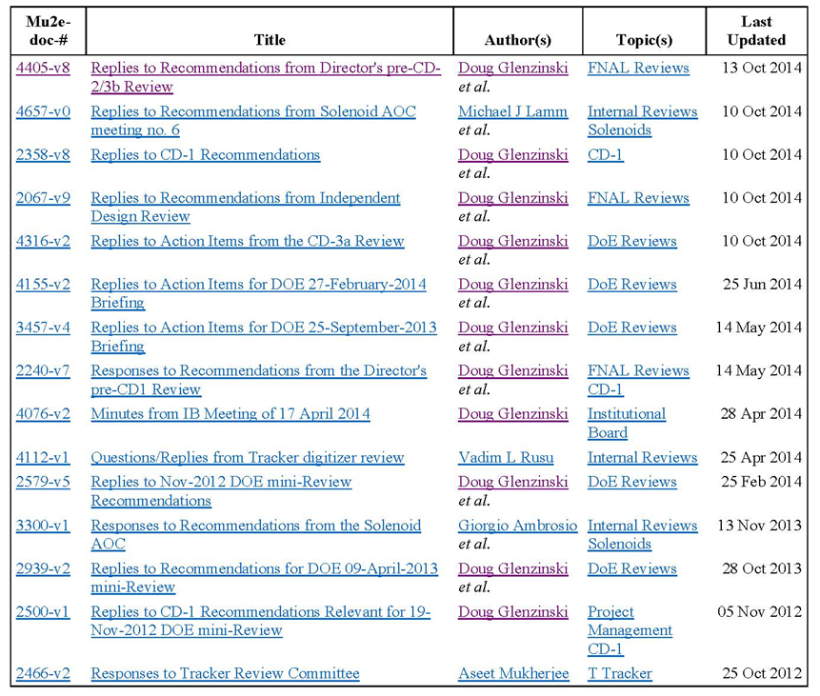
Charge #6
Has the project responded satisfactorily to the recommendations from the previous independent project review?
  Responses from past
  reviews.

Slide 26
Charge #7
Is the detailed design sufficiently mature so that the project can continue with procurement and fabrication? Has there been adequate progress on the long-lead procurement activities approved under CD-3a?
  Not applicable to CRV at CD-2 stage.

Slide 27
Charge #8
Is the documentation required by DOE Order 413.3b for CD-3b complete?
  Not applicable to CRV at CD-2 stage.

Slide 28
Level 2 Graphics and Tables

Slide 29
Cost Table: CRV
Costs are fully burdened in AY $K
Includes actuals
Note: Labor Fermilab only; Univ. labor captured in M&S.
 | Base Cost (AY K$)
 | M&S | Labor | Total | Uncertainty (on remaining budget) | % Contingency (on remaining budget) | Total Cost
475.8.1 Project Management | 267 | 178 | 445 | 75 | 21% | 520
475.8.2 Mechanical Design | 135 | 3 | 138 | 24 | 38% | 162
475.8.3 Scintillator extrusions | 567 | 462 | 1,029 | 209 | 25% | 1,238
475.8.4 Fibers | 462 |  | 462 | 106 | 24% | 568
475.8.5 Photodetectors (SiPMs) | 464 | 305 | 769 | 190 | 41% | 959
475.8.6 Electronics | 1,314 | 407 | 1,720 | 511 | 33% | 2,231
475.8.7 Module Fabrication | 1,482 | 8 | 1,490 | 466 | 35% | 1,956
475.8.8 Detector assembly and installation | 127 | 81 | 208 | 64 | 35% | 273
475.8.9 Conceptual Design/R&D | 258 | 252 | 511 |  | 0% | 511
475.8.99 Risk Based Contingency |  |  |  | 318 | - | 318
Grand Total | 5,077 | 1,696 | 6,773 | 1,963 | 38% | 8,735

Slide 30
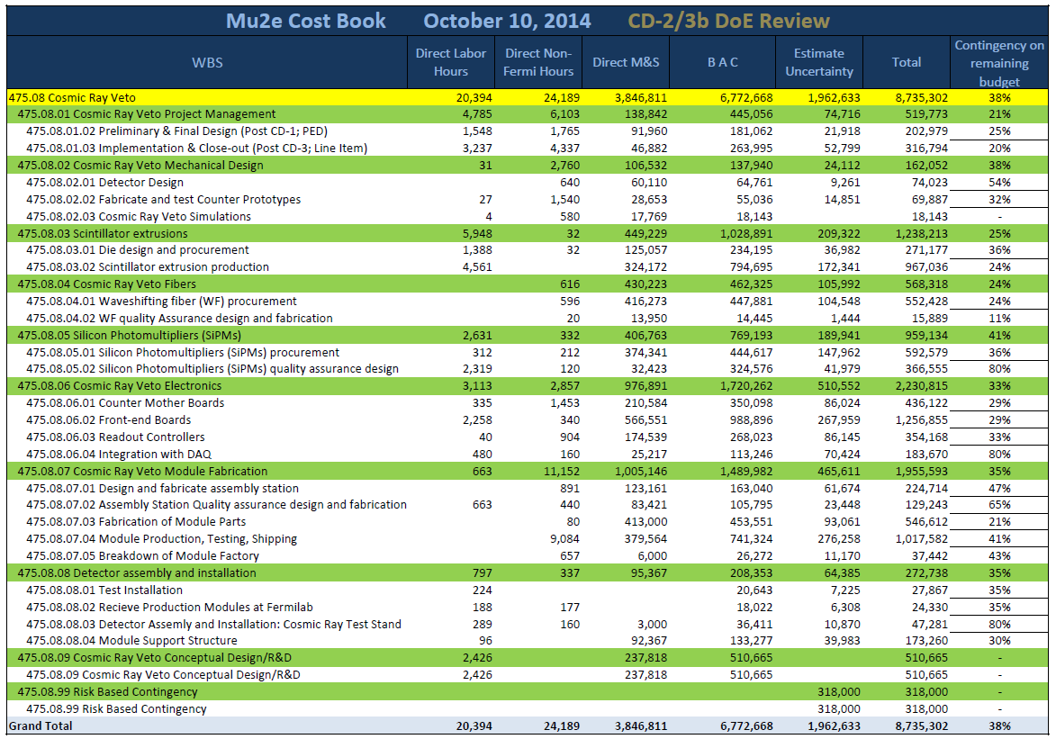
Cost Table: CRV
Costs are fully burdened in AY $K

Slide 31
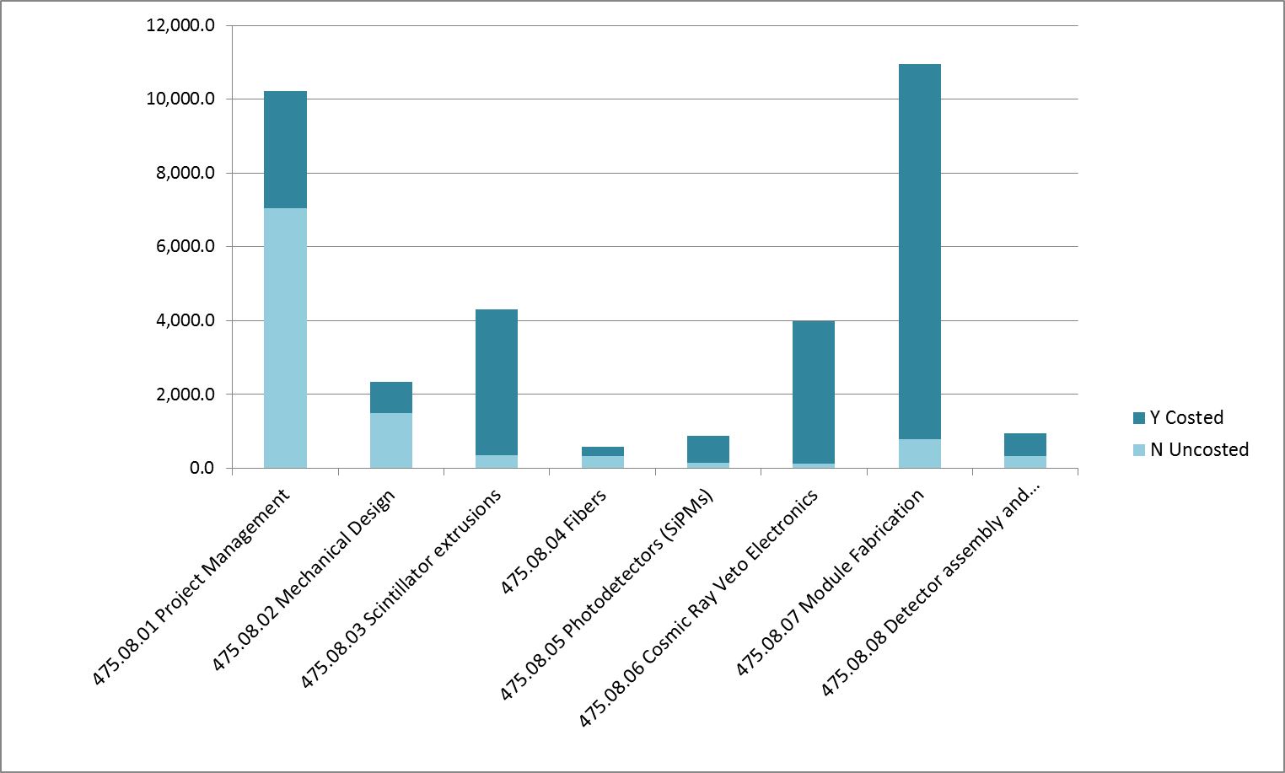
Costed / Uncosted Labor by Hours

Slide 32
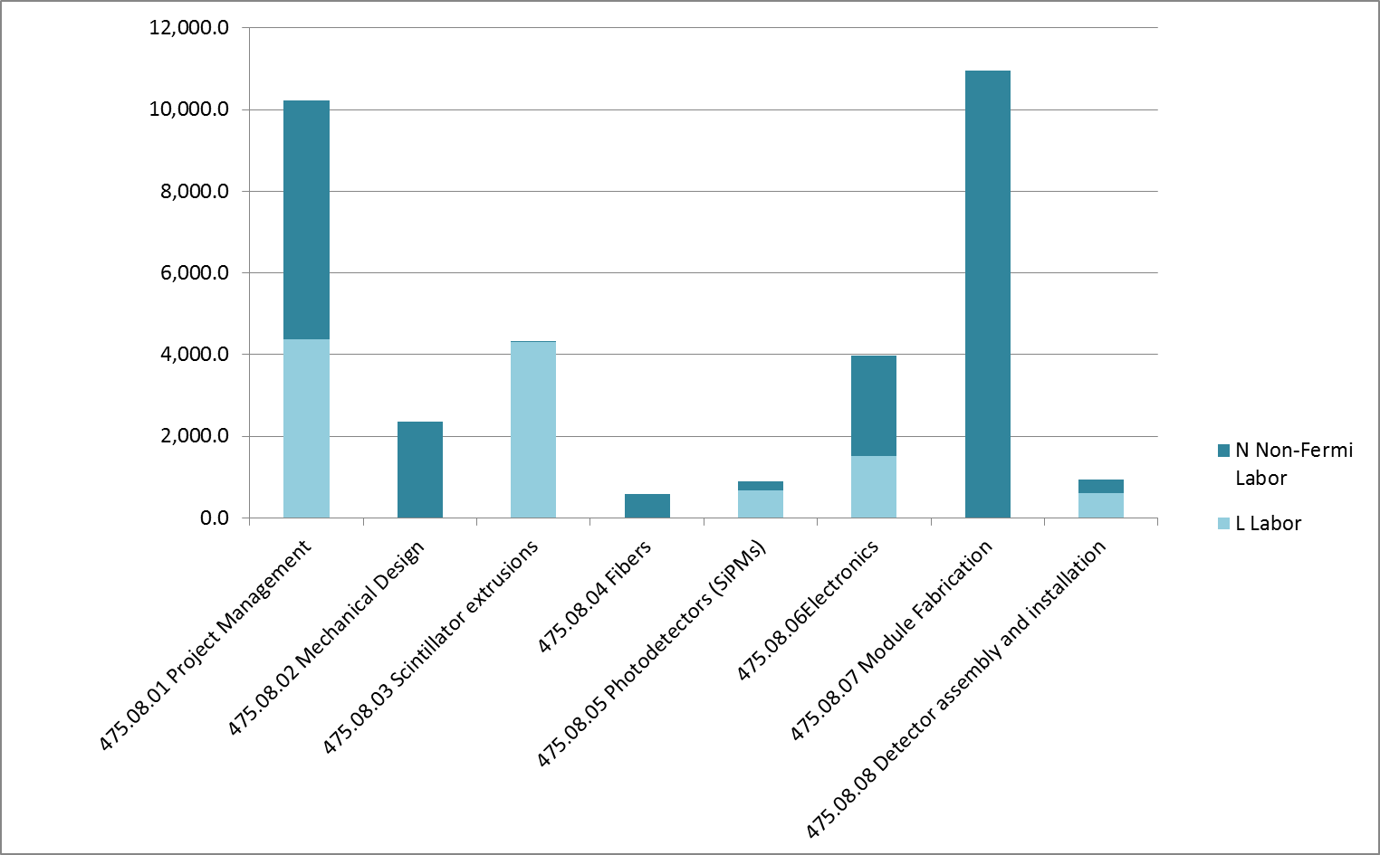
Fermilab / non-Fermilab Labor by Hours

Slide 33
Cost Breakdown: Sub-Project
Base Cost in AY K$
SiPMs

Slide 34
Cost Breakdown: Resource Type
Base Cost in AY K$
Note: non-Fermi labor hours > Fermi

Slide 35
Labor Resources by FY

Slide 36
Quality of Estimate
Base Cost in AY K$

Slide 37
Labor Resources by FY

Slide 38
Labor / Material Breakdown by FY
Base Cost in AY K$

Slide 39
Project Slides: Cost Breakdown

Slide 40
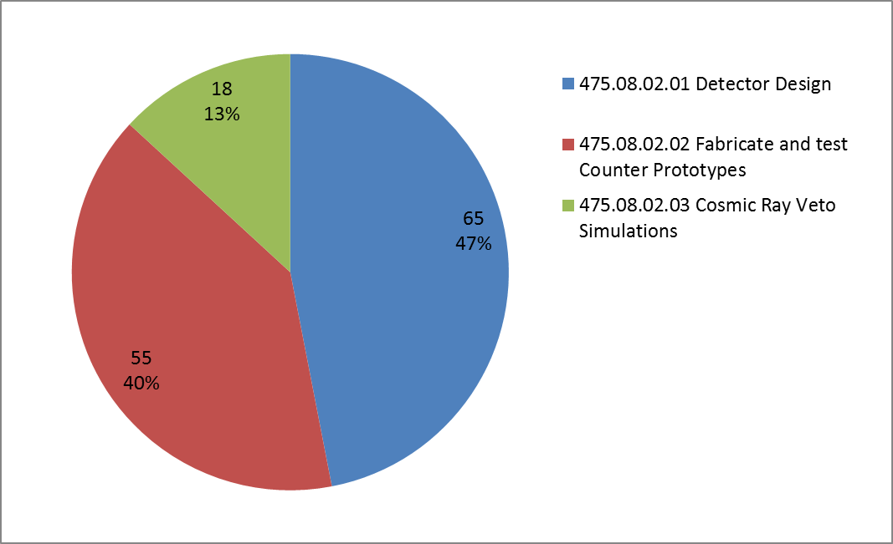
8.2 Mechanical Design

Slide 41
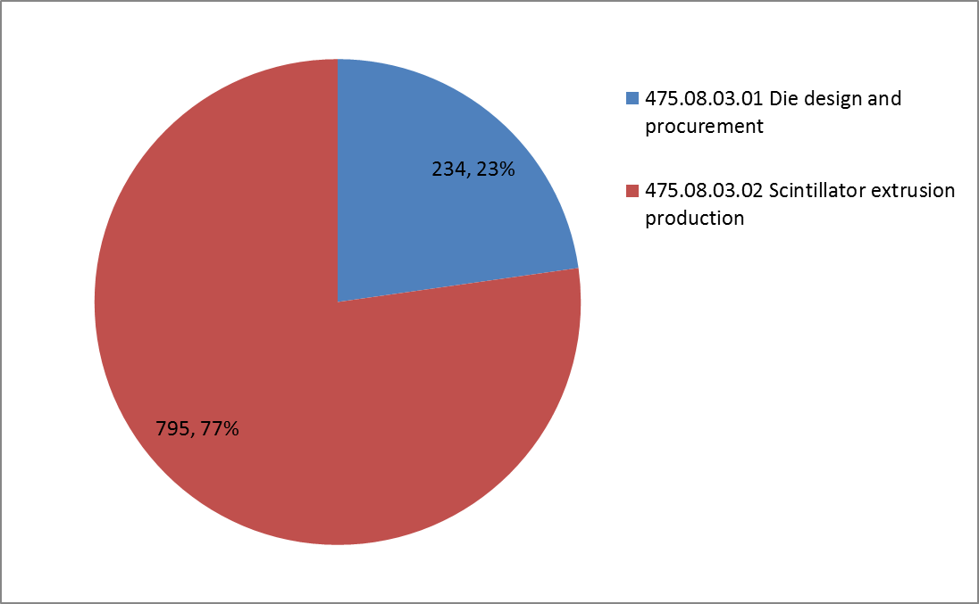
8.3 Scintillator Extrusions

Slide 42
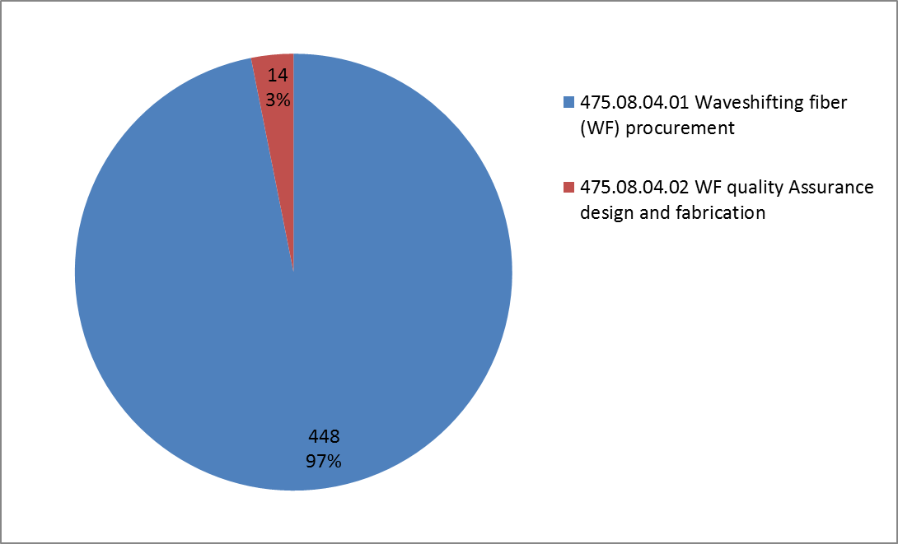
8.4 Fibers

Slide 43
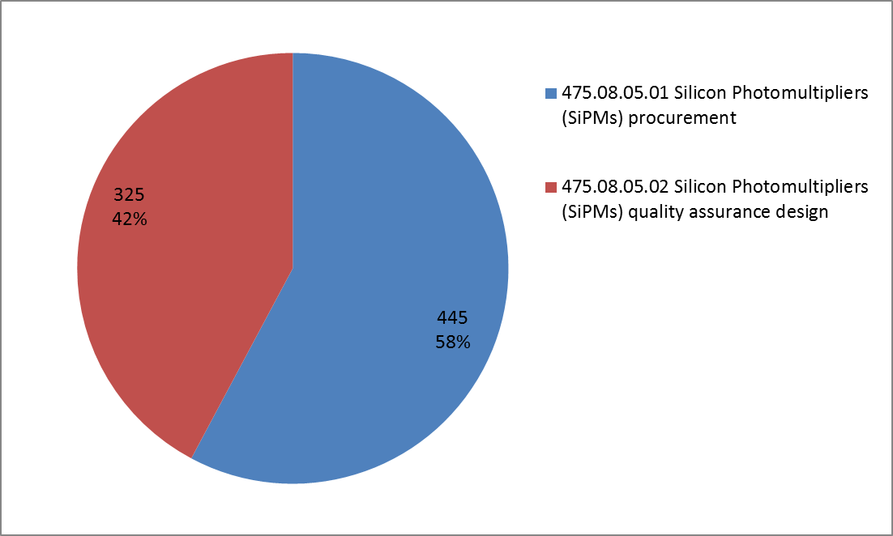
8.5 Photodetectors (SiPMs)

Slide 44
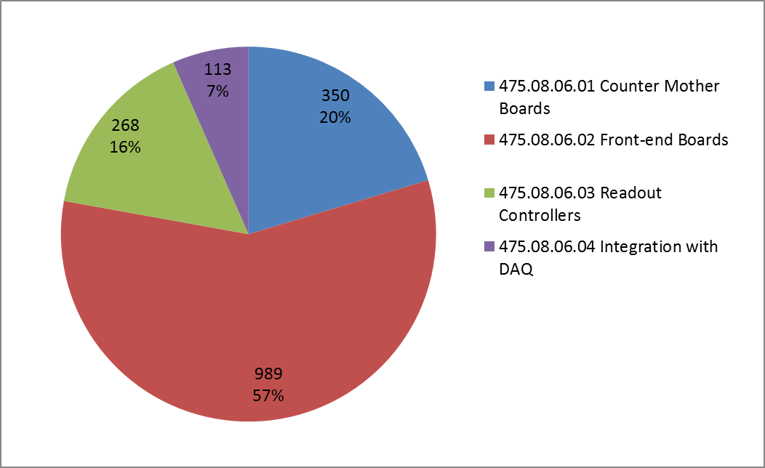
8.6 Electronics

Slide 45
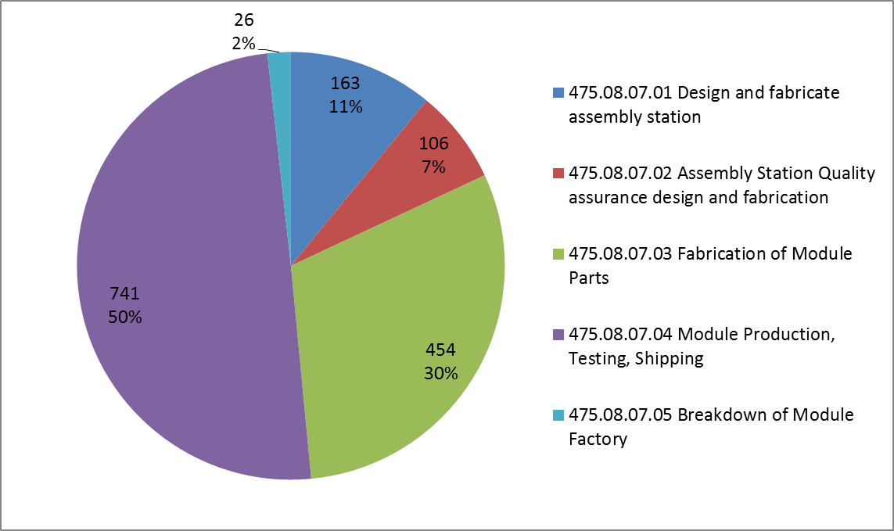
8.7 Module Fabrication

Slide 46
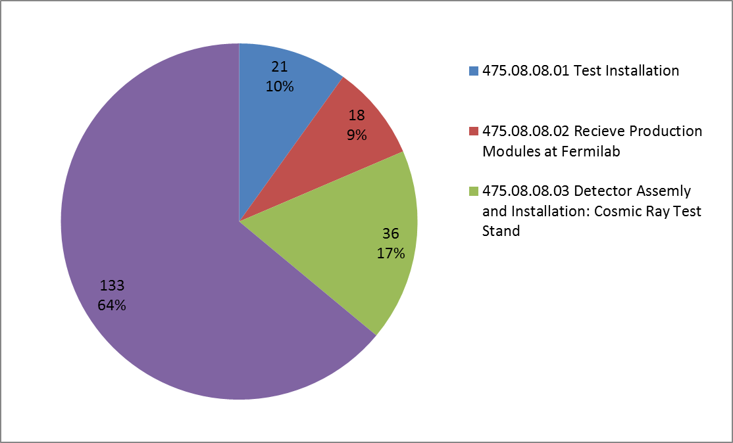
8.8 Detector Installation & Assembly

Slide 47
Project Slides: Resource Type

Slide 48
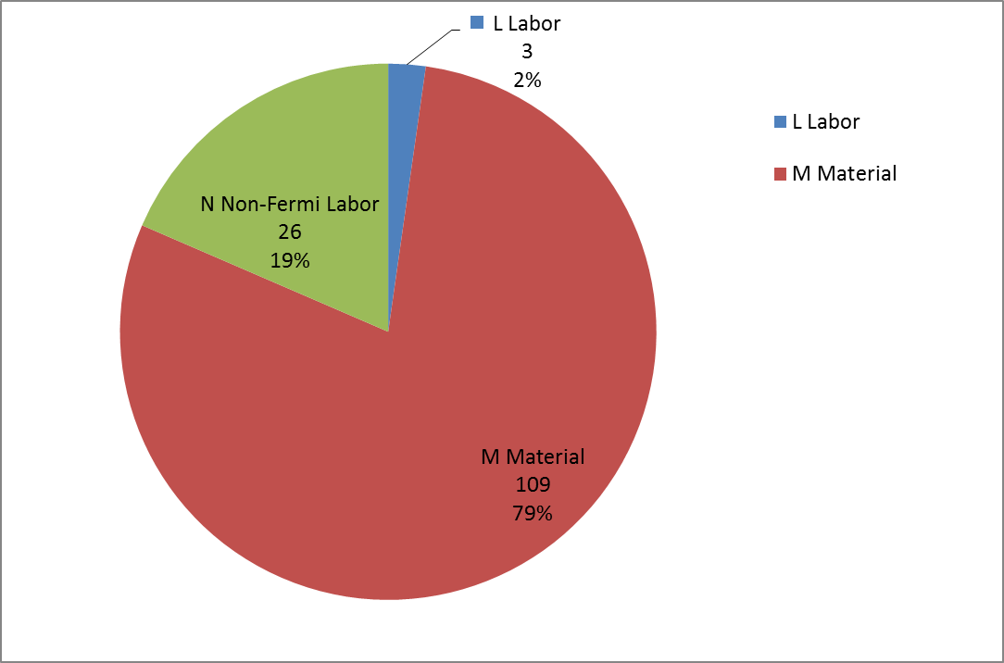
8.2 Mechanical Design

Slide 49
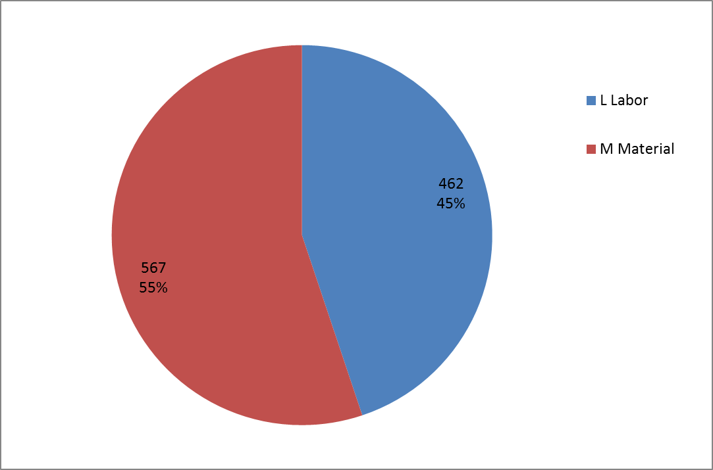
8.3 Scintillator Extrusions

Slide 50
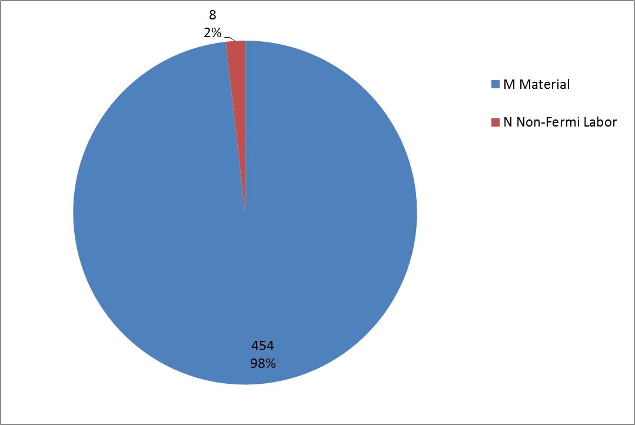
8.4 Fibers

Slide 51
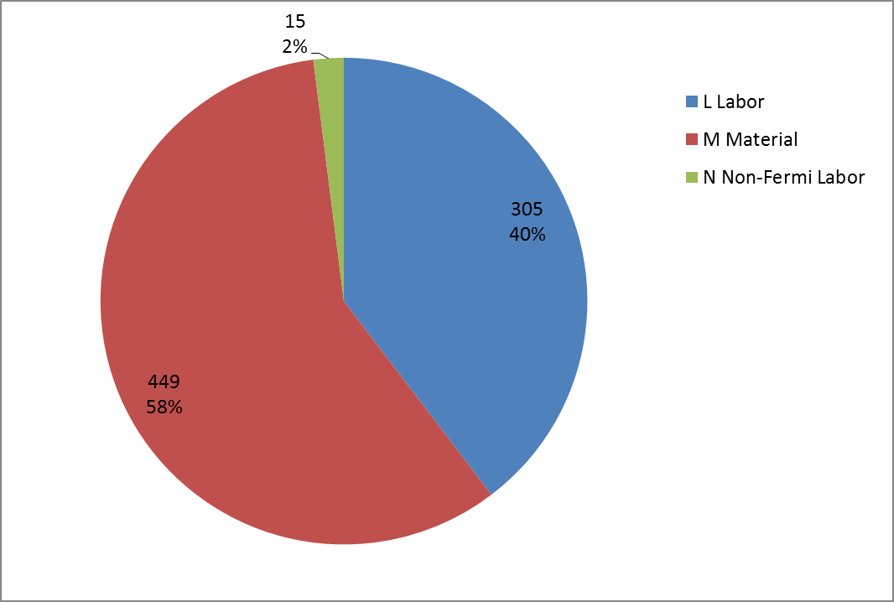
8.5 Photodetectors (SiPMs)

Slide 52
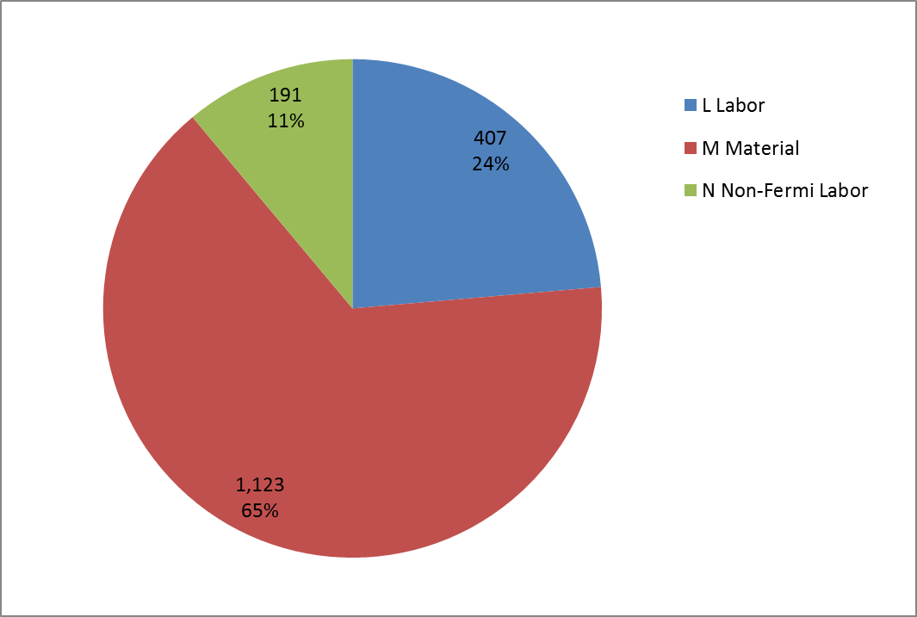
8.6 Electronics

Slide 53
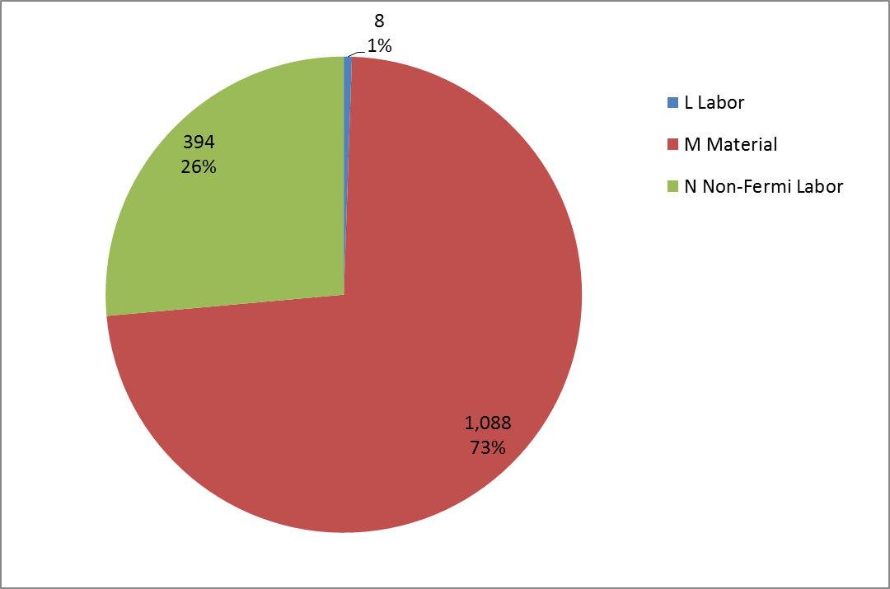
8.7 Module Fabrication

Slide 54
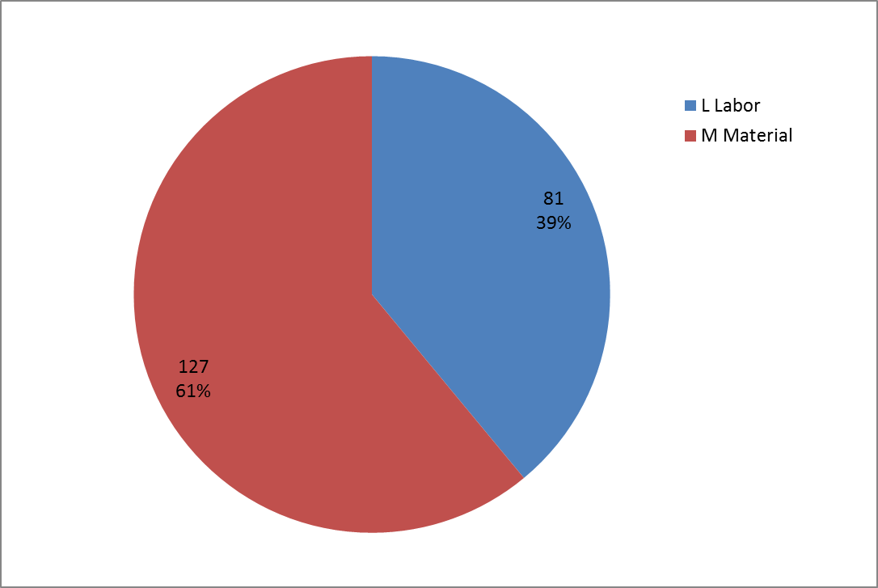
8.8 Detector Installation & Assembly

Slide 55
Project Slides: Quality of Estimate

Slide 56
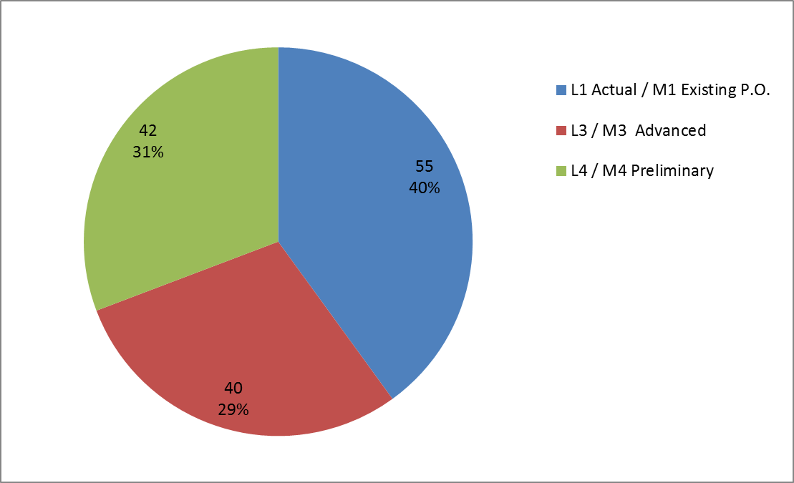
8.2 Mechanical Design

Slide 57
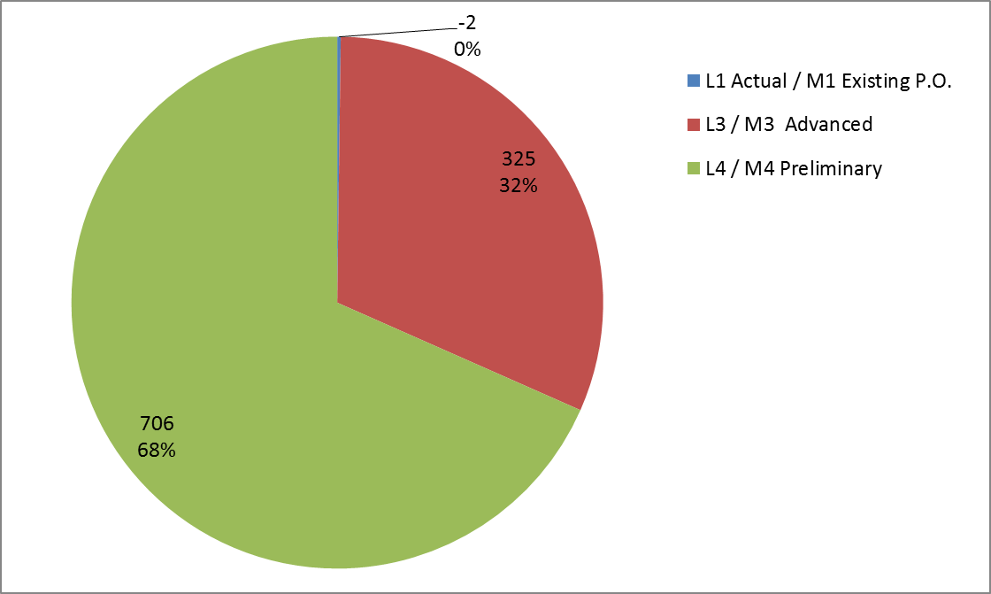
8.3 Scintillator Extrusions

Slide 58
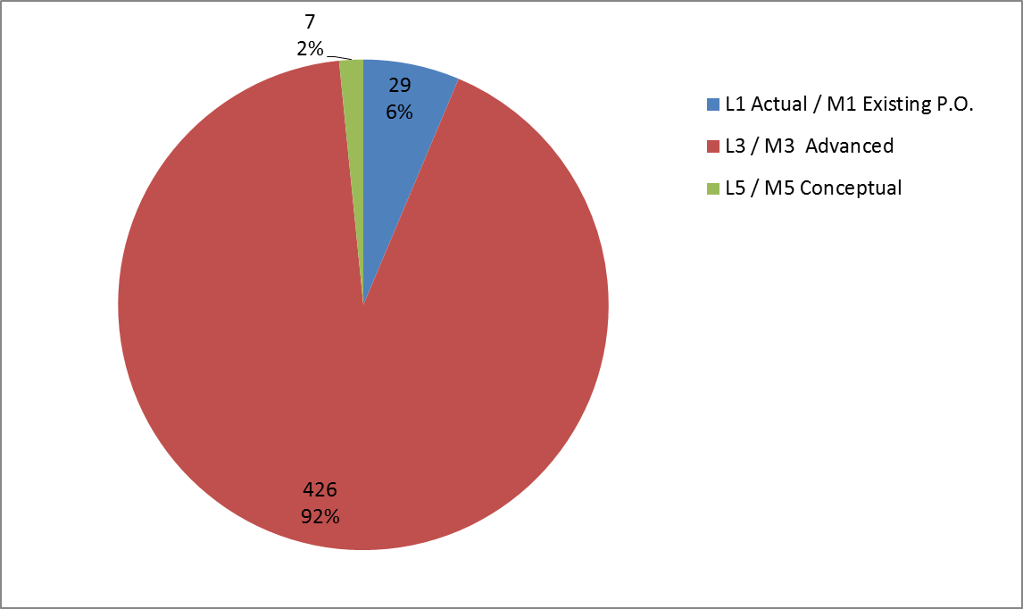
8.4 Fibers

Slide 59
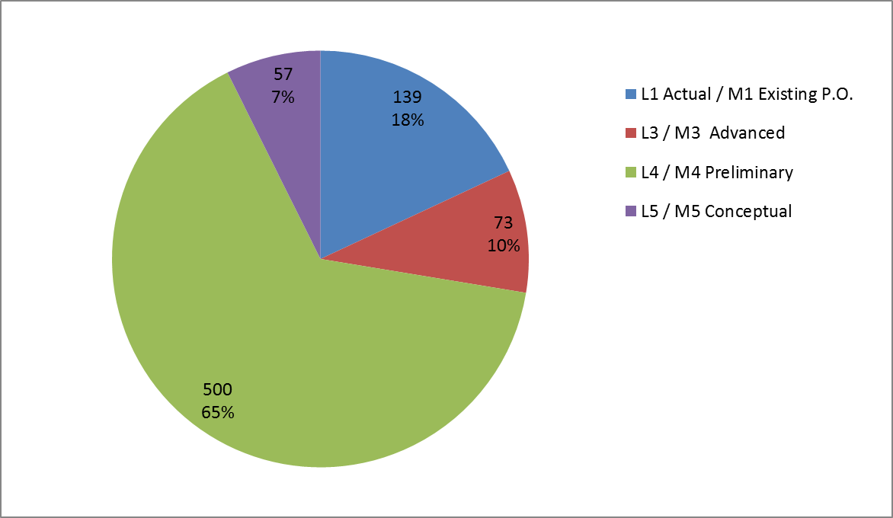
8.5 Photodetectors (SiPMs)

Slide 60
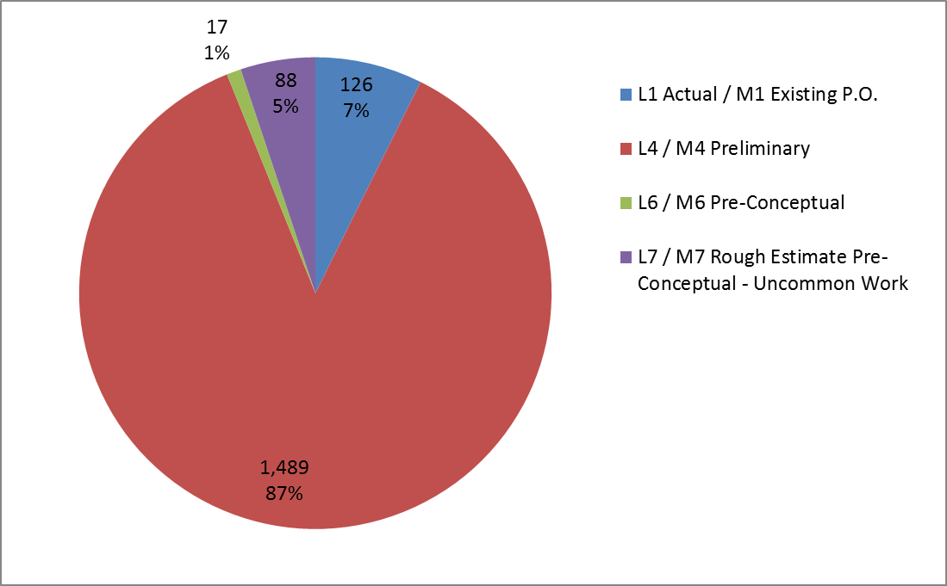
8.6 Electronics

Slide 61
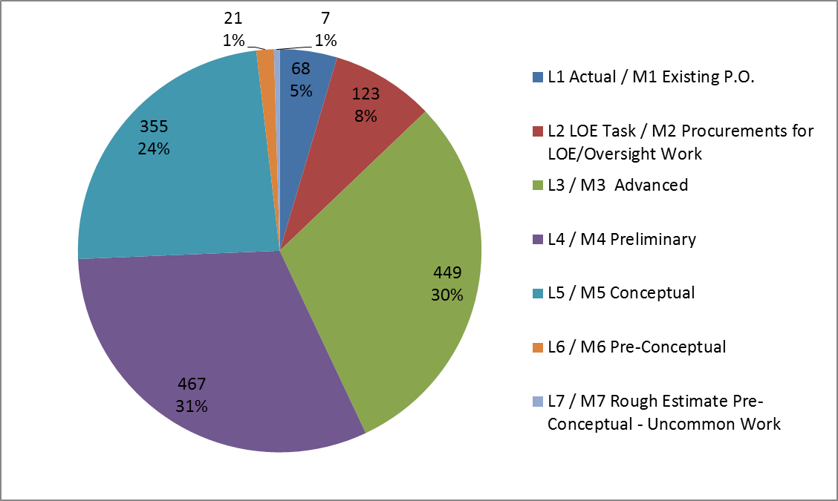
8.7 Module Fabrication

Slide 62
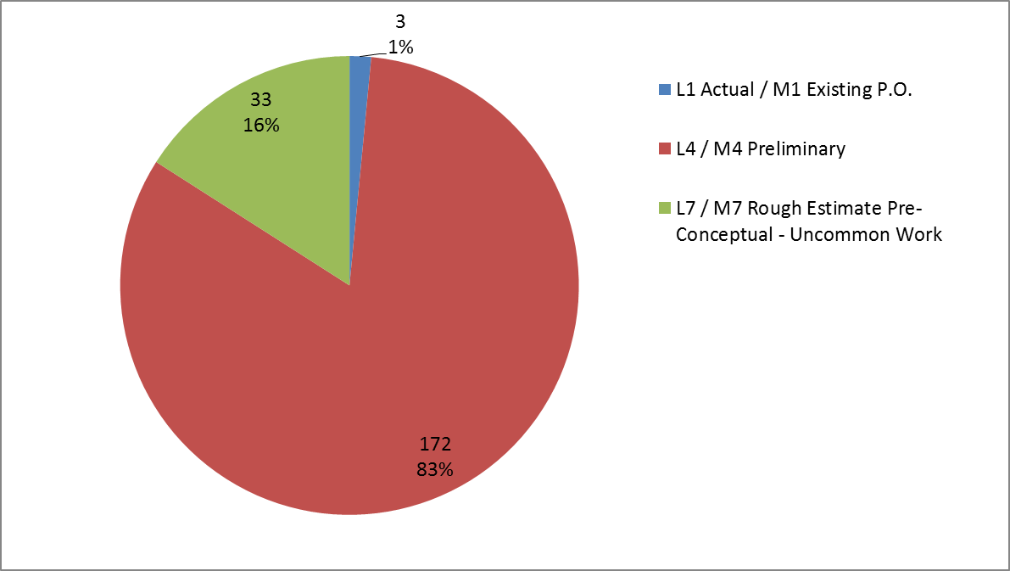
8.8 Detector Installation & Assembly

Slide 63
Project Slides: Labor / Material Breakdown

Slide 64
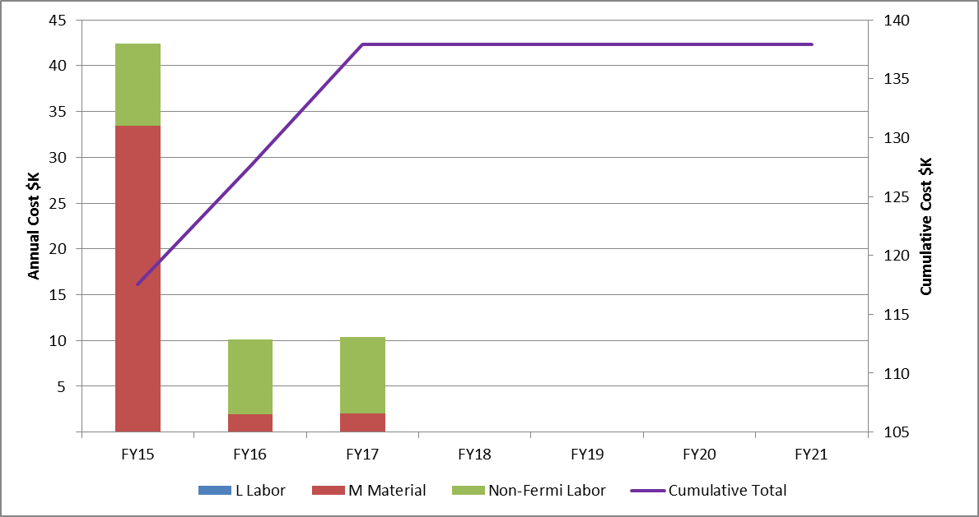
8.2 Mechanical Design
Base Cost in AY K$

Slide 65
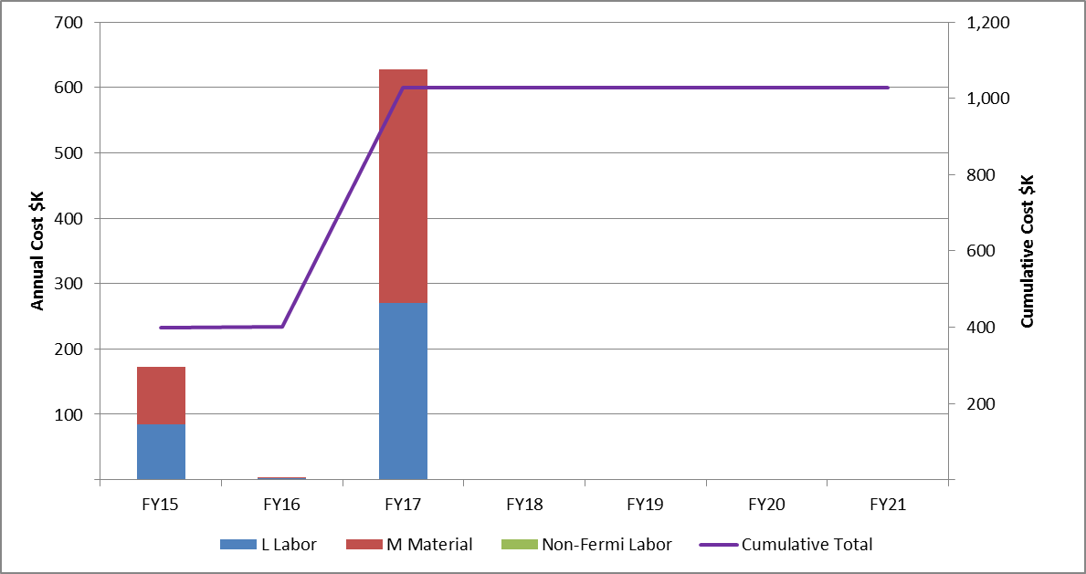
8.3 Scintillator Extrusions
Base Cost in AY K$

Slide 66
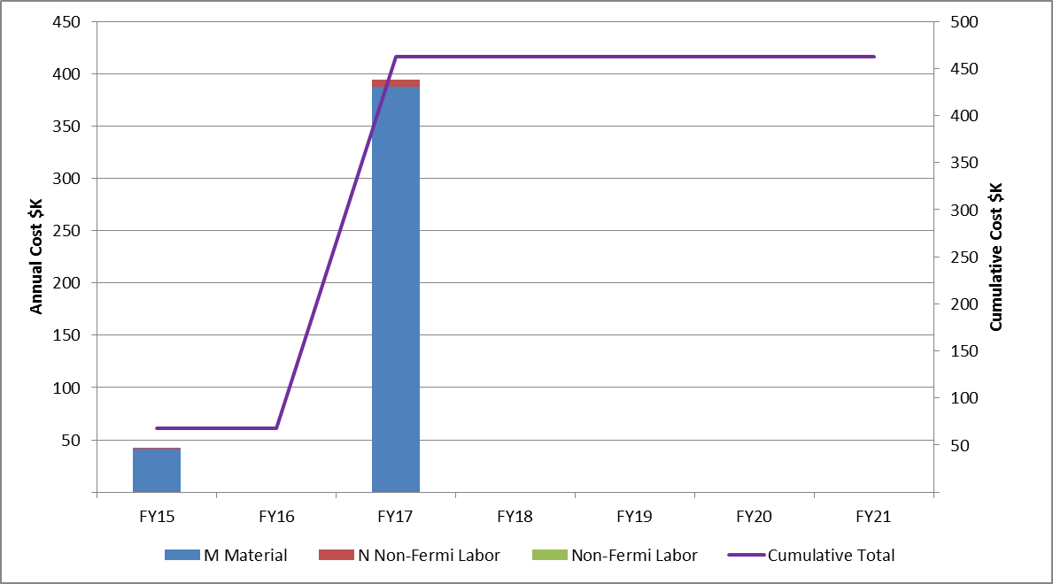
8.4 Fibers
Base Cost in AY K$

Slide 67
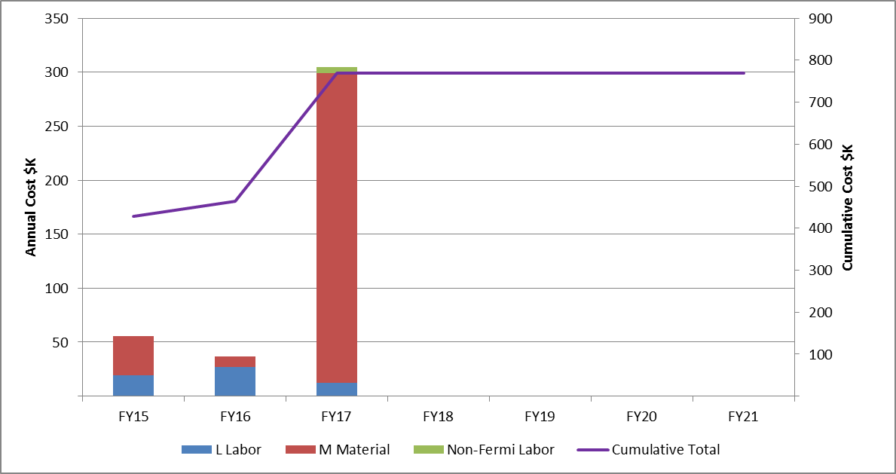
8.5 Photodetectors (SiPMs)
Base Cost in AY K$

Slide 68
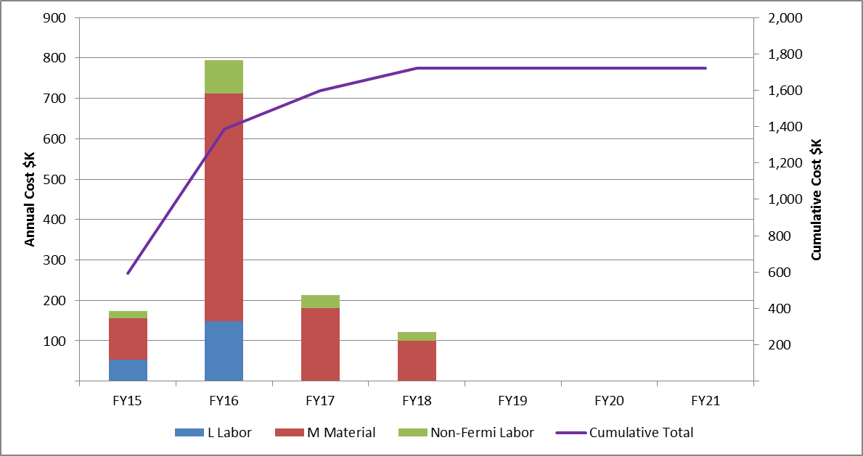
8.6 Electronics
Base Cost in AY K$

Slide 69
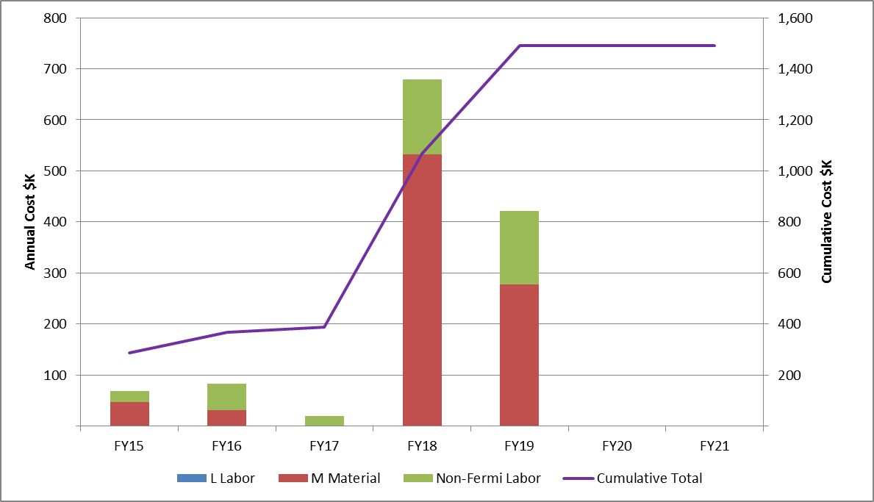
8.7 Module Fabrication
Base Cost in AY K$

Slide 70
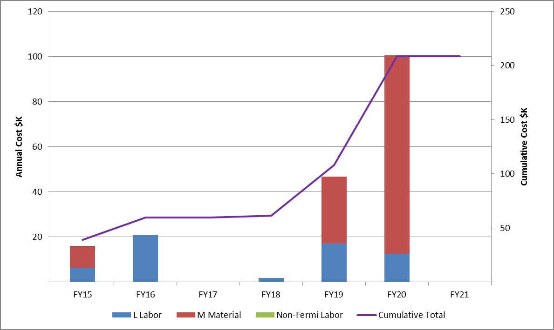
8.8 Detector Installation & Assembly
Base Cost in AY K$

Slide 71
Project Slides: FTE’s by Discipline

Slide 72
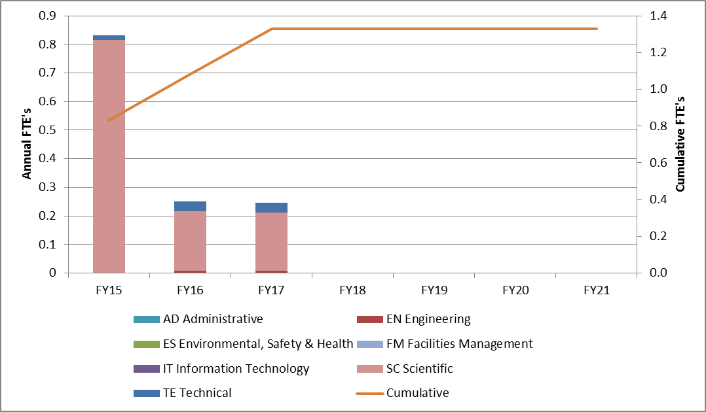
8.2 Mechanical Design

Slide 73
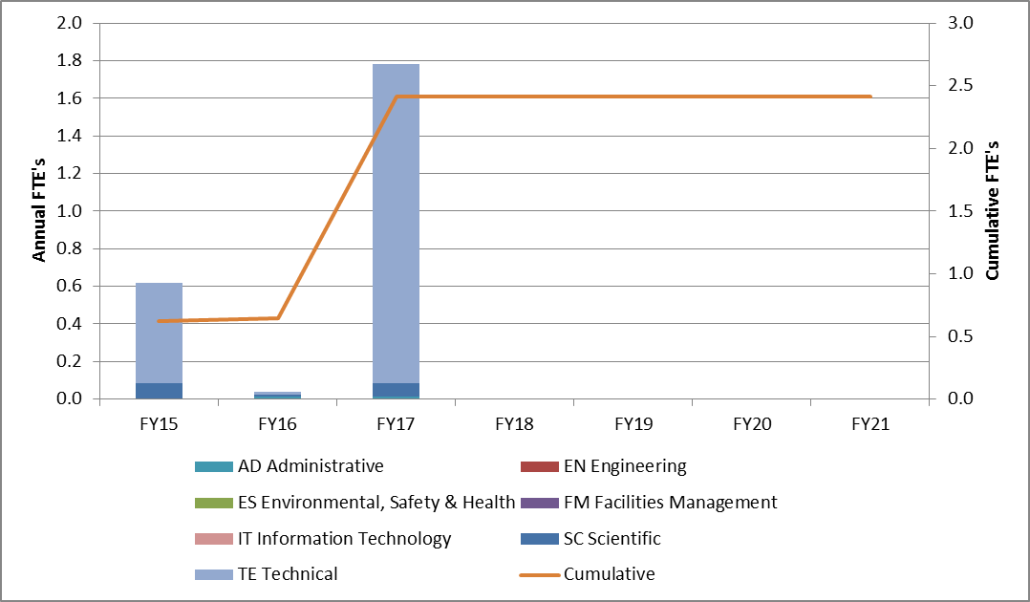
8.3 Scintillator Extrusions

Slide 74
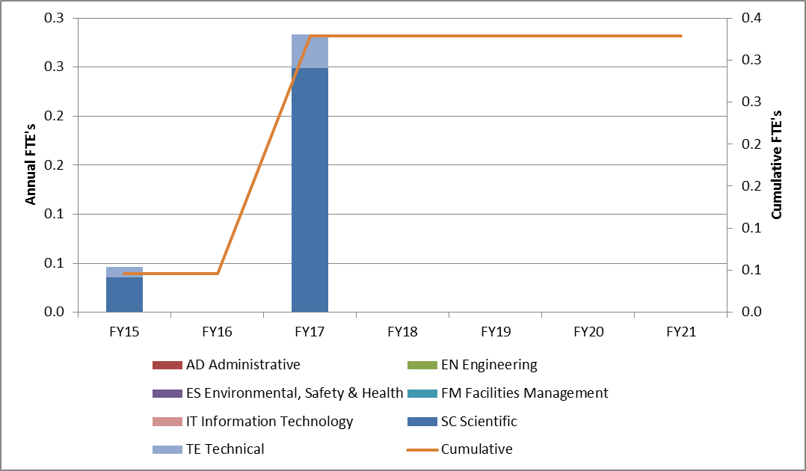
8.4 Fibers

Slide 75
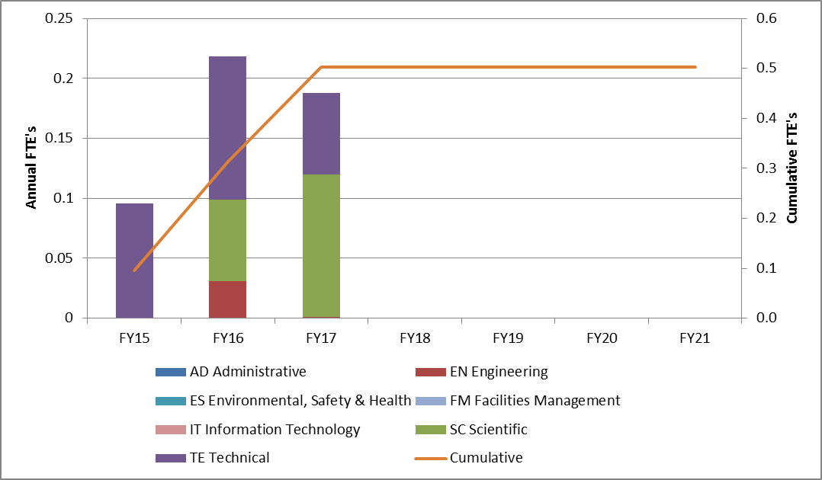
8.5 Photodetecters (SiPMs)

Slide 76
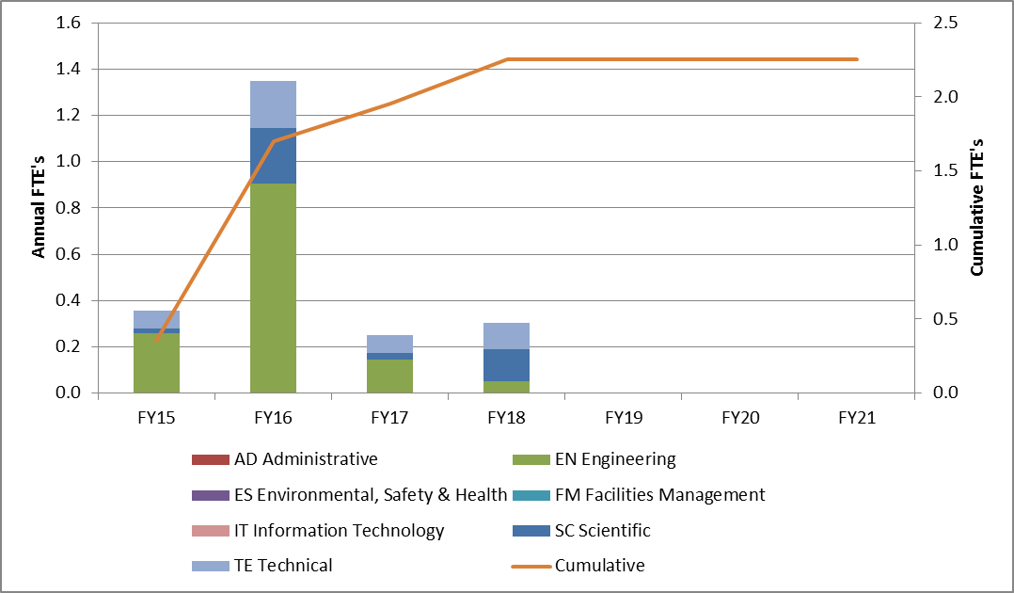
8.6 Electronics

Slide 77
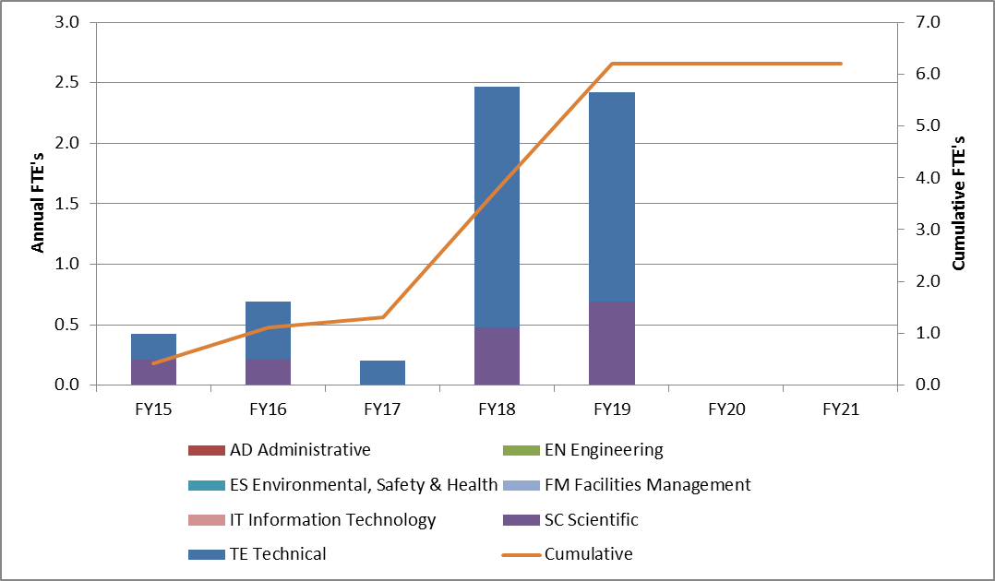
8.7 Module Fabrication

Slide 78
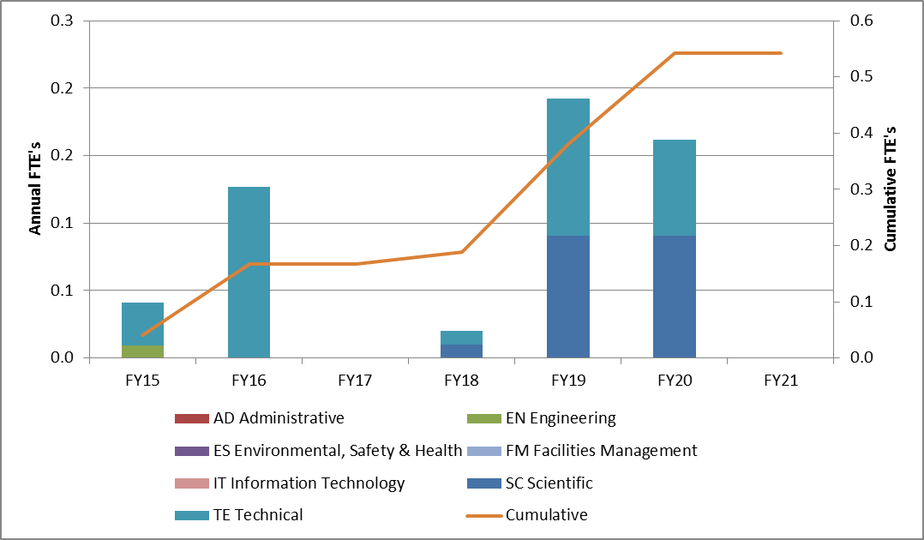
8.8 Detector Installation & Assembly

Slide 79
Project Slides: Cost Book

Slide 80
475.8 Cost Book
 | Base Cost (AY K$)
 | M&S | Labor | Total | Uncertainty (on remaining budget) | % Contingency (on remaining budget) | Total Cost
475.8.1 Project Management | 267 | 178 | 445 | 75 | 21% | 520
475.8.2 Mechanical Design | 135 | 3 | 138 | 24 | 38% | 162
475.8.3 Scintillator extrusions | 567 | 462 | 1,029 | 209 | 25% | 1,238
475.8.4 Fibers | 462 |  | 462 | 106 | 24% | 568
475.8.5 Photodetectors (SiPMs) | 464 | 305 | 769 | 190 | 41% | 959
475.8.6 Electronics | 1,314 | 407 | 1,720 | 511 | 33% | 2,231
475.8.7 Module Fabrication | 1,482 | 8 | 1,490 | 466 | 35% | 1,956
475.8.8 Detector assembly and installation | 127 | 81 | 208 | 64 | 35% | 273
475.8.9 Conceptual Design/R&D | 258 | 252 | 511 |  | 0% | 511
475.8.99 Risk Based Contingency |  |  |  | 318 | - | 318
Grand Total | 5,077 | 1,696 | 6,773 | 1,963 | 38% | 8,735

Slide 81
8.1 Project Management
 | Base Cost (AY K$)
 | M&S | Labor | Total | Uncertainty (on remaining budget) | % Contingency (on remaining budget) | Total Cost
8.01.02 Preliminary & Final Design (Post CD-1; PED) | 123 | 58 | 181 | 22 | 25% | 203
8.01.03 Implementation & Close-out (Post CD-3; Line Item) | 144 | 120 | 264 | 53 | 20% | 317
Grand Total | 267 | 178 | 445 | 75 | 21% | 520

Slide 82
8.2 Mechanical Design
 | Base Cost (AY K$)
 | M&S | Labor | Total | Uncertainty (on remaining budget) | % Contingency (on remaining budget) | Total Cost
8.02.01 Detector Design | 65 |  | 65 | 9 | 54% | 74
8.02.02 Fabricate and test Counter Prototypes | 52 | 3 | 55 | 15 | 32% | 70
8.02.03 Cosmic Ray Veto Simulations | 18 |  | 18 |  | - | 18
Grand Total | 135 | 3 | 138 | 24 | 38% | 162

Slide 83
8.3 Scintillator
 | Base Cost (AY K$)
 | M&S | Labor | Total | Uncertainty (on remaining budget) | % Contingency (on remaining budget) | Total Cost
8.03.01 Die design and procurement | 158 | 77 | 234 | 37 | 36% | 271
8.03.02 Scintillator extrusion production | 410 | 385 | 795 | 172 | 24% | 967
Grand Total | 567 | 462 | 1,029 | 209 | 25% | 1,238

Slide 84
8.4 Fibers
 | Base Cost (AY K$)
 | M&S | Labor | Total | Uncertainty (on remaining budget) | % Contingency (on remaining budget) | Total Cost
8.04.01 Waveshifting fiber (WF) procurement | 448 |  | 448 | 105 | 24% | 552
8.04.02 WF quality Assurance design and fabrication | 14 |  | 14 | 1 | 11% | 16
Grand Total | 462 |  | 462 | 106 | 24% | 568

Slide 85
8.5 Photodetectors (SiPMs)
 | Base Cost (AY K$)
 | M&S | Labor | Total | Uncertainty (on remaining budget) | % Contingency (on remaining budget) | Total Cost
8.05.01 Photodetectors (SiPMs) procurement | 409 | 36 | 445 | 148 | 36% | 593
8.05.02 Photodetectors (SiPMs) quality assurance design | 56 | 269 | 325 | 42 | 80% | 367
Grand Total | 464 | 305 | 769 | 190 | 41% | 959

Slide 86
8.6 Electronics
 | Base Cost (AY K$)
 | M&S | Labor | Total | Uncertainty (on remaining budget) | % Contingency (on remaining budget) | Total Cost
8.06.01 Counter Mother Boards | 314 | 36 | 350 | 86 | 29% | 436
8.06.02 Front-end Boards | 697 | 292 | 989 | 268 | 29% | 1,257
8.06.03 Readout Controllers | 262 | 6 | 268 | 86 | 33% | 354
8.06.04 Integration with DAQ | 41 | 73 | 113 | 70 | 80% | 184
Grand Total | 1,314 | 407 | 1,720 | 511 | 33% | 2,231

Slide 87
8.7 Module Fabrication
 | Base Cost (AY K$)
 | M&S | Labor | Total | Uncertainty (on remaining budget) | % Contingency (on remaining budget) | Total Cost
8.07.01 Design and fabricate assembly station | 163 |  | 163 | 62 | 47% | 225
8.07.02 Assembly Station Quality assurance design & fabrication | 98 | 8 | 106 | 23 | 65% | 129
8.07.03 Fabrication of Module Parts | 454 |  | 454 | 93 | 21% | 547
8.07.04 Module Production, Testing, Shipping | 741 |  | 741 | 276 | 41% | 1,018
8.07.05 Breakdown of Module Factory | 26 |  | 26 | 11 | 43% | 37
Grand Total | 1,482 | 8 | 1,490 | 466 | 35% | 1,956

Slide 88
8.8 Detector Assembly & Installation
 | Base Cost (AY K$)
 | M&S | Labor | Total | Uncertainty (on remaining budget) | % Contingency (on remaining budget) | Total Cost
8.08.01 Test Installation |  | 21 | 21 | 7 | 35% | 28
8.08.02 Recieve Production Modules at Fermilab |  | 18 | 18 | 6 | 35% | 24
8.08.03 Detector Assemly & Installation: Cosmic Ray Test Stand | 4 | 32 | 36 | 11 | 80% | 47
8.08.04 Module Support Structure | 123 | 10 | 133 | 40 | 30% | 173
Grand Total | 127 | 81 | 208 | 64 | 35% | 273

Slide 89
Project Slides: EVMS

Slide 90
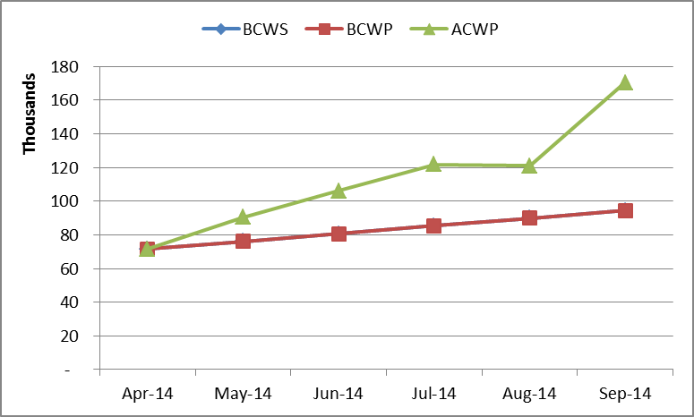
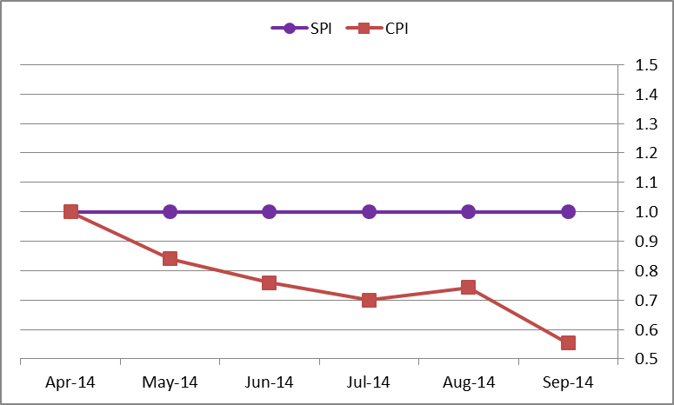
8.1 Project Management

Slide 91
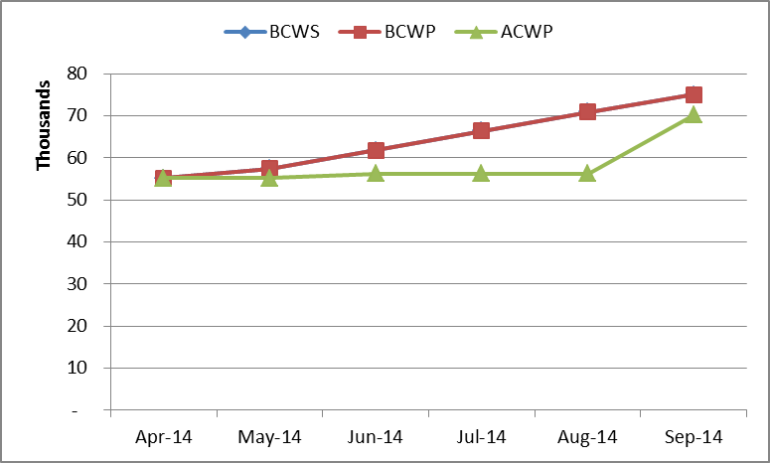
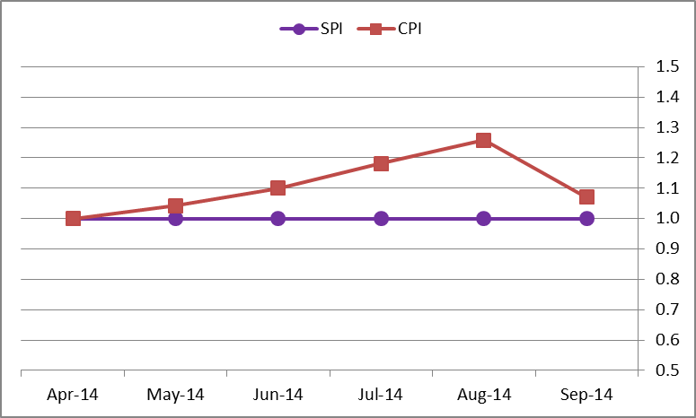
8.2 Mechanical Design

Slide 92
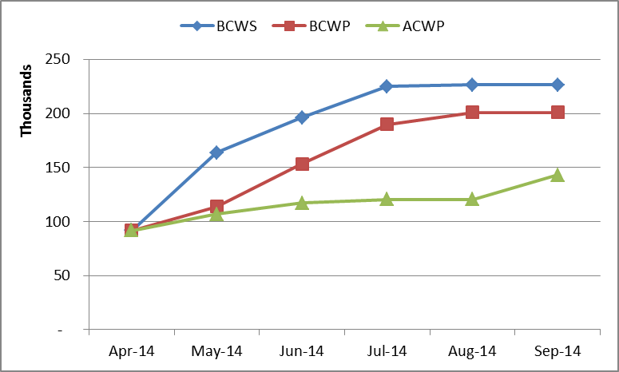
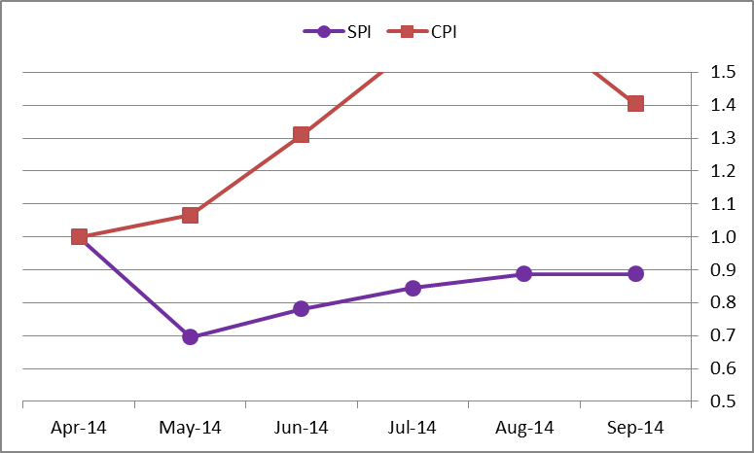
8.3 Scintillator

Slide 93
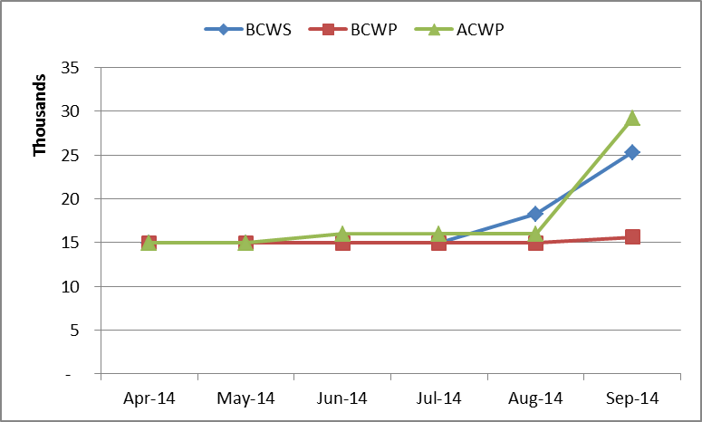

8.4 Fibers

Slide 94


8.5 Photodetectors

Slide 95


8.6 Electronics

Slide 96


8.7 Module Fabrication

Slide 97


8.8 Detector Assembly & Installation

Slide 98


8.9 OPC

Slide 99
CRV CPR

