Slide 1
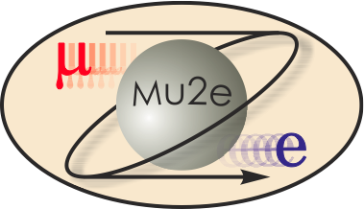
WBS 475.04.09 Ancillary Equipment
Thomas Page
Project Engineer
DOE CD-2/3b Review
October 21-24, 2014

Slide 2
Requirements
Transport Solenoid Magnet Assembly Area
Assembly area must have minimum 40 T crane, 18 ft hook clearance.
Enough room for TSu and TSd assembly in parallel with staging area for components.
Below-the-Hook (BTH) Lifting fixtures
Capacity: 60T, using two tandem cranes in Mu2e building.
Must fit through hatches in Mu2e building.
Installation equipment capable of moving magnets around within the lower level of the Mu2e building without crane coverage.

Slide 3
Transport Solenoid Magnet Assembly
TSu and TSd final assembly will take place in the Heavy Assembly Building (HAB, formally CDF), west end.
TS coil modules and cryostat components procured from industry.
Final magnet assembly completed at Fermilab.
Workflow for TS coil modules
Coil modules arrive at FNAL in Industrial Building 4.
After initial QC, coils will be moved to Industrial Building 2.
Magnetic measurements and testing preparations are performed in Industrial Building 2.
Coil modules are moved to the Solenoid Test Facility for testing.
After testing, coil modules will be moved to HAB for assembly preparation and staging.

Slide 4
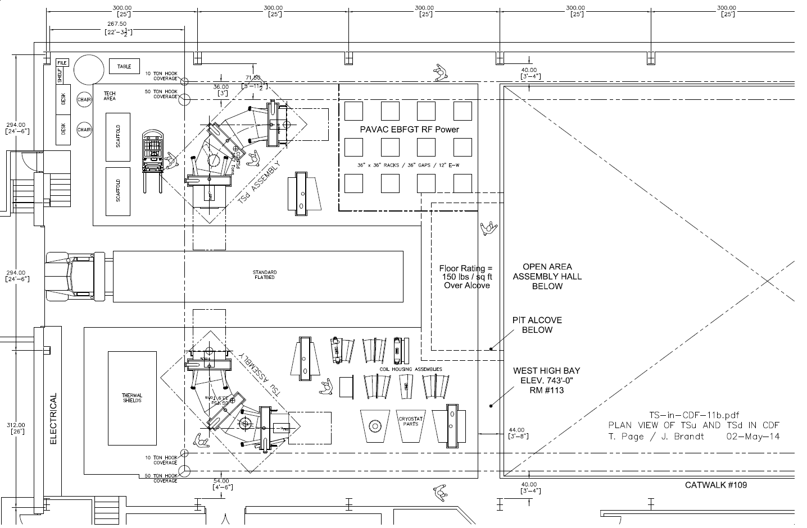
HAB (formally CDF) TS Assembly Layout

Slide 5
Tooling for Magnet Installation
Detector solenoid can be placed in final position by crane.
Production solenoid and transport solenoids are not fully under crane coverage so they must be moved into place using tooling.
Method for moving magnets will be similar to that used for moving the CDF detector.
Track plates integrated into the building floor
Hillman rollers placed under the magnet frame
Large hydraulic cylinders used to push or pull the magnet and frame along the track plates
This tooling will be shared with the Muon Beamline (WBS 475.05) to save costs.

Slide 6
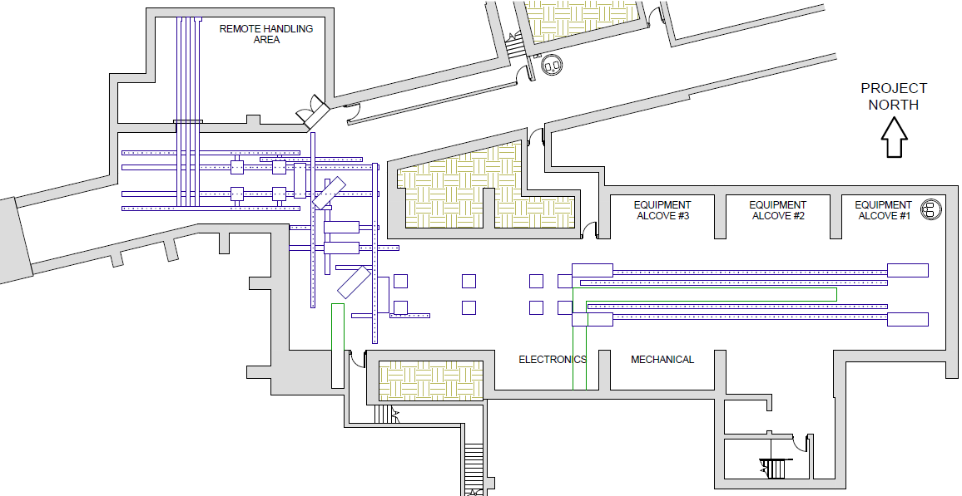
Mu2e Building Transport Rail Layout
Hatch area
System similar to that used for moving CDF detector.

Slide 7
Improvements since CD-1
Production Solenoid lowered through TS hatch instead of separate outside hatch.
Assembly space was moved from the Industrial Center Building to HAB.

Slide 8
Value Engineering since CD-1
Muon Beamline is using a similar rail system to allow for sharing of the magnet installation tooling.

Slide 9
Remaining work before CD-3c
Final tooling designs need to be completed when the magnet details are known.

Slide 10
Organizational Breakdown
WBS 4.9
Ancillary Equipment
T. Page
WBS 4.9.2
Below-the-Hook Lifting Equipment
WBS 4.9.3
Installation Equipment
WBS 4.9.1
Magnet Assembly Equipment

Slide 11
Quality Assurance
Tooling components will be fully tested and qualified before use in production.
BTH lifting fixtures will be load tested to 125% of capacity per FESHM 5022.

Slide 12
ES&H
BTH Lifting Fixtures will comply with the Fermilab ESH&Q Manual, Chapter 5022.
HA’s will be written and followed by workers covering the following:
Manipulating heavy objects
Personnel allowed to operate cranes
Personnel allowed to operate fork trucks
Proper PPE
Any special considerations

Slide 13
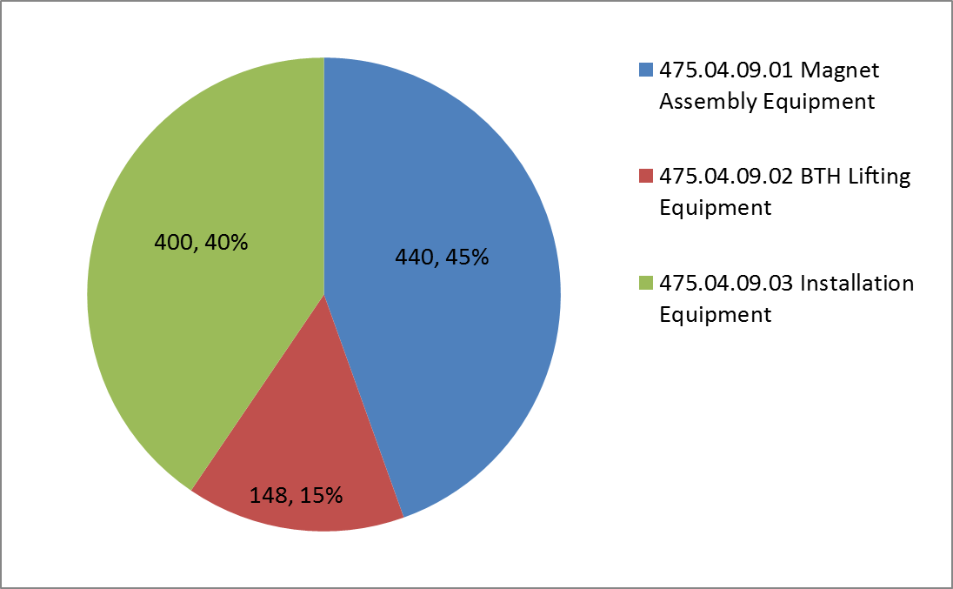
Cost Distribution by L4
Base Cost by L4 (AY $k)

Slide 14
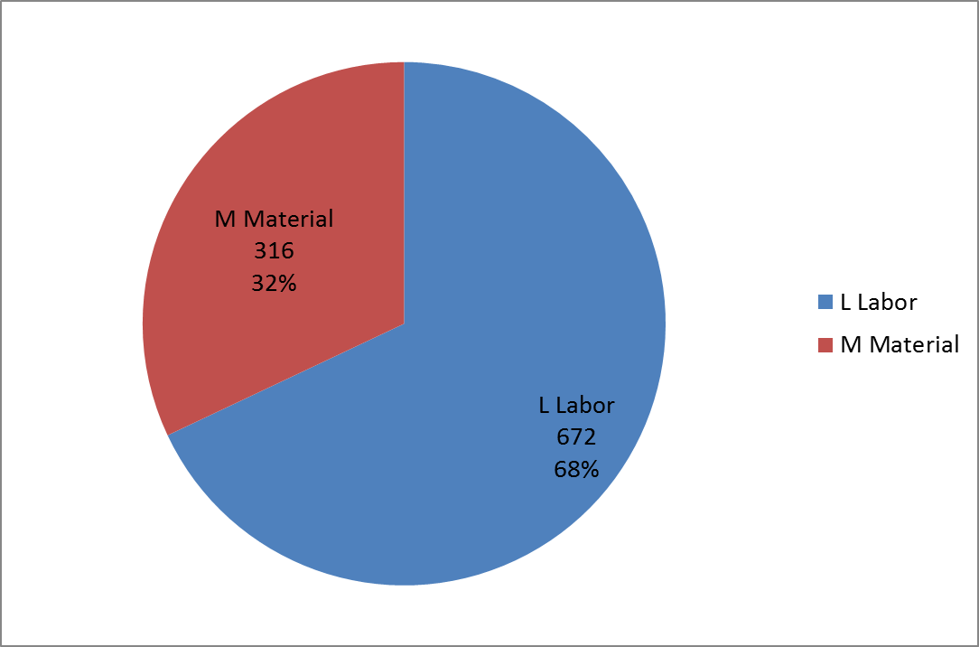
Cost Distribution by Resource Type
Base Cost (AY $k)

Slide 15
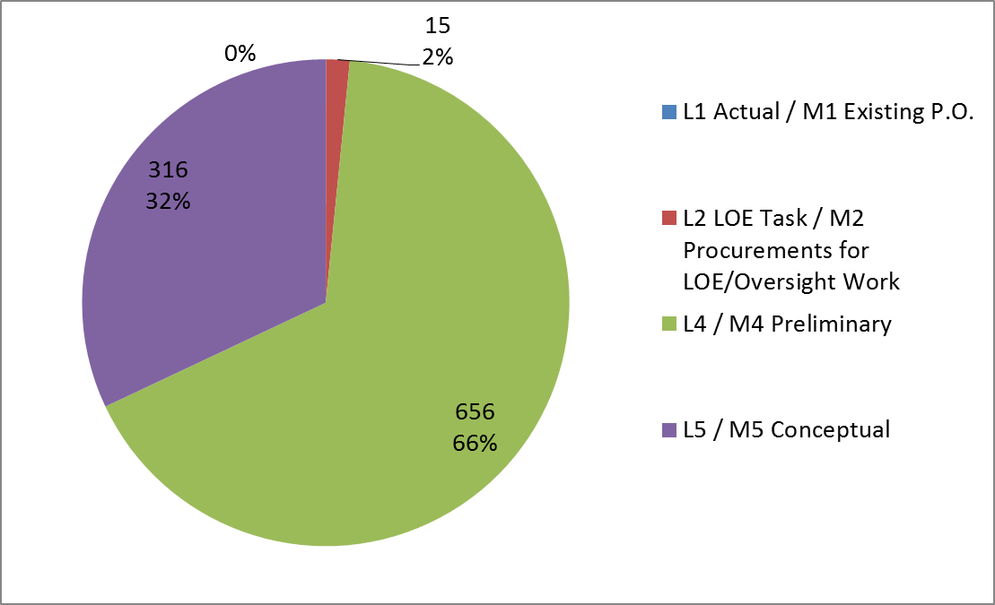
Quality of Estimate
Base Cost by Estimate Type (AY $k)

Slide 16
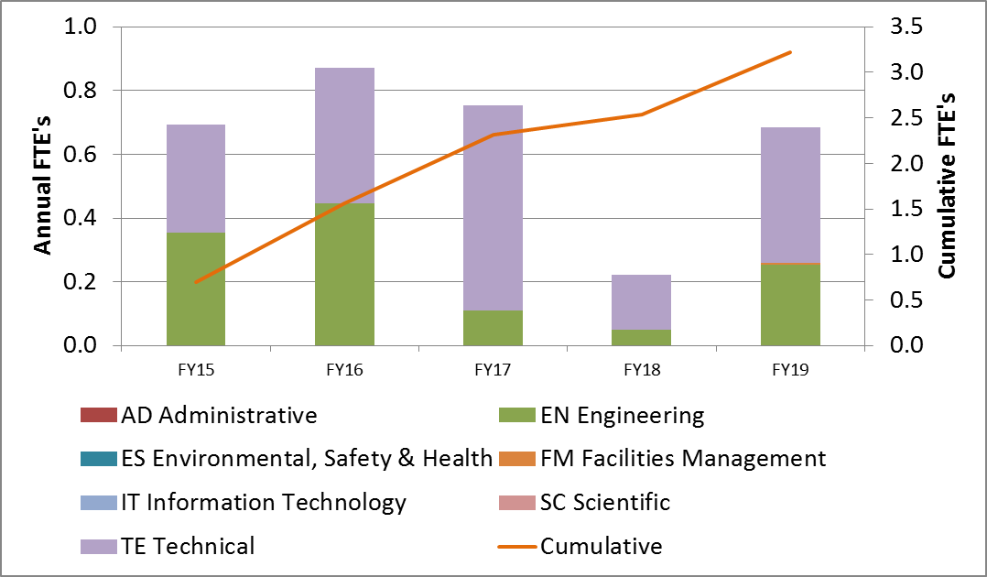
Labor Resources
FTEs by Discipline

Slide 17
Cost Table
WBS 4.9 Ancillary Equipment
Costs are fully burdened in AY $k

Slide 18
Major Milestones
Activity ID | Activity Name | Date
47504.9.1.001120 | T5 - Final design of Magnet Assembly Equipment complete | 6/23/2016
47504.9.2.001120 | T5 - Final design of BTH Lifting Equipment complete | 11/5/2015
47504.9.3.001080 | T5 - Final design of Installation Equipment complete | 4/18/2016

Slide 19
Schedule
CD-3a
CD-3c
CD-2/3b
CD-4
Fabricate and QA Superconductor
KPPs Satisfied
Solenoid Design/Prototypes
Solenoid Fabrication and QA
Detector Hall Construction
Solenoid Infrastructure
Solenoid Installation and Commissioning
Tooling Design and Fabrication
Q3 | Q4 | Q1 | Q2 | Q3 | Q4 | Q1 | Q2 | Q3 | Q4 | Q1 | Q2 | Q3 | Q4 | Q1 | Q2 | Q3 | Q4 | Q1 | Q2 | Q3 | Q4 | Q1 | Q2 | Q3 | Q4 | Q1 | Q2 | Q3 | Q4 | Q1 | Q2 | Q3 | Q4
FY14 FY15 FY16 FY17 FY18 FY19 FY20 FY21

Slide 20
Summary
Components will comply with all applicable FESHM Chapters.
Tooling components are ready for CD-2.

