Slide 1
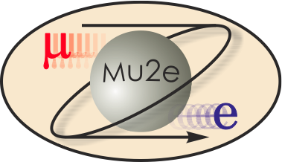
WBS 475.04.10 System Integration, Installation and Commissioning
Jeff Brandt
Mechanical Engineer
DOE CD-2/3b Review, October 21-24, 2014

Slide 2
Requirements
Two 30 Ton cranes which can be connected and controlled in tandem for use as a 60 Ton crane – needed for all solenoids.
All heavy lifts through MAIN and TS hatches.
An embedded floor track system to transport PS, TSu, and TSd solenoids into place.
Embedded solenoid floor pads must accommodate large forces from magnet system interaction.
Infrastructure to support solenoid power and cryogen delivery, insulating vacuum, and instrumentation needs.

Slide 3
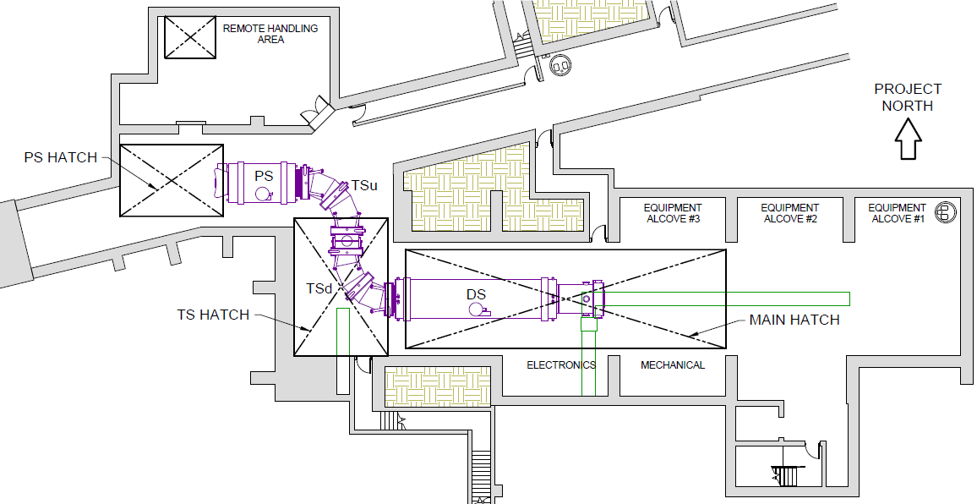
Design – Solenoids, Building and Hatches

Slide 4
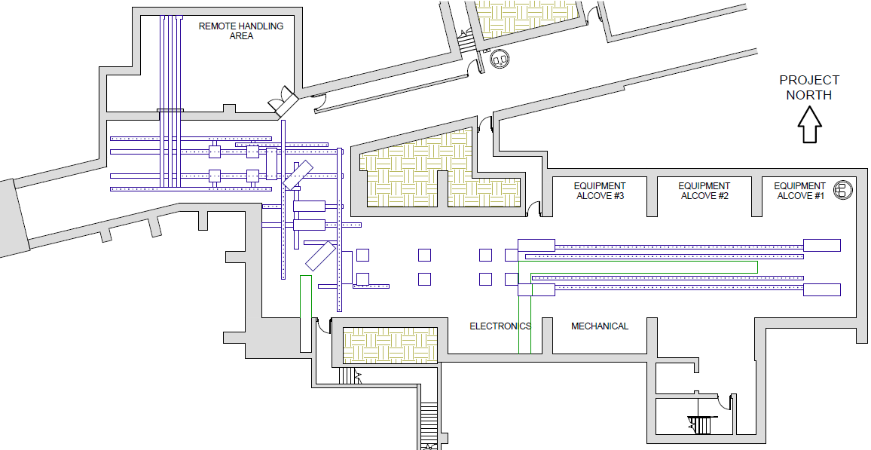
Design – Floor Tracks and Floor Pads

Slide 5
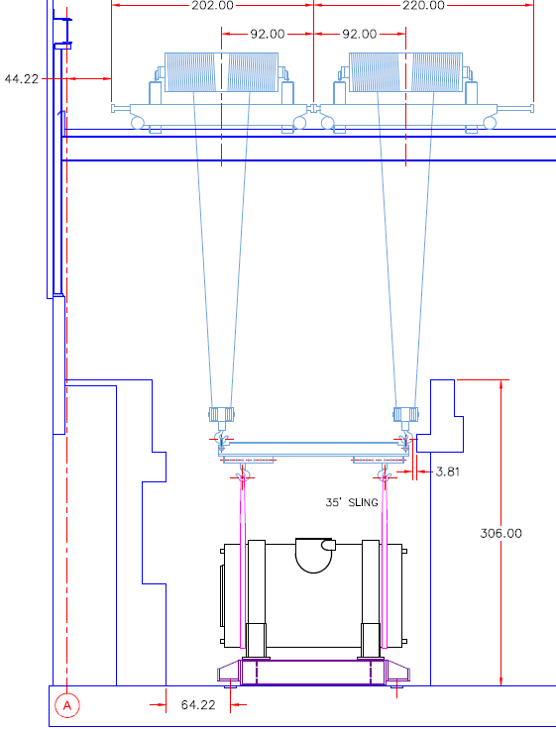
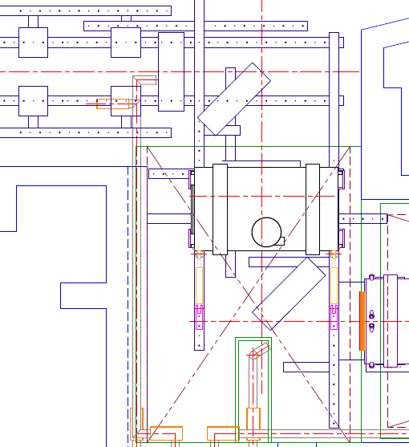
Design – PS Installation
Side view – lowered into place
Top View – ready for transport

Slide 6
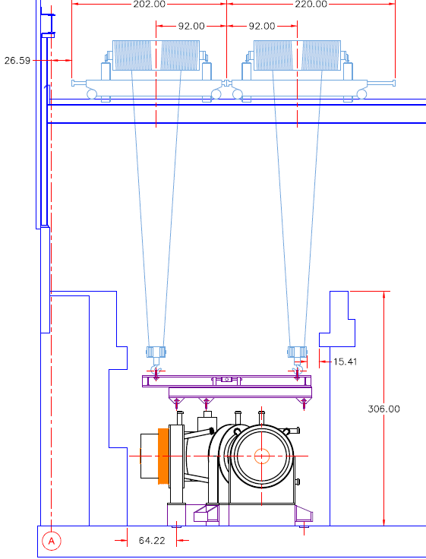
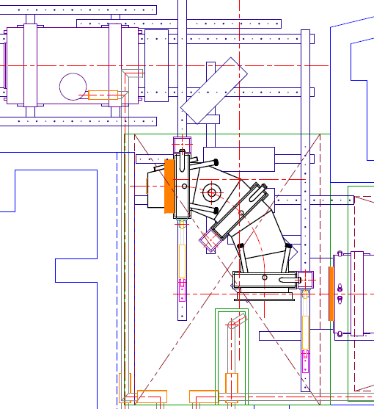
Design – TSu Installation
Side view – lowered into place
Top View – ready for transport

Slide 7
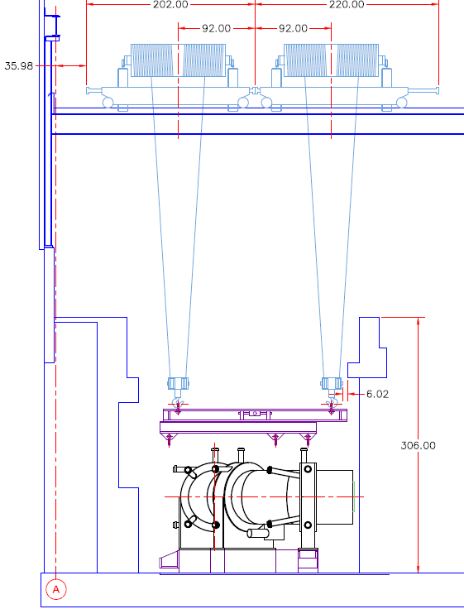
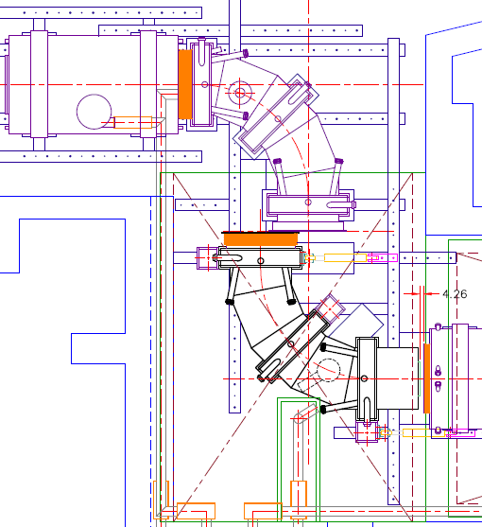
Design – TSd Installation
Side view – lowered into place
Top View – ready for transport

Slide 8
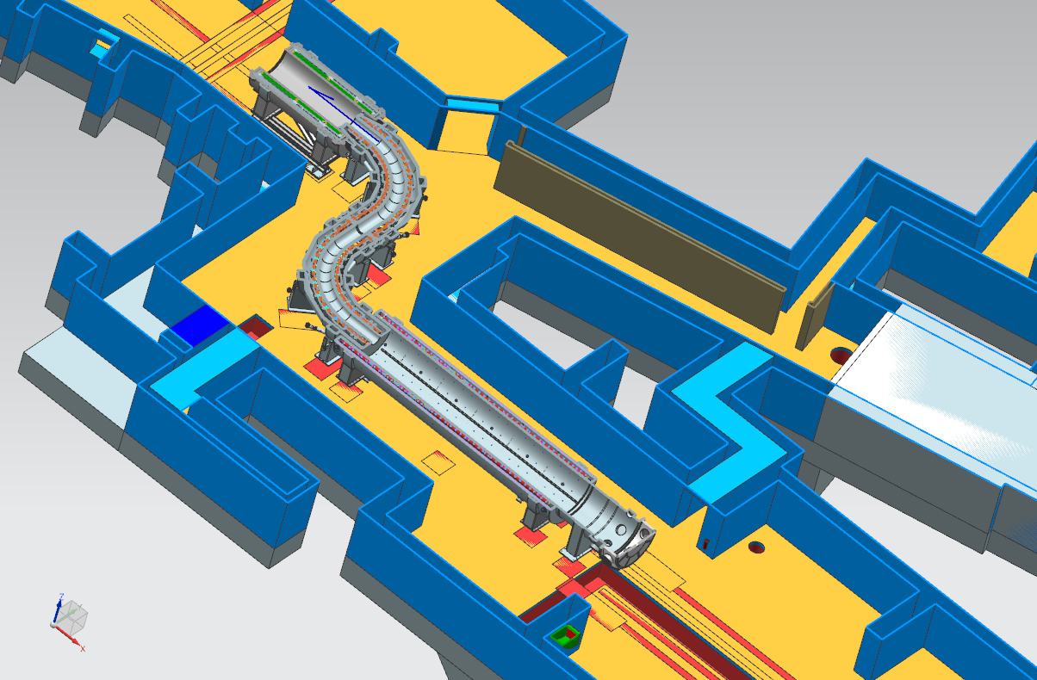
Design – 3D Integration Model

Slide 9
Improvements since CD-1
Decision to perform all heavy lifts through MAIN and TS hatches, avoiding crane and climate issues with PS hatch.
Revisions and additions to embedded floor track system.
Location of transfer line routing and connection to each solenoid – addition of cross trench for TSd connection.

Slide 10
Value Engineering since CD-1
Significant cost savings in avoiding large crane rentals for PS hatch lifts.
Common outriggers attach to all solenoid support feet and frames, as well as Heat and Radiation Shield (HRS) tooling.
Transport and jacking system tooling shared across other WBS sub-projects, common for all major solenoid, equipment, and shielding moves.

Slide 11
Remaining work before CD-3
Finalize solenoid interfaces.
Finalize alignment designs for solenoids.
Complete detailed installation and commissioning plans integrated across project.
Generate design documentation per chapter 4 of the Fermilab Engineering Manual and review per chapter 5.
Produce final design engineering drawings.
Complete incorporation of all systems into 3D Integration Model.

Slide 12
Quality Assurance
Building will be fully networked by metrology experts.
Detailed installation and commissioning plans, integrated across project, will be implemented using Travelers.
All tasks will be signed off, critical tasks will be verified by metrology and responsible engineer.
Responsible engineer is L3 and CAM, is heavily involved in building, infrastructure, interface, and installation tooling designs, and is L4 for Support Frames and Interconnects.

Slide 13
ES&H
All required Engineering Notes will be written. All personnel will follow Hazard Analyses and Procedures written to cover the following ES&H concerns:
Very large and very heavy objects.
Overhead lifts with cranes connected in tandem.
Pressurized hydraulic fluid in jack and transport systems.
Working at heights and working overhead.
Welding, cutting, and grinding during fit-up and installation.
Working with hand and power tools using proper PPE.

Slide 14
Cost Table
WBS 475.04.10 System Integration,
Installation and Commissioning
Costs are fully burdened in AY $k
 | Base Cost (AY k$)
 | M&S | Labor | Total | Estimate Uncertainty (on remaining costs) | % Contingency on ETC | Total Cost
475.04 Solenoids
475.04.10 System Integration, Installation and Commissioning | 548 | 4,647 | 5,195 | 1,870 | 39% | 7,065
Grand Total | 548 | 4,647 | 5,195 | 1,870 | 39% | 7,065

Slide 15
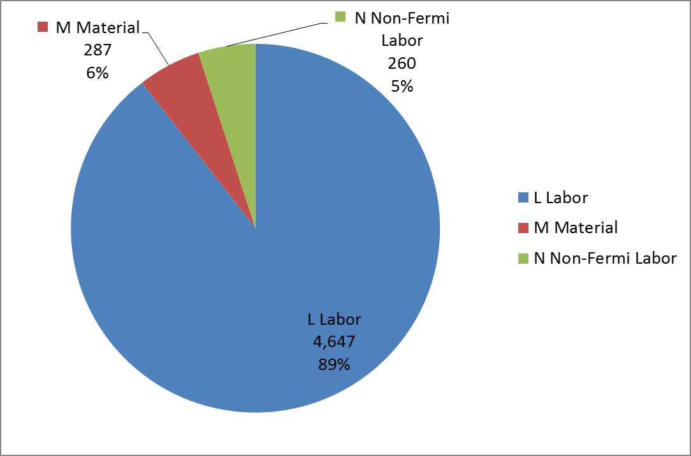
Cost Distribution by Resource Type
Base Cost (AY $k)

Slide 16
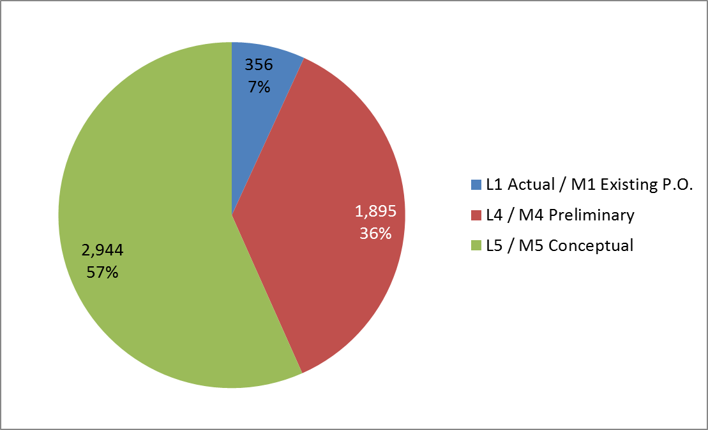
Quality of Estimate
Base Cost by Estimate Type (AY $k)

Slide 17
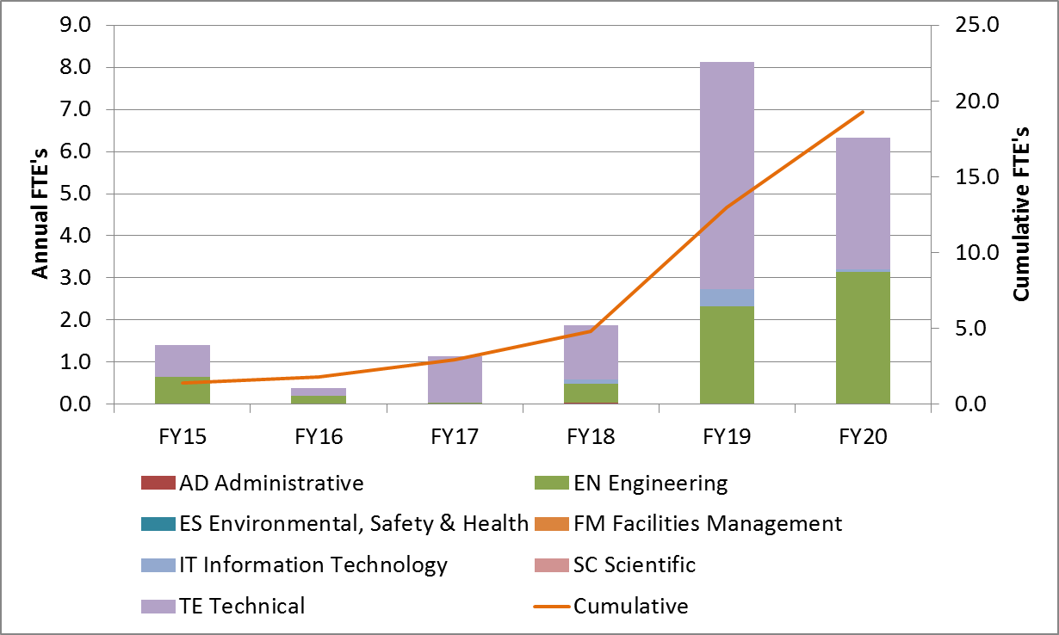
Labor Resources
FTEs by Discipline

Slide 18
Major Milestones
Activity ID | Activity Name | Date
47504.10.000550 | Final design complete | 7/1/2015
47504.10.000950 | Building ready for solenoid installation | 8/7/2018
47504.10.002850 | Transfer line from cryo-plant complete (by GPP) | 7/17/2017
47504.10.002900 | Cryo plant operational (by GPP) | 7/17/2017
47504.10.005950 | Solenoid install complete, ready for cool-down | 4/9/2020
47504.10.006850 | KPP on-project solenoid commissioning complete | 9/29/2020

Slide 19
Schedule
CD-3a
CD-2/3b
CD-3c
CD-4
Fabricate and QA Superconductor
KPPs Satisfied
Solenoid Design / Prototypes
Solenoid Fabrication and QA
Detector Hall Construction
Solenoid Infrastructure
Solenoid Installation and Commissioning
Building Beneficial Occupancy
WBS 475.04.10 Planning
System Integration, Installation and Commissioning
Q3 | Q4 | Q1 | Q2 | Q3 | Q4 | Q1 | Q2 | Q3 | Q4 | Q1 | Q2 | Q3 | Q4 | Q1 | Q2 | Q3 | Q4 | Q1 | Q2 | Q3 | Q4 | Q1 | Q2 | Q3 | Q4 | Q1 | Q2 | Q3 | Q4 | Q1 | Q2 | Q3 | Q4
FY14 FY15 FY16 FY17 FY18 FY19 FY20 FY21

Slide 20
Summary
Solenoid installation and commissioning needs are fully integrated with conventional construction design.
Systems required for solenoid operation are well defined, supported by building, and included in preliminary design.
ESH&Q, Labor, and M&S well understood.
Integrated installation and commissioning plans in process.
WBS 475.04.10 System Integration, Installation and Commissioning ready for CD-2.

