Slide 1
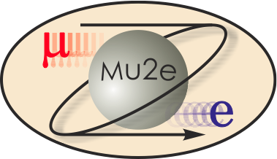
Mu2e DOE CD-2 Review: Resonant Extraction L3
Vladimir Nagaslaev
Resonant Extraction L3 Manager
10/22/2014

Slide 2
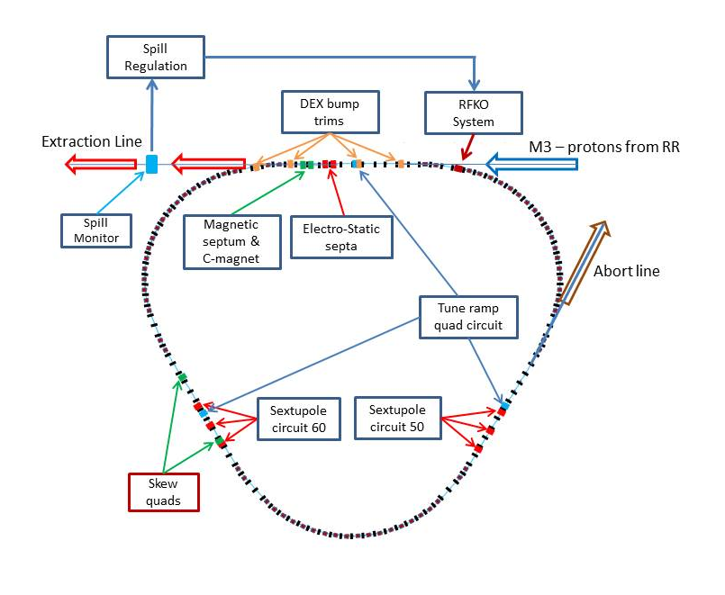
WBS 475.02.05 Resonant Extraction System
The scope of the Resonant Extraction Systems includes:
Development of the physics model
Design, fabrication and installation of:
Tune quad magnets (3)
Sextupole magnets (6)
Dynamic bump correctors (4)
Skew quad magnets (2)
Electro static septa (2)
Spill Monitor (1)
RFKO system (1)
Spill regulation electronics (1)
Map of Resonant Extraction elements in the Delivery Ring (L=505m)

Slide 3
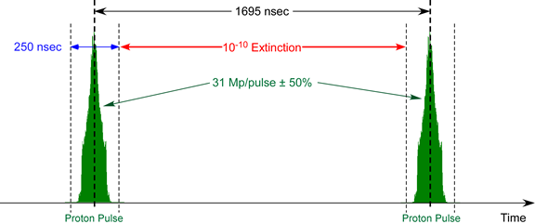
Requirements
Slow extraction preserves the time structure of the proton beam circulating in the Delivery Ring
Time structure of the proton beam on target
Mu2e Proton Beam Requirements (doc-1105)
Parameter | Design | Limit
Length of slow spill period | 54 ms | >20 ms
Average intensity per pulse on target | 31 Mp | <50 Mp
Maximum variation of pulse intensity on target | ±50% | ±50%

Slide 4
Design: Delivery Ring Spill Parameters
Parameter | Value | Units
MI Cycle time | 1.333 | sec
Number of spills per MI cycle | 8
Number of protons per micro-pulse | 3.1×10⁷ | protons
Maximum Delivery Ring Beam Intensity | 1.0×10¹² | protons
Instantaneous spill rate | 18.5×10¹² | protons/sec
Average spill rate | 6.0×10¹² | protons/sec
Duty Factor (Total Spill Time ÷ MI Cycle Length) | 32 | %
Duration of each spill | 54 | msec
Spill On Time per MI cycle | 497 | msec
Spill Off Time per MI cycle | 836 | msec
Time Gap between 1st set of 4 and 2nd set of 4 spills | 36 | msec
Time Gap between spills | 5 | msec
Pulse-to-pulse intensity variation | ±50 | %
Extraction efficiency | 98 | %

Slide 5
Design

Slide 6
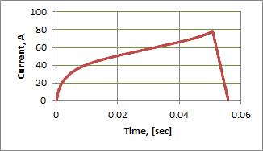
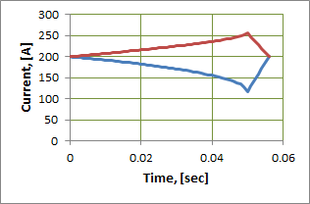
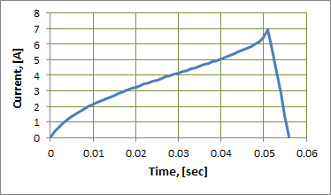
Design: Main Magnets and Power Supplies
Derived requirements/specs for
3 families of specialized magnets to drive the slow extraction
Sextupole magnets
Tune ramp quad magnets
DEX – dynamic bump correctors
Magnet | Quantity | Integrated gradient excursion | Base* Current, [A] | Max Current Excursion, [A] | Max supply Current [A] | Max dI/dt [A/sec] | Regulation accuracy, % | Regulation stability | Curve accuracy | Ripple, %
Tune Quad | 3 | 0.2 T | 0 | 80 | 100 | 16,000 | <0.5% | <0.5% | <0.5% | <0.05%
Sextupoles | 6 | 32 T/m | 200 | +-80 | 300 | 16,000 | <0.5% | <0.5% | <0.5% | <1%
DEX trims | 4 | 0.014 Tm | ND | 14 | +-40 | 2,800 | <1% | <1% | <1% | <1%
Tune quad ramp curve I(t)
Sextupole ramp curve I(t)
DEX bump ramp curve I(t)

Slide 7
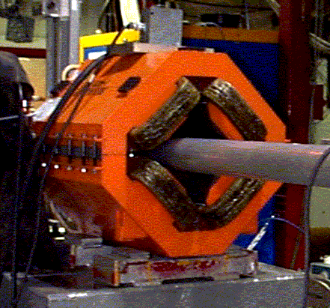
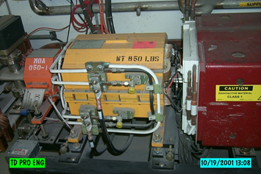
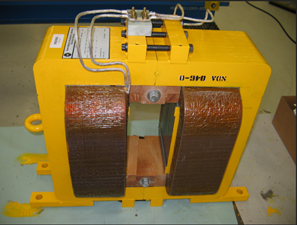
Design: Solution for Magnets and PS
Tune quad magnets : CQA | Sextupole magnets : ISA | Dynamic bump trims: NDB
Cooling Ring magnets, available in abundance. Some refurbishing may be needed. | Existing design of Main Injector sextupoles. Spare magnets are not available – will be built. | Debuncher style correctors. Available in working conditions
Power supplies for all magnet types will be built on the basis of the Booster switch-mode 65A 180 V units
2 units in parallel 3 independent bulk supplies; | 6 units in parallel to provide 300A current for each circuit | Split magnet coils in 2; Upgrade bulk supply to 350V with higher voltage FETs and filter module
Status: building PS prototypes and testing magnets with representative ramps will complete the Final design for magnets and their power supplies.

Slide 8
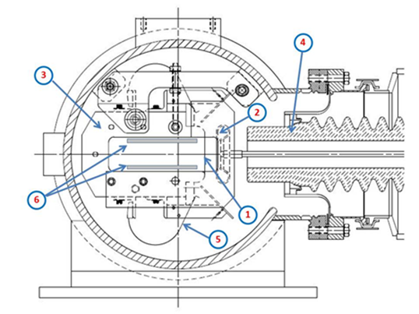
Design: Electrostatic Septa
Design considerations for ESS:
Foils instead of wires (advantages!)
Rad levels → Minimize service time in tunnel and maximize septa lifetime
2 septa straddle the focusing quad Q203
Main technical challenge:
Strive to achieve HV>100kV
Vacuum conditions in Delivery Ring
Using prior experience:
Building ESS for MI at FNAL
Building ES Separators for Tevatron
Other labs experience with ESS

Slide 9
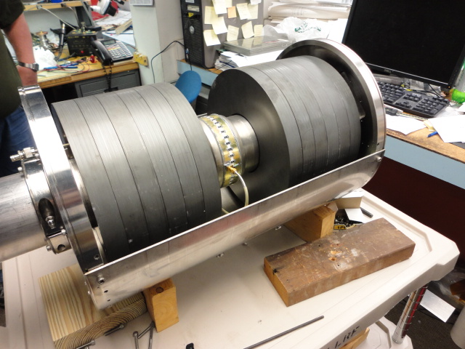
Design: Spill Monitoring
Fast spill rate monitoring is required for effective regulation. A WCM Spill Monitor prototype has been built and tested.
This device will be used as a working module - no new fabrication is needed.

Slide 10
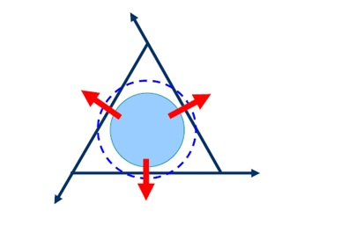
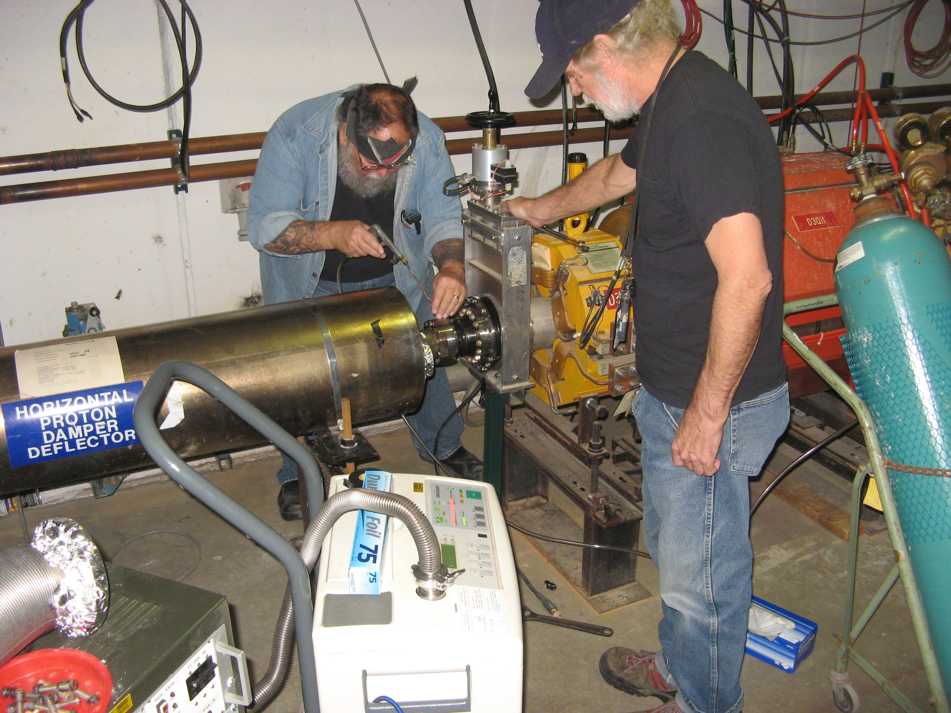
Design: RF Knock-Out
Fast ripples on the spill rate will be regulated with the RF Knock-Out method that employs transverse heating of the beam.
Kicker waveform is FM-ed to cover the beam betatron frequency spread.
AM is provided by the regulation logic
Reuse old Tevatron damper kicker as the RFKO device.
RFKO beam heating rates have been measured with beam
The kicker has been identified, prepped and tested with the beam: Ready for use.

Slide 11
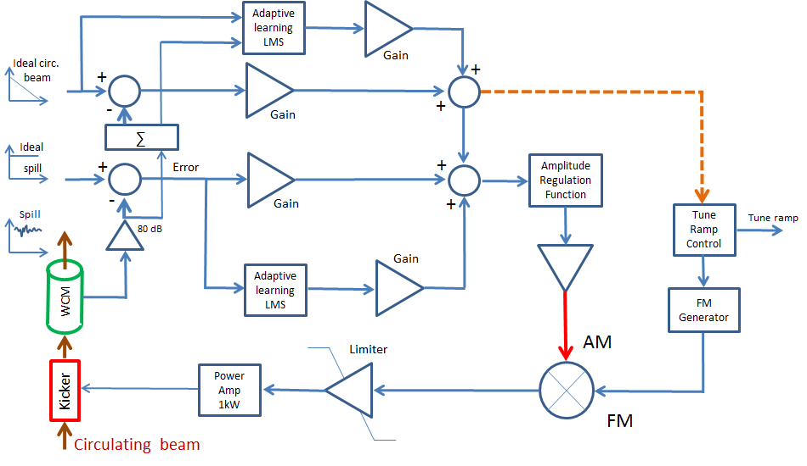
Design: Spill regulation electronics
Regulation logic is realized in the MVME5500 processor
Slow regulation (feedforward) to the tune quad ramp
Fast regulation (feedback) to the RFKO kicker
Currently we are doing prototyping in order to validate design solutions.
This will complete the Final Design of Spill Regulation Electronics

Slide 12
Performance
Physics Design
ESS R&D

Slide 13
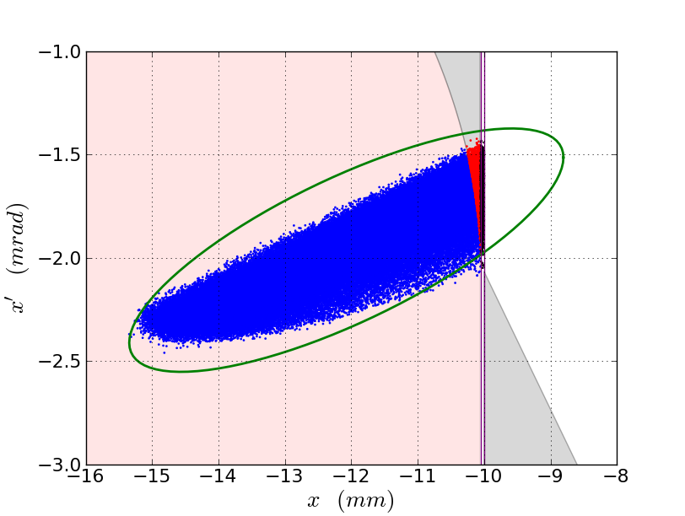
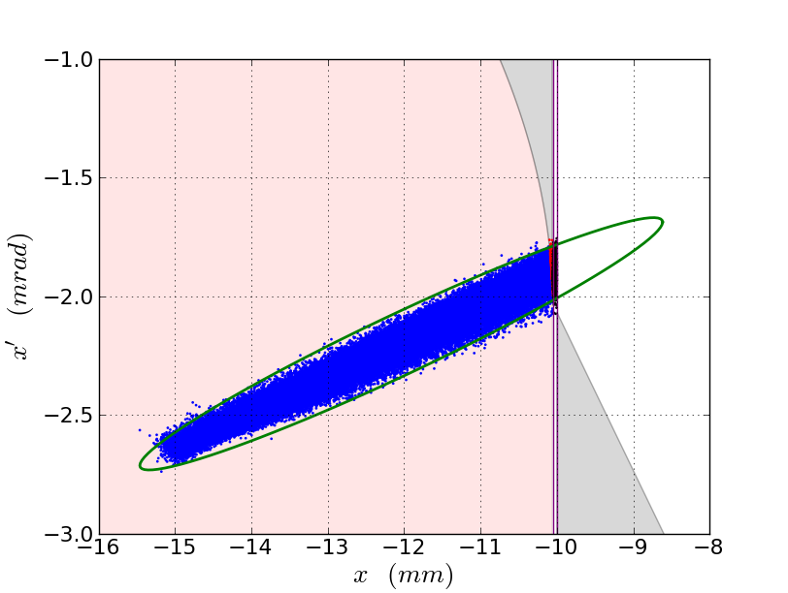
Performance: Synergia tracking simulations
Synergia – state of the art tool
Model improved since CD1
All features: DEX, RF, RFKO, aperture, ramping
Full spill
Substantially sped up
Main results:
Main parameters verified and optimized through the entire spill
Performance consistent with earlier ORBIT simulations and physics model; no showstoppers within known physics
RFKO process - heating rates consistent with expected
Status: Complete
Extracted beam footprint, DEX bump off
Extracted beam footprint, DEX bump on

Slide 14
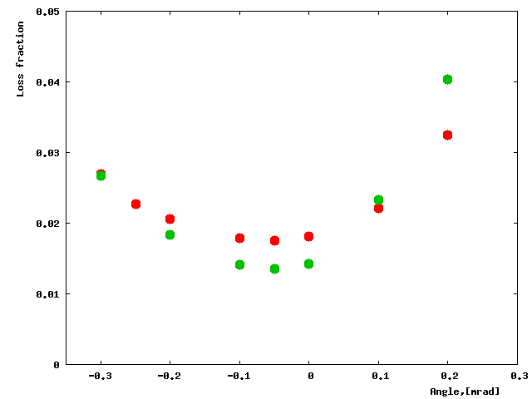
Performance: MARS tracking simulations
Tracking extracted beam with MARS code:
Tracking particles in media and DC fields
Detailed calculations of interaction with materials
Radiation levels, Residual activation, Energy deposition, etc
Essential for beam loss calculations and geometry optimization
Main outcomes include:
Wires do not have advantage over foils in terms of losses
Fine alignment is important
Performance can be improved by making septa asymmetric
Using a pre-scattering diffuser reduces losses further
Losses vs beam angle.
Status: Complete
Red- 100μ wires; Green- 50μ foils

Slide 15
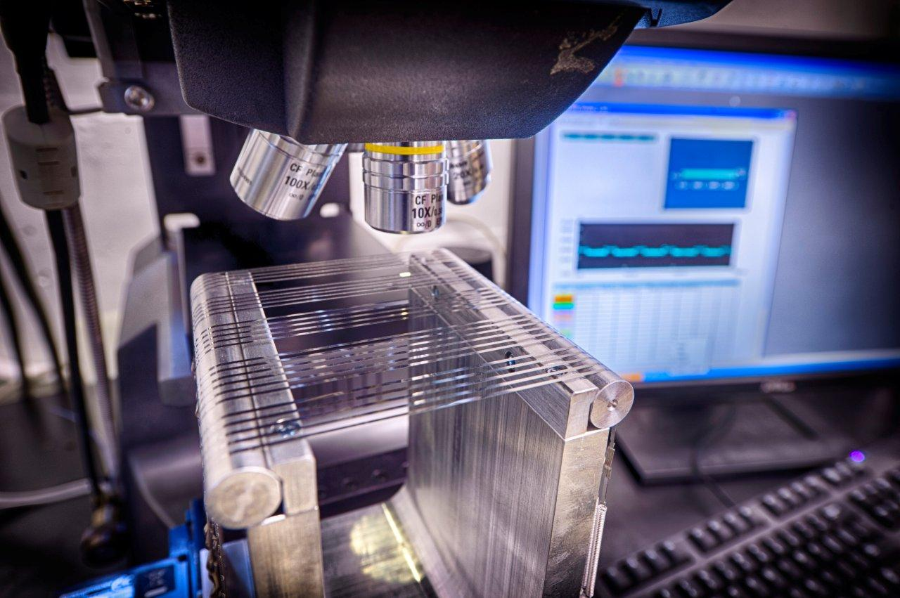
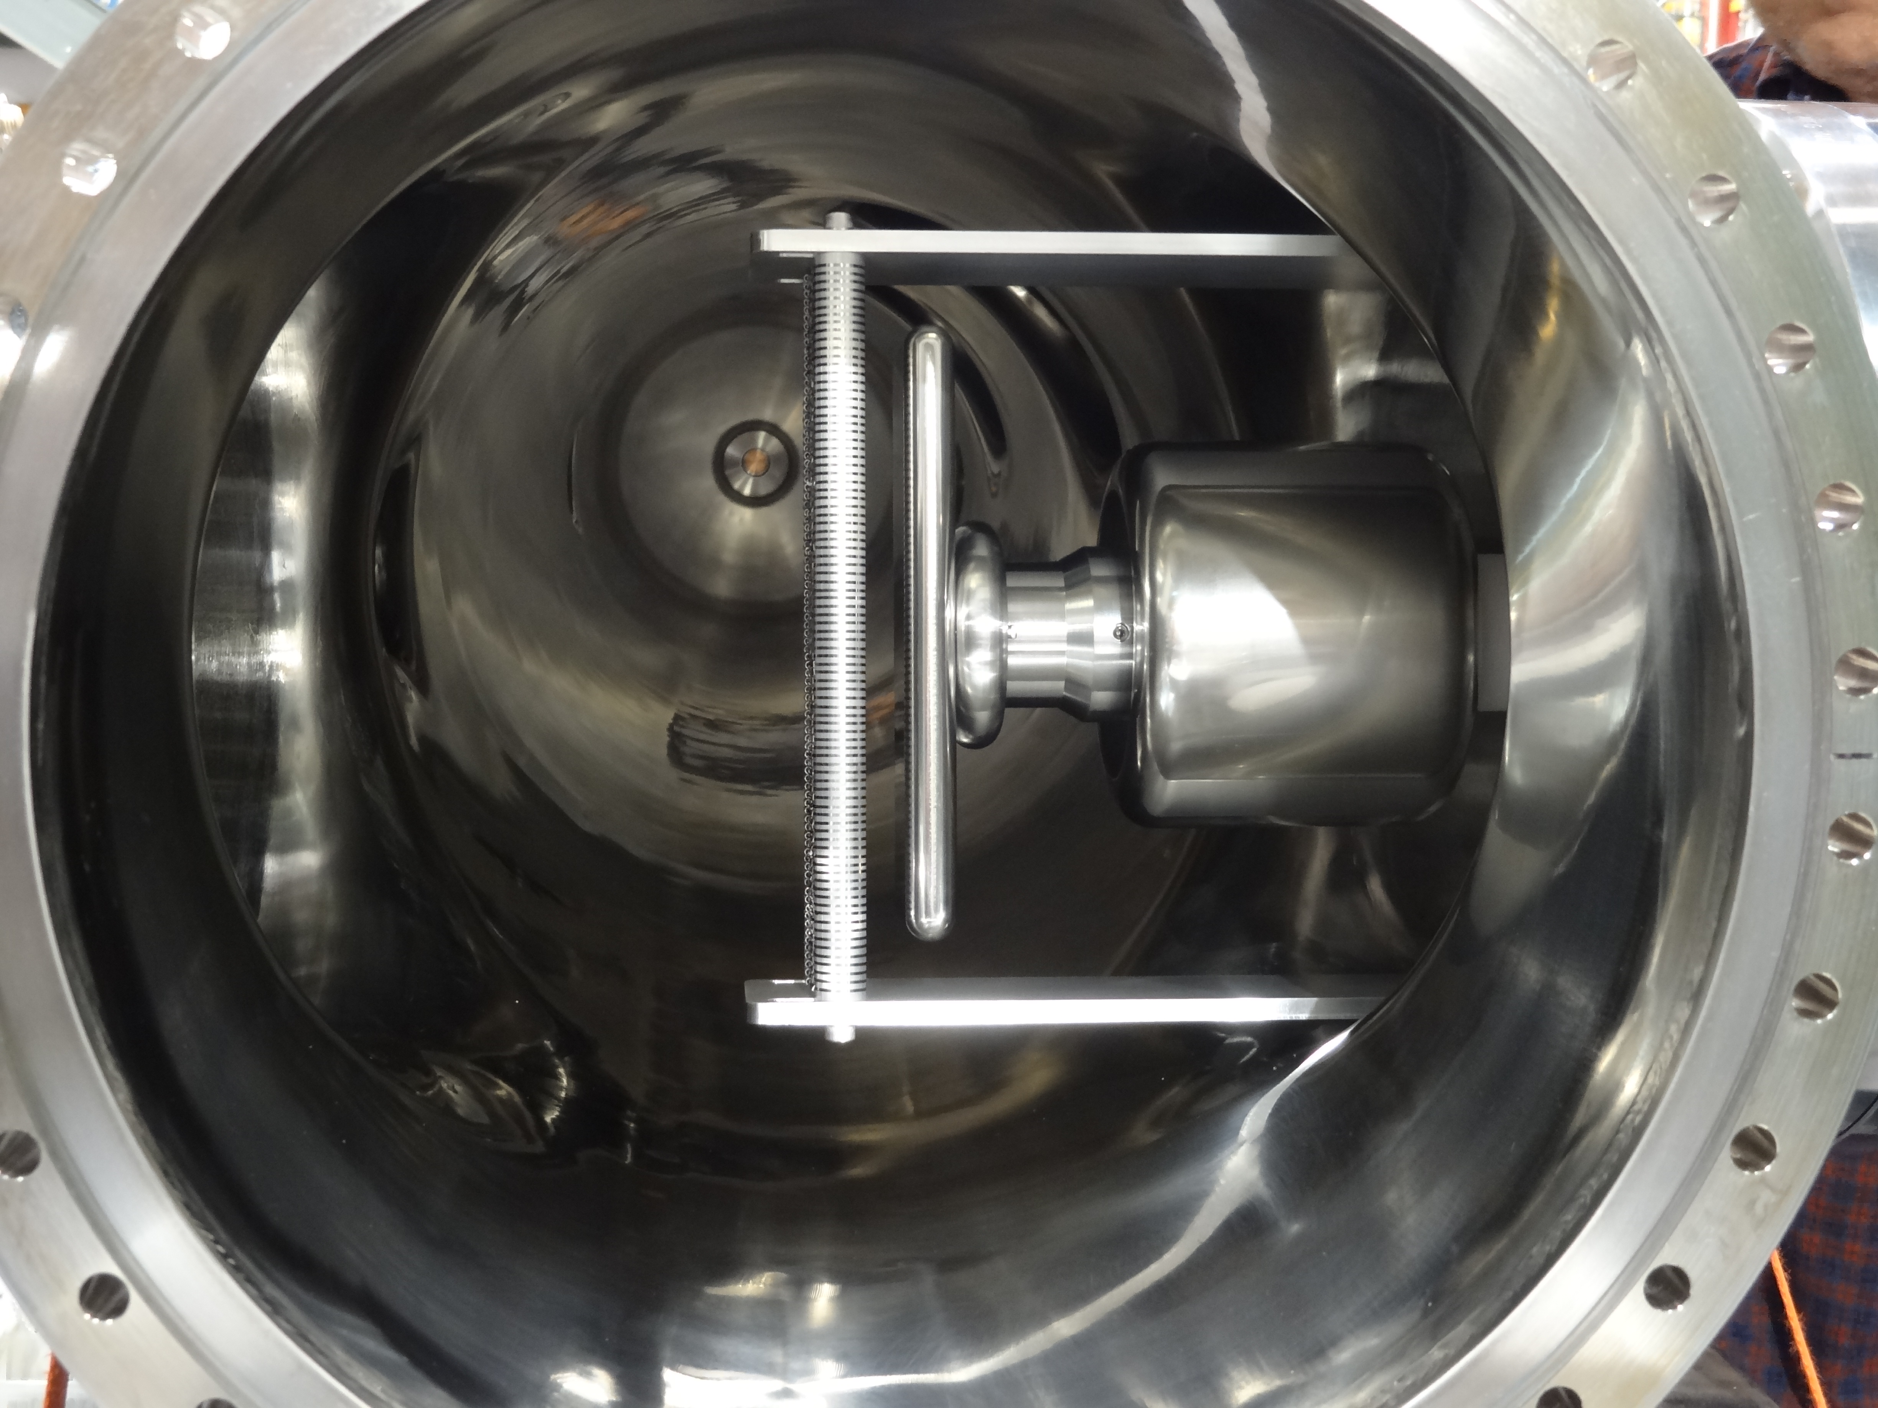
Performance: ESS studies
FEA field calculations:
Determined optimal geometries with foils and electrodes
Prototype-I:
Built a prototype to study mechanical properties, techniques for clamping, stretching, measuring.
Developed a strategy to achieve good performance
Prototype-II for HV testing in vacuum:
Testing cave is made available and ready
Old Tevatron separator vessel reused to house the structure
Stage-0 prototype structure fabricated and tests are in progress
Status: in progress

Slide 16
Essential Project information

Slide 17
Changes since CD-1
Magnetic septa have been moved out from our scope as a synergy with g-2 project
Added new scope to improve performance:
Dynamic bump
Skew quadrupole magnets
Change in the extraction geometry: flipped direction as part of integration plan with the Muon Campus

Slide 18
Value Engineering since CD-1
Used synergy with Main Injector operations in preparations of the septa testing cave at the NWA building.
Use the prototype WCM as a working instrument
Reuse existing hardware:
Old style Tevatron damper kicker as RFKO kicker
CQA magnets for tune ramping
NDB magnets for Dynamic Bump
TeV separators for the HV/vac prototyping

Slide 19
Downselects
The choice of the machine resonance for the slow extraction has been finalized in favor of the third integer one.
Selection has been made for use of foils in the ESS instead of wires. Milestone has been met.

Slide 20
Remaining work before CD-3
Complete ESS prototyping studies with HV in vacuum
Fabricate prototypes of power supplies for each type of ramped magnets and complete magnet testing with representative ramps
Develop a prototype of the timing module for spill regulation and complete its testing.

Slide 21
Quality Assurance
QA standards and guidelines
Fermilab Integrated QA Program – esh-docdb#2469
Fermilab Engineering Manual
QA Management Plan for Mu2e Experiment - mu2e-docdb# 677
Design Level QA
Design analysis tools (simulations, FEA)
Prototyping, performance tests
Beam studies
Reviews, reports, communications
Fabrication and installation QA
Built in process QA (written procedures, travelers)
Personnel training

Slide 22
Risks
6 risk items considered:
1 absorbed in the BL
1 realized
1 mitigated by an external project (AIP)
2 risks transferred to operations
Presently only one item in the Risk Registry (opportunity)
RR index | Risk/ Opportunity | Impact | Probability | Point estimate | Status
203 | Opportunity to reuse existing spare sextupoles | Cost | L | $164k | Current

Slide 23
ES&H
Radiation hazard during operations and service
Tunnel hazards during installation
Specific hazards in the prototype testing area (UV and HV):
Testing cave is interlocked and operation protocol is included in the AD operations procedures.
LOTO procedure has been written and approved with AD ES&H
Fermilab Environment, Safety and Health Manual (FESHM)
Safety practices discussed in the Mu2e Hazard Analysis Report (Mu2e-doc-675).

Slide 24
Cost & Schedule

Slide 25
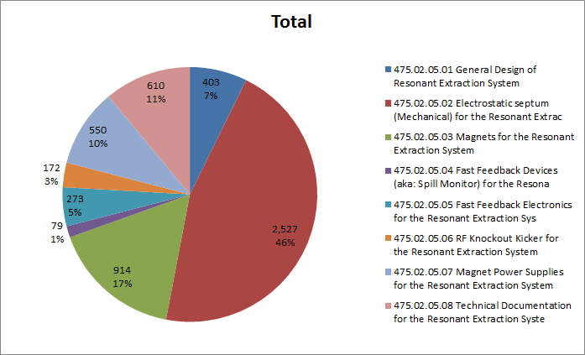
Cost Distribution by L4
Base Cost by L4 (AY $k)

Slide 26
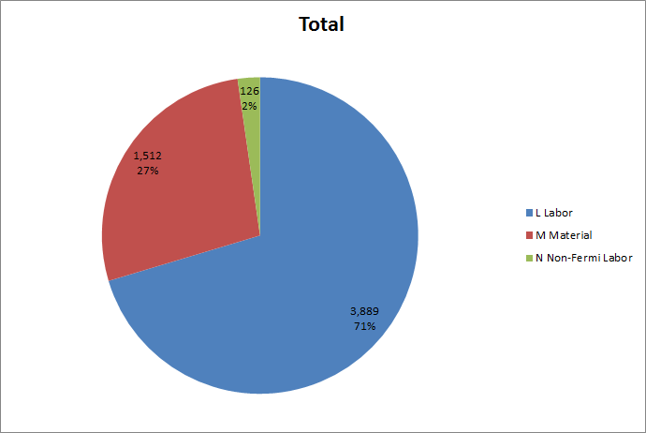
Cost Distribution by Resource Type
Base Cost (AY $k)

Slide 27
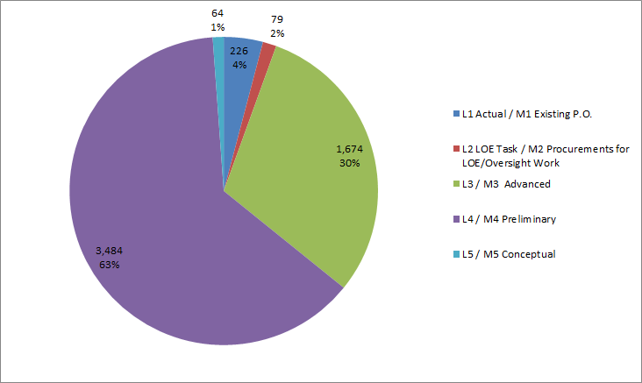
Quality of Estimate
Base Cost by Estimate Type (AY$k)
99% of estimate is at Preliminary level or better

Slide 28
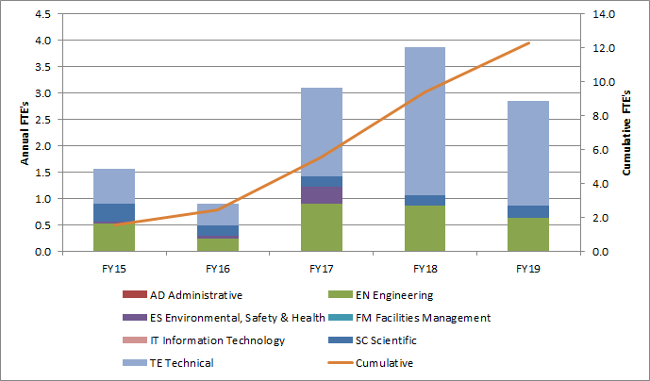
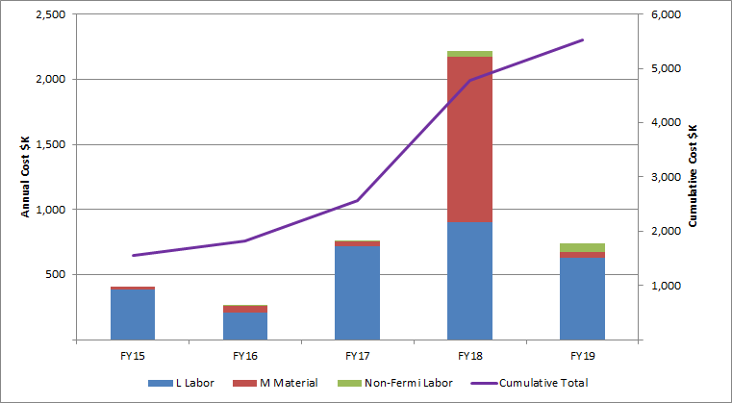
Labor Resources
FTEs by Discipline
Labor/Material breakdown

Slide 29
Cost Table
WBS 2.5 Accelerator Resonant Extraction System
Costs are fully burdened in AY $k
 | Base Cost (AY K$)
 | M&S | Labor | Total | Estimate Uncertainty (on remaining budget) | % Contingency on (on remaining budget) | Total Cost
475.02.05.01 General Design |  | 403 | 403 | 15 | 143% | 418
475.02.05.02 Electrostatic septum (Mechanical) | 528 | 1,999 | 2,527 | 939 | 41% | 3,466
475.02.05.03 Magnets | 594 | 320 | 914 | 237 | 26% | 1,152
475.02.05.04 Fast Feedback Devices (aka: Spill Monitor) | 15 | 65 | 79 | 14 | 30% | 93
475.02.05.05 Fast Feedback | 40 | 233 | 273 | 81 | 41% | 354
475.02.05.06 RF Knockout Kicker | 143 | 29 | 172 | 60 | 35% | 232
475.02.05.07 Magnet Power Supplies | 317 | 232 | 550 | 132 | 26% | 682
475.02.05.08 Technical Documentation |  | 610 | 610 | 137 | 30% | 747
Grand Total | 1,638 | 3,889 | 5,527 | 1,616 | 35% | 7,143

Slide 30
Major Milestones
Total 53 tier-5 milestones in the MS dictionary
14 most significant in the table below
47502.05.001020 | T5 - Septum Technology Choice Complete | 12-Dec-12
47502.05.03.000500 | T5 - Resonant Extraction Magnet Design Complete | 26-Feb-14
47502.05.01.001070 | T5 - Milestone: Beamline Studies Complete | 18-Apr-14
47502.05.05.001105 | T5 - Resonant Extraction Fast Feedback Electronics Design Complete | 24-Nov-14
47502.05.07.000500 | T5 - Resonant Extraction Magnet Power Supply Design Complete | 27-Feb-15
47502.05.02.001215 | T5 - Resonant Extraction Electro-Static Septum Design Complete | 22-May-15
47502.05.001050 | T5 - DOE CD-3c Accelerator Resonant Extraction Approval | 24-Feb-16
47502.05.03.2.001020 | T5 - Start of Resonant Extraction Harmonic Sextupole Magnet Fabrication | 3-Oct-16
47502.05.03.2.001095 | T5 - Resonant Extraction Harmonic Sextupole Magnet Fabrication Complete | 29-Jan-18
47502.05.03.001000 | T5 - Resonant Extraction Magnet Installation Complete | 30-Oct-18
47502.05.07.001000 | T5 - Resonant Extraction Magnet Power Supply Installation Complete | 13-Dec-18
47502.05.02.001315 | T5 - Resonant Extraction Electro-Static Septum Assembly Complete | 11-Jul-19
47502.05.02.001318 | T5 - Start Resonant Extraction Electro-static Septum Installation | 12-Jul-19
47502.05.02.001350 | T5 - Installation of Electrostatic Septum Modules Complete | 13-Sep-19

Slide 31
Schedule
Design
Fabrication
Installation
Off project
CD-2
CD-3c
Beam to Diagnostic Absorber
g-2 Beam Operations
KPP
General Design
Beam Studies
ES Septum R&D and prototyping
Development of the ES Septa
In
Commission Res Extr
Magnet Design
Magnet Fabrication
In
Magnet PS Design
Magnet PS Fabrication
In
Spill Mon Design
In
Spill Regulation Design
Development of the Spill Regulation
Installation
Beam Line Implementation
Commissioning with single turn Beam
Q3 | Q4 | Q1 | Q2 | Q3 | Q4 | Q1 | Q2 | Q3 | Q4 | Q1 | Q2 | Q3 | Q4 | Q1 | Q2 | Q3 | Q4 | Q1 | Q2 | Q3 | Q4 | Q1 | Q2 | Q3 | Q4 | Q1 | Q2 | Q3 | Q4 | Q1 | Q2 | Q3 | Q4
FY14 FY15 FY16 FY17 FY18 FY19 FY20 FY21
Notes:
Notes:
ESS Installation depicted here is not what is in the P6 schedule. P6 does not account yet for the fact that the beamline must be commissioned with single turn extracted beam before the ESS can be installed.
The ESS replaces a Delivery Ring extraction kicker module. Therefore, ESS installation precludes further single turn extracted beam to the M4 beamline.
Res. Extr. beam commissioning is off-project

Slide 32
Summary
Resonant Extraction Systems Preliminary Design is complete
Design of the Resonant Extraction meets the requirements
The final studies are underway with the high confidence of success
Cost and schedule estimates are well understood and ready to establish the baseline

Slide 33
Backup slides

Slide 34
Organizational Breakdown
Key people in the subproject:
V. Nagaslaev, AD, L3 Manager
C. S. Park, CD, L3 Deputy Manager, Synergia
D. Tinsley, AD, Sr. Mechanical Engineer, ESS design
P. Prieto, AD, Sr. Electronics Engineer, Spill Controls
G. Krafczyk, AD, Sr. Electrical Engineer, Power Supplies
TJ Gardner, TD, liaison for magnet production

Slide 35
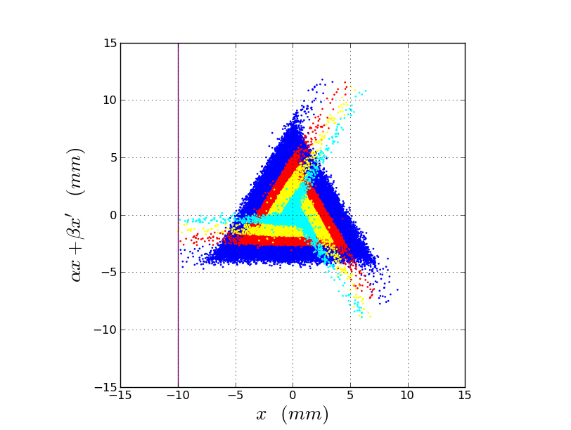
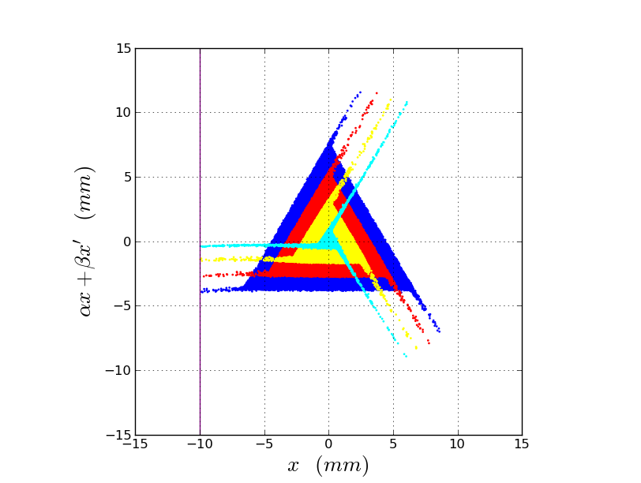
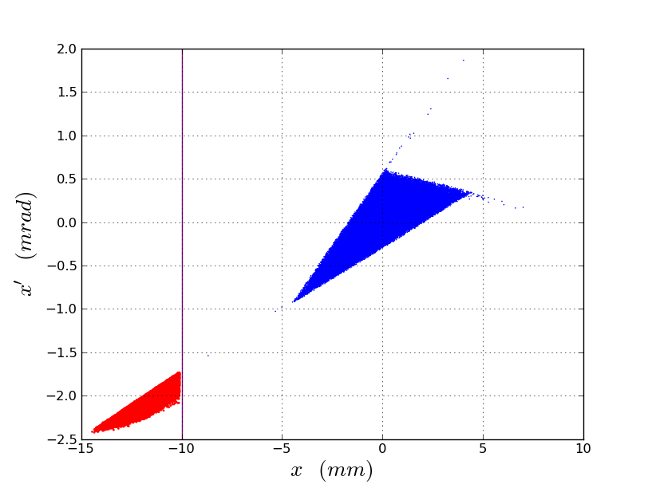
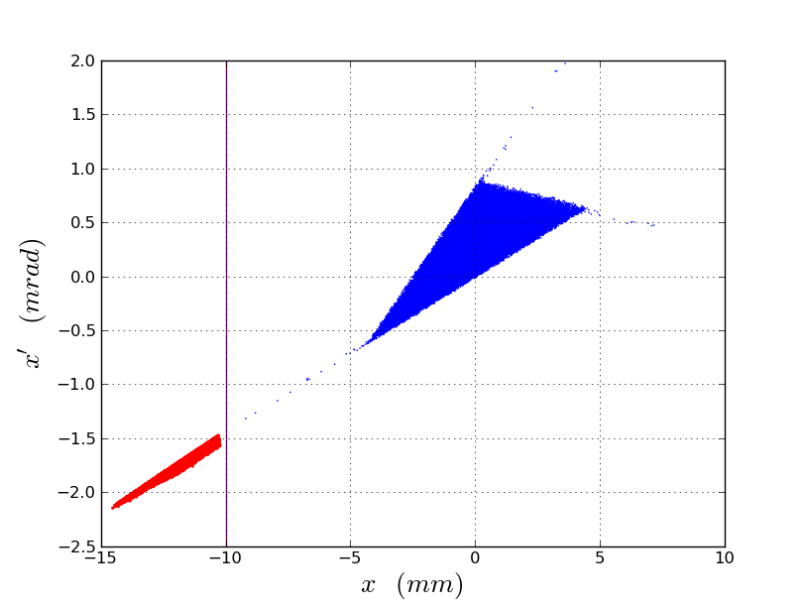
Phase space diagrams

Slide 36
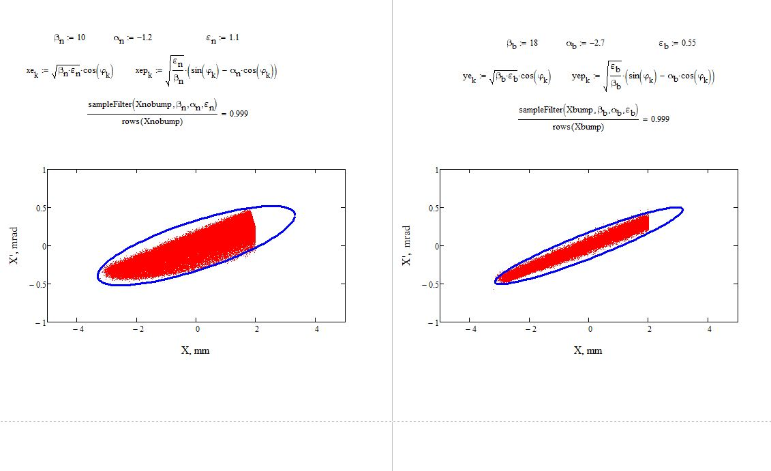
Extracted beam footprint

Slide 37
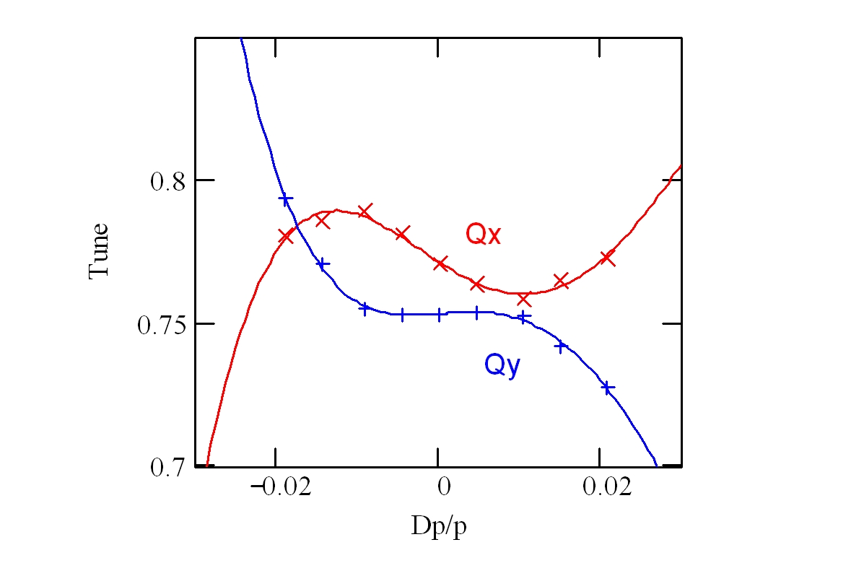
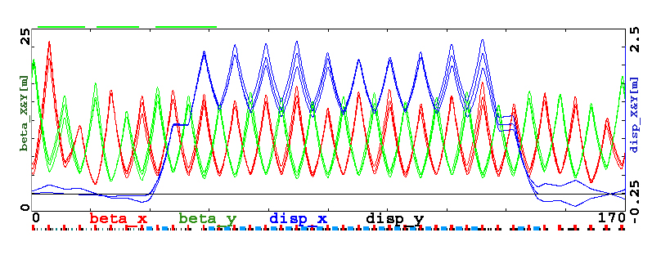
Optics of the Debuncher: chromaticity
f
Chromaticity:
Large momentum spread
2 families of sextupoles in arcs
Tunes vs Δp/p
Fit: 6- and 10-pole harmonics in dipoles
Included in the model
Chromaticity of functions
No problem for injection matching
No dynamic aperture limitation

Slide 38
Risks
Presently only one item in the Risk Registry (opportunity)
RR index | Risk/ Opportunity | Impact | Probability | Point estimate | Status
203 | Opportunity to reuse existing spare sextupoles | Cost | L | $164k | Current
025 | Need to ramp Delivery Ring sextupoles | Technical | M | -- | Mitigated in BL
024 | Inability to locate and reuse tooling for ESS | Cost | M | ND | Realized
023 | Inacceptable amount of beam left in the DR | Technical | L | -- | Mitigated by AIP
022 | High Beam Loss | Technical, Schedule | M | -- | Transferred
012 | Mu2e beam commissioning delayed. | Schedule | L | -- | Transferred

Slide 39
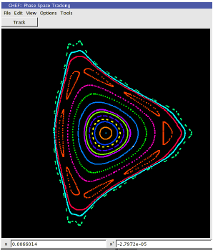
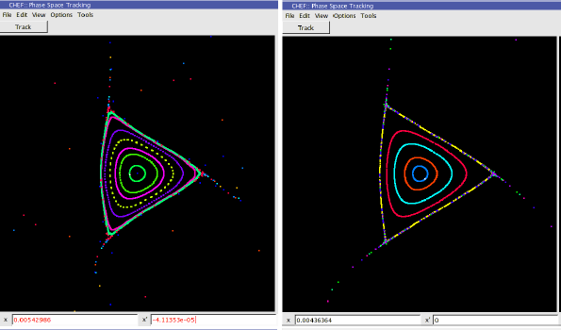
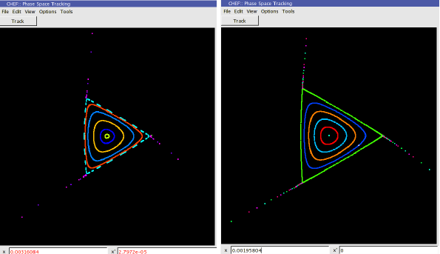
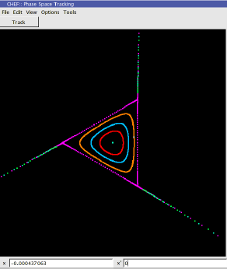
Tune space
ν_{x}=9.61
ν_{x}=9.62
ν_{x}=9.63
ν_{x}=9.64
ν_{x}=9.65
ν_{x}=9.67

