Slide 1
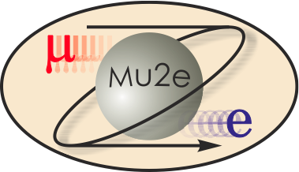
Mu2e External Beamline
Eric Prebys*
External Beam Line
DOE CD-2/3b, October 21-24, 2014
*standing in for Eliana Gianfelice-Wendt Most of talk written by Carol Johnstone

Slide 2
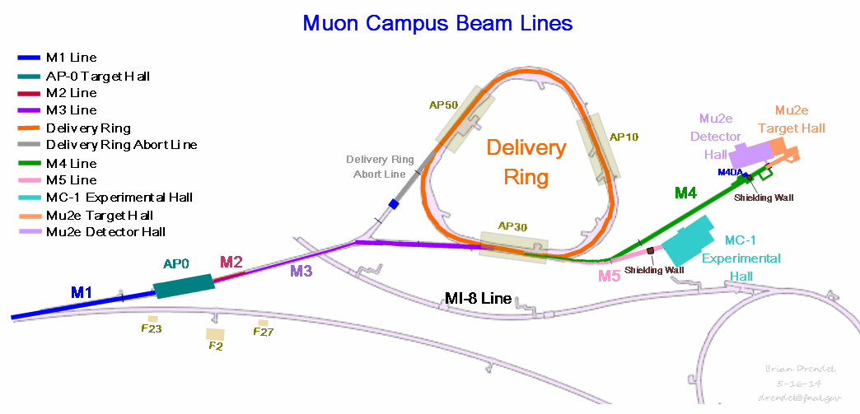
WBS 475.02.07 External Beamline
The Mu2e external beam line, or M4 line, must
cleanly separate and transport resonantly extracted beam from the Delivery Ring to the Mu2e production target,
deliver beam with the required spot size for the experiment
perform inter-bunch extinction of out-of-time particles, and
as part of the Muon Campus complex, the M4 beamline must support beam operations for the g-2 experiment (M5 beam line)
Note: experiments cannot run simultaneously
.

Slide 3
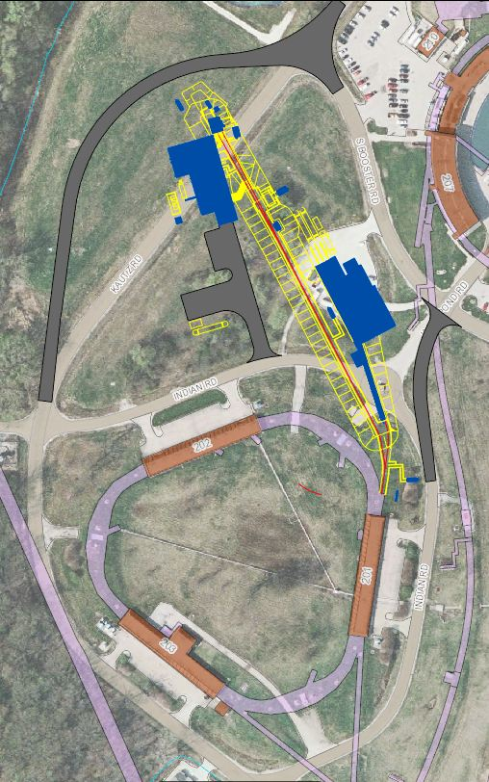
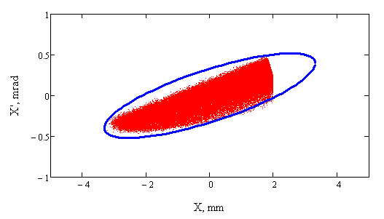
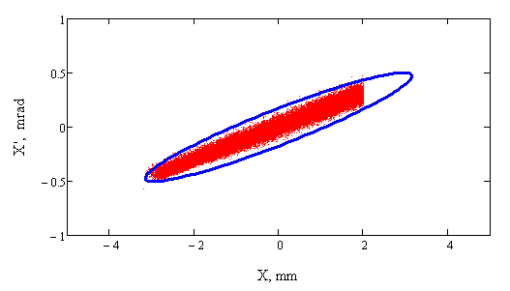
External Beamline Requirements
Mu2e Proton Beam Requirements (Mu2eDoc-1105)
Resonantly extracted phase space
Bunch structure provided by Delivery Ring period
Beam requirements on production target (Mu2eDoc-887
Transverse Spot Size 0.5 to 1.5 mm (rms)
Divergence < 4 mr (rms)
Alignment/target scans +/- 1 cm and +/- 0.8°
Final focus: 7 m to final focus
Accommodate elevation change for shielding
accommodate solenoid systems
Instrumentation, target scans and protection collimator
Booster
Mu2e
Bldg
MC-1
Bldg
Two examples of extracted phase space
Delivery Ring

Slide 4
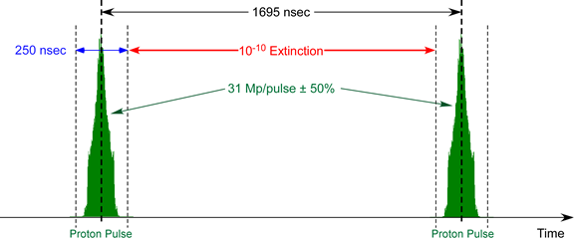
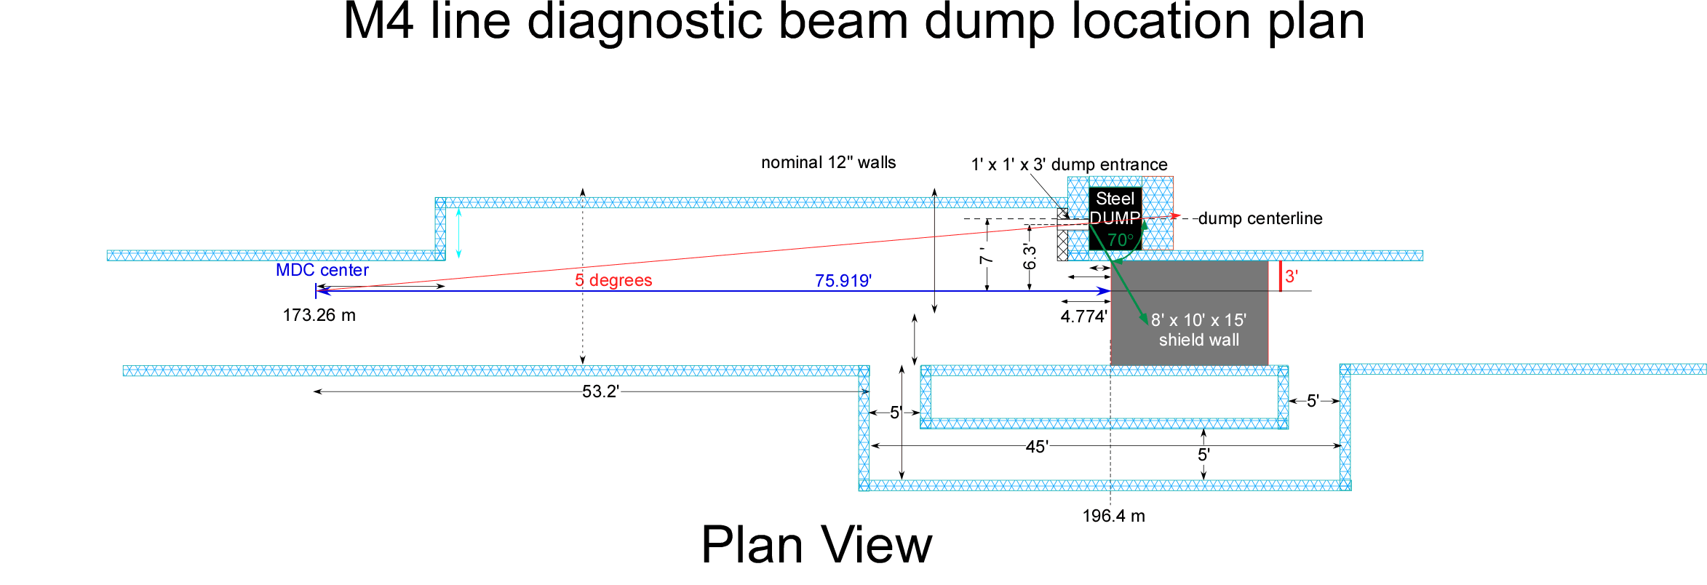
External Beam line Requirements
Beam Extinction Requirement for Mu2e (Mu2e-doc-1175)
10⁻¹⁰ total extinction of out of time beam
10⁻⁷ provided by beamline
Diagnostic beamline
Low-intensity commissioning and beam studies – no beam to experiment
Requires separate diagnostic beam absorber
Requires component-free shield wall in primary beamline to permit access to hall
Exp Hall

Slide 5
Mu2e/g-2 Extraction and Upstream Design
Except for Mu2e septa, the extraction and M4/M5 beamline hardware and installation not part of M4 cost and schedule
Designed to optimize acceptance for Mu2e resonant extraction
Delivery Ring lattice very similar to Debuncher pBar lattice
g-2 kicker extraction system will be replaced by Mu2e septa
Lambertson for vertical extraction
An 8” aperture quad is required at D2Q5 location (BNL 8Q24)
Design provides a common extraction channel
40 π-mm-mr acceptance as required for g-2
Mu2e septa
g-2 kickers

Slide 6
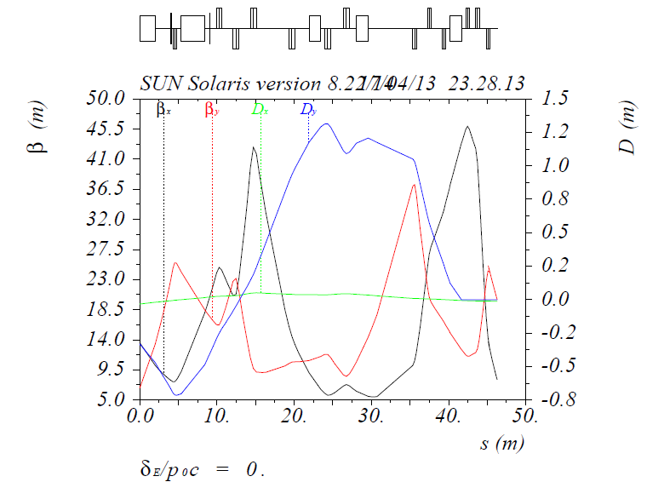
M4 /M5 Common section Design
M4/M5 line installation part of g-2 schedule and cost
Mu2e/g-2 have independent vertical achromats
No residual vertical dispersion
Mu2e achromat end (V907)
Elevation change of 48” to final M4 beamline height must occur in two steps for dispersion suppression
1st step 32” to clear Delivery ring magnets
2nd step 16” to final height
5 bends total in achromat
Vertical dispersion cancelled at V907 for Mu2e
Two different sets of optics for g-2 and Mu2e
“Switch” Magnet at V907 reverses polarity for g-2 vs. Mu2e operation to separate g-2 from Mu2e beamline
Vertical dispersion canceled at V003 in M5 line for g-2
C-magnet
2nd step
g-2 achromat end
1st step
Vertical bend magnets:
UP: DOWN:

Slide 7
M4 /M5 beamline Separation Design
Mu2e/g-2 split is now vertical
Two independent vertical achromats implemented
No Mu2e/g-2 conflicts past split
g-2 will reverse the last Mu2e vert dipole (not an achromat at this point)
This bend changes from -3.8° (Mu2e) to +5.5° (g-2). Magnet tilt change will require realignment.
g-2 will separate from Mu2e at ~32” above Mu2e in ~5m downstream of the reversed dipole
A 9.3° final vertical bend levels the g-2 M5 line
Final separation ~6.5’ above Mu2e at level of g-2 ring
Realignment of reversing bend will be required between g-2/Mu2e run periods

Slide 8
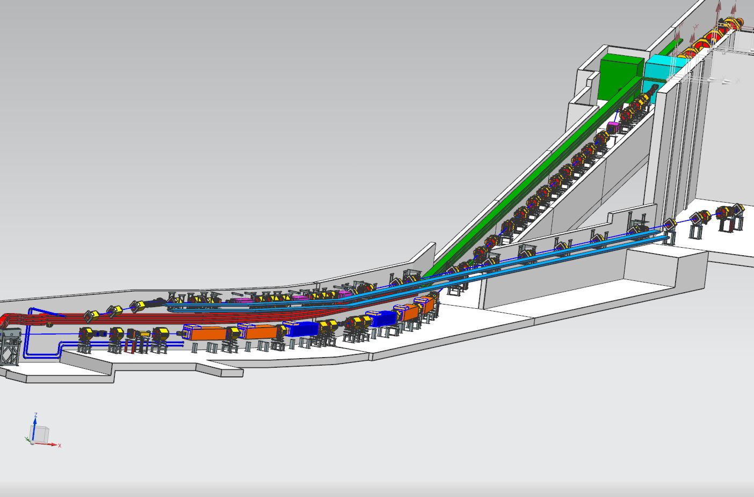
Left Bend and Enclosure Design
Mu2e/g-2 experiment locations and separate beamline enclosures are achieved through two independent horizontal bend strings.
The two left bends determine the bearings and locations of the MC-1 (g-2) and Mu2e experiments.
MC-1 location is constrained by road, utility corridors and maximal distance from strong Mu2e magnetic fields
40.5º of total Mu2e bend required to steer away from MC1 building for sufficient shielding
Wetlands limit overall length of the Mu2e line

Slide 9
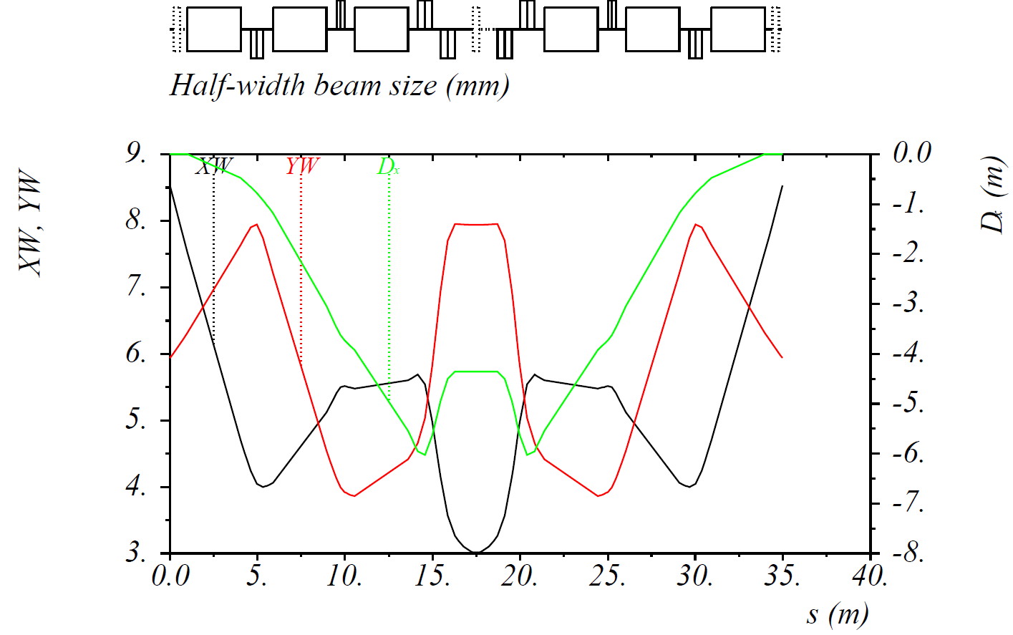
Left Bend Optics Design
Horizontal Bend details
A total of 40.5º generated by two mirror symmetric sections.
Each consists of two 6‑4‑120 type dipole magnets (SDFW) powered in series followed by a stronger 6-3-120 dipole to deliver 2 × 6.25° and 7.75° of horizontal bend, respectively.
Bend string as close as possible to last vertical bend;
This section must fulfill conditions for a linear achromat; i.e. Phase advance and compact dipole placement for dispersion cancellation highly constrain the optics of this section.
Trims have been installed upstream,
downstream and center to provide
10% of net bend correction.

Slide 10
Extinction Section Considerations*
Extinction is accomplished through a system of resonant dipoles and collimators, such that only in-time (un-deflected) beam is transmitted.
Somewhat counter intuitively, magnet considerations lead to
long, low field magnets (6m total length)
high-β (large aperture) in the bend (horizontal) plane (250 m)
low-β waist in the non-bend plane
Need to allow for collimation
Upstream of AC dipole system, to remove high-amplitude halo
Downstream of AC dipole system to absorb out-of time beam that has been deflected by the magnetic field.
These considerations result in significant constraints on the beam line design.
*details of motivation in E. Prebys’ Extinction talk

Slide 11
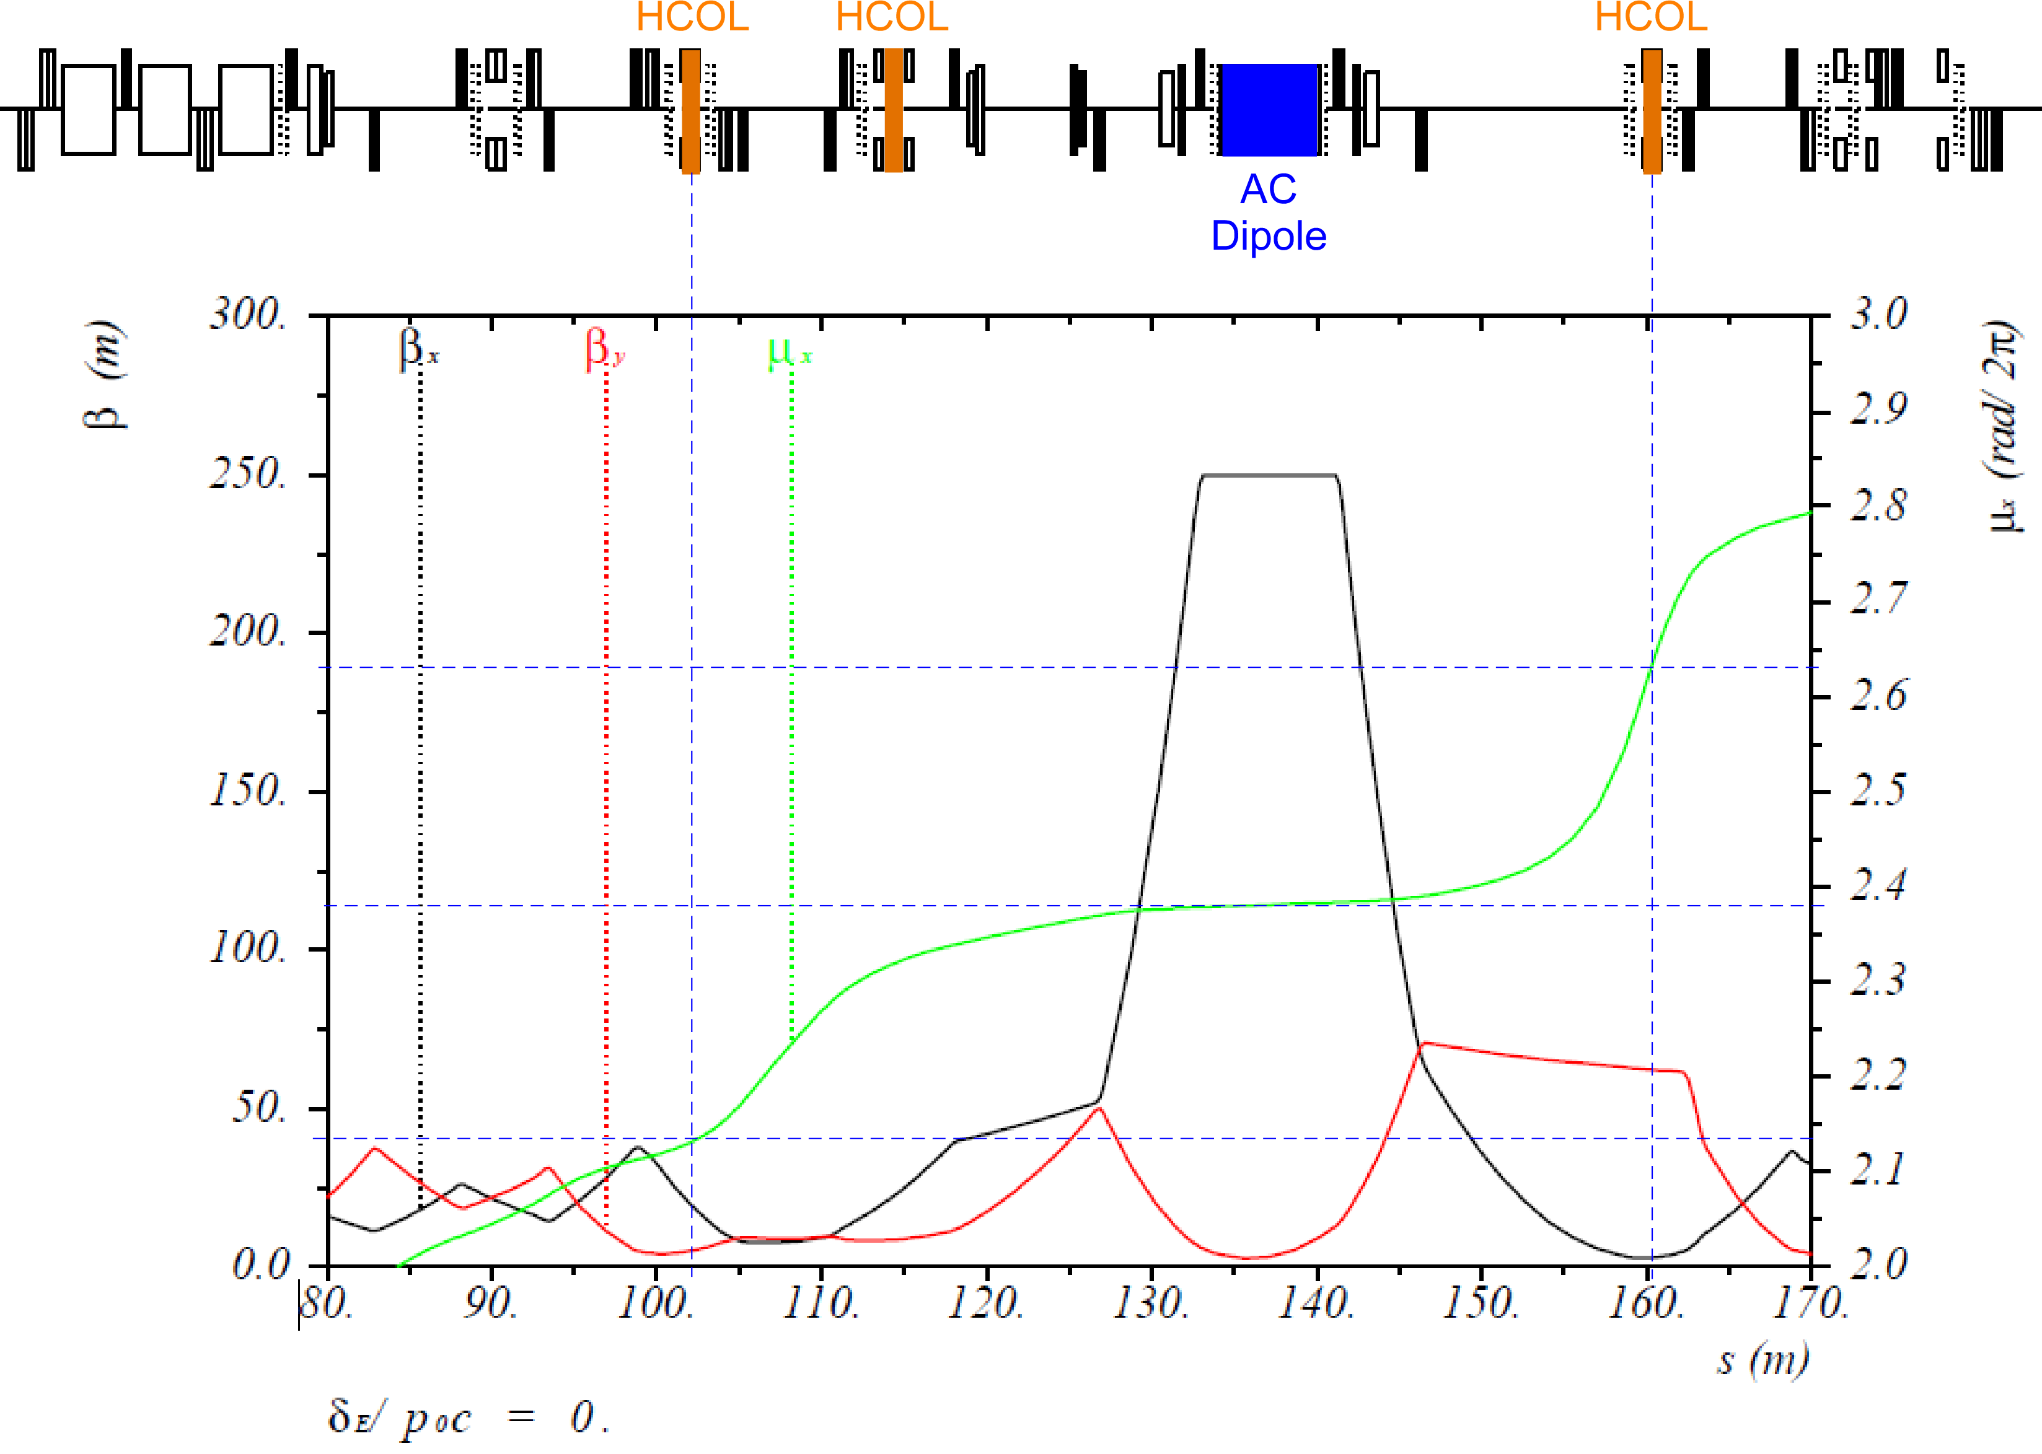
Extinction Optics
Halo collimation
Extinction collimation

Slide 12
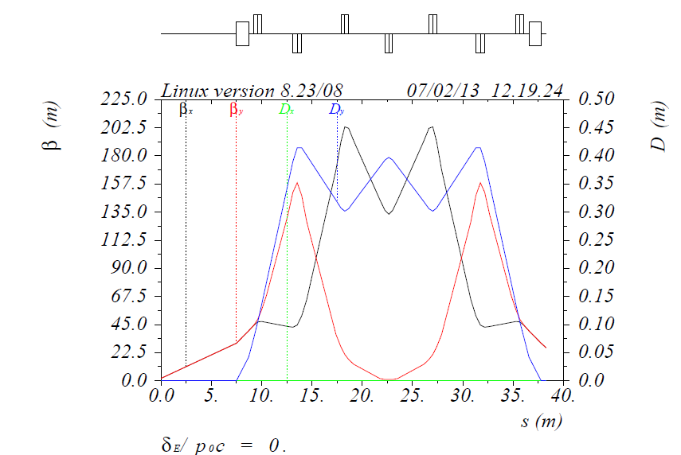
Final Focus Design
protection collimator
Target Beam Optics: Final focus requirements
Beam Spot
Small, circular (σ = 1mm) beam spot on a 6 mm target target
2.8° final declination at entrance to compensate for bending in solenoidal field.
Dispersion-free
Target Scan
Independent position/angle controls in BOTH vertical and horizontal
±1 cm offset for vert target scan
±1 cm offset for horz target scan
±0.8° in horz/vert targeting angle
Steering magnets H: V:
(2.5σ_{x} , 2..5σ_{y})
target
Final focus optics

Slide 13
Significant Changes since CD-1
Vertical Mu2e/g-2 separation instead of horizontal
Location and bearing of g-2 ring established
Increased bearing of Mu2e by 4.5°
Extraction flipped from outside to inside of Delivery ring to permit Lambertson power and water connections (extensive shielding in this area)
Magnet selection changed – nearly finalized.
Extinction collimation and high beta region revamped
Upstream collimation and fewer collimators overall

Slide 14
Value Engineering since CD-1
Vertical Mu2e/g-2 separation instead of horizontal, compact, minimizes civil enclosure costs, optimizes available space for beamline
Roll of C magnet rather than changes to civil enclosure
Optimal target steering magnet locations to minimize aperture and motion in target scans
Magnets now selected from inventory of available magnets from Accumulator and BNL
Minimize vacuum prep work, reuse vacuum pumps and parts inventory from Accumulator

Slide 15
Performance
Combined Mu2e/g-2 civil constraints were met (utility corridor, roads, wetlands, shielding, stray magnetic field levels, separation of beamlines)
Upstream beamline supports Mu2e/g-2 combined operation (40π mm-mrad emittance for g-2) with minimal reconfiguration
Extinction simulations indicate that the collimation and high-beta AC dipole optics design achieves <10⁻⁷ goal (Mu2e-doc-4054)
Target spot size, divergence and scan criteria were met in the design of the final focus
Elevation change and the 2.8° declination angle as required by the fringe field of the production solenoid were successfully combined in the final focus (which sits on a 1.4° incline)

Slide 16
Remaining work before CD-3
Finalize beamline optics, particularly the extinction section.
Finalize magnet stand design and installation drawings, including motorized final focus stands.
Finalize vacuum design.
Finalize LCW design.
Finalize installation scheduling.
Technical documentation of final design.

Slide 17
Summary
We have a beamline design which satisfies all of the requirements of the Mu2e experiment, including the needs of the external extinction system.
We are confident we have met the requirements for CD-2 approval.

