Slide 1
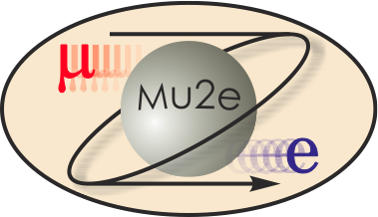
Mu2e CD-2 Review Target Station
Rick Coleman
L3 Manager Target Station
10/22/2014

Slide 2
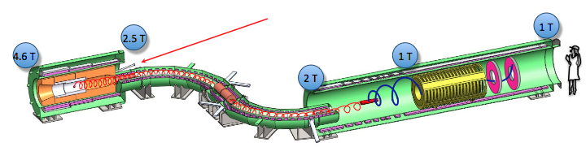
WBS 475.02.09 Target Station
The Target Station
  proton beam production target
  heat and radiation shield (HRS)
  target remote handling system
  proton beam absorber
  protection collimator
There is a WBS task for each of above, plus one for simulations and one for technical documentation (& general support)

Slide 3
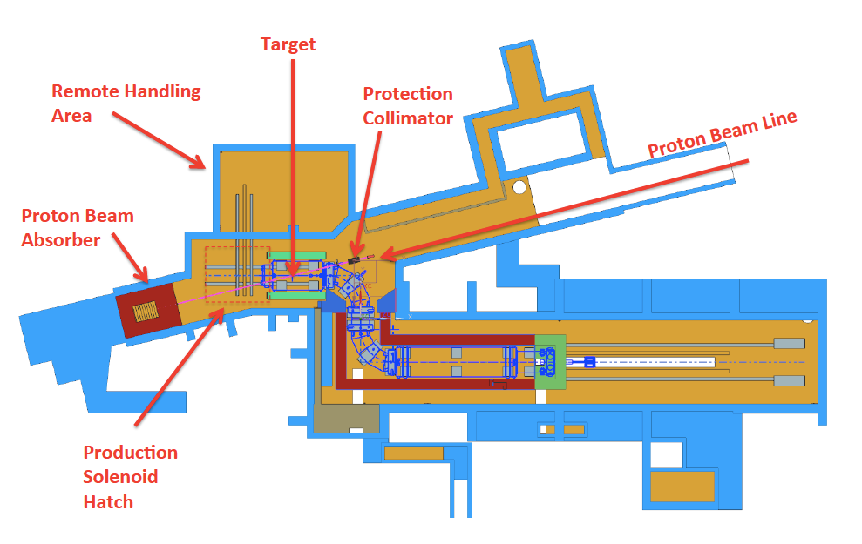
Overview of Layout

Slide 4
Requirements
Mu2e Proton Beam Requirements (DocDB 1105)
  3.6 x 10²⁰ protons on target over 3 years to obtain sensitivity
  Repeat period > 864ns (lifetime of muons in aluminum stopping target)
  6 x 10¹² protons/sec at 8 GeV delivered every 1.33 seconds, 0.3 duty factor
  Transverse Spot Size 0.5 to 1.5 mm (rms), Divergence < 4 mr (rms)
  For alignment & target scans +/- 1 cm and +/- 0.8 °
  Low intensity for commissioning and special calibration runs
Production Target Requirements (DocDB 887)
  Maximize number of stopped muons (high Z material, small radius target and minimize target support structure material to reduce pion reabsorption)
  Target Lifetime > 1 year to minimize interruptions to experiment, since target replacement time ~ 1 month
  Target-Beam Alignment < 0.5 mm transverse, < 10 mr angle

Slide 5
Requirements
Mu2e Proton Beam Absorber Requirements (DocDB 948)
  Designed to absorb the primary proton beam and secondary particles left after the production target for normal beam over the experiment lifetime(10 yrs) and full beam power for 10 minutes in an accident condition
  Placed far enough away from target to eliminate back-scattered particles from entering muon beam channel and allow access for target remote handling
  No maintenance or service directly over lifetime
  Maintain surface and ground water contamination below limits
  Air activation from absorber must be below limits after cooled down
  Minimize residual radiation during access
  Shielding for the extinction monitor must be sufficient
Protection Collimator Requirements (DocDB 2897)
  With loss monitor instrumentation provide a means to abort the proton beam if it is missteered to provide protection for the solenoid systems
  Provide an "out" position for target scans

Slide 6
Requirements
Mu2e Production Solenoid (PS) Heat and Radiation Shield (HRS) Requirements (Mu2e-doc-1092- G. Ambrosio, R. Coleman, V. Kashikhin, M. Lamm, M. Lopes, N. Mokhov, J. Popp, V. Pronskikh)
  Limit Magnet from Heat Load
    Limit the overall dynamic heat load in the PS magnet to less than 100 W.
    Limit the instantaneous heat load in any coil of the PS to less than 30 μW/gm.
  Prevent radiation damage to PS magnet materials
    Limit dose rate to the superconductor insulation and epoxy to less than 350 kGy/year.
  Geometry
    The heat shield must have sufficient inner aperture to preserve the muon yield
  Maintain electrical conductivity of superconducting cables and normal conducting quench stabilizing matrix
    Limit the DPA †experienced by the component metals of any PS superconducting cable to less than 4 to 6 ×10⁻⁵ DPA/year.
➔ RRR*> 100 , Annual warm-up to anneal
†DPA = Displacements per Atom
*

Slide 7
Organizational Breakdown
WBS 475.02.09
Target Station
R. Coleman
R. Schultz (deputy)
WBS 9.3
Remote Handling
M. Campbell
AD/FNAL
WBS 9.4
HRS
L. Bartoszek
Bartoszek
Engineering
WBS 9.5
Proton Absorber
A. Stefanik
PPD/FNAL
WBS 9.6
Protection
Collimator
A. Stefanik
PPD/FNAL
WBS 9.7
PS Hatch
Blocks
R. Coleman
AD/FNAL
WBS 9.1
Simulations
R. Coleman
V. Pronskikh
AD/FNAL
WBS 9.2
Fabricate Target
C. Densham
Rutherford
Labs
WBS 9.8
Technical
Doc.
R. Coleman
AD/FNAL

Slide 8
Target Station Team
Steve Werkema, Vladimir Nagaslaev, Mike Campbell
- L2 Manager, Deputy and Engineer
Rick Coleman, Ryan Schultz
  L3 Manager, Deputy
Target- Rutherford High Power Targetry Group- Chris Densham, Peter Loveridge, Joe O'Dell, Roger Bennett, Otto Caretta
Remote Handling- Mike Campbell
Heat and Radiation Shield- Bartoszek Engineering- Larry Bartoszek
Proton Beam Absorber and Protection Collimator- Andy Stefanik
Simulations- V. Pronskikh, N. Mokhov, Y. Eidelman
Radiation Safety & ES&H – A. Leveling, M. Wolters, D. Hahn
Project Mechanical Engineer (Integration) - K. Krempetz
Muon Beamline L2 Manager- G. Ginther
University Collaborators- J. Popp, K. Lynch
Alignment- H. Friedman

Slide 9

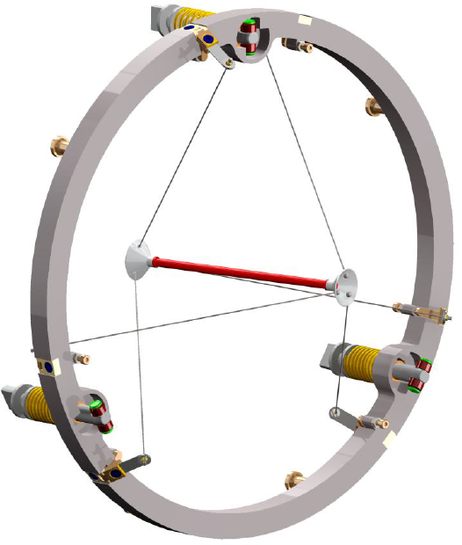
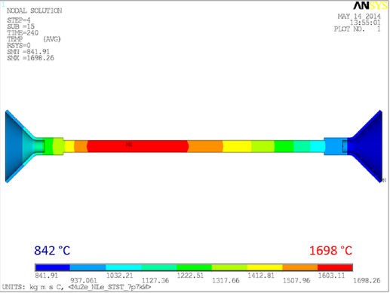
Target Design
L=16 cm r=3.2 mm Tungsten Rod
Doc db 2406
68 pages,
August 2012

Slide 10
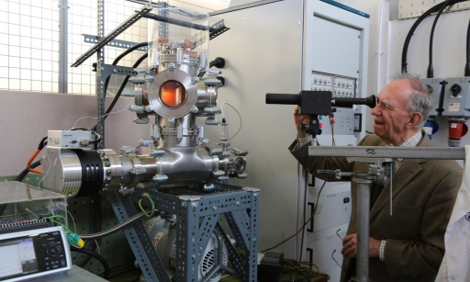
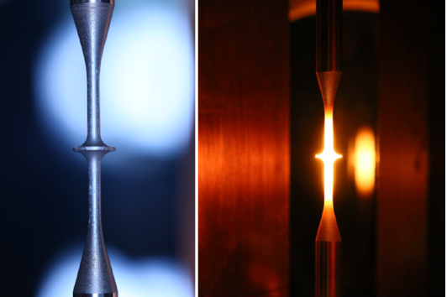
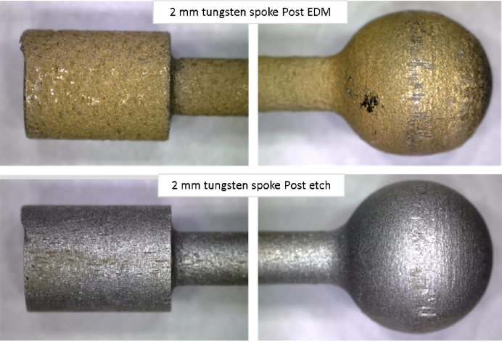
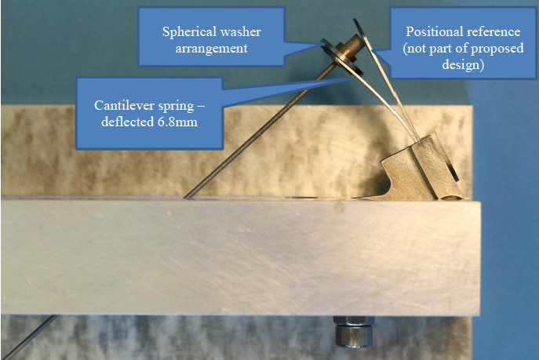
Target Design/R&D
STFC Rutherford Appleton Laboratory
High Power Targets group
Doc db 4305, 76 pages,
June 2014 (2nd Contract)
Completed Design, Testing, and Prototype work
  Design shown on previous page
    spoke tensioner, support ring detailed work
  Measurements
    vacuum vessel and equipment setup for testing
    emissivity measurements at high T (5% verification of literature)
    lifetime pulsed heating tests (fatigue)-OK for 4 yrs equivalent so far
  Study of Creep in the Target Support- 6 micron elongation OK
  Chemical Erosion Study (vacuum quality, oxidation) 1e-3 Torr not good enough, design is 1e-5 Torr
  Spoke Prototyping (manufacturing, spring tests, adjustments)

Slide 11
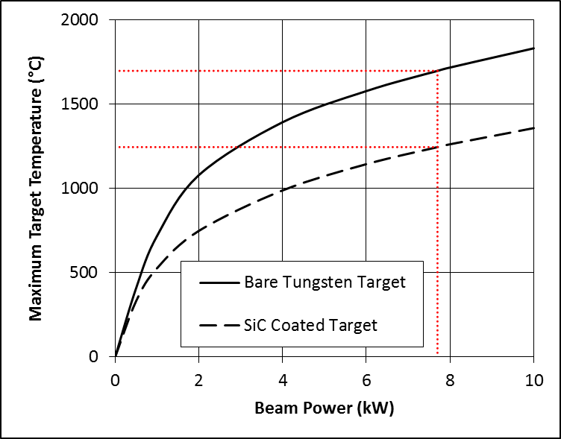
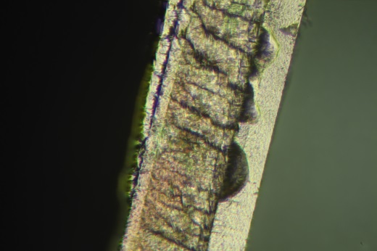
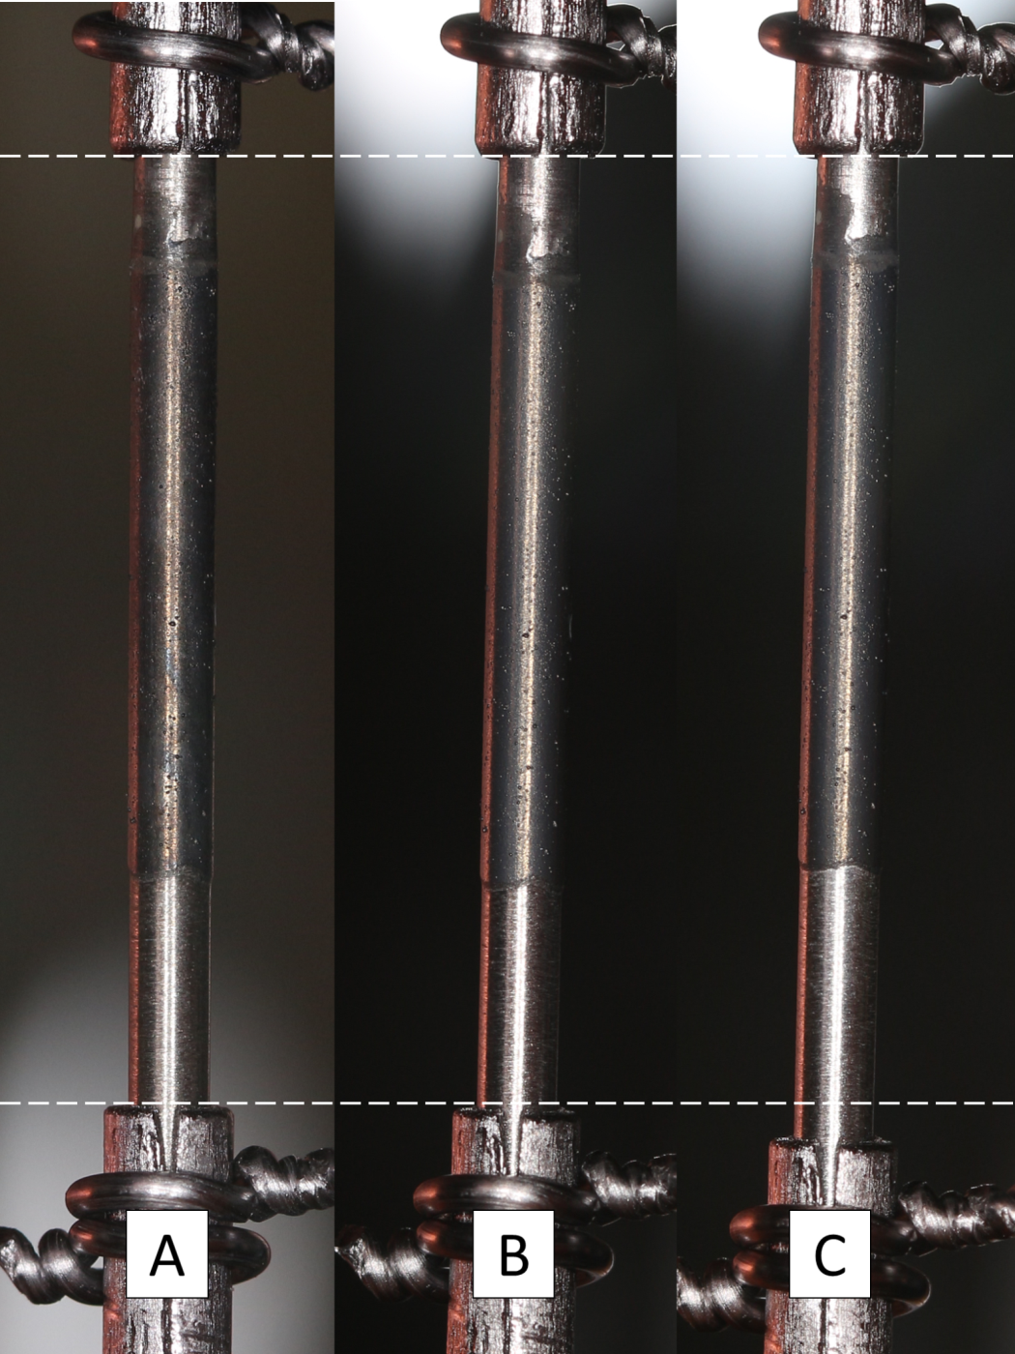
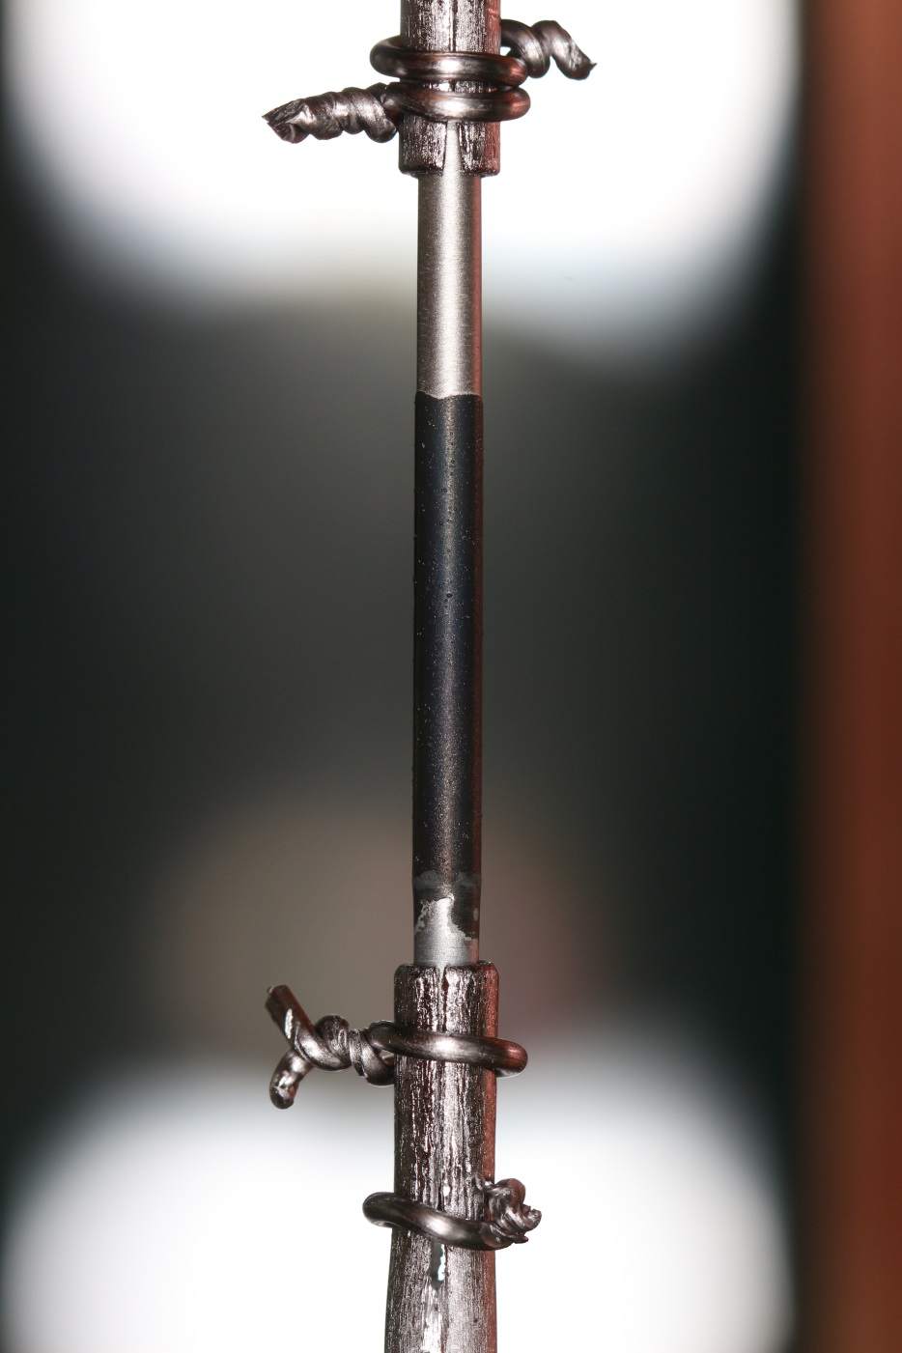
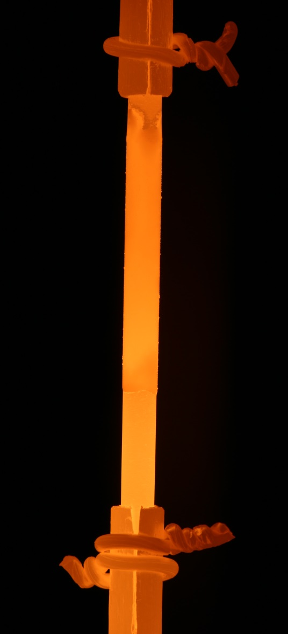
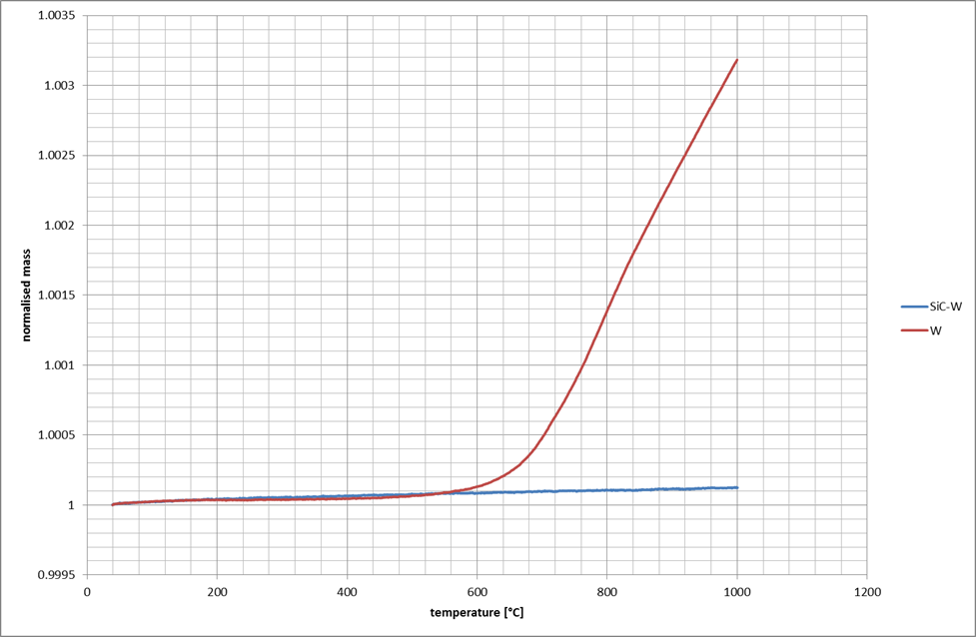
Target Design/R&D
STFC Rutherford Appleton Laboratory
High Power Targets group
3rd Contract- started recently
  Tungsten surface finish versus emissivity characterization
  SiC coating/surface/oxidation/fatigue R&D, including:
    Various surface treatment/coating R&D
    Emissivity measurements of surface coatings
    Medium vacuum (10⁻⁴ to 10⁻⁵ Torr) lifetime testing
    Pulsed current fatigue testing for shaped test samples (horizontal test)
  High temperature creep testing of spokes and spring tensioners
  He cooling feasibility study and preliminary plant specification
  Optimization of end joints
Baking 40 days
Voids in
coating
W
SiC
TGA
W
500 C in air
coated
Thermal Cycles 1500 C

Slide 12
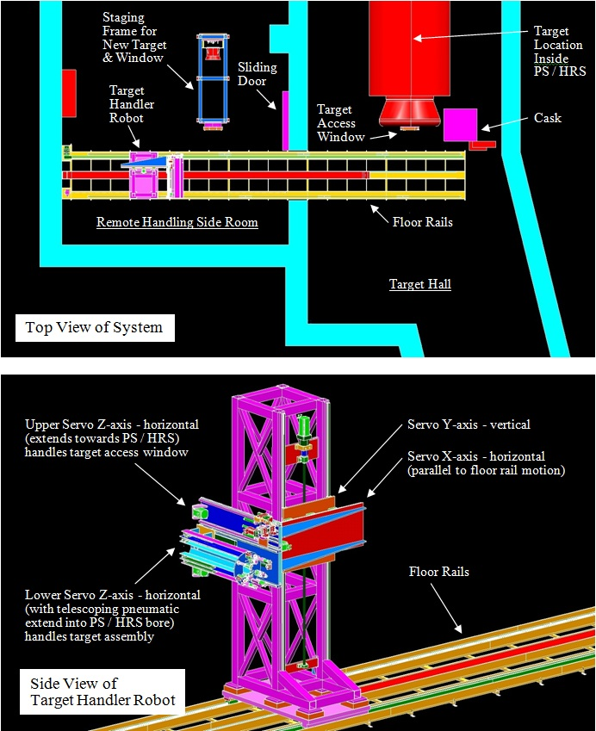
Target Remote Handling Design
Mike Campbell/ FNAL
Tasks
  Enter Hall from RH room
  Remove access window
  Place window in cask
  Detach/remove target
  Place old target in cask
  Obtain new target
  Latch new target into place
  Obtain new window
  Bolt window in place
  Exit Target Hall

Slide 13
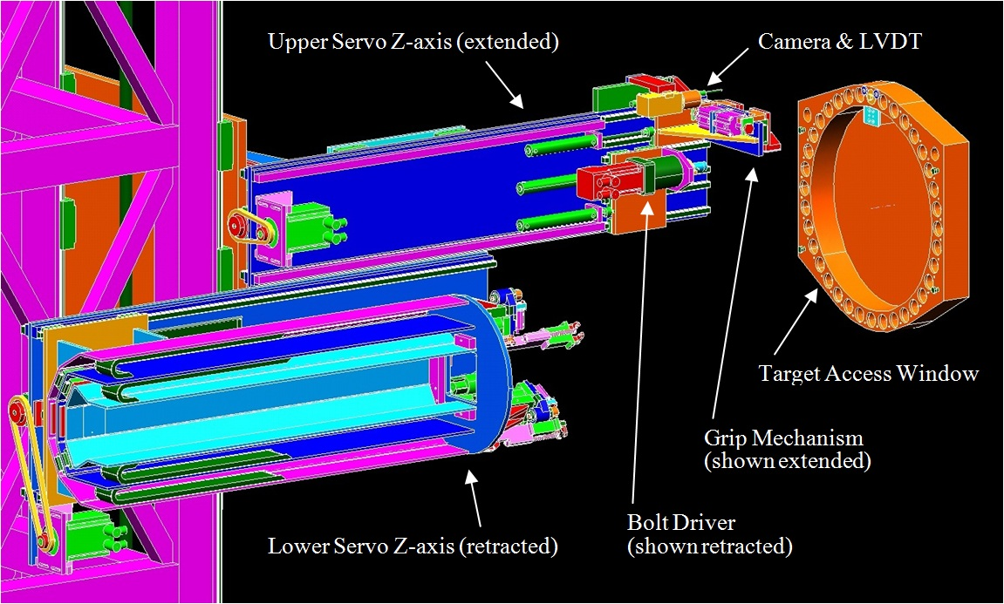
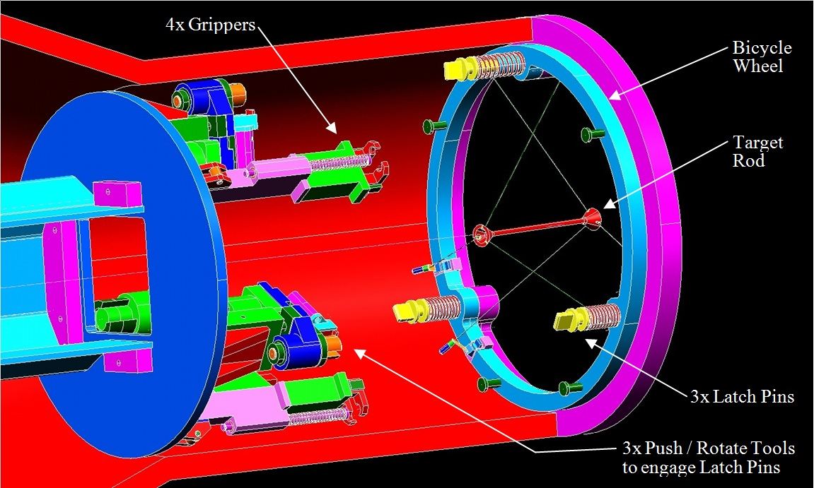
Target Remote Handling Design
Camera with machine vision software
Target Access Window
Upper Servo z-axis
Target Interface Mechanism
Lower Servo z-axis
Target Interface Mechanism
Detailed View

Slide 14
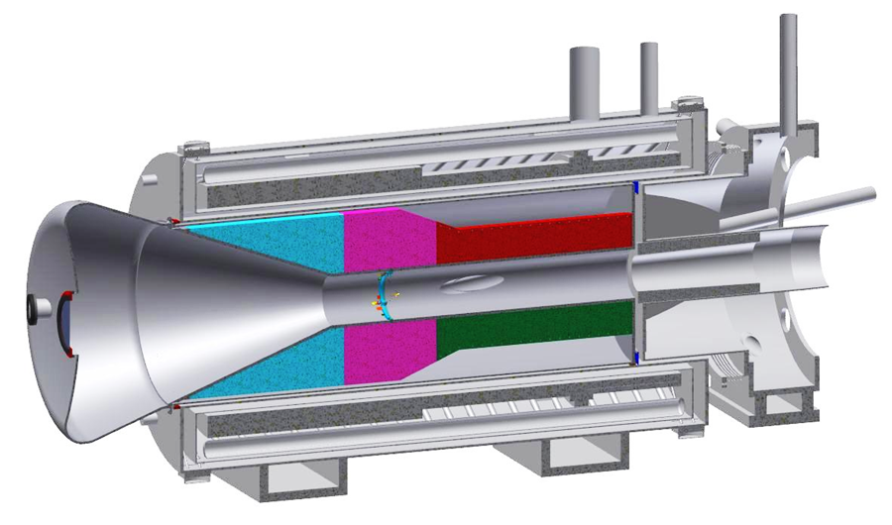
Heat & Radiation Shield Design
Bartoszek Engineering
Larry Bartoszek
PS Coils
Target
Proton Beam Pipe
Water
Water
HRS Bronze Pieces
14
7/8/14

Slide 15
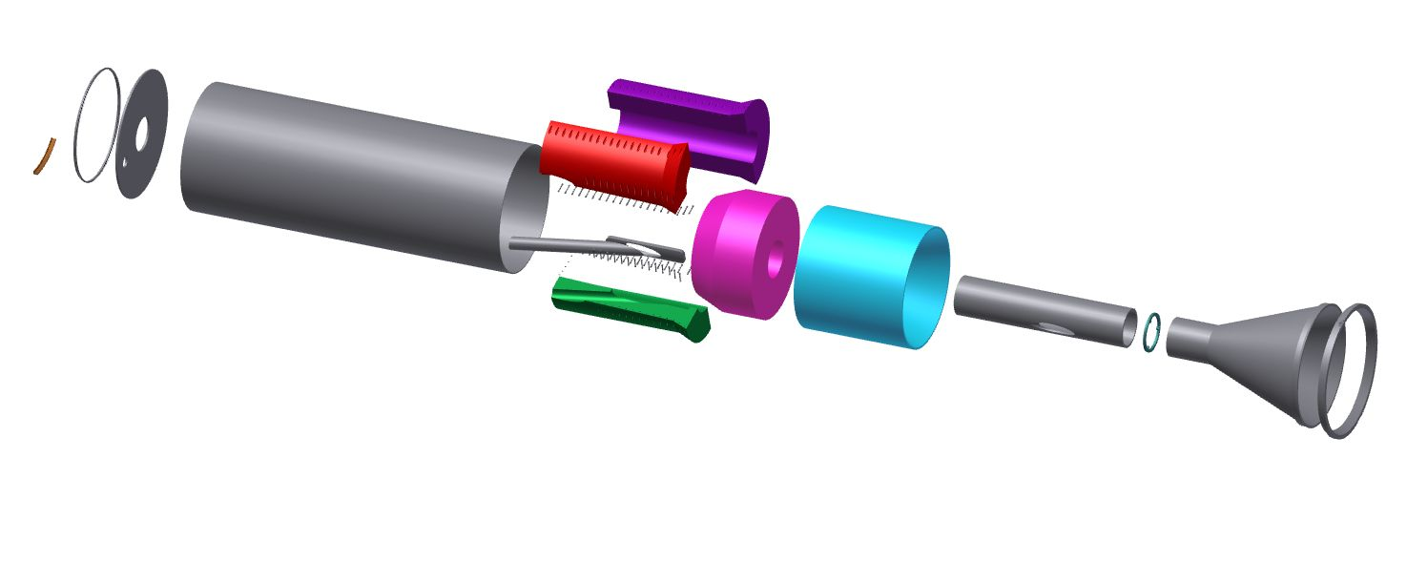
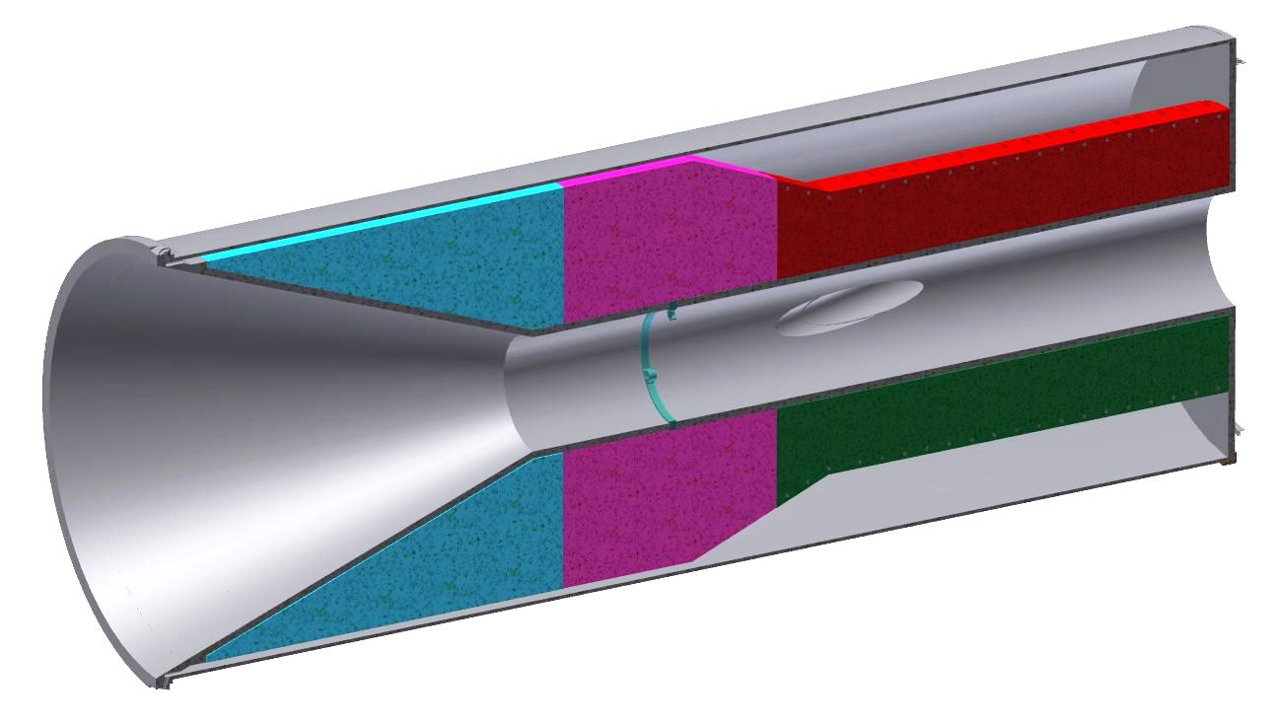
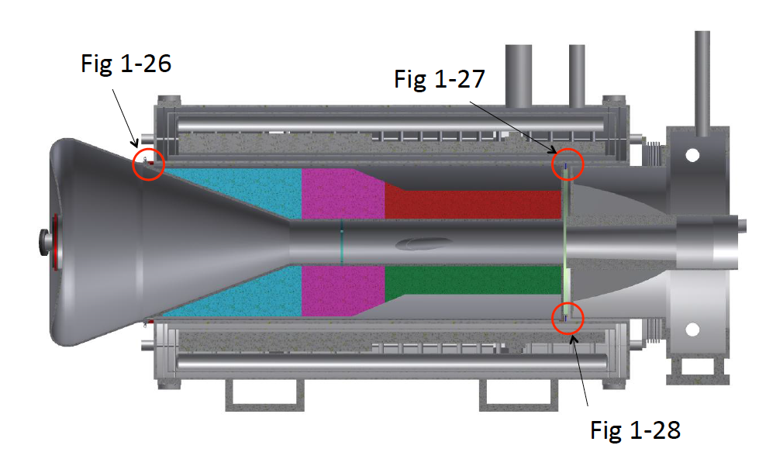
Heat & Radiation Shield Design
67° C max
Figure 4.179
Figure 4.180
Figure 4.181

Slide 16
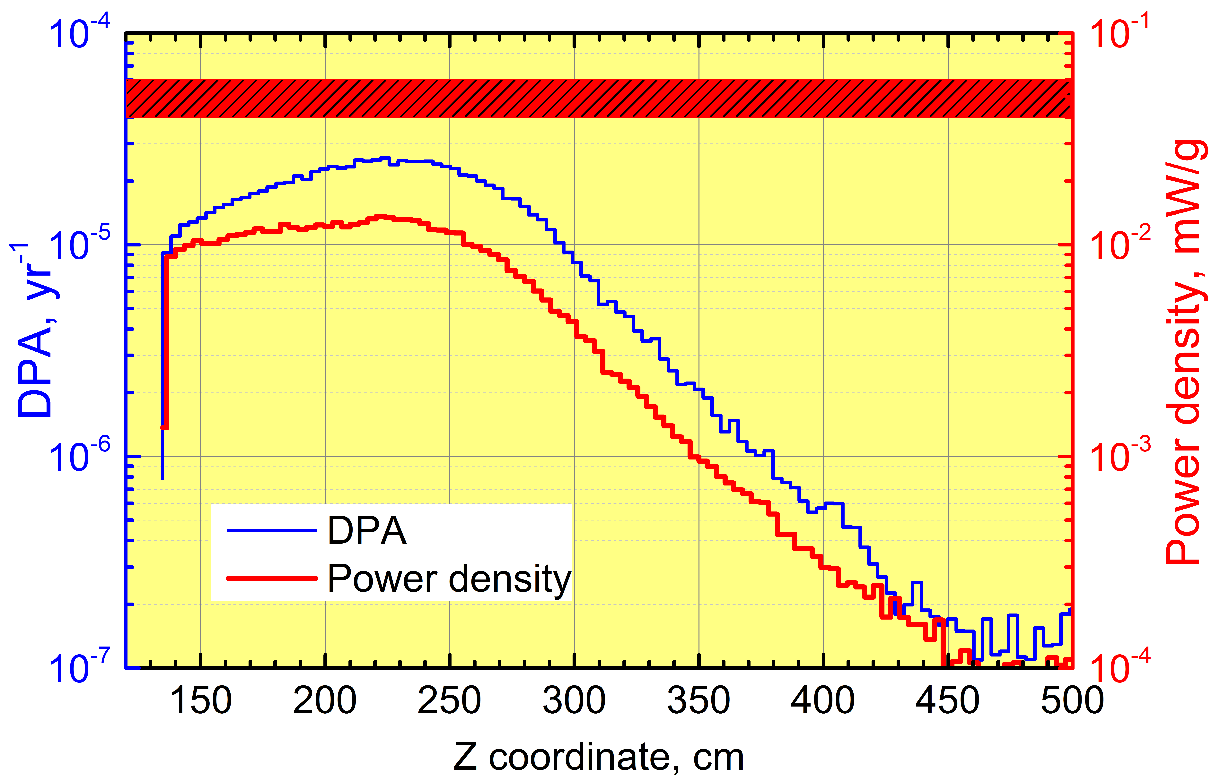
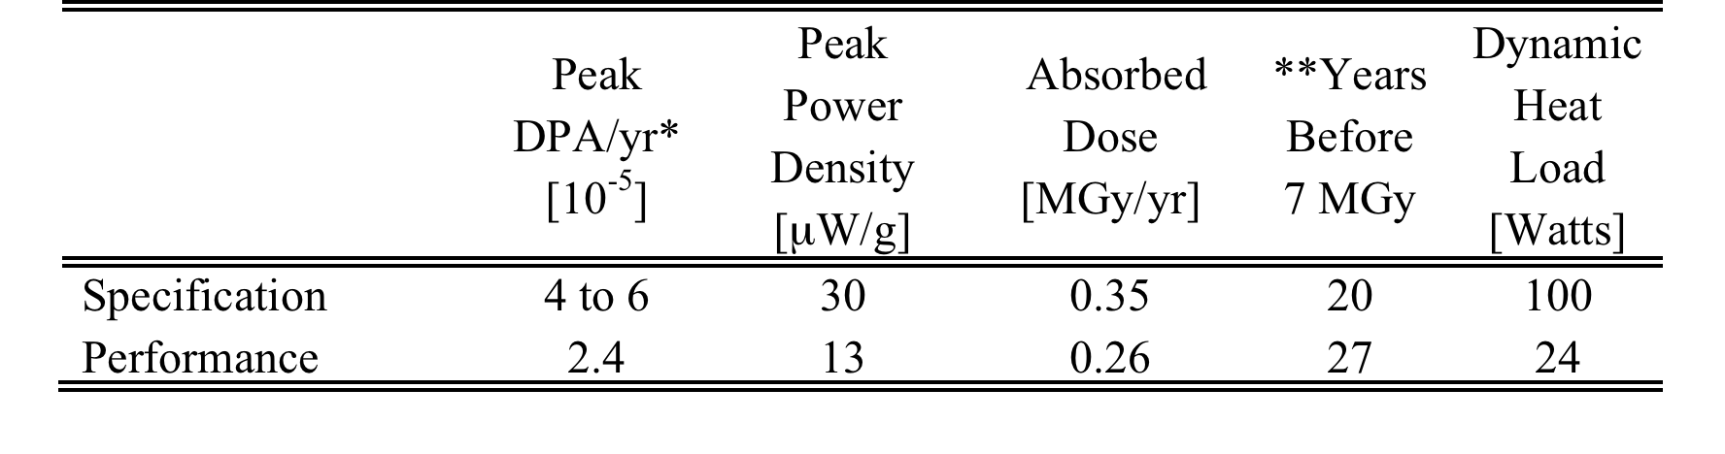
Performance- HRS
MARS Simulations
Vitaly Pronskikh
DPA Limit

Slide 17
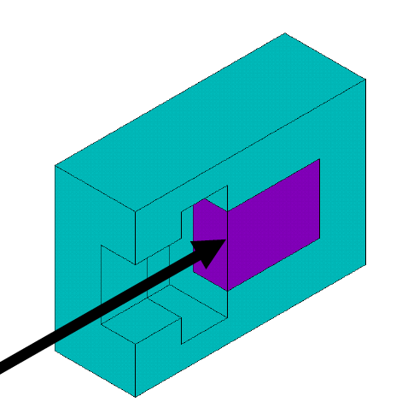
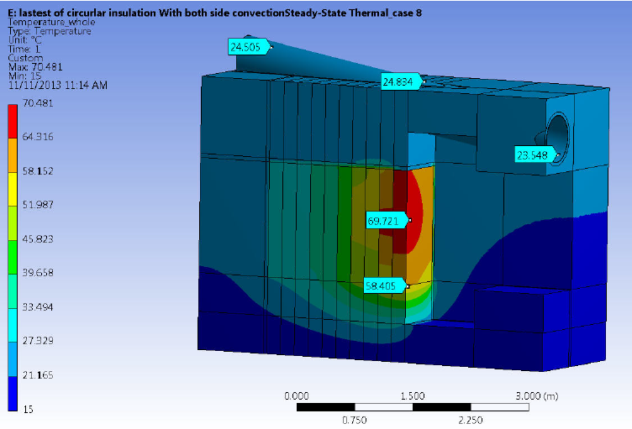
Proton Beam Absorber Design
Andy Stefanik
Left Section View
concrete
70° C max
70° C max
Fe
2 m
Proton
Beam
Fe core 1.5 m x 1.5m x 2 m
A. Lee
forced air cooling

Slide 18
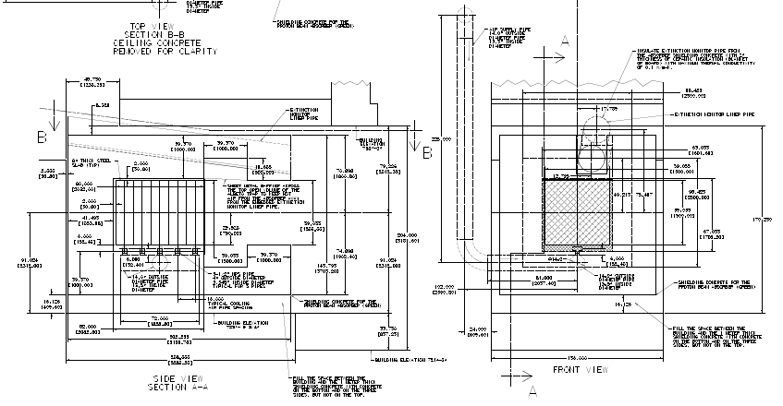
Proton Beam Absorber Design
Andy Stefanik – Doc db 1665
Sheet metal forms used to pour surrounding concrete during civil work
Forced Air Cooling
10 Fe Slabs 8" x 59" x 59"

Slide 19
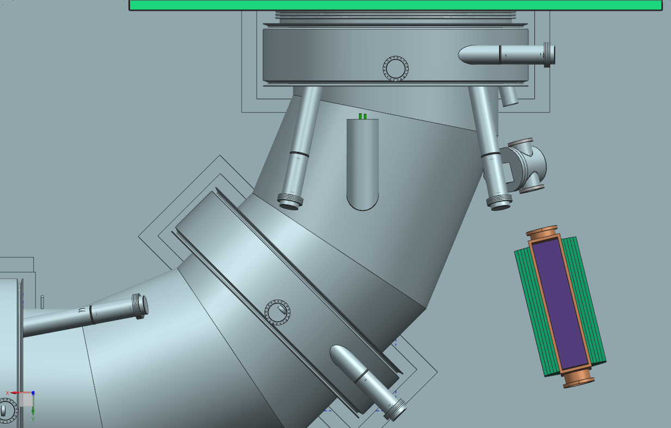
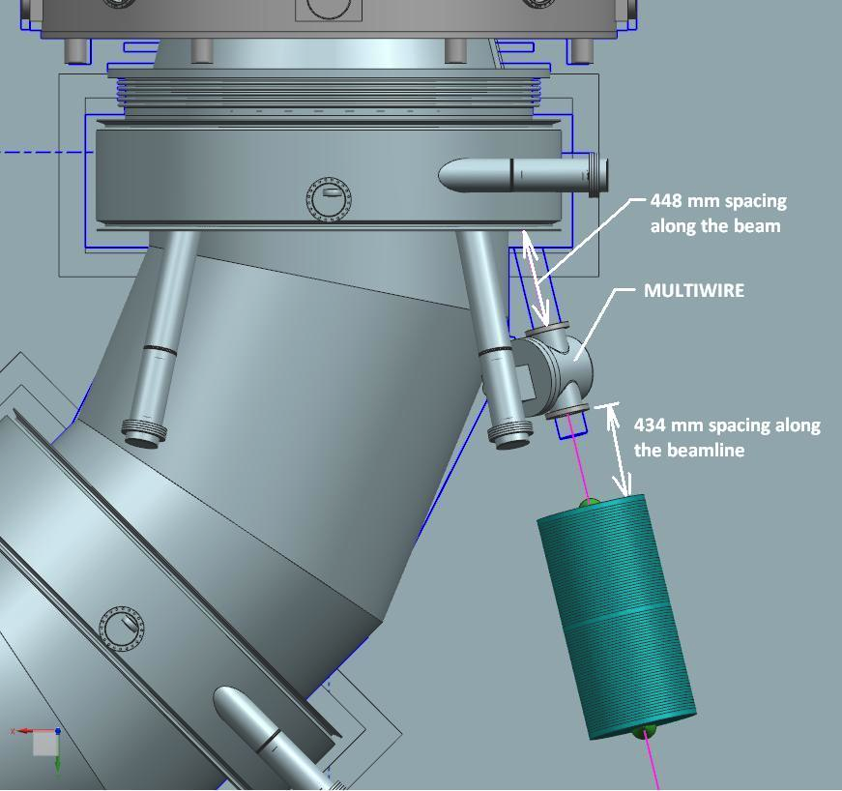
Protection Collimator Design
A. Stefanik
Multiwire
Profile
Monitor
Protection
Collimator
Transport
Solenoid
Proton Beam

Slide 20
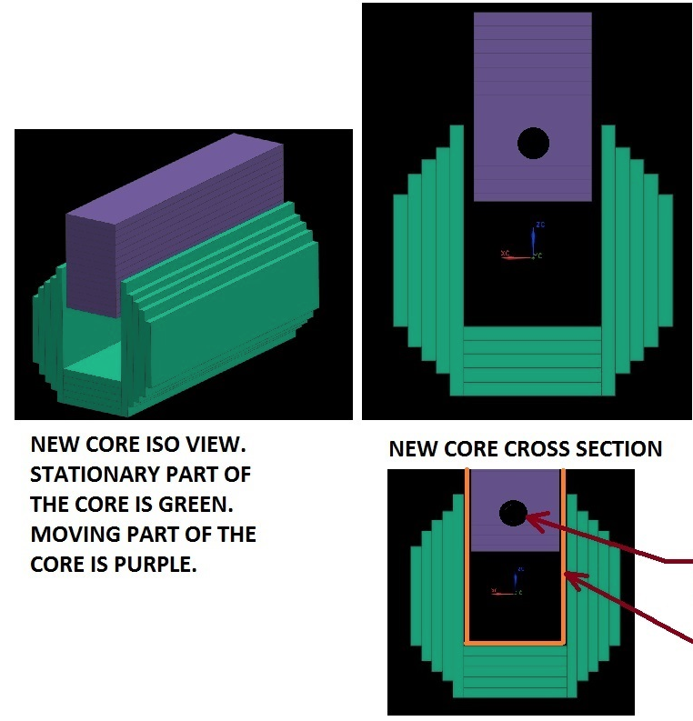
Protection Collimator Design
Beam Hole
shown in out position
Vacuum Vessel

Slide 21
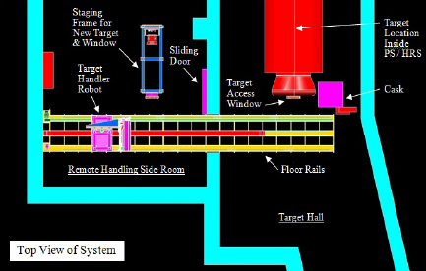
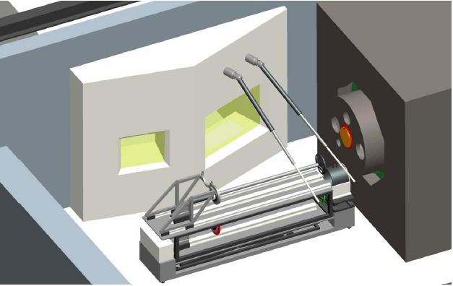
Changes since CD-1
Target Remote Handling Hot Cell and manipulator arms changed to current "robot" design
  Move (Overall project beam power reduced by 3x for economics) -> from water-cooled to radiatively cooled target
  Above removes the need for a longer plunger tool as shown on left
  Responsibility of remote handling changed from contractor to FNAL
  Started from discussions of a moveable hot cell
  Minimize need for access through main PS hatch with temporary crane into high radiation area
  Given building layout and large span to reach PS hatch, requires very large crane ($$$)
  Minimize the need for massive shielding for hot cell/ manipulator arms (40 ton shield not shown in picture on left )

Slide 22
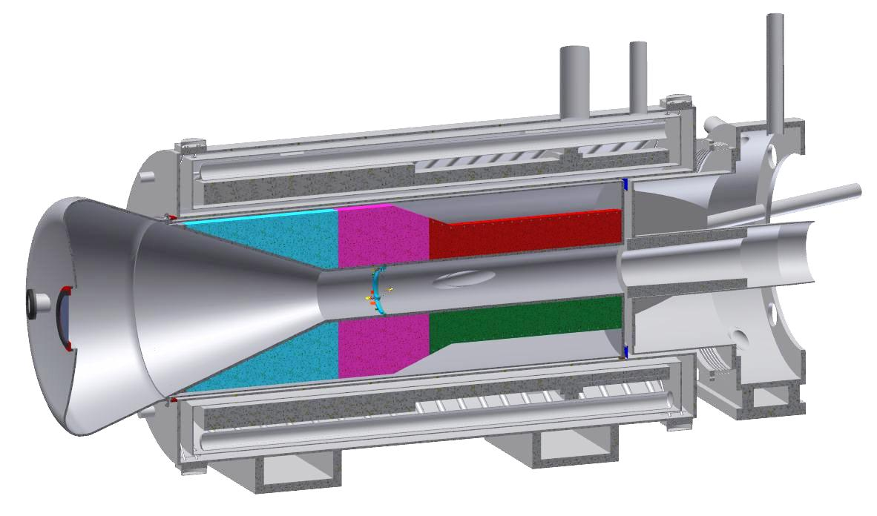
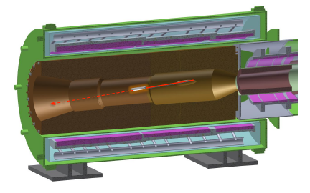
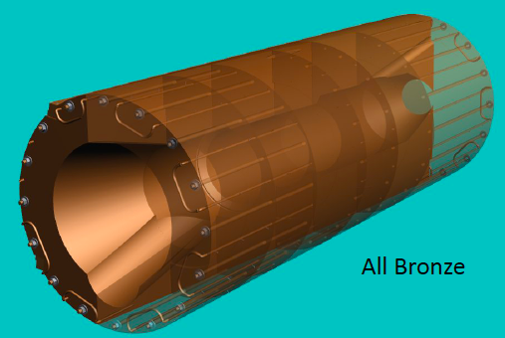
Changes since CD-1
Heat & Radiation Shield
  Mass of Bronze reduced from 41 tons to 31 tons
  Water replaces some Bronze, serves as cooling & neutron shielding
  Shape of Bronze simplified to cone plus cylindrical pipe, original had steps in radius, scalloped region
  Stainless Steel liner -> Vacuum cleaner, vacuum surface area reduced
  Concerns about water cooling lines contact in shield eliminated, number of pipe connections reduced

Slide 23
Value Engineering since CD-1
Both design changes for Remote handling and HRS described on previous slides were motivated by Value Engineering
Proton Beam Absorber design simplified, cost effective
  Machined Al plates for core replaced with "boneyard" steel
  Much of concrete around core poured in place during civil construction rather than using blocks
Proton Collimator design simplified, cost effective
  Motion of block inside vacuum changed, greatly reduces vacuum volume
  Further work with look at larger reduction in mass of steel used

Slide 24
Value Engineering since CD-1- Rutherford Labs
here is a list of the value of equipment RAL has used, or in some cases purchased specifically with no cost to the project:
1. Roger’s ‘little wire’ test rig – c.£10k(?) of relevant costs not including pulsed psu
2. Vacuum pumps (turbo + scroll), gauges (Pirani + Penning + Controller/Display) - £9435
3. Pulsed PSU (components and much of the effort) c.£15k
4. DC power supply for emissivity measurements c.£2k
5. Induction PSU for future testing of prototype target £20k
6. Tensile test facility £300k
7. TGA test machine
8. Vac furnace for baking out and stress relieving – Run in a large vacuum furnace @ Culham ~ £500/day (capital cost ~£50,000 ?)
9. Oscilloscope - £2240
10. DAQ system
11. Optical pyrometer
12. Digital pyrometer - £3175
13. Optical microscope - £5k
14. EDM capital costs (running costs only paid for?) Machine cost ~100k +VAT
15. Laser fin cutting (prototyping)
16. Advanced metrology facilities (3D co-ordinate measuring machine, profilometry, non-contact measuring machine etc) – A number of high value instruments
17. Graphtec datalogger - £2500
18. ANSYS multiphysics license - £45k purchase list price plus £8.4k pa support
19. Residual Gas Analyser – c.£5k

Slide 25
Risks
        Poor quality vacuum reduces target lifetime due to chemical processes
          Erosion of the tungsten rod, supports and spoke material is expected due to oxidation and water vapor-induced corrosion from impurities in the vacuum. It is difficult to predict the erosion rate by these processes at the expected achievable vacuum level of 1 × 10⁻⁵ Torr due to uncertainties in the vacuum impurity constituents, uncertainties in the operating temperature as described above, and discrepancies and extrapolations in the data from different sources in the literature.
          Mitigation strategy is the extensive RAL studies: measuring the effect, testing protective coatings, and exploring He cooling as an alternative.
        Remote Handling needs redesign and cost increase if we abandon radiatively cooled target
          Mitigation strategy is to evaluate our option of above ground remote handling room with crane which has remote handling solution for either radiative or He cooled target.

Slide 26
Remaining work before CD-3
Complete Proton Beam Absorber and install during civil construction next year
Complete the HRS assembly and transportation fixture design
Evaluate the option of an overhead remote handling room with crane coverage added above existing PS hatch
  Civil bids done with and without underground RH room
  A first pass of redesign of "robot" into several modules done
  Detailed discussion with Accelerator Radiation Safety Group started
  After costs are developed for overhead, planning a review
Based on completed target R&D, decide on radiation cooled or He cooled target, modifications to RH, minimal if overhead solution is chosen

Slide 27
Quality Assurance
Every part of the target will be thoroughly prototyped and tested off-line. A complete prototype will then be manufactured. All manufacturing and test methods will be thoroughly documented. The actual target supplied for experimental operation will use the same procedures as were developed for the prototype.
Target Station sub-systems will be designed and built in accordance with the requirements of the Fermilab Engineering Manual. The design of these systems is monitored by in-progress design review during weekly meetings of the Target Station Group. The in-progress review is followed by a final project review. The design is documented in the requirements and specification documents, CAD model, and drawings. As-built dimensions will be checked against the fabrication drawings. Operation is verified as part of the fabrication process and again after installation.

Slide 28
ES&H
Mu2e Hazard Analysis Document doc-db 675 covers a complete list of topics
Two members from ES&H group attend weekly Target Station meetings
Radiation Safety is particularly important for the Target Station, including:
  Prompt Dose
  Residual Dose
  Contamination
  Air and Ground Water Activation

Slide 29
Cost Table
 | Base Cost (AY K$)
 | M&S | Labor | Total | Estimate Uncertainty (on remaining budget) | % Contingency on (on remaining budget) | Total Cost
475.02.09.01 Simulations and Calculations | 67 | 1,329 | 1,396 | 171 | 31% | 1,567
475.02.09.02 Fabricate Target | 1,863 |  | 1,863 | 497 | 41% | 2,360
475.02.09.03 Target Handling | 1,177 | 1,457 | 2,634 | 777 | 33% | 3,410
475.02.09.04 Production Solenoid Heat & Radiation Shield | 2,632 | 200 | 2,831 | 875 | 32% | 3,706
475.02.09.05 Target Station Proton Beam Absorber |  | 57 | 57 | 14 | 53% | 71
475.02.09.06 Solenoid & HRS Protection Collimator | 126 | 201 | 326 | 128 | 42% | 454
475.02.09.07 Hatch Shielding Blocks |  |  |  |  | n/a
475.02.09.08 Technical Documentation |  | 1,240 | 1,240 | 245 | 22% | 1,485
Grand Total | 5,863 | 4,483 | 10,346 | 2,706 | 32% | 13,053

Slide 30
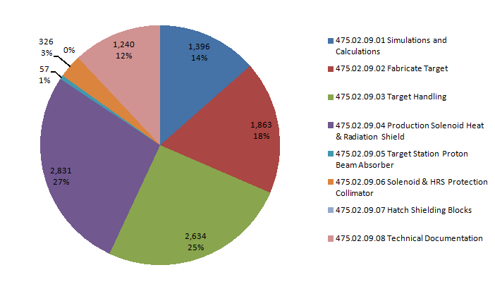
Cost Breakdown
475.02.09 Target Station
WBS Level 4
Base Cost in AY $K

Slide 31
Quality of Estimate
475.02.09 Target Station
AY $K
Estimates at Preliminary or better

Slide 32
Cost Breakdown by FY
475.02.09 Target Station
AY $K

Slide 33
FTE's by Discipline

Slide 34
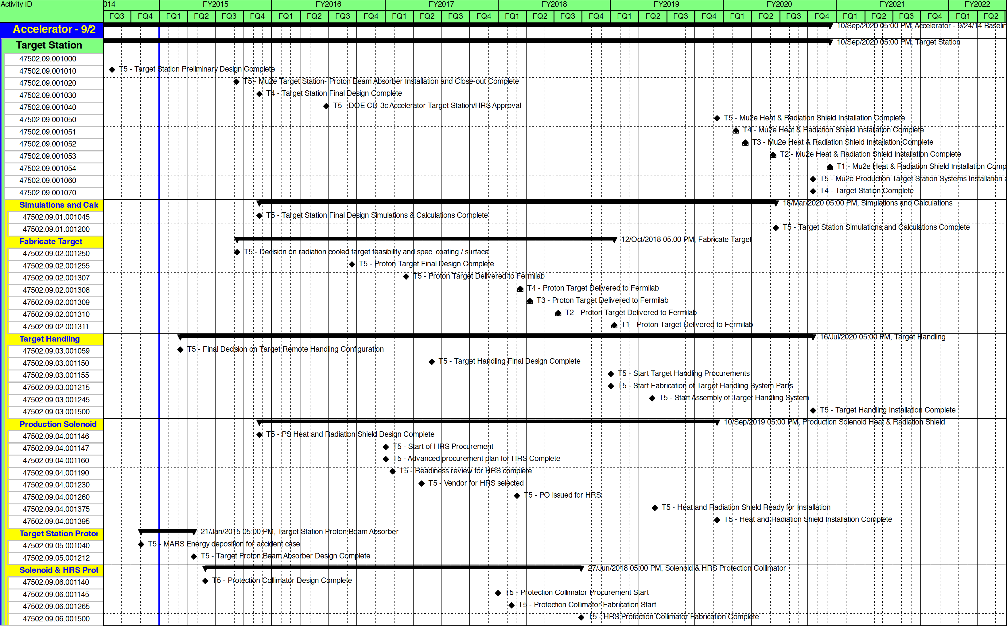
Milestones

Slide 35
Schedule
Target
Station
CD-3c
PS
Installed in
Bulding
CD-2
CD-4
Proton Absorber
Installed
Target Station
Final Design
Target R&D
Target Prototype/Thermal Tests
1st Target
Target Installation
December 2021 →
Remote
Handling Assembly/Testing
Remote
Handling
Design
HRS
Final
Design
HRS Procurement
& Assembly
HRS
Install
Q3 | Q4 | Q1 | Q2 | Q3 | Q4 | Q1 | Q2 | Q3 | Q4 | Q1 | Q2 | Q3 | Q4 | Q1 | Q2 | Q3 | Q4 | Q1 | Q2 | Q3 | Q4 | Q1 | Q2 | Q3 | Q4 | Q1 | Q2 | Q3 | Q4 | Q1 | Q2 | Q3 | Q4
FY14 FY15 FY16 FY17 FY18 FY19 FY20 FY21

Slide 36
Summary
The Target Station Design is well integrated with the Solenoids, Muon Beam line, Civil Construction, and Radiation Safety
A preliminary design is complete
A review and choice is needed on the remote handling scheme
R & D is well underway to decide on target choice- radiative or convection cooled
We are ready to baseline our schedule

Slide 37
Backup Slides

Slide 38
Milestones
475.02BL-5.09 Target Station
47502.09.001000 | T5 - Target Station Conceptual Design Complete |  | 28-Jun-12 A | T5
47502.09.001010 | T5 - Target Station Preliminary Design Complete |  | 30-Apr-14 A | T5
47502.09.05.001040 | T5 - MARS Energy deposition for accident case | 02-Jun-14* |  | T5
47502.09.05.001212 | T5 - Target Proton Beam Absorber Design Complete |  | 25-Aug-14 | T5
47502.09.06.001140 | T5 - Protection Collimator Design Complete |  | 5-Nov-14 | T5
47502.09.03.001059 | T5 - Final Decision on Target Remote Handling Configuration |  | 9-Dec-14 | T5
47502.09.02.001250 | T5 - Decision on radiation cooled target feasibility and spec. coating / surface |  | 2-Jan-15 | T5
47502.09.001020 | T5 - Mu2e Target Station- Proton Beam Absorber Installation and Close-out Complete |  | 15-Apr-15 | T5
47502.09.001030 | T4 - Target Station Final Design Complete |  | 20-Aug-15 | T4
47502.09.04.001146 | T5 - PS Heat and Radiation Shield Design Complete |  | 20-Aug-15 | T5
47502.09.01.001045 | T5 - Target Station Final Design Simulations & Calculations Complete |  | 20-Aug-15 | T5
47502.09.001040 | T5 - DOE CD-3c Accelerator Target Station/HRS Approval | 24-Feb-16 |  | T5
47502.09.04.001147 | T5 - Start of HRS Procurement | 3-Oct-16 |  | T5
47502.09.04.001160 | T5 - Advanced procurement plan for HRS Complete |  | 4-Oct-16 | T5
47502.09.04.001190 | T5 - Readiness review for HRS complete |  | 26-Oct-16 | T5
47502.09.04.001230 | T5 - Vendor for HRS selected |  | 27-Jan-17 | T5
47502.09.03.001150 | T5 - Target Handling Final Design Complete |  | 31-Jan-17 | T5
47502.09.02.001255 | T5 - Proton Target Final Design Complete |  | 21-Apr-17 | T5
47502.09.06.001145 | T5 - Protection Collimator Procurement Start | 2-Oct-17 |  | T5
47502.09.02.001307 | T5 - Proton Target Delivered to Fermilab |  | 13-Oct-17 | T5
47502.09.06.001265 | T5 - Protection Collimator Fabrication Start | 14-Nov-17 |  | T5
47502.09.04.001260 | T5 - PO issued for HRS |  | 1-Dec-17 | T5
47502.09.06.001500 | T5 - HRS Protection Collimator Fabrication Complete |  | 27-Jun-18 | T5
47502.09.03.001155 | T5 - Start Target Handling Procurements | 1-Oct-18 |  | T5
47502.09.03.001215 | T5 - Start Fabrication of Target Handling System Parts | 1-Oct-18 |  | T5
47502.09.03.001245 | T5 - Start Assembly of Target Handling System | 13-Feb-19 |  | T5
47502.09.04.001375 | T5 - Heat and Radiation Shield Ready for Installation | 21-Feb-19 |  | T5
47502.09.001050 | T5 - Mu2e Heat & Radiation Shield Installation Complete |  | 10-Sep-19 | T5
47502.09.04.001395 | T5 - Heat and Radiation Shield Installation Complete |  | 10-Sep-19 | T5
47502.09.001051 | T4 - Mu2e Heat & Radiation Shield Installation Complete |  | 11-Nov-19* | T4
47502.09.001052 | T3 - Mu2e Heat & Radiation Shield Installation Complete |  | 11-Dec-19* | T3
47502.09.01.001200 | T5 - Target Station Simulations and Calculations Complete |  | 18-Feb-20 | T5
47502.09.001070 | T4 - Target Station Complete |  | 16-Jul-20 | T4
47502.09.001060 | T5 - Mu2e Production Target Station Systems Installation and Close-out Complete |  | 16-Jul-20 | T5
47502.09.03.001500 | T5 - Target Handling Installation Complete |  | 16-Jul-20 | T5

Slide 39
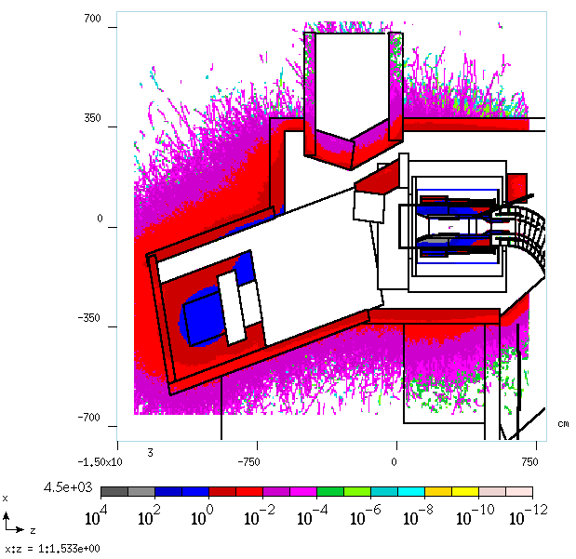
Residual Dose PS Hall-
30 Days Irr, 1 Day Cool | (mrem/hr)
Point 1 | 596
Point 2 | 1087
Point 3 | 32816
Point 4 | 2269
Point 5 | 2473
30 Days Irr, 7 Day Cool
Point 1 | 55
Point 2 | 101
Point 3 | 3035
Point 4 | 210
Point 5 | 229
365 Days Irr, 1 Day Cool
Point 1 | 692
Point 2 | 1261
Point 3 | 38066
Point 4 | 2631
Point 5 | 2868
365 Days Irr, 7 Day Cool
Point 1 | 147
Point 2 | 269
Point 3 | 8105
Point 4 | 560
Point 5 | 611
Point 1
Point 3
Point 4
Point 5
Point 2
N. Duff, doc db 2717

Slide 40
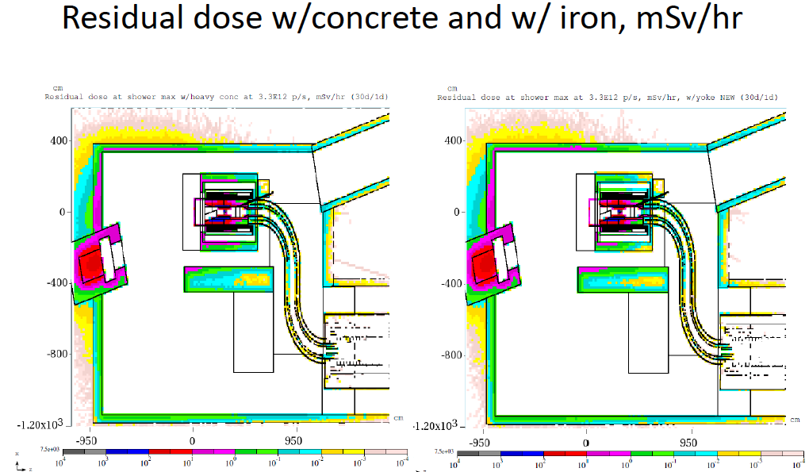
Target Hall Radiation Levels

Slide 41
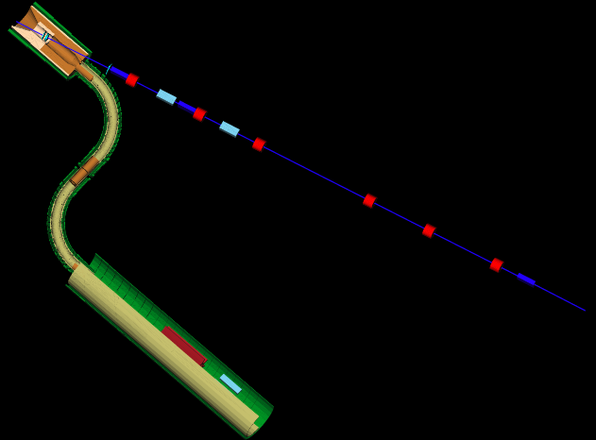
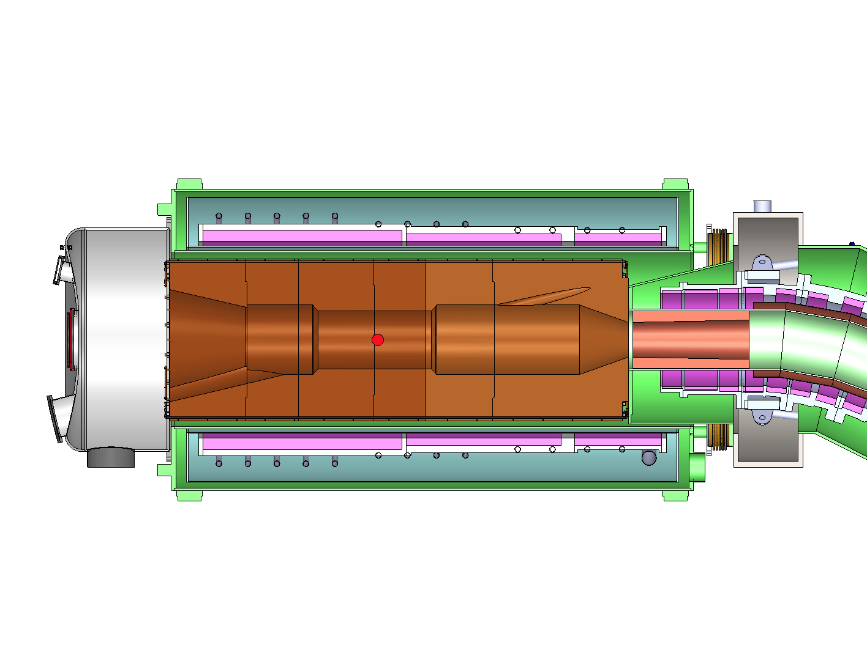
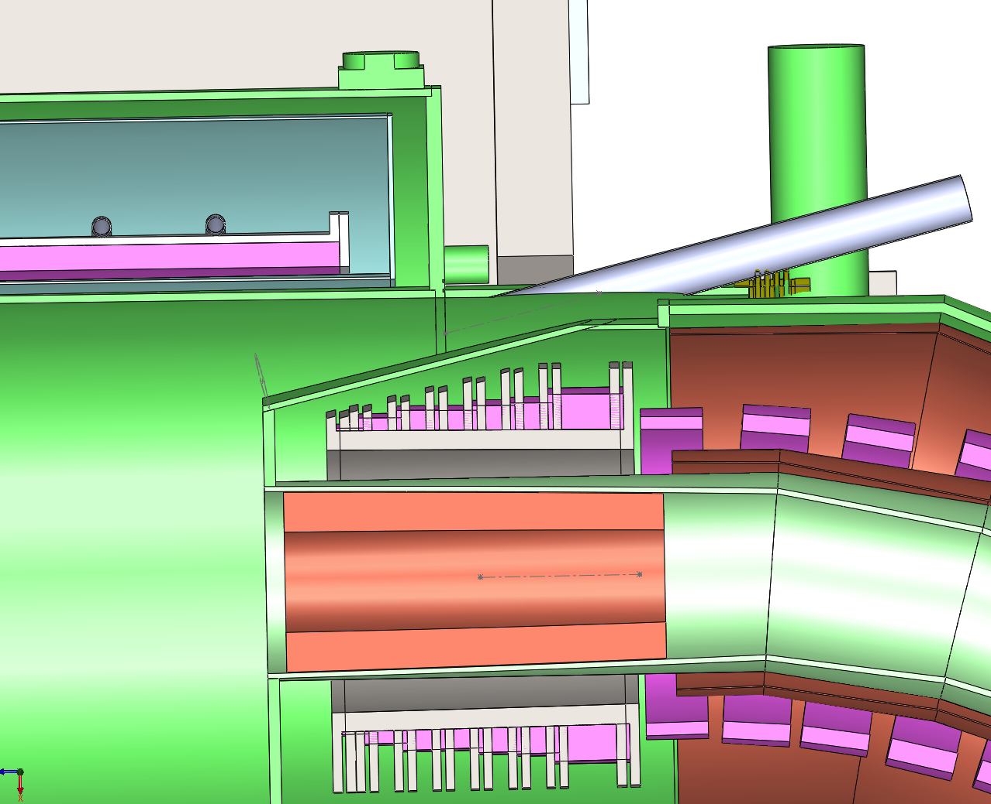
Proton Beam Through Solenoids
T. Page

Slide 42
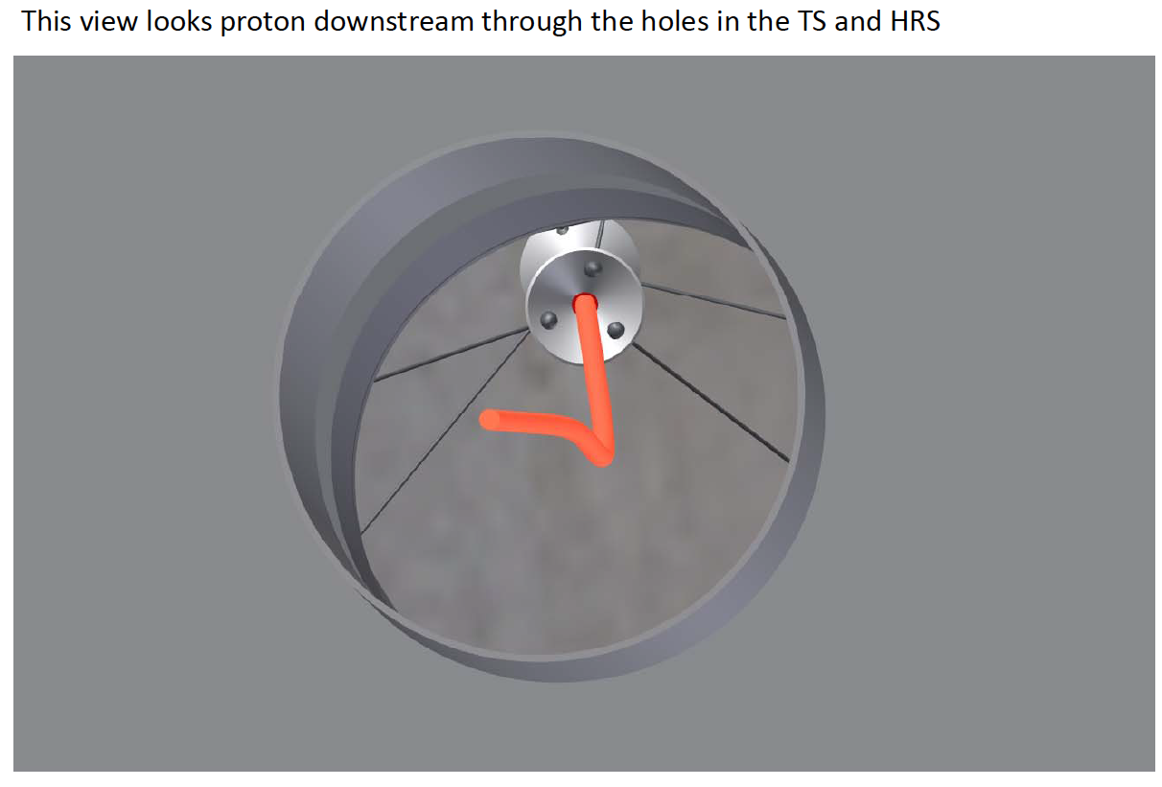
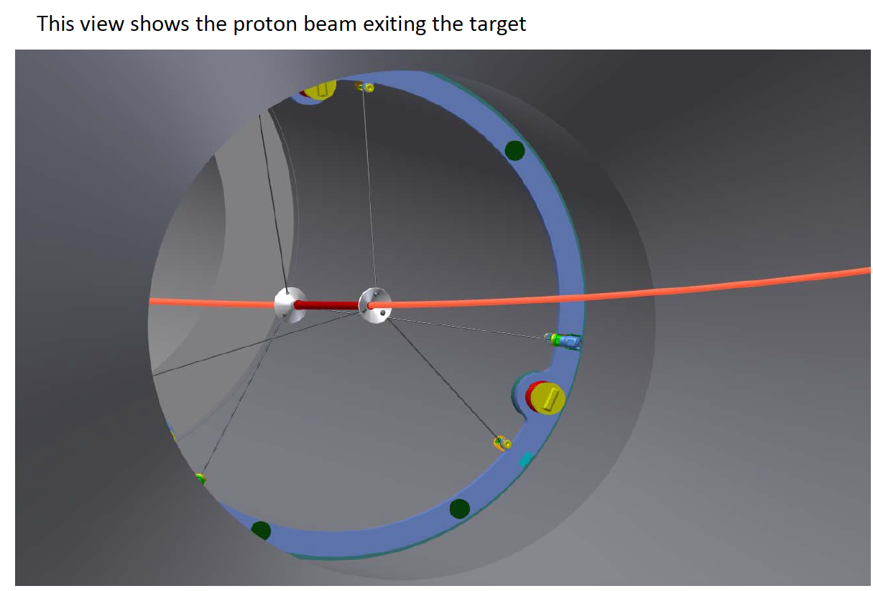
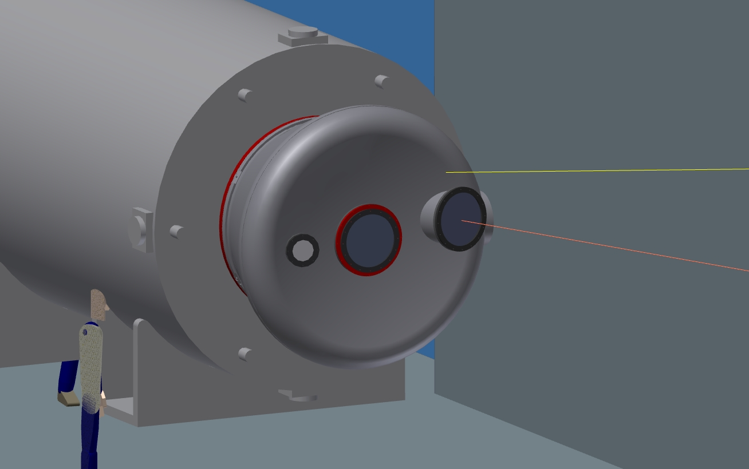
Proton Trajectory in Engineering Model
L. Bartoszek
Check of Trajectory
Other checks by:
A. Stefanik
T. Page
J. Brandt
PS endcap
Beam trajectory

Slide 43
Target Alignment/Tolerances Summary
Target dimension tolerances
Target Length = 16 cm ±2 mm
Target Radius = 3 mm ±0.1 mm
Alignment of target with respect to PS/HRS
Replacement target positioning repeatability: ±0.25 mm
Transverse placement w/resp. to PS axis: ±5 mm
Longitudinal placement along PS axis: ±10 mm
Alignment of target with respect to the proton beam:
Transverse beam positioning requirement: ±0.5 mm
Horizontal and vertical angle alignment: ±0.2°

Slide 44
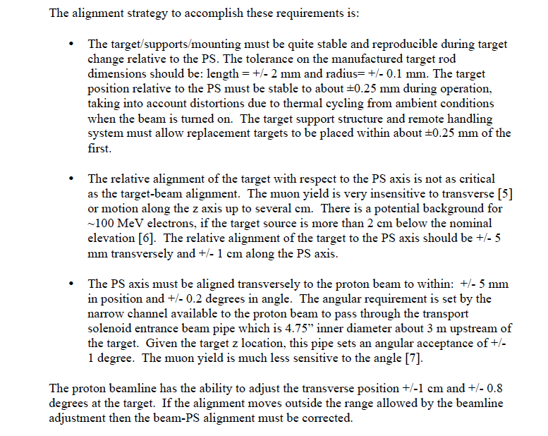
Alignment Details

Slide 45
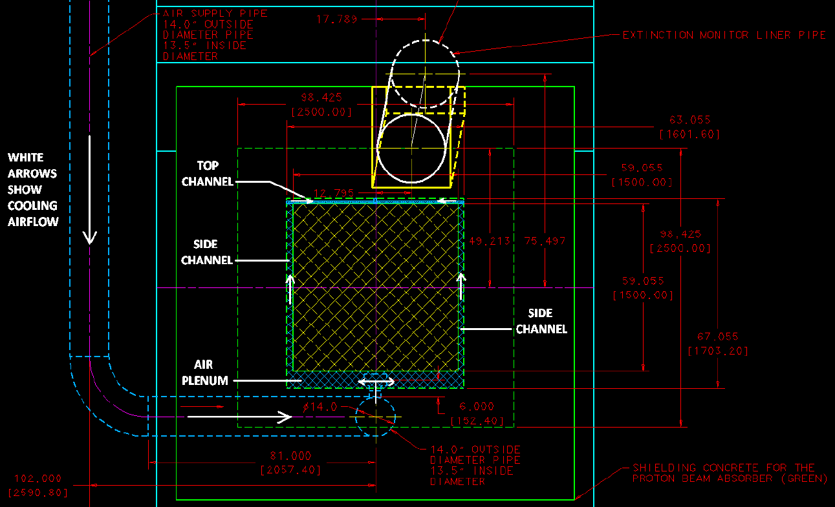
Proton Beam Absorber Design

