Slide 1
The Team WBS 3.0
T. Lackowski
L2 Manager
8/22/2014

Slide 2
Emergencies
Voice alarm will describe type of emergency and action to be taken.
Exit the building through the south stairways, do not use north stairs unless voice command states differently.
Leave all belongings and walk steadily towards the exit.
Stay in area of refuge until given the all clear.

Slide 3
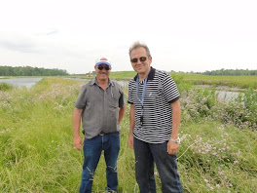
Coordinators
Construction Coordinator Tim Trout
Design Coordinator
Ron Jedziniak

Slide 4
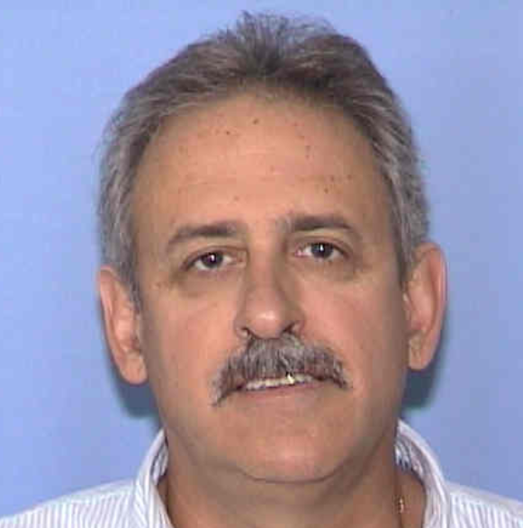
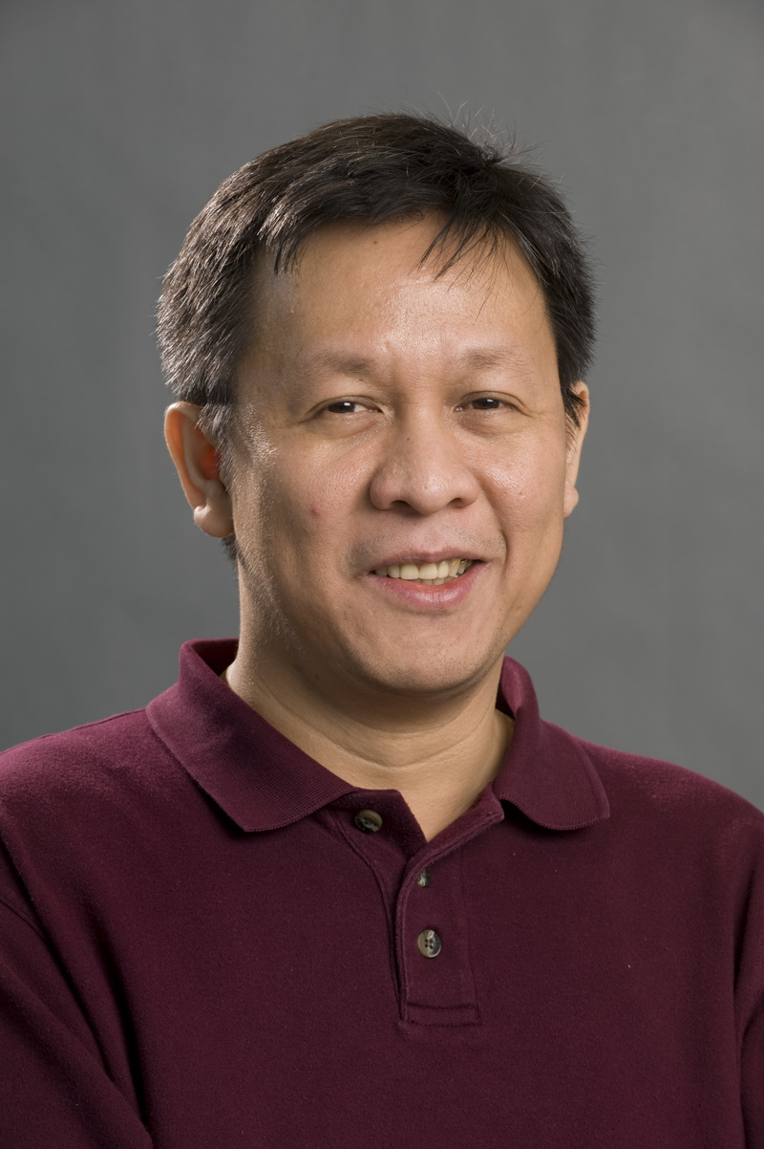
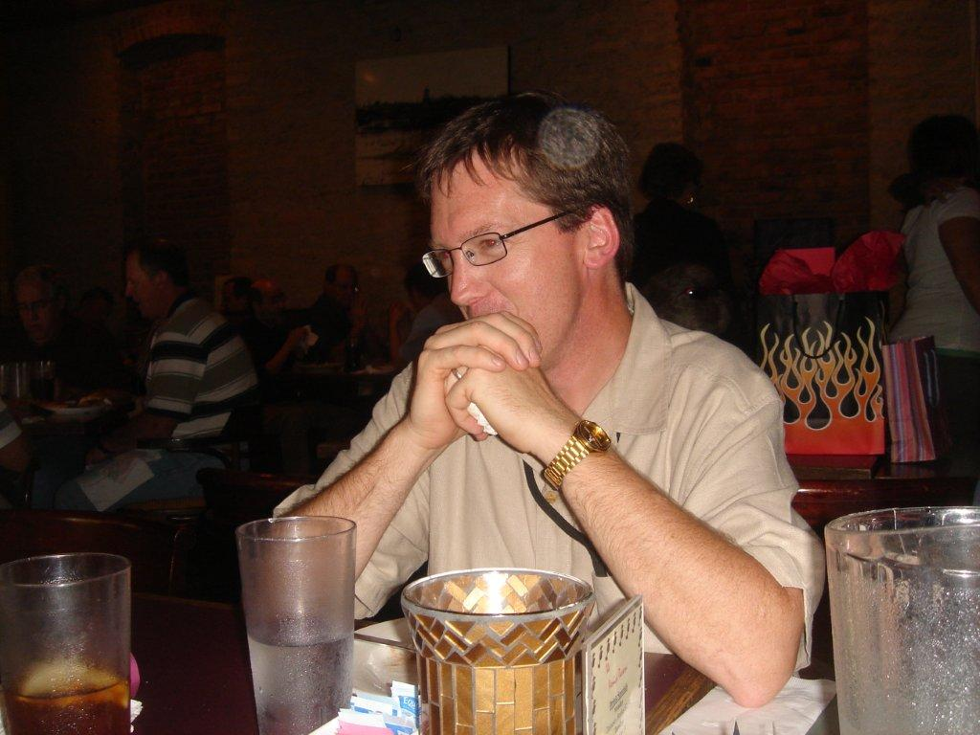
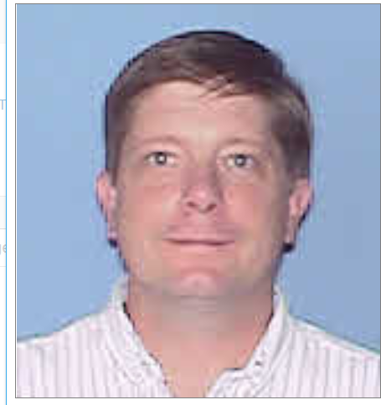
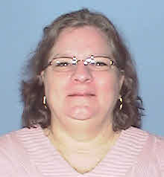
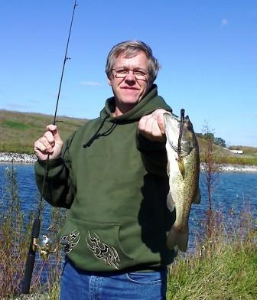
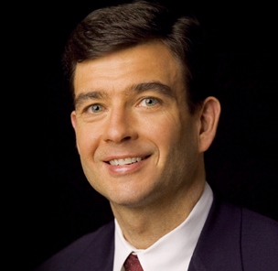
Conventional Support Team
Chuck Federowicz - Civil
Lee Hammond –VE Coordinator
Jim Niehoff –Life Safety / Fire Protection detection
Emil Huedem – HVAC, Process Water Sustainability
Steve Dixon Architect
Randy Wielgos Electrical
Sandra Efstathiou – Procurement Officer
Mike Gardner–Project Controls

Slide 5
Consultants

Slide 6
AD Team Members
Brian Drendel is level 3 for the purchase and installation of site communications wiring to the building.
In order to take Beneficial Occupancy there needs to be a FIRUS panel connected to the site system. The fire panel, sump pump monitoring and security systems are connected to FIRUS. Metesys for HVAC controls uses a 24 pair control.
For economy all of the required communication wiring will be pulled at the same time.
Rick Coleman is level 3 for fabricating the steel plates (existing steel in railyard)that make up the Beam Absorber core. The safest way to install these plates is to have the building subcontractor install with heavy equipment. The installation of the plates is in the subcontract.

