Slide 1
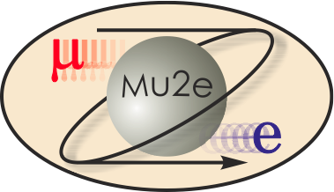
WBS 475.04.08 Field Mapping System
Michael Tartaglia
L3 for Magnetic Field Mapping
DOE CD-2 Review
October 21-24, 2014

Slide 2
Solenoid Team
Mike Tartaglia – L3 Manager for Field Mapping System
18 years in TD magnet test operations, magnetic measurement and analysis
TD Test & Instrumentation Department Head since May 1, 2014
Team
Marc Buehler, Associate Scientist in Magnet Systems Dept.
And students
Mau Lopes, Associate Scientist in Magnet Systems Dept.
And students
Charles Orozco, Co-op Mechanical Engineer
Konstantinos Vellidis, Guest Engineer

Slide 3
Requirements
Field Mapping System Requirements – Docdb#1275
In Summary:
Verify that the solenoid system meets all magnetic field requirements (Docdb #1266)
Monitor fields in critical regions of the muon beamline during solenoid operation
Obtain precision field maps of the DS spectrometer and calorimeter regions at nominal & calibration operating currents

Slide 4
Requirements
In Greater Detail:
Map {Bx,By,Bz} along DS bore (0<R<70cm)
DS-only during commissioning – QA check of DS magnetic field
Final magnetic configuration; DS at reduced currents (calibration settings)
Most demanding – precise tracker region requires dB/B~10⁻⁴
Map {Bz,Br} and {dBz/dz} in PS along HRS bore (limited to R<17cm)
PS-only during commissioning – QA check of PS magnetic field, HRS permeability
Final magnetic configuration (all solenoids powered)
Map {Bz} into PS/TS1 and DS/TS5 collimators (limited to R<15cm)
Final magnetic configuration; TS adjustments and trim power supply settings
Monitor {B} in DS spectrometer region during Mu2e operation
Monitor {Bz} and {dBz/dz} along TS1, TS3u, TS3d, TS5 collimators (R~15cm)
Measure straight section continuous negative gradients, final magnetic configuration
Perform Electron Source Test (off project)
Map electron transport through TS, final magnetic configuration

Slide 5
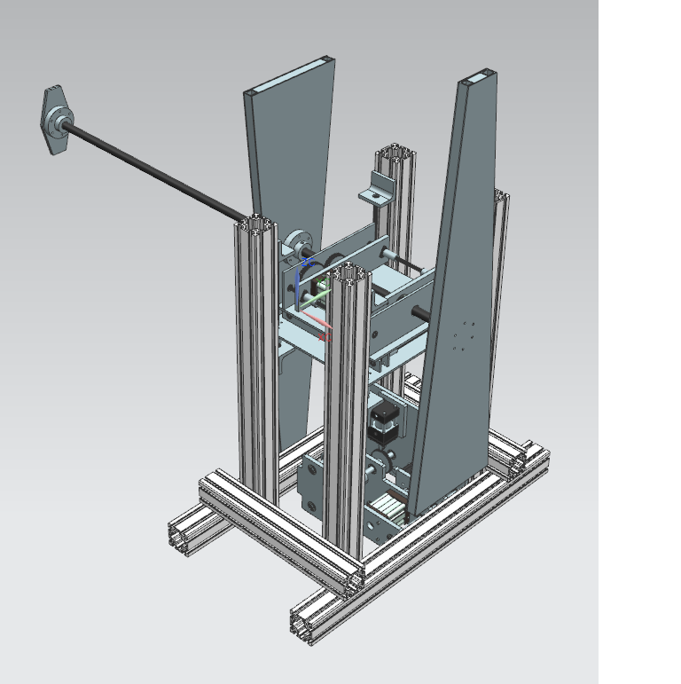
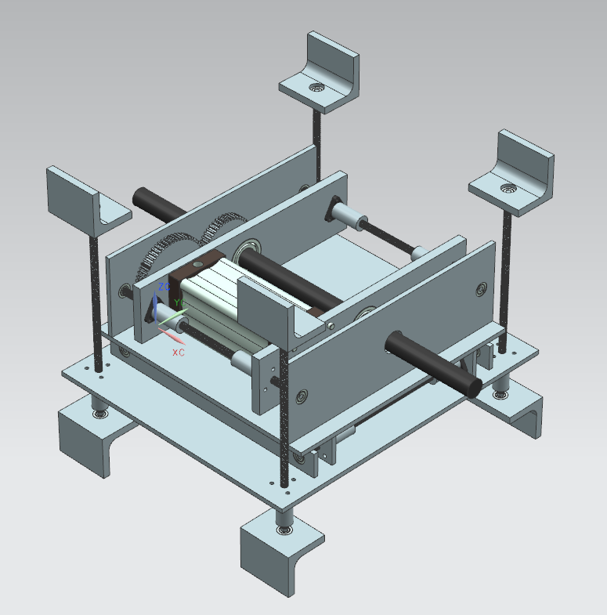
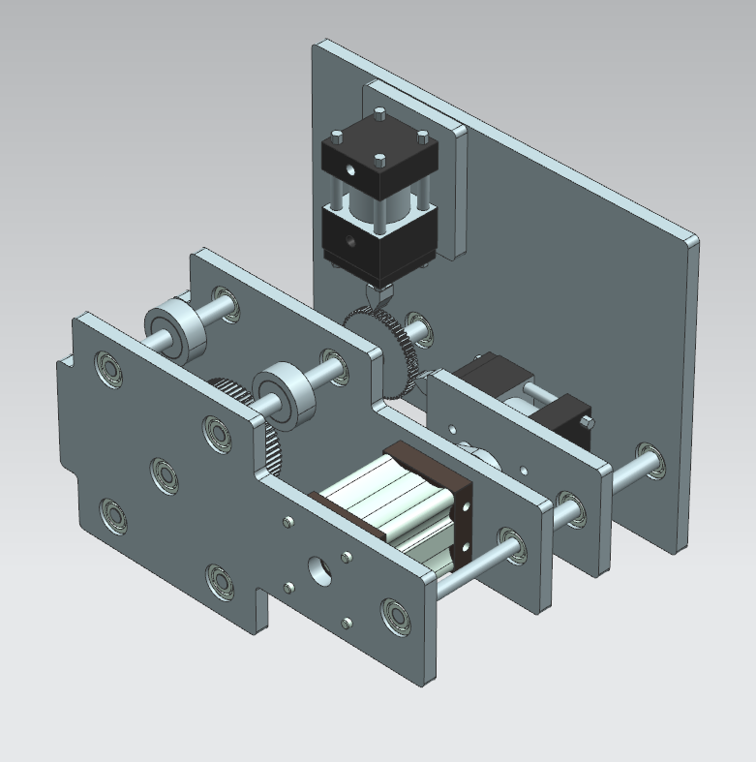
Design
DS Field Mapper
Probe positioning mechanism, similar to CMS solenoid mapper
Axial motion along precise DS detector support rails
Modern calibrated 3D Hall probes at fixed {R_{i}} on rotating “propellers”
Shaft extension to map into TS5 collimator
Z drive: stepper air motor, piezo control valves
toothed drive belt, position encoder
ϑ drive: 270° continuous air motor, geared 360° motion
Angle encoder
Fixed position NMR probes

Slide 6
Design
DS Field Mapper Status
3D model, bill of materials ~complete
Developing preliminary drawings
Field Mapper DAQ and Controls
New FNAL/TD Magnet Measurement System
Configurable, Extensible, Modern Software Architecture
Software framework & component developments are advanced
Utilize mostly commercial off-the-shelf components
PXIe, NI, Labview; Metrolab NMR
Hall and NMR prototype (calibration) system testing started
Detailed instrumentation design will begin soon
Readiness for CD-3

Slide 7
Design
PS Field Mapper
Hall probes to measure field strength and axial gradient
Will be calibrated in Tevatron Dipole to 5 T
Probe positioning mechanism still very preliminary
Following evolution of PS bore (HRS=heat & radiation shield)
Utilize linear guide supported by HRS bore and upstream flange
Cantilevered section downstream of target support ring
Extends map into TS1 collimator
External Z-drive system & encoder
Azimuthal positioning with non-magnetic rotary piezo stage
Detailed mechanical design to begin soon
Same Control & Instrumentation as DS
Tailored interface boxes and separate cabling

Slide 8
Design
PS Field Mapper
PS with Heat & Radiation Shield
inner bore tube
upstream end
flange
PS
HRS
Space may not be sufficient , ~5-6m long cantilevered arm
[CERN MICE Mapper]
d.s. end of TS1 Collimator
Target support ring

Slide 9
Design
In-Situ Sensors
NMR probes in DS spectrometer region
Mounted to inner bore (fixed positions to detect field changes)
In place during field mapping
Mounted to tracker frame ends (distinguish position changes)
Re-use probes from DS field mapper
Same electronics used during DS field mapping
Hall probes in TS Collimators [Now part of “TS Instrumentation”]
This is the only viable approach to check TS3 straight regions
Expect to map TS1 & TS5; these sensors monitor changes over time
1D Hall probes (& RTDs) embedded in collimators (3 designs)
after epoxy-impregnated construction in precisely spaced pre-machined slots
Read out by multiplexed instrumentation system (all magnet sensors)
Working on wiring and signal feed-through design details

Slide 10
Design
TS Collimator In-Situ Sensors
TS1 Collimator
TS5 Collimator

Slide 11
Design
Electron Transport Test
Off project; design & cost studied under Field Mapping WBS
Validate transport from primary target region through TS1,3,5 collimators to stopping target in “final magnetic configuration”
Position source near primary target position
Few-MeV Beta or Electron Conversion Source
Re-use PS field mapping device to move the source
Need components to allow rough evacuation of Muon Beamline
Detect electrons at downstream positions
Thin Scintillator tiles with on-board SiPM detectors (& electronics?)
Study detected position versus start position
Simulation in progress to define detector segmentation
Step 1: Detect at TS3 pbar-window gap (test TSu transmission)
Step 2: remove TS3 detector, detect at DS stopping target
Detailed studies and simulations in progress

Slide 12
Changes since CD-1
Production Solenoid/TS1 Collimator
No longer mapping the PS full aperture
Heat & Radiation Shield will now be an integral part of PS
Field mapping only in limited aperture of the HRS bore
Target support ring ~17 cm radius
Bkgd Simulations → new pbar window requirement
upstream of TS1 Col → could impact TS1 mapping
Looking at timing and method of this material installation
Electron Source Test could also be affected
In-Situ Hall Probes
Collimator instrumentation is TS responsibility

Slide 13
Value Engineering since CD-1
Control and DAQ Readout Same Controls and DAQ Readout System will be utilized for both DS and PS (map one at a time; tailored interface boxes and software configurations)
PS field map Hall Probe positioning device will also be used to position the Electron Source in the e-SourceTest
In-Situ Hall probe readout system will be common with all other magnet sensors
Same NMR probes and instrumentation will be used both for mapping and in-situ monitoring of DS field

Slide 14
Downselects
Electron Source Test at CD-1 considered using low energy electron gun array, vs radioactive source on positioning stage
Few MeV Beta or Conversion source has several advantages

Slide 15
Remaining work before CD-3
Complete preliminary designs
Complete preliminary design drawings
Complete final designs
Complete final design drawings

Slide 16
Quality Assurance
All mechanical components & materials will be inspected, and tested for magnetic properties (proximity to NMR in calibration magnet) for conformance with specifications
All Hall probes & electronics will be calibrated to the required level over the specified operating range; probe tilt angles and sensitivity to temperature variations will be measured
Multiple probes provide redundancy for cross-checks; NMR probes provide absolute field at reference points
Metrology will be used to determine the precise probe positions: for internal alignment, adjustment, and motion
Entire system will be assembled, bench- and field- tested well in advance of solenoid cryogenic and powered operations
Data analysis tools will be developed and ready to allow rapid evaluation of data quality during the field mapping operations

Slide 17
Risks
No major risks have been identified with field mapping

Slide 18
ES&H
ES&H issues associated with Field Mapping System and Operation:
DS confined space: access to DS bore is required for installation and removal of Field Mapper Z-drive belt
During cryogenic operations: ODH conditions may apply within regions of the Mu2e Hall
During magnet powered operations: high magnetic field hazard will apply within some regions of the Mu2e Hall
Electron Source Test: training in proper handling and storage of radioactive source (beta or electron conversion) will be needed

Slide 19
Major Milestones
475.04.08 Field Mapping System
001170 Final Design of Magnetic Field Mapping System Complete
001310 Vendor for magnetic field mapping system purchased parts selected
001360 PO issued for magnetic field mapping system purchased parts

Slide 20
Cost Table
 | Base Cost (AY K$)
 | M&S | Labor | Total | Estimate Uncertainty (on remaining costs) | % Contingency on ETC | Total Cost
475.04.08 Magnetic Field Mapping System
475.04.08 Magnetic Field Mapping System | 339 | 715 | 1,053 | 448 | 43% | 1,501
Grand Total | 339 | 715 | 1,053 | 448 | 43% | 1,501

Slide 21
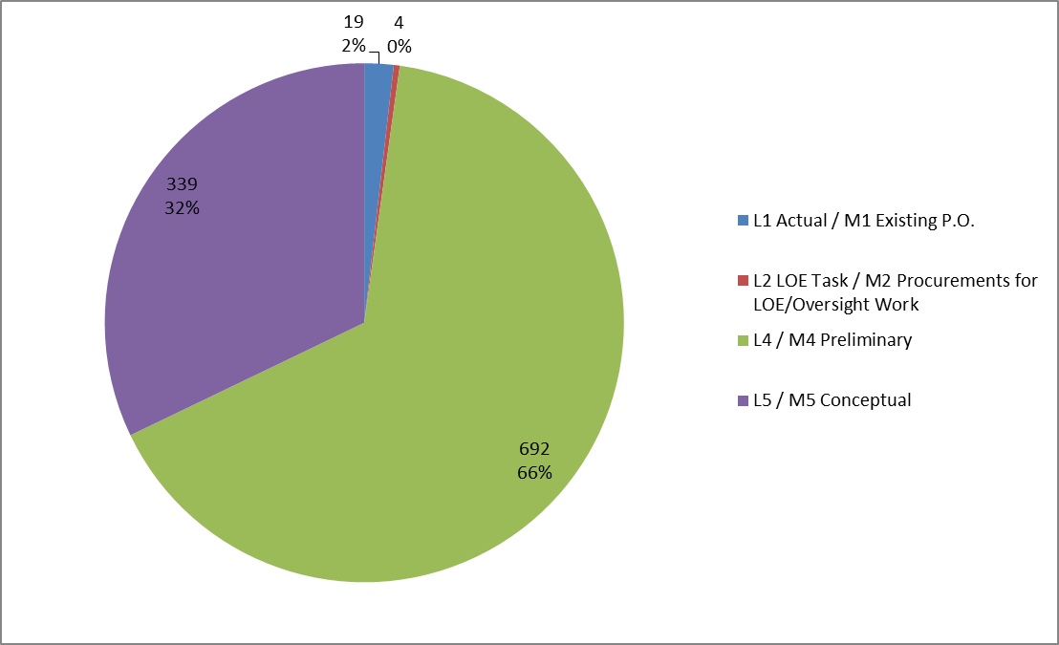
Quality of Estimate
Base Cost by Estimate Type (AY $k)

Slide 22
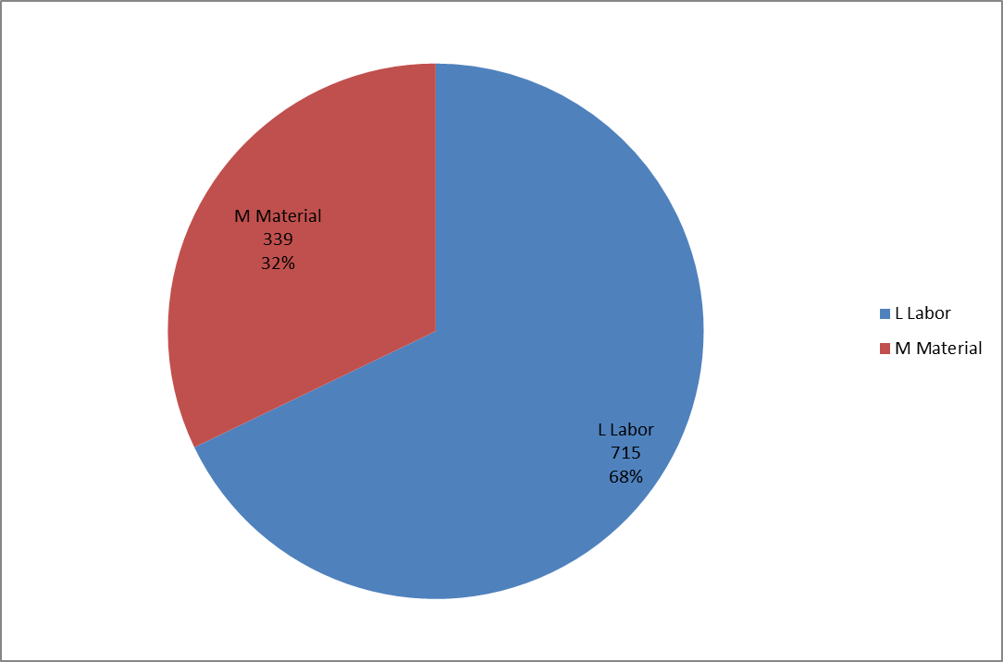
Resource Type

Slide 23
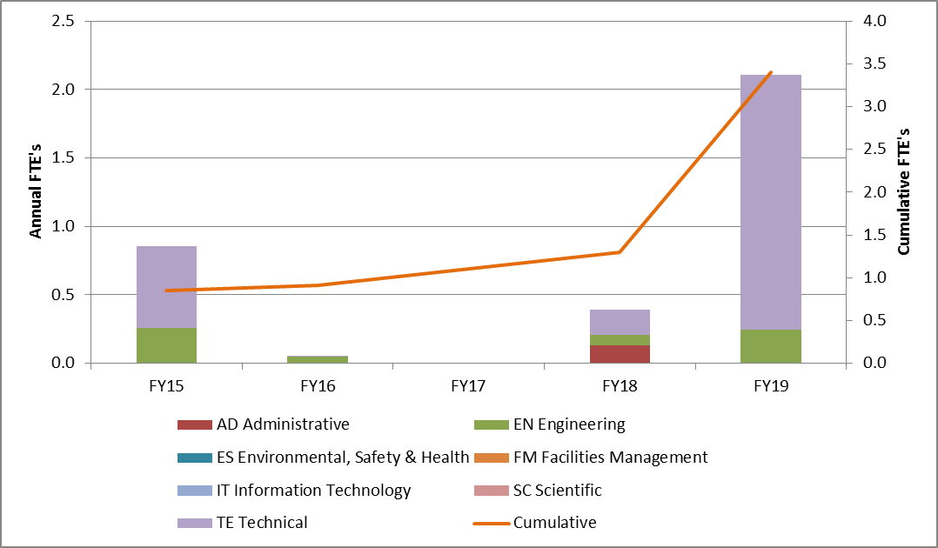
Labor Resources by FY
FTEs by Discipline

Slide 24
Schedule
CD-3a
CD-3c
CD-2/3b
CD-4
Fabricate and QA Superconductor
KPPs Satisfied
Solenoid Design/Prototypes
Solenoid Fabrication and QA
Detector Hall Construction
Solenoid Infrastructure
Field Mapping
FM Parts Procured
Solenoid Installation and Commissioning
FM Final Design
Detector Prototypes and Construction
Cosmic Ray System Test
Accelerator Commissioning (off Project)
Accelerator and Beamline Construction
Q3 | Q4 | Q1 | Q2 | Q3 | Q4 | Q1 | Q2 | Q3 | Q4 | Q1 | Q2 | Q3 | Q4 | Q1 | Q2 | Q3 | Q4 | Q1 | Q2 | Q3 | Q4 | Q1 | Q2 | Q3 | Q4 | Q1 | Q2 | Q3 | Q4 | Q1 | Q2 | Q3 | Q4
FY14 FY15 FY16 FY17 FY18 FY19 FY20 FY21

Slide 25
Summary
Field Mapping System preliminary design is in progress
Mapping is not on the critical path
In-situ sensors needed at end of TS construction
Other Mapping activities happen during Solenoid commissioning
DS is the most important, is the most advanced
Next focus on the daq & controls
PS Mapper
mechanical design following DS mechanical completion
Field Mapping System is ready for CD2

