Slide 1
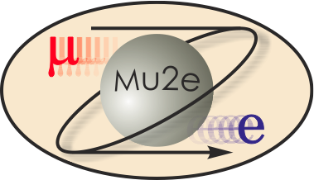
WBS 475.04.05 Cryogenic Distribution
Thomas Page
Project Engineer
DOE CD-2/3b Review
October 21-24, 2014

Slide 2
Requirements
Cryogenic Distribution Requirements Document: DocDB 1244
Distribution Box Functional Requirements Document: DocDB 3784
Summary of requirements
The solenoids are divided into 4 separate cryogenic circuits fed from a common distribution box. This allows the magnets to be cooled down and warmed up independent of each other.
All solenoid coils will be indirectly (conduction) cooled by liquid helium.
PS and DS magnets are cooled using a thermal siphon system.
TSu and TSd magnets are cooled using a forced flow system.
Liquid nitrogen will be used to cool the thermal shields and thermal intercepts within the magnet cryostats and transfer lines.
During operation the insulating vacuum should be below 10e-6 torr.
Feed boxes will be installed on the main level of the Mu2e building, the magnets are installed in the lower level of the Mu2e building.
Steady state operation will be within the limits of one satellite refrigerator.

Slide 3
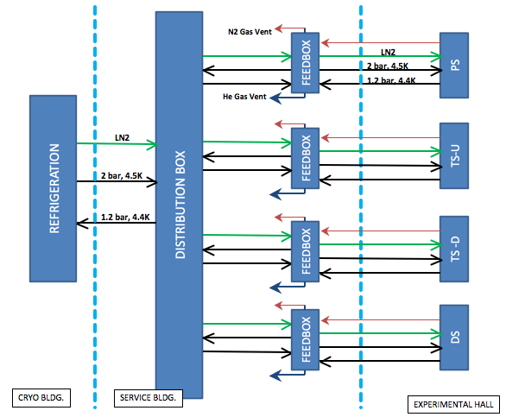
Block Diagram of Mu2e Cryogenic System

Slide 4
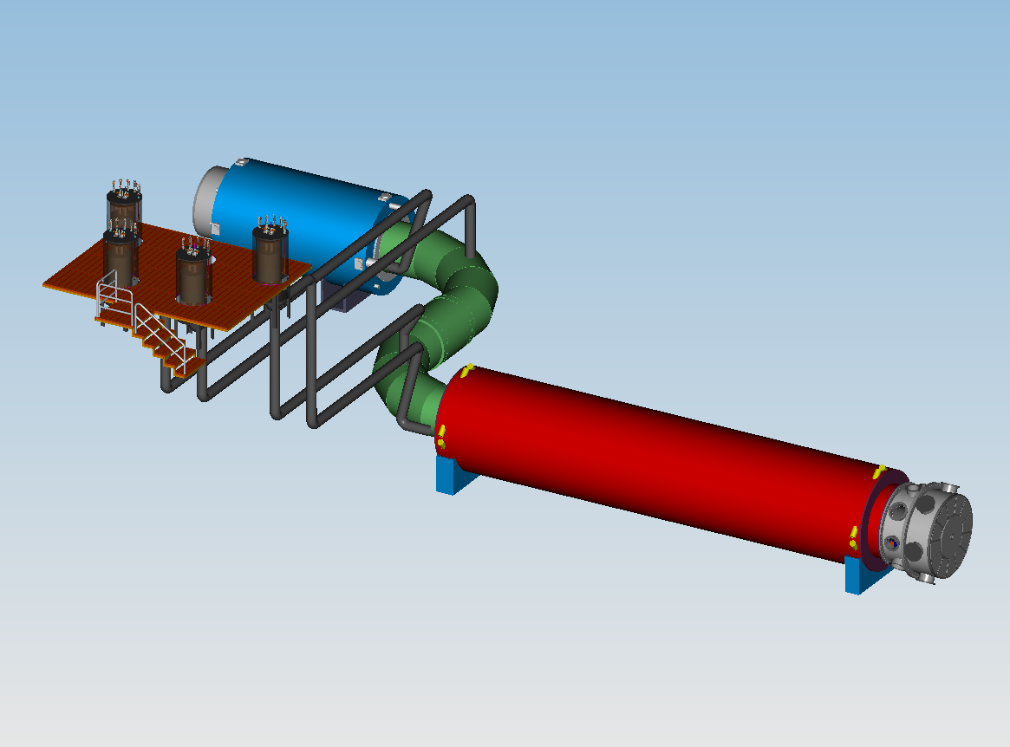
Cryogenic Distribution model
Feed boxes
Transfer Lines run
along the ceiling of the
experimental hall

Slide 5
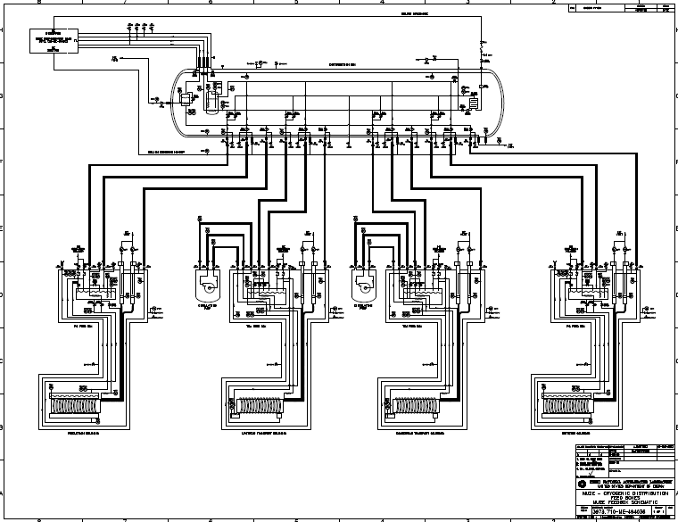
Preliminary P&ID

Slide 6
Design
A distribution box in the service building interconnects the refrigeration system with the solenoid feed boxes. Interconnections will be for:
Liquid helium supply
Helium vapor return
Liquid nitrogen supply
Liquid nitrogen comes from LN2 storage to the distribution box
Distribution box passes cryogens to four feed boxes, one for each magnet assembly
Transfer lines and bayonets allow isolation of feed boxes from distribution box

Slide 7
Design
Control valves in feed boxes
No cryogenic control valves in high radiation / high magnetic field areas
Transfer lines from feed boxes to magnets carry cryogens to and from its magnet as well as electrical bus to the same magnet
Insulating vacuum is separate for each feed box / magnet system such that separate warm up and isolation of magnets is possible.
10kA power leads for PS/DS
Re-purpose Tevatron HTS leads.
Validate each pair and reconfigure lower end for conduction cooling.

Slide 8
Improvements since CD-1
The transfer line routing has changed since CD-1
The DS transfer line penetrates through shielding near the downstream end of the DS magnet.
The TSd transfer line is routed under the shielding in a trench in the Mu2e building floor.
Cryogenic Controls WBS (formally 475.04.05.06) has been moved to Quench Protection WBS (475.04.07.03).

Slide 9
Downselects
The Detector Solenoid will be cooled using a thermal siphon system.
The Transport Solenoids will be cooled using a forced flow system.

Slide 10
Performance – Heat Load to 80 K
Best Estimates (no contingency) | Production Solenoid | TSu | TSd | Detector Solenoid | Total
Nominal Temperature | 80 K
80 K Magnet Heat (W) | 129 | 252 | 252 | 539 | 1172
80 K Feedbox and Transfer Line* Heat (W) | 140 | 140 | 140 | 140 | 560
Total 80 K Heat (W) | 269 | 392 | 392 | 679 | 1732
Nitrogen usage for Magnet (liquid liters/day) | 148 | 215 | 215 | 373 | 951
Number of 10kA HTS Leads | 2 | 0 | 0 | 2 | 4
Number of 2kA Leads | 0 | 2 | 2 | 0 | 4
N2 10kA lead flow per magnet (g/s) | 2.2 | 0 | 0 | 2.2 | 4.4
N2 usage for 10kA leads (liquid liters/day) | 236 | 0 | 0 | 236 | 472
He vapor 2kA lead flow per magnet (g/s) | 0 | 0.16 | 0.16 | 0 | 0.32
He vapor usage for 2kA leads (liquid liters/day) | 0 | 111 | 111 | 0 | 222
*Transfer Line length only from feedbox to magnet considered

Slide 11
Performance – Heat Load to 4.7 K
Best Estimates (no contingency) | PS | TSu | TSd | DS | Total
Nominal Temperature | 4.7 K
4.7 K Magnet Heat (W) | 67 | 44 | 42 | 32 | 185
4.7 K Feedbox and Transfer Line** Heat (W) | 14 | 14 | 14 | 14 | 56
Thermosiphon
Total heat load (W) | 81 | 0 | 0 | 46 | 127
Total helium flow (g/s) | 4.8 | 0 | 0 | 2.8
3.0 bar to 2.7 bar forced flow
Helium inlet temperature (K) |  | 4.7 | 4.7
Total heat added (W) |  | 58 | 56
Selected flow rate (g/s) |  | 50 | 50
Exit temperature (K) |  | 4.82 | 4.81
Circulating pump real work (W) |  | 25 | 25
Circulating pump system static heat (W) |  | 15 | 15
Total load for forced flow (W) | 0 | 98 | 96 | 0 | 194
Total refrigerator cooling load at 4.7 K (W) |  |  |  |  | 321
**Transfer Line length only from feedbox to magnet considered

Slide 12
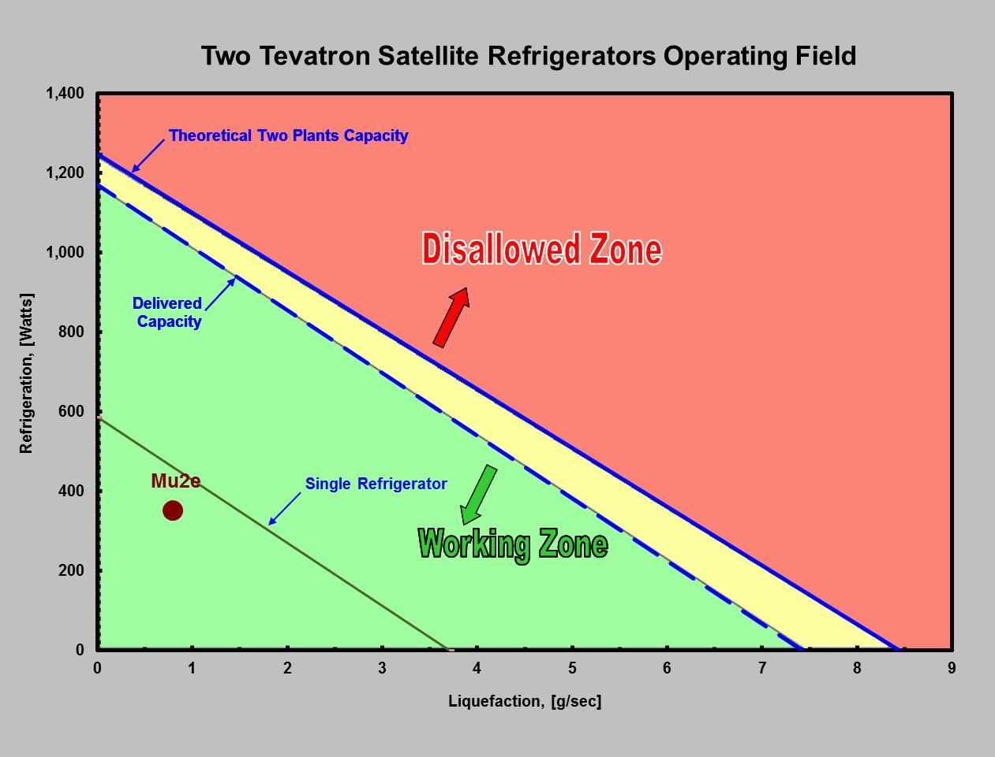
Performance – One Satellite Refrigerator
Two satellite refrigerators dedicated to Mu2e.
Steady state operation will utilize one refrigerator.
Second refrigerator is used during cooldown and upset conditions.
Refrigerators are part of the Muon Campus Cryo AIP.

Slide 13
Remaining work before CD-3
Complete qualification of the existing HTS power leads.
Develop feed through for 2kA power leads.
Complete the detailed final design and specification of the feed boxes and transfer lines.
Complete the detailed final design and specification of the insulating vacuum system.
Complete the detailed final design and specification of the distribution box.

Slide 14
Organizational Breakdown
WBS 4.5
Cryo Distribution
R. Schmitt (T. Page)
WBS 4.5.2
Feed Boxes
WBS 4.5.3
Transfer Lines
WBS 4.5.4
Interconnects
WBS 4.5.5
Insulating Vacuum
WBS 4.5.7 Distribution Box
WBS 4.5.1
Power Leads

Slide 15
Quality Assurance
Power leads are tested to full current prior to sending to vendor for integration.
Inspections, leak checks and pressure tests during fabrication prior to vessel closure.
Regular vendor meetings and vendor visits during fabrication.
Travelers will be written for installation at FNAL.

Slide 16
ES&H
Oxygen Deficiency Hazards (ODH)
FESHM chapter 5064 (ODH) will be followed
Pressure vessel, pressure piping, vacuum vessels, cryogenic system review
FESHM chapters 5031, 5031.1, 5032, 5033 and associated material
General cryogenic safety practices
“Burn” protection, PPE
Written procedures and training as required

Slide 17
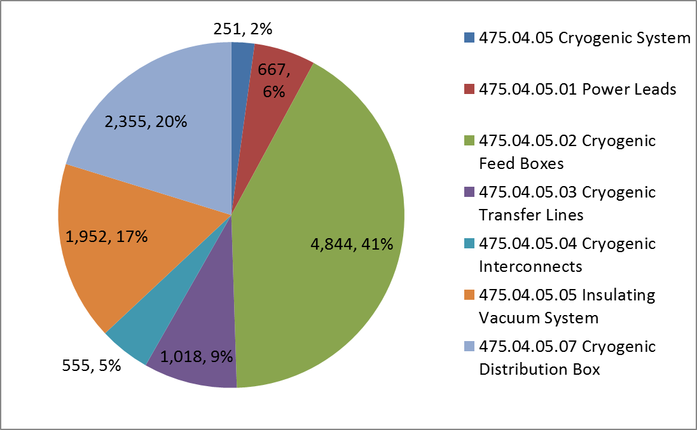
Cost Distribution by L4
Base Cost by L4 (AY $k)

Slide 18
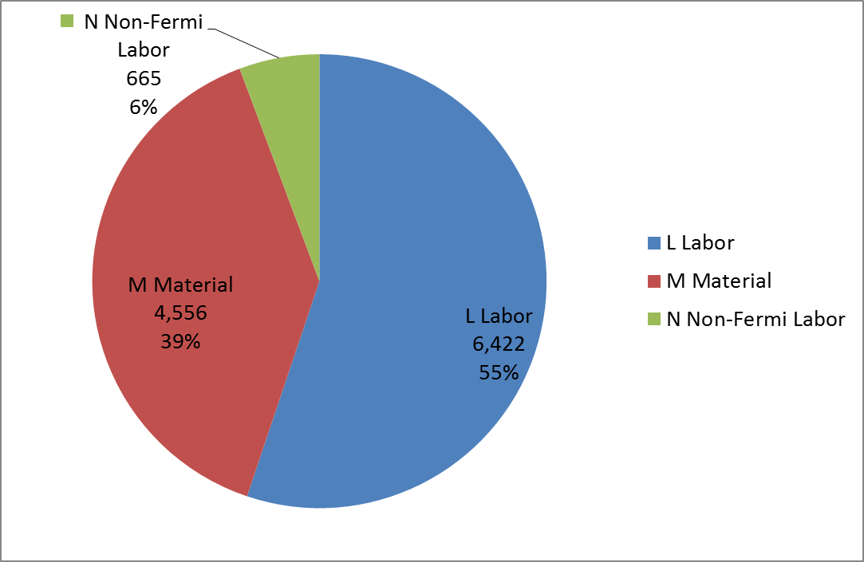
Cost Distribution by Resource Type
Base Cost (AY $k)

Slide 19
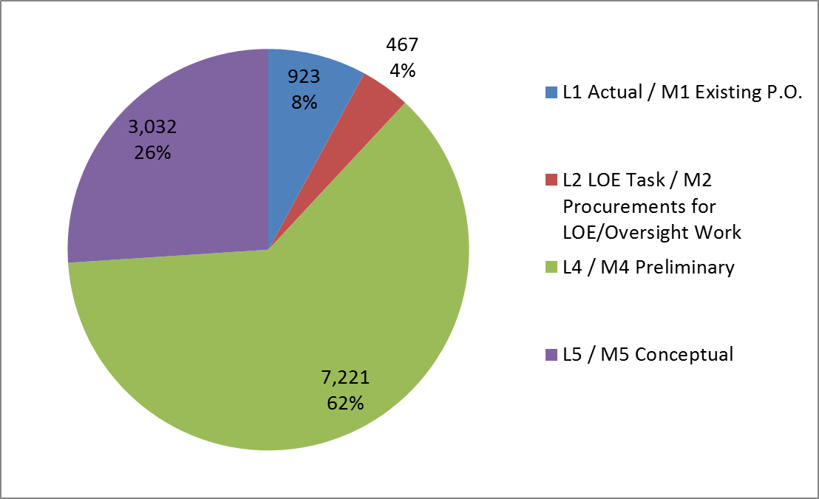
Quality of Estimate
Base Cost by Estimate Type (AY $k)

Slide 20
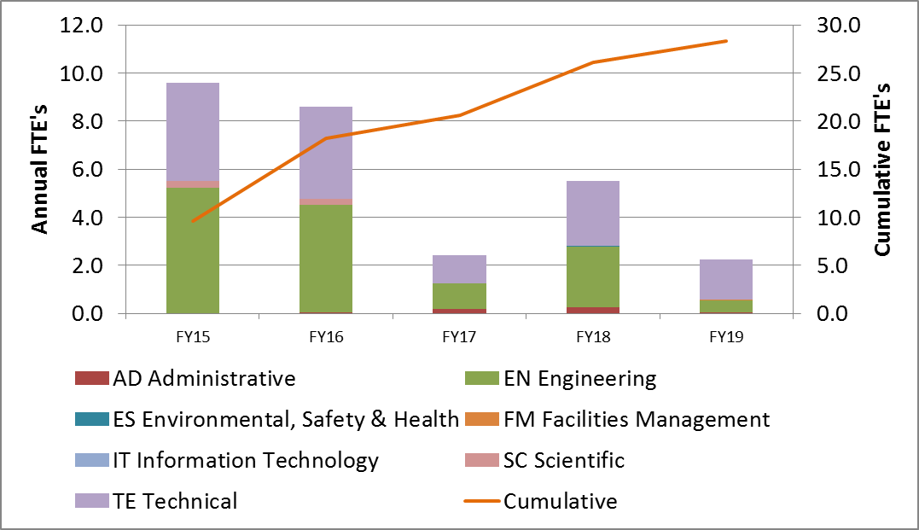
Labor Resources
FTEs by Discipline

Slide 21
Cost Table
WBS 4.5 Cryogenic Distribution System
Costs are fully burdened in AY $k

Slide 22
Major Milestones
Activity ID | Activity Name | Date
47504.5.1.001106 | T5 - Final design of Cryogenic System Power Leads complete | 5/4/2016
47504.5.2.001125 | T5 - Advanced Procurement Plan for Feed Boxes Fabrication complete | 3/28/2016
47504.5.2.001330 | T5 - Final design of Cryogenic Feed Boxes complete | 5/13/2016
47504.5.2.001336 | T5 - Vendor for Feed Boxes Fabrication selected | 8/29/2016
47504.5.2.001353 | T5 - Final design of Cryogenic Feed Boxes Platform complete | 8/1/2016
47504.5.2.001380 | T5 - Vendor for Feed Box platform Fabrication selected | 10/4/2016
47504.5.2.001400 | T5 - PO issued for Feed Boxes Fabrication | 1/3/2017
47504.5.2.001500 | T5 - PO issued for Feed Box platform Fabrication | 4/25/2018
47504.5.3.001150 | T5 - Final design of Cryogenic Transfer Lines complete | 3/25/2016
47504.5.3.001240 | T5 - Vendor for cryogenic transfer lines Fabrication selected | 3/24/2017
47504.5.3.001270 | T5 - PO issued for cryogenic transfer lines Fabrication | 4/5/2017
47504.5.4.001140 | T5 - Final design of Cryogenic Interconnects complete | 6/13/2016
47504.5.5.001170 | T5 - Advanced Procurement Plan for purchased vacuum system items complete | 2/27/2015
47504.5.5.001220 | T5 - Final design of Insulating Vacuum System complete | 12/16/2015
47504.5.5.001280 | T5 - Vendor for purchased vacuum system items selected | 9/25/2017
47504.5.5.001300 | T5 - PO issued for purchased vacuum system items | 10/2/2017
47504.5.7.002090 | T5 - Advanced Procurement Plan for Distribution Box Fabrication complete | 9/7/2016
47504.5.7.002120 | T5 - Distribution Box Final Design Complete | 10/5/2016
47504.5.7.002175 | T5 - Vendor for Distribution Box Fabrication selected | 5/9/2017
47504.5.7.002250 | T5 - Deliver Distribution Box to Mu2e Experimental Hall Complete | 10/5/2018

Slide 23
Schedule
CD-3a
CD-3c
CD-2/3b
CD-4
Fabricate and QA Superconductor
KPPs Satisfied
Solenoid Design/Prototypes
Solenoid Fabrication and QA
Detector Hall Construction
Solenoid Infrastructure
Solenoid Installation and Commissioning
Design and Fabrication of Feedboxes, Transfer Lines and Insulating Vacuum System
Installation
Design and Fabrication of Distribution Box
Q3 | Q4 | Q1 | Q2 | Q3 | Q4 | Q1 | Q2 | Q3 | Q4 | Q1 | Q2 | Q3 | Q4 | Q1 | Q2 | Q3 | Q4 | Q1 | Q2 | Q3 | Q4 | Q1 | Q2 | Q3 | Q4 | Q1 | Q2 | Q3 | Q4 | Q1 | Q2 | Q3 | Q4
FY14 FY15 FY16 FY17 FY18 FY19 FY20 FY21

Slide 24
Summary
Preliminary design is complete.
Resources are in place to complete the final design and specifications.
The Cryogenic Distribution system is ready for CD-2.

