Slide 1
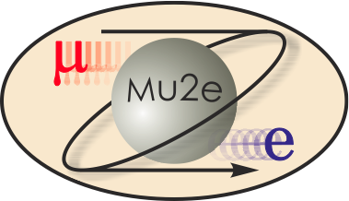
475.04.03.02.01 TS Cold Mass Prototype
Giorgio Ambrosio
L3 deputy for the Transport Solenoid
Oct 21-24, 2014

Slide 2
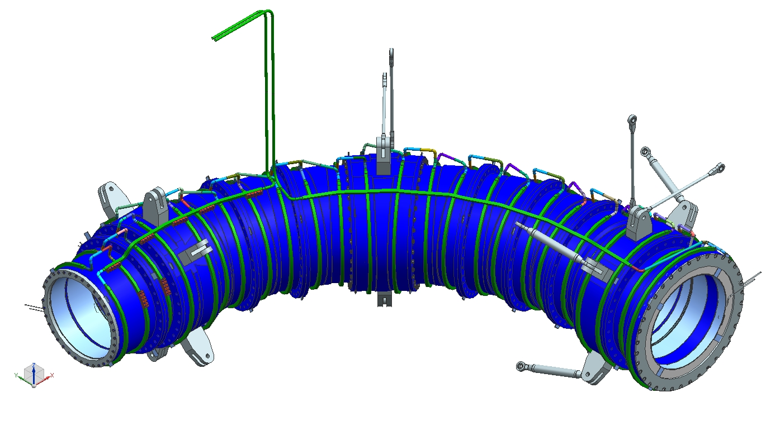
TS Cold mass assembly
Prototype

Slide 3
TS Prototype = Coil#14#15 Module + Flanges
coil leads
cooling tube
ground insulation
coil
The coils are epoxy impregnated with the ground insulation and the Al sheet.
pure Al sheet
for coil cooling
wedge

Slide 4
Goals
Allows validation of:
Design concept
Drawings
Tolerances, fabrication and integration details
Coils and Shell Fabrication
Achievable tolerances, procedure for He pipe, QC plan
Integration
Procedure, gap ➔ prestress
Performance

Slide 5
Plan
The TS prototype is fabricated by FNAL-INFN collaboration
INFN-Genoa group lead by P. Fabbricatore
FNAL is in charge of:
Prototype conductor procurement and QC
Complete CAD model
Coils drawings (envelope)
Shell fabrication drawings
Shell fabrication and QC
Shell instrumentation and Test
INFN is in charge of:
Coil fabrication and integration (vendor selected by INFN)
Supervision of work performed by vendor
FNAL & INFN: FEM modeling and interference decision

Slide 6
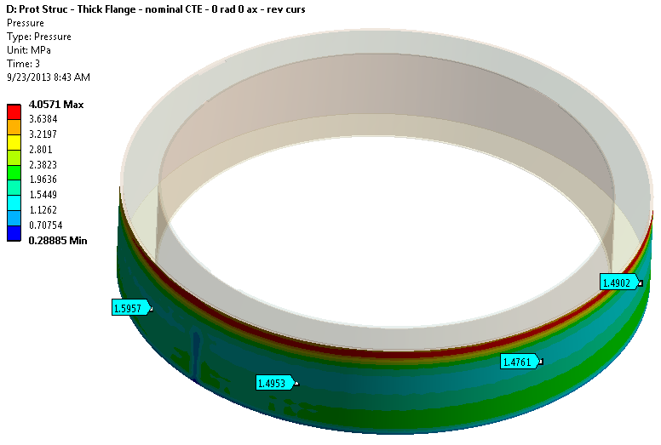
FEM Analysis
3D model with average coil properties and actual dimensions (Wands)
2D model with measured coil properties and simulation of all assembly steps (Farinon)
Optimal rad. interference 3D: 100+ um
Optimal rad. interference 2D: 100-300 um
➔ Nominal rad. interference: 200 +/- 100 um

Slide 7
Coil Fabrication
Coil #14
17 layers
Coil #15
18 layers

Slide 8
Coil Electrical QC
Electrical tests:
During winding:
V_tot and layer-layer DV with 1 A
Coil to ground at 1kV
After impregnation:
Inductance and resistance
Coil to ground at 2 kV
Coil to heaters at 1 kV
After coil machining:
Inductance and resistance
Coil to ground at 2 kV
Coil to heaters at 1 kV
Impulse test at 1 kV
Both coils passed all tests

Slide 9
Coil Dimensional QC
Dimensional tests:
During winding:
Min & Max radius at selected layers and positions
After impregnation:
ID, OD, height, coil sides parallelism
After final machining:
Inner radius (best fit, max inscribed, min circumscribed) and range
Outer radius (best fit, max inscribed, min circumscribed) and range
Sides: planarity and parallelism
Concentricity, Perpendicularity,
Roughness of outer surface.
Radius (mm) | Nominal | Tol. | Meas. | Δ_max* | RMS | Temp.
Coil #14 | 475.0 | +/-0.1 | 475.00 | -0.10/+0.08 | 0.05 | 21.8 °C
Coil #15 | 479.0 | +/-0.1 | 479.05 | -0.11/+0.08 | 0.05 | 22.3 °C
*With respect to measured Outer Radius

Slide 10
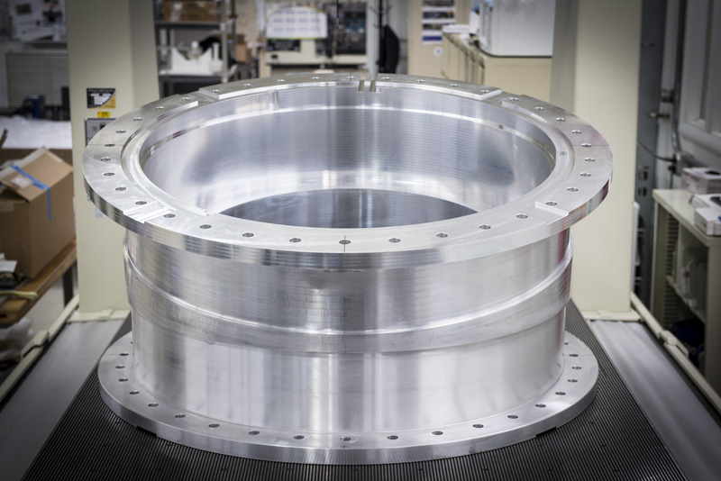
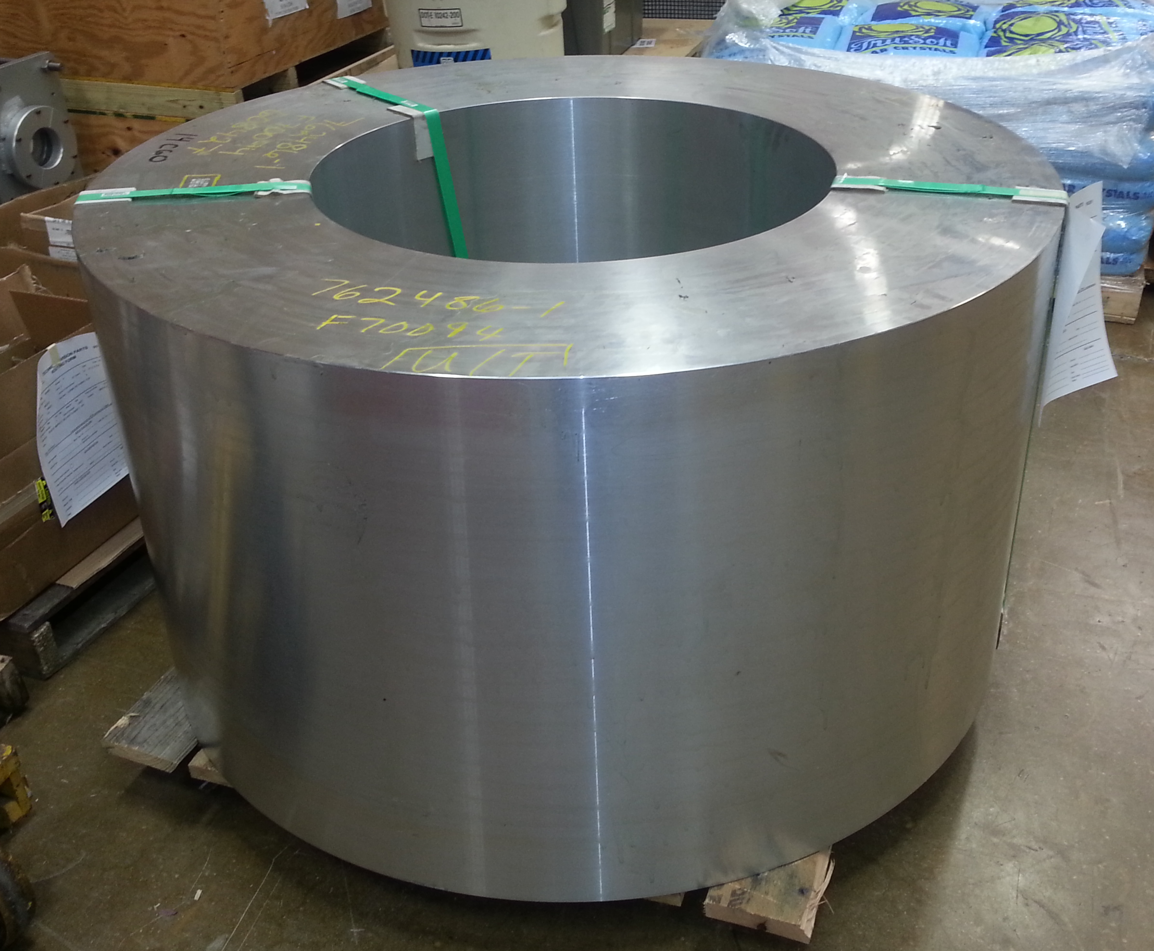
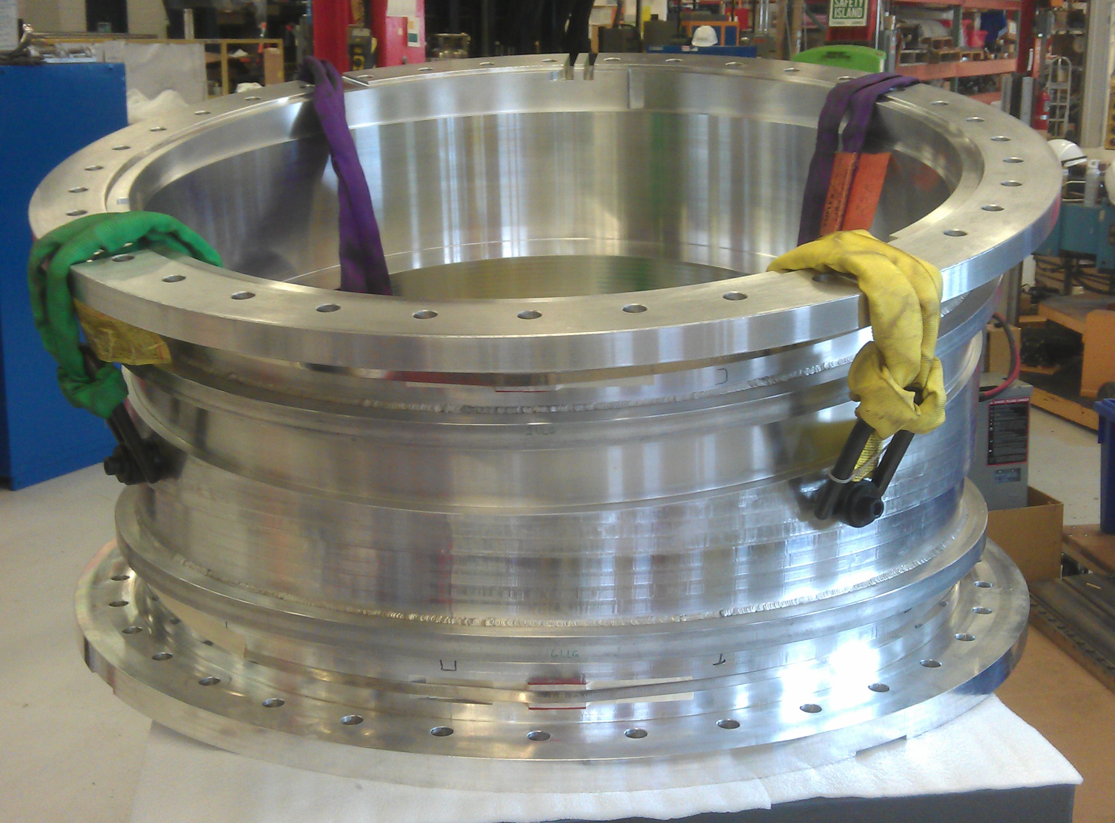
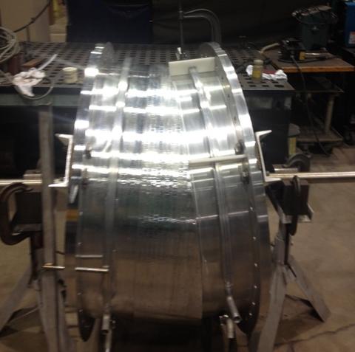
Shell Fabrication
2. Rough machining of ID
1. Forged cylinder
4. Fine machining of ID based on coil
measurements at controlled temp.
3. Weld cooling pipes

Slide 11
Shell QC
Cooling pipes ASME test:
Hydrostatic Pressure Test at 83 Psig for 10 min
Dimensional tests:
The shell looks very good
All major dimensions are within tolerance
Seen the impact on the flange flatness of welding the pipes
Coil housing surfaces are acceptable
Tolerance were very tight requiring temperature adjustment
Radius (mm) | Nominal | Tol.* | Meas. Max In | Meas. LS | Temp.
Coil #14 house | 474.78 | +/-0.025 | 474.78 | 474.83 | 20 °C
Coil #15 house | 478.83 | +/-0.025 | 478.81 | 478.86 | 20 °C
*+/-50 um on diameter

Slide 12
Integration
Plan for shrink-fit integration:
Warm up shell
Insert coil A
Lock coil A in place
Insert coil B
Lock coil B in place
Let shell cold down
Put stycast to fill gap between coil-side and wedge
Install wedge and side flange
Repeat steps 7 and 8 on the other side
Hard copy of integration tooling is available (proprietary)

Slide 13
Integration
Prototype Integration
Oct 20-24

Slide 14
Integration QC & Acceptance Tests - I
Electrical:
Coil to Ground
Heater to Coil
Inductance & Resistance of each coil
Impulse test
Prestress:
Strain gauge readings (after vs. before integration)
Shell OD CMM measurements (after vs. before integration)

Slide 15
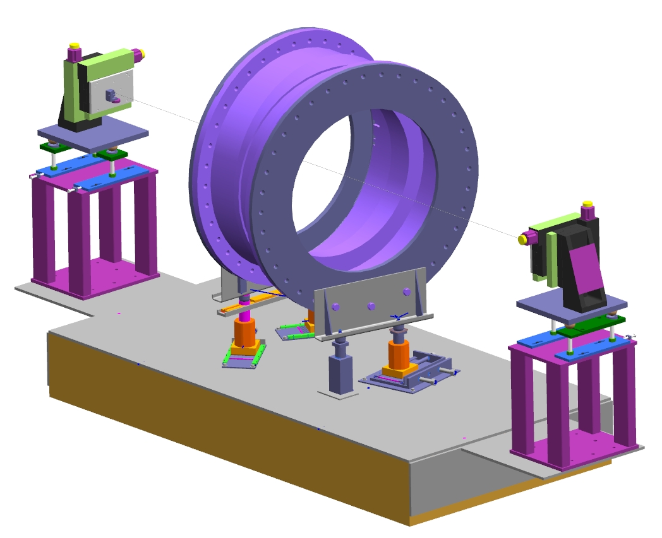
Integration QC & Acceptance Tests - II
Dimensional tests:
CMM to evaluate impact of integration on all interfaces
Cooling pipes and joints:
ASME pressure test
Warm Magnetic Measurements:
Stretched wire measurements
Each coil separately

Slide 16
Cold Tests
Cold electrical check out
Hi-pot tests (coil-ground; heaters-coil)
Cooling tests:
Temperature profile vs. cooling rate
Cold powering:
Up to nominal current
Up to 120% nominal current (same Ic margin as in operation)
Reverse polarity: up to 60% nominal current (Max axial force vs. flange)
Warm up: measure RRR

Slide 17
Goals Summary
Allows validation of The prototype has validated:
Design concept
Drawings
Tolerances, fabrication and integration details
Coils and Shell Fabrication
Achievable tolerances, procedure for He pipe, QC plan
Integration
Procedure, gap ➔ prestress
Performance
To be demonstrated in Feb./Mar. 2015
Drawings for tender in progress
Contract to be placed after Prototype test

Slide 18
Back-up Slides

Slide 19
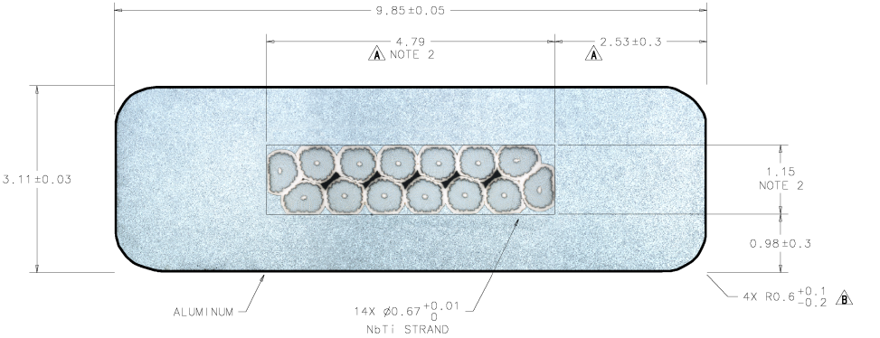
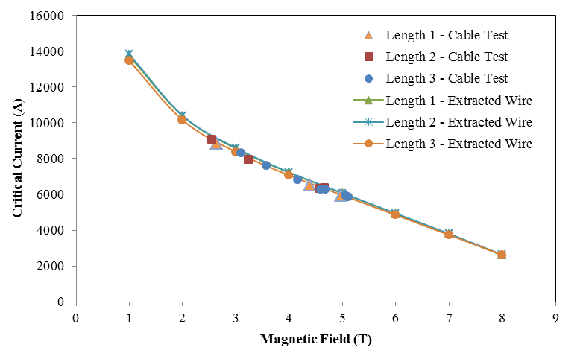
Design - Conductor
Conductor Parameter | Unit | Design Value |  | Measured Value
Cable critical current at 5T, 4.2K | A |  | 5900 | 5950-6300
Number of strands |  |  | 14
Strand diameter | mm |  | 0.67 | within tolerances
Strand copper/SC ratio |  |  | 1 ± 0.05 | 0.97-1.02
Initial RRR of Cu matrix |  |  | 150 | 100-104
Filament size | µm |  | < 30 | 25.5-25.7
Strand twist pitch | mm |  | 15 ± 2 | 15.8-15.9
Rutherford cable width | mm |  | 4.79 ± 0.01 | within tolerances
Rutherford cable thickness | mm |  | 1.15 ± 0.006 | within tolerances
Al-stabilized cable width (bare) at room temperature | mm |  | 9.85 ± 0.05 | within tolerances
Al-stabilized cable thickness (bare) at room temperature | mm |  | 3.11 ± 0.03 | within tolerances
Initial RRR of Aluminum stabilizer |  |  | > 800 | 925-1160
Aluminum 0.2% yield strength at 300 K | MPa |  | > 30 | 45-56
Aluminum 0.2% yield strength at 4.2 K | MPa |  | > 40 | 74-84
Shear strength between Aluminum and NbTi strands | MPa |  | > 20 | 35-46
I_{op} = 1730 A
J_{eng} ~ 50 A/mm²
I_{op}/I_{c}~= 58% (at 5.1 K, 3.4 T)
Temp margin = 1.5 K

