Slide 1
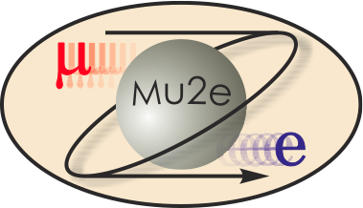
Overview of Solenoid Breakout
Michael Lamm
L2 for Solenoids
10/21/2014

Slide 2
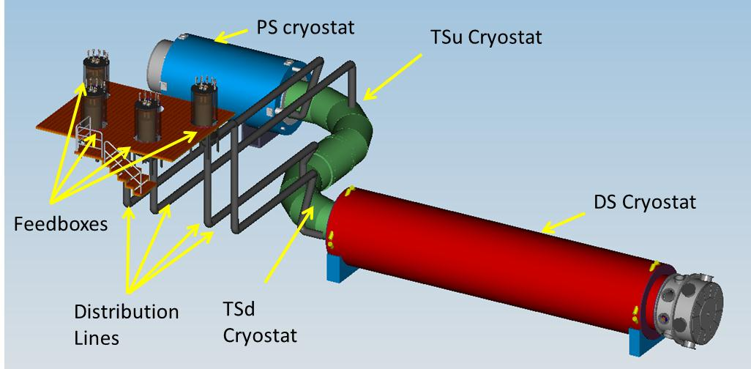
Mu2e Solenoids Scope
Production Solenoid (PS)
Transport Solenoid (TSu,TSd)
Detector Solenoid (DS)
Cryogenic Distribution
Field Mapping
Ancillary Equipment
Installation and commissioning
Cryo distribution box
Power Supply/Quench Protection

Slide 3
L3 Talks Organized around WBS
475.4
Solenoids
M. Lamm (FNAL)
475.4.1 Project Management
L3 – M. Lamm
CAM – M. Lamm
475.4.6 Magnet Power Systems
L3 – S. Hays
CAM - S. Hays
475.4.2 Production Solenoid
L3 – V. Kashikhin
CAM – V. Kashikhin
475.4.7 Quench Protection and Monitoring System
L3 – D. Orris
CAM – D. Orris
475.4.3 Transport Solenoid
L3 – M. Lopes
CAM – M. Lopes
475.4.8 Magnetic Field Mapping
L3 – M. Tartaglia
CAM – M. Lamm
475.4.4 Detector Solenoid
L3 – M. Buehler
CAM – M. Buehler
475.4.9 Ancillary Equipment
L3 – T. Page
CAM – T. Page
Technical Procurement Leads
-Vito Lombardo for Conductor
-Tom Page for PS/DS
475.4.5 Cryogenic Distribution
L3 – R. Schmitt
CAM – T. Page
475.4.10 System Integration, Installation and Commissioning
L3 – J. Brandt
CAM – J. Brandt

Slide 4
L3 Talks
Talks for each of the L3 Deliverables B04-6 through B04-15
Follow similar format to the Solenoid Plenary talk
  Cost and labor breakdowns
  Technical details. We are happy to provide additional details i.e. backup slides, backup documentation etc…
  Procurement and Risks will be covered in separate talks
Expanded talks on Transport Solenoid
  Because we are asking for CD3 approval for the TS coil modules

Slide 5
Project Related Talks
In addition to the Level 3 talks , we have 4 presentations B04-2 to B04-5 on special topics
Solenoid Procurement Strategy: Talk is dedicated to our procurement methodology. We can give you an update on our nearly completed placement of contracts for PS/DS.
Status of superconductor with an emphasis on progress since CD3a..
Risk Analysis: How we assess risk and determine risk contingency. We have expanded the analysis since the directors review.
Lessons Learned: Following your advice and the advice of other reviewers, we have reached out to JLAB, ITER and a few others who are going through or have previous experience with magnet procurements with outside vendors, to learn about the potential pitfalls.

Slide 6
Proposed Breakout Schedule
Project-Related Talks
PS/DS L3 Talks
Expanded TS L3 Talks
Other L3 Talks

