Slide 1
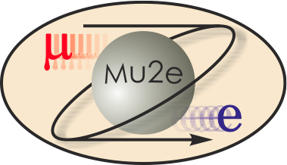
475.04.03 Transport Solenoid
Mauricio Lopes
L3 for the Transport Solenoid
Oct 21-24, 2014

Slide 2
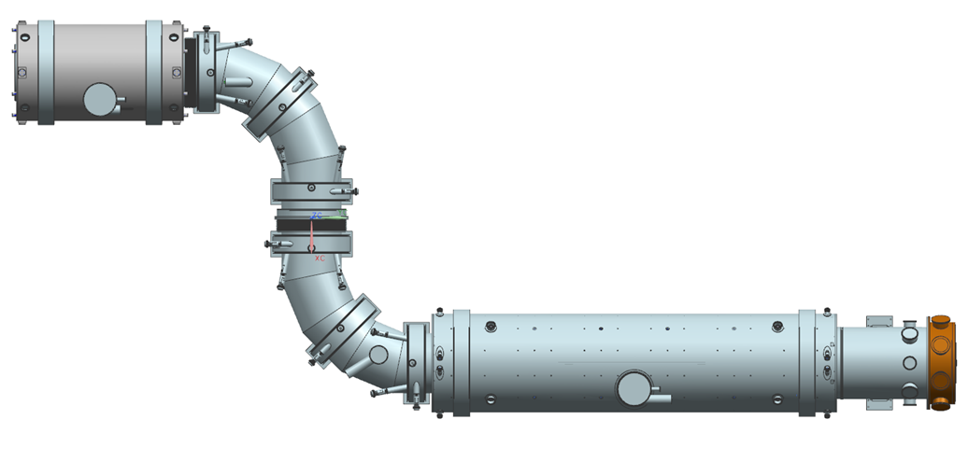
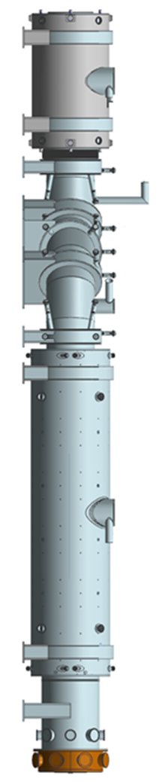
Scope
TSu
TSd
PS
TS
DS

Slide 3
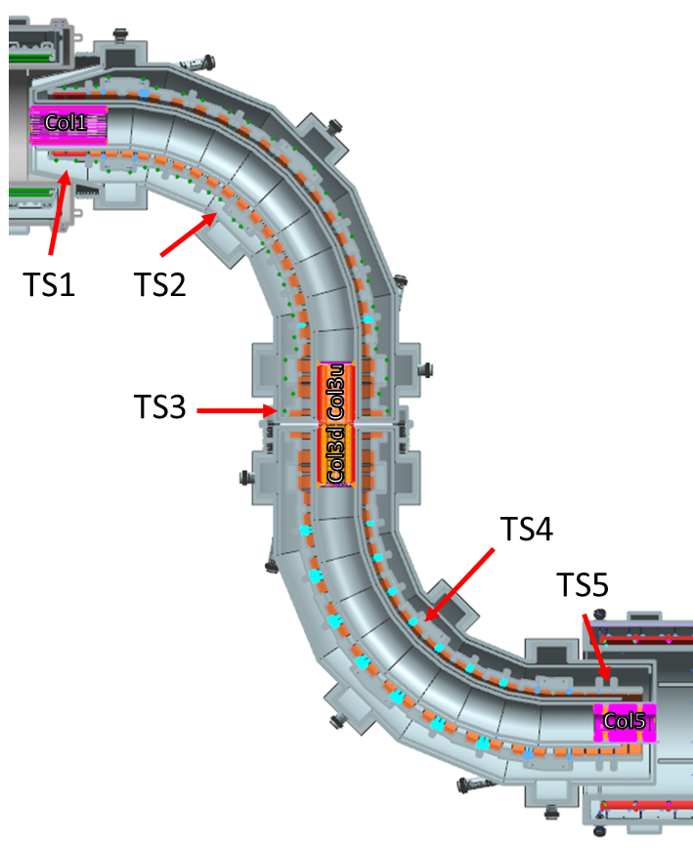
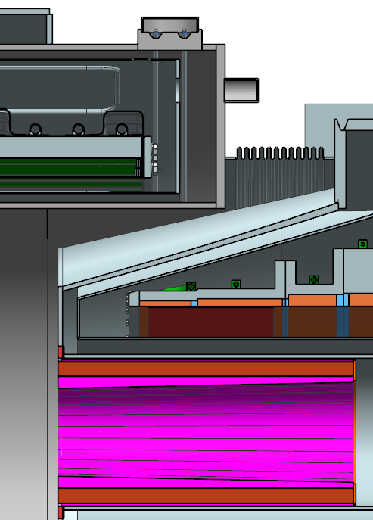
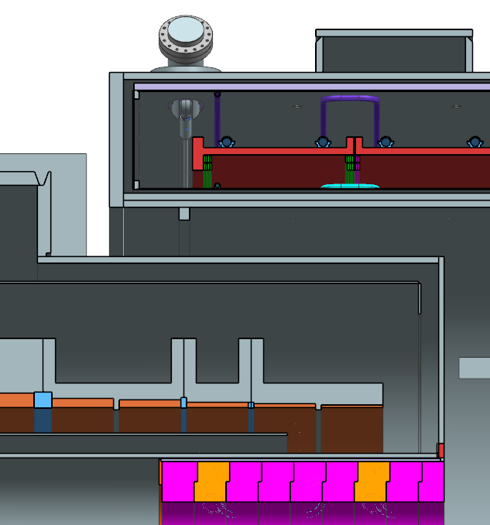
Requirements - Mechanical Requirements
PS
DS
Due to space constraints, the primary proton beam pipe must be routed through the TS cryostat.
When the TS is at full power, there is a net axial force of around 130 Tons pulling the TS and PS together.
There is a physical overlap of around 940 mm between the DS and TS cryostats.
When the TS is at full power, there is a net axial force of around 100 Tons pulling the TS and the DS together.
There are four collimator elements. COL3u and COL3d are located in TS3 and they are used to filter particles based on electric charge and momentum.
DocDB 947

Slide 4
Requirements - Magnetic Requirements
Region | s_{min} (m) | s_{max} (m) | B_{initial} (T) ±5 % | B_{final} (T) ±5% | R_{max} (m) | dB_{s}/d_{s} (T/m) | dB_{s}/d_{r} (T/m) | Ripple (T) | Where
TS1 | -6.58 | -5.58 | 2.50 | 2.40 | 0.15 | < -0.02 | na | na | r=0, r=0.15 m
TS2 | -5.58 | -0.98 | na | na | 0.15 | na | > 0.275 | ±0.02 | r < 0.15 m
TS3 | -0.98 | 0.98 | 2.40 | 2.10 | 0.15 | < -0.02 | na | na | r=0, r=0.15 m
TS4 | 0.98 | 5.58 | na | na | 0.15 | na | > 0.275 | ±0.02 | r < 0.15 m
TS5 | 5.58 | 6.58 | 2.10 | 2.00 | 0.15 | < -0.02 | na | na | r=0, r=0.15 m
DocDB 947

Slide 5
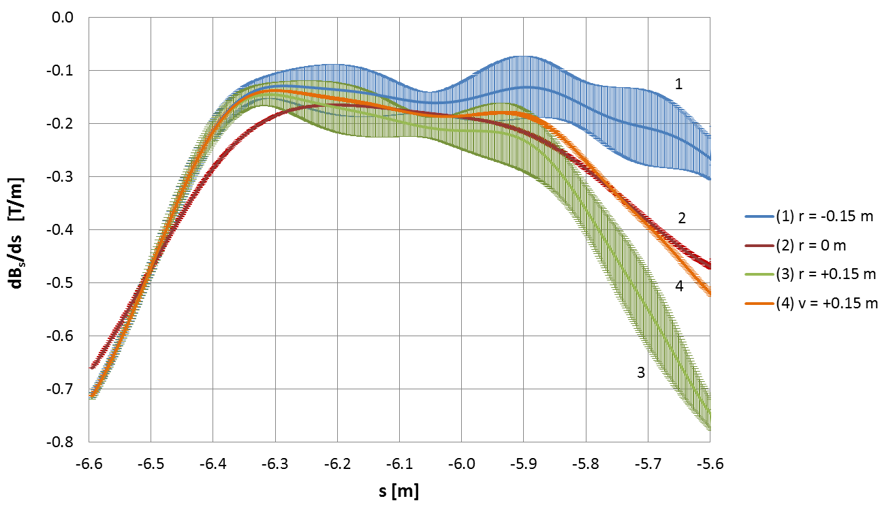
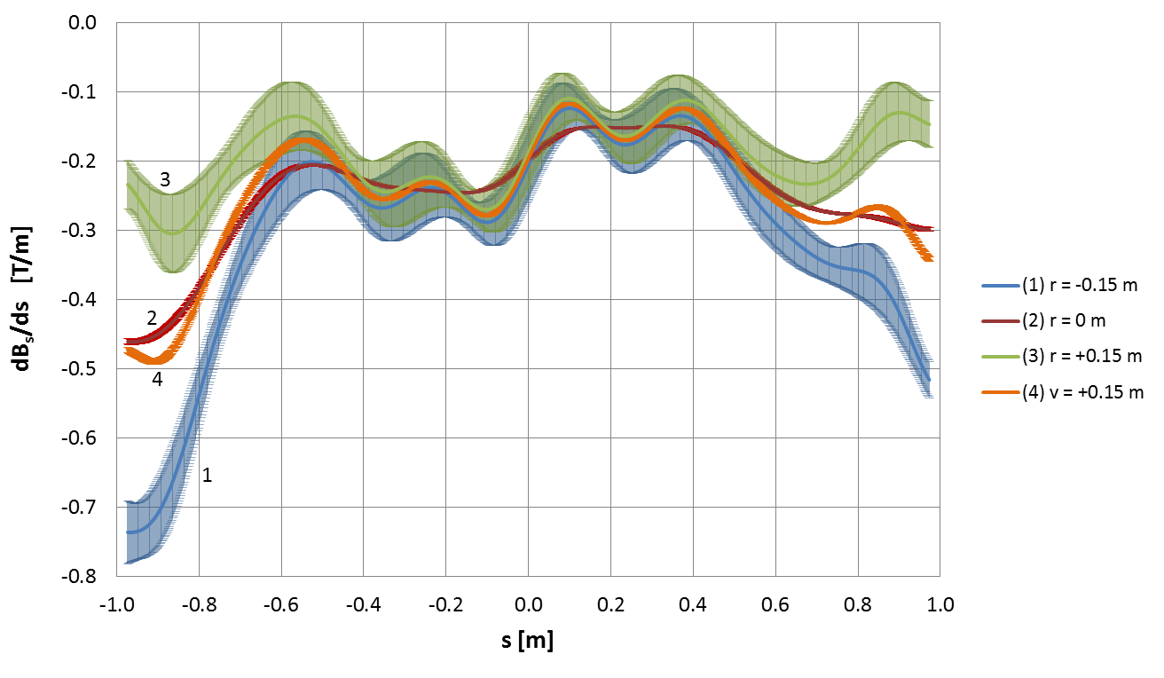
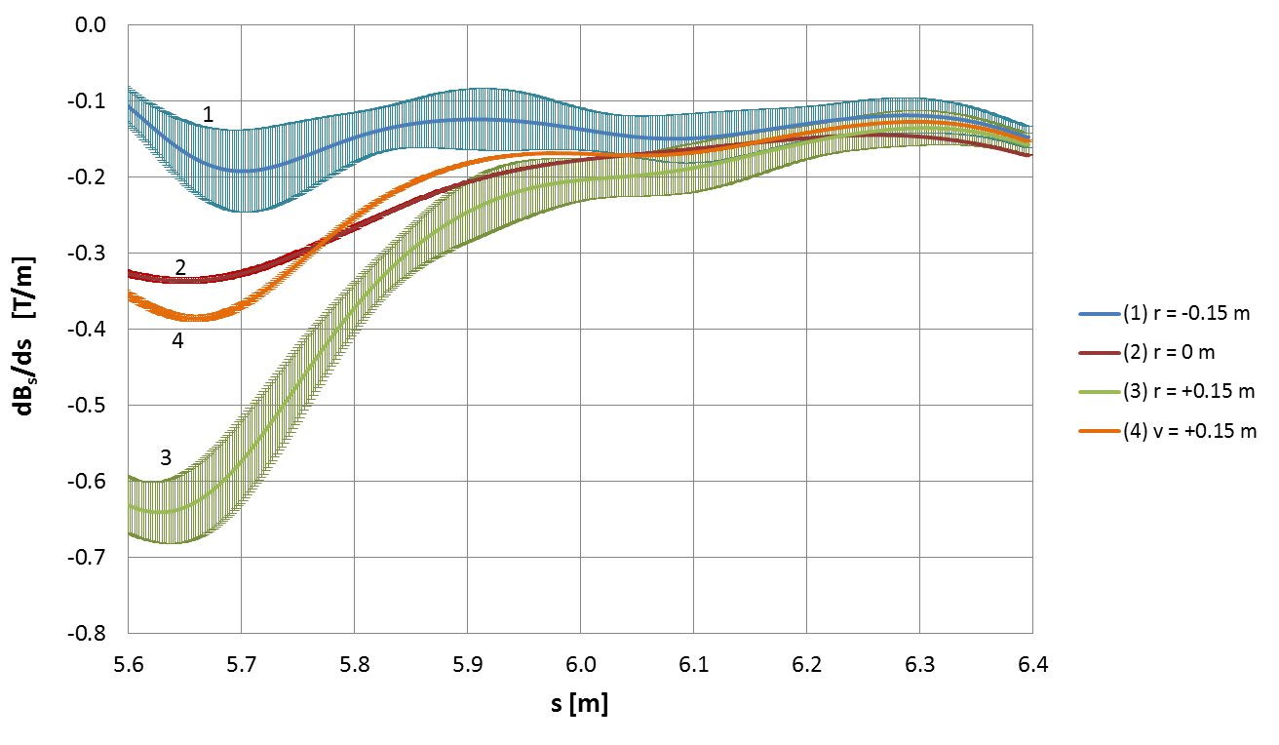
Requirements - Magnetic Requirements
Error type | Maximum error | Maximum logitudinal gradient (T/m)
 |  | TS1 | TS3 | TS5
Radial | 10 mm | -0.072 | -0.072 | -0.083
Radial | 2 mm | -0.114 | -0.106 | -0.115
Vertical | 10 mm | -0.103 | -0.082 | -0.104
Longitudinal | 10 mm | -0.023 | -0.009 | -0.060
Longitudinal | 2 mm | -0.111 | -0.096 | -0.109
Pitch | 10 mrad | -0.120 | -0.092 | -0.116
Pitch | 2 mrad | -0.124 | -0.112 | -0.12
Yaw | 10 mrad | -0.108 | -0.086 | -0.105
Yaw | 2 mrad | -0.121 | -0.107 | -0.119
DocDB 2156

Slide 6
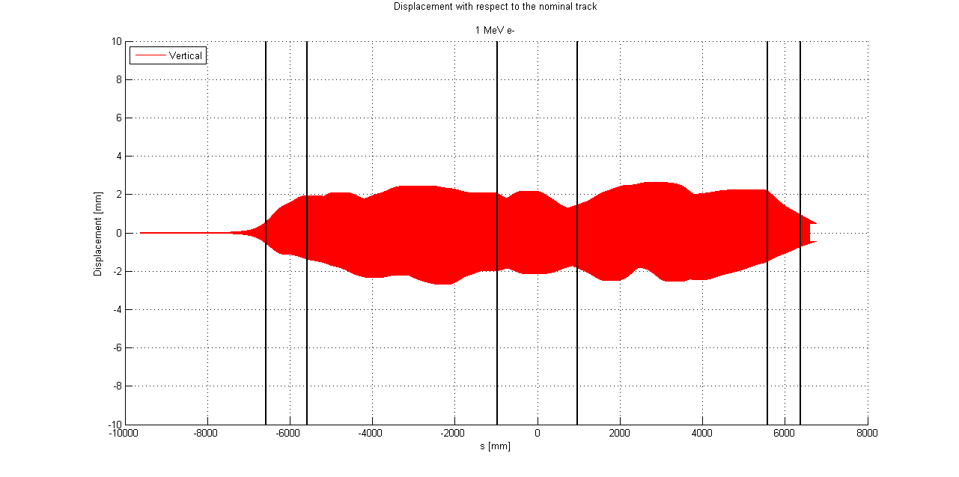
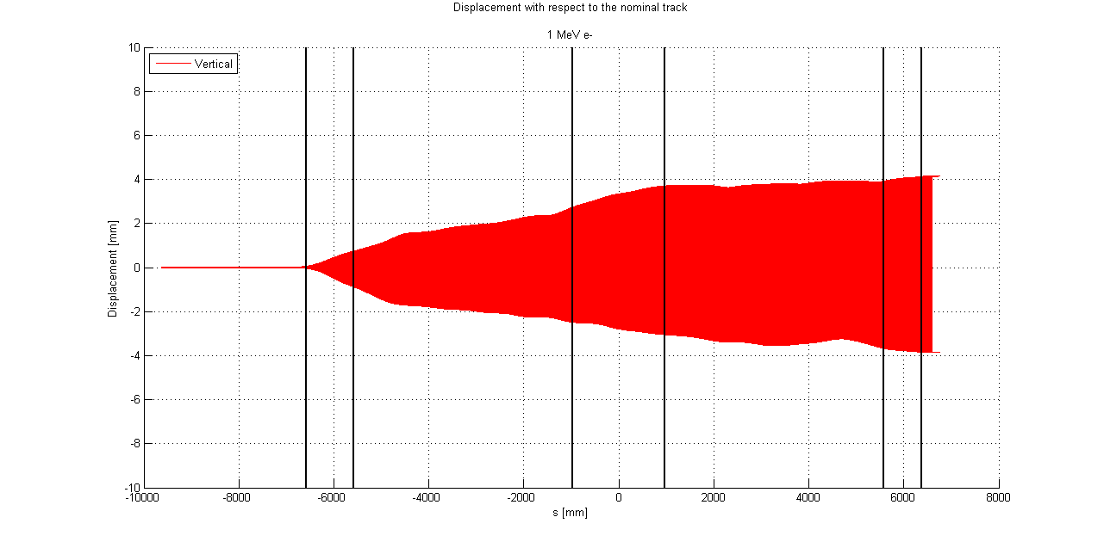
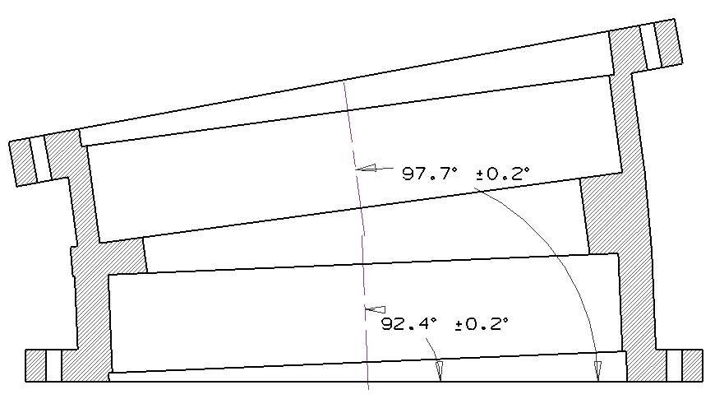
Requirements - Magnetic Requirements
ΔV = 10 mm
ΔP = 5 mrad
DocDB 2403

Slide 7
Design – Magnet System
TS is formed by 52 SC solenoid coils.
Most coils have the same aperture. TS3 coils have slightly bigger aperture to help with the large gap between cryostats.
Each cryostat is powered by a different 2kA power supply (nominal current 1730 A)
Each magnet has a pair of two 200 A trim power supplies (TPS).
The TPS allows field matching with the adjacent magnets and gives an extra knob to control backgrounds.
The coils that form the curve sections had their angles adjusted to center the particle distribution with respect to the axis of the solenoids.

Slide 8
Design - Cold Mass Breakdown
TS has 52 Coils:
              TSu - 25
              TSd - 27
Coils are housed in Al Shells and they form a coil module. There are 27 Coil modules:
              TSu – 13
              TSd – 14
Modules are assembled together (bolted and cryogenic connections) and they form a test unit. There are 14 test units:
              TSu – 7
              TSd – 7

Slide 9
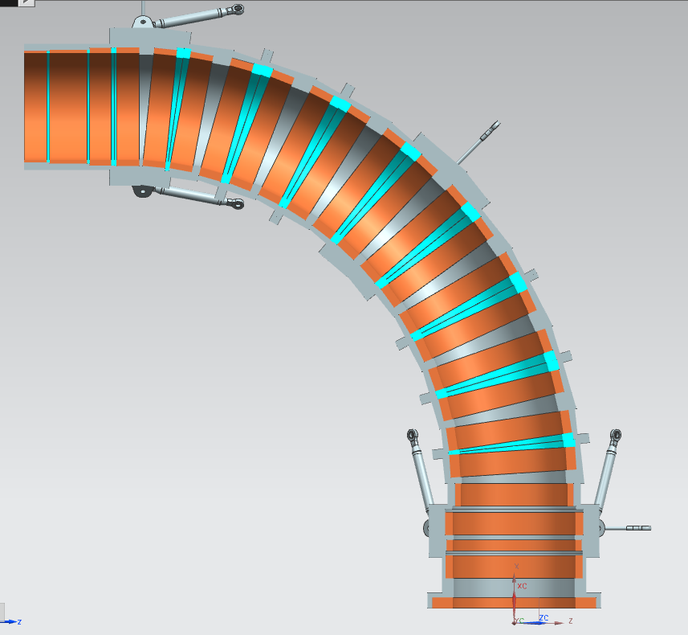
Design – TSu Coils
1
2
3
4
5
6
7
8
9
10
11
12
13
14
15
16
17
18
19
20
21
22
23
24
25

Slide 10
Design – TSu Coil Modules
1
2
3
4
5
6
7
8
9
10
11
12
13

Slide 11
Design – TSu Test Units
6
4
3
1
2
5
7

Slide 12
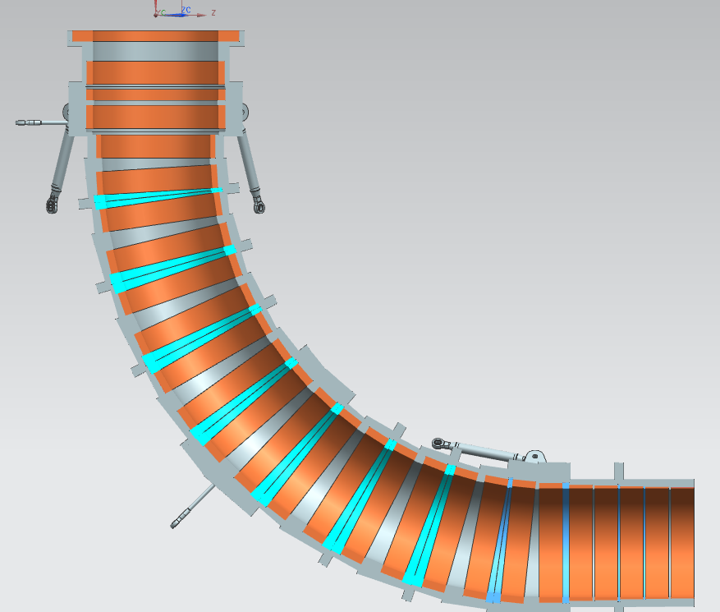
Design – TSd Coils
26
27
28
29
30
31
32
33
34
35
36
37
38
39
40
41
42
43
44
45
46
47
48
49
50
51
52

Slide 13
Design – TSd Coil Modules
14
15
16
17
18
19
20
21
22
23
24
25
26
27

Slide 14
Design – TSd Test Units
13
12
9
8
10
11
14

Slide 15
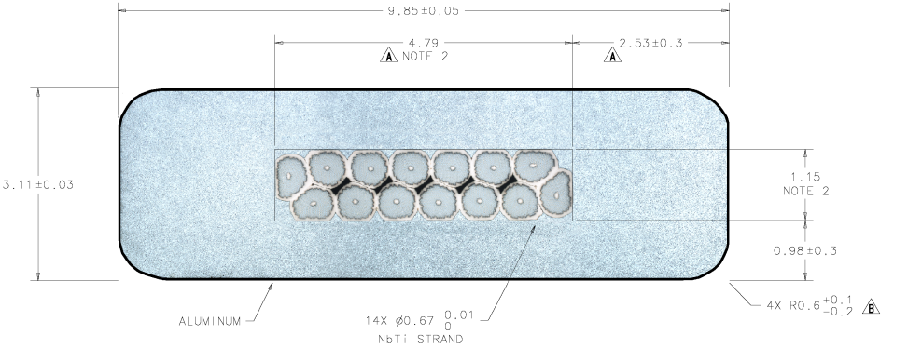
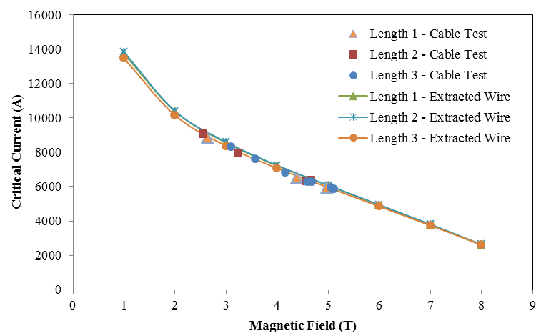
Design - Conductor
Conductor Parameter | Unit | Design Value |  | Measured Value
Cable critical current at 5T, 4.2K | A |  | 5900 | 5950-6300
Number of strands |  |  | 14
Strand diameter | mm |  | 0.67 | within tolerances
Strand copper/SC ratio |  |  | 1 ± 0.05 | 0.97-1.02
Initial RRR of Cu matrix |  |  | 150 | 100-104
Filament size | µm |  | < 30 | 25.5-25.7
Strand twist pitch | mm |  | 15 ± 2 | 15.8-15.9
Rutherford cable width | mm |  | 4.79 ± 0.01 | within tolerances
Rutherford cable thickness | mm |  | 1.15 ± 0.006 | within tolerances
Al-stabilized cable width (bare) at room temperature | mm |  | 9.85 ± 0.05 | within tolerances
Al-stabilized cable thickness (bare) at room temperature | mm |  | 3.11 ± 0.03 | within tolerances
Initial RRR of Aluminum stabilizer |  |  | > 800 | 925-1160
Aluminum 0.2% yield strength at 300 K | MPa |  | > 30 | 45-56
Aluminum 0.2% yield strength at 4.2 K | MPa |  | > 40 | 74-84
Shear strength between Aluminum and NbTi strands | MPa |  | > 20 | 35-46
I_{op} = 1730 A
J_{eng} ~ 50 A/mm²
I_{op}/I_{c}~= 58% (at 5.1 K, 3.4 T)
Temp margin = 1.5 K
Successful conductor prototype program completed.
The PO was placed in July 2014

Slide 16
Conductor delivery / Module fabrication
10 % of spare conductor included

Slide 17
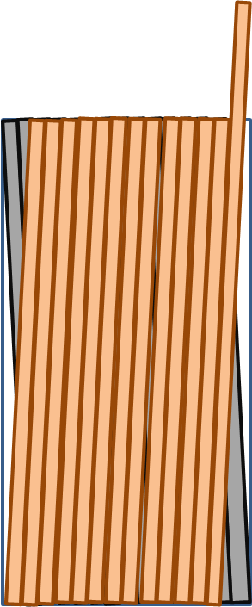
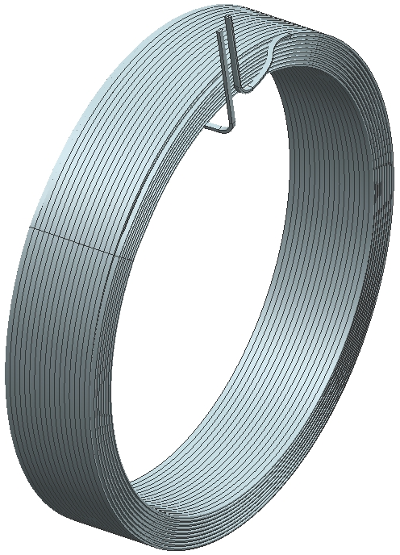
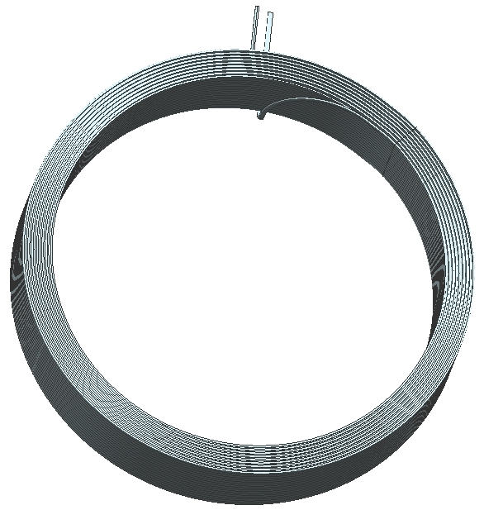
Coil Winding
Machined surface
OD
… layer 17
…
…
…
… layer 1
turn 1
turn 2
turn 17
ID
Aluminum sheet
Ground insulation
G10 spacer (layer jump)
Insulated cable

Slide 18
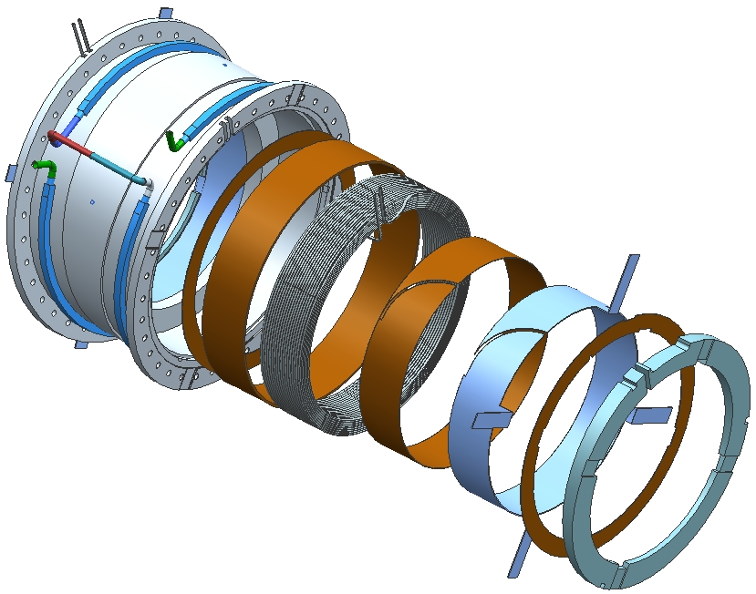
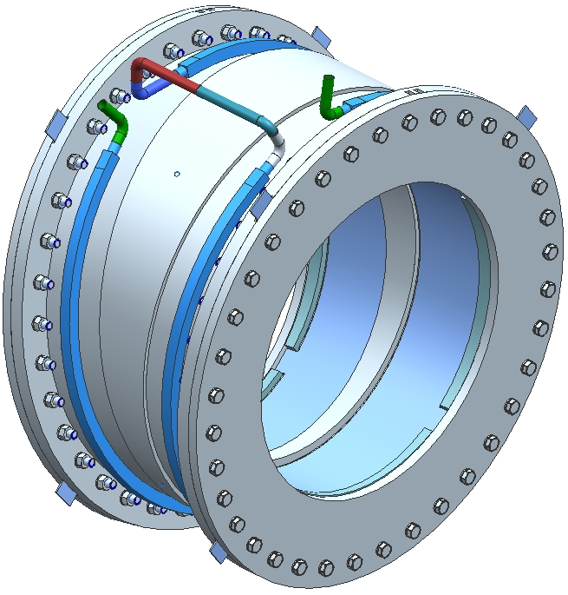
Design – Coil Module
coil leads
cooling tube
ground insulation
coil
The coils are epoxy impregnated with the ground insulation and the Al sheet.
pure Al sheet
for coil cooling
wedge

Slide 19
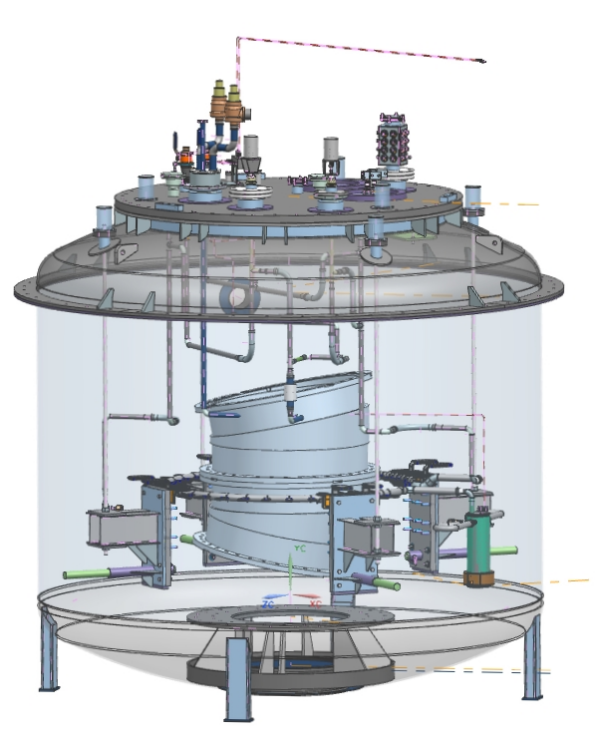
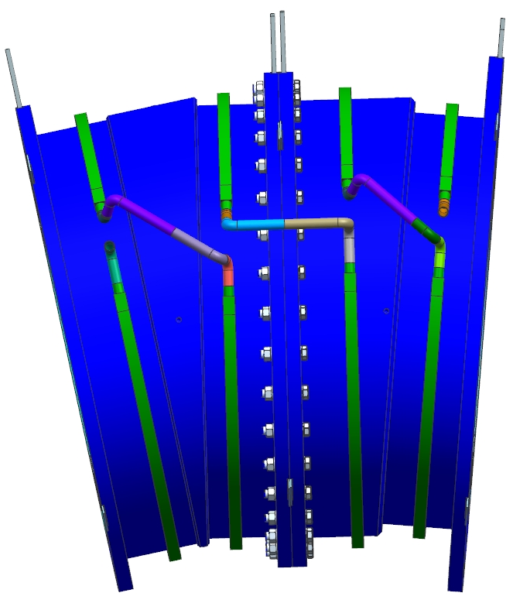
Design - Test units
We will test all 52 coils in our test cryostat (in the CHL building).

Slide 20
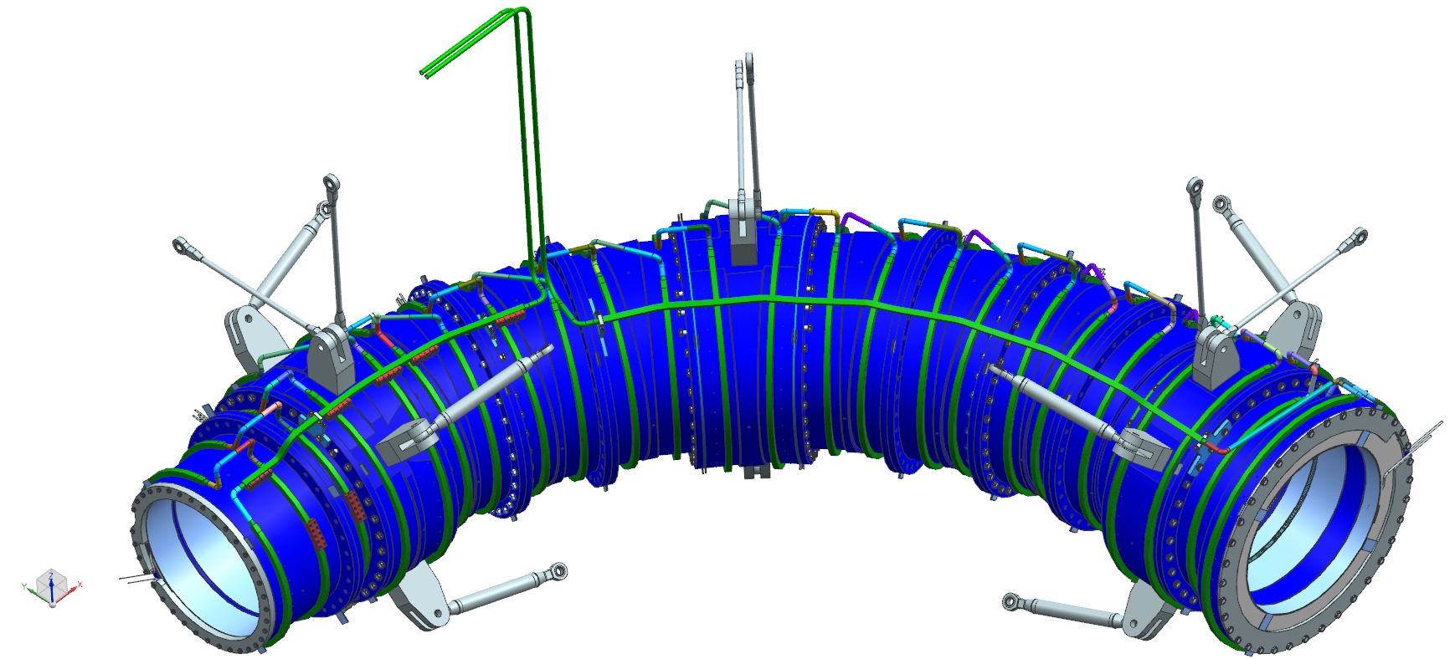
Design – Cold mass assembly

Slide 21
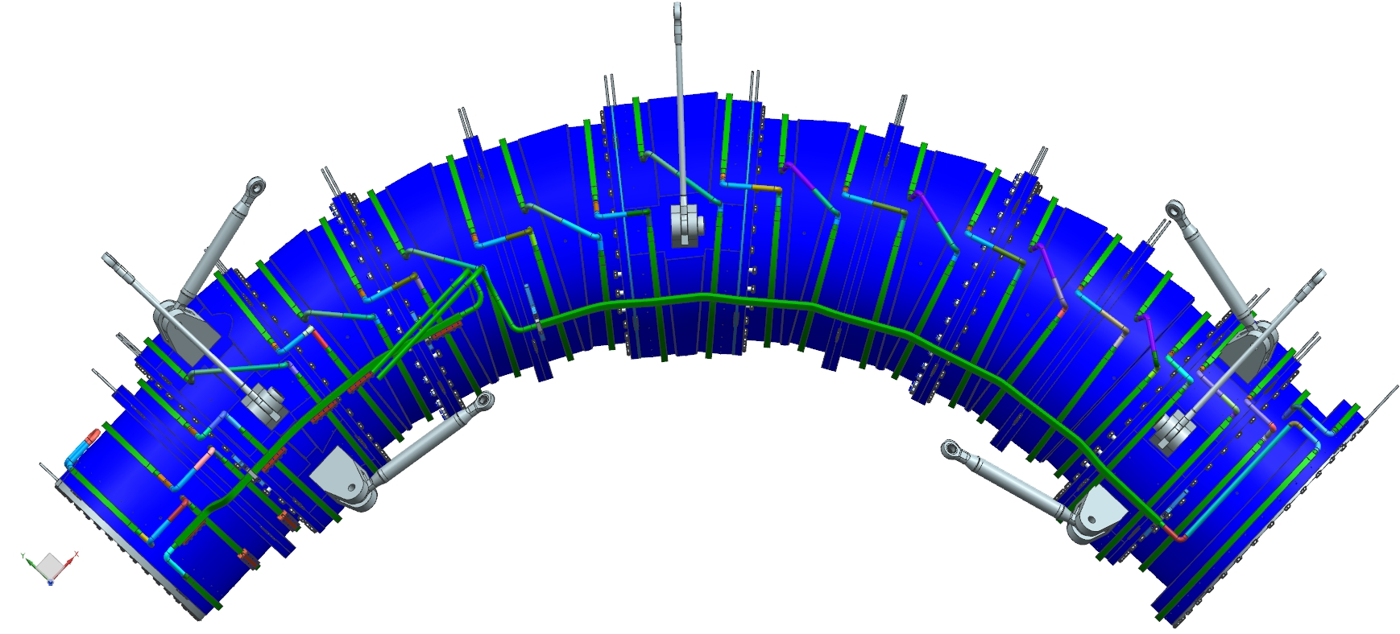
Design – Cold mass assembly

Slide 22
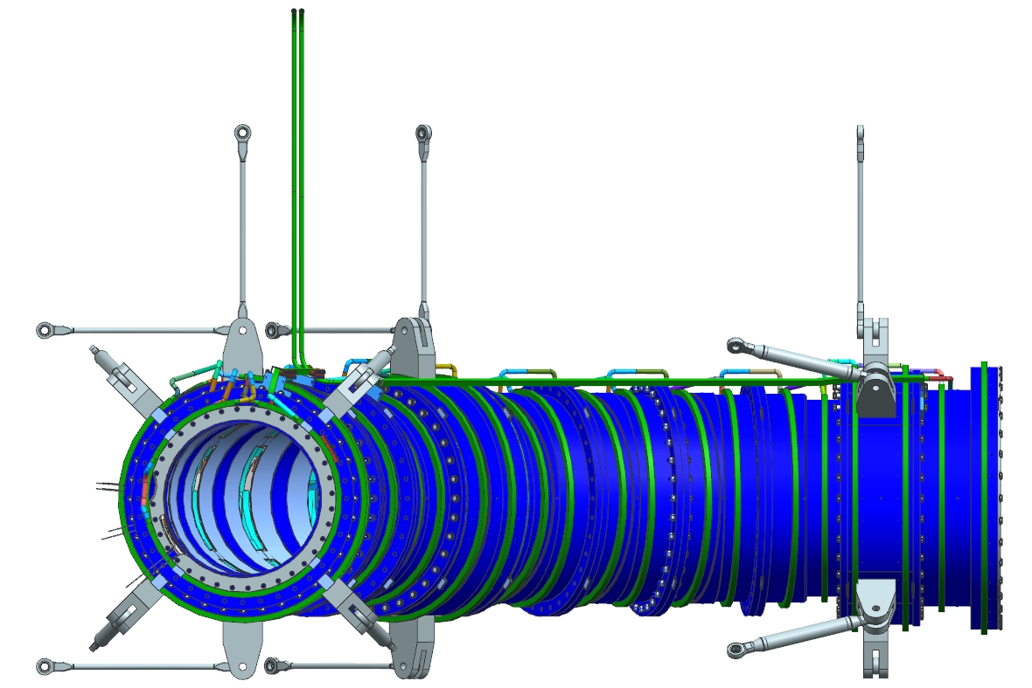
Design – Cold mass assembly

Slide 23
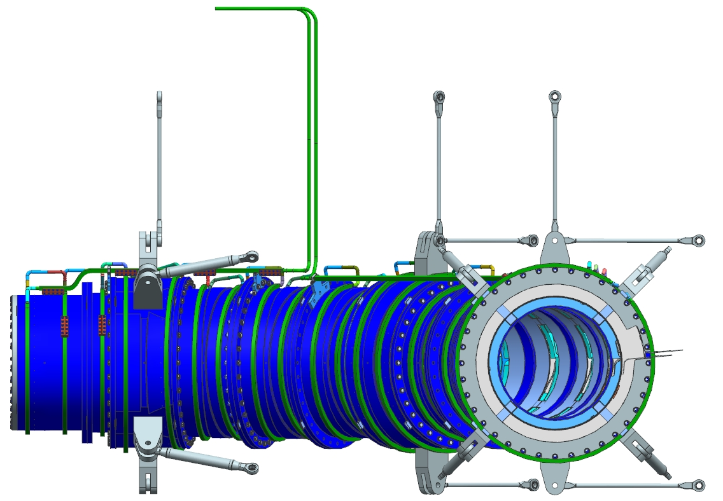
Design – Cold mass assembly

Slide 24
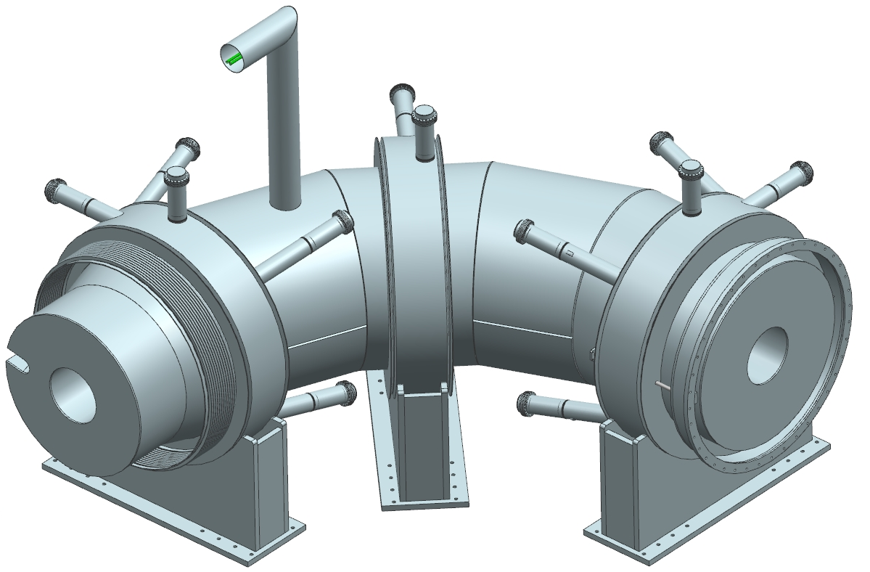
Design – Cryostat assembly

Slide 25
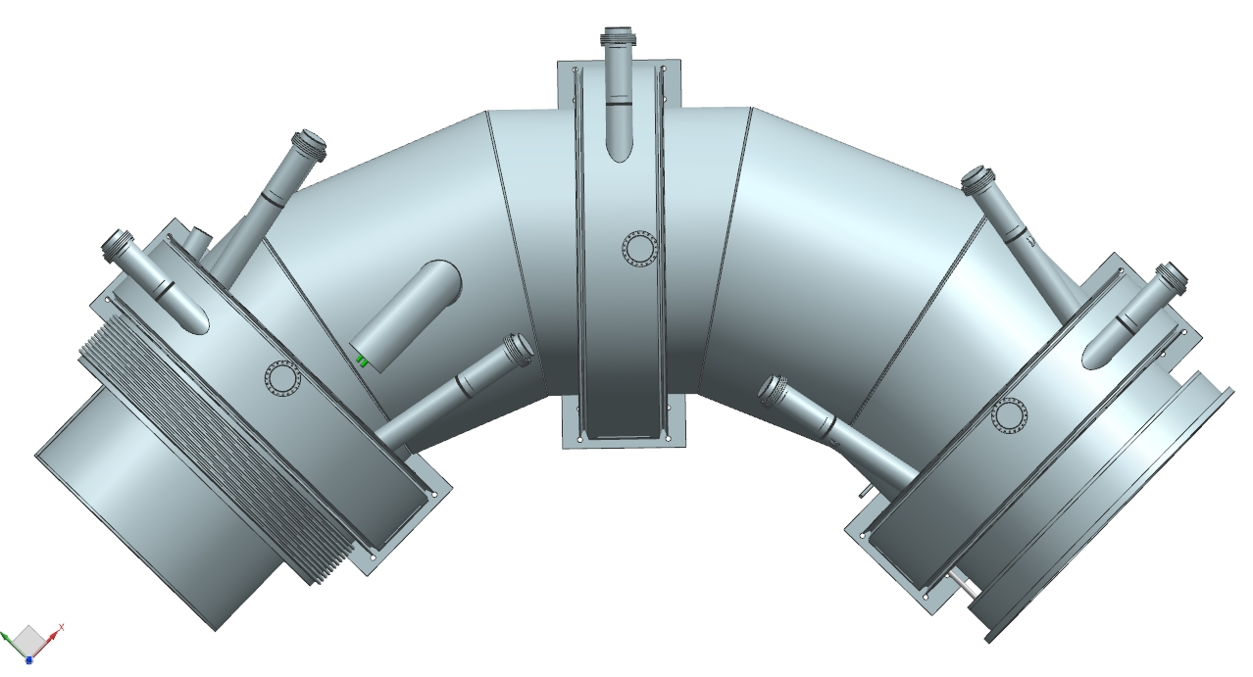
Design – Cryostat assembly

Slide 26
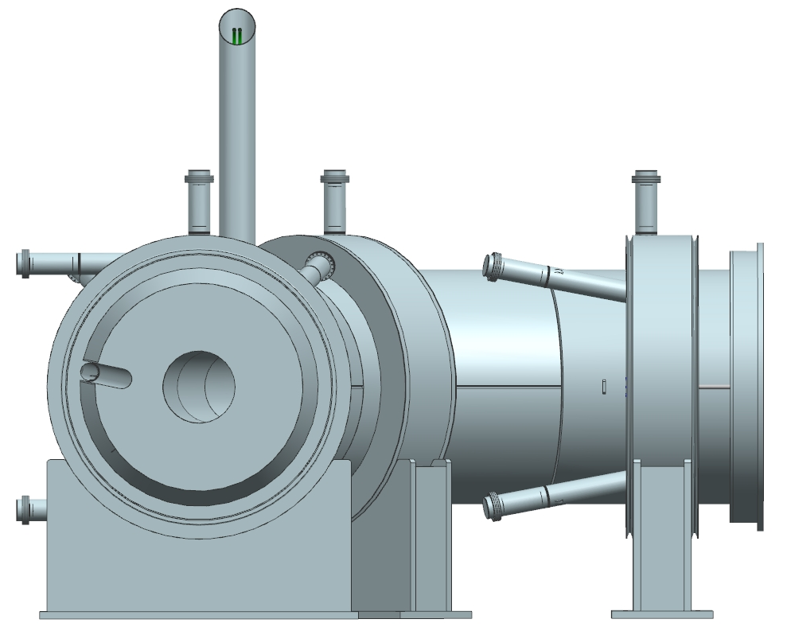
Design – Cryostat assembly

Slide 27
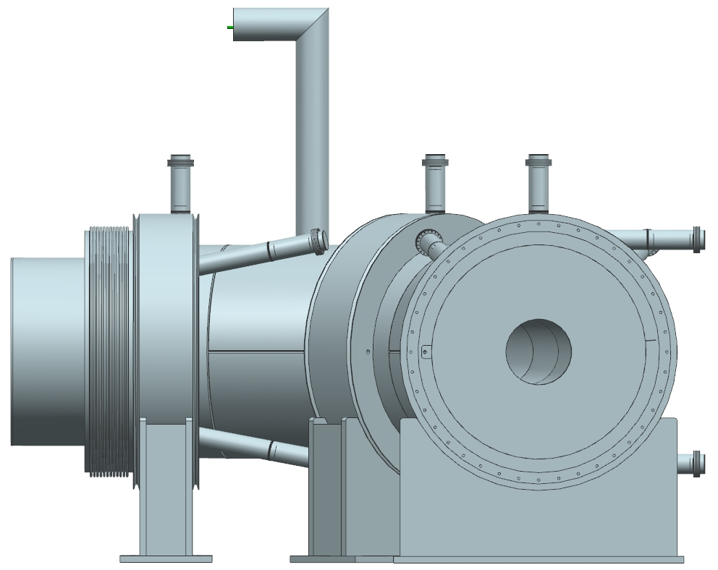
Design – Cryostat assembly

Slide 28
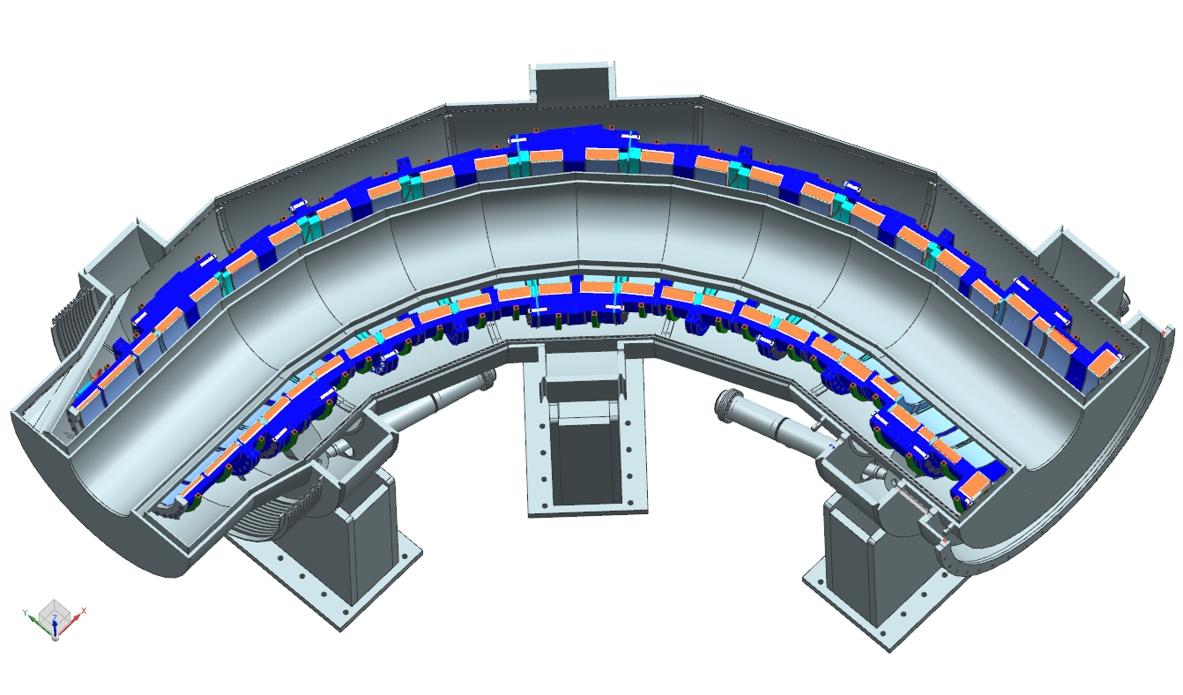
Design – Cryostat assembly

Slide 29
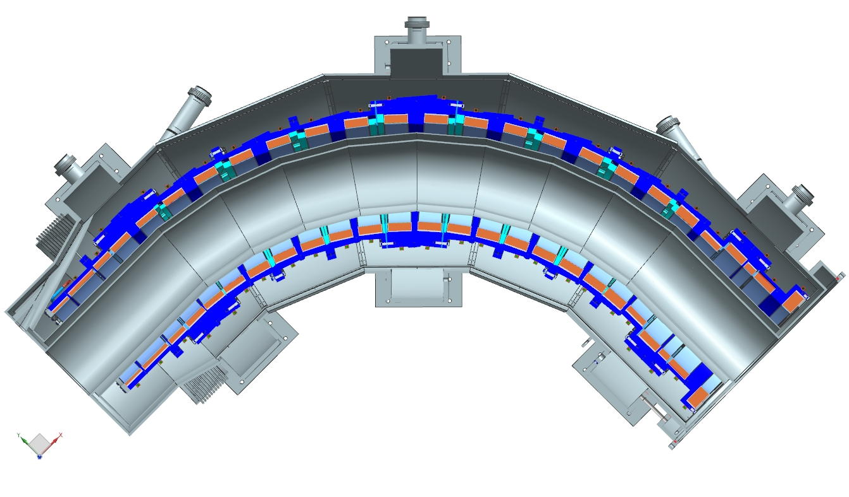
Design – Cryostat assembly

Slide 30
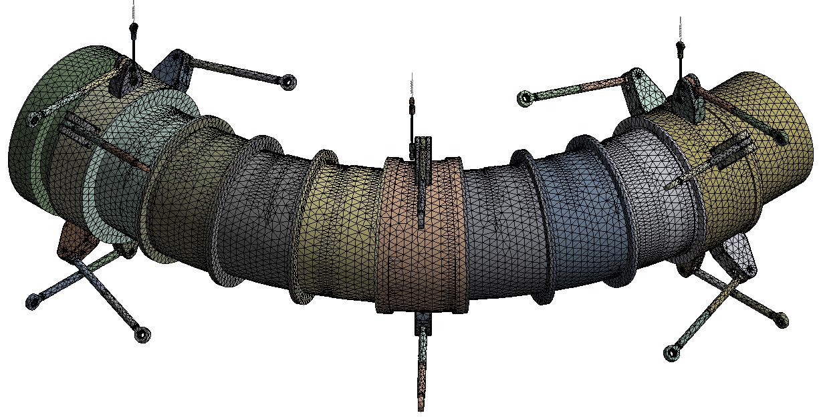
Design – Structural Analysis
The magnetic forces for each load case were calculated by the ANSYS program and verified by comparison to the Opera forces from the magnetic design work.
The results of the calculations show that the coils, the support system, cold mass support attachment points, cryostat support attachment points, and cryostat elements are sufficiently strong to withstand the expected loads.

Slide 31
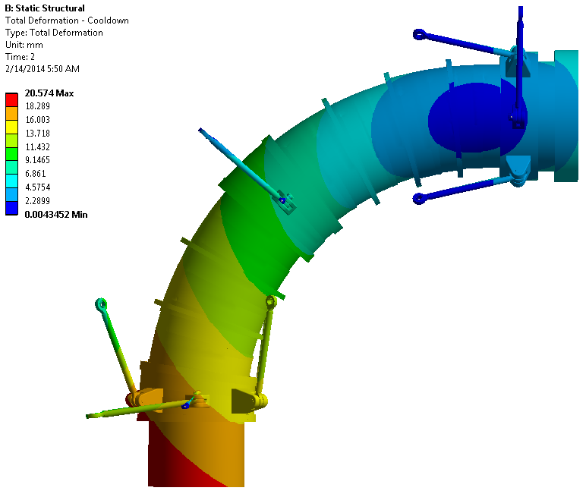
Design – Structural Analysis
Cold mass displacements due to the cooldown

Slide 32
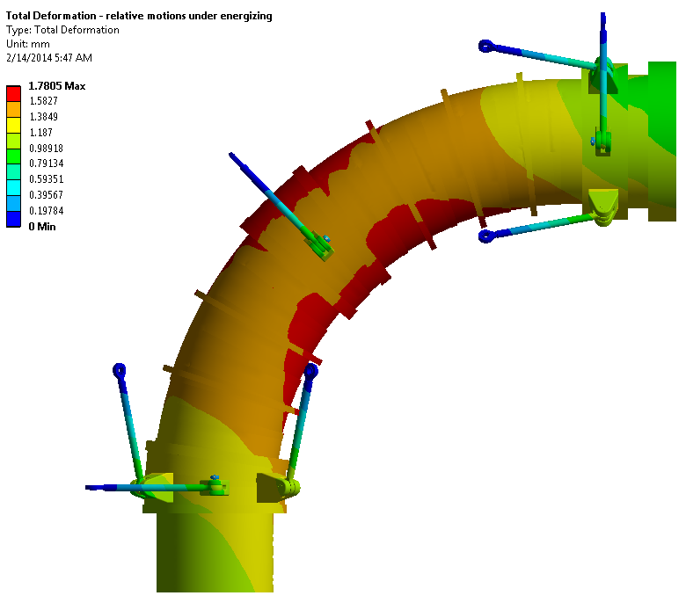
Design – Structural Analysis
Cold mass displacements due to energization (relative to cool down)

Slide 33
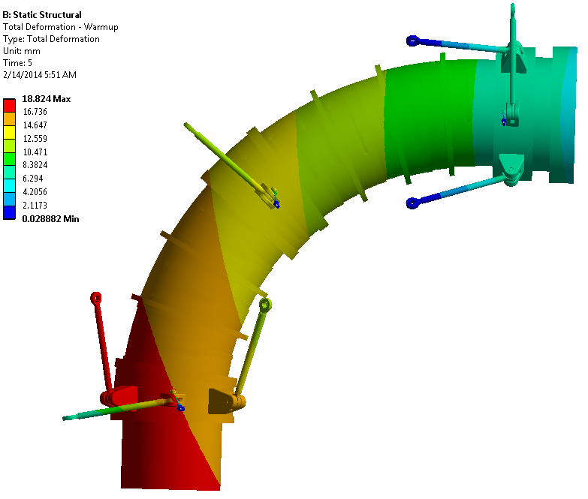
Design – Structural Analysis
17 mm
9 mm
Cold mass displacements due to the warm up

Slide 34
Design – Structural Analysis
Support | Load Case
 | Normal Operation | PS off | TSd Off
Upstream Axial 1 | 158 | 0 | 250
Upstream Axial 2 | 169 | 0 | 262
Upstream Axial 3 | 151 | 0 | 208
Upstream Axial 4 | 164 | 0 | 220
Downstream Axial 1 | 175 | 371 | -121
Downstream Axial 2 | 176 | 374 | -119
Downstream Axial 3 | 192 | 294 | -62
Downstream Axial 4 | 204 | 309 | -53
Upstream Radial 1 | 159 | 51 | 70
Upstream Radial 2 | 154 | 18 | 64
Downstream Radial 1 | 140 | 0 | 94
Downstream Radial 2 | 134 | 3 | 88
Center Radial 1 | 283 | 14 | 165
Center Radial 2 | 263 | 18 | 145
Gravity 1 | 24 | 24 | 24
Gravity 2 | 28 | 27 | 28
Gravity 3 | 20 | 19 | 20
in kN
Design Values
Maximum tension 414 kN
Maximum compression -169 kN

Slide 35
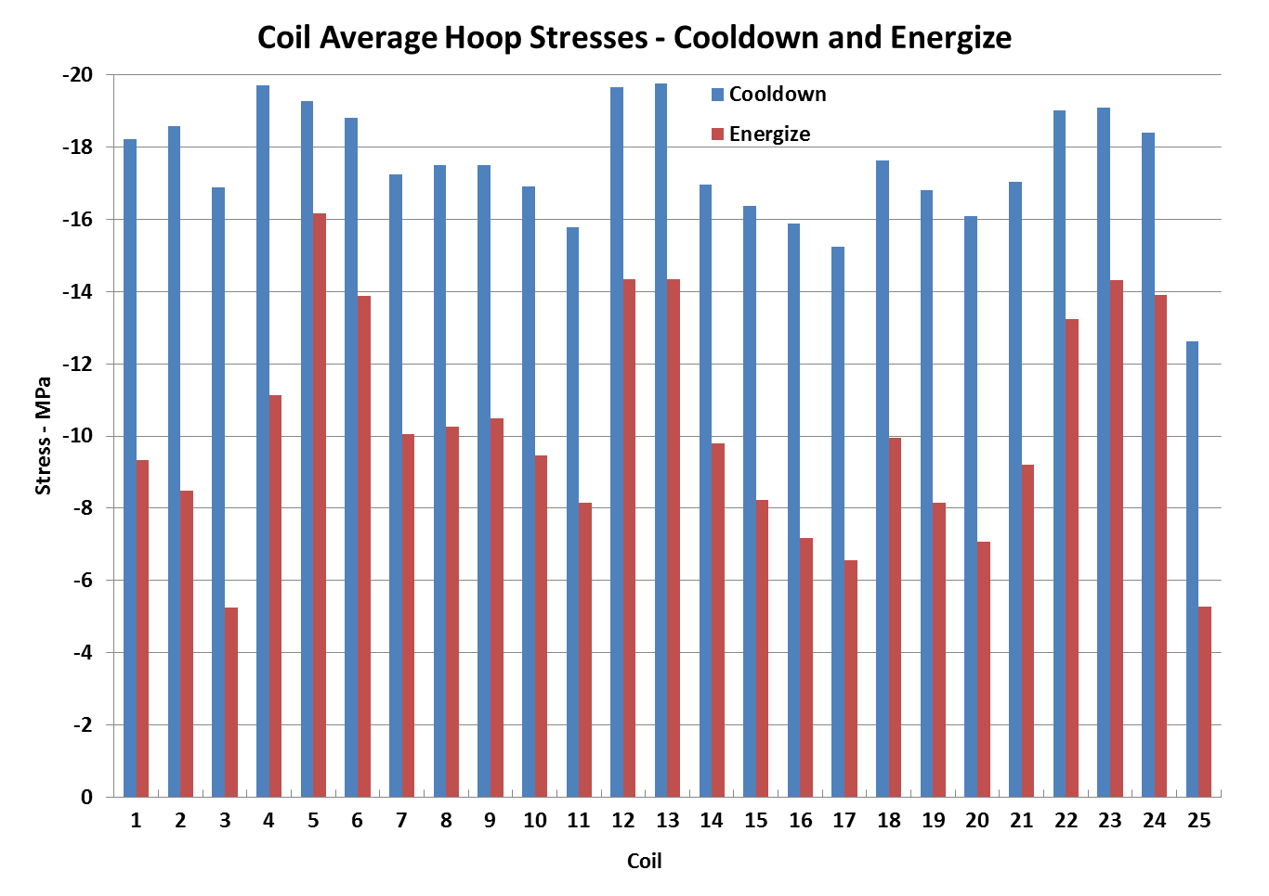
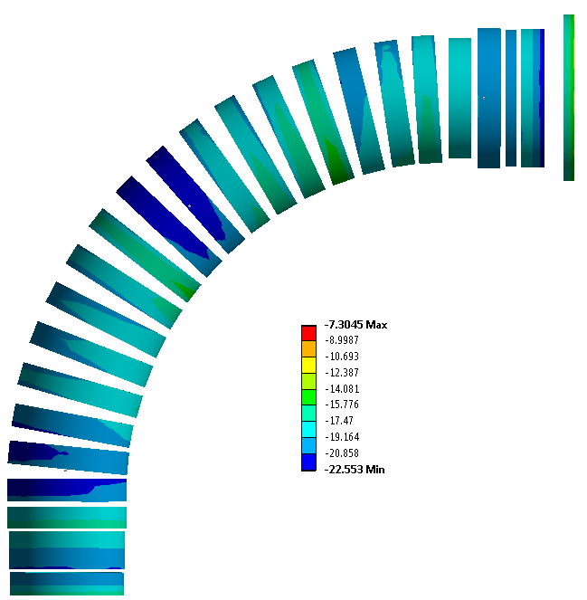
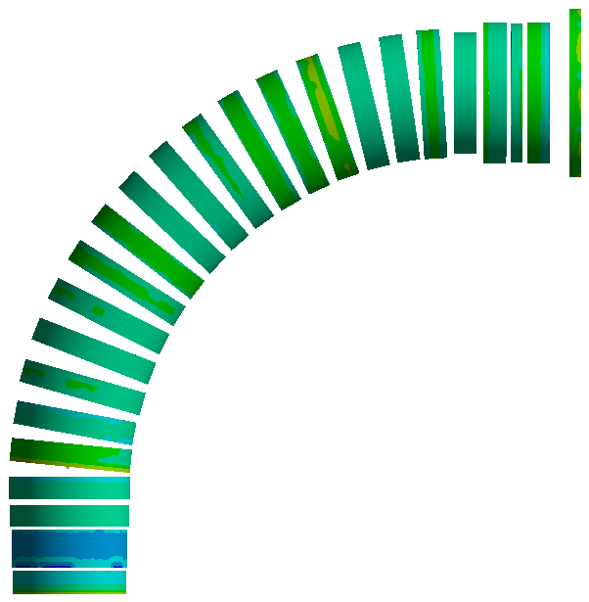
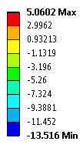
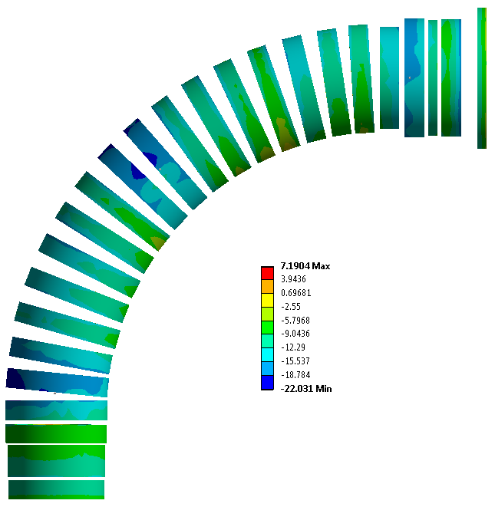

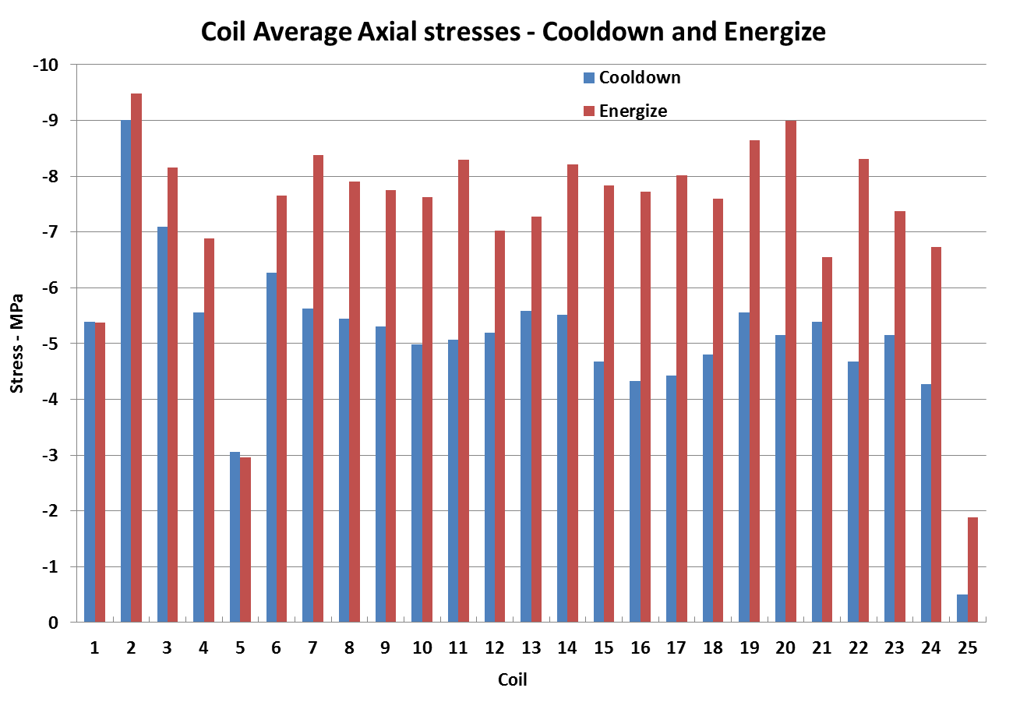
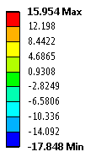
Design – Structural Analysis
Hoop stress
Axial stress
Maximum allowed: 40 MPa
Cool down
Energize

Slide 36
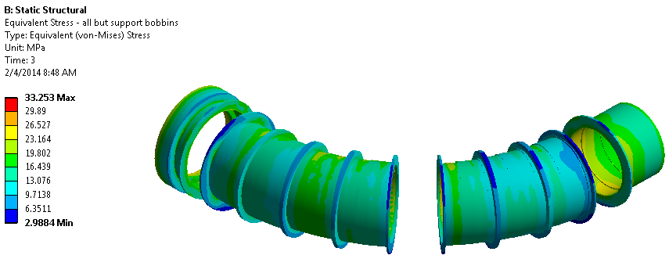
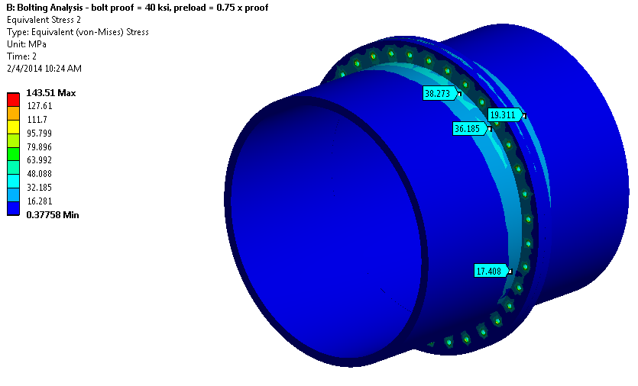
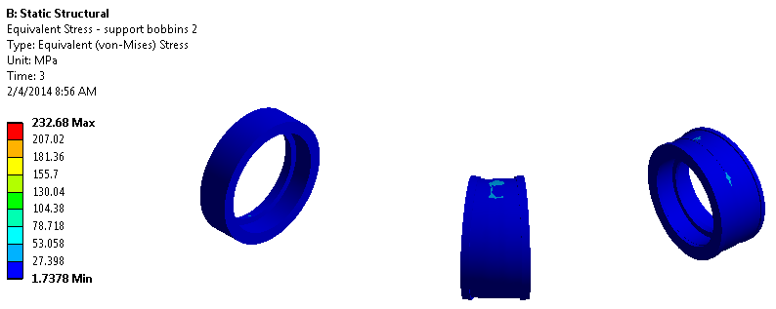
Design – Structural Analysis
Overall stress are below the maximum allowed: 107 MPa for Al 5083-O
The high stresses are concentrations, numerical artifacts caused by discontinuities in the region of the lug-to-bobbin attachment. This attachment was designed separately using local finite element models and standard weld strength calculations, and not this global cold mass model
Below 30 MPa

Slide 37
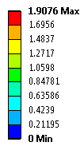
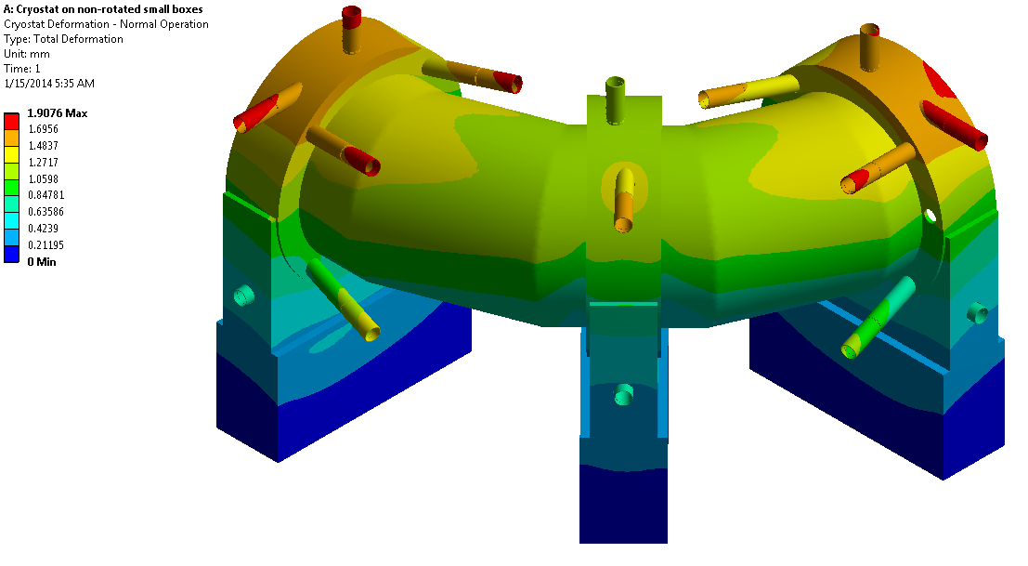
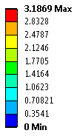



Design – Structural Analysis
Normal operation
Cryostat displacements (mm)
PS Off
TSd Off

Slide 38






Design – Structural Analysis
Normal operation
Cryostat stresses (MPa)
PS Off
TSd Off
Overall stress are bellow the maximum allowed: 115 MPa for 316L

Slide 39



Design - Radiation analysis
DocDB 4622
Peak power density 1.3.10⁻⁴ mW/g
Dose 2.6 kGy/year
DPA 2.6.10⁻⁶ (target <10⁻⁵)
Those numbers give a safety factor around 10

Slide 40


Design – Cooling scheme analysis

Slide 41

Design – Cooling scheme analysis
Helium inlet parameters:
    T=4.7[K],
    P=3e5[Pa],
    flow rate=0.050[kg/s].
Cooling tube:
    ID=0.021[m],
    L~110[m],
    L_eq~150[m],
    dP~5e3Pa.
*
* inches

Slide 42
Load Line
>50% margin in current
>1.5 K temperature margin

Slide 43


Design – Cooling scheme analysis

Slide 44
Design – Cooling scheme analysis
axial support
5 K
4.5 W
1.5 W
300 K
80 K
Helium temperature
Support section | Coils | Heat (W) |  |  |  | Helium temperature (K)
 |  | Radiation | Dynamic load | Support load | Total | in | out
 | 25-24 | 0.51 | 0.00 | 0.00 | 0.51 | 4.700 | 4.701
3 | 23-22 | 0.48 | 0.00 | 9.00 | 9.48 | 4.701 | 4.736
 | 21-14 | 2.11 | 0.00 | 0.00 | 2.11 | 4.736 | 4.743
2 | 13-12 | 0.60 | 0.00 | 3.00 | 3.60 | 4.743 | 4.756
 | 11-6 | 1.56 | 0.00 | 0.00 | 1.56 | 4.756 | 4.761
1 | 5-4 | 0.52 | 0.00 | 9.00 | 9.52 | 4.761 | 4.795
 | 3-1 | 0.76 | 0.05 | 0.00 | 0.81 | 4.795 | 4.797

Slide 45


Design – Cooling scheme analysis
Aluminum bobbin
Coil

Slide 46




Design – Cooling scheme analysis
Maximum temperature of coil
4 straps
2 straps fixed on 1 side
Scheme | Coil Temp. (K) | Shell Temp. (K)
1 strap | 5.0532 | 8.8421
2 straps 2 sides | 5.0183 | 8.6974
2 straps 1 side | 4.9870 | 8.3832
4 straps | 4.9515 | 8.1706
2 straps fixed on 2 sides
1 strap

Slide 47
Design – Splices R&D
Rutherford to Rutherford
Aluminum soldered joints
Aluminum weld
EM pulse joints
Explosive joints
Ultrasonic weld
Type | R (nOhm) | SC Degradation (%)
Rutherford-Rutherford #1 | 0.875 | 0
Rutherford-Rutherford #2 | 0.711 | 0
Rutherford-Rutherford #3 | 1.14 | 0
Rutherford-Rutherford #4 | 0.62 | 0
Soldered - SnPb | 31.03 | -
Soldered - SnAg | 144.98 | -
Soldered - SnZn | 37.7 | -
Ultrasonic welded #1 | 0.397 | 0
Ultrasonic welded #2 | 0.778 | 0
Ultrasonic sample #3 | 0.681 | 0
Standard welded #1 | 13.8 | 20
Standard welded #2 | 12 | 30

Slide 48
Improvements since CD-1
Changes on the TSu nose that connects to PS due to the proton beam pipe.
Change of the position of the Chimneys to accommodate the shield around the TS magnets.
We removed the vertical supports located in the bottom of the magnet due to interference with the support feet.
Trim power supplies included in TS

Slide 49
Value Engineering since CD-1
TSu and TSd cryostat geometry nearly identical resulting in common parts, tooling, and assembly.
TSu and TSd support feet positions identical resulting in common parts, tooling, support frames, and lifting fixtures.
TSu and TSd axial and radial supports identical resulting in common parts, tooling, and assembly.
Eliminated lower vertical supports resulting in lower cost, easier assembly, and easier cold mass alignment.

Slide 50
Downselects
Forced flow was selected as the cooling scheme for TS (as opposed to thermo-syphoning).
TS1 coils will be housed into a 2+1 coil modules (instead of a single 3-coils module)
Coil modules will be fabricated in industry. Magnet assembly (cold mass and cryostat) will be done in-house.

Slide 51
CD3-b strategy
The design of the complete magnet is still preliminary, but we have the details in hand to finish the coil module design.
The design of coil modules is very advanced (~90% complete).
Most of the design is based on the experience we had building the prototype.

Slide 52




Prototype
More details on G. Ambrosio’s talk

Slide 53
Prototype
Proprietary Information

Slide 54
Prototype
Proprietary Information

Slide 55
Remaining work for the coil modules
Finish all the drawings
(90% of the design and 70% of the drawings are complete),
      -Drawings review
Finish (Procurement) Technical Specifications,
      -Roberto Penco (Consultant).
Complete the test of the TS Prototype at Fermilab
      -Warm magnetic measurement (stretched wire)
      -Finish the preparation of the test cryostat
      -Cold tests

Slide 56
Remaining work for the coil modules
List of drawings that are ready:
      Coils w/Excel Chart
      Coils Spacers and Wedges
      Cooling Square Tubes
List of drawings that needs update:
      Module Assemblies (16)
      Housing Final Machining (16)
      Housing Weldment (16)
      Housings (16)
List of remaining designing:
      Splices Boxes (40)
      Update bolt holes end went holes for on all housings (16)
      Add hardware for TSu and TSd (8)
      For some module make room for new Lugs Support (24)
      Test assembly modules for TSu and TSd (40)
      Aluminum cooling sheets for global and test units cold mass assembly (80)
      Leads and splices routing for global and test units cold mass assembly (200)
      Support Splices (80)
List of remaining drawings:
      Splices boxes (80)
      Supports for leads (80)
      Supports for cooling tubes (40)
      Test units cold mass Assembly Modules for TSu and TSd (40)
      Global Cold Mass Assembly TSu and TSd (40)
~3 months of work (2 designers)

Slide 57
Organizational Breakdown
WBS 4
Solenoids
M. Lamm
WBS 4.3
Transport Solenoid
M. Lopes
G. Ambrosio (D)
4.3.1
Conductor
V. Lombardo
4.3.2
Cold Mass Design
D. Evbota
4.3.3
Cryostat Design
T. Nicol
4.3.4
Magnet Assembly
D. Evbota &
T. Nicol
4.3.5
Magnet support
J. Brandt
4.3.6
Interconnects
J. Brandt
4.3.7
Test Cryostat
L. Kokoska
Module testing
M. Tartaglia

Slide 58
Remaining work before CD3-c
Finalize the design of the cryostat
        -Thermal shield
        -Support rods
            >Prototype
Finalize the tooling for the overall assembly (WBS 4.9)
Finalize the magnet support feet
Finalize the magnet interconnects

Slide 59
Quality Assurance
Vendors must provide Preliminary QAP as part of bid package
Vendor’s QAP will include tests requested by Fermilab
Hold points in fabrication at major milestones
Regularly scheduled meetings to discuss fabrication status/issues. Regular visits to the vendor.
Use of traveler system at the vendor and at Fermilab
Acceptance tests upon delivery at Fermilab:
  Electrical tests
  Mechanical surveys
  Magnetic measurements
  Cold tests of coils and splices
Monthly EVMS-style reporting

Slide 60
ES&H
Common to large superconducting magnet systems
  Cryogenic fluids
  Large stored energy (13 MJ)
  High currents (up to 2 kA)
  Large voltages during quench (up to 600 V)
  ODH
  Mechanical forces (up to 130 Tons of axial force)
  Stray magnetic fields
  Use of chemicals (Sodium hydroxide)
  Radiation
All of these are covered in the Mu2e Hazard Analysis

Slide 61

Cost Distribution
AY k$

Slide 62

Cost Distribution by Resource Type
AY k$

Slide 63

Quality of Estimate
69% of the cost is preliminary or better
AY k$

Slide 64

Labor Resources
All the resources for FY15 are identified by name

Slide 65
Cost Table

Slide 66
Major Milestones

Slide 67
Schedule
CD-3a
CD-3c
CD-2/3b
CD-4
Fabricate and QA Superconductor
KPPs Satisfied
Solenoid Design/Prototypes
Solenoid Fabrication and QA
Detector Hall Construction
Solenoid Infrastructure
Solenoid Installation and Commissioning
Detector Prototypes and Construction
Cosmic Ray System Test
Accelerator and Beamline Construction
Accelerator Commissioning (off Project)
Q3 | Q4 | Q1 | Q2 | Q3 | Q4 | Q1 | Q2 | Q3 | Q4 | Q1 | Q2 | Q3 | Q4 | Q1 | Q2 | Q3 | Q4 | Q1 | Q2 | Q3 | Q4 | Q1 | Q2 | Q3 | Q4 | Q1 | Q2 | Q3 | Q4 | Q1 | Q2 | Q3 | Q4
FY14 FY15 FY16 FY17 FY18 FY19 FY20 FY21

Slide 68
Critical Path
CD3-b approval > CD-4 approval of 11/09/20
CD3-c approval > CD-4 approval of 9/17/21
TS Final Design
TS Module Procurement Activities
PO issued for TS Module Fabrication
Vendor Fabricates TS Modules
Test TS Modules
Finished Testing TS Modules
Assemble/Test TSd
Installation Activities
Solenoid Installation Complete and Ready for cooldown
Commissioning Activities
KPPs Satisfied
Q3 | Q4 | Q1 | Q2 | Q3 | Q4 | Q1 | Q2 | Q3 | Q4 | Q1 | Q2 | Q3 | Q4 | Q1 | Q2 | Q3 | Q4 | Q1 | Q2 | Q3 | Q4 | Q1 | Q2 | Q3 | Q4 | Q1 | Q2 | Q3 | Q4 | Q1 | Q2 | Q3 | Q4
FY14 FY15 FY16 FY17 FY18 FY19 FY20 FY21

Slide 69
Summary
The TS conductor performed really well and the PO was placed (July14).
The solenoid magnetic design meets the requirements for the experiments and tolerances are well understood.
Cost and Schedule understood.
We believe we are ready for CD2 project baseline
The coil modules design is very advanced (90% of the design and 70% of the drawings are complete) and they are based on the experience we are having with the prototype.
We believe we are ready for CD3-b for the coil modules in order to avoid a major delay in the project (~1 year).

