Slide 1
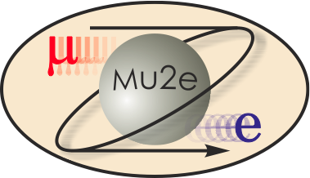
Solenoid Conductor Status
Vito Lombardo
DOE CD-2/3b Review
October 21-24, 2014

Slide 2
Outline
Overview of the prototype phase
Brief summary of production orders
Hitachi Cable:
Status of Transport Solenoid order
Status of Detector Solenoid 2 order
Furukawa Electric:
Status of Detector Solenoid 1 order
Status of Production Solenoid order
Conclusions

Slide 3
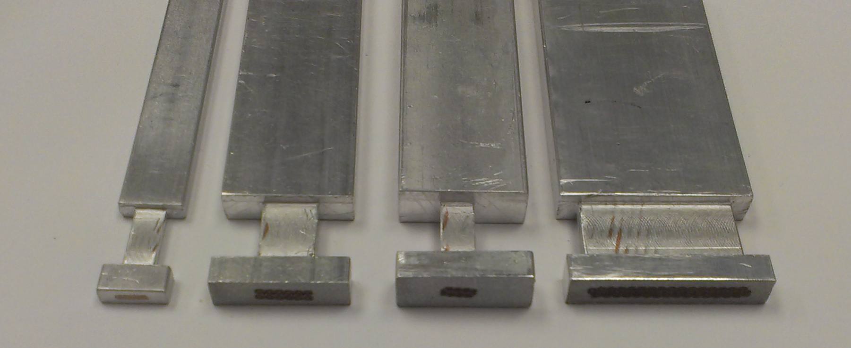
Overview of Prototype Phase
All four SC cables went through a successful prototype stage aimed at demonstrating the feasibility of such cables in industry.
About 3,600m of mu2e cables were successfully procured as part of this prototype campaign.
The orders were awarded to two vendors according to the following summary
Transport Solenoid: (3x1000m)
Superconducting Wire (Hitachi, Japan) – Completed
Rutherford Cable (New England, US) – Completed
Pure Al-Stabilized Cable (Hitachi, Japan) – Completed.
Production Solenoid: (200m)
Superconducting Wire (Furukawa, Japan) – Completed
Rutherford Cable (Furukawa, Japan) – Completed
Ni-doped Al-Stabilized Cable (Furukawa, Brazil) – Completed
Detector Solenoid 1: (200m)
Superconducting Wire (Furukawa, Japan) - Completed
Rutherford Cable (Furukawa, Japan) – Completed
Pure Al-Stabilized Cable (Furukawa, Brazil) – Completed
Detector Solenoid 2: (200m)
Superconducting Wire (Hitachi, Japan) – Completed
Rutherford Cable (Hitachi, Japan) – Completed
Pure Al-Stabilized Cable (Hitachi, Japan) – Completed
TS
14x0.67mm
Cable size:
9.85x3.11mm
DS1
12x1.466mm
Cable size:
20.1x5.27mm
DS2
8x1.303mm
Cable size:
20.1x7.03mm
PS
32x1.466mm
Cable size:
30.1x5.52mm

Slide 4
Overview of Prototype Phase
For each of the 4 procurements, three hold points were placed throughout the development process.
At each hold point, test data and samples are sent to Fermilab from the various vendors. Tests are performed at Fermilab and compared to vendors’ results. After an internal review, Fermilab releases the hold point and allows vendors to proceed with the next development phase or final shipment of the conductor.
Frequent conference calls were done throughout the process to monitor progress and discuss technical details.
Fermilab visited all the vendors at crucial times of the development process.
Hold
Hold
Hold
ROUND WIRE
RUTHERFORD CABLE
STABILIZED CABLE
Wire diameter *
Wire ovality *
Critical Current *
n-Value *
Cu RRR *
Cu-SC ratio *
Twist pitch length and direction *
Filament diameter and spacing *
Sharp bent *
Eddy current
Rutherford Cable thickness *
Rutherford Cable width *
Cable lay direction *
Cable transposition length *
Rutherford cable Bend test
Mechanical stability *
Residual twist
Surface condition
Crossovers or broken strands
Sharp edges *
Critical Current *
Cu RRR *
Stabilized Cable thickness *
Stabilized Cable width *
Conforming parameters
Surface condition of the cable after conforming
Surface condition of the final cable
Al-Cu Bonding strength *
Aluminum RRR before conforming
Aluminum yield at 300 K after cold work *
Aluminum yield at 4.2 K after cold work
Aluminum RRR after cold work *
Critical Current *
Cu RRR *
* Also measured at FNAL

Slide 5
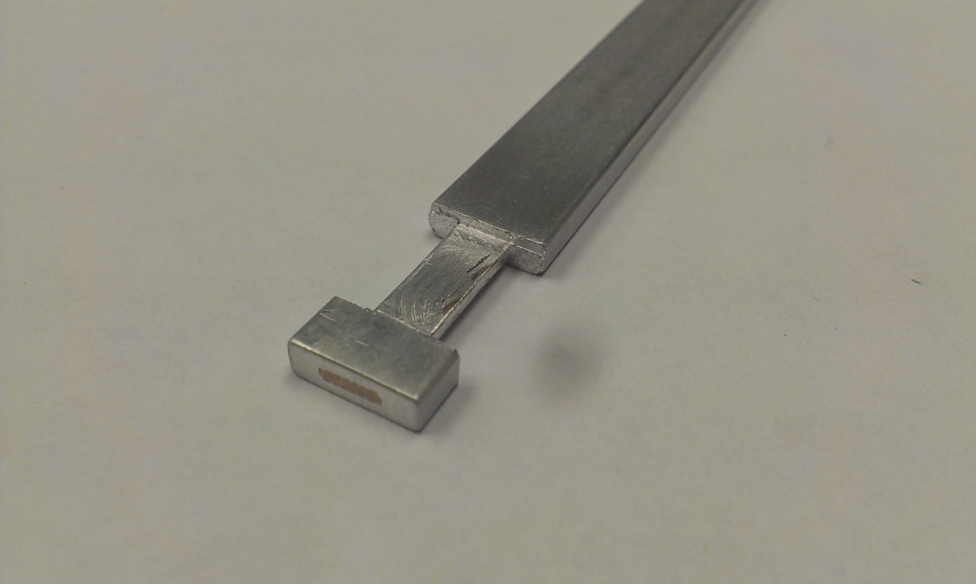
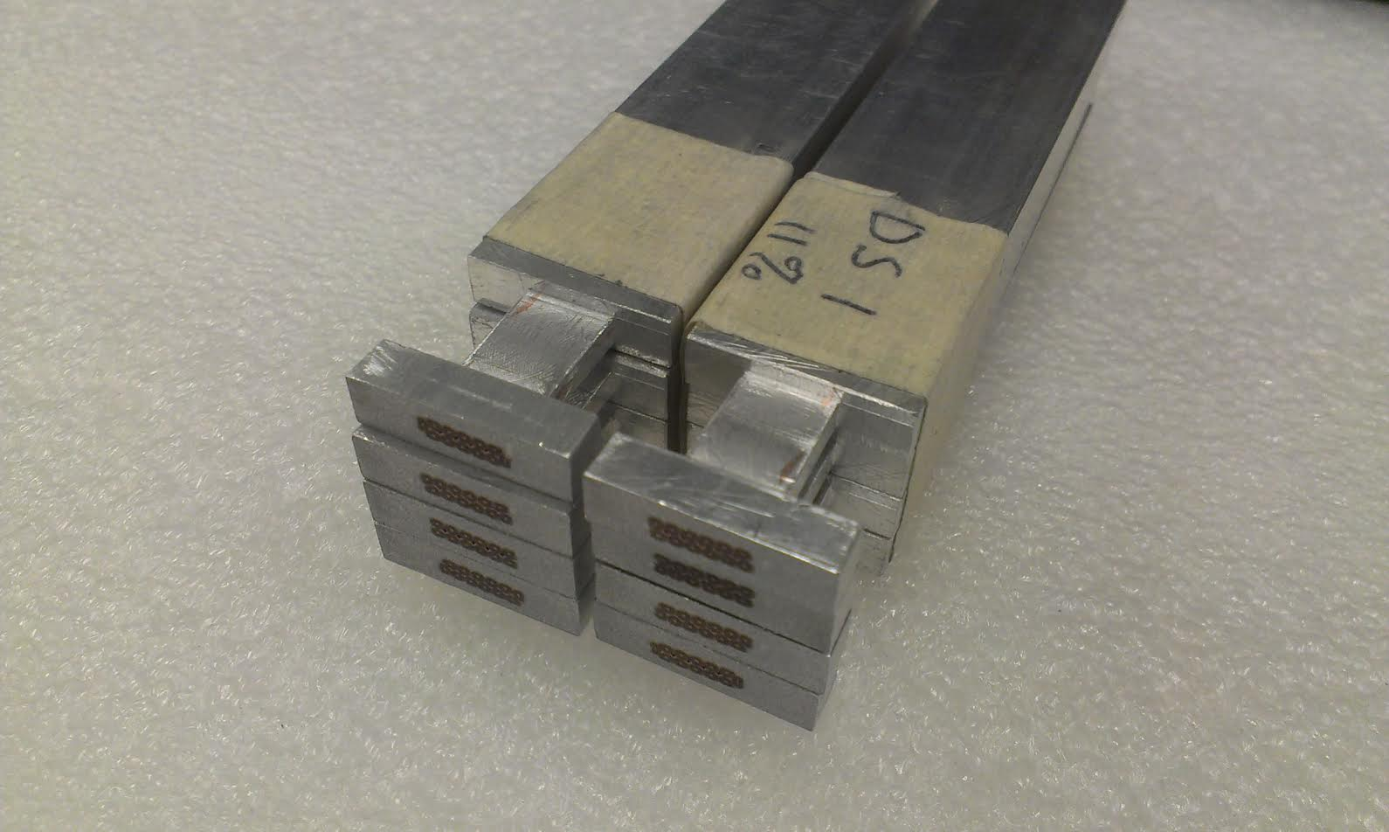
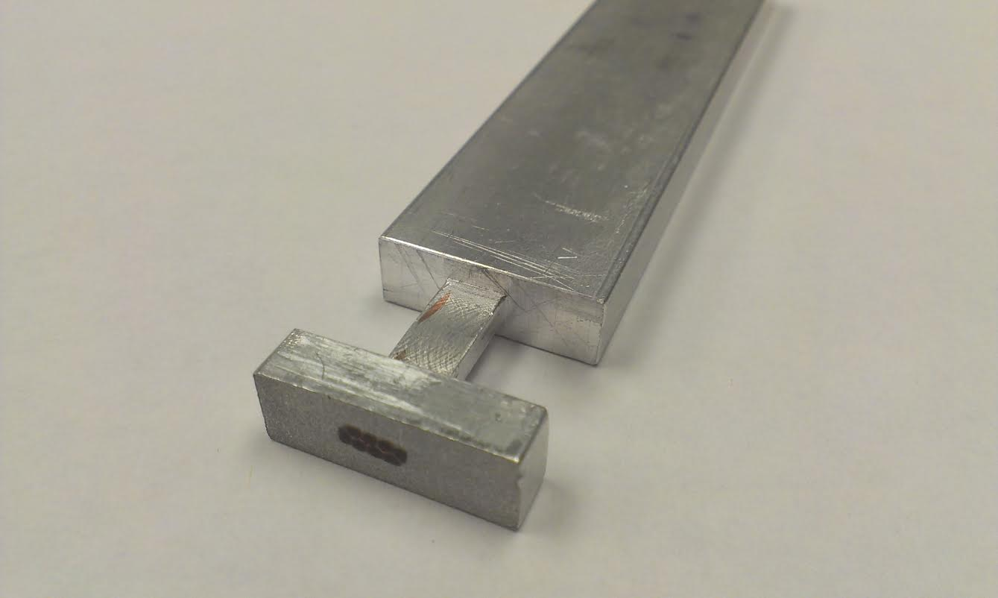
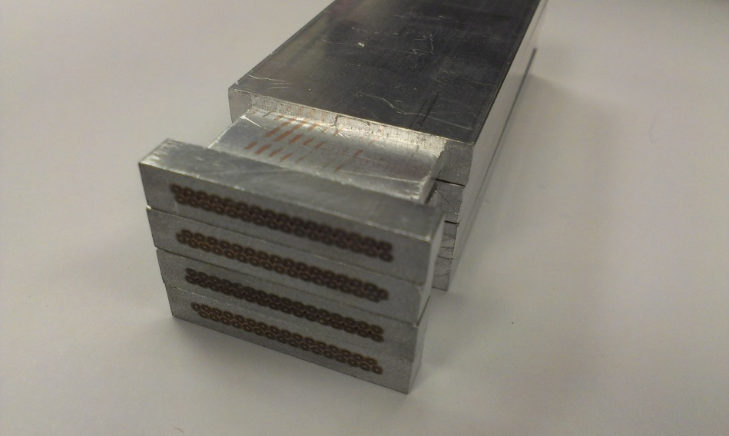
Overview of Prototype Phase
Based on this approach, 4 prototype cables were successfully procured.
The project was awarded CD-3a in July 2014.
The prototype campaign has proven to be extremely useful. Vendors had the chance to tweak their processes to deliver the best cable possible for the project. Numerous lessons learned along the way.
In summary:
A total of 3,000m of TS cable were produced by Hitachi and fully accepted by Fermilab without any issue.
DS1 (Furukawa) and DS2 (Hitachi) cables met all our specs with the only exception of cross-section dimensions. Vendors are working on improving their cold-work dies to ensure production cables are within our specs.
PS cable (Furukawa) met all our specs with the exception of the RRR of the Al stabilizer which came in slightly below spec (500 instead of 600). The effect of this reduction has been investigated and found to be acceptable. A minor redesign of the cold-work die is needed for PS as well.
For further technical details, please refer to slides presented at CD-3a review http://mu2e.fnal.gov/public/project/reviews/cd3a-review/index.shtml
Transport Solenoid
Prototype cable
Detector Solenoid 1
Prototype cable
Detector Solenoid 2
Prototype cable
Production Solenoid
Prototype cable

Slide 6
Status of Production Orders
The prototype orders were structured to include an option to manufacture production quantities of each of the four cables at a fixed price.
TS, DS1, DS2 production orders have been placed; PS order is currently being finalized after recent vendor visit.
All the production orders are being managed similarly to the prototype orders
One hold point after production of the NbTi wire is completed
One hold point after production of the Rutherford cable is completed
One hold point for each batch of Al-stabilized cable ready to be shipped to Fermi.
For PS only, we are requiring an extra 100m demo length and a first article (1700m) to be completely tested before approving the rest of the production.
Regular (bi-weekly) conference calls with both vendors to monitor progress.
Vendor visits during conforming/cold-work of at least the first article of each cable are scheduled.
Transport Solenoid
Prototype cable
Detector Solenoid 1
Prototype cable
Detector Solenoid 2
Prototype cable
Production Solenoid
Prototype cable

Slide 7
Status of Production Orders
Almost no changes in the procurement strategy with the respect to the prototype phase with only two exceptions.
TS wires will be cabled by New England under a contract signed between Hitachi cable and New England (Fermilab won’t actively manage that contract as for the prototype phase)
Hitachi cable decided to outsource the cabling of DS2 wires to New England instead of performing it in house (in Japan).
Transport Solenoid:
Superconducting Wire (Hitachi, Japan)
Rutherford Cable (New England, US)
Pure Al-Stabilized Cable (Hitachi, Japan)
Detector Solenoid 2:
Superconducting Wire (Hitachi, Japan)
Rutherford Cable (New England, US)
Pure Al-Stabilized Cable (Hitachi, Japan)
Detector Solenoid 1:
Superconducting Wire (Furukawa, Japan)
Rutherford Cable (Furukawa, Japan)
Pure Al-Stabilized Cable (Furukawa, Brazil)
Production Solenoid:
Superconducting Wire (Furukawa, Japan)
Rutherford Cable (Furukawa, Japan)
Ni-doped Al-Stabilized Cable (Furukawa, Brazil)
TS
14x0.67mm
Cable size:
9.85x3.11mm
DS1
12x1.466mm
Cable size:
20.1x5.27mm
DS2
8x1.303mm
Cable size:
20.1x7.03mm
PS
32x1.466mm
Cable size:
30.1x5.52mm

Slide 8
Status of Production Orders
About 75km of Al-stabilized cable are required by the experiment.
About 62km are needed for coil winding and about 13km are procured as spares.
In order to mitigate risk, the PS spare piece lengths have been increased from 1 to 3 in order to have enough conductor to re-manufacture the largest PS coil (only if necessary).
 | Prototype Length | Production lengths needed for coil winding | Spare production lengths | Total Production Length
Transport Solenoid | 3x1000m | 14x1540mm 22x800 | 2x1540m 2x800m | ~ 44km
Detector Solenoid 1 | 200m | 8x1100m | 1x1100m | ~ 10km
Detector Solenoid 2 | 200m | 3x1750m | 1x1750m | ~ 7km
Production Solenoid | 200m | 3x1700m 2x1300m 1x1500m | 3x1700m | ~ 14km

Slide 9
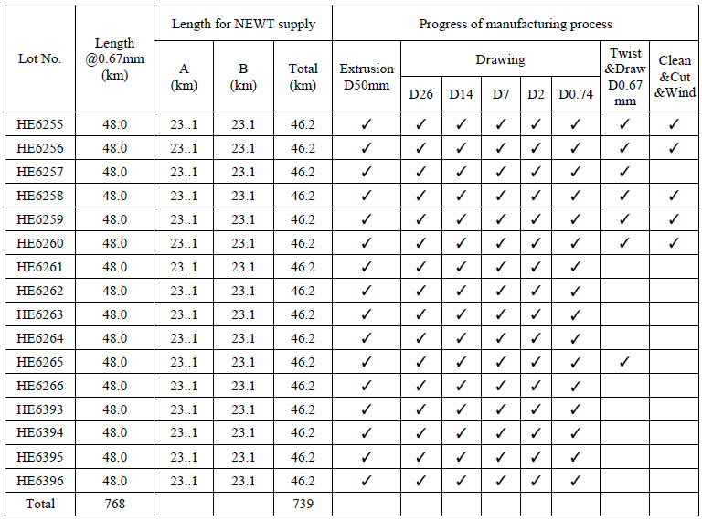
Status of Transport Solenoid order
Hitachi is currently manufacturing a total of 768 km of TS wire.
Wire production is being constantly monitored and is moving forward according to schedule.
Billets will be delivered in three batches:#1-6 are scheduled to be completed in Oct, #7-12 in Nov and #13-16 in Dec.
Samples from the first 6 billets expected to be delivered to Fermilab shortly for approval.
The cabling of the TS wire will be performed at New England (US) via contract signed between Hitachi and New England.
The cabling process is scheduled to start in late December.
The 44km of TS Al-stabilized cable will be delivered in 4 batches, from 6/30/2015 to 12/31/2015.
The order and the timeframe for delivery of the conductor has been chosen to match the order in which the coil units will be wound, tested and assembled.
Cross-section of TS wire

Slide 10
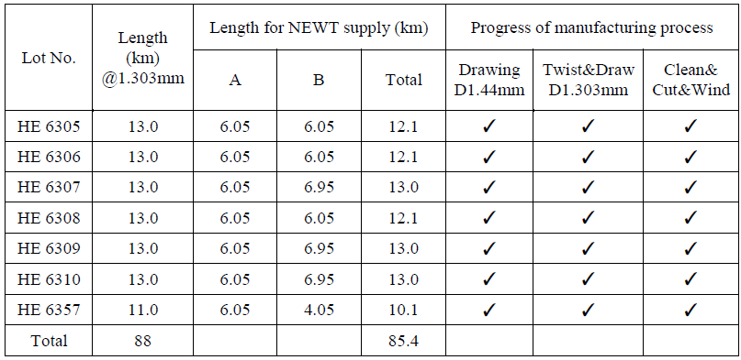
Status of Detector Solenoid 2 order
7 billets for a total of 88km of wire completed on schedule.
Samples received on time. Cold tested and approved by Fermi on schedule.
During the prototype phase, cabling of DS2 wire was performed by Hitachi in Japan, whereas for the production quantities, cabling will be done in the US at New England.
Procurement of Aluminum is scheduled to be completed by the end of October.
Cabling started last week and is scheduled to be completed in November.
After approval, the cable lengths will be shipped to Japan for conforming and cold work.
7km of DS2 Al-stabilized cable are scheduled to be delivered by 6/30/2015

Slide 11
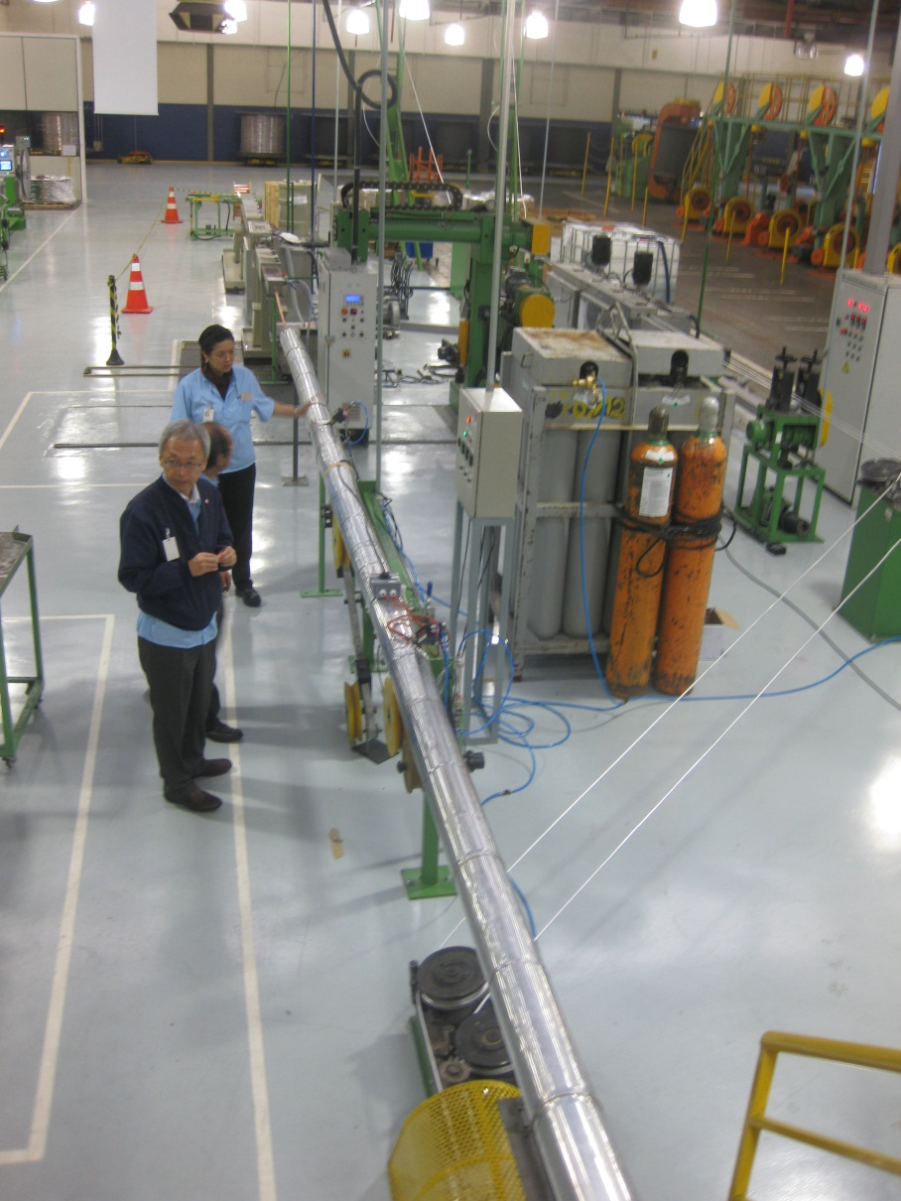
Status of DS1 and PS orders
Detector Solenoid 1
DS1 wires are currently being manufactured in Japan by Furukawa Electric.
This process is scheduled to be completed by the end of November.
Cabling will be performed in Japan by Furukawa and expected to be completed by the end of January.
Procurement of Aluminum is completed. Tests to be started soon.
9.9km of DS1 Al-stabilized cable are scheduled to be delivered by 6/30/2015.
Production Solenoid
PS production order will be placed shortly.
Vendor visited Fermilab recently to iron out the final details, including additional piece lengths and hold points.
First article is expected in 12-13 months.
The overall process is estimated to take approximately 19-20 months.
Furukawa’s facilities in Curitiba, Brazil

Slide 12
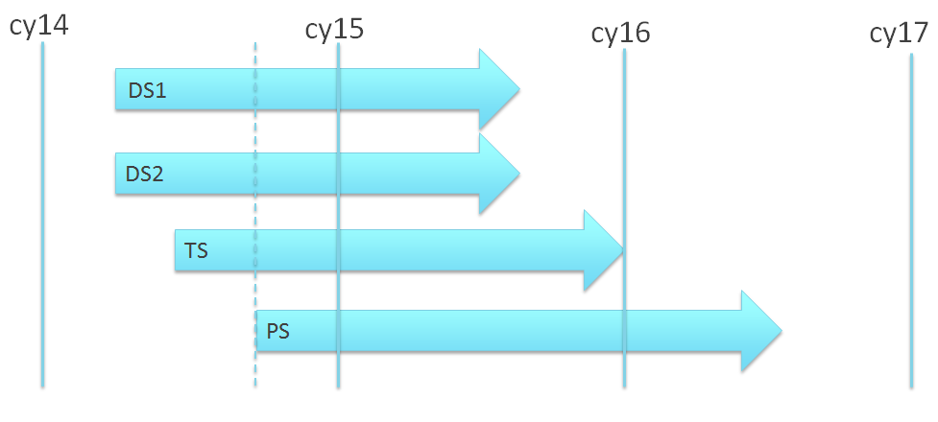
Conclusions
Detector Solenoid 1:
Superconducting Wire (Furukawa, Japan) - In progress
Rutherford Cable (Furukawa, Japan) – Not started
Pure Al-Stabilized Cable (Furukawa, Brazil) – Not started
Detector Solenoid 2:
Superconducting Wire (Hitachi, Japan) – Completed
Rutherford Cable (New England, US) – In progress
Pure Al-Stabilized Cable (Hitachi, Japan) – Not started
Transport Solenoid:
Superconducting Wire (Hitachi, Japan) – In progress
Rutherford Cable (New England, US) – Not started
Pure Al-Stabilized Cable (Hitachi, Japan) – Not started
Production Solenoid:
Superconducting Wire (Furukawa, Japan) – Not started
Rutherford Cable (Furukawa, Japan) – Not started
Ni-doped Al-Stabilized Cable (Furukawa, Brazil) – Not started
Overview of production orders
TS, DS1 and DS2 orders placed. PS order to be placed shortly.
All placed orders are moving forward on or slightly ahead of schedule.
According to present schedules, all the conductors will be ready for delivery to the magnet vendors with a generous amount of float.

