Slide 1
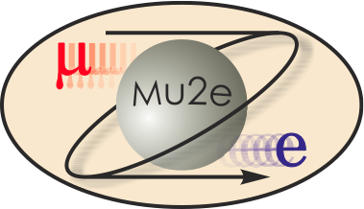
475.04.06 Magnet Power Supplies
Steven Hays
AD E/E Support Electrical Engineer
Mu2e CD-2/3b Review, October 21-24, 2014

Slide 2
Magnet Power Supply Team
Steven Hays – L3 Manager Magnet Power Supplies
  38 years at Fermilab on Main Ring, TeV, Main Injector, Proton Source, Pbar, Beam Line systems and now Muon Campus power supply systems.
  Tev Dump Switch lead designer, and TeV operation support
  Pbar pulsed power supplies
  Ramped power supplies for Main Injector
  DC supplies for Muon Campus
Engineering Group:
  Matt Kufer Electrical Designer
  Ryan Crawford AC Distribution Engineer
  5 electronic technicians

Slide 3
Requirements Magnet Systems
Mu2e Power Supply Document 1237
  Four main loops
  Four trim loops, two on each TS magnet.
  Energy Extraction on all main loops.
Parameter | Unit | PS | TSu | TSTU x2 | TSd | TSTD x2 | DS
Nominal current | A | 9200 | 1730 | 250 | 1730 | 250 | 6114
Peak field in coil | T | 5.48 | 3.4 |  | 3.4 |  | 2.2
Inductance | H | 1.58 | 4.77 |  | 3.79 |  | 1.40
Stored energy | MJ | 66.8 | 7.1 |  | 5.7 |  | 26.1

Slide 4
Requirements Energy Extraction
The TS magnet loops with two trim power supplies, one on each end.
  The main Dump Switch disconnects the power supply from the magnet.
  Two small switches will be installed on the trim power supplies to isolated them from the magnet during a Quench/Dump.
Notes:
The TSx solenoids use smaller versions of the high current dumps to disconnect the trim supplies from the magnets during a dump to protect the trims supplies from the main power supply and coil back feed.
The PS and DS solenoids run at much higher current, 6114 and 9200 amps. Each 375kW power supply can provide 7500 amps so the PS will use two supplies in parallel, the DS will use a single.

Slide 5
Design DS shown, typical of all loops.
BASIC POWER SUPPLY DESIGN
  Commercial device for the power supply.
  Output filter Commercial build to print.
  Dump switches FNAL design.
  Regulation and control FNAL design.
Notes:
Power Supply System consist of the power converter, filter choke and capacitor bank, dump switch, dump resistor, current monitoring/regulation and interface to both the quench protection and controls systems.

Slide 6
Improvements Since CD-1
Updated the requirements document to clarify and better detail the minimum requirements of the power system.
  Updated operating currents
  Removed the Trim power supply requirement from the PS coil
  Increased the number of Trim power supplies for the TSu and TSd magnets to two each.
  Improved the wording for the Power Supply Function definition.

Slide 7
Quality Assurance
The equipment being reused was part of the TeV in collider operation and maintained at a very high level so they are still valuable and usable.
We will replace components that have limited life times
Some modifications need to be done to the supplies to make them operate in two quadrant mode (+/- Voltage)

Slide 8
Risks
The risk for reusing the type of equipment is reasonable and low and not included in the risk registry.
We will be constructing new Dump Switches but they will be copies of a proven design used in the TeV.
The trim power supplies are a new design but similar to other system used in the TeV.
Magnetic coupling issues will need to be addressed during the detail design.

Slide 9
Performance
The requirements for the power supply system is required to track at 10⁻³ and regulate at 10⁻⁴, the Low Beta Quad System in the TeV operated at 10⁻⁵ .
We can only be as accurate as the current measurement we make, The use of DCCTs and temperature regulated reference allow us to regulate to these levels.
Notes:
We will be able to meet the regulation specification with little difficulty. But the new item in this system that will need to be designed to manage is the coupling between coils. This is being designed using the AD E/E Support embedded processor regulation controller, PSRAC. The TDR describes the operation of this controller. This regulator will reduce the amount of cabling between equipment. In addition the current regulator controls up to Four power supplies. This allows us to share regulation information in one controller and will use this sharing to manage the magnet coupling.

Slide 10
Remaining work before CD-3
Detailed Control Cable Drawings
Detailed building layout
Detailed design work the common controls

Slide 11
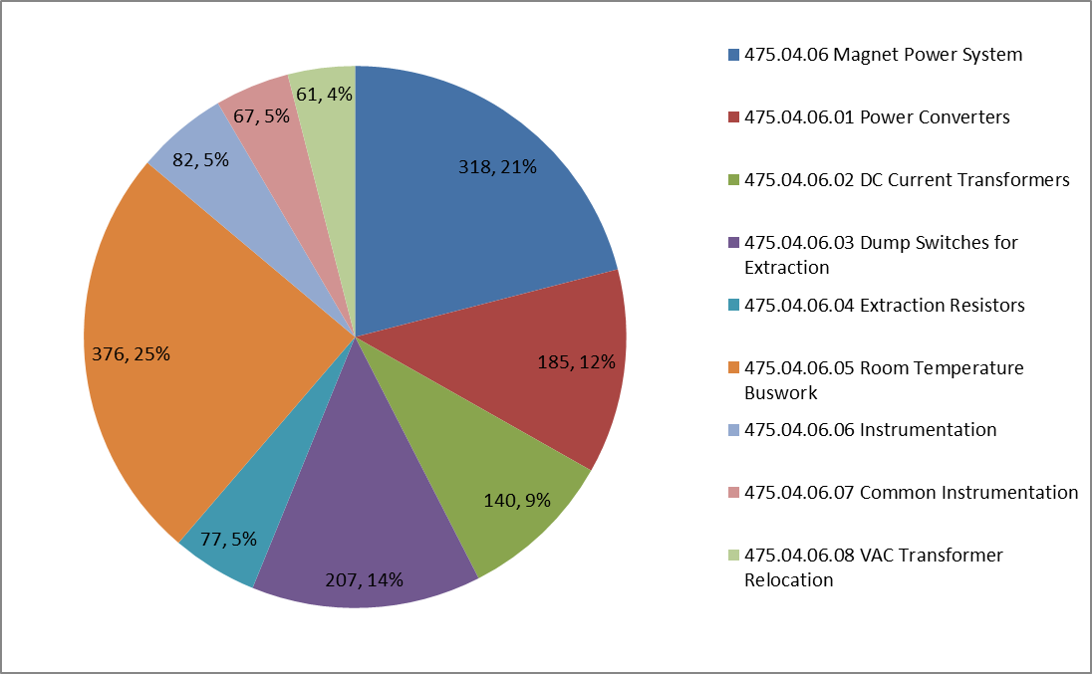
Cost Breakdown
All Design time in the first level
Installation management in each sub system
WBS Level 4 AY K$
TRIM POWER SUPPLIES
DUMP SWITCHES
DUMP RESISTORS

Slide 12
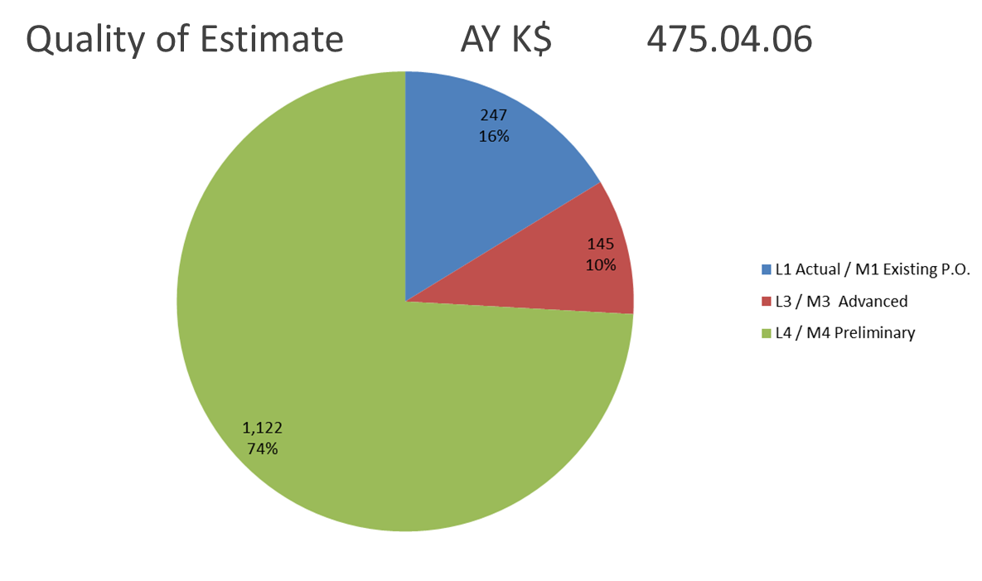
Quality of Estimate
All equipment based on existing designs and equipment on hand but need final design
Notes:
The one item that will require more design time and reviews are the trim power supplies on the

Slide 13
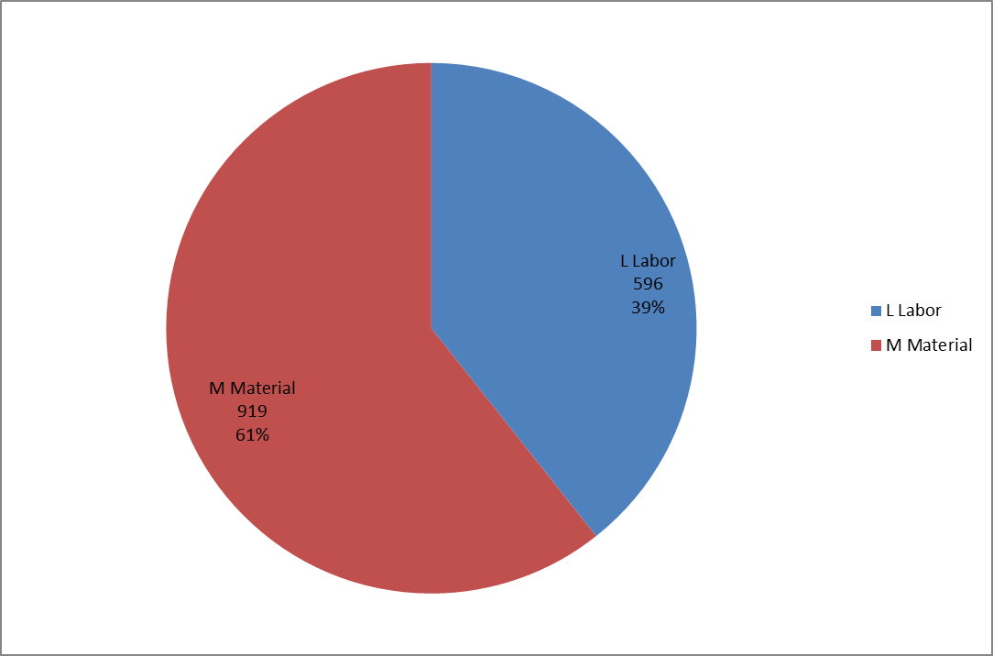
Resource Type
Material Cost driven by two large items: Copper & Dumps
Labor driven by detail design and Dump Switch Construction
Resource Type AY K$ 475.04.06

Slide 14
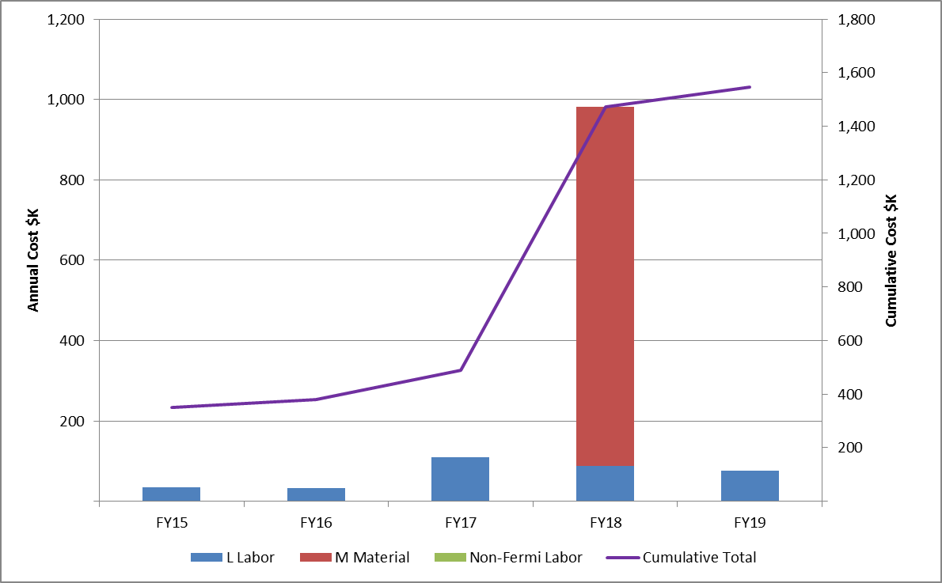
LABOR AND MATERIALS
Detailed design first followed by construction then we need a building to install equipment
Labor / Material Breakdown AY K$ Budget

Slide 15
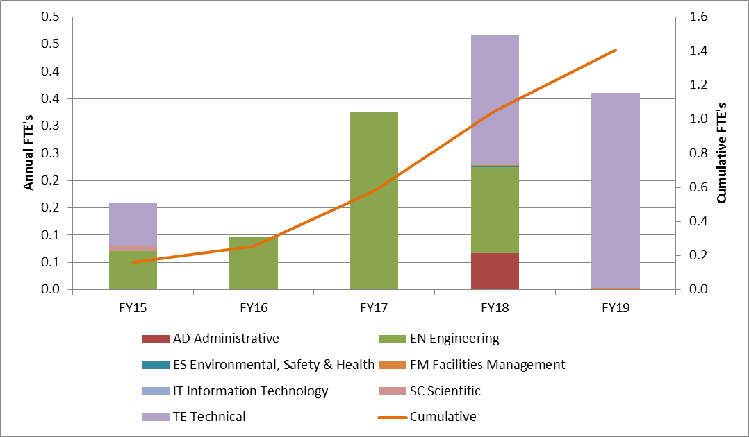
FTE's by Discipline
Detailed design to be completed then Tech will assemble and install in Service Building
FTEs by Discipline FTEs Budget

Slide 16
Cost Table
Most of the labor consumed doing detailed design because we have equipment on hand and the new construction of equipment will be based on existing designs.

Slide 17
Schedule
CD-3a
CD-3c
CD-2/3b
CD-4
Fabricate and QA Superconductor
KPPs Satisfied
Solenoid Design/Prototypes
Solenoid Fabrication and QA
Detector Hall Construction
Solenoid Infrastructure
Building Ready
Solenoid Installation and Commissioning
Power Supply Design
Materials
Power Supply Construction Installation &Testing
Final Design Procurement
Detector Prototypes and Construction
Cosmic Ray System Test
Accelerator and Beamline Construction
Accelerator Commissioning (off Project)
Q3 | Q4 | Q1 | Q2 | Q3 | Q4 | Q1 | Q2 | Q3 | Q4 | Q1 | Q2 | Q3 | Q4 | Q1 | Q2 | Q3 | Q4 | Q1 | Q2 | Q3 | Q4 | Q1 | Q2 | Q3 | Q4 | Q1 | Q2 | Q3 | Q4 | Q1 | Q2 | Q3 | Q4
FY14 FY15 FY16 FY17 FY18 FY19 FY20 FY21

Slide 18
Summary
By reusing existing power supplies most of the large dollar and long lead time items are on hand.
  We will not be able to move equipment until we have the service building constructed.
  We will need to coordinate the installation in the building with other large equipment being installed.
The major cost in both M&S and Labor will be spend on constructing new Dump Switches and Bus work.
We are ready to move forward on the final design.

Slide 19
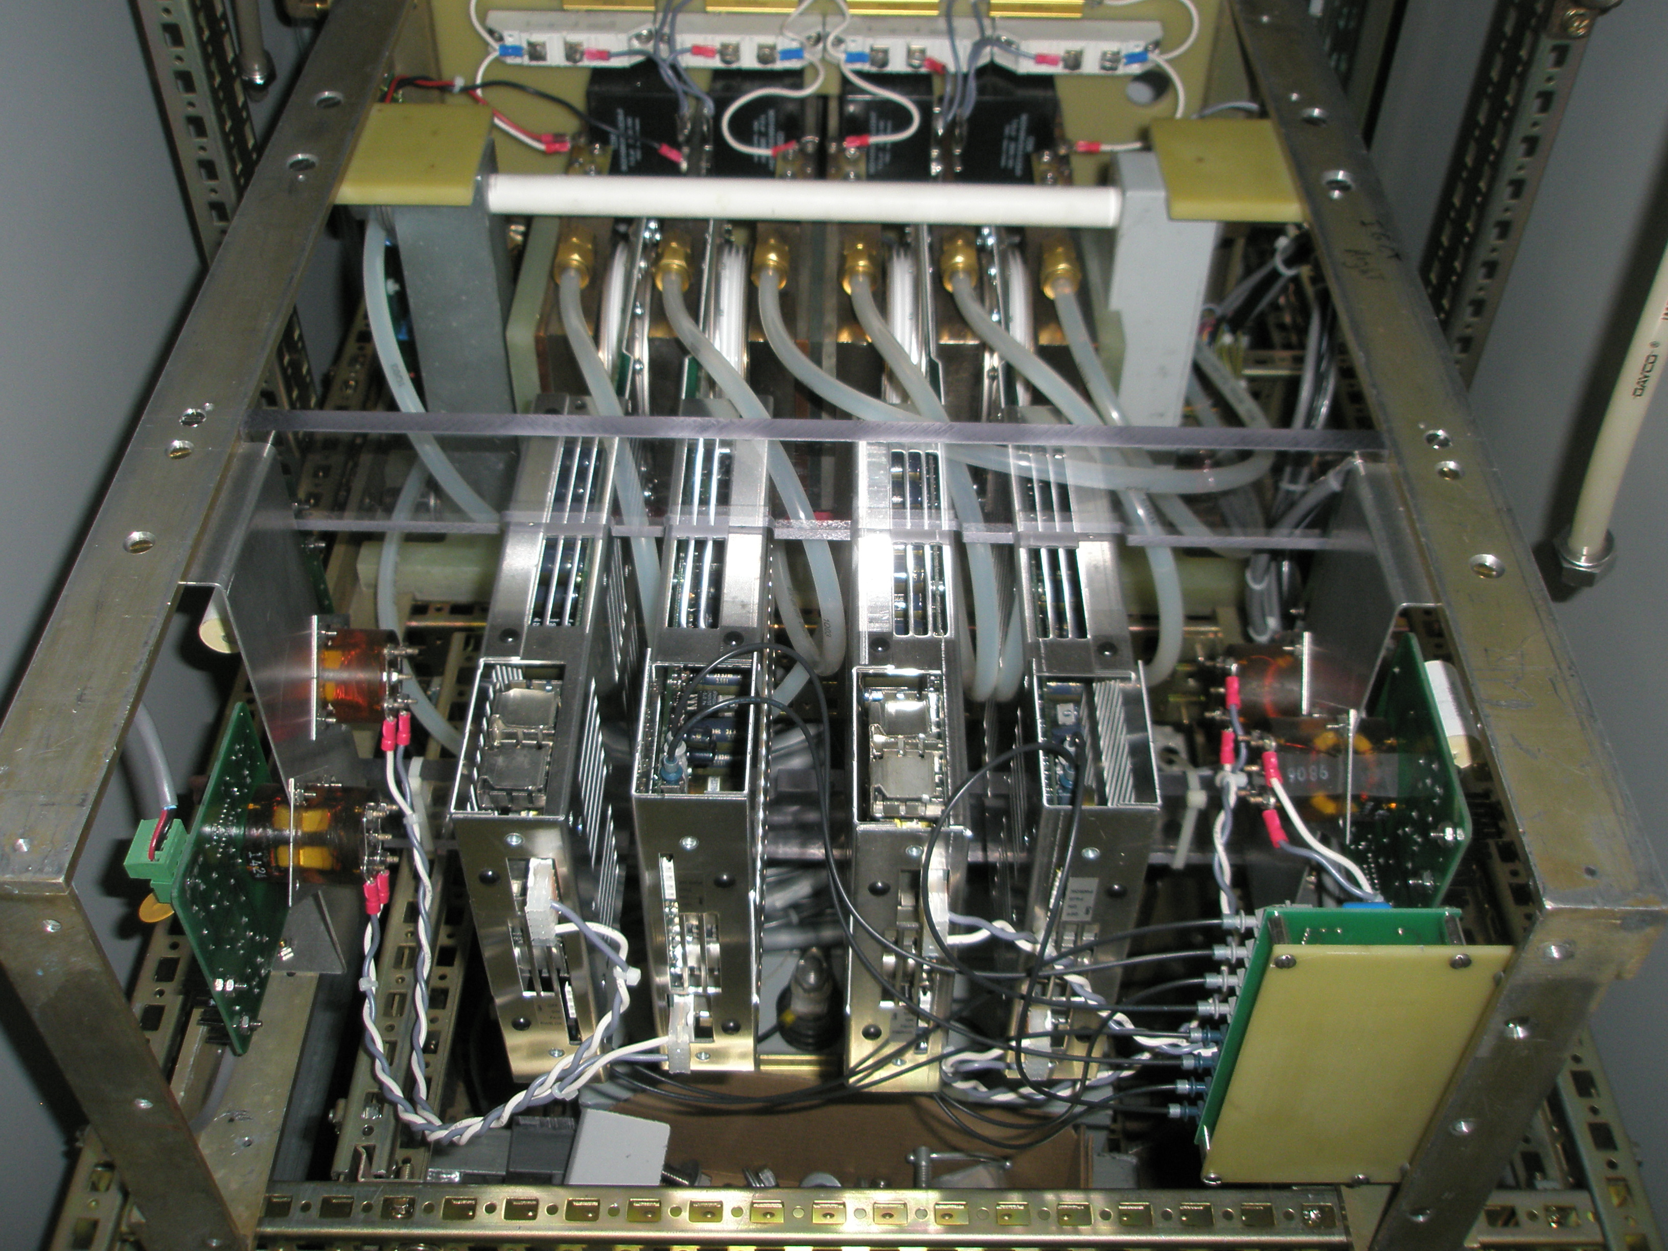
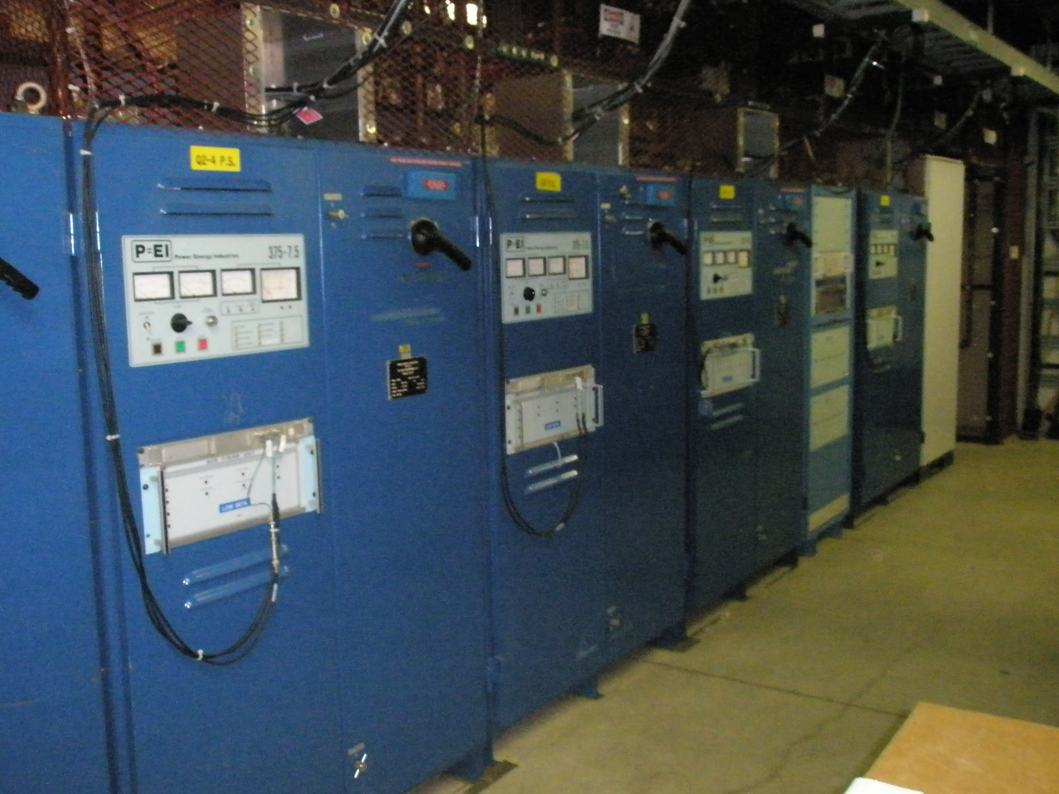
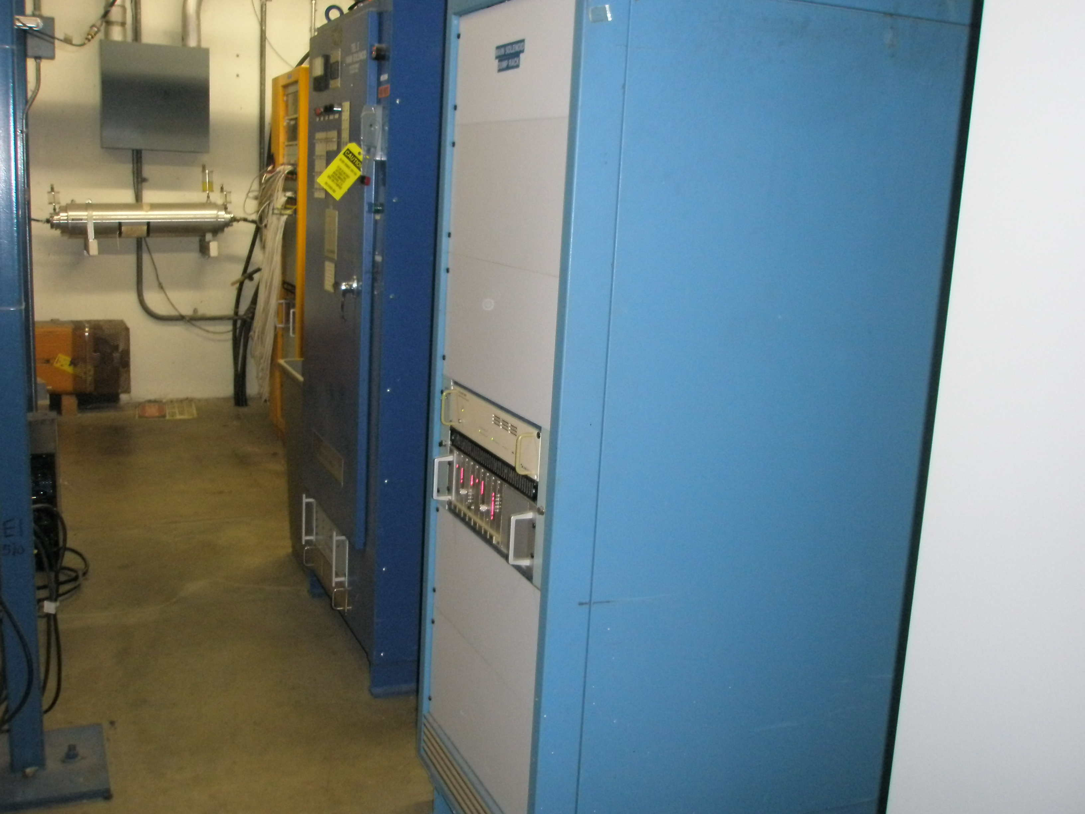
Power Supplies Components being used
375kW supplies for PS & DS
Electronic Dump Switch
50kW supply system for TSx

Slide 20
Remaining work before CD-3 extra detail
Detailed Control Cable Drawings
  Power Supply to Regulator/Controller
  Regulator/Controller to Quench Protection
  Dump Controller to Quench Protection
Detailed building layout
  Power Supply, Filter and Dump Switch floor plan
  Cable tray routing
  Bus Work routing
Detailed design work the common controls
  Water monitoring system that is common to all magnet loops.
  Independent overcurrent monitors for all loops.
  UPS system monitors.

Slide 21
Quality Assurance extra detail
The equipment being reused was part of the TeV in collider operation and maintained at a very high level so they are still valuable and usable.
  All regulation and control circuits were replaced with FNAL designs to improve the reliability early in operation.
We will replace components that have limited life times
  Electrolytic Capacitors in all control circuits
  Electrolytic Capacitors in Filter bank
  Internal low level control power supplies
Some modifications need to be done to the supplies to make them operate in two quadrant mode (+/- Voltage)
  We will install new proven design firing circuits for all the SCRs in the high current supplies to add the Bypass device.
    We will replace the existing 3 circuit boards with new four circuit boards.
High current testing will be done in AD lab before installation.

Slide 22
Risks extra detail
The risk for reusing the type of equipment is reasonable and low and not included in the risk registry.
  The Low Beta Systems operated at very close to the same level as they will in the experiment.
  The 375kW power supplies are designed to operate at 7,500 amps each and we will only use them at 6,114 for DS and 4,600 for PS (two in parallel).
  The TSx supplies will be 50kW supplies that are designed for 2,500 amp operation and will be used at 1,730 amps.
We will be constructing new Dump Switches but they will be copies of a proven design used in the TeV.
The trim power supplies are a new design but similar to other system used in the TeV. Magnetic coupling issues will need to be addressed during the detail design.

Slide 23
ES&H Extra Details
All of this equipment will require written Lock Out Tage Out “LOTO”s because we have multiple input power sources and stored energy in the magnets.
The Power Supply, Filter and Dump Racks are all separate cabinets that will require interlocking in addition to the written LOTOs.
  These LOTOs will be written by AD E/E Support and be part of the department training and qualification process.
  On large Super Conducting load we normally manage access using a registered Key system to ensure that the systems are turned Off in a controlled way. This Key system will defined by E/E support but issued by the Main Control Room in conjunction with Experiment Control Room.

