Slide 1
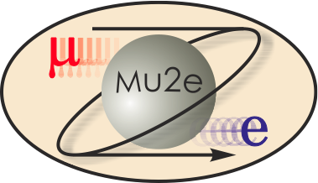
WBS 475.04.07 Quench Protection and Monitoring
Darryl Orris
L3 Manager for QPM
Mu2e CD-2/3b Review, October 21-24, 2014

Slide 2
Quench Protection Requirements
The quench protection system is responsible for the safe operation (equipment and ES&H) of the Mu2e solenoids and associated power bus system.
Monitors signals from sensors – typically voltage taps – installed on the mu2e solenoid coils, leads, and superconducting power bus and generates an interlock signal if the sensor signal exceeds a specified threshold. The interlock signal will trigger the ramp down of the power supplies and switch in the energy extraction circuit to remove stored energy from the magnet.
The primary goal of the mu2e quench protection system is to reliably detect true quenches while the secondary goal is to minimize the number of falsely detected quenches.
Quench detection is complicated by the mutual coupling between the independently powered magnets. As individual magnets are ramped, the changing magnetic fields will induce voltages in the other magnets that, if not taken into account, can cause false quench detection events.

Slide 3
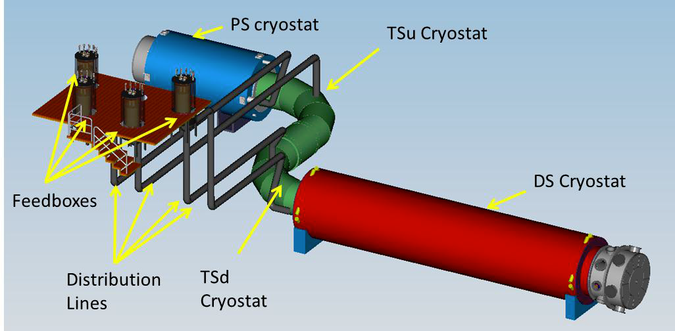
Quench Detection Requirements
The Quench Protection Scope Includes:
The PS, TSu, TSd, & DS Solenoids
All Solenoid Superconducting Leads & Trim Bus
All the Superconducting Bus Bars (Distribution lines)
All the HTS Leads (Feedboxes)
& Resistance Threshold Detection of All Copper Leads (Feedboxes)

Slide 4
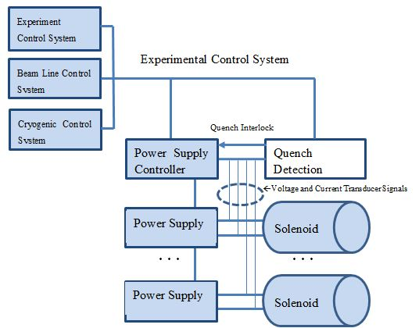
Quench Protection Requirements
The Quench Protection System will Require Redundancy and Failsafe Design with Heterogeneous Subsystems
Design for High Availability (Low Hardware Maintenance / Downtime)
Design for High Reliability (minimize false quench triggers)
System Integration: The mu2e Quench Protection System must communicate with the Solenoid Power System, Cryogenic Controls, Quench DAQ, Experimental Controls, and Beam Line Controls.

Slide 5
Quench Protection Design
Quench development in each of the mu2e solenoids has been simulated using both quench specific computer codes such QLASA and more general simulation packages such as COMSOL Multi-physics
The quench characteristics for each of the magnets are listed below:
 | Units | PS | TS | DS
Longitudinal Quench Velocity | m/s | 4.20 | 4.20 | 4.80
Radial Quench Velocity | m/s | 0.05 | 0.04 | 0.13
Axial Quench Velocity | m/s | 0.08 | 0.06 | 0.10
Response Time | s | 0.6 | 0.8 | 1
Threshold | V | 0.5 | 1 | 1
Peak Resistive Voltage | V | 112 | 16 | 170
Peak Temperature | K | 69 | 47 | 55

Slide 6
Quench Protection Design
Magnet and power supply system parameters relevant to quench detection are summarized below:
The characteristic signals expected from quenches in each of the mu2e solenoids were modeled using QLASA quench detection simulation program (written and maintained by INFN)
This was done to verify the detection sensitivity and response times required for the design of the quench detection system using the same simulation tool
Studies include quench development versus fractional Iq
Parameter | Unit | PS | TSu | DS
Operating temperature | K | <5.1 | 5.0 | 4.7
Design operating current | A | 9200 | 1730 | 6114
Peak field in coil | T | 4.96 | 3.4 | 2.15
Inductance | H | 1.58 | 4.77 | 1.4
Cold mass | tons | 10.9 | 13 | 10
Dump Resistance | Ohms | 0.059 | 0.340 | 0.050

Slide 7
Quench Protection Design
It was determined that the threshold voltages and response times are well within the capabilities of the quench detection system design:
Required threshold voltages of 0.5V-1.0V – expect sensitivity <50mV
Required response times of 0.6s-1.0s – expect response <5ms
A 1/3 coil bucking scheme is expected to be implemented
This scheme will allow quenches to be detected even if they develop symmetrically between two bucked segments
The 1/3 bucking scheme: Seg1-Seg2, Seg1-Seg3, Seg2-Seg3
Segments will be chosen to optimize inductive balance
The following is a table of bucking segments chosen for initial study:
Magnet | Segment 1 | Segment 2 | Segment 3
PS | Layers 1-2 | Layers 3-4 | Layers 5-7
TSu | Coils 1-11 | Coils 12-18 | Coils 19-25
TSd | Coils 26-33 | Coils 34-39 | Coils 40-47
DS | Coils 1-3 | Coils 4-7 | Coils 8-11

Slide 8
Quench Protection Design
The 1/3 bucking scheme will also improve bucked errors due to voltages from coupled coils
A 12x12 mutual inductance matrix (based on a 792 layer model) was generated to determine coupled voltages for the 4 magnets
The following table lists magnet ramp rates that will induce bucking errors due to coupled inductive voltages at 10% quench thresholds:
Magnet | Nominal Current | Quench Threshold | Bucked Segments | Bucked Voltage Error
 |  |  |  | (Mutual Induc. Voltages not Subtracted)
PS | 9200 | 0.5 | PS 1-2 | 0.000 | -0.003 | 0.000 | 0.000
 |  |  | PS 2-3 | 0.000 | -0.023 | 0.000 | 0.000
 |  |  | PS 3-1 | 0.000 | 0.018 | 0.000 | 0.000
TSu | 1730 | 1.0 | TSu 1-2 | 0.090 | 0.000 | -0.005 | -0.001
 |  |  | TSu 2-3 | 0.005 | 0.000 | -0.100 | -0.002
 |  |  | TSu 3-1 | -0.099 | 0.000 | 0.100 | 0.003
TSd | 1730 | 1.0 | TSd 1-2 | 0.002 | 0.080 | 0.000 | -0.005
 |  |  | TSd 2-3 | 0.001 | 0.003 | 0.000 | -0.069
 |  |  | TDs 3-1 | -0.003 | -0.100 | 0.000 | 0.099
DS | 6114 | 1.0 | DS 1-2 | 0.000 | 0.000 | 0.028 | 0.000
 |  |  | DS 2-3 | 0.000 | 0.000 | 0.006 | 0.000
 |  |  | DS 3-1 | 0.000 | -0.001 | -0.038 | 0.000
 | Solenoid Ramped |  |  | PS | TSu | TSd | DS
 | Ramp Rate (A/sec) |  |  | 1.55 | 0.37 | 0.45 | 1.25
 | Ramp Time (Minutes) |  |  | 98.92 | 77.93 | 63.93 | 81.52

Slide 9
Quench Protection Design
The quench detection system will be capable of rejecting inductive voltages from mutually coupled solenoid coils
Bucking out the voltages from coupled coils will allow the magnets to be ramped simultaneously at a much greater ramp rate
An FPGA simulator that models the operation of the four magnetically coupled solenoids and the coupled inductive voltages has been implemented in an FPGA and tested
Used to determine expected voltages from ramping magnetically coupled solenoids and can be used for QP system tests
A prototype quench detection system that rejects coupled voltages will be parasitically tested during a test of the mu2e TS prototype solenoid at the Fermilab Solenoid Test Facility (SolTF)
System identification used to measure coupling coefficients

Slide 10
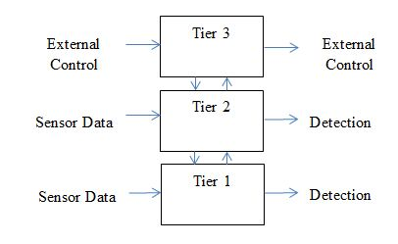
Quench Protection Design
Quench Detection System Architecture –
Redundancy ensures that quenches will be detected even in the event of single point failures and that any single point failure can be detected and corrected when they occur. The use of heterogeneous components minimizes the likelihood that undetected design errors will be duplicated in the redundant channels.
To ensure reliable detection of true quenches while remaining immune to false quenches, the mu2e quench detection system is organized into three heterogeneous redundant tiers shown below:

Slide 11
Quench Protection Design
The quench protection system is modeled after existing systems designed and built in the Technical Division for testing superconducting magnets:
The Vertical Magnet Test Facility (VMTF) with its 30kA DC power system uses a Digital Quench Detection system (primary) running on a real-time operating system and an Analog Quench Detection (AQD) system (secondary) for redundancy
In service since 1997
Tested LHC short magnets, High Field R&D magnets, LARP short magnets, etc.
Most recently, the new Fermilab Solenoid Test Facility (SolTF) uses a National Instruments C-RIO based Quench Detection System with FPGA / Real-Time for Digital Quench Detection and Analog Quench Detection (AQD) for redundancy
The Test Stand was commissioned in 2013
Testing of the MICE Coupling Coil Solenoid (L=596H) was successfully completed in May, 2014
HTS power leads have been extensively tested to 10.15kA in TD using a similar FPGA / AQD based quench detection system

Slide 12
QP Improvements Since CD-1
Incremental changes have been made to the QD architecture for greater reliability and sensitivity of quench detection
Improvements have be made to the coil bucking design including subtraction of mutual inductive voltages
Developed an FPGA based quench simulator that will be used for quench detection modeling and validation tests of the completed QD system
Slow logging of the magnet instrumentation will be controlled by an independent PLC, which will be integrated/interfaced with the cryogenic and experiment’s DAQ and controls

Slide 13
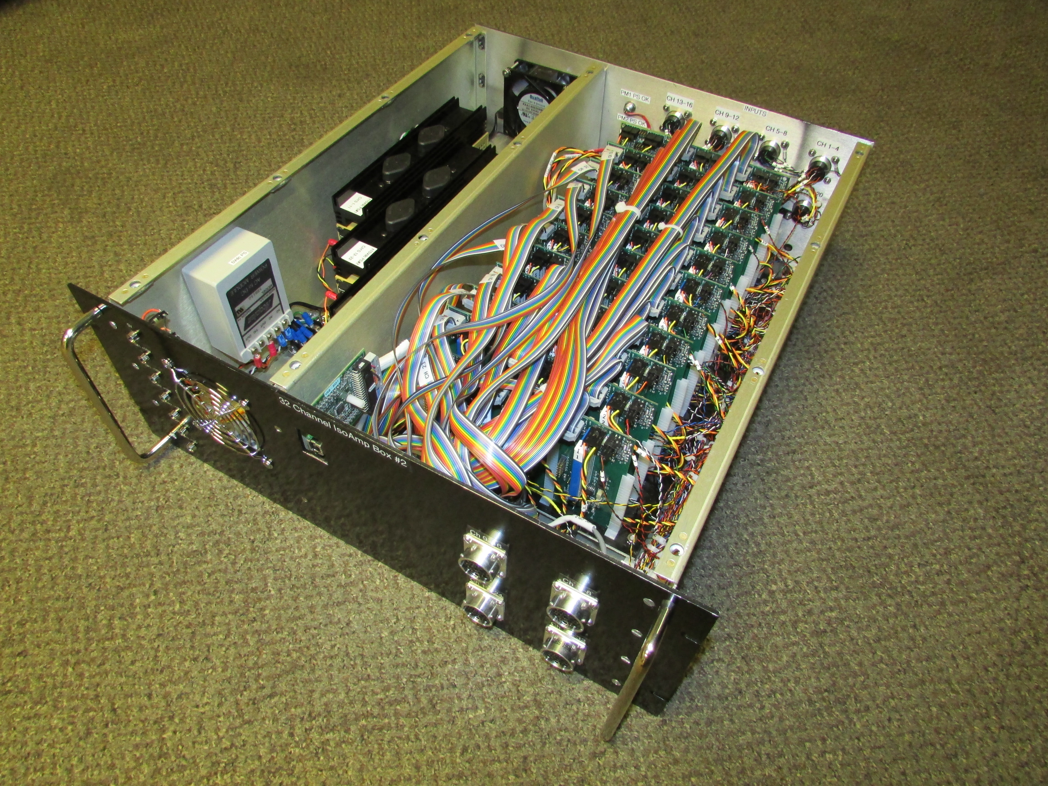
QP Value Engineering since CD-1
The quench protection system will be based on designs similar to proven systems currently used in the TD Magnet Test Facility – improve on existing designs
Less expected risk of design issues that could cost more effort
The quench protection system will be based mostly on commercial hardware with long term support
The exception are in-house built isolation amplifiers but the current design is mature and has been in service for several years
32 Channel Isolation Amplifier Box: Uses USB and Serial Peripheral Interface (SPI) Bus

Slide 14
QP Performance
The threshold voltages and response times are well within the capabilities of the quench protection system design
The quench protection system design incorporates redundancy by:
Instrumenting redundant quench sensors and wires from each device (magnet, bus, and leads)
Redundant isolation amplifiers and quench detectors
The quench detector performance will be validated using a real-time simulator
A simulator that models the operation of the four magnetically coupled magnets and the coupled inductive voltages has been implemented in an FPGA and tested
When a quench is detected, all magnets will be de-energized

Slide 15
QP Remaining work before CD-3
A prototype quench detection system will be assembled and tested parasitically on the prototype TS solenoid test at SolTF
The detailed engineering design will be completed following the test of the prototype system

Slide 16
QP Quality Assurance
Multiple mechanisms to ensure quality of design and implementation
Peer review
Independent coding of redundant systems
Extensive validation using real-time simulator
Validation against existing QP systems during multiple mu2e prototype and production magnet tests
Formal testing to relevant accepted standards
Comprehensive validation against offline system models during commissioning of the final product
Development team has extensive experience designing and developing quench protection systems, which have been in service for many years

Slide 17
QP ES&H
The final product will have solenoid voltage tap cabling that carries voltages up to 600V (when the dump is fired). These cables are terminated in a relay rack to the inputs of isolation amplifiers. Since these cables may be accessible to personnel during powered operation, steps will be taken to prevent accidental exposure in accordance with the Fermilab Electrical Safety Program (FESHM 5040).
Instrumentation rack power will also follow the Fermilab Electrical Safety Program (FESHM 5040).

Slide 18
QPM Organizational Breakdown
WBS 4.7
Quench Protection & Monitoring
D. Orris
J. Nogiec (D)
WBS 4.7.1
Quench Protection
WBS 4.7.2
Slow Monitoring
WBS 4.7.3
Cryogenic Instru. & Controls

Slide 19
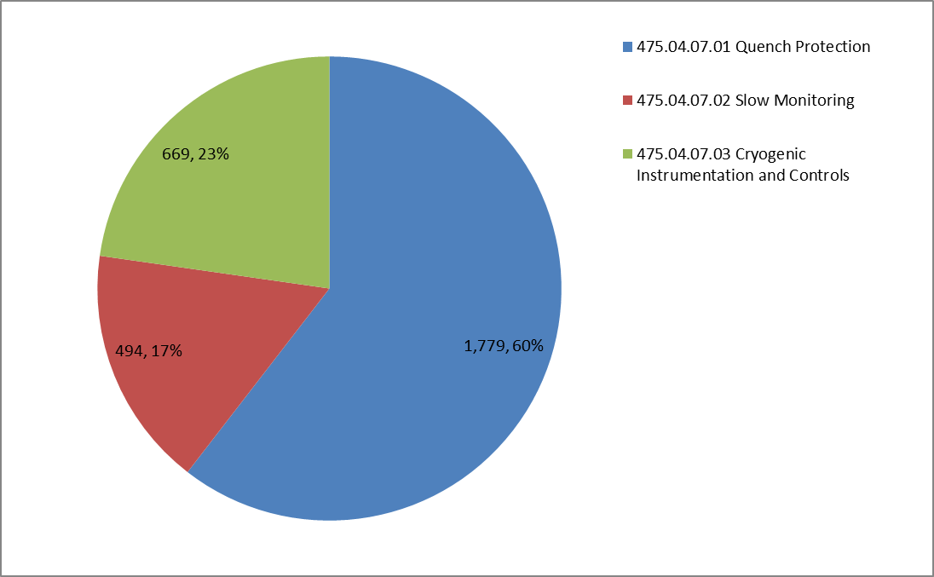
QPM Cost Distribution by L4
Base Cost by L4 (AY $k)

Slide 20
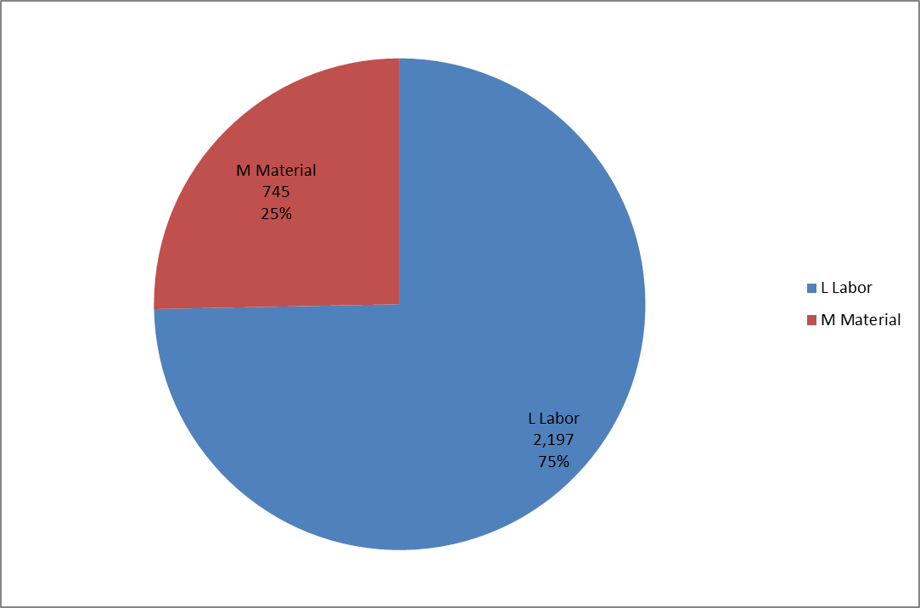
QPM Cost Distribution by Resource Type
Base Cost (AY$k)

Slide 21
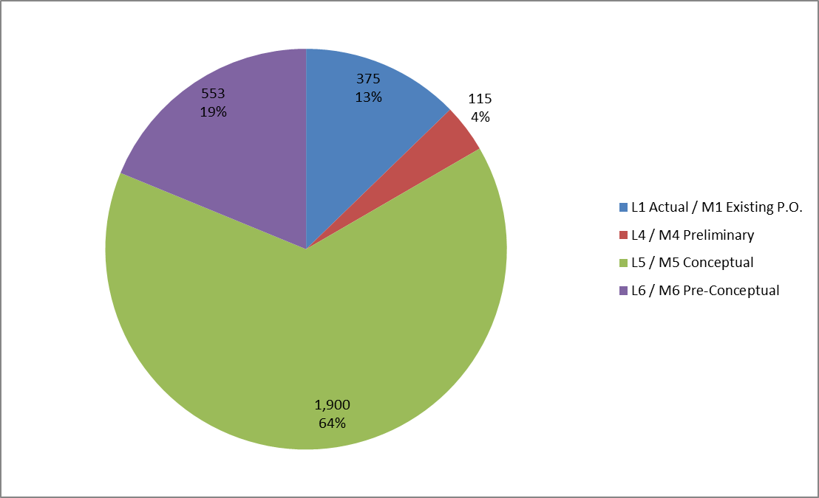
QPM Quality of Estimate
Base Cost by Estimate Type (AY K$)

Slide 22
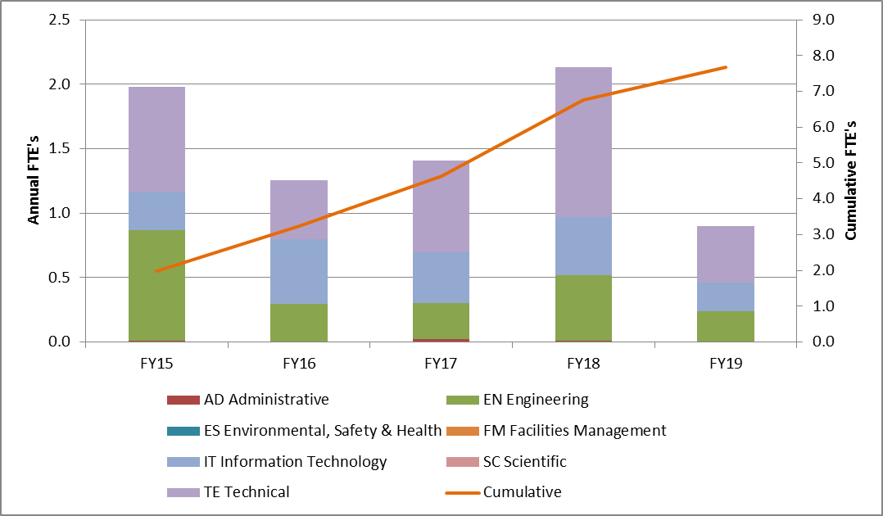
QPM Labor Resources by FY
FTEs by Discipline

Slide 23
QPM Cost Table
WBS 4.7 Quench Protection & Monitoring (AY K$)
 | Base Cost (AY K$)
 | M&S | Labor | Total | Estimate Uncertainty (on remaining budget) | % Contingency on (on remaining budget) | Total Cost
475.04.07 Magnet Quench Protection System
475.04.07.01 Quench Protection | 215 | 1,564 | 1,779 | 609 | 41% | 2,388
475.04.07.02 Slow Monitoring | 246 | 248 | 494 | 174 | 36% | 668
475.04.07.03 Cryogenic Instrumentation and Controls | 284 | 385 | 669 | 208 | 37% | 877
Grand Total | 745 | 2,197 | 2,942 | 991 | 39% | 3,933

Slide 24
Major Milestones
Complete the Detailed Engineering & Software design for Quench Detection – 04/07/2016
Perform Preliminary Quench Protection Integration Tests – 12/26/2018
Completion of slow monitoring detailed engineering design – 4/1/2015
Completion of preliminary slow monitoring integration tests – 9/18/2018
Completion of cryo controls detailed engineering design – 4/3/2015
Completion of preliminary cryo controls integration tests – 12/19/2018

Slide 25
Schedule
CD-3a
CD-3c
CD-2/3b
CD-4
Quench Protection (QP) Design
& Prototype Tests
Procure Components, Fabricate, Assemble, Program, Test, and Document the QP System
QP Installation and Commissioning
KPPs Satisfied
Procure Components, Fabricate, Assemble, Program, Test, and Document the SM System
SM Installation and Commissioning
Slow Monitoring (SM) Design
& Prototype Tests
Cryogenic Instr. & Controls (CIC) Design & Prototype Tests
Procure Components, Fabricate, Assemble, Program, Test, and Document the CIC System
CIC Installation and Commissioning
Solenoid Fabrication and QA
Detector Hall Construction
Solenoid Infrastructure
Fabricate and QA Superconductor
Solenoid Installation and Commissioning
Solenoid Design/Prototypes
Cosmic Ray System Test
Detector Prototypes and Construction
Accelerator and Beamline Construction
Accelerator Commissioning (off Project)
Q3 | Q4 | Q1 | Q2 | Q3 | Q4 | Q1 | Q2 | Q3 | Q4 | Q1 | Q2 | Q3 | Q4 | Q1 | Q2 | Q3 | Q4 | Q1 | Q2 | Q3 | Q4 | Q1 | Q2 | Q3 | Q4 | Q1 | Q2 | Q3 | Q4 | Q1 | Q2 | Q3 | Q4
FY14 FY15 FY16 FY17 FY18 FY19 FY20 FY21

Slide 26
Summary
The magnet quench protection requirements are well within the capabilities of the quench detection system
QP based on heterogeneous design architecture with redundancy
Bucking 1/3 magnet coil sections will improve quench detection reliability.
Subtracting coupled coil voltages will minimize bucked errors, allowing the magnets to be ramped much faster.
The quench protection system is largely based on commercial hardware. The design is similar to the heterogeneous combination of digital and analog quench detection systems used for the superconducting magnet test stands in TD
A preliminary design of a quench detection system that can reliably detect mu2e solenoid quenches is well understood. The QPS is ready for the next phase of design.

