Slide 1
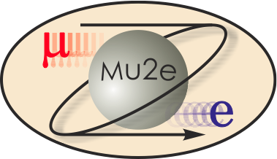
Mu2e CD-2/3b Review 8.8 CRV Assembly & Installation
James Fagan
CRV Detector Assembly & Installation L3 Manager
10/21/2014

Slide 2
CRV Detector Assembly & Installation
James Fagan L3 Manager since 10/2013
‒ Operations Specialist Sr – Fermilab – 30 yrs.
‒ Associate Department Head – DD&OD
‒ NOvA L3 manager for PVC Extrusion Production
‒ ANL - 10 yrs.
‒ B.S. Industrial Technology

Slide 3
Organization
WBS 475.8 Cosmic Ray Veto
Craig Dukes / Virginia
Julie Whitmore / Fermilab (Deputy)
475.8.1 Project Management
Craig Dukes / Virginia
CAM: Dukes
475.8.5 Photodetectors
Julie Whitmore / Fermilab
CAM: Whitmore
475.8.2 Mechanical Design
Craig Dukes / Virginia
CAM: Dukes
475.8.6 Electronics
Sten Hansen / Fermilab
CAM: Dukes → Whitmore
475.8.3 Scintillator Extrusions
Anna Pla-Dalmau / Fermilab
CAM: Pla-Dalmau
475.8.7 Module Fabrication
Craig Group / Fermilab & Virginia
CAM: Group
475.8.4 Fibers
Yuri Oksuzian / Virginia
CAM: Dukes
475.8.8 Detector Assembly & Installation
Jim Fagan / Fermilab
CAM: Dukes

Slide 4
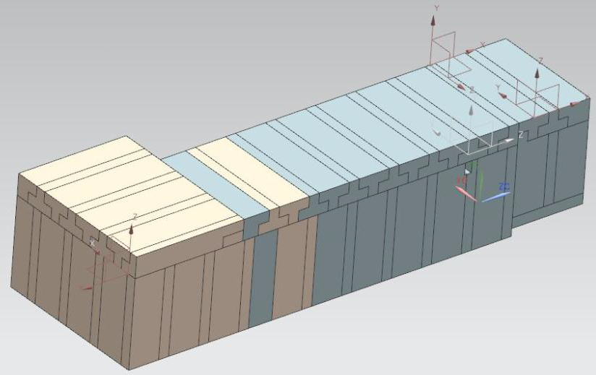
Requirements
Staging area at FNAL - 4k ft²– 5k ft² with crane access for several years
Storage area at FNAL – 500 ft² for indefinite time – module storage
Modules & supports should facilitate opening the neutron shielding
Shielding with movable end-cap.

Slide 5
Requirements
Access to CRV electronics
Shield blocks
Surfaces must be flat and allow anchor attachments
Dead spots no larger than 8 X 15 in²
No penetrations on the top
Positioning tolerance should be no greater than ±1 inch
The gap between counters of the same layer must be ≤ 5 mm
Module position tolerance must be ±5 mm
Side clearance on CRV-R and CRV-L must be at least 36 inches

Slide 6
Requirements
Overhead crane
Must have fine positioning in 3 dimensions
The block must be sized to allow side module positioning
The vertical reach must accommodate rotating side modules
Must have the capacity to lift 7,500 lbs.
• Interior space to off-load modules & rotate vertical
• End-cap moving should allow reposition of modules to ±4 mm
• Module mounting must allow modules on or near the end-cap to be moved to prevent possible damage.

Slide 7
CRV Detector Assembly & Installation
Test Installation - 475.8.8.1 – Pre CD-3 Task
Receive two prototype side modules from module factory
Construct neutron shield mockup
Install module supports
Use lifting jig to install prototypes testing hardware and procedures
Receive Production Modules at Fermilab – 475.8.8.2
‒ Receive modules
‒ Inspect and test
‒ Return to crate for storage
• Cosmic Ray Test Stand – 475.8.8.3
‒ Transport a few modules to Mu2e facility
‒ Setup and operate to test the tracker and calorimeter integration to DAQ – (Threshold Key Performance Parameter(KPP))
‒ Disassemble cosmic ray test stand

Slide 8
CRV Detector Assembly & Installation
Module Support Structure – 475.8.8.4
Design of components is found in 475.08.02
Engineering Review
Fabricate module supports
• Detector Installation and Testing – 475.8.8.5 (Off project)
‒ Install module supports
‒ Install modules
‒ Obtain operational readiness certificate
‒ Commission Cosmic Ray Veto

Slide 9
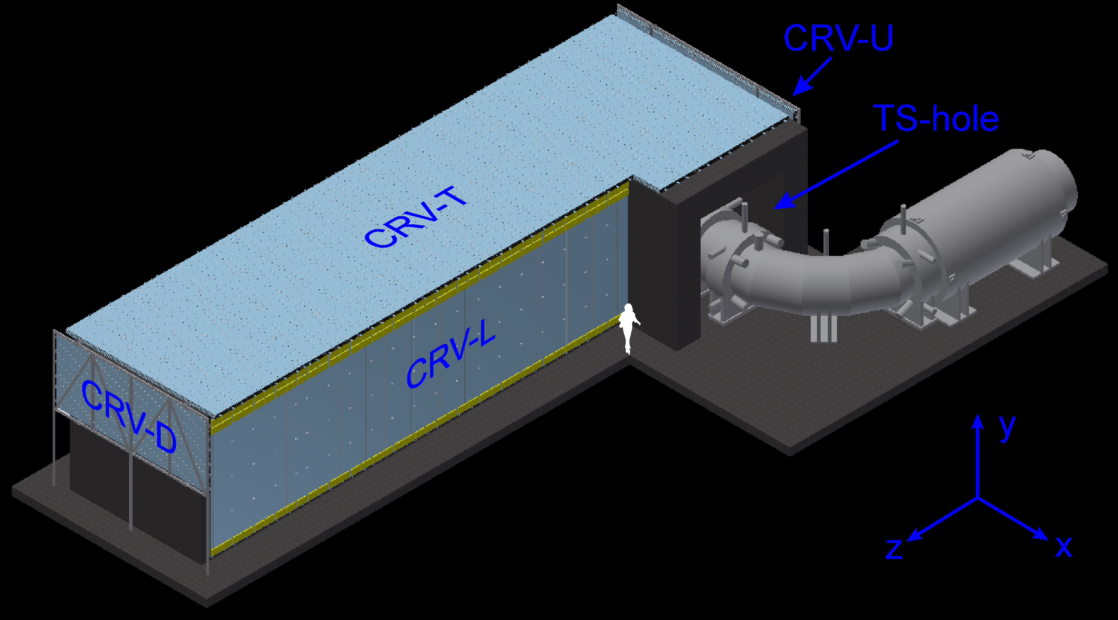
Design
The cosmic ray veto covering the detector solenoid looking upstream, showing the downstream (CRV-D), left (CRV-L), top (CRV-T) sectors, as well as the hole where the transport solenoid enters the enclosure.

Slide 10
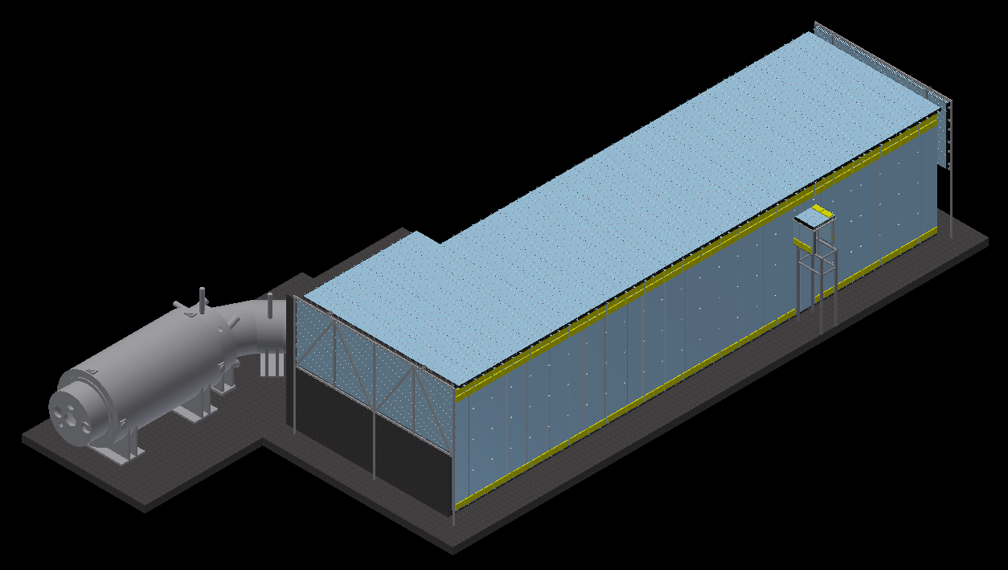
Design
The cosmic ray veto covering the detector solenoid looking downstream, showing the upstream (CRV-U), right (CRV-R), and top (CRV-T) sectors.

Slide 11
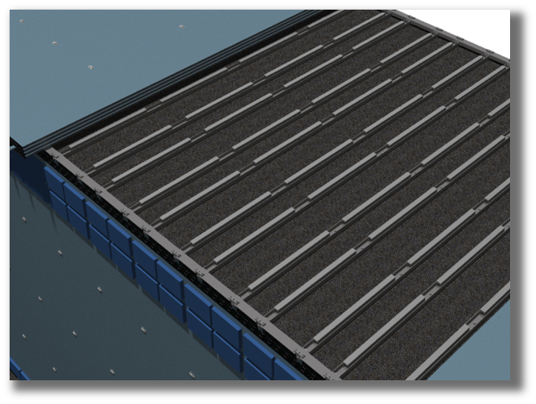
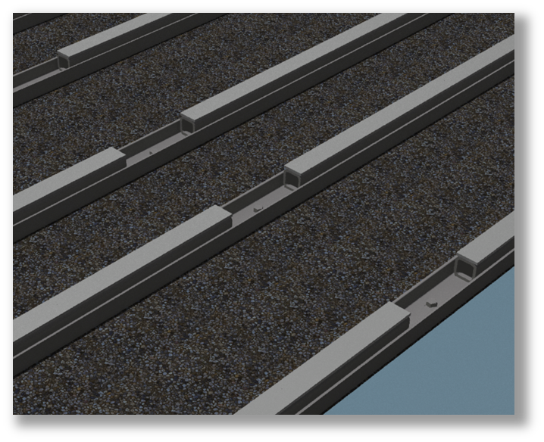
Design: Top Support Structure
Strips of Teflon will be attached to the tops of the 2 inch square tubing using counter-sunk bolts. This will allow the top modules to slide into position without risking damage to the scintillator.

Slide 12
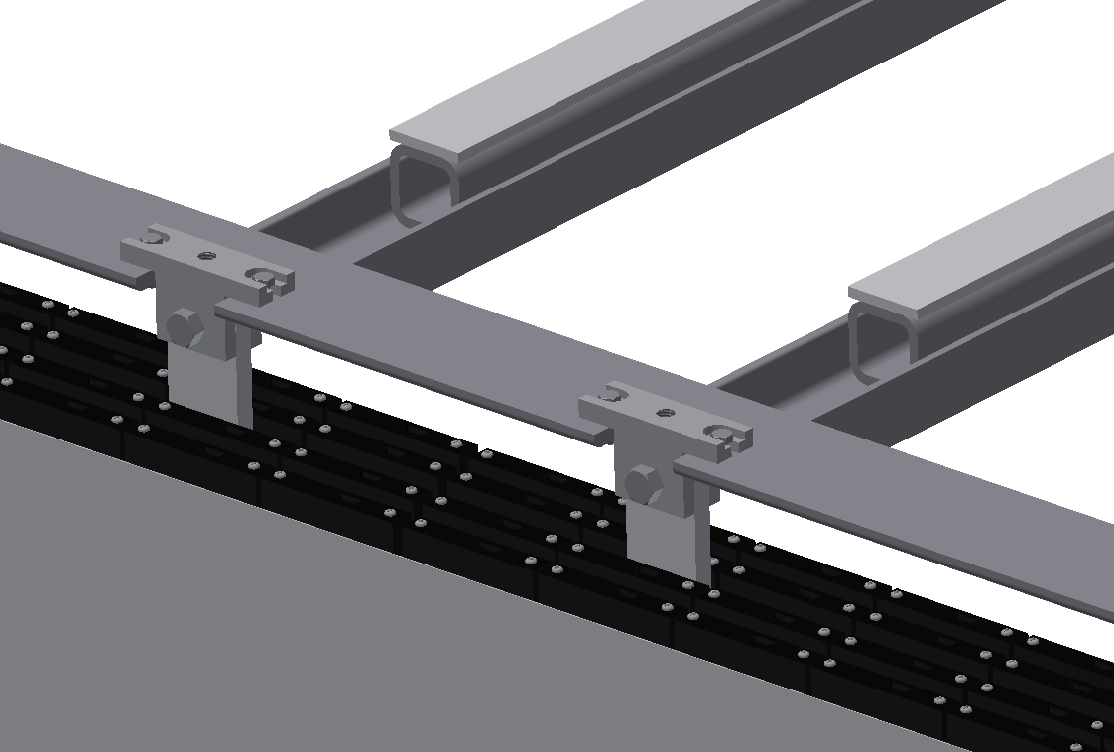
Design: Side Support Structure
Module support structure – top and side

Slide 13
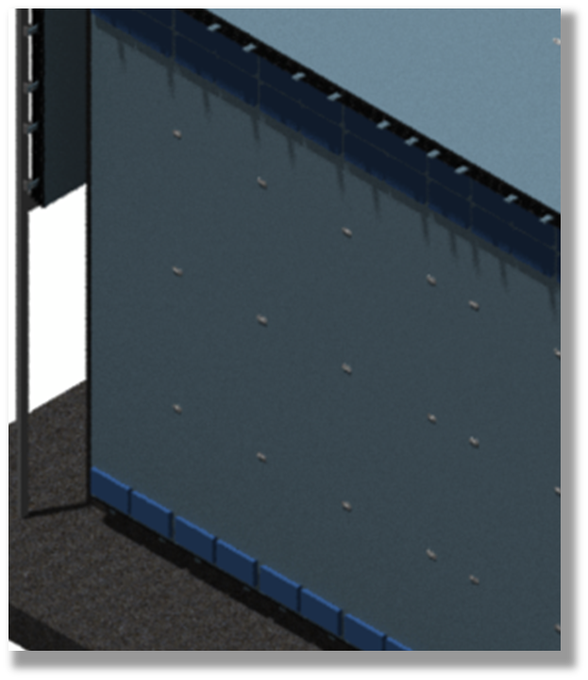
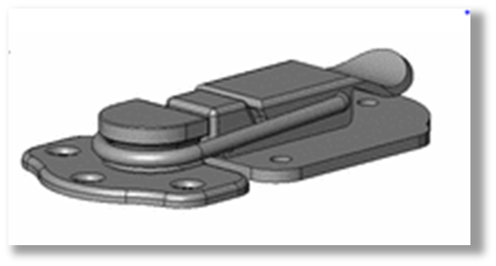
Design: Side Support Structure
We plan to ensure that the modules are flush and in the correct position by using latches attached to their sides using epoxy.

Slide 14
Design: CRV-U and CRV-D
Strong-back supports the modules in the CRV-U and -D sectors
Modules loaded onto the strong-back upstairs and lowered by crane into positions

Slide 15
Installation: Tipping Procedure
Crane or hydraulic rotating device is used to rotate the entire assembly to the vertical position
Module is moved onto tipper using vacuum lift and fastened to it using bolts into the tops of the hangers
The module/tipper assembly can now be lowered into the detector hall using the crane
Bolts fasten module to tipper
Module
Tipper

Slide 16
Installation: Lifting Jig
Front and back views of module lifting jig

Slide 17
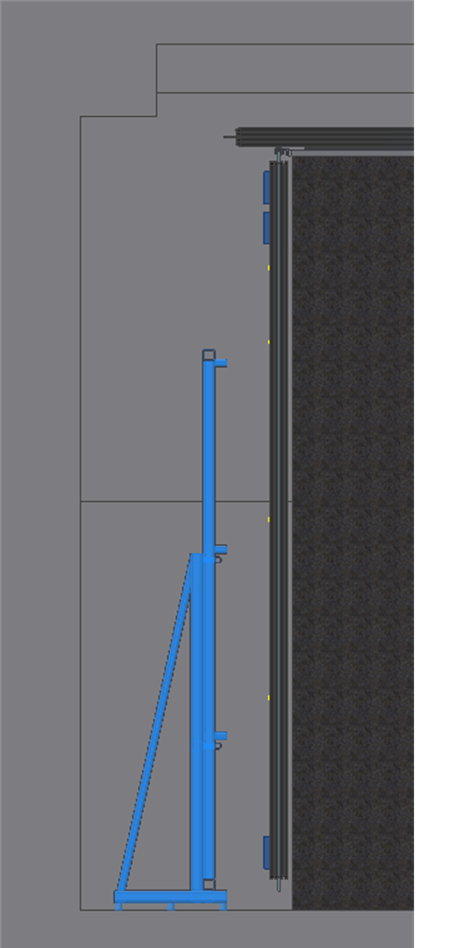
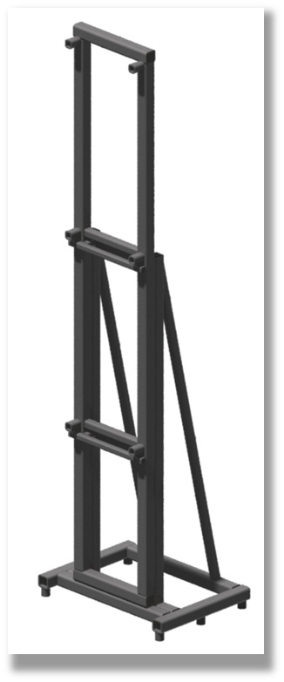
Installation: Lifting Jig
The installer will be made from standard lengths of different sized square tubing, welded together to form a kind of forklift whose size would be small enough to maneuver within the confined spaces of the building. It would need to fit between the wall and the neutron shielding as well as under the cryo tube assembly.

Slide 18
Installation: Side Module Mount. Procedure
Attach hangers to a module and then bolt the module to the module tipper
Rotate the entire assembly 90 degrees using the crane and maneuver it into the correct position to be lowered onto the installer.
Lower the module tipper assembly onto the installer, and ensure that they have interfaced correctly before detaching the crane.
Using the installer, maneuver the module so that it can be lowered onto the support structure. The installer will be equipped with a jack, allowing it to raise and lower the module, and will move laterally using either tracks or rollers.
Lower the module onto the support structure and detach it from the module tipper.
Using the installer jack, lift the module tipper up and away from the module.
Using bolts, secure the module to the support structure.
Using the crane, lift the module tipper up and away from the installer, returning it to the correct position to have another module attached to it.

Slide 19
Quality Assurance
Quality Assurance Program for the Mu2e Project Doc 677
Design reviews
Written & approved procedures
Worker qualifications & training
Inspection & testing
Test installation

Slide 20
ES&H Issues
Worker Training
Standard FNAL rigging procedures
Crane & fork truck
Working at heights – fall protection
• JHA & Written Procedures
‒ Rigging modules
‒ Vacuum lifter
• ES&H Reviews

Slide 21
Integration and Interfaces
CRV interfaces to the neutron shielding and movable end-cap
Participation in bi-weekly integration meetings
Formal sign-off between owners of all external interfaces as part of final design requirements
Interfaces understood and under control
Reference DocDB 1551

Slide 22
8.8 Detector Assembly & Installation
 | Base Cost (AY K$)
 | M&S | Labor | Total | Uncertainty (on remaining budget) | % Contingency (on remaining budget) | Total Cost
475.08.08.01 Test installation |  | 21 | 21 | 7 | 35% | 28
475.08.08.02 Receive Production Modules at FNAL |  | 18 | 18 | 6 | 35% | 24
475.08.08.03 Cosmic Ray Test Stand | 4 | 32 | 36 | 11 | 80% | 47
475.08.08.04 Module Support Structure | 123 | 10 | 133 | 40 | 30% | 173
Grand Total Detector Assembly & Installation | 127 | 81 | 208 | 64 | 35% | 273

Slide 23
WBS Breakdown Base cost in AY K$

Slide 24
Resource Type Base cost in AY K$

Slide 25
Quality of Estimate Base cost in AY K$

Slide 26
Labor/Material Breakdown
M&S estimates are based on Quotes Labor estimates are based on extensive previous experience

Slide 27
FTE’s by Discipline AY K$

Slide 28
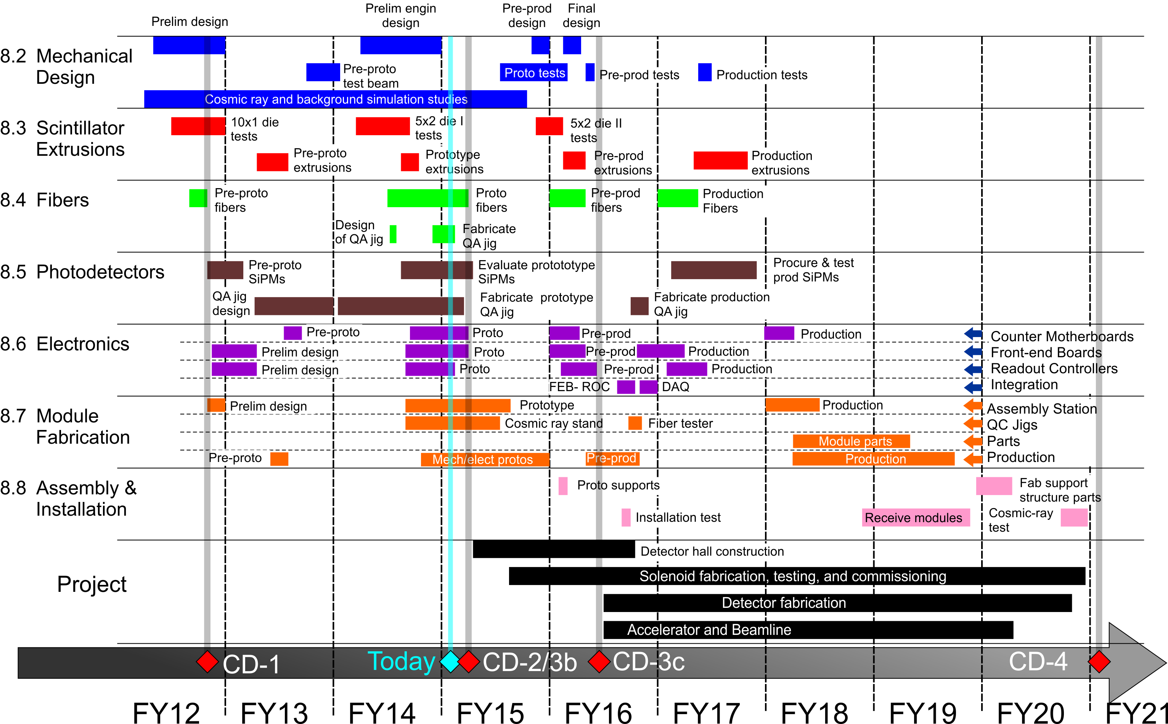
Schedule

Slide 29
Milestones
Side module test installation complete - 3/16/16
10% Production modules received at Fermilab - 11/5/18
Production modules received at Fermilab - 8/29/19, 10/29/19, 12/2/19, 3/2/20
Module support structure components fabricated - 12/26/19

Slide 30
Remaining work before CD-3
What needs to be completed before design is complete?
Test Installation - 475.8.8.1
Receive two prototype side modules from module factory
Construct neutron shield mockup
Install module supports
Use lifting jig to install prototypes testing hardware and procedures
Complete engineering design - 475.08.02

Slide 31
Summary
Installation Plan Factorized
Module support (on project)
Detector Installation and Testing (off project)
We have a design that fully satisfies the requirements
Installation Requirements are well understood and achievable
Installation plan, cost, and schedule are well understood
All interfaces are identified and defined

