Slide 1
Mu2e Cosmic Ray Veto: 8.7: CRV Module Fabrication
Craig Group
L3 Manager and CAM for CRV Fabrication
10/21/2014

Slide 2
CRV Fabrication Team
Craig Group – CAM and L3 Manager
Joint UVA faculty and Fermilab scientist position.
Ph.D. in 2006 – U. Florida on CDF
Also on NOvA experiment
Involved in CRV R&D since 2009
Richard Bomgardner– Lead Technician
B.S. Physics
Several years experience as each: electrician, scientist, and machinist.

Slide 3
Outline
Organizational Breakdown
Overview of Module Production Factory
Quality Assurance
ES&H
Schedule and Remaining Work Before CD3
Cost Table
Cost Breakdown
Quality of Estimate
Labor Resources by Fiscal Year
Schedule

Slide 4
Organization
WBS 475.8 Cosmic Ray Veto
Craig Dukes / Virginia
Julie Whitmore / Fermilab (Deputy)
475.8.1 Project Management
Craig Dukes / Virginia
CAM: Dukes
475.8.5 Photodetectors
Julie Whitmore / Fermilab
CAM: Whitmore
475.8.2 Mechanical Design
Craig Dukes / Virginia
CAM: Dukes
475.8.6 Electronics
Sten Hansen / Fermilab
CAM: Dukes → Whitmore
475.8.3 Scintillator Extrusions
Anna Pla-Dalmau / Fermilab
CAM: Pla-Dalmau
475.8.7 Module Fabrication
Craig Group / Fermilab & Virginia
CAM: Group
475.8.4 Fibers
Yuri Oksuzian / Virginia
CAM: Dukes
475.8.8 Detector Assembly & Installation
Jim Fagan / Fermilab
CAM: Dukes

Slide 5
Organizational Breakdown
WBS 8.7
CRV Fabrication
Craig Group
8.7.1
Design and
Fabricate
Assembly
station
8.7.2
Assembly Station
Quality Assurance
Design and
Fabrication
8.7.3
Fabrication of
Module
Parts
8.7.4
Module
Production ,
Testing, and
shipping
8.7.5
Breakdown of
Module
Factory

Slide 6
WBS Dictionary for 8.7
475.08.07.01 Design and Fabricate Assembly Station: This set of activities cover the design and fabrication of the equipment needed to fabricate the counters and modules.
475.08.07.02 Assembly Station Quality Assurance Design and Fabrication: This set of activities cover the design and fabrication of the quality assurance jigs needed to test the counters and modules during and after assembly.
475.08.07.03 Fabrication of Module Parts: This task covers the fabrication of the all the parts needed for the assembly of the counters and the modules, save the extrusions, fibers, photodetectors, and electronics.
475.08.07.04 Module Production, Testing, and Shipping: This task covers all aspects of the counter and module assembly, testing, and shipping. It includes non-working mechanical prototype modules, pre-production modules, and production modules.
475.08.07.05 Breakdown of Module Factory: This task covers the decommissioning of the module fabrication factory.

Slide 7
CRV Fabrication Overview
Fabrication: assemble scintillator extrusions, wavelength-shifting fibers, and photodetectors into working modules.
QA at each assembly step – large component of labor effort.
82 modules of 7 different sizes, as well as 9 spare modules.
Scintillator lengths range from 0.9 m for the cyro modules to 6.6 m for the extra-long modules.
Module widths for 16 (8) counters for normal (narrow) width modules is ~80 cm (40 cm).
The “extra long” modules weigh about 2000 lbs

Slide 8
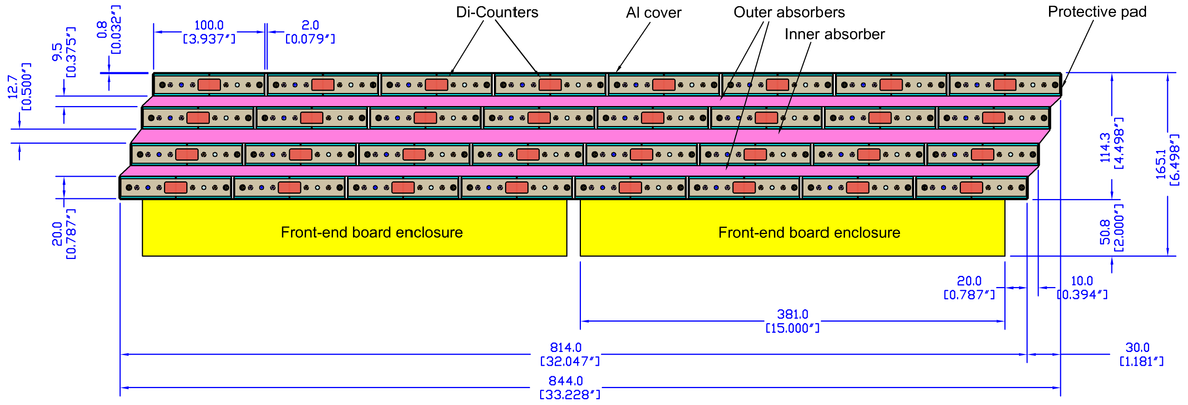
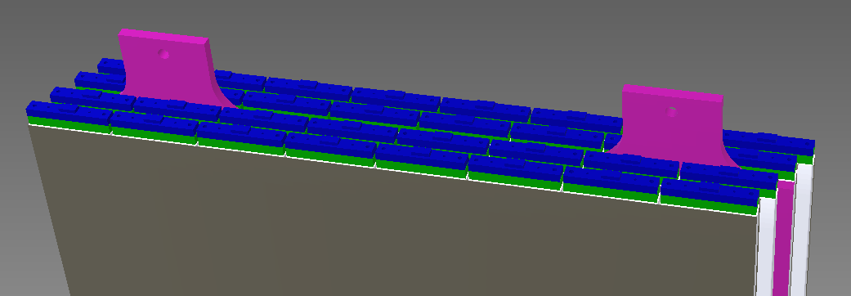
Reminder: Basic CRV Module
~4.5 m (for medium module)
~0.8 m

Slide 9
Overview (continued)
Factory space will be rented near UVA.
Materials shipped to UVA factory.
Di-counters assembled with fiber, manifolds and SiPMs. Di-counter QA performed.
Modules assembled from di-counters, epoxy, and aluminum sheets. Module QA performed.
Modules crated and shipped to Fermilab.
During peak production factory will be capable of producing 6 modules per month.
Note: we have a “pilot” production phase for the first 10% of the production modules in which we estimate that fabrication will proceed at 50% of the peak rate.

Slide 10
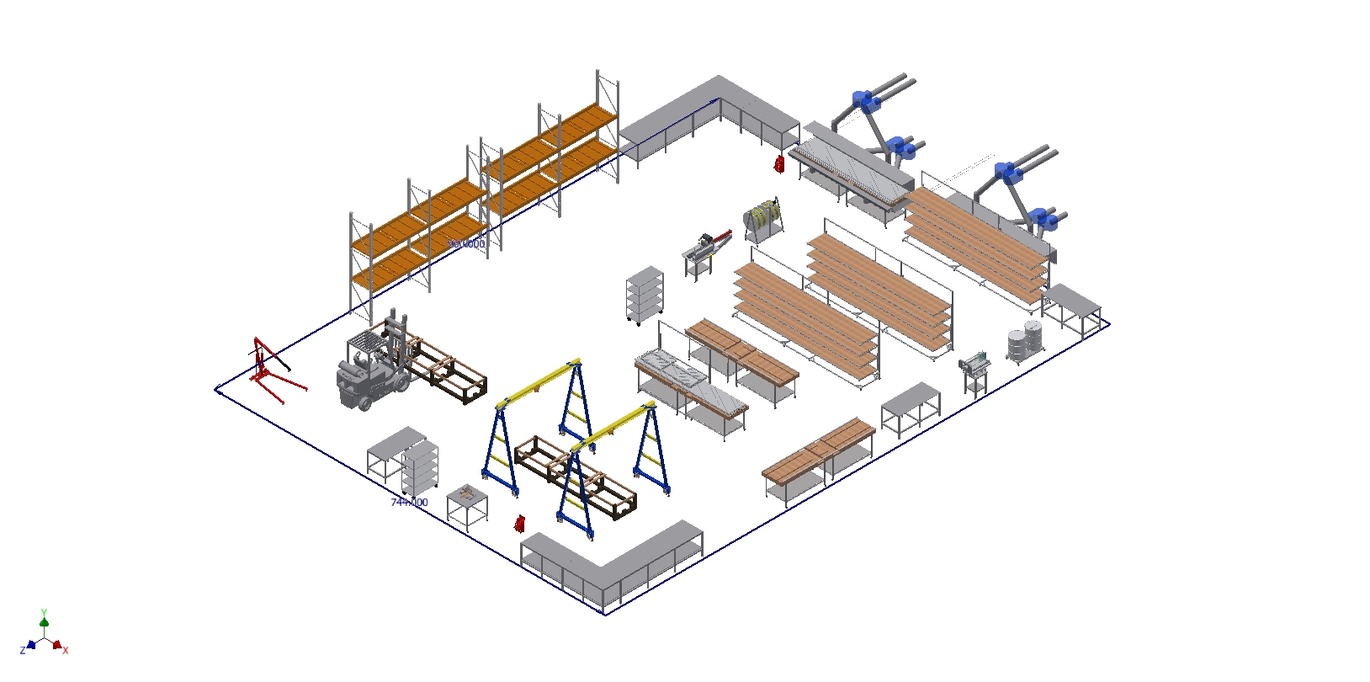
Module Factory
5000 ft²

Slide 11
Module Factory
5000 ft²
Storage and Receiving

Slide 12
Module Factory
5000 ft²
Counter assembly

Slide 13
Module Factory
5000 ft²
Module assembly

Slide 14
Module Factory
5000 ft²
Module QA

Slide 15
Module Factory
5000 ft²
Crating and Shipping

Slide 16
Required Space
Ideally, we would have 5000 square feet of space in the module factory.
(Less space would be possible, but would stretch the fabrication timeline)

Slide 17
Factory Notes
Plan is to rent industrial space. ~$1/ft²/month
Discussion ongoing at UVA to find space on campus.
May provide an opportunity to reduce cost.
Finding space at UVA is an opportunity and listed in the risk registry.
All major components will be on locking casters to maximize flexibility of available space.
Counter Assembly Tables and Module Assembly Tables will be moved to vent hoods for epoxy application steps.

Slide 18
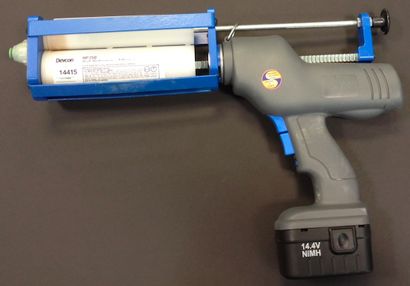
Epoxy
Modules held together only by epoxy
Plastic-aluminum bond is critical!
Devcon HP250 – 400 ml cartridges
(will use about 2000 cartridges)
Plan to spread the epoxy “manually”
→ Dispenser and squeegee

Slide 19
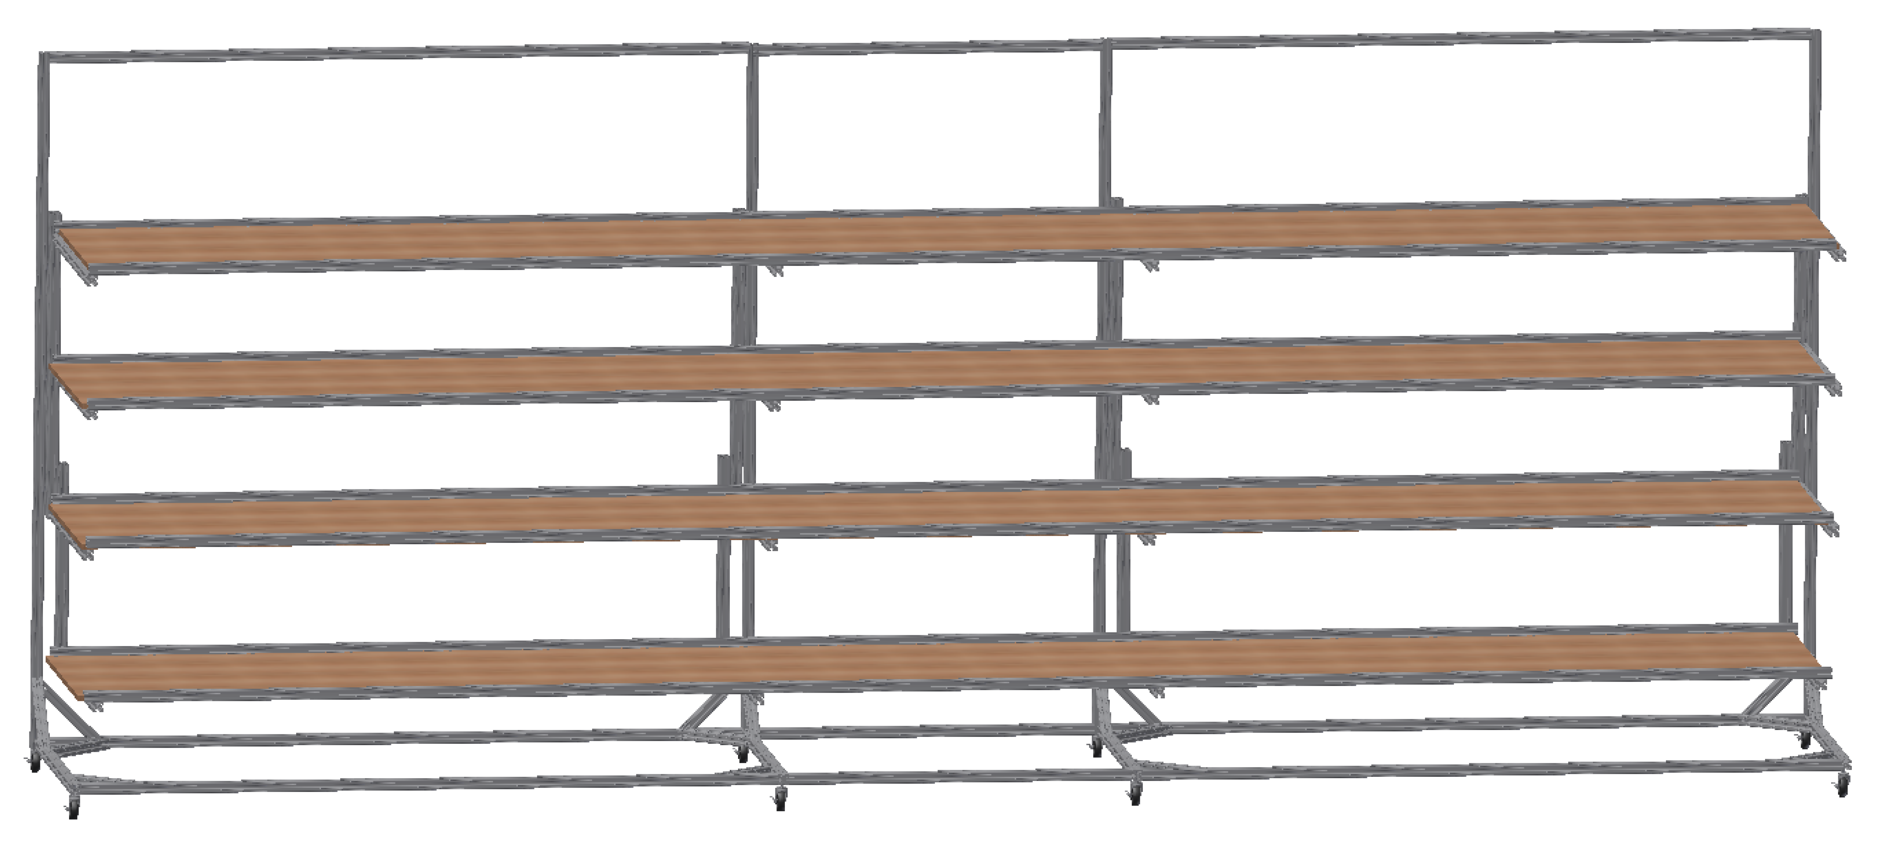
Counter Assembly Table
Shelf heights adjustable to working level.
One shelf to assemble di-counters for each module layer
Epoxy di-counter pairs ( overnight cure required)
Di-counter pairs cut to length with chop saw
Install fiber
Epoxy fiber guide bar (3 day cure required for FGB)
Fly cut FGB with fibers (one 0.015" trim cut and one 0.004" polish cut)
Fiber QA to test cut/polish (details in QA section)
Digital photo with 80x microscope
Fiber light transmission tester
Bar-counter interface will be painted using black latex-enamel paint.

Slide 20
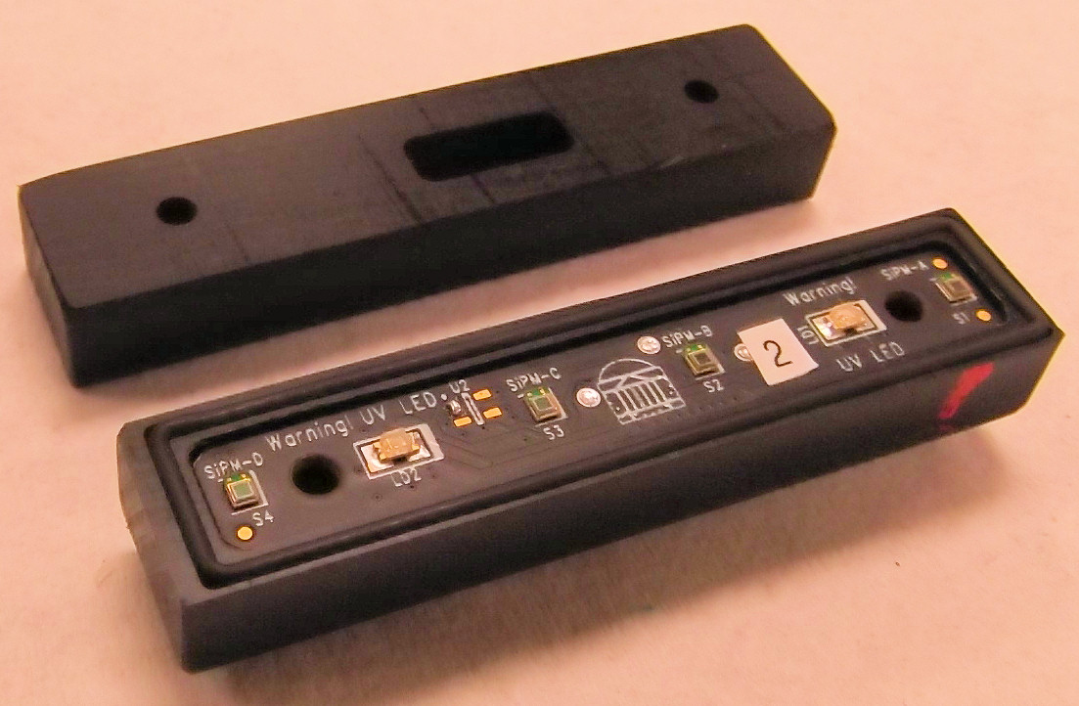
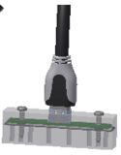
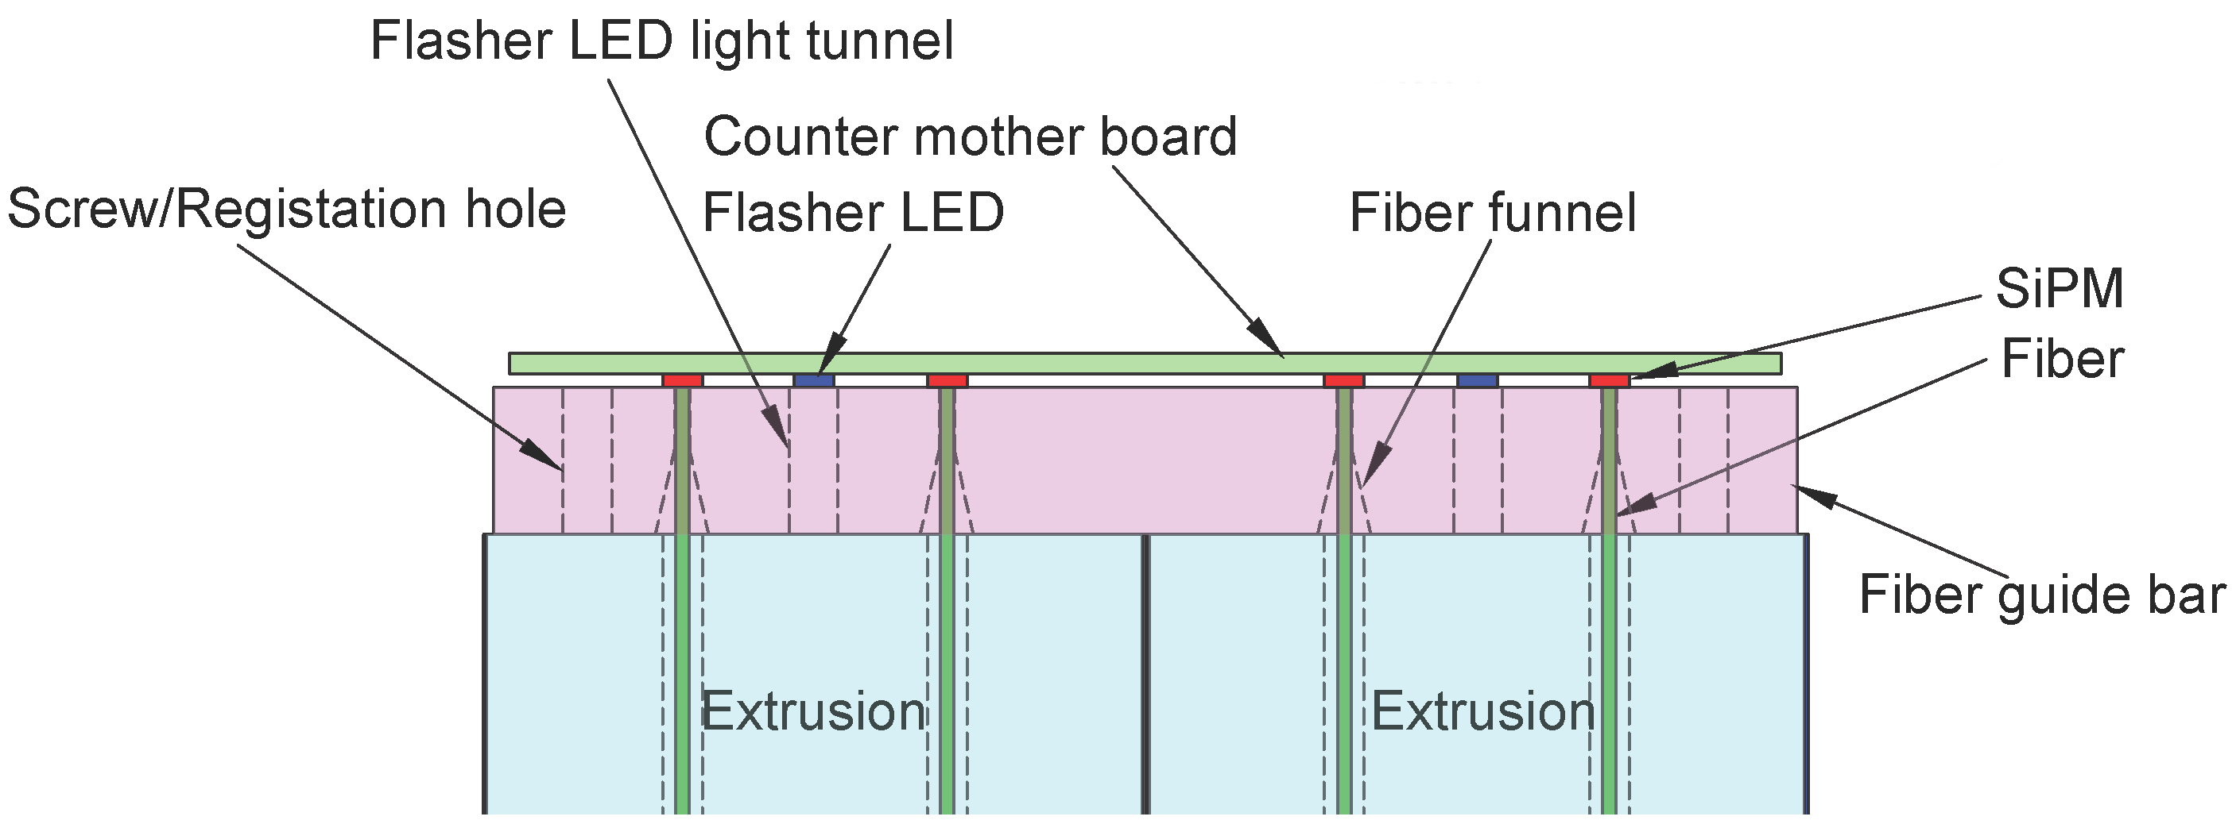
Di-counter Assembly

Slide 21
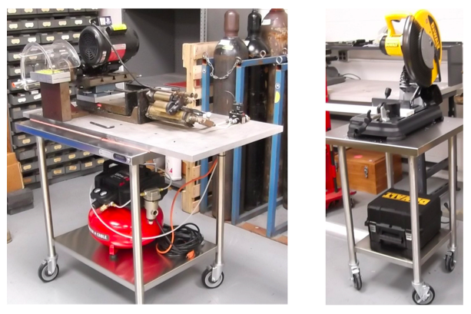
Chop Saw and Fly Cutter
To be modified with cross-slide stage for 36” travel so that full module layer can be cut at once.

Slide 22
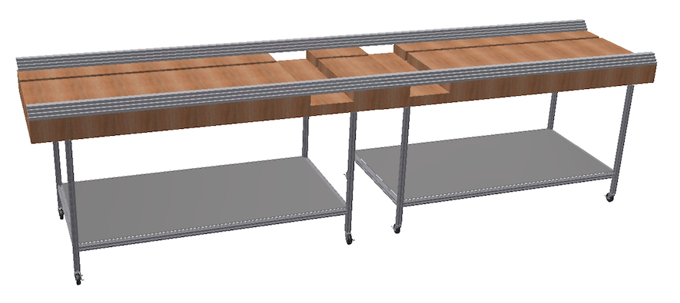
Module Assembly Table
Simple table for module assembly
-- Base: two heavy-duty machine tables with locking casters
-- 80/20 frame attaching the two tables
-- 2"x6" lumber frame and ¾” plywood top
--The table has guides (module glue jig) to locate the counter pairs onto the aluminum
absorber plates and to offset counter layers 10 mm from each other
-- Vacuum lifter (with crane or gantry hoist) required for handling aluminum
sheets and completed modules

Slide 23
Module Assembly Steps
Aluminum cover (0.032"-thick ) placed on table and epoxy spread to a uniform ~0.010" thickness (or 0.005” on each interface).
Di counters are placed and spaced carefully so that edge counters are aligned with aluminum edges (8 di counters for normal-width module)
Epoxy spread to a uniform ~0.005" thickness on di-counter layer
AL absorber (0.250"-thick) placed onto the wet di-counter layer and positioned using the module glue jig.
Repeat previous steps to build up 4 layers.
Aluminum cover (0.032"-thick ) is placed onto the wet di-counter layer and positioned with using the module glue jig.
A plywood weight is placed on top to provide light contact pressure while curing (3 day cure required).

Slide 24
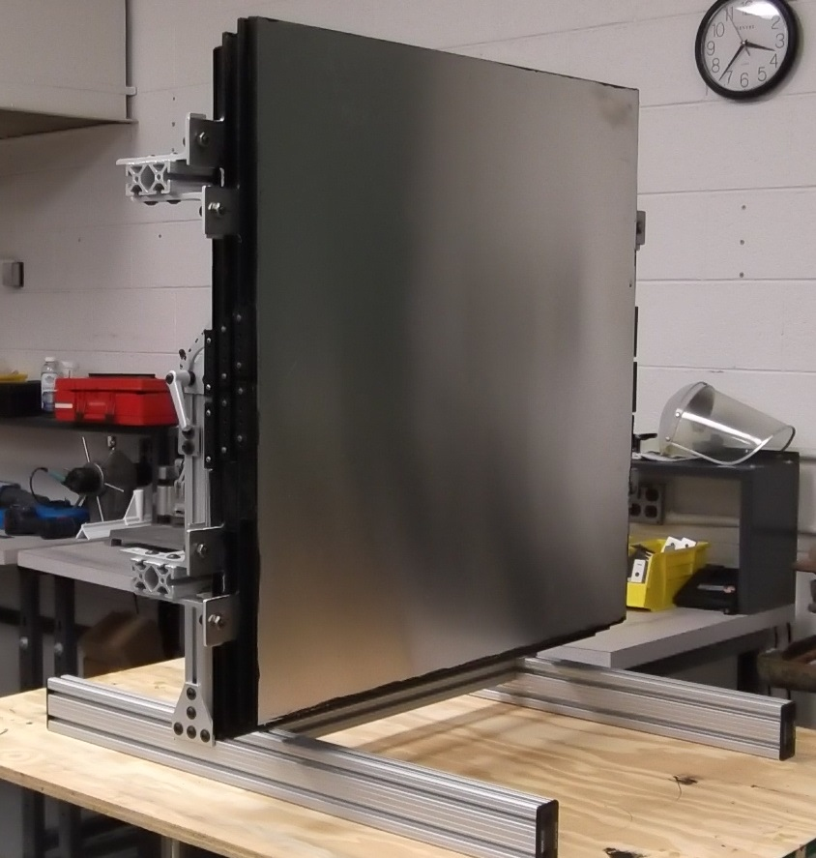
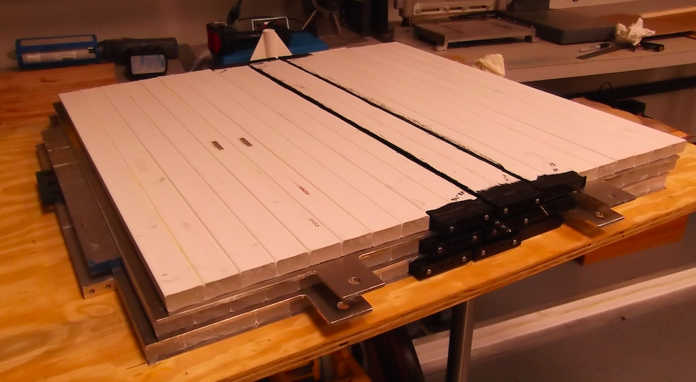
Test Beam Prototype Assembly

Slide 25
Test Beam Prototype Assembly

Slide 26
QA at the Fabrication Factory
Counters:
→Digital photo with 80x microscope
→Fiber light transmission tester
Modules:
→PE yield measurement with CSC cosmic ray test stand
QA checklist in QAP (DocDB 4165 – attachment 3)

Slide 27
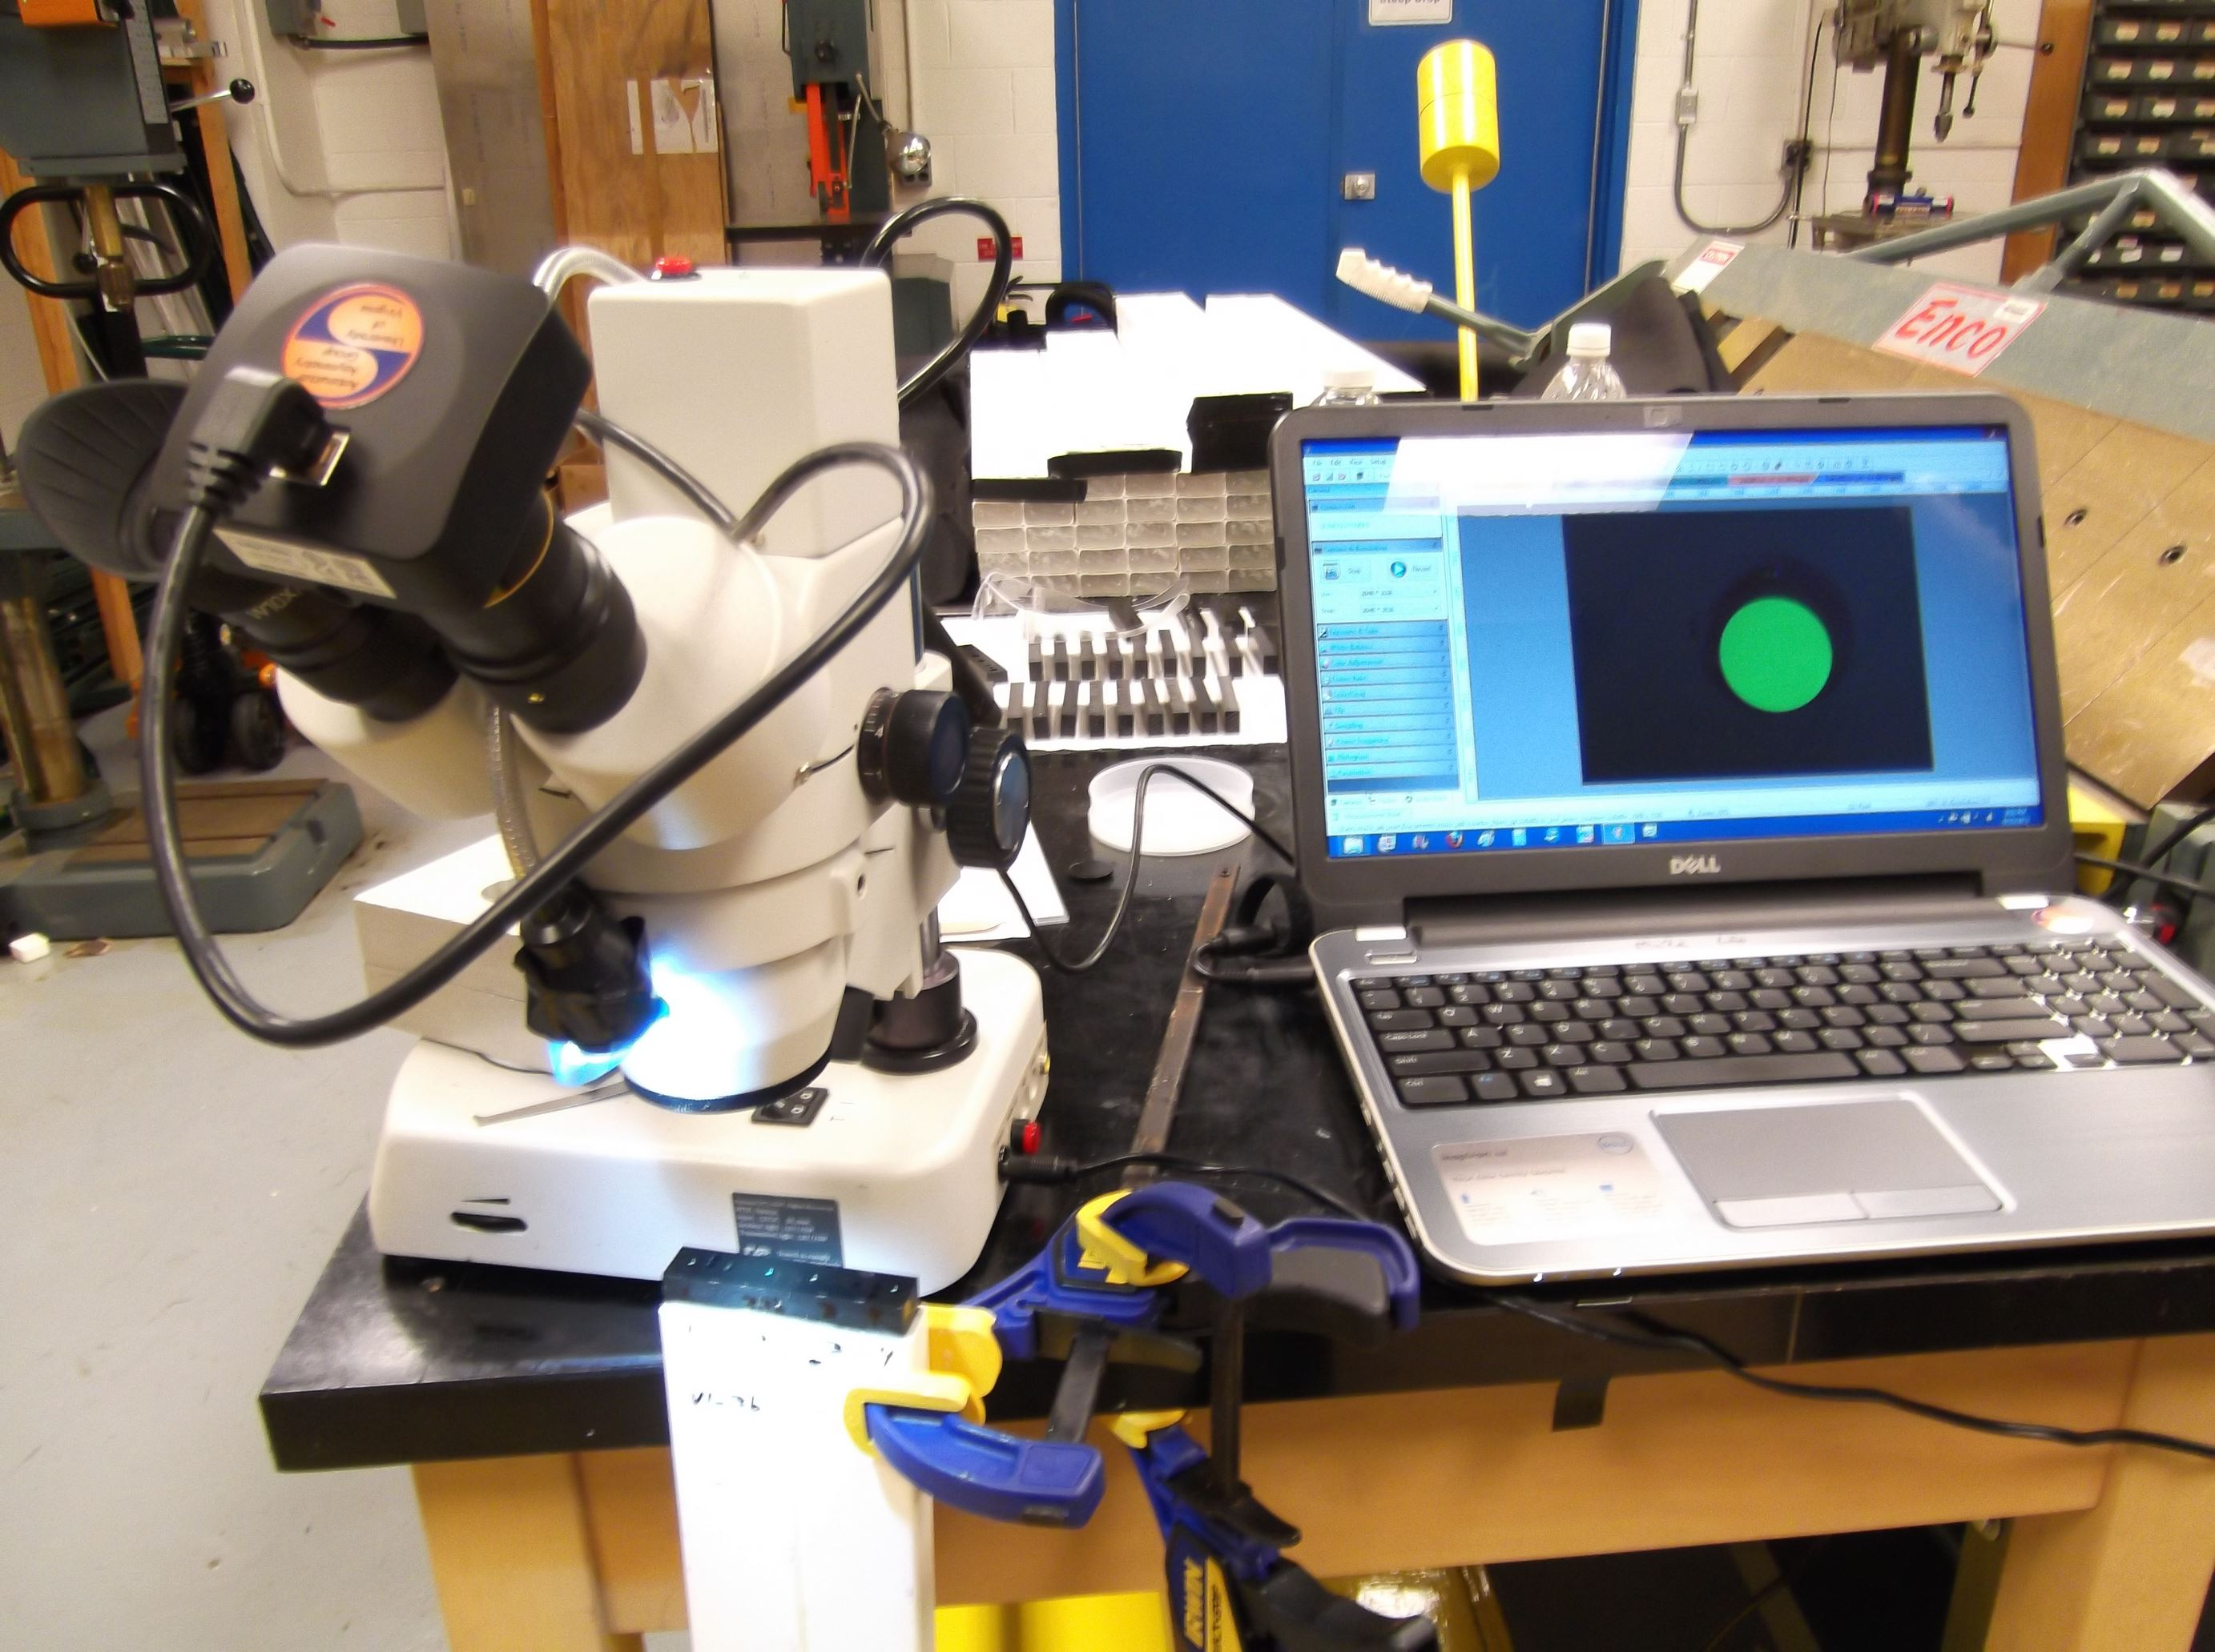
Counter QA
Counters can’t be “unglued”, so QA is critical at the counter assembly step.
Optical QA via digital image with 80x microscope.
Image will be stored for each fiber cut.

Slide 28
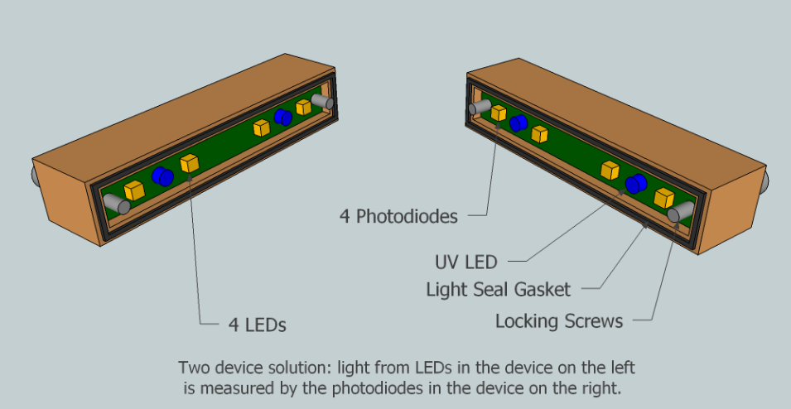
Counter QA
Counters can’t be “unglued”, so QA is critical at the counter assembly step.
Fiber tester: to be designed/fabricated by Dean Shooltz who built similar devices for NOvA.

Slide 29
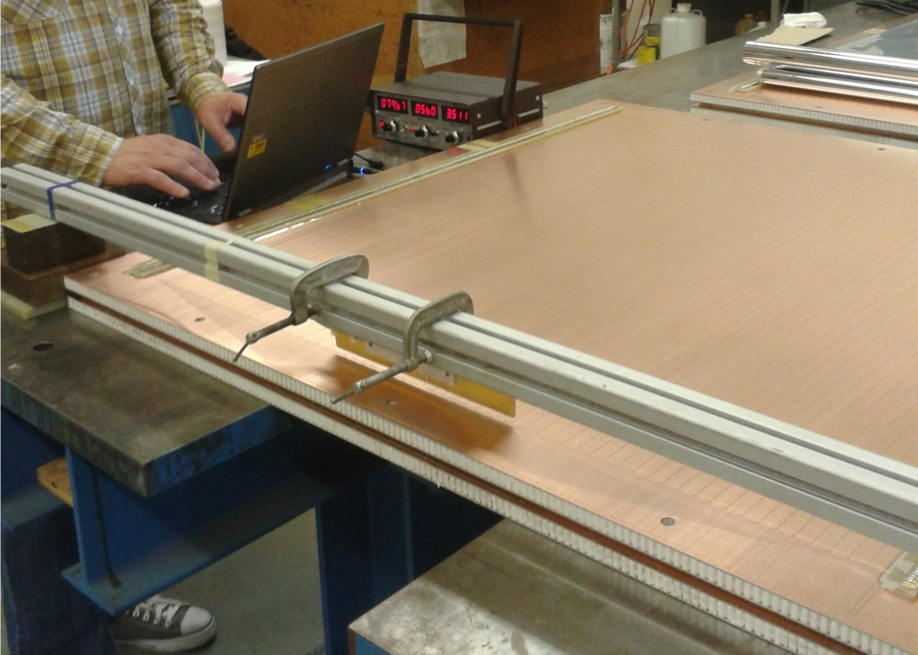
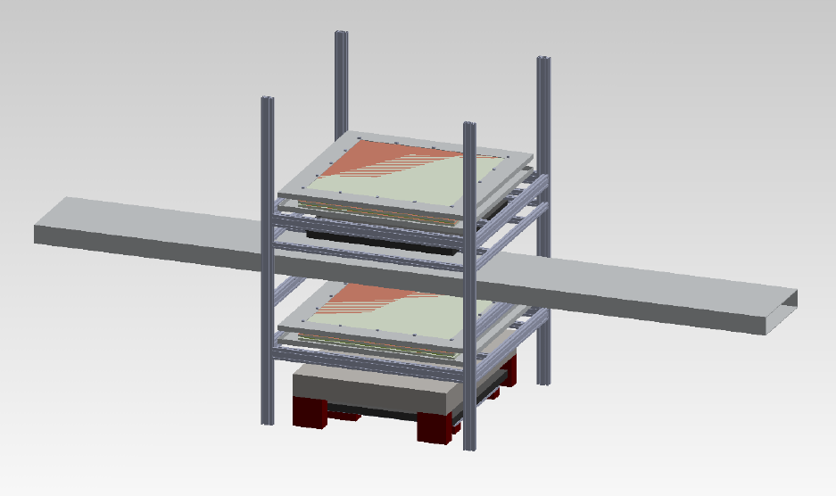
Module QA: CSC Test Stand
A CSC prototype is being assembled that will be converted into a cosmic ray test stand for module QA.
Winding complete
HV/noise tests ongoing

Slide 30
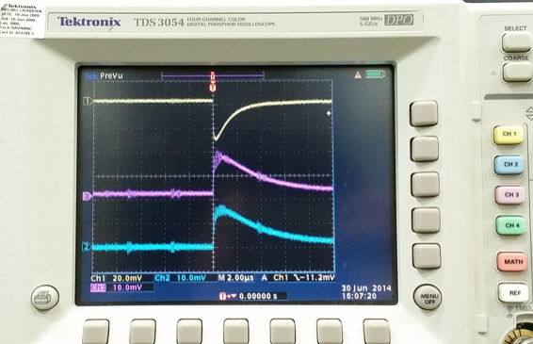
Test Stand Plan
1x1 m² active area
Test stand will employ:
two multi-layer CSCs
gas system (Ar-CO2)
Trigger: large scintillation counter
(for minimum energy confirmation)
Readout electronics
PE yeild will be measured from each module end
10-hour runs will yield several hundred thousand cosmic ray muons
Test procedure will be optimized using module prototypes
Chamber commissioning is going well…
Cathode strips register signal from
cosmic-ray trigger.

Slide 31
QA Checklist
Mu2e DocDB: 4150
Summary of additional QA checks:
Scintillator extrusions - dimensional tolerances, defect free, test hole with spare fiber.
Devcon HP 250 Epoxy - Glue test protocol, peel, shear, durability, hardness.
Fiber guide bars (FGB) - dimensional tolerances, defect free.
Counter motherboards (CMB) - dimensional tolerances, electronics tests.
SiPM mounting blocks (SMB) - dimensional tolerances, defect free.
Front end boards (FEB) - dimensional tolerances, electronics tests.
Aluminum absorbers - dimensional tolerances, defect free.
Light-tight paint and bumpers - defect free.
…

Slide 32
Safety at the Module Factory
Safety plans are also covered by the QAP (DocDB 4150)
There are several hazards in the module factory: high voltage, compressed gas, epoxy fumes, power and other sharp tools…
All employees must study and sign the UVA standard operating procedures (SOP) document to begin work.
Each employee will be trained in all current OSHA, Fermilab and UVA ES&H safety guidelines for identifying, mitigating and managing all relevant hazards at the job site.
Operation of the chop-saw or fly-cutter or access to the machine shop will require UVA machine shop training.
All epoxies contain some toxic chemicals, engineering controls will be employed to mitigate occupational exposure levels.
Working closely with industrial hygienist at UVA to finalize ventilation plan

Slide 33
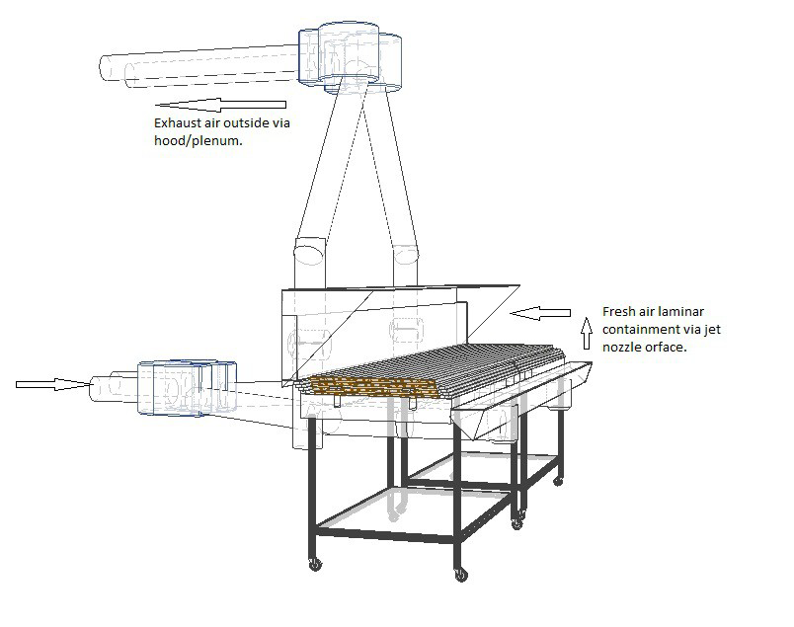

Slide 34
Epoxy Fumes
A similar design will be adapted for the Counter Assembly Tables.
Devcon HP250 does not contain MDA which is a known carcinogen often found in epoxy. We chose a “safer” epoxy.
However, it does contain a suspected carcinogen, MBCHA, and other known toxins.
A prototype ventilation system will be tested via air sampling while building prototype modules to ensure air contaminants are mitigated to acceptable levels.

Slide 35
Personnel at the Module Factory
Technician Leader: Factory design, prototyping, factory management (QA/safety), documentation, fabrication, …
Mechanical Technician: Assist in moving into factory, building assembly stations, and fabrication efforts.
Undergraduates: tedious tasks in the module factory: cleaning/de-burring components, spreading epoxy, QA checklists, …
Uncosted graduate students, postdocs, and faculty: commission the QA tools, establish metrics, and analyze data from QA measurements.

Slide 36
Personnel at the Module Factory
About 7300 total hours of effort to fabricate, pack, and ship 91 modules to Fermilab.
~80 hours of fabrication effort per module.
~54 hours of tech effort per module for fabrication.
With full-time effort, about 6 modules per month can be produced in the module factory.
Example work flow to follow, more details in DocDB 4197.

Slide 37
Work flow at module factory
Month 1
(DocDB 4197)

Slide 38
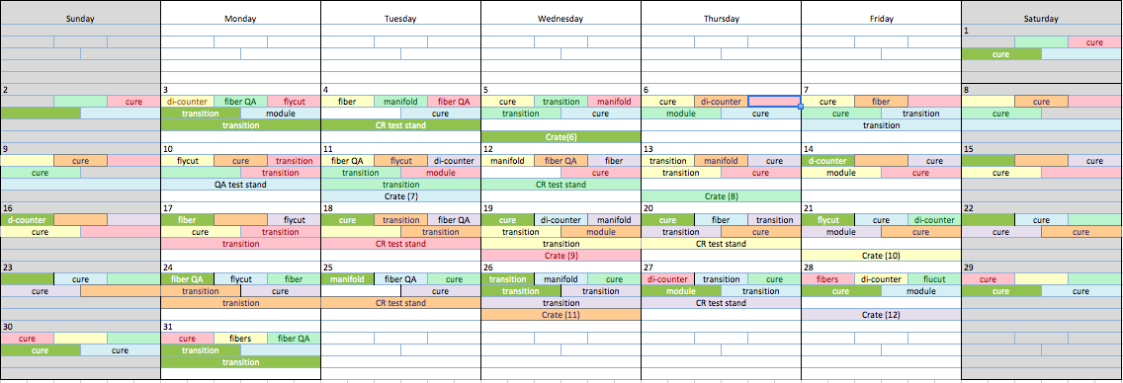
Work flow at module factory
Module 12 crated in less than 2 months!
Month 2

Slide 39
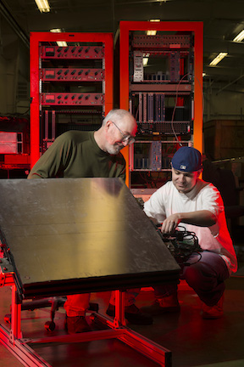
Prototype Plan
Past experience with “test beam” prototype
Prototyping is critical for understanding ideal tooling and required tech hours

Slide 40
Prototype Plan
Mechanical prototype (early FY15):
4.7 m long; No electronics
Time and motion studies; handling modules
Test/practice epoxy application
Two short (cryo-length) electronics prototypes (FY15):
Outfitted with electronics
Study mounting techniques
Test bed for electronics
Two “pre-production” prototypes (FY16):
Outfitted with electronics
Production scintillation and fiber
Shipped to Fermilab to test installation and mounting procedures

Slide 41
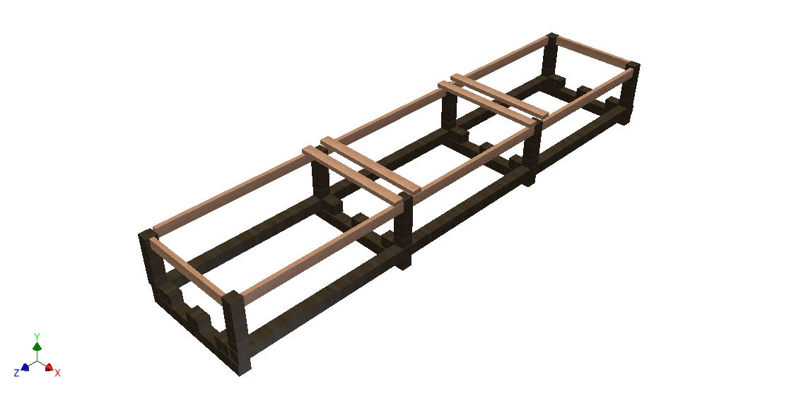
Shipping
Plan for ~9 shipments (~10 modules per shipment)
Plan for 2 modules per crate
Crates will weigh about 4000 lbs
Crates will be assembled at a local job shop
Will consider shipping crates back to UVA.
Crates designed to be stackable.

Slide 42
Shipping
Crates will be loaded via fork lift
Need access from side of truck
Flatbed truck with tarps possible, but “Conestoga 2” seems ideal -- sliding tarp system:

Slide 43
Schedule and Remaining work before CD3
Complete fabrication of prototype assembly stations
Complete fabrication of cosmic ray test stand
Produce “mechanical” prototype module
Produce “short electronics” prototype module
Produce “pre-production” prototype
Test “pre-production” prototype
Design and fabricate “pre-production” prototype shipping crate
Ship “pre-production” prototype to Fermilab

Slide 44
Cost Table (Base Cost – AY k$)
 | Base Cost (AY K$)
 | M&S | Labor | Total | Uncertainty (on remaining budget) | % Contingency (on remaining budget) | Total Cost
8.07.01 Design and fabricate assembly station | 163 |  | 163 | 62 | 47% | 225
8.07.02 Assembly Station Quality assurance design & fabrication | 98 | 8 | 106 | 23 | 65% | 129
8.07.03 Fabrication of Module Parts | 454 |  | 454 | 93 | 21% | 547
8.07.04 Module Production, Testing, Shipping | 741 |  | 741 | 276 | 41% | 1,018
8.07.05 Breakdown of Module Factory | 26 |  | 26 | 11 | 43% | 37
Grand Total | 1,482 | 8 | 1,490 | 466 | 35% | 1,956

Slide 45
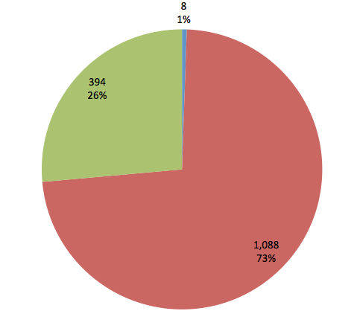
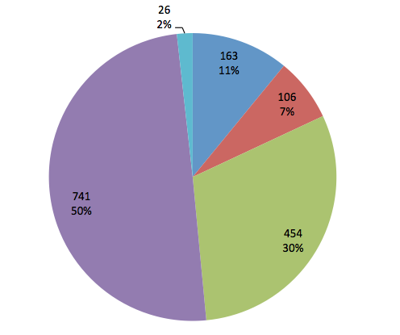
Cost Breakdown (Base Cost – AY k$)
Labor
Materials
Non-FNAL Labor
08.07.01
08.07.02
08.07.03
08.07.04
08.07.05

Slide 46
Quality of Estimate (Base Cost – AY k$)

Slide 47
Labor Resources by FY (Base Cost in AY K$)

Slide 48
Integration and Interfaces
CRV fabrication is integrated with most other CRV L3s: design, fibers, electronics, extrusions, instillation…
Many interfaces require coordination:
Fabrication procedure dependent on design
Components are shipped to module factory
QA of many parts done during fabrication
Completed modules shipped back
All interfaces are internal to the CRV group.
Discuss interfaces at weekly CRV meeting.
Share documentation – same chapter for the TDR.

Slide 49
Major Milestones
Oct. 2014: Cosmic Ray Test Stand Ready
Dec. 2014: Approve mechanical prototype
Feb. 2016: Approve pre-production prototype
June 2019: Production modules complete
Sept. 2019: Module factory breakdown complete

Slide 50
Summary
Factory plan is complete and prototyping is ongoing...
All factory components on castors -- flexibility is important-- location won’t be finalized until rental space is acquired.
Prototype assembly will allow us to fine tune assembly plan.
The cost and schedule are well understood, with contingency estimated to reflect estimate uncertainty.
The CRV fabrication activity is ready for CD2 and has a clear plan to get to CD3.

Slide 51
Supplementary Material

Slide 52
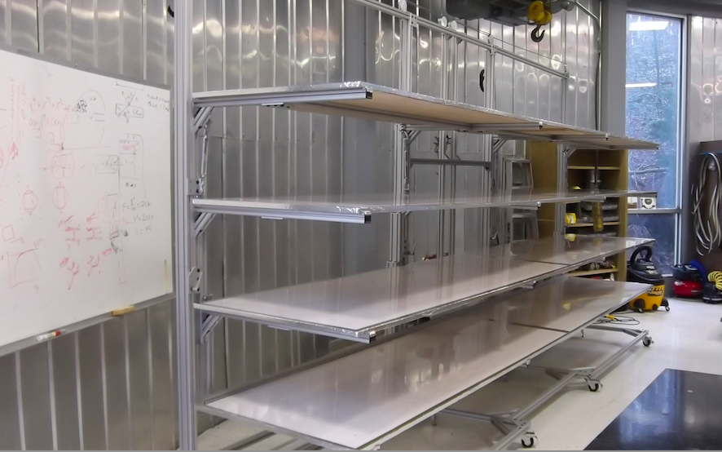
Prototype Counter Assembly Table

Slide 53
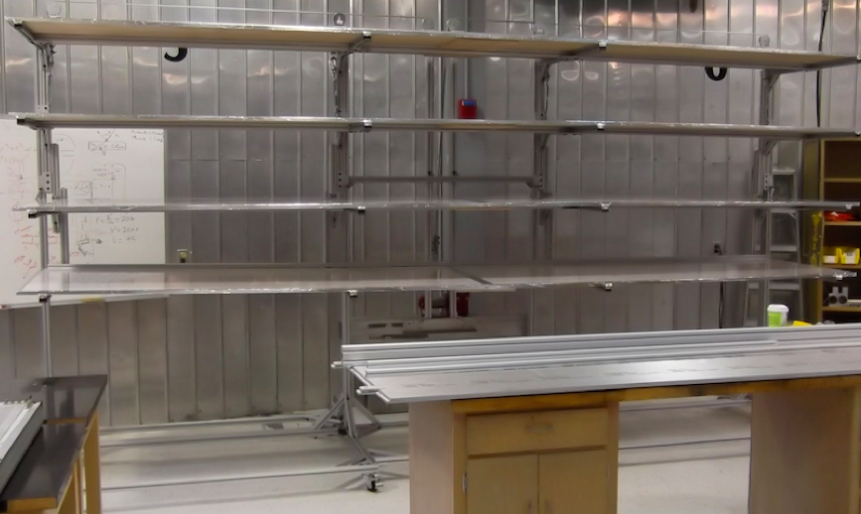
Up

Slide 54
Down

Slide 55
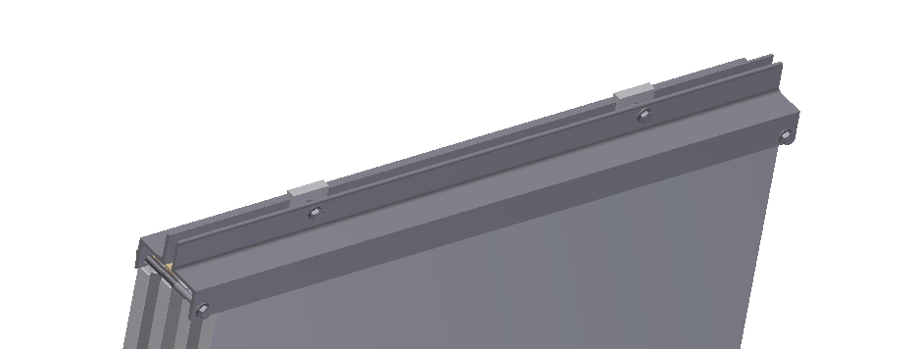
Module End Caps
Simple “Z bar” design.
To protect the sensitive module readout ends during transportation and handling.

Slide 56
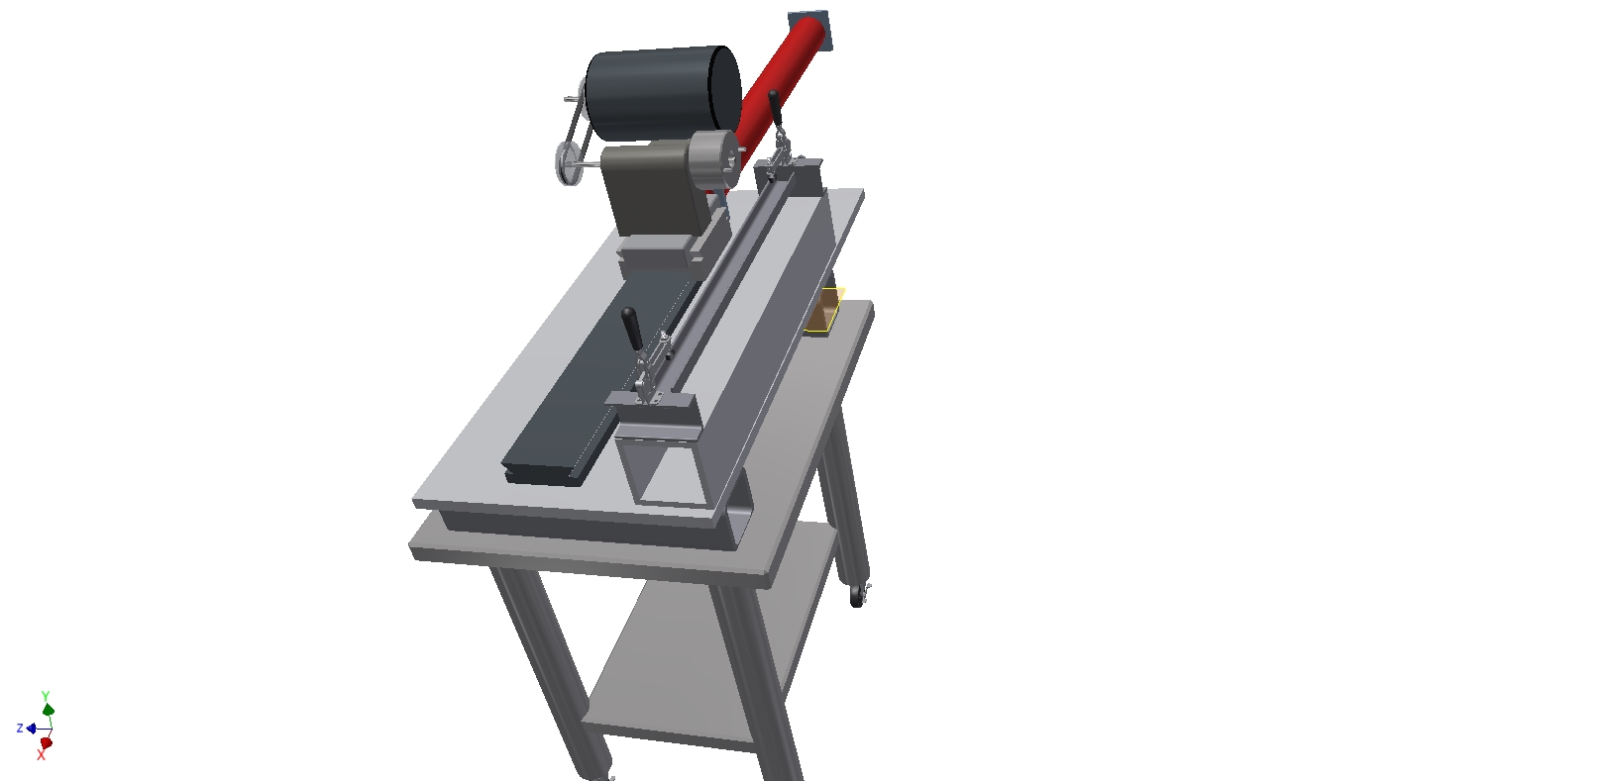
Fly Cutter With 36” Slide…

Slide 57
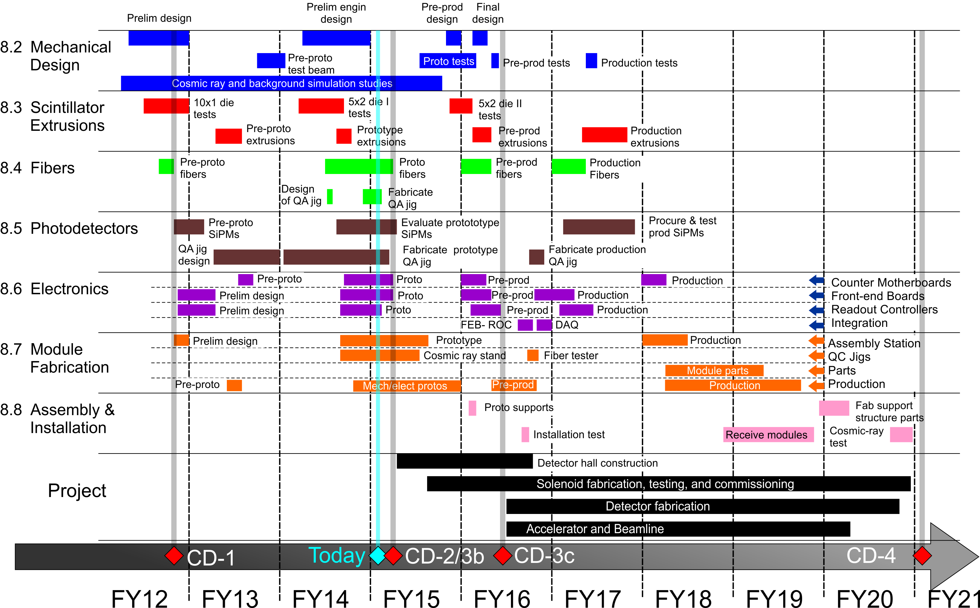
Full Schedule

