Slide 1
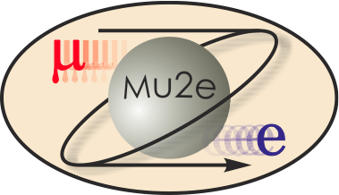
WBS 5 Muon Beamline
Mu2e CD-2 Review
George Ginther
Muon Beamline Level 2 Manager
10/21/2014

Slide 2
L2 Manager’s Previous Experience
Participated in a Fermilab prompt muon triggered charm search (1979-1985)
Participated in assembly, operation and commissioning of the Fermilab E706 electromagnetic liquid argon calorimeter (1985-1988)
Physicist-in-charge for Fermilab fixed target experiment E706 from 1988 through completion
Physicist-in-charge for the SSC GEM Fermilab test beam program (1993)
  Planned decommissioning of Meson West Spectrometer in anticipation of re-purposing beamline to serve as a GEM test beam and preliminary planning of the test beam installation and operation
Level 4 for the DØ Run II Fiber Tracker VLPC cassettes (1997-2001)
  100000 channels, 5M$ M&S and team of ~10 people including engineer, techs, post doc and grad students
Managed the CMS HCAL Motion Table fabrication the H2 beamline at CERN (1997-1999)
Coordinated commissioning and operation of the DØ fiber tracker and preshower detectors (2001-2003)
Level 2 co-manager for DØ Run IIb silicon tracker upgrade 2003 through project termination
  Assisted in converting the successful R&D into the Run IIb Layer 0 project
DØ Technical Integration Coordinator since 2004
  Oversight of detector operations and data quality
  Scheduled and coordinated shutdown activities, installation and commissioning of DØ Run IIb Upgrade project
Particle Physics Division DØ Experiment Department Head (2007-2012)
  ~40 department personnel in addition to technical support team
  Managed department resources and facilities in support of the DØ experiment, the professional growth of the department staff, and other lab priorities as appropriate
Currently serving as a Guest Scientist in the Technical Division (2012-2015)

Slide 3
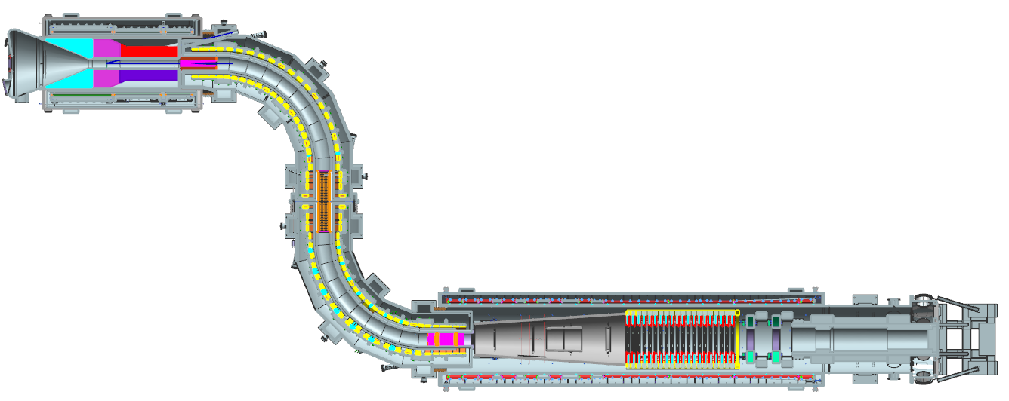
Muon Beamline Orientation
Muon Beamline Vacuum System
Muon Beamline Collimators
Upstream External Shielding
Muon Stopping Target
Muon Stopping Target Monitor
DS Internal Shielding
Muon Beam Stop
Downstream External Shielding
Detector Support & Installation System
Antiproton
Windows
Muon Beam Stop
Collimators
Stopping Target
Proton Absorbers

Slide 4
Requirements
Provide end enclosures for muon beamline vacuum spaces
Maintain pressure inside the Production Solenoid (PS) + Upstream Transport Solenoid (TSu) warm bore at ≤10⁻⁵ torr
  Primary target lifetime
Maintain pressure inside the Downstream Transport Solenoid (TSd) + Detector Solenoid (DS) warm bore at ≤ 10⁻⁴ torr
  Detector performance
Collimators preferentially charge and momentum select muons from the particle beam spiraling downstream from the PS production target
Reduce beam related backgrounds
  Suppress antiproton transmission down the beamline
  Suppress migration of radioactive molecules from PS+TSu to TSd+DS region

Slide 5
Requirements
  Reduce heat load on TS superconducting coils
  Reduce background rates at detectors to facilitate efficient operation and experiment sensitivity
    Shielding to reduce rates at the Cosmic Ray Veto
    Shielding to reduce rates at the tracker
  Efficiently capture muons in the stopping target
    40% efficiency or higher without compromising the sensitivity of the detectors and maximizing signal-to-background ratio (including energy resolution degradation due to energy straggling in the stopping target)
Monitor the number of captured muons at the stopping target
Absorb the beam that passes through the target in the muon beam stop
  Reduce this potential source the backgrounds in the detectors generated by the secondaries

Slide 6
Requirements
Provide mechanical infrastructure to facilitate installation, positioning, alignment, and servicing of the detector train
  Detector train is composed of the following elements
    Stopping Target and surrounding shielding (Proton Absorbers)
    Tracker
    Calorimeter
    Muon Beam Stop
  Detector access requires extracting the detector train from the DS bore
  Provide 500 µm transverse position reproducibility for the tracker and calorimeter
  Provide 1mm longitudinal position reproducibility for the tracker and calorimeter
Provide a mechanical base to support the Cosmic Ray Veto
Requirements documents are available via the Review web page

Slide 7
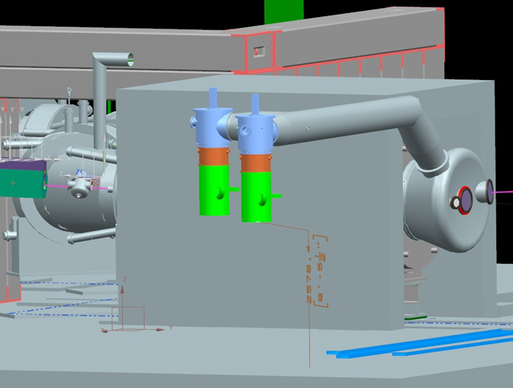
WBS 5.2 Muon Beamline Vacuum System Design
Major Components
  Enclosures on PS and DS ends
    Windows
    Feedthroughs
  External Vacuum Components
    Roughing pumps
    High vacuum pumps
      Diffusion pumps
    Piping
    Seals, instrumentation, valves
  Controls, Monitoring and Interlocks
Radiation levels, magnetic fields, gas loads, and shielding requirements must be considered

Slide 8
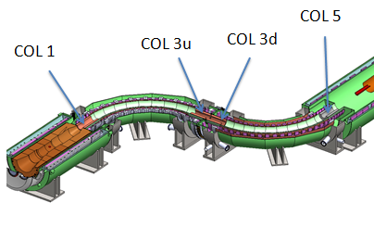
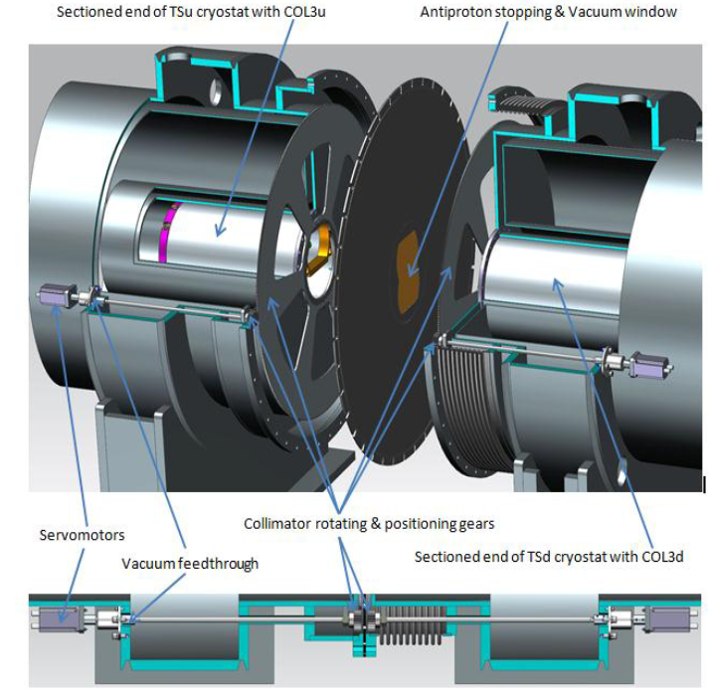
WBS 5.2 Muon Beamline Collimator Design
COL 1, COL3u and COL3d are (primarily) copper
COL 5 is poly
COL3u and COL3d can be rotated to select positive charge for calibration purposes
Antiproton window also isolates upstream from downstream vacuum space

Slide 9
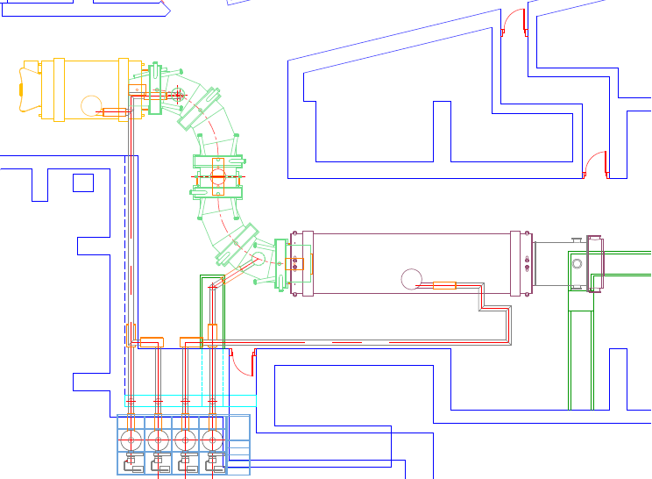
WBS 5.4 and 5.9 External Shielding Design

Slide 10
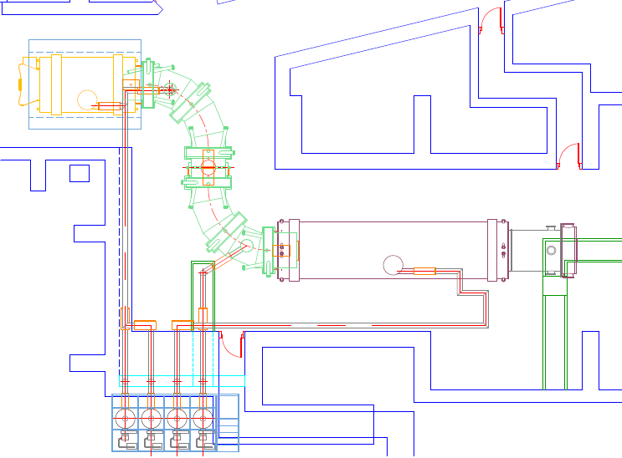
WBS 5.4 and 5.9 External Shielding Design
PS External shielding
  Concrete cave
  90 tons
  Cast under PS Hatch and move using rollers on floor track plates

Slide 11
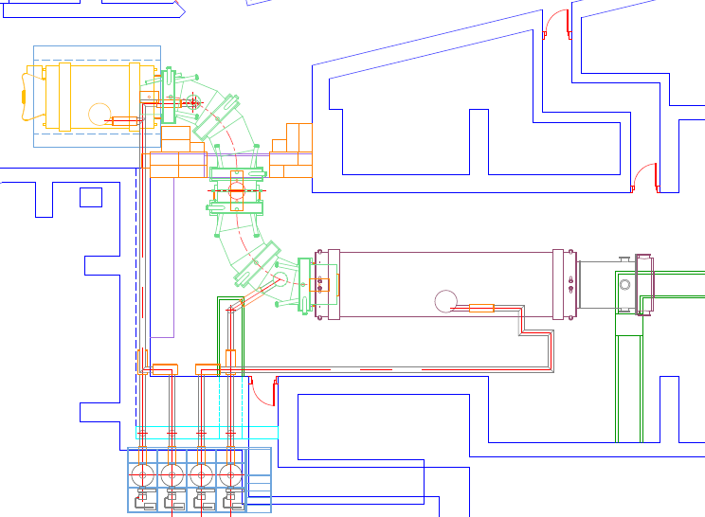
WBS 5.4 and 5.9 External Shielding Design
TS isolation wall and west wall shielding
  High density (barite) concrete blocks capped with normal concrete blocks
  242 tons high density concrete
  48 tons normal density concrete

Slide 12
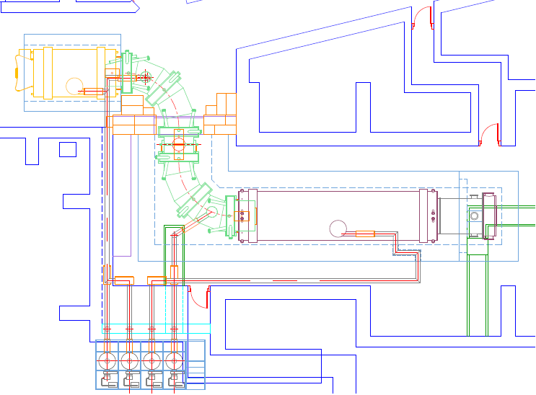
WBS 5.4 and 5.9 External Shielding Design
Downstream External Shielding
  T block downstream cave and independent end cap shielding
  409 tons high density (barite) concrete
  430 tons normal density concrete

Slide 13
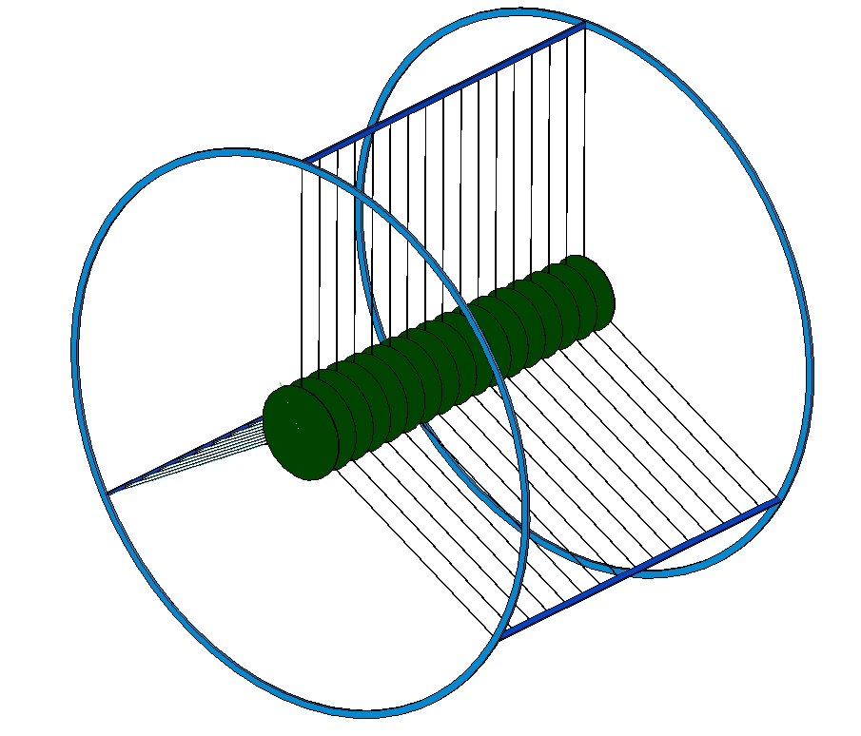
WBS 5.5 and WBS 5.6 Designs
WBS 5.5 Muon Stopping Target
  Seventeen 200μm thick aluminum disks
  Tungsten wire supports
WBS 5.6 Muon Stopping Target Monitor
  Stopping Target Monitor is a germanium detector monitoring delayed photons from the de-excitation of ²⁷Mg created by muon capture on aluminum
    ²⁷Mg decays to excited ²⁷Al with a 9.5 minute half life
      Detect 844 keV photon from ²⁷Al transition
  Germanium detector located outside vacuum volume downstream in low magnetic field region
  Sweeping magnet
  Beam shutter protects detector from beam flash
  Additional shielding surrounding detector

Slide 14
WBS 5.7 and WBS 5.8 Designs
WBS 5.7 Detector Solenoid Internal Shielding
  50 mm thick polyethylene covering the downstream end of the TSd cryostat vacuum jacket
  Inner Proton Absorber
    0.5 mm thick
  Outer Proton Absorber
    20 mm thick borated polyethylene
WBS 5.8 Muon Beam Stop
  Stainless steel tube supporting polyethylene both inside and outside
  Hole in the downstream end for line of sight to the muon stopping target monitor

Slide 15
WBS 5.10 Detector Support & Installation System Design

Slide 16
Improvements since CD-1
New Level 2 manager appointed
WBS 5.2 Muon Beamline Vacuum System
  Dave Pushka now serving as the Level 3 manager
  PS+TSu warm bore maxiumum operating pressure requirement modified from 10⁻¹ torr to 10⁻⁵ torr
    Requirement to support radiatively cooled primary target
    Modifications which help address this challenge
      Isolate outside surface of Heat and Radiation Shield reducing surface area inside volume
        Introduces another volume to be purged or pumped
      Explored and dropped poly liner inside TSu warm bore
      Position upstream high vacuum pump closer to vacuum volume
      Increase duct size for upstream high vacuum pump
      Plan on dry nitrogen backfills during pump and purge cycle
  Replace several large seals with welds
    Should improve reliability particularly in areas that will be difficult to service after operations begin due to high radiation levels anticipated
  Include potential for additional pumping capacity for TSd+DS warm bore if needed
  Introduce dry purges and modified transitions plans

Slide 17
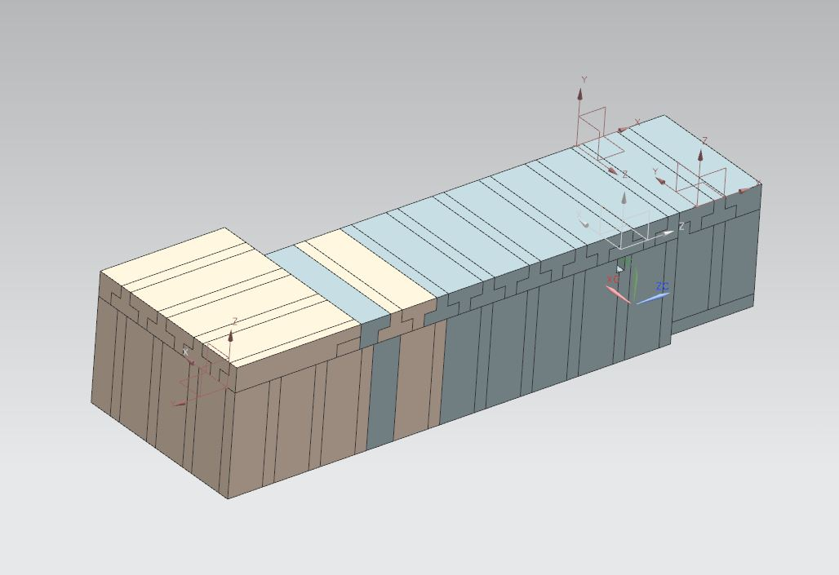
Improvements since CD-1
WBS 5.3 Muon Beamline Collimators
  Collimator locations shifted slightly
  Additional optimization of antiproton suppression
    Introduced an antiproton window in the vicinity of COL1
    Refined geometry of antiproton window at the TSu/TSd interface
    Added a lip on the downstream edge of the COL1 graphite liner
  Now anticipate mag field instrumentation inside the collimators
WBS 5.4 and 5.9 Upstream and Downstream External Shielding
  Introduce PS external shielding (90 tons)
  Make TS isolation more robust
    240 tons of hand stacked blocks now 249 tons barite blocks and 48 tons concrete blocks
  Increase shielding around DS from 18 inches thick to 36 inches thick
    And introduce high density concrete around stopping target
  Extend cave to surround TSd (entirely high density concrete)
  Minimize cracks in downstream cave (T-block design)
  Incorporate penetration to facilitate DS thermosiphon cooling

Slide 18
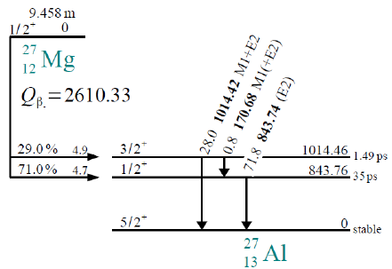
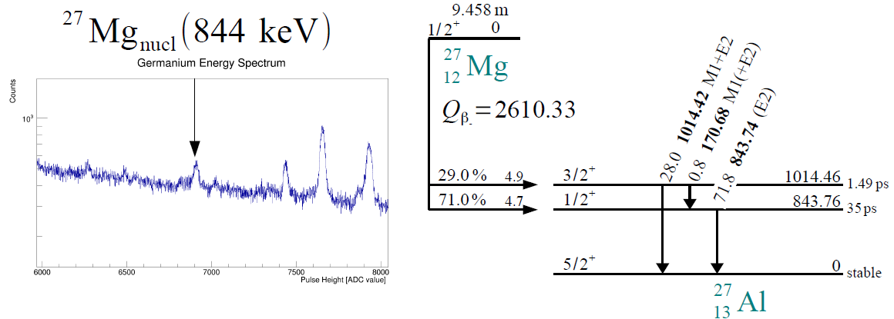
Improvements since CD-1
WBS 5.7 Detector Solenoid Internal Shielding
  Hank Glass now serving as the Level 3 manager
  Inner Proton Absorber length reduced
  Introduce Outer Proton Absorber
    0.4 tons additional borated polyethylene
  Introduce TSdA
WBS 5.5 Muon Stopping Target
  Outer Proton Absorber surrounds Muon Stopping Target complicating support
  Prototyping to refine target support material
WBS 5.6 Muon Stopping Target Monitor
  Switch to delay gamma signal
  Introduce beam shutter
WBS 5.8 Muon Beam Stop
  Optimizing design to enhance performance
  Support of downstream end transferred from rails to enclosure
    Reduces number of individual external stands required in detector support and installation system

Slide 19
Improvements since CD-1
WBS 5.10 Detector Support and Installation System
  Develop 2nd tier bars in rail alignment system *
    Based upon experience with rail system mock-up
  Refined external rail supports design
    Fewer individual stands should reduce installation/alignment time *
    Reduced footprint will allow better access to detector train but requires additional floor track plates *
  Preliminary design of detector support adjustment mechanism
  Include bore heaters and associated instrumentation to reduce temperature variation inside warm bore
  Revisit tolerance specifications for positioning of detector elements to optimize cost/performance *
WBS 5.11 Muon Beamline Integration
  Substantial development of installation sequence
  Introduce hydrostatic levels *
Note * that several of these items might also be considered as examples of value engineering

Slide 20
Value Engineering since CD-1
Diffusion pumps instead of cryo pumps
Instrumentation/ports to verify COL3u and COL3d orientation
Shielding related optimizations
  Investigate less expensive shielding materials
    Employ high density concrete instead of copper or stainless steel
    Increase concrete thickness instead of higher density concrete
  Eliminate stainless steel frame from DS cave
  Plan to cast PS external shielding
  Plan for multiple use of same hydraulic system
Influence civil construction plans
  Optimize installation crane coverage, hatch size and locations to streamline shielding installation process (where possible)
  Floor track plates and trenches
  Plan for staging area for shielding
  Increase floor space to facilitate equipment staging
  Routing of services in the building

Slide 21
Downselects
Explored and eliminated poly liner within TS warm bore
Confirmed copper as the material of choice for COL3
Confirmed poly as the material of choice for COL5
Explored and eliminated inner neutron absorbers (from DS bore)
Inner proton absorber
  Frustum selected over blade configuration
Explored many different shielding configurations and identified one that addresses detector performance requirements

Slide 22
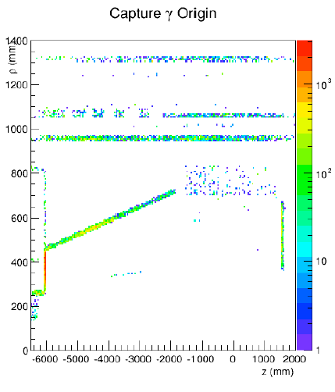
Muon Beamline Vacuum and Shielding Performance
Many muon beamline deliverables are particularly sensitive to and dependent upon interfaces with most other subsystems
  Based upon current gas load and pumping configuration, anticipate after 10 hours
    PS+TSu pressure 5x10⁻⁵ torr
    TSd+DS pressure 6x10⁻⁴ torr
    Once outgassing becomes negligible the pressures satisfy the requirements
  See the CRV presentation in particular for a summary of the current performance of the external shielding
D. Brown Mu2e docdb 3479

Slide 23
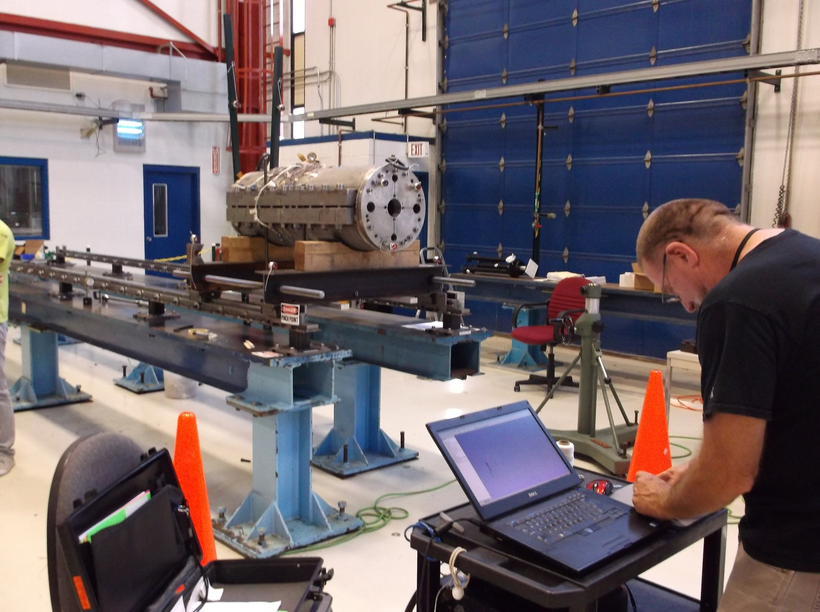
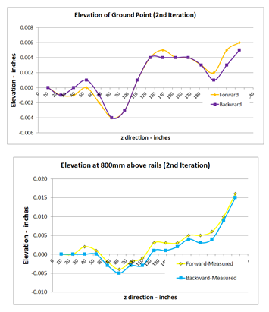
Detector Support and Installation System Performance
Studies at rail system mockup indicate that position measurements are reproducible to within ±25μm at seven meters from the laser tracker as measured via the laser tracker
Reproducibility degrades as a function of distance from the laser tracker.
The laser tracker device uncertainty is expected to be ±50μm at 10 meters.
R. Bossert Mu2e docdb 3037

Slide 24
Integration and Interfaces
Muon Beamline has external interfaces to Accelerator, Conventional Construction, Solenoids, Tracker, Calorimeter, CRV, and Trigger & DAQ
The muon beamline level 3 subsystems each have interfaces to other several muon beamline level 3 subsystems
The external and internal interfaces are identified and described in the WBS dictionary and the Muon Beamline interface document (docdb 1168).
Identifying and addressing interfaces and integration is central to muon beamline
  Bi-weekly muon beamline meetings
  Regular participation in mechanical and electrical integration meetings
  Regular participation in accelerator target station, solenoid, CRV and calorimeter meetings
  Highlight key features at Mu2e Tech Board meetings
  Participated in conventional construction formal value engineering exercise
  Review of conventional construction plans (and participated in conventional construction meetings)
  Formal sign-off between owners of all external interfaces will be part of the final design process

Slide 25
Muon Beamline Organization
475.5
Muon Beamline
G. Ginther (FNAL/Rochester)
L2 Manager and CAM
J. Brandt, G. Gallo, S. Krave, and B. Woods are providing significant additional engineering
York is contributing to the vacuum system
Boston University is involved in stopping target and stopping target monitor
NIU involved in the Muon Beam Stop and Detector Support and Installation System
  D. Hedin and physics students
  N. Pohlman and engineering students (currently L. Martin and U. Okafor )
Accelerator Physics Center contributing to MARS simulation effort
Mu2e collaboration continues to make crucial contributions to development primarily through simulations studies
  Neutron task force
  Caltech, Fermilab, LBNL, NIU, Rice, UC Irvine, Virginia, York
475.5.1 MB Project Management
L3 – G. Ginther
475.5.2 MB Vacuum System
L3 – D. Pushka
475.5.3 MB Collimators
L3 – N. Andreev
475.5.4 Upstream External Shielding
L3 – N. Andreev
475.5.5 Stopping Target
L3 – J. Miller
475.5.6 Stopping Target Monitor
L3 – J. Miller
475.5.7 DS Internal Shielding
L3 – H. Glass
475.5.8 Muon Beam Stop
L3 – R. Bossert
475.5.9 Downstream External Shielding
L3 – R. Bossert
475.5.10 Detector Support and Installation System
L3 – R. Bossert
475.5.11 MB Integration
L3 – G. Ginther
H. Brown Muon Beamline Project Controls Specialist

Slide 26
Quality Assurance
Quality Assurance in the muon beamline efforts relies upon the following tools :
  Fermilab Quality Assurance Manual
  Fermilab Engineering Manual
  Mu2e Quality Assurance Program
  Documented engineering calculations and drawings
    reviewed, approved and released
  Verification of physics simulations
    Comparisons between MARS and GEANT4
  Prototypes and mockups as appropriate
  Documentation of procedures
  Delivered materials will be inspected for conformance to the specifications

Slide 27
Muon Beamline Project Risks
Risks are being mitigated to the extent possible
After mitigation, three identified muon beamline related risks remain (at the moderate or higher classification level)
  All three represent potential threats
    Muon-138 Detector installation takes longer than anticipated
      Classified as a high risk due to potential cost impact
    Muon-146 Rate exceeds muon stopping target monitor capability
      Classified as a moderate risk
    Muon-147 Degrader required for calibration
      Classified as a moderate risk
One risk has been retired
Nine risks are being mitigated and the residual risk has been transferred
Mitigation plans for the identified risks are documented in forms available on docdb, and linked from the Risk Register (docdb 4320)

Slide 28
ES&H
To perform muon beamline activities safely will require appropriate planning (JHA), attention to ES&H considerations and FESHM and FRCM requirements
  Vacuum vessels FESHM 5033
  Thin windows on the vacuum vessel FESHM 5033.1
    Possibly beryllium (hazardous materials) FESHM 5052.5
  Inspection and testing of relief systems FESHM 5031.4
  Liquid nitrogen FESHM 5030 series
  Accessing confined space FESHM 5063
  Possible use of lead (hazardous materials)
    FESHM 5052.3
    Beam shutter and other shielding
  Crane, hoist, and forklift use FESHM 5021
    Including lifts beyond direct crane coverage
  Fall Hazards FESHM 5066
  Magnetic fields FESHM 5062.2
  Electrical hazards FESHM 5042
  Fire hazards
  Hydraulic and perhaps pneumatic systems (and potential stored energy)
  Radiation hazards FRCM
    Stopping target monitor calibration source
    Activation by beam
  Hazardous waste
  Cable Trays
    FESHM 5043
  And possibly ODH
    FESHM 5064

Slide 29
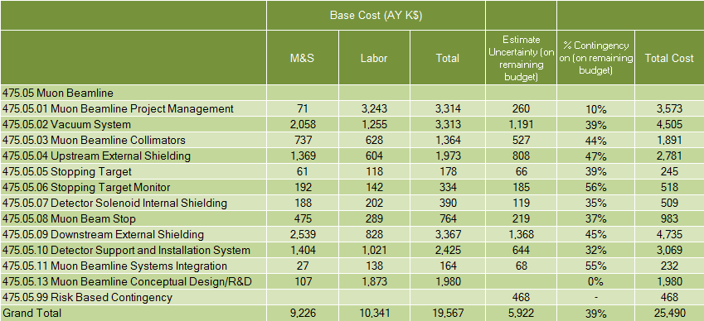
Muon Beamline Cost Table (k$)

Slide 30
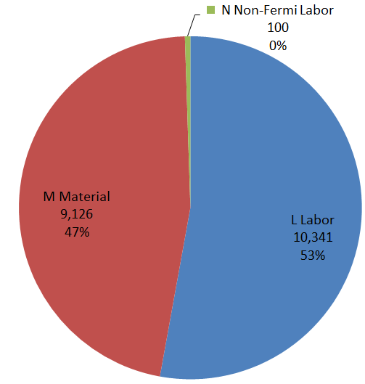

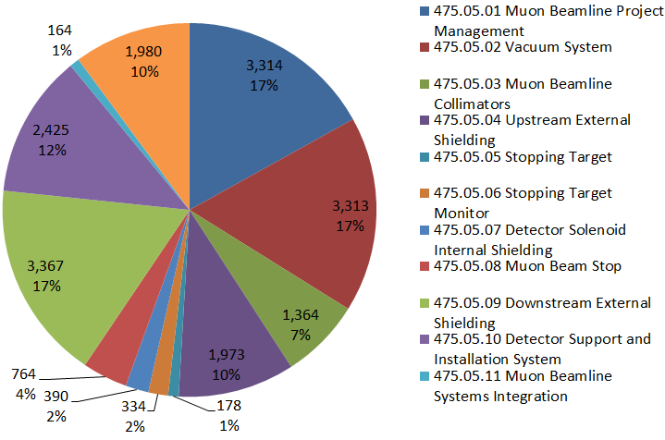
Cost Breakdown Base Costs in AY k$

Slide 31
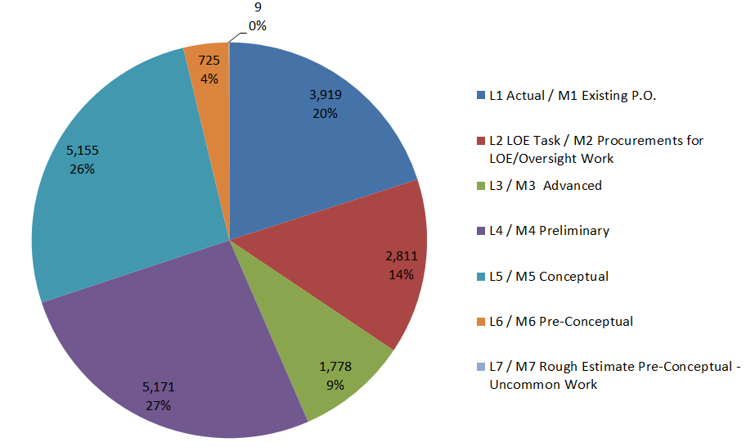
Quality of Estimate Base Costs in AY k$

Slide 32
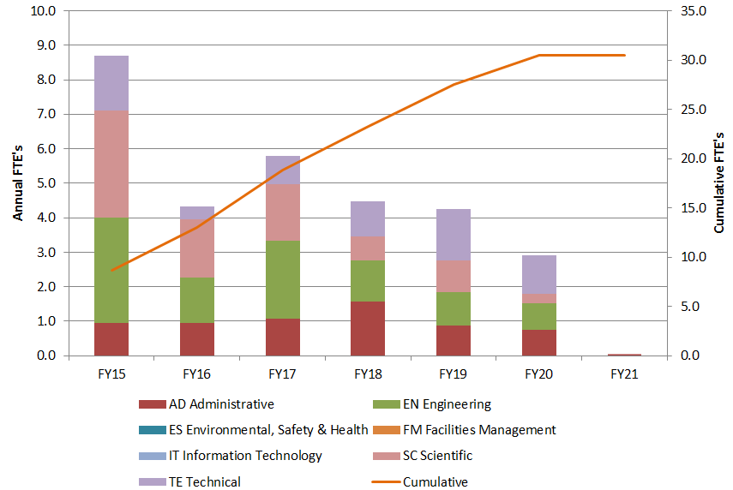
Labor Resources by FY

Slide 33
Major Milestones
Muon Beamline ready for CD-3c review 15-Dec-2015
External vacuum components ready for fabrication 9-Dec-2016
Downstream External Shielding ready for fabrication 17-Nov-2017
All external vacuum system components at FNAL 15-Sep-2017
Upstream Shielding ready for fabrication 26-Jan-2018
DS Internal Shielding ready for fabrication 26-Jan-2018
Muon Beam Stop and Supports at FNAL 11-Apr-2018
Stopping Target at FNAL 26-Apr-2018
Stopping Target Monitor Infrastructure at FNAL 09-Oct-2018
PS enclosure ready 15-Oct-2018
COL1 installed 22-Jan-2019
All DS enclosure components at FNAL 12-Mar-2019
COL3u and COL3d installed 30-Aug-2019
COL5 installed 9-Sep-2019
Detector Train Test Insertion Complete 21-Feb-2020
Muon Beamline Ready for CD-4 16-Jun-2020

Slide 34
Schedule
CD-3a
CD-2/3b
CD-3c
KPPs Satisfied
CD-4
MB Vacuum System Design
MB Vacuum System Assembly/Installation
MB Vacuum System Fabrication and QA
Muon Beamline Shielding Design
MB Shielding
Fabrication and QA
MB Collimator
Fabrication and QA
MB Collimator
Installation
Muon Beamline Collimator Design
Detector
Support
Installation
Detector Support and Installation System Design
Detector Support
Fabrication
Fabricate and QA Superconductor
Solenoid Design/Prototypes
Solenoid Fabrication and QA
Solenoid Installation and Commissioning
Detector Hall
Construction
Solenoid Infrastructure
Cosmic Ray System Test
Detector Prototypes and Construction
Accelerator Commissioning (off Project)
Q3 | Q4 | Q1 | Q2 | Q3 | Q4 | Q1 | Q2 | Q3 | Q4 | Q1 | Q2 | Q3 | Q4 | Q1 | Q2 | Q3 | Q4 | Q1 | Q2 | Q3 | Q4 | Q1 | Q2 | Q3 | Q4 | Q1 | Q2 | Q3 | Q4 | Q1 | Q2 | Q3 | Q4
Accelerator and Beamline Construction
FY14 FY15 FY16 FY17 FY18 FY19 FY20 FY21

Slide 35
WBS 5 Muon Beamline Summary
WBS 5 Muon Beamline has a diverse set of responsibilities aimed at supporting efficient and reliable detector operation
  Muon beamline deliverables are particularly sensitive to and dependent upon interfaces with all other subsystems
Have made substantial progress since CD-1
  Many designs have been significantly refined/optimized
Preliminary designs meet the requirements
Cost estimate are complete
  70% of the costs understood at the preliminary design level or better
Interfaces are identified
Risks are understood and being mitigated to the extent possible
Finalizing many of the designs will be dependent upon ongoing physics simulations (and in a few cases prototyping)
  The collaboration continues to make vital contributions to this effort
Anticipate that many major WBS 5 procurements will be scheduled towards the end of the project
Muon Beamline is prepared for CD-2

Slide 37
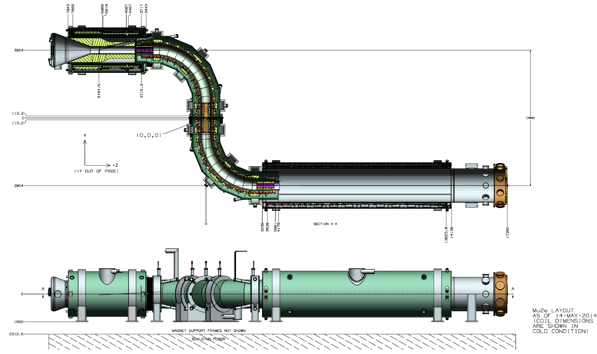

Slide 38
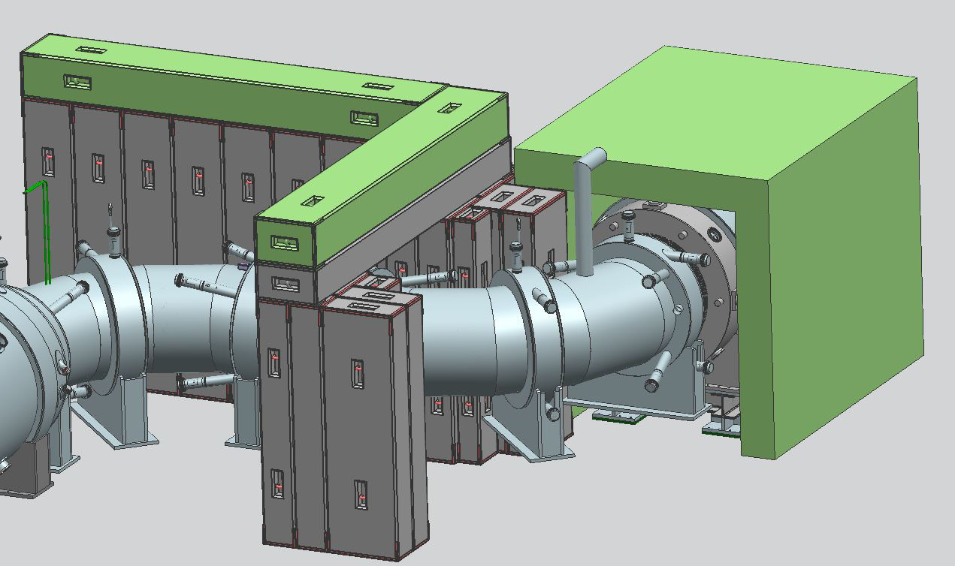
WBS 5.4 Upstream External Shielding

Slide 39
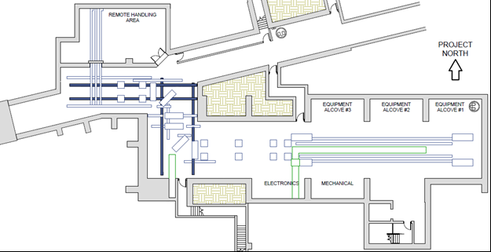
Floor track plate layout

Slide 40
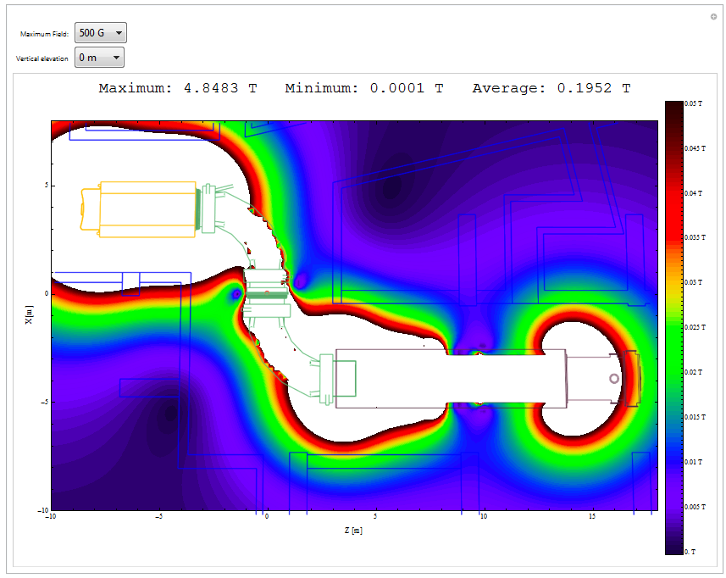

Slide 41
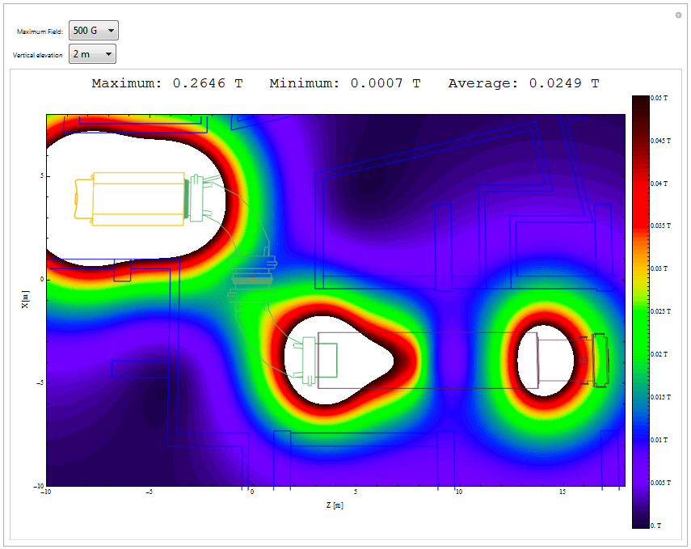
Gi

Slide 42
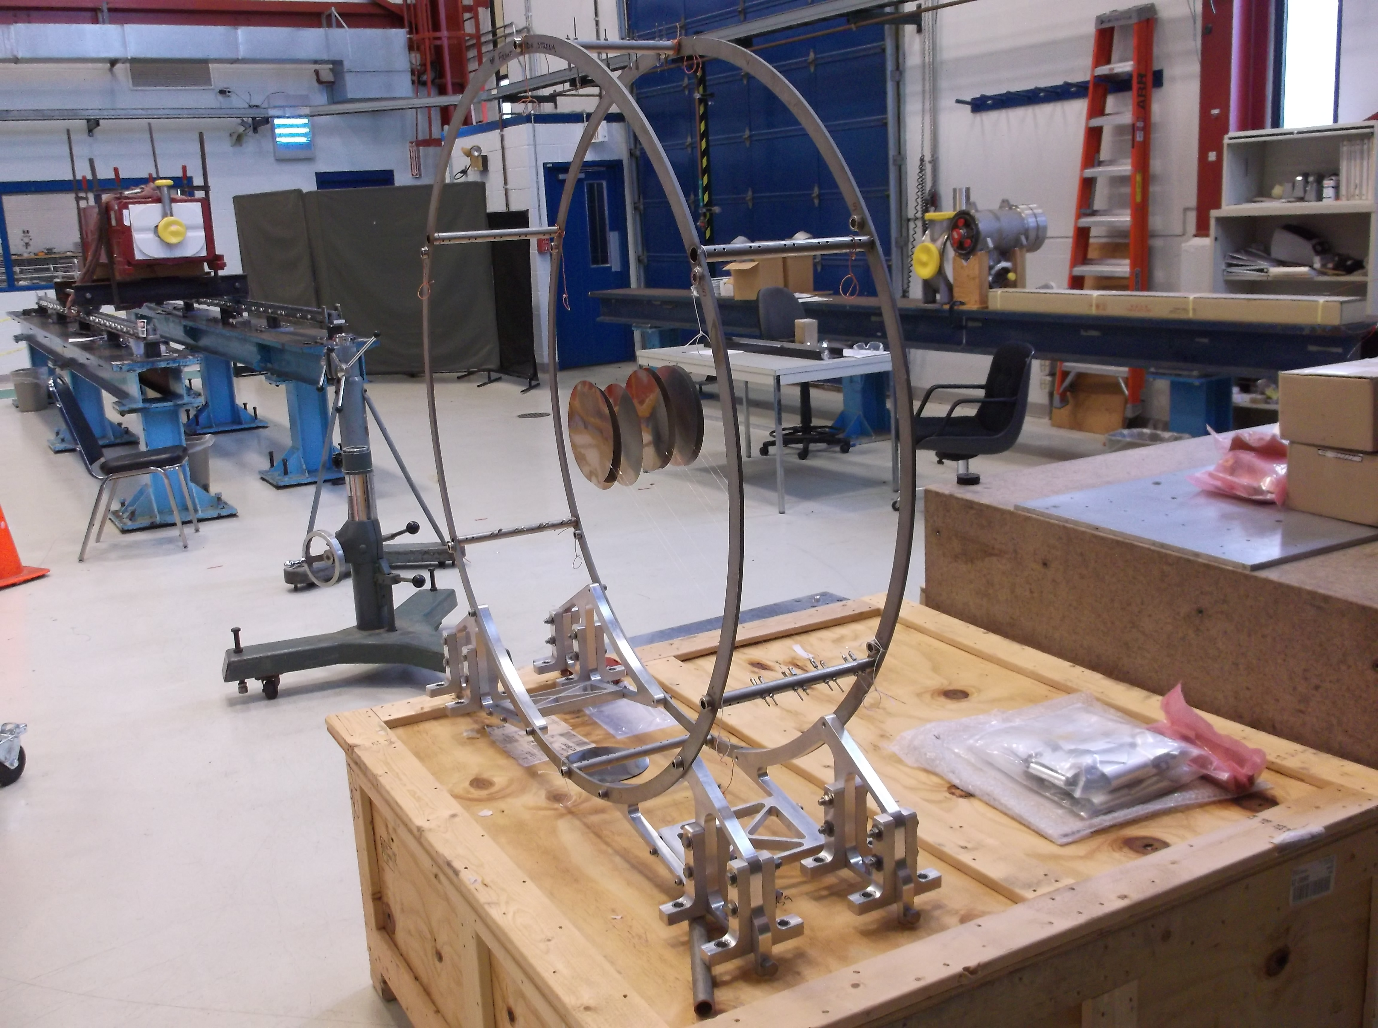

Slide 43
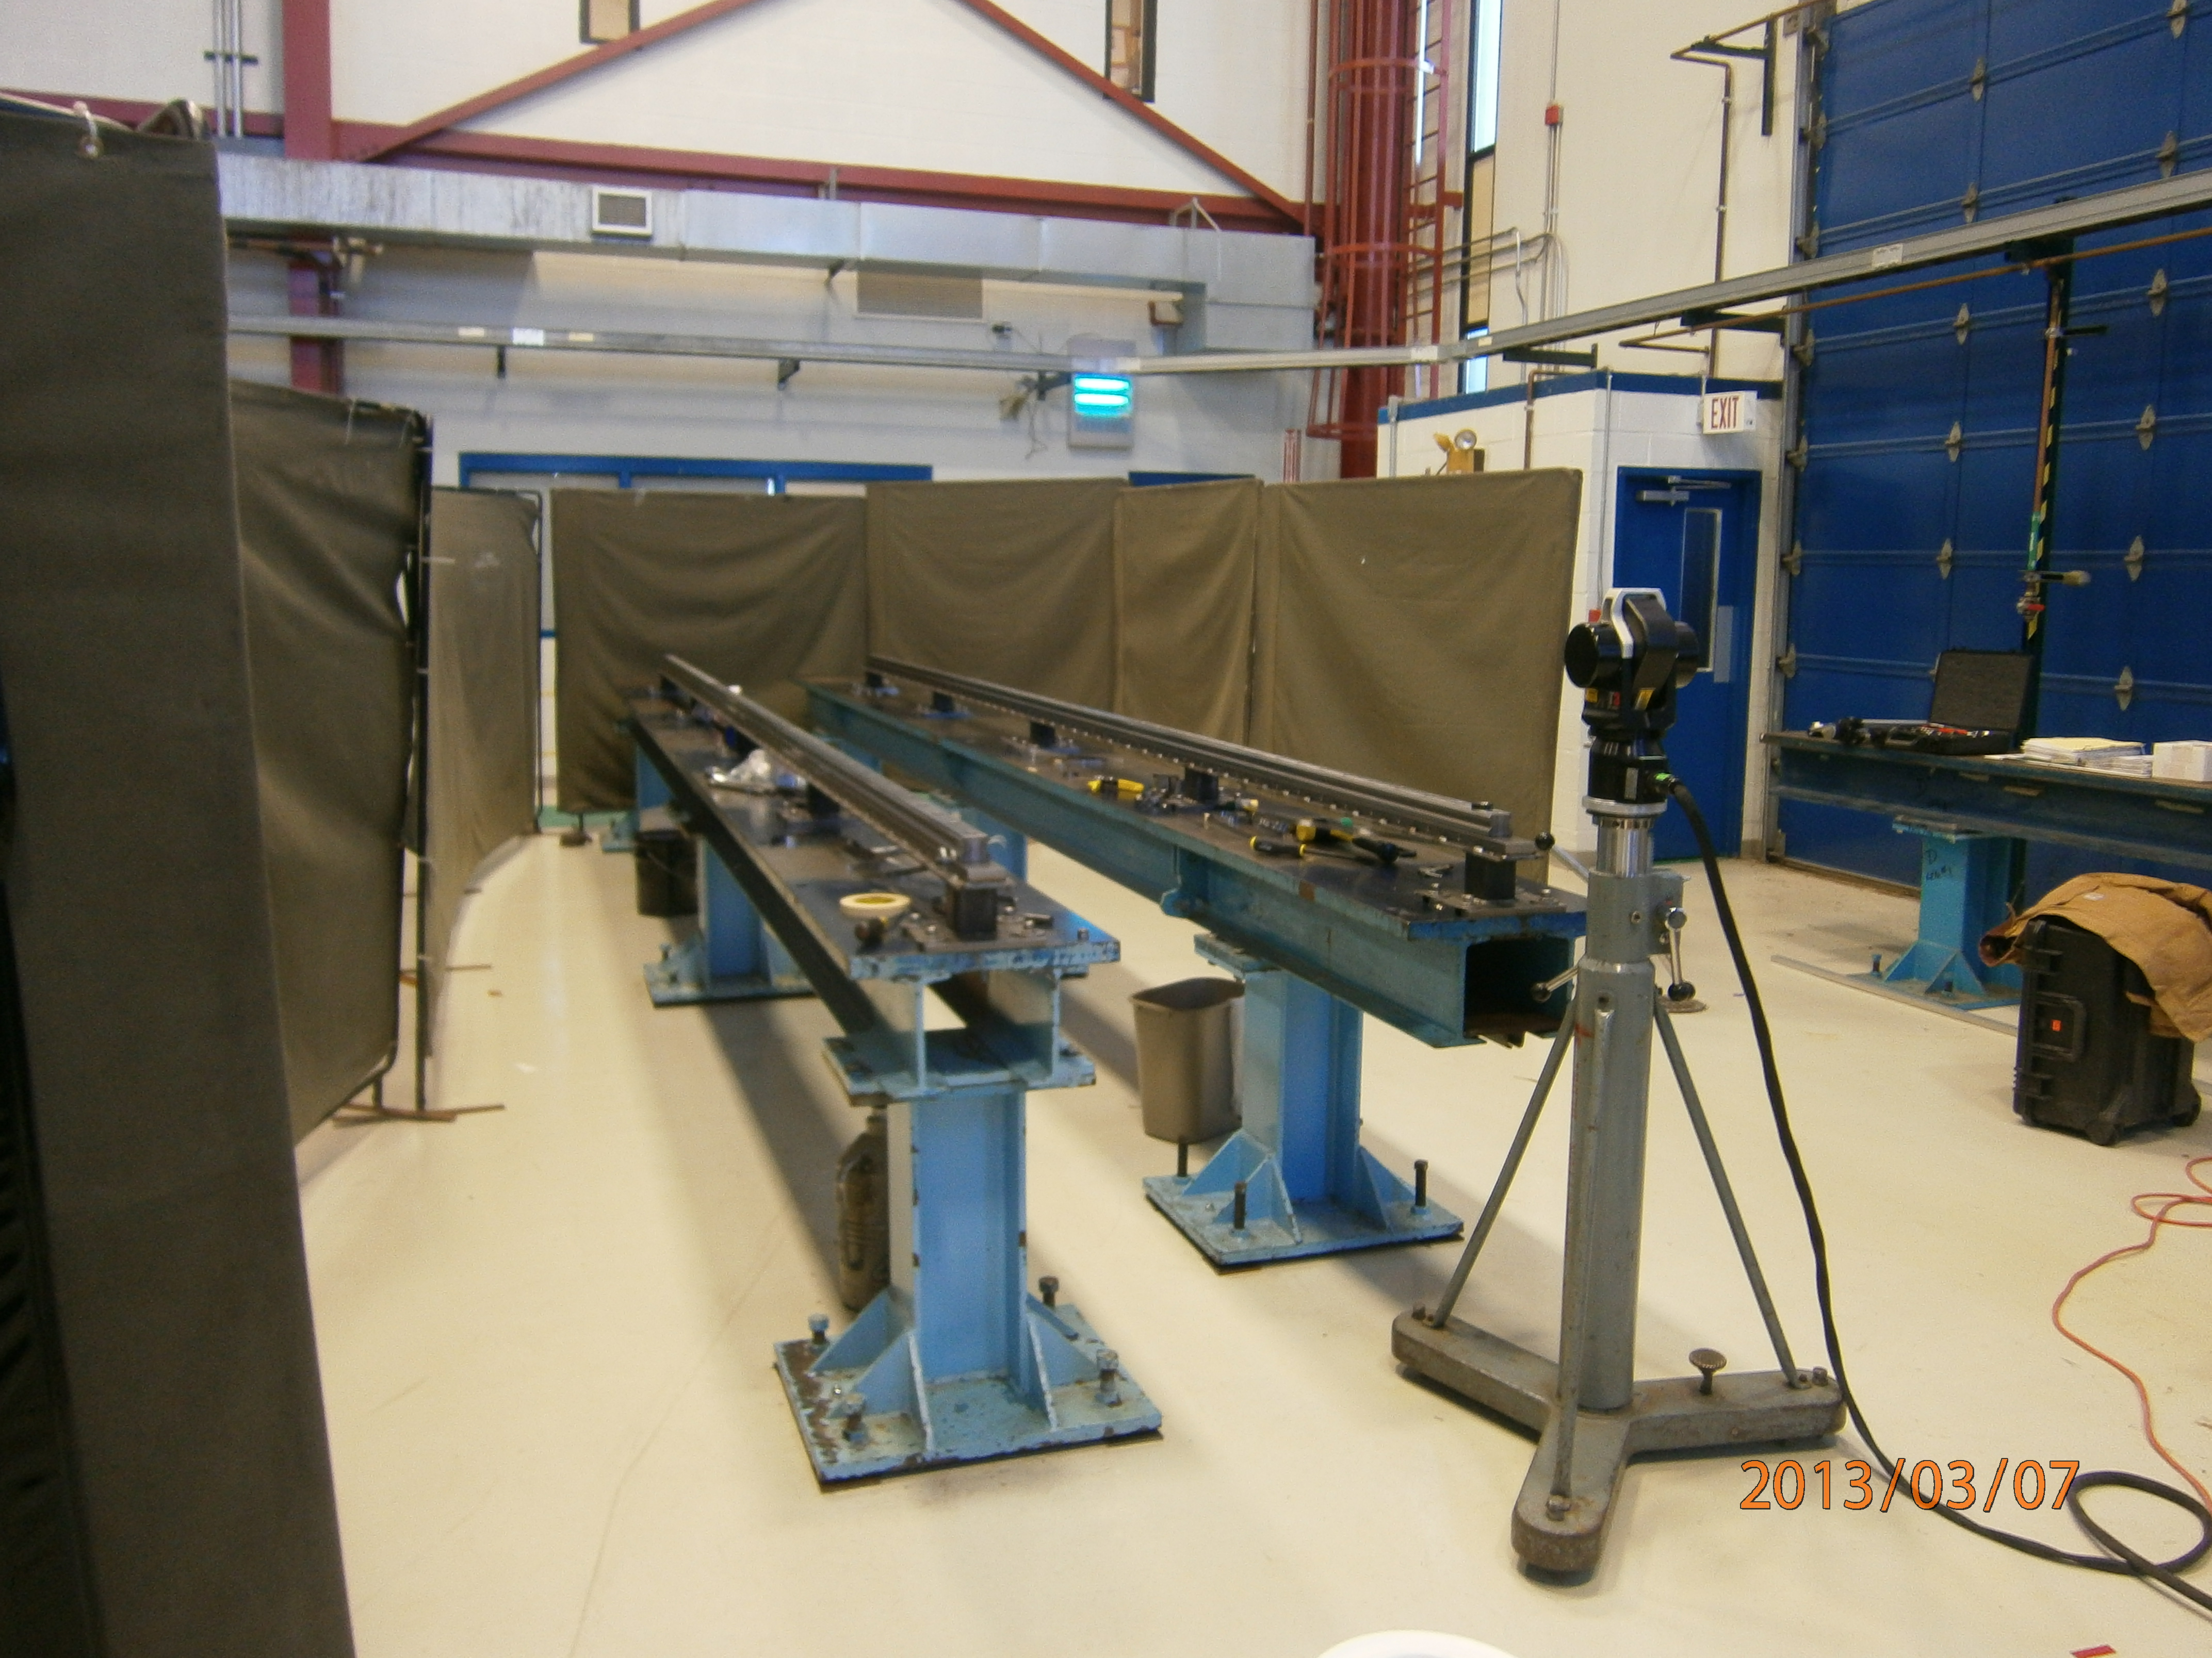

Slide 45
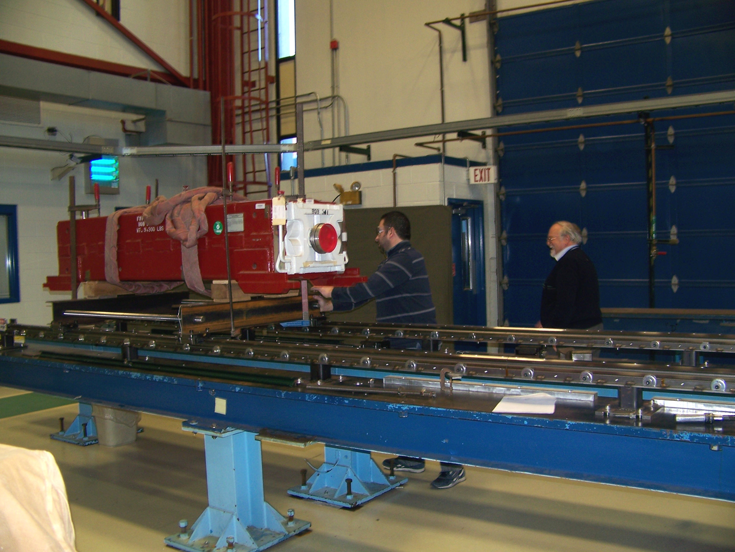

Slide 46
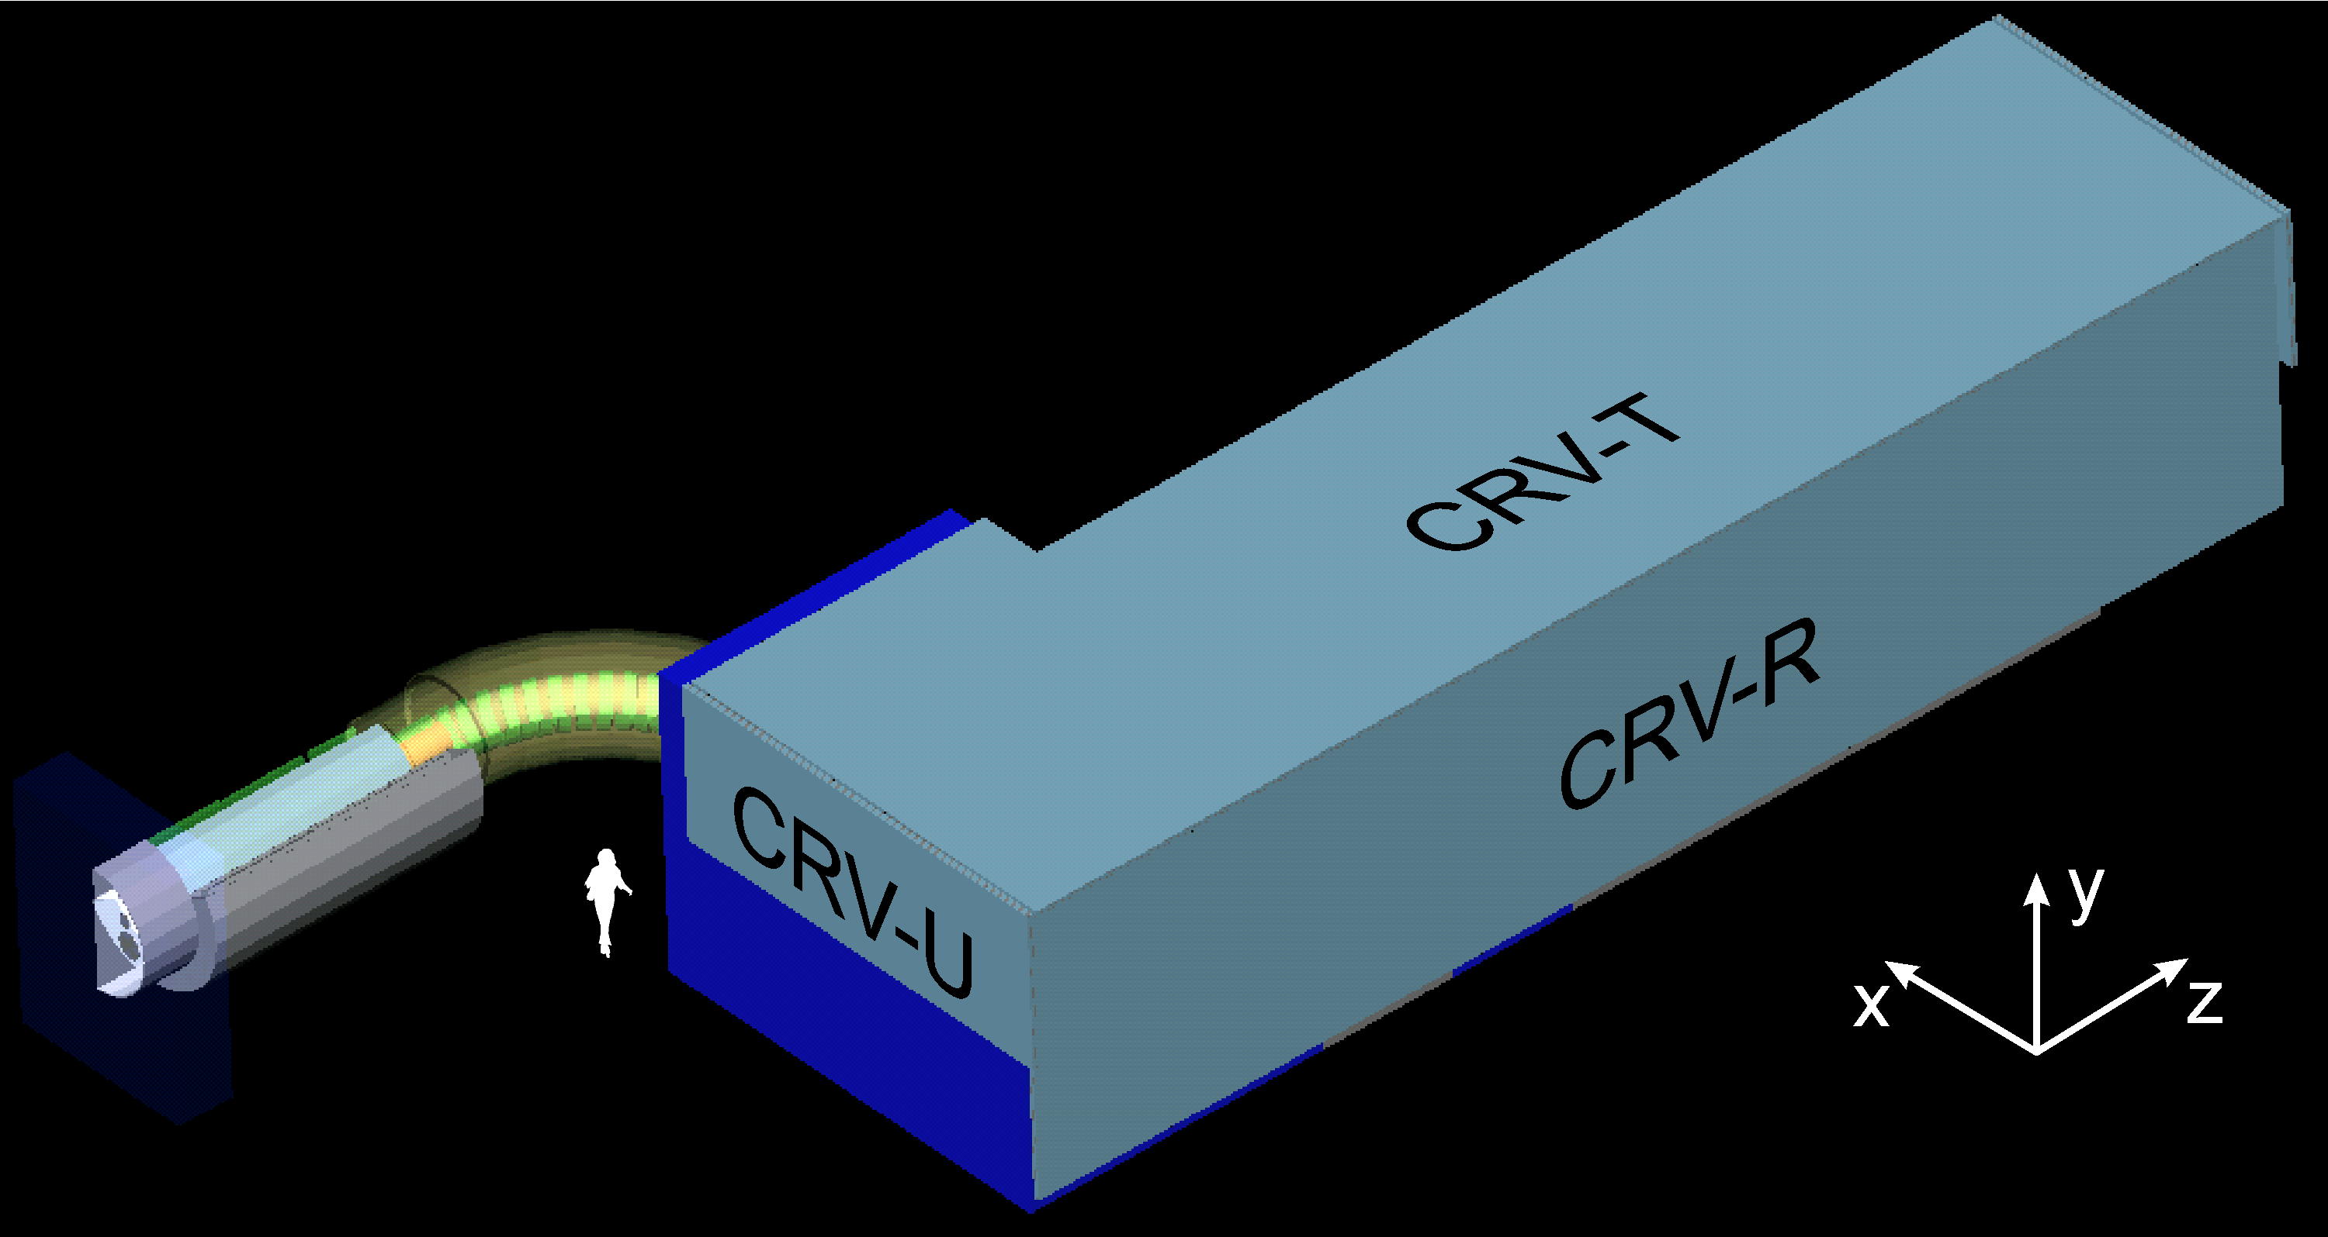
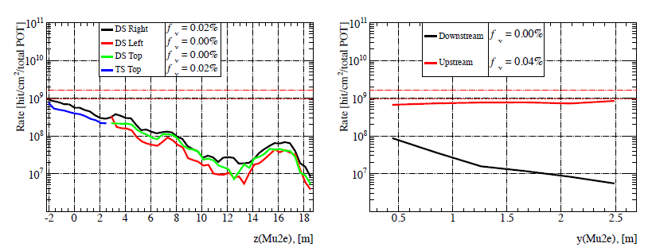
Accidental CRV rates
Accidental hit rates per unit area over the entire running period. Dashed and dotted red lines correspond to 1% and 5% fractional dead time assuming uniform flux distribution.
CRV deadtime requirement is ≤ 10%

Slide 47
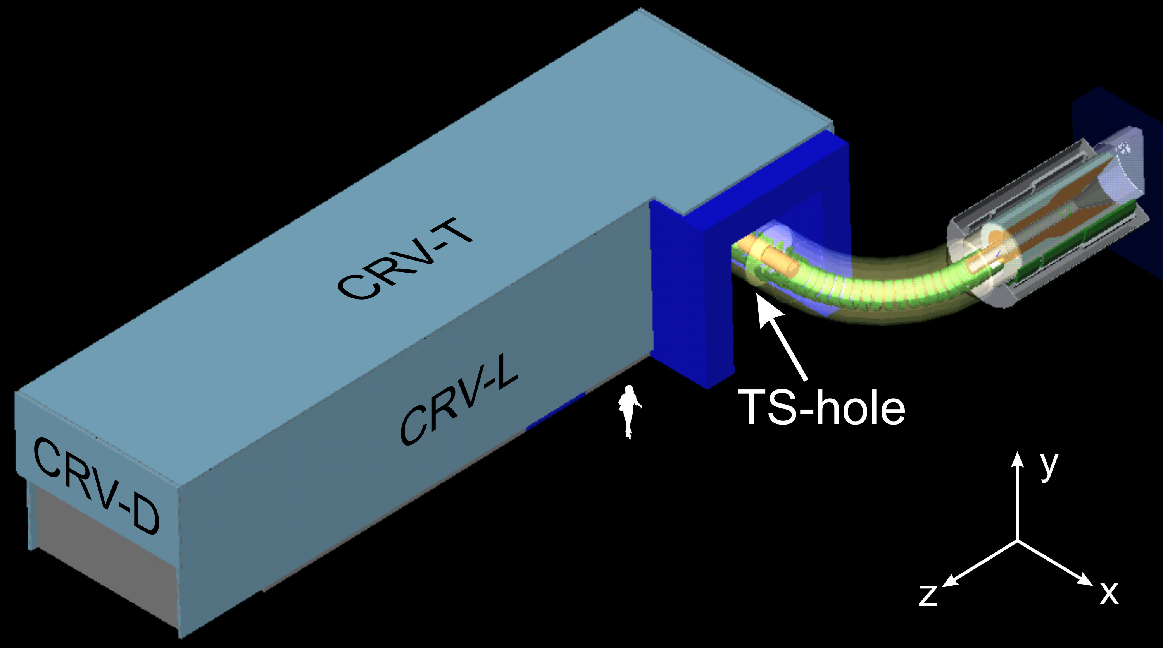
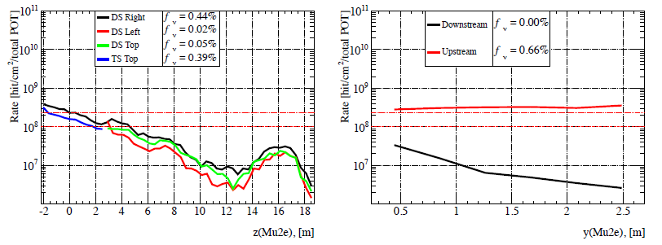
Semi-correlated CRV rates
Semi-correlated hit rates per unit area over the entire running period. Dashed and dotted red lines correspond to 1% and 5% fractional dead time assuming uniform flux distribution.
CRV deadtime requirement is ≤ 10%

Slide 48
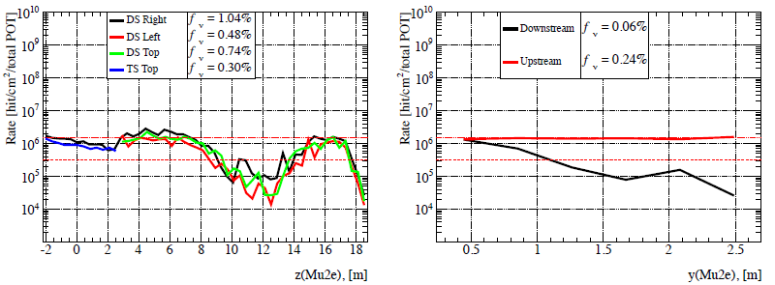
Correlated CRV rates
Correlated hit rates per unit area over the entire running period. Dashed and dotted red lines correspond to 1% and 5% fractional dead time assuming uniform flux distribution.
CRV deadtime requirement is ≤ 10%

Slide 49
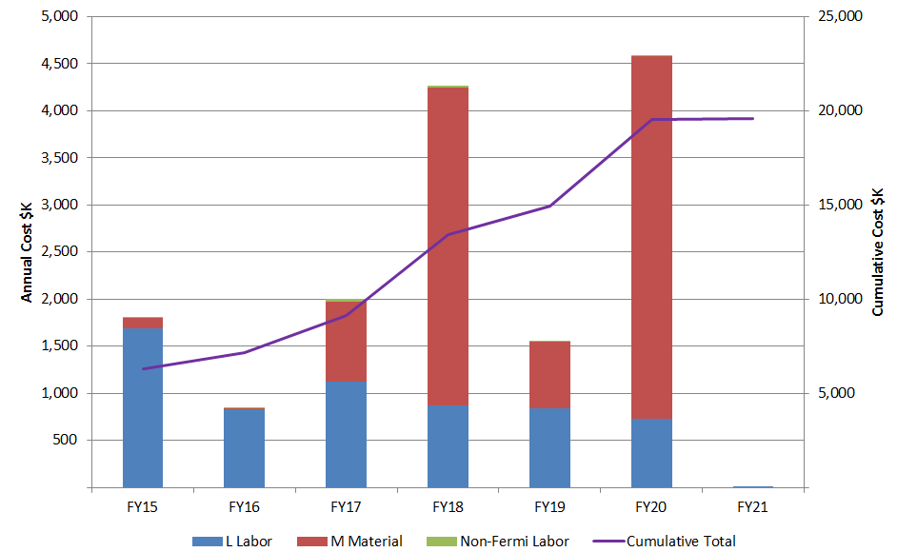
Labor and Material per FY in AYk$

