Slide 1
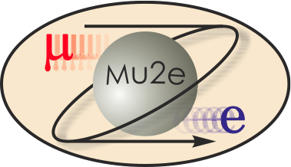
Delivery Ring RF 475.02.06
Mu2e DOE CD-2 Review
Joseph E. Dey
L3 Manager
10/21/2014

Slide 2
WBS 475.02.06 Delivery Ring RF
The Delivery Ring’s 2.4 MHz RF systems purpose is to produce an efficient transfer of beam from Recycler and to preserve a 250 ns bunch structure in the Delivery Ring.

Slide 3
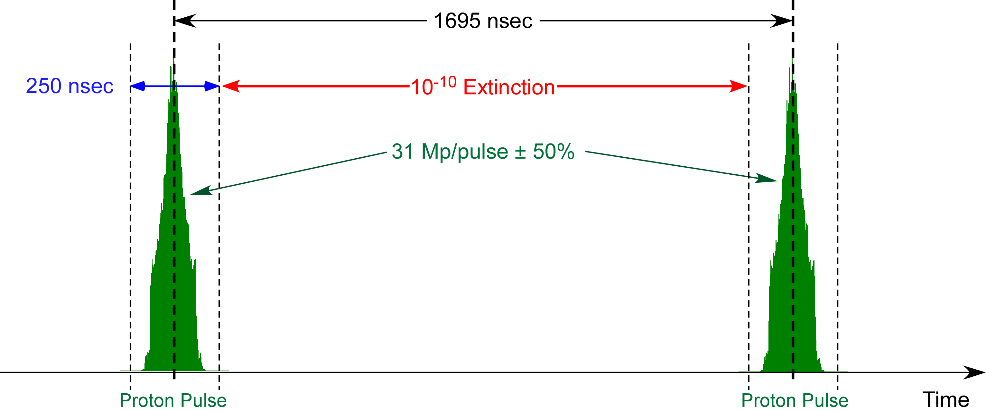
Proton Beam Requirements
The bunch length requirement is primarily accomplished by the Recycler Ring 2.5 MHz RF system (Recycler AIP).
The function of the Delivery Ring 2.4 MHz RF system is to preserve the narrow bunch width received from the Recycler.
Bunch Length Requirements Full width
Mu2e | g-2
250 nsec | 149 nsec
The g-2 experiment uses the same Recycler 2.5 MHz system for their bunch formation.
Since the g-2 requirements are more severe than those of Mu2e, the system will meet the needs of Mu2e.

Slide 4
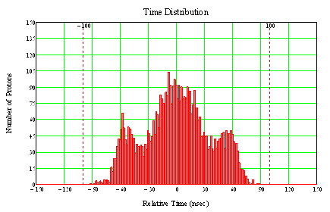
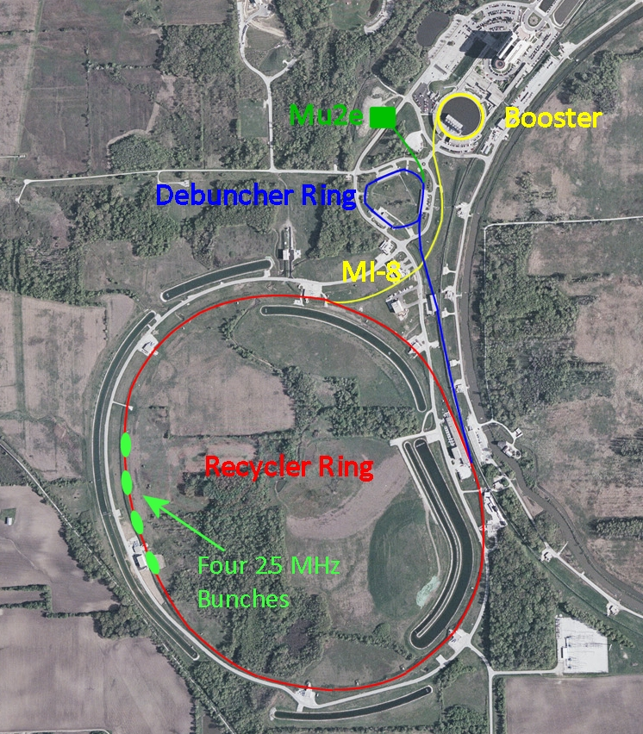
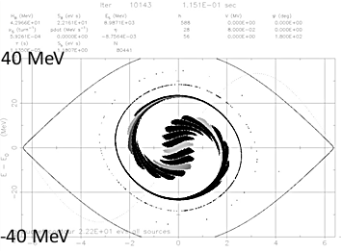
Big Picture Conceptual Design
Delivery Ring
Single bunch extraction
After bunch formation
(Δt_{FW} < 200 nsec)
Recycler

Slide 5
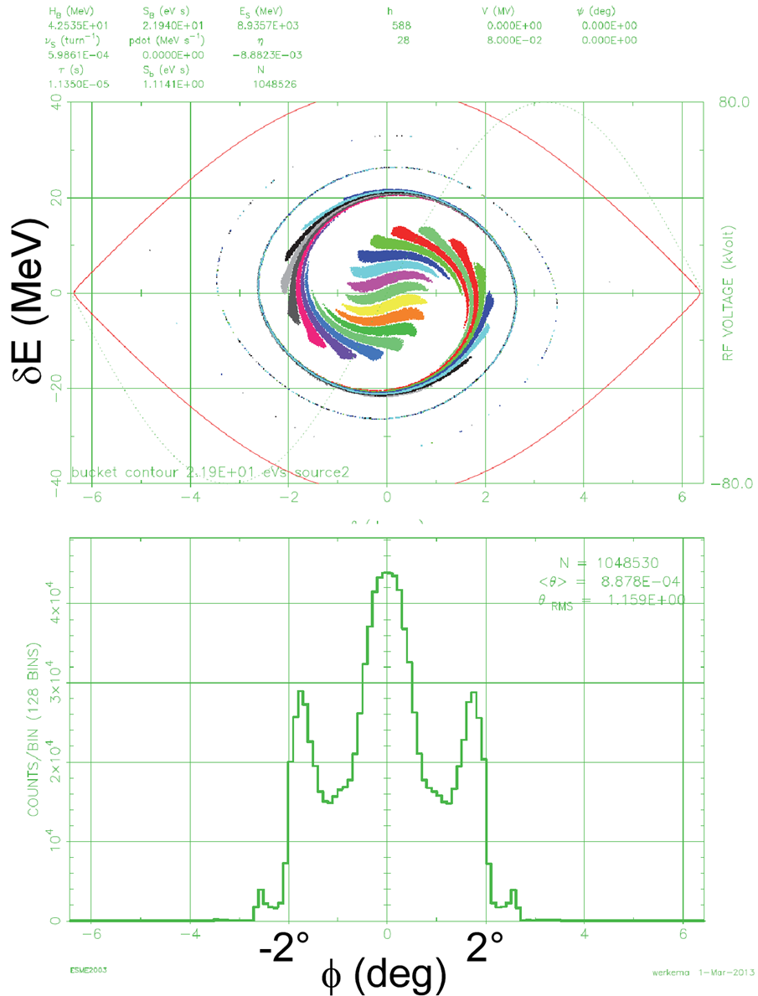
Recycler Bunch Formation
Recycler bunch shape
The 53 MHz bunched beam from the Booster Synchrotron is re-bunched with the 2.5 MHz RF system in the Recycler.
This re-bunching cycle requires 90 msec. At the end of this time, the Recycler beam consists of four bunches that occupy 1/7 of the circumference of the Recycler Ring.
This beam is extracted one bunch at a time to the Delivery Ring.
1° = 31 nsec

Slide 6
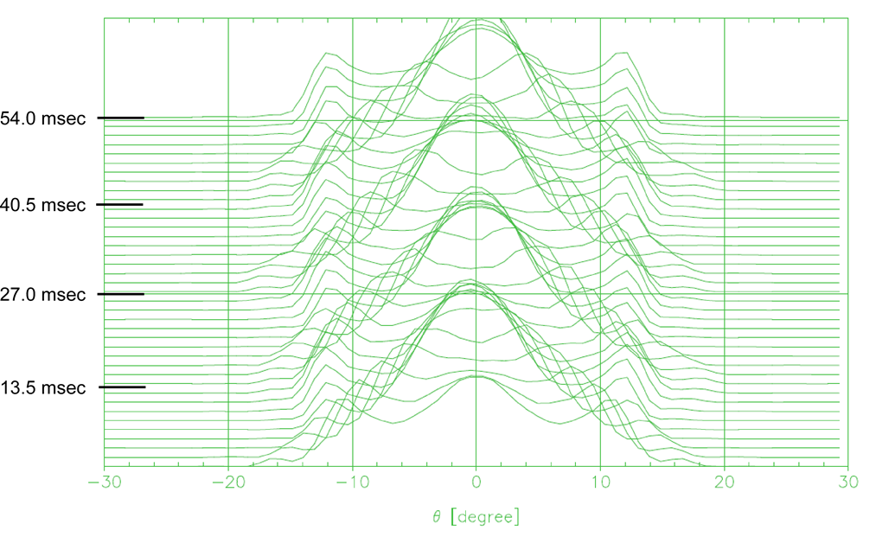
Bunch Shape Time Variation
The re-bunched beam from the Recycler is poorly matched to the 2.4 MHz RF bucket in the Delivery Ring. Thus, the beam tumbles in the bucket. The bunch shape changes at twice the synchrotron frequency (T_{synch} = 25.6 msec).
Waterfall display of the variation of the proton bunch time profile as the bunch rotates in the 2.4 MHz RF bucket. A trace is plotted every 1.35 msec over the course of the spill. The vertical axis is time relative to the start of the spill. The horizontal axis is Delivery Ring phase (1° = 4.708 nsec).

Slide 7
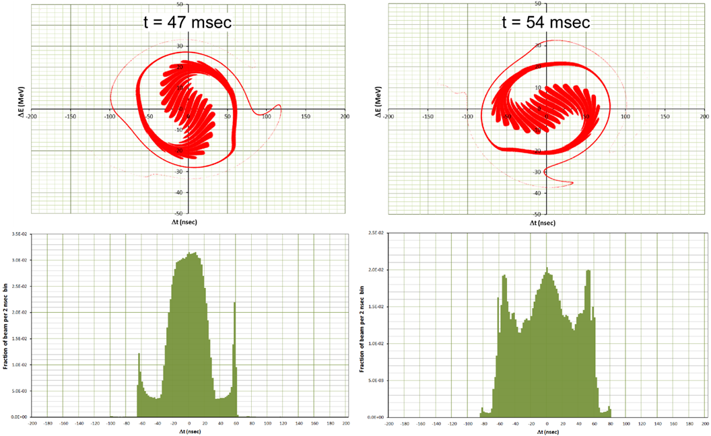
Bunch Shape Time Variation
ΔE vs. Δt
Bunch time distribution

Slide 8
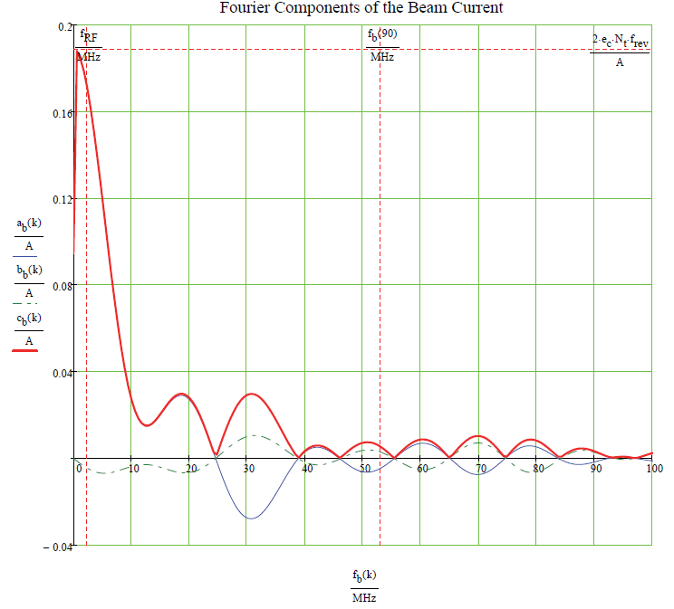
Fourier Components of the Beam
1×10¹² protons
Single Bunch
ESME Simulation
a_{b}(k) = cosine amplitudes
b_{b}(k) = sine amplitudes
c_{b}(k) = overall magnitude

Slide 9
Requirements

Slide 10
Requirements

Slide 11
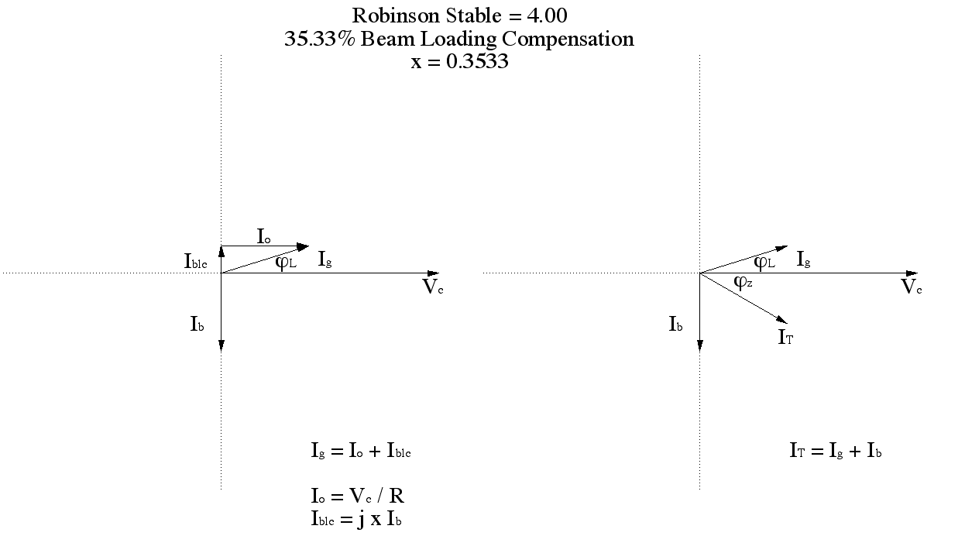
Requirements

Slide 12
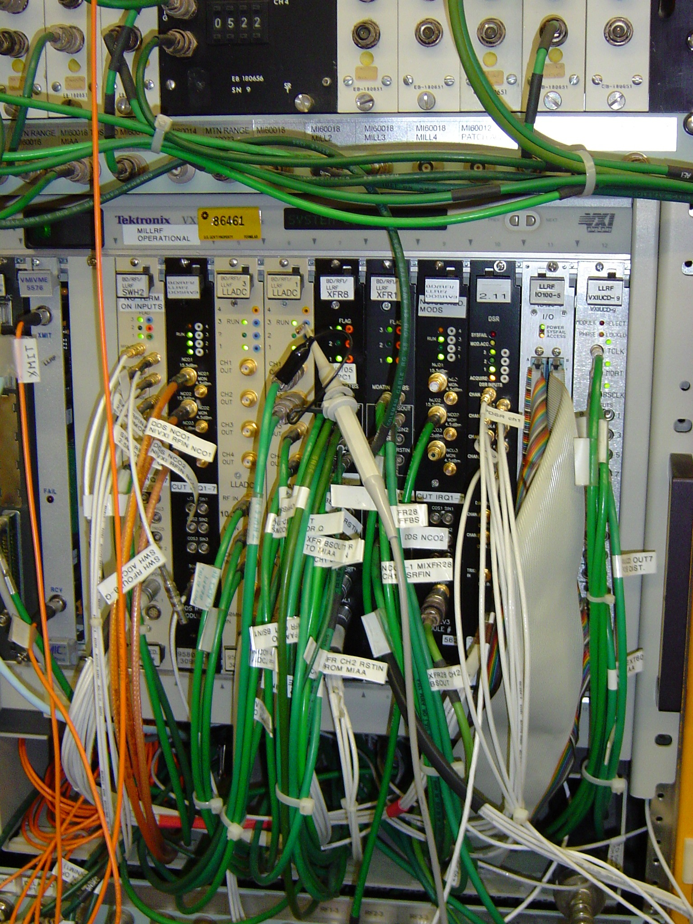
Design – Low Level RF System
Main Injector VXI Controlled Low Level RF

Slide 13
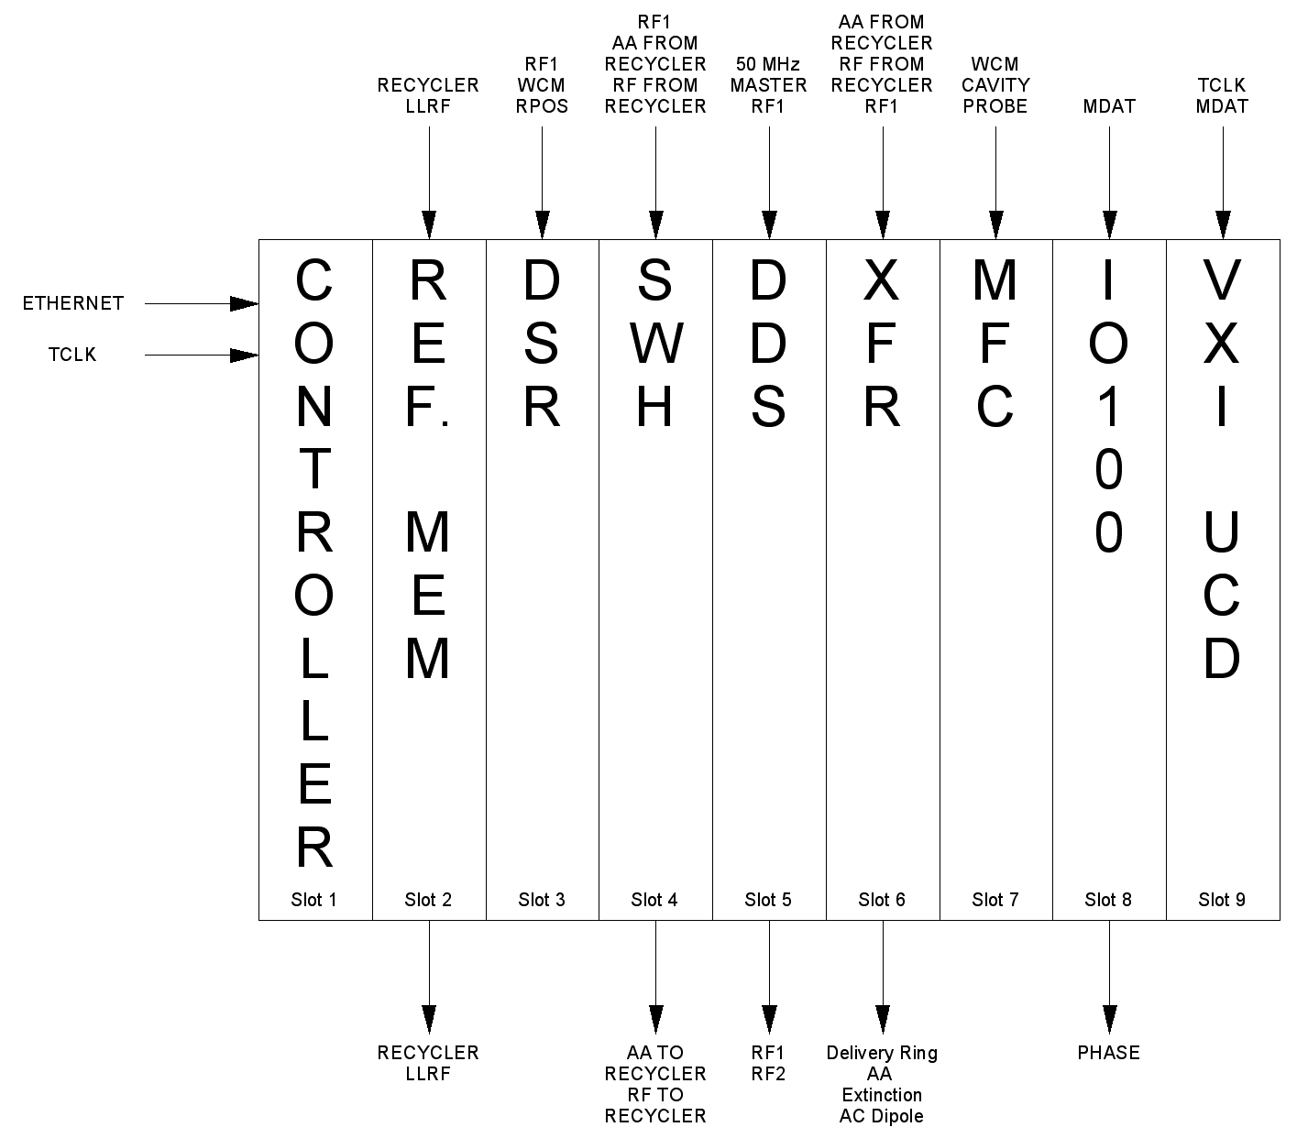
Design – Low Level RF System
VXI Crate Block Diagram

Slide 14
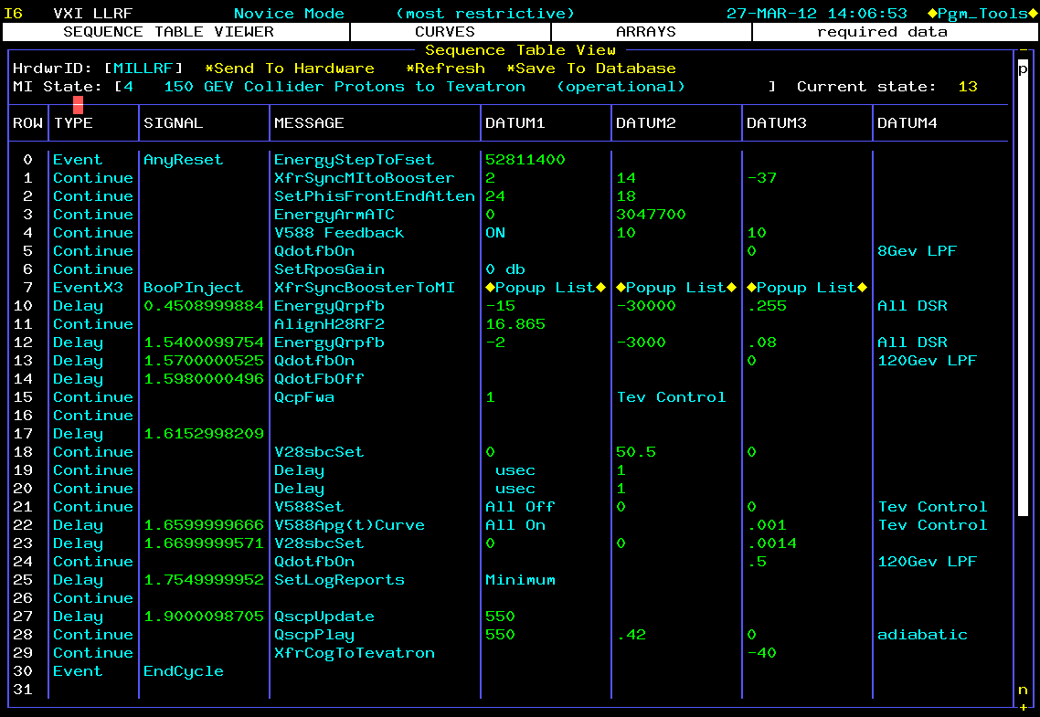
Design – Low Level RF System
Main Injector VXI Low Level RF Console Application

Slide 15
Performance – Low Level RF System
In using an embedded system LLRF, we will be able easily accommodate studies and modify operations as needed.
The LLRF system will be very similar to the existing Main Injector and Recycler LLRF systems.
In using a Console Application, one will be able to access the Delivery Ring RF from any Console onsite.
State of the art embedded systems hardware will be used for this design.

Slide 16
Changes since CD-1
BOE, 475.02.06.03 Delivery Ring RF Cooling System, was moved off Project to Recycler RF AIP.
BOE, 475.02.06.04 Delivery Ring 2.4 MHz RF, Cavity Installation and 8 kW 2.4 MHz Solid State Driver Items were moved off Project to Recycler RF AIP.

Slide 17
Organizational Breakdown
Low Level RF System – 475.02.06.01
Engineers – Brian Chase, Ed Cullerton, Philip Varghes
Technician – Dan Klepec
Delivery Ring RF Studies & Tuning – 475.02.06.02
Steve Werkema, Dave Peterson,
Dave Vander Meulen and Joe Dey
Delivery Ring 2.4 MHz RF -475.02.06.04
Physicist – Steve Werkema

Slide 18
Quality Assurance
Low Level RF System – Will have been completely bench tested and documented before being released to the project.

Slide 19
Risks
Risks from TDR
Low Level RF System – No risks are noted here.
Delivery Ring RF Studies & Tuning – No risks are noted here.

Slide 20
ES&H
LOTO procedures will be written for the Operation of the Delivery Ring High Level RF and for the Delivery Ring RF Cooling System.

Slide 21
Cost Distribution by L4
Base Cost by L4 (AY $k)

Slide 22
Cost Distribution by Resource Type
Base Cost (AY $k)

Slide 23
Quality of Estimate
Base Cost by Estimate Type (AY $k)
Quality of Estimate of Preliminary or Better is 100%

Slide 24
Labor Resources
FTEs by Discipline

Slide 25
Cost Table
WBS 2.6 Delivery Ring RF
Costs are fully burdened in AY $k

Slide 26
Major Milestones

Slide 27
Schedule
CD-2
CD-4
Low Level RF System
Delivery Ring RF
Studies & Tuning
KPPs Satisfied
Technical Documentation
Q3 | Q4 | Q1 | Q2 | Q3 | Q4 | Q1 | Q2 | Q3 | Q4 | Q1 | Q2 | Q3 | Q4 | Q1 | Q2 | Q3 | Q4 | Q1 | Q2 | Q3 | Q4 | Q1 | Q2 | Q3 | Q4 | Q1 | Q2 | Q3 | Q4 | Q1 | Q2 | Q3 | Q4
FY14 FY15 FY16 FY17 FY18 FY19 FY20 FY21

Slide 28
Summary
Our Final Design is complete and we are ready to Baseline the schedule.

