Slide 1
Mu2e Accelerator Systems Overview: Muon Campus Projects, Procedures
Steve Werkema
Mu2e Accelerator Level 2 Manager
10/21/2014

Slide 2
Outline
Muon Campus Projects
Key Performance Parameters
Cost Estimating Procedures
Risk Management
Interface Management
Miscellaneous
Breakout talks

Slide 3
Muon Campus Projects

Slide 4
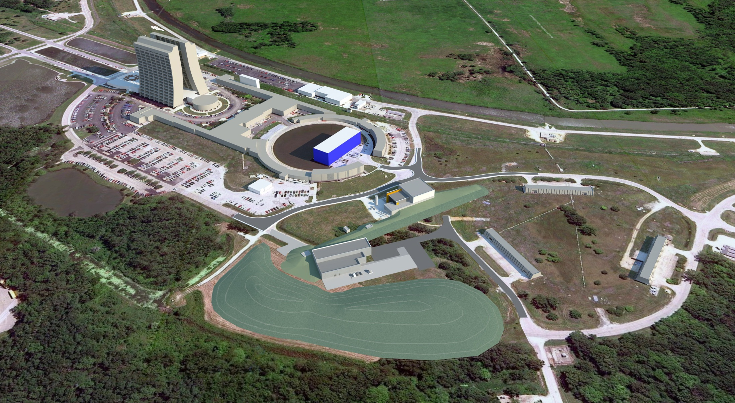
The Fermilab Muon Campus
Three General Components:
AIPs and GPPs (AIP = Accelerator Improvement Project, GPP = General Plant Project)
Mu2e project
g-2 project
g-2
Former Anti-proton Source
Mu2e

Slide 5
Scope of Muon Campus Projects
Mu2e
Delivery Ring AIP
M4
MC Beamline Enclosure GPP
D10
D50
D30
M5
g-2 is responsible for the D30 Straight Section reconfiguration and extraction from the Delivery Ring (different devices used for g-2 and Mu2e)
Recycler RF AIP
Recycler 2.5 MHz RF
Delivery Ring 2.4 MHz RF cavity and High Level system
The Delivery Ring AIP is responsible for Delivery Ring injection devices (common)
g-2
Beam Transport AIP
Single bunch extraction from Recycler
Beamline Aperture upgrades
Beam transport to Delivery Ring
(AIP = Accelerator Improvement Project)

Slide 6
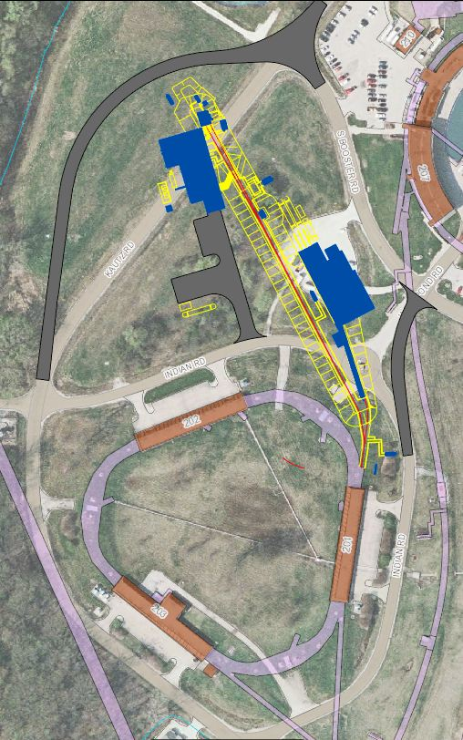
Mu2e Scope Overview
×
475.02.08.03 Extinction Monitor
475.02.09 Target Station
Mu2e
Bldg
475.02.07 External (M4) Beamline
MC-1
Bldg
475.02.08.02 Extinction
475.02.03 Instrumentation & Controls
475.02.04 Radiation Safety
Everywhere
Delivery Ring
475.02.05 Resonant Extraction
475.02.06 Delivery Ring RF
Notes:
Note: Kautz Road will not be routed around the Mu2e building – hence the big red X.

Slide 7
Required New Construction Not on the Mu2e Project
Accelerator Upgrade | Project
MI-8 beamline to Recycler Ring Injection | NOvA Project
Recycler Ring 2.5 MHz RF system | Recycler RF AIP
Delivery Ring 2.4 MHz RF Cavities and HL Amps & Cooling | Recycler RF AIP
Single bunch extraction from Recycler Ring | Beam Transport AIP
Beamline aperture upgrades | Beam Transport AIP
AP1, AP2, AP3 to M1, M2, M3 conversion & upgrade | Beam Transport AIP
Beam transport instrumentation & infrastructure | Beam Transport AIP
Beam transport controls | Delivery Ring AIP
Delivery Ring Injection | Delivery Ring AIP
Delivery Ring Abort | Delivery Ring AIP
Delivery Ring infrastructure | Delivery Ring AIP
Delivery Ring Controls and Instrumentation | Delivery Ring AIP
D30 straight section reconfiguration | g-2 Project
Delivery Ring Extraction (except ESS) | g-2 Project
Extraction line (M4) to M5 split | g-2 Project
M4 beamline enclosure | MC Beamline Enclosure GPP

Slide 8
Why Would We Do This to Ourselves?
Advantages
Exploits the common requirements of Mu2e and g-2. Integrated planning to meet these requirements reduces the combined cost of these two projects
Scheduling: moving scope that must be accomplished early to AIPs allows implementation to begin before CD-3 for either project –
Muon Campus construction is underway now and neither Mu2e or g-2 have CD-3.
Without this scheduling flexibility the g-2 run would start later (1 – 2 years) which would delay the start of the Mu2e run
Why many AIPs?
Collect common scope
Keep AIP TPCs below $10M maximum
Risk
Complicated interdependence … a setback in one project may affect the others
Mitigation: This risk is mitigated by continuous management attention
Monthly PMGs (Mu2e, g-2, Muon Campus) and POGs
Key management straddles Muon Campus project boundaries (next slide)
Interface Milestones maintained by the Muon Campus Program Coordinator

Slide 9
Muon Campus Program Organization
Chief Accelerator Officer
S. Nagaitsev
Deputy Chief Research Officer
G. Bock
Accelerator Division Head
S. Nagaitsev
Particle Physics Division Head
P. McBride
Muon Campus Program Coordinator
M. Convery (AD)
Mu2e
R. Ray (PPD)
L2 Accelerators
S. Werkema (AD)
L3 Ext Beamline: D. Still
L3 Ctrls Instrum: B. Drendel
Install Coord: C. Gattuso
Beamline Mech E: C. Ader
g-2
C. Polly (PPD)
L2 Accelerators
M. Convery (AD)
L3 Beamlines: J. Morgan
L3 Ctrls Instrum: B. Drendel
Install Coord: C. Gattuso
Beamline Mech E: C. Ader
MC-1 Building GPP
Project Director
E. Gottschalk (PPD)
Project Manager
R. Alber (FESS)
AIP Installation Coordinator
C. Gattuso (AD)
AIP Beamline Mechanical Engineer
C. Ader (AD)
Same team working on Mu2e accelerators, g-2 Accelerators, and AIP beamlines (Muon Dept.)
Common installation coordinator and beamline mechanical engineer
MC Beamline Enclosure GPP
Project Director
G. Annala (AD)
Project Manager
T. Lackowski (FESS)
MC Cryo Plant AIP
Project Director
G. Annala (AD)
Project Manager
A. Klebaner (AD)
MC Beam Transport AIP
Project Director
G. Annala (AD)
Project Manager
I. Kourbanis (AD)
L2 Beamlines: J. Morgan
L2 Ctrls Instrum: B. Drendel
MC Infrastructure Upgrade GPP
Project Director
R. Ortgiesen (FESS)
Project Manager
T. Lackowski (FESS)
MC Recycler RF AIP
Project Director
I. Kourbanis (AD)
Project Manager
I. Kourbanis (AD)
MC Delivery Ring AIP
Project Director
G. Annala (AD)
Project Manager
G. Annala (AD)
L2 Beamlines: J. Morgan
L2 Ctrls Instrum: B. Drendel

Slide 10
Interface Milestones
Interface milestone document under configuration control in the Beams Document Database
Maintained by the Muon Campus Program Coordinator (Mary Convery)

Slide 11
Mu2e Accelerator Systems Key Performance Parameters

Slide 12
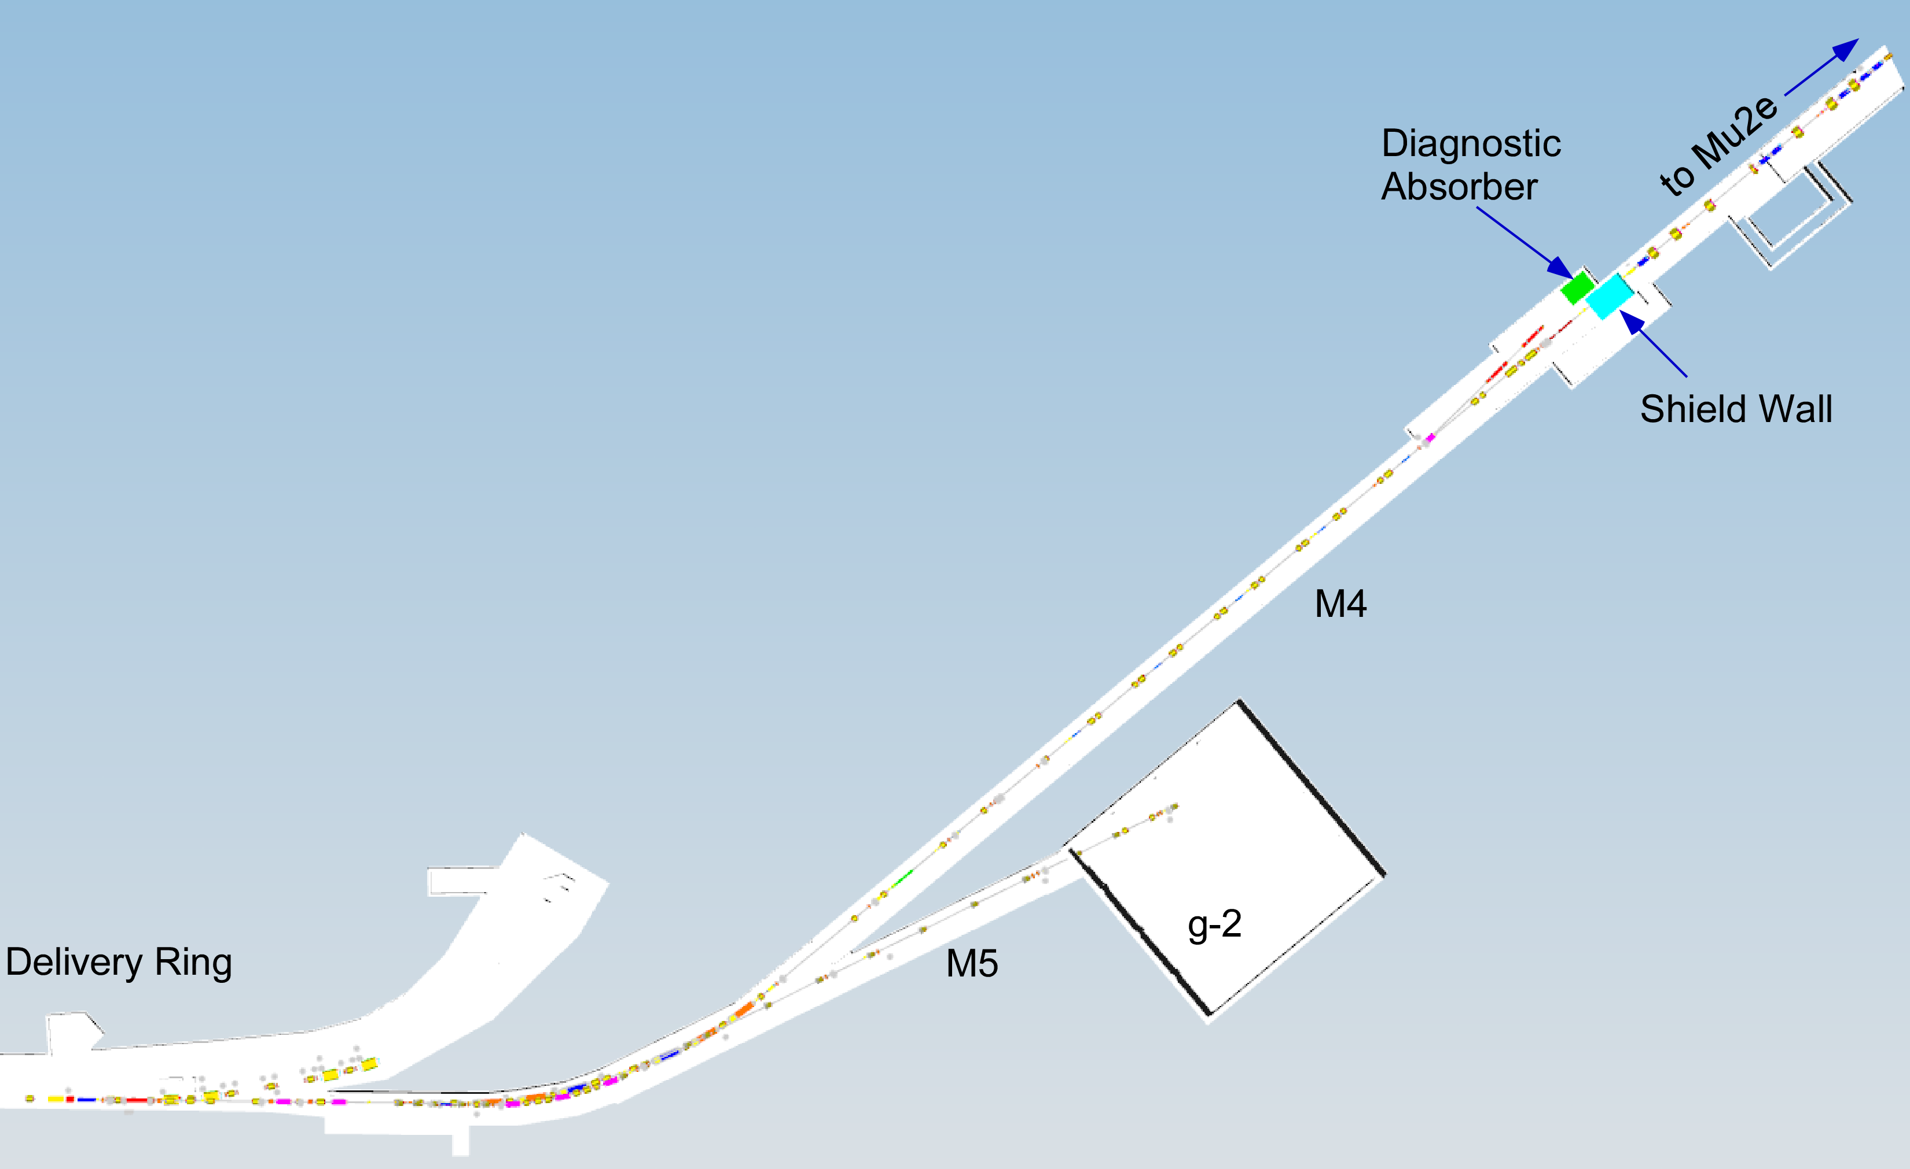
Mu2e Accelerator KPPs
Threshold Performance
All accelerator components, RF and resonant extraction components are installed and tested at nominal voltages and currents.
All target station components are complete, delivered to Fermilab and tested. Heat and Radiation Shield is installed in Production Solenoid. Other components are ready to be installed after field mapping.
Shielding designed for 1.5 kW operation delivered.
Objective Performance
Protons are delivered to the diagnostic absorber in the M4 beamline.
Shielding designed for 8 kW operation delivered.
Note: the commissioning of beam from the Delivery Ring to the Diagnostic Absorber is off-project

Slide 13
Cost Estimating Procedures
Mu2e BOEs
BOE Review

Slide 14
Cost Estimate Procedure
Project Controls (Mike Gardner) generates a BOE Report that contains an entry for every activity in the schedule (example on next slide).
Sent to every L3 manager and selected L4 managers. Posted to Mu2e-doc-3001
Updated at least Monthly
L3 and L4 managers in consultation with technical experts enter the resources, estimate uncertainties, and estimate types into the BOE report and return it to project controls.
Project Controls meets face-to-face with each L3/L4 manager to transfer the resource data into the schedule along with any associated schedule logic. This is an iterative process – adjustments are made as the schedule and cost estimates evolve.
L3 and L4 managers generate BOE Forms (details later) that contain the justification for the resources loaded for each activity.
Review: BOEs are reviewed at all levels: preparers, CAMs, L2 management

Slide 15
BOE Report
WBS | WBS Name | Activity ID | Activity Name | Most Likely Duration | Estimate Type Activity Level | Division / Section | Resource Name | Most Likely Units | Estimate Uncertainty Factor | Resource Note | Predecessors | BOE DocDB
475.02W.03.01.1 | Transport Controls and Delivery Ring Controls | 47502.03.01.1.001195 | Coordinate Implementation Plan with Delivery Ring AIP | 30 | L3 | AD | Control System Engineer | 8 | 0.25 | G Brown | 47502.03.01.1.001190 | 3703
 |  | 47502.03.01.1.001200 | Purchase Network & Communication Hardware Implementation and Closeout | 30 | M4 |  | M&S Standard with Base Year FY14 | 5000 | 0.25 | Repurposed / Pro Card | 47502.01.02.001050, 47502.03.01.1.001195 | 3703
 |  | 47502.03.01.1.001220 | Abort Link Implementation | 60 | L4 | AD | Engineering Physicist | 10 | 0.3 | A Franck | 47502.03.01.1.001200 | 3703
 |  |  |  |  |  |  | Electronics Design Engineer | 100 | 0.3 | D McArthur | 47502.03.01.1.001200 | 3703
 |  |  |  |  |  |  | Control System Engineer | 47 | 0.3 | G Vogel | 47502.03.01.1.001200 | 3703
 |  | 47502.03.01.1.001230 | Camac and Timing Links Implementation and Closeout | 60 | L4 | AD | Electronics Technician | 40 | 0.3 | TBD | 47502.01.02.001050, 47502.03.01.1.001200 | 3703
 |  |  |  |  |  |  | Control System Engineer | 10 | 0.3 | G Vogel | 47502.01.02.001050, 47502.03.01.1.001200 | 3703
 |  | 47502.03.01.1.001240 | Network Installation Implementation and Closeout | 60 | L4 | AD | Electronics Technician | 16 | 0.3 | S Conlon | 47502.03.01.1.001200 | 3703
 |  |  |  |  |  |  | Control System Engineer | 8 | 0.3 | G Brown | 47502.03.01.1.001200 | 3703
475.02W.03.01.2 | Mu2e Experimental Hall Controls | 47502.03.01.2.001090 | Purchase Controls Hardware | 30 | M3 |  | M&S Standard with Base Year FY14 | 31000 | 0.15 |  | 47502.01.02.001050, FY18B02 | 3553
 |  | 47502.03.01.2.001110 | Purchase Network and Communication Hardware | 30 | M3 |  | M&S Standard with Base Year FY14 | 45800 | 0.15 |  | 47502.01.02.001050, FY18B02 | 3553
 |  | 47502.03.01.2.001130 | Pull Innerduct | 4 | M4 |  | Electrician | 128 | 0.3 | Assumes 4 day pull for 4 workers | 47502.03.01.2.001110, 47502.03.01.2.001120 | 3553
 |  | 47502.03.01.2.001140 | Pull Cable CrossGallery(Xgal) to Mu2e | 5 | M4 |  | Electrician | 160 | 0.3 | 5 day pull for 4 workers | 47502.03.01.2.001130, 47502.03.01.2.001100, 47502.03.01.2.001090 | 3553
 |  | 47502.03.01.2.001150 | Pull Cable AP30 to Mu2e | 3 | M4 |  | Electrician | 96 | 0.3 | 3 day pull for 4 workers | 47502.03.01.2.001140, 47502.03.01.2.001100, 47502.03.01.2.001090 | 3553
 |  | 47502.03.01.2.001160 | Terminate Connectors | 20 | M4 |  | Electrician | 64 | 0.3 | Fiber Terminations | 47502.03.01.2.001150, 47502.03.01.2.001140, 47502.03.01.2.001130 | 3553
 |  | 47502.03.01.2.001170 | Controls Infrastructure | 60 | L3 | AD | Electrical Technician | 47 | 0.2 | M Colburn (FIRIS) | 47502.03.01.2.001160 | 3553
 |  |  |  |  |  |  |  | 94 | 0.2 | TBD | 47502.03.01.2.001160 | 3553
 |  |  |  |  |  |  | Control System Engineer | 14 | 0.2 | G Vogel | 47502.03.01.2.001160 | 3553
 |  |  |  |  |  |  |  |  |  | A Franck | 47502.03.01.2.001160 | 3553
 |  | 47502.03.01.2.001180 | Network Infrastructure | 60 | L3 | AD | Electrical Technician | 9 | 0.2 | S Conlon | 47502.03.01.2.001160 | 3553
 |  |  |  |  |  |  | Control System Engineer | 5 | 0.2 | G Brown | 47502.03.01.2.001160 | 3553
 |  | 47502.03.01.2.001190 | HRM Installation | 60 | L3 | AD | Electrical Technician | 188 | 0.2 | TBD | 47502.03.01.2.001160 | 3553
 |  |  |  |  |  |  | Control System Engineer | 4 | 0.2 | G Vogel | 47502.03.01.2.001160 | 3553
 |  |  |  |  |  |  | Computing Services Specialist | 64 | 0.2 | TBD | 47502.03.01.2.001160 | 3553
This is a small portion of the Instrumentation and Controls part of the BOE report
The BOE Report is a working document
The BOE Report is the vehicle by which the L3, L4 managers and project controls communicate with one another about schedule and resource information
Notes:
all of the required information is entered in this example

Slide 16
Access to Mu2e BOEs
Mu2e Accelerator BOEs are accessible from the Accelerator page on the review web site:
http://mu2e.fnal.gov/public/project/reviews/cd2-review/accel.shtml
The Mu2e doc # links take you to the Mu2e doc DB item containing the BOE and its supporting documents.

Slide 17
BOE Doc DB contents
BOE Form
(Often there are more than one)
Supporting Documents
BOE Report spreadsheet
BOE Review and Response

Slide 18
Mu2e BOE – Page 1
Supporting Documents – all available in the same doc DB item
BOE Review
BOE Baseline date = May 1, 2014
M&S in 2014 dollars
Notes:
I will not show the BOE change log

Slide 19
Mu2e BOE – Page 3ff
There is an entry for each Activity in the schedule
Contingency and contingency rule used are cited (Called “Estimate Uncertainty” in schedule)
Each Resource this activity is listed with quantities and justification
.
.
.

Slide 20
BOE Review
This is an excerpt from a BOE review form (Mu2e-doc-4265) for the BOE shown in the preceding slides.
The BOE review checks the following:
that all the required information is present and correct
the information given actually supports the cost estimate given
contingency rules are properly applied
resources given match the Mu2e schedule in P6
that all costs have been accounted for

Slide 21
Risk Management

Slide 22
Risks
22 Accelerator Risks in Risk Register
All risks mitigated to the extent possible
8 Threats
4 High
3 Medium
1 Low
2 Opportunities
12 Retired Risks
Detailed mitigation plans for all risks are documented in risk forms in the Mu2e doc DB and are linked from the Risk Register (docdb column)
All risks are understood and under control
Details on specific risks will be provided in the breakout session

Slide 23
Risk Register
Links to risk forms
Notes:
The link to the Mu2e Risk Register can be found on the Review Web site on the Documentation Home page.

Slide 24
Interface Management

Slide 25
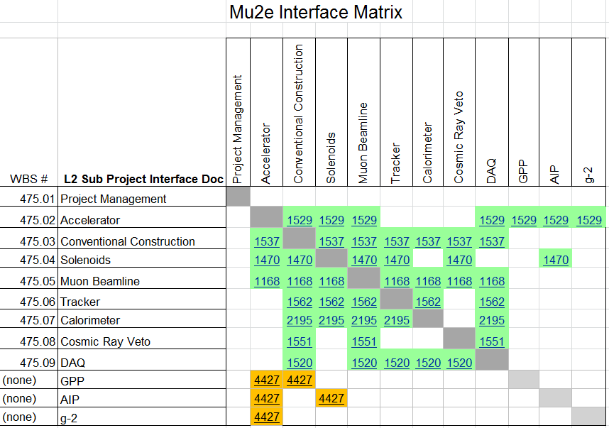
Project Interface Matrix
Available on Project Management page of the review web site under “Requirements and Interface Documents”
Accelerator Interface Document
Notes:
All interfaces with WBS 475.03 (Conventional Construction) are under change control and have been formally signed by the interface owners.

Slide 26
Accelerator Interface Document
Accelerator Interface Document is divided into two sections:
Internal interfaces – interfaces of each Accelerator L3 with other Accelerator L3s
External Interfaces – interfaces of each Accelerator L3 with other Mu2e L2s and other Muon Campus projects
The Accelerator Interface document is available from the review web site

Slide 27
Accelerator Interface Document (continued)
Extract from the Accelerator Interface Document for External Beamline external interfaces
Owners are the L3 manager for the External Beamline and one of the following:
The L2 manager for the indicated Mu2e L2, or
The AIP/GPP/g-2 manager indicated by name
Reference Documents/Drawing will be created and signed by the owners prior to CD-3c

Slide 28
Miscellaneous
Technical Documentation

Slide 29
Project Management Costs
Project management costs for L2 management is in the Accelerator Project management L3.
Project management activities and costs for each L3 are contained in a L4 category called “Technical Documentation”

Slide 30
Mu2e Accelerator Breakout Session Talks

Slide 31
Mu2e Accelerator Breakout talks
Title | File | Speaker | Time (min)
Mu2e Accelerator Overview | B02-1 Accelerator Overview | S. Werkema | 30
Radiation Safety | B02-2 Radiation Safety | A. Leveling | 30
Delivery Ring RF | B02-3 Delivery Ring RF | J. Dey | 20
Target Station | B02-4 Target Station | R. Coleman | 50
Resonant Extraction | B02-5 Resonant Extraction | V. Nagaslaev | 30
External Beamline Design | B02-6 External Beamline Design | E. Prebys | 20
External Beamline Cost & Schedule | B02-7 External Beamline Cost-Sched | D. Still | 20
Instrumentation & Controls | B02-8 Instrumentation-Controls | B. Drendel | 30
Extinction | B02-9 Extinction | E. Prebys | 30
Extinction Monitoring | B02-10 Extinction Monitoring | P. Kasper | 30
Installation & Commissioning | B02-11 Installation-Commissioning | S. Werkema | 20
>>> Not shown in chronological order

Slide 32
Proposed Schedule
Tuesday Afternoon (3:10 – 5:00 pm) Combined Session
Accelerator Overview S. Werkema 40 min
Muon Beamline Overview G. Ginther 40 min
Muon Beamline Vacuum D. Pushka 30 min
Wednesday Morning (8:00 – 11:30 am)
Target Station R. Coleman 60 min
Radiation Safety A. Leveling 40 min
Break 10 min
Delivery Ring RF J. Dey 30 min
Resonant Extraction V. Nagaslaev 40 min
Instrumentation & Controls B. Drendel 40 min
Notes:
10 min. added to talk durations to allow time for questions and discussion.

Slide 33
Proposed Schedule (continued)
Wednesday Afternoon (12:30 – 2:00 pm)
External Beamline Design E. Prebys 30 min
External Beamline Cost & Schedule D. Still 30 min
Thursday Morning (8:00 – 11:30 am)
Extinction E. Prebys 40 min
Extinction Monitoring P. Kasper 40 min
Installation and Commissioning S. Werkema 20 min
Notes:
10 min. added to talk durations to allow time for questions and discussion.

