Slide 1
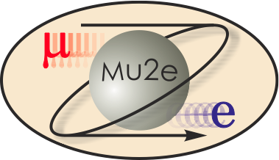
Mu2e CD-2 DOE Review Accelerator Radiation Safety Improvements 475.02.04
A. Leveling
L3 Manager, Accelerator Radiation Safety 10/21-24/2014

Slide 2
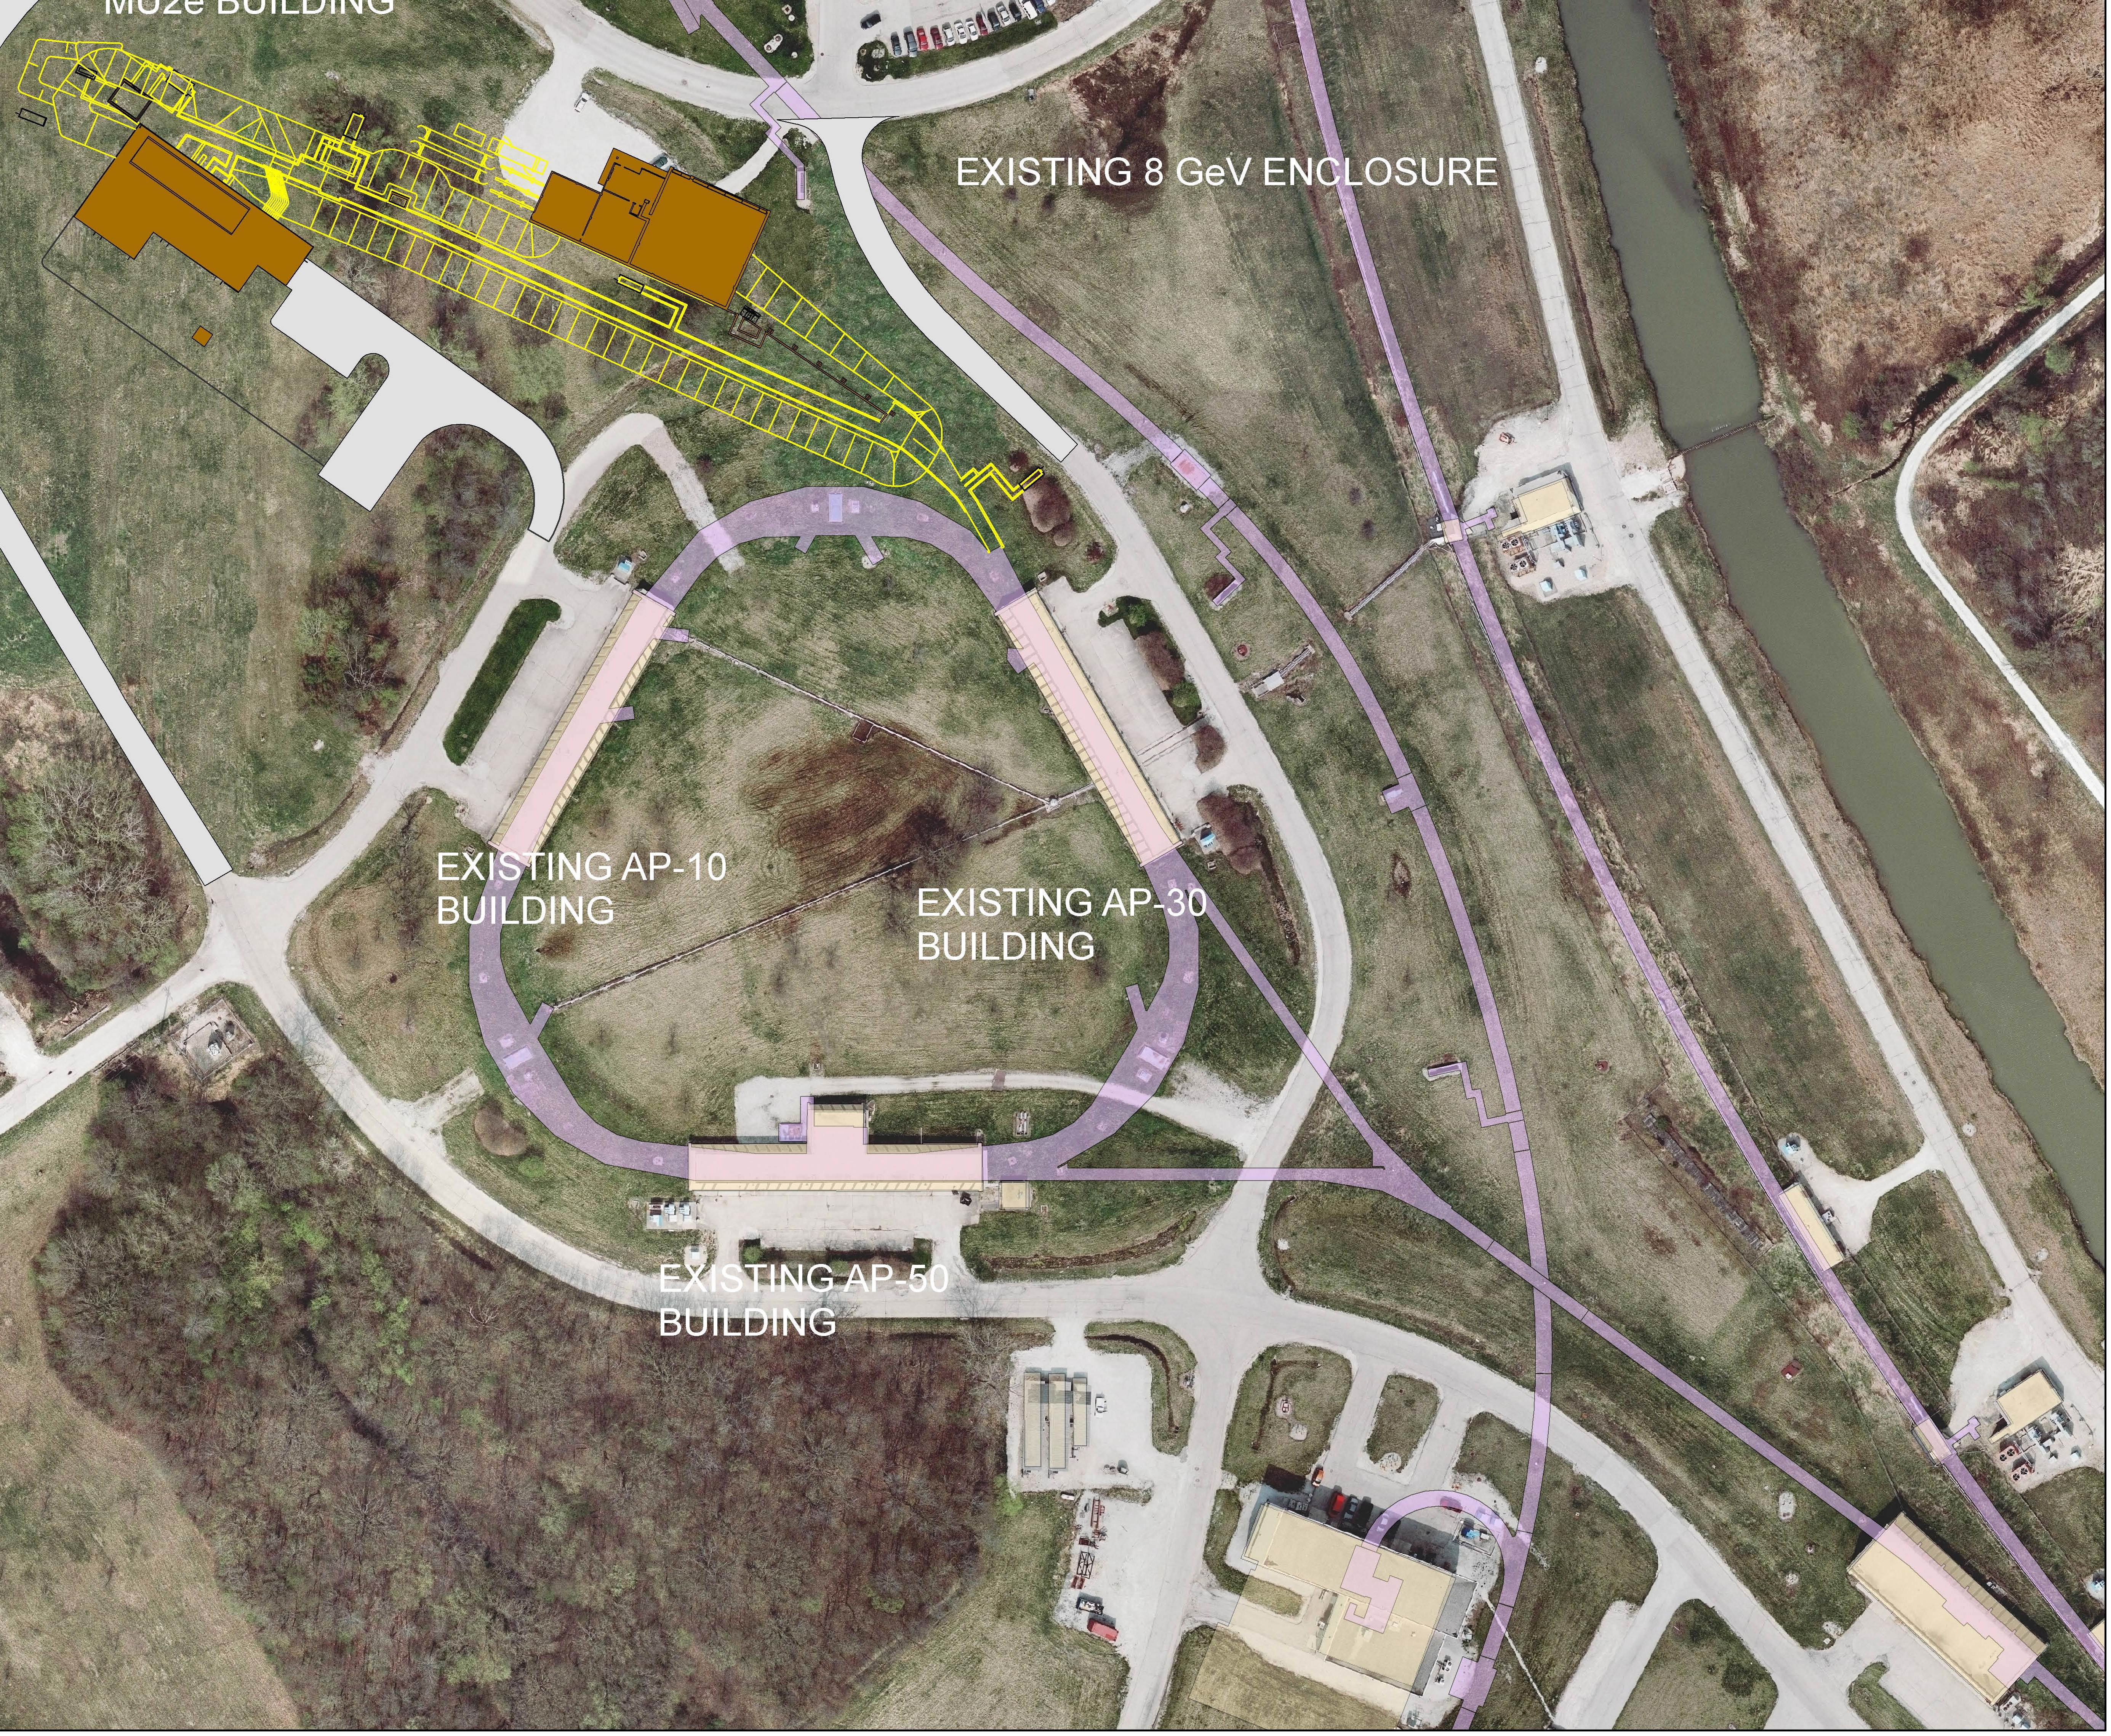
WBS 475.02.04 Radiation Safety Improvements
Scope includes:
Beam enclosure interlocks
Radiation Safety Systems
Electrical Safety Systems
ODH for the Solenoid Rooms
Muon Campus Total Loss Monitor systems
AP1 line to Delivery Ring
Delivery Ring
M4 beam line
In Tunnel shielding
Delivery Ring at AP30 extraction
Temporary shield wall at the M4/M5 intersection
M4 line shield wall at Diagnostic Absorber
Other
Friskers, wallflowers, air monitors

Slide 3
Requirements
Fermilab Radiological Controls Manual (FRCM)
Key requirements:
Prompt radiation dose rate outside beam enclosure shields
Includes radiation skyshine
Residual activation in the beam enclosures
Most notable are AP30 extraction and PS Room
Entry Controls
AP30 service building not accessible during operations
Radiological Postings
Muon campus beam lines will require Controlled Area posting
Air activation
Surface water activation
Groundwater activation
Preliminary shielding assessments
Required before going out for construction bids
Exemption Request to allow use of interlocked radiation detectors in lieu of passive shielding
The Radiation Safety Plan has to accommodate 8 kW operation

Slide 4
Design Assumptions
Antiproton Source Facilities designed for 13 watts, 8 GeV
Repurposed facilities now to operate at 8 kW, 8 GeV
Available passive shielding is insufficient to meet requirements of FRCM
Design basis:
the distribution of beam power lost
not the beam power delivered
this point will be illustrated
The design must simultaneously:
meet all requirements for the FRCM, e.g.,
Limit the severity of single-pulse, beam loss within the time-weighted average FRCM dose limits
Not require inordinate beam operation interruption to recover from interlocked radiation detector trips
Implies a critical level of shielding is required for the facility
accommodate normal beam losses

Slide 5
Design Assumptions
Known loss points
AP30 extraction region
Delivery Ring cleanup abort dump
Extinction Collimators
Diagnostic Absorber
Mu2e Production Solenoid
Mu2e Main Beam Absorber
Other potential loss points
Delivery Ring Injection
Delivery Ring Cleanup Abort beam line
Delivery Ring distributed losses due to beam scattering at extraction region
The design assumes:
beam loss at known loss points
no significant losses at other potential loss points

Slide 6
Design Activities
An in-tunnel shield design has been produced to shield the AP30 extraction region
Can be adapted to other locations if found to be required
A new radiation beam loss detector has been developed and characterized
Total Loss Monitor System
Provides continuous coverage of beam loss through areas of common shield thickness
Conservatively limits total beam loss based upon trip levels established for single point beam loss
Serves as active protection in the capacity of a credited safety system
Preliminary approval has been given by the ESH&Q Section
Complete systems are now being deployed at Booster accelerator
MARS simulations for TLM detector have been produced to predict response
MARS simulations and measurements have been made to study shield/TLM design combinations for beam loss conditions

Slide 7
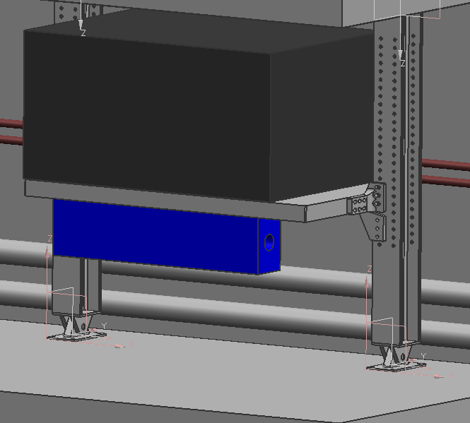
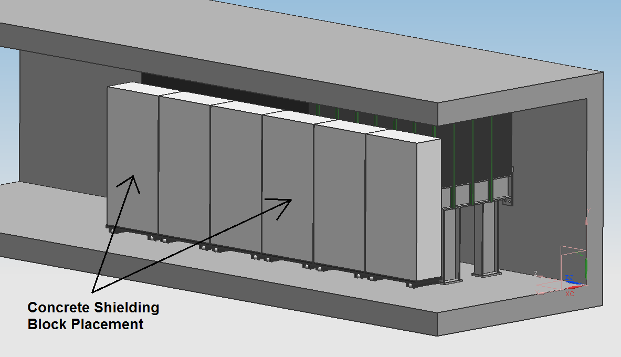
In-tunnel shielding at AP30 extraction region
The design for in-tunnel shielding has been created
Modular
Requires unobstructed clearance above the loss points
Cable trays, especially at AP30, have to be re-routed
This is already underway
Aisle shield is included to limit worker radiation exposure (ALARA)
Shield design has been incorporated into the resonant extraction line MARS simulation

Slide 8
MARS simulation is used to predict beam loss and prompt radiation effective dose with in-tunnel shielding
Inside to outside extraction
Plan view
Proton beam through the Electrostatic septa, quads, Lambertson, and cmagnet
Elevation view
Full extraction system model with in-tunnel shielding

Slide 9
Extraction system model detail
A detailed model of the aisle shield and the exit stairway near the extraction region is included in the MARS simulation

Slide 10
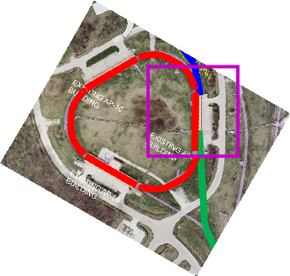
MARS simulation results for AP30 service building region
Line 1: Delivery Ring centerline – 24 mrem/hr
Line 2: Tunnel outer concrete edge – 1 to 5 mrem/hr
Line 3: Edge of service building
Line 3/4: Parking Lot 0.05 to 2 mrem/hr
Line 5: Edge of Indian Road <0.05 mrem/hr
Normal losses at extraction region running at 8 kW
Includes direct and skyshine contributions
Units are mrem/hr
A. Leveling - Radiation Safety Improvements

Slide 11
MARS simulation result for radiation skyshine – mrem/hr
Radiation skyshine has been calculated using the model for slow resonant extraction at AP30.
This model has a radius of 5 km and a height of 10 km.
Proton beam direction

Slide 12
MARS simulation result for radiation skyshine
At ground level
Wilson Hall
Site Boundary

Slide 13
MARS simulation result for radiation skyshine
In addition, the annual effective dose rate at Wilson Hall as a function of floor has been calculated based on the extraction system model. Radiation dose rates are acceptable
Wilson Hall

Slide 14
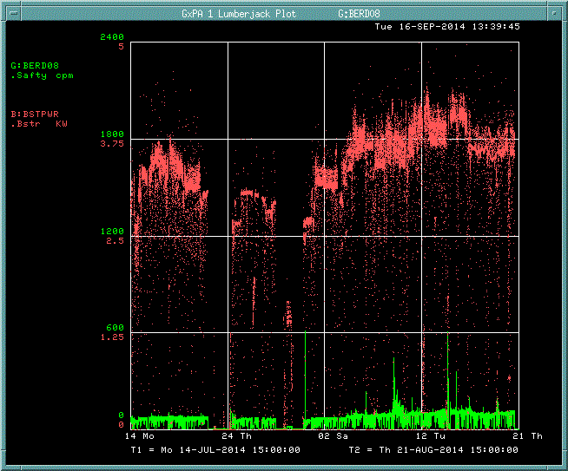
Booster Beam power/beam loss illustration & TLM Response
Proposed TLM trip limit
Booster beam power
Peak 30 to 35 kW
180’ TLM response
1/8th of the Booster Ring
A thirty-eight day operating period July 14 -> August 21, 2014

Slide 15
NuMI Beam power/beam loss illustration & TLM Response
800 foot TLM installed (green trace) at NuMI
250 kW beam transmission (red trace) & minimal losses
Losses are quite insignificant except when wire chambers are inserted for tuning
A nine day operating period October 20-> October 29, 2013

Slide 16
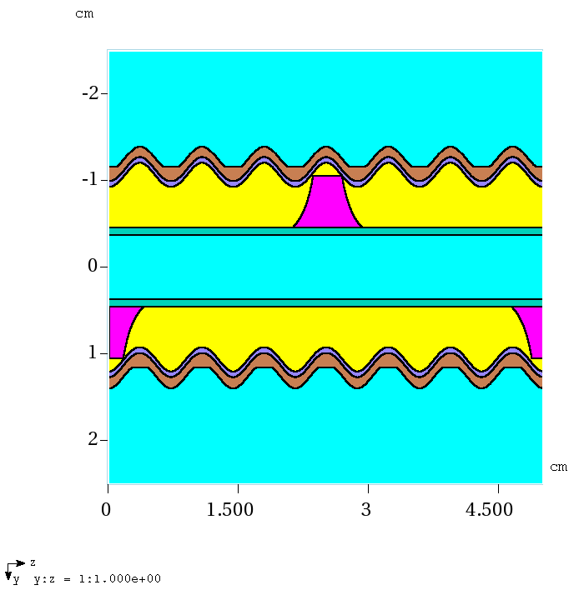
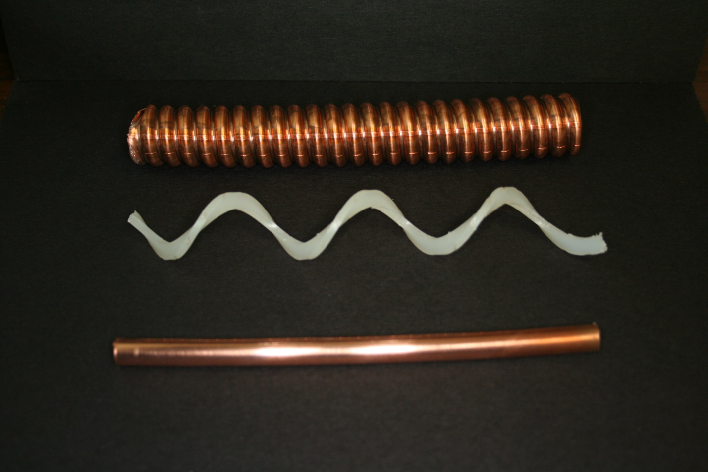
TLM detector cable
15 cm length of cable, disassembled
5 cm length of modeled detector cable
MARS model of detector cable components has been produced; MARS simulations have been compared with experimental data
It may not be possible to make measurements for every TLM detector installation; consequently, it is important to have a method to predict TLM response

Slide 17
Changes since CD-1
Developed detailed MARS models for
Slow resonant extraction system
In-tunnel shielding
Skyshine
TLM detector cable
Developed a remote method to monitor TLM detector gas flow at 25 cc/minute with commercially available detector
Added scope - external beam line shielding walls
M4/M5
M4 line DS of diagnostic absorber
Developed TLM electrometer & heartbeat
Expanded our understanding of TLM system response (Booster, NuMI, pbar)
Found an application of the TLM system which should accelerator the approval process
Booster CY14

Slide 18
Value Engineering since CD-1
Changed TLM detector gas from argon to argon/CO₂
Lower sensitivity
flatter response
Lower detector gas cost
Increases the dynamic range of the TLM system

Slide 19
TLM review status
TLM testing continues following preliminary approval
Entire Booster has been outfitted with detector systems
1/8 of the Booster has a parallel redundant TLM system
Existing credited safety system inputs (chipmunks) will run in parallel with the new TLM system
Upon completion of a test period and system documentation, we will seek final approval from ESH&Q Section
Additional MARS simulations, measurements, and inter-comparisons are planned
MI-52
MI-30
NuMI
ASTA
TLM approval is expected well in advance of Mu2e

Slide 20
Organizational Breakdown
WBS 475.02.04
Radiation Safety Improvements
A. Leveling (AD)
475.02.04.02
Delivery Ring
C. Crowley (AD)
C. Worel (AD)
M. Andrews (AD)
475.02.04.03
External Beam Line
C. Crowley (AD)
C. Worel (AD)
M. Andrews (AD)
475.02.04.04
Mu2e Safety Systems
C. Worel (AD)
475.02.04.05 Technical Documentation A. Leveling (AD)
475.02.04.01
AP1 Line TLMs
M. Andrews (AD)

Slide 21
Quality Assurance
In-tunnel shielding
AD mechanical engineer created structural design
Design is documented in an engineering note
Design is subject to two reviews:
Facility Engineering Services Section reviewed the design for compatibility with tunnel enclosure structures
AD Mechanical Review committee
Installation oversight is by AD Mechanical Support Department engineers
Radiation and Electrical Safety Systems
Proven design in use for decades at the Laboratory
The RSS and ESS designs are subject to review and approval by the ESH&Q Section
RSS and ESS undergo thorough testing every 6 months

Slide 22
Quality Assurance
TLM system design
System design is subject to review and approval by the ESH&Q section.
TLM system installation is under the purview of the AD ES&H Department Interlocks Group.
Initial testing of the detector and electrometer installation is by AD ES&H Department Interlocks Group
The TLM system will be subject to periodic calibration and testing by AD ES&H Department Interlocks Group
Specific applications of TLM systems are subject to review by the Laboratory’s Shielding Review Committee (SRC) in conjunction with the shielding review process
Final approval is by the ESH&Q Section Head

Slide 23
Risks – Radiation Safety Improvements
Risk ID | Risk Form | Risk | Impact | Probability | Action
ACCEL-020¹ | 3333 | TLMs cannot be used to limit the intensity and duration of beam loss | Technical, Schedule | Very Low | pending
ACCEL-017² | 3332 | Radiation levels outside of the mu2e facility are too high | Schedule | Low | Transferred to operations
ACCEL-152³ | 3838 | Need to install additional Delivery Ring tunnel shielding (list B) | Technical | Medium | Transferred to operations
ACCEL-150³ | 3839 | Need to install additional DR tunnel shielding (list C) | Cost | Low | Transferred to operations
NOTES:
1. Preliminary Approval has been received for TLMs. Expect final approval in CY 2015.
2. Improved MARS simulation with extraction device details indicate losses will be low enough. We will need to tune up machines to reduce losses to acceptable levels and believe this will be possible.
3. Based upon observation of losses at other machines, we believe it is possible to run with very low losses, e.g., NuMI, Booster. We will need to tune up machines to reduce losses to acceptable levels and believe this will be possible.

Slide 24
ES&H
Air activation
No unusual issues
Surface water activation
No unusual issues
Groundwater activation
No unusual issues
Residual radiation
ALARA planning
Extraction Region Maintenance
Target change out

Slide 25
Cost Table
WBS 2.4 Accelerator Radiation Safety Improvements
Costs are fully burdened in AY $k
 | Base Cost (AY K$)
 | M&S | Labor | Total | Estimate Uncertainty (on remaining budget) | % Contingency on (on remaining budget) | Total Cost
475.02.04.01 AP1 Line to Delivery Ring Total Loss Monitor System | 38 | 37 | 74 | 18 | 30% | 92
475.02.04.02 Delivery Ring Radiation Safety Upgrades | 597 | 331 | 929 | 236 | 32% | 1,164
475.02.04.03 External Beamline Safety System | 180 | 135 | 316 | 102 | 36% | 417
475.02.04.04 Mu2e Safety Systems | 171 | 164 | 335 | 74 | 22% | 409
475.02.04.05 Technical Documentation |  | 368 | 368 | 67 | 23% | 434
Grand Total | 986 | 1,034 | 2,021 | 497 | 29% | 2,517

Slide 26
Cost Breakdown – Radiation Safety Improvements
Base Cost by L4 (AY $k)
Base Cost (AY $k)

Slide 27
Quality of Estimate
Base Cost by Estimate Type (AY$k)
96% of the estimate is Preliminary or better

Slide 28
FTEs by Discipline

Slide 29
Major Milestones
47502.04.001050 | T5 - Mu2e Radiation Safety System Conceptual Design Complete | 28-Jun-12 A | T5
47502.04.001060 | T5 - Mu2e Radiation Safety System Preliminary Engineering Design Complete | 20-Dec-13 A | T5
47502.04.02.1.001004 | T5 - Resolution of revisions to beam line geometry at M4 line at extraction from delivery ring | 20-Dec-13 A | T5
47502.04.001090 | T5 - M4 Shield Wall Ready for g-2 Beam Operations | 28-Feb-17 | T5
47502.04.03.1.001080 | T5 - External Beamline Safety System Interlocks Complete | 18-Apr-17 | T5
47502.04.02.1.001075 | T5 - Start Procurement for Delivery Ring In-Tunnel Shielding | 2-Oct-17 | T5
47502.04.04.2.1050 | T5 - External Beamline Enclosure Safety Systems Complete | 24-Apr-18 | T5
47502.04.04.4.1050 | T4 - ODH Safety System Installation Complete | 25-Apr-18 | T4
47502.04.04.1.1110 | T4 - Target Hall Safety Systems Complete | 18-Jul-19 | T4
47502.04.03.3.001087 | T5 - Ready to Move M4 Shield Wall to Diagnostic Absorber | 3-Sep-19 | T5
47502.04.03.3.001110 | T5 - External Beamline In-Tunnel Shielding Complete | 14-Oct-19 | T5
47502.04.02.2.001150 | T4 - Delivery Ring TLM System Complete | 7-Jan-20 | T4
47502.04.1080 | T5 - Radiation Safety ready for beam to the diagnostic absorber | 29-Jan-20 | T5
47502.04.04.001000 | T5 - Mu2e Safety Systems Complete | 26-Feb-20 | T5
47502.04.02.001000 | T5 - Delivery Ring Radiation Safety Upgrades Complete | 21-Apr-20 | T5
47502.04.001082 | T3 - Radiation Safety Improvements Complete | 22-Jul-20* | T3

Slide 30
Schedule
Radiation Safety Technical Documentation
External Beam Line Safety Systems move M4/M5 shield wall to downstream of diagnostic absorber
AP1 to Delivery Ring TLMs complete
Delivery Ring In-tunnel shielding
External Beam Line Safety Systems install M4/M5 shield wall
ODH Solenoid Room Systems Complete
External Beam Line Safety Systems ESS/RSS installation
External Beam Line TLMs complete
Delivery Ring TLMs complete
Q4 | Q1 | Q2 | Q3 | Q4 | Q1 | Q2 | Q3 | Q4 | Q1 | Q2 | Q3 | Q4 | Q1 | Q2 | Q3 | Q4 | Q1 | Q2 | Q3 | Q4 | Q1 | Q2 | Q3 | Q4
Friskers, Wallflowers, and Air Monitors
FY14 FY15 FY16 FY17 FY18 FY19 FY20 FY21

Slide 31
Summary
A preliminary design for Radiation Safety Improvements is complete
The design anticipates final approval of the TLM system in CY15

Slide 32
Extra Slides

Slide 33
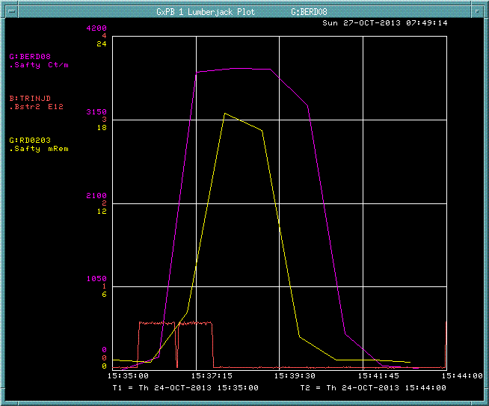
Booster 6 to 8 GeV beam loss study and TLM response
Booster accident condition, ramping radial position late in the acceleration cycle
6 to 8 GeV
TLM response (magenta)
Booster beam intensity (red)
chipmunk response (yellow)
TLM trip level (green)
The TLM trip would occur in seconds rather than in minutes as would occur with the existing protection scheme
NOTE!!! – Booster operation would not be curtailed by unnecessary safety system trips but is turned off promptly in the event of severe accident condition

Slide 34
TLM prototype electrometer

Slide 35
Booster 400 MeV beam loss study and TLM response
Response for 8 chipmunks spaced 5’ apart for
various trim magnet currents
TLM response is demonstrated to be
linear over several decades of intensity
The marriage of these data sets is the basis for establishing trip levels

Slide 36
Labor and Materials

Slide 37
Facility overview
Exit stairway details are included in the simulation
Notes:
Some other cross sections of the exit stairway

Slide 38
Normal 8 kW beam operation – Skyshine only Total effective dose rate (mrem/hr) vs distance in tissue detector
Notes:
Histogram of effective dose rate in mrem/hr due to SHYSHINE in the TE detector volume

Slide 39
DIRECT model angle of interest
Wilson Hall
500 m radii circles
Centered on
AP10
AP30
AP50
Service buildings
AP30
Notes:
The red circles are 500 m in radius with centers located at each of the three Anti-proton source service buildings. The angle of the incident beam is 0 degrees; Wilson Hall is 23 degrees CW in azimuth relative to the incident beam direction. One can imagine the cylindrical shell of the DIRECT detector (slide 18) placed upon the red circle centered on the AP30 service building.

Slide 40
X/Z plane, total effective dose rate mrem/hr
Y/Z plane, total effective dose rate mrem/hr
mrem/hr
Notes:
The full model, total effective dose rate due to radiation skyshine in units of mrem/hr are shown for the xz plane and the yz plane through the center of the Stage 2 source term. The tilt in the plume in the xz plane is due to particle momentum of the emerging particle shower. The slight tilt to the left in the yz plume is due to the proximity of the Delivery Ring extraction components to the tunnel shield wall.

Slide 41
Effective dose rate (mrem/hr) – 8 kW normal losses vs. altitude
Layers 1 through 5
Layers 6 through 10
Notes:
The average effective dose rate of each of the 10 layers of 1 km of atmosphere are shown resulting from a 1.25% beam loss.

Slide 42
8 kW beam operation with 1.25% extraction losses
Determined from SKYSHINE tissue equivalent detector layer
Bin size transition
Notes:
The average annual effective dose rate for continuous operation of the 8 kW beam with 1.25% beam loss is shown as a function of distance. The effective dose rate is averaged over the volume of each of the bins. The first 50 bins are 1 meter and the remaining bins are 10 meter wide. The break in the statistical error is due to the huge increase in bin volume starting with bin 51. Wilson Hall (0.17 mrem/year) is located at a distance of 500 meters. The West Booster Tower (1.18 mrem/year) is at 200 meters and the new MC-1 service building is approximately 100 meters from the AP30 service building (3.3 mrem/year).

Slide 43
DIRECT model
Root Geometry:
Cylindrical shell
500 m radius
0.3 m thick
70 m high
Divided into 16 levels
Divided in azimuth into 36 ten degree segments
Purpose: To capture effective dose rate at Wilson Hall as a function of floor
An addition to the SKYSHINE model
Used for determination of effective dose rate at Wilson Hall
No credit taken for the massive shielding afforded by the concrete structure
Azimuthal angle of interest is 23 degrees CW wrt incident beam direction
Notes:
The DIRECT model is essentially the SKYSHINE model with an additional tissue equivalent detector 70 meters high, 0.3 meters in thickness, and with a radius of 500 meters. The cylinder is subdivided into 16 slices, each of which is an approximate representation of a floor in Wilson Hall. Each of the layers is further divided in azimuth into 36 ten degree bins. Wilson Hall is located at 23 degrees relative to the 0 degrees in which the incident beam is directed. The center of the cylindrical shell is located at the center of the AP30 beam loss point. The tissue equivalent detector is meant to measure the direct component of the shower resulting from the Stage 2 surface as well as the reflected SKYSHINE component.

Slide 44
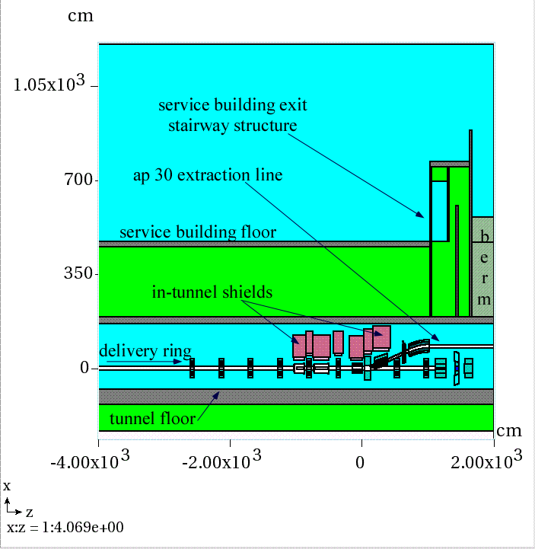
Facility overview
AP30 Anti-proton source service building
10 foot tunnel shield in service building
sufficient for 13 watts of 8 GeV protons
Building is to be repurposed for mu2e experiment
10 foot shield remains unchanged
Mu2e requires 8 kW of 8 GeV protons
Beam is to be extracted beneath the service building by 1/3 integer, slow resonant extraction
A lossy process
In addition, there is an exit stairway just downstream of the beam extraction point
Longitudinal elevation view
Notes:
If this facility was to be built in a “green field”, a more appropriate choice of shield thickness would be 18 to 22 feet depending upon the desired occupancy requirements in the service building. Due to the shielding arrangement available to us, personnel occupancy at the AP10, AP30, and AP50 service buildings will be excluded during beam operations.
Other views of the exit stairway are included in extra slides section following this talk.

Slide 45
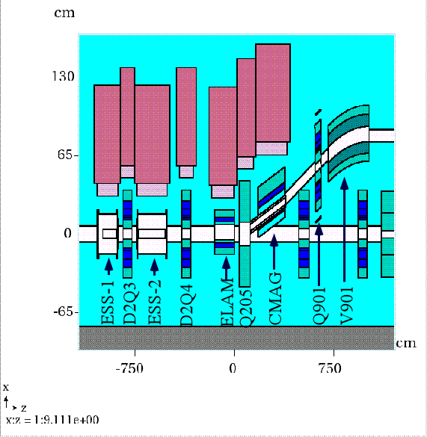
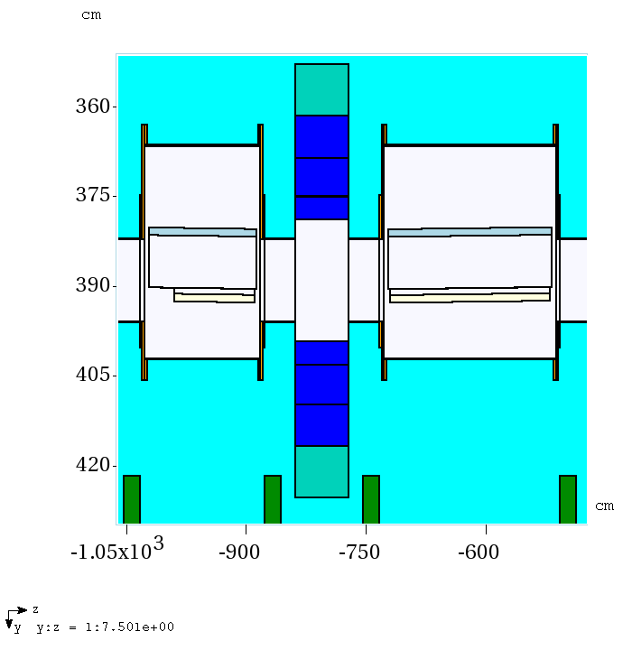
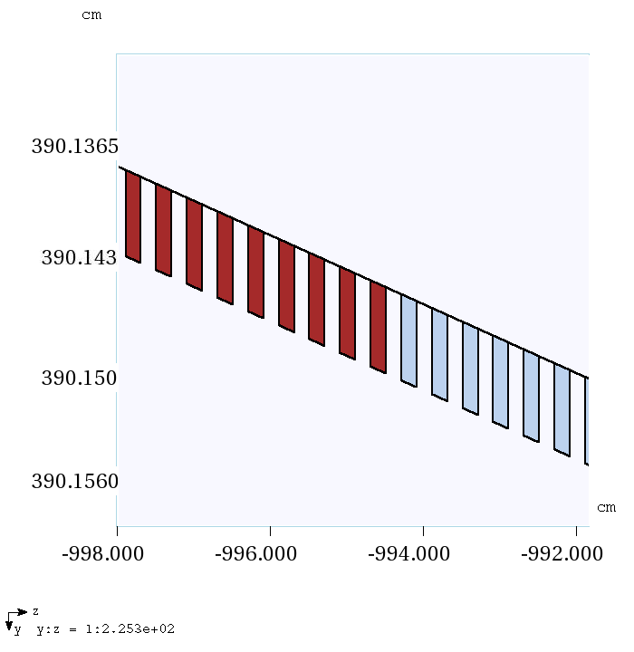
Extraction system
Graphite
diffuser foils
W foils
Foils are
2 mm x 2 mm every 4 mm
Extraction system is modeled with full details of magnets, star chambers, magnetic fields, and extraction septa foils (850)
Notes:
Details of the extraction system are shown here. The detailed nature of the septa model is illustrated. The final dimensions and materials choices for the septum foils remains to be determined. In addition, the extraction system shown has the beam extracted to the outside of the Delivery Ring. It is alternately being considered to make the extraction system toward the inside of the Delivery Ring. For these reasons, this work will need to be repeated to incorporate the final design features.

Slide 46
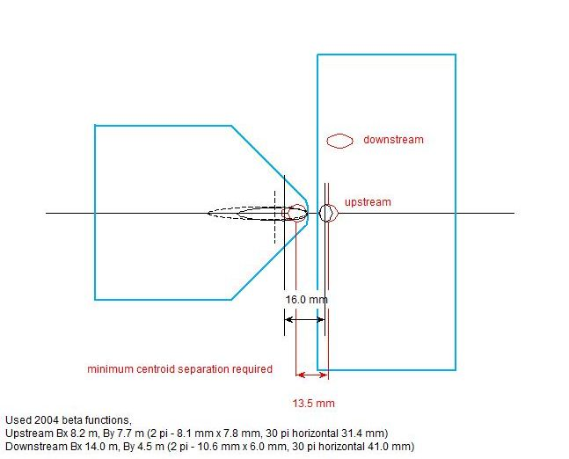
Extraction system
field free region
circulating aperture
vertical bending field
extraction aperture
Cross section of
Lambertson Magnet
critical extraction system
region where beam loss
will occur
Notes:
The circulating beam in the Delivery Ring (formerly the Debuncher Ring) passes through the non-field region of the Lambertson magnet (left side) while the extracted beam passes through the extraction channel at right where it is deflected vertically.
A large part of the beam which hits the wire plane scatters and is loss in the Lambertson magnet at the septum, a 3 mm wide steel divide between the circulating and extraction channels. The septum is required as a magnetic field flux return. The thickness of the septum is design constraint which results in unavoidable beam loss.

Slide 47
Extraction system
Plan view
Elevation view
Extraction system tuning was required to optimize apertures and minimize losses
Diffusion section wires modeled as black holes to eliminate scattering during aperture scans
Beam loss is determined to be 1.25%
Notes:
At left is a trial run with a few hundred protons directed to the extraction orbit of the Delivery Ring. The septa wires material is black hole in the illustration at left to prevent scattered beam tracks interfering with tune up of other device positions. In the left image, beam entering the extraction channel is touching the Lambertson septum which has initiated a shower. The Lambertson magnet is subsequently moved magnet so that both the circulating and extracted beams miss the septum. At right, an elevation view of the circulating and extracted beams are shown to be lossless. After this tune up is completed, the wire materials are changed back to graphite and tungsten for purposes of the shielding calculations.

Slide 48
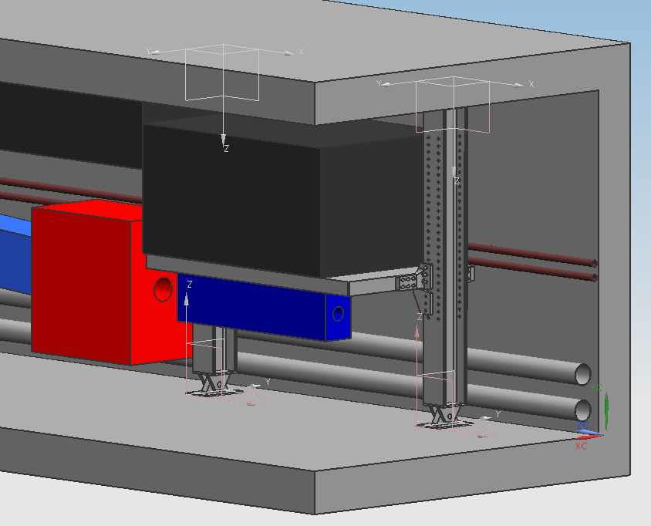
Supplemental shield system
81 cm thick steel shield
quadrupole
C-magnet
Lambertson magnet
10 cm thick steel shelf
Support columns
Notes:
Modular shield design can be adopted at any required location. The tunnel where the Debuncher Ring is located presently has cable tray running through the region where the shield is shown. All cable trays are to be removed in the tunnel beneath the AP30 service building and relocated to the other side of the tunnel. The supplemental shield system could then also be used at the injection region if it is found to be necessary.

Slide 49
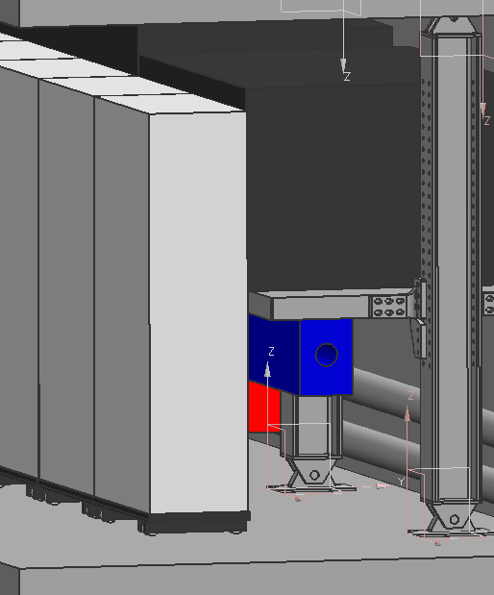
Supplemental shield system
Aisle way shield is required to limit worker exposure during maintenance activities
45 cm concrete
10 cm marble (not shown)
Notes:
Residual radiation dose rates for the extraction system devices have been calculated. The aisle shield will be useful in minimizing personnel exposure. No significant improvement was noted in earlier shielding calculation comparisons between the “no aisle shield” and “aisle shield” cases.

Slide 50
MARS simulations
Stage 1 – generate a particle source file at an intermediate surface, source term for Stage 2 run
Stage 2 – generate a particle source file at surface of service building floor for SKYSHINE and DIRECT calculations
SKYSHINE calculation
Effective dose rate at ground level vs. distance from AP30 service building
DIRECT calculation
Effective dose rate at Wilson Hall by floor elevation
Includes direct and skyshine contributions
Stage 2
Stage 1
Notes:
The number of incident particles chosen for the Stage 1 run is determined by the size of particle source file which is required for the Stage 2 run. The recommended number of particles ranges from 2E5 to 1E6 lines. Cuts can be made to exclude particles such as neutrinos and low energy particles which cannot penetrate the 10 foot thick shield. The overwhelming majority of particles crossing the Stage 1 surface are neutrons.
For the Stage 2 run, the Stage 1 generated particle file is used as the source term. The main output of the Stage 2 run is yet another particle output file to be collected at the Stage 2 surface indicated in the sketch. The Stage 2 surface also included the top surface of the exit stairway structure, though this is not indicated in the sketch. Particles of all energies are collected in the Stage 2 output file with lowest energy thresholds of the mcnp option. The EGS5 compiler option was not used in this work, so some low energy beta/gamma components, thought to be unimportant for the skyshine calculation are omitted. As in the Stage 1 run, the number of particles desired in the Stage 2 particle output file is 2E5 to 1E6.
Additional weighting factors are applied to the particle source files to ensure proper normalizations occur among the 4 MARS runs.

Slide 51
Stage 1 & 2 total flux results – mars.hbook histograms
Stage 1
Stage 2
Dashed lines indicate surface of shower particle collection
Notes:
The Stage 1 run flux histogram is shown at left. The yellow dashed line is the particle collection surface for the run.
The Stage 2 run flux histogram is shown at right. The Stage 2 particle file includes particles from both surfaces indicated by the yellow dashed lines.

Slide 52
SKYSHINE model
Not to scale
Concrete base, radius 5 km x 2m
Tissue equivalent detector, 5 km x 0.3 m
Atmosphere, 5 km radius x 10 km
A histogram volume (air) 170 cm high and 100 m x 100 m is used to determine effective dose rates in service building, parking lot, and Indian Road
Stage 2 surface lies between TE detector and histogram volume (red horizontal bar)
Tissue equivalent detector volume is just below the Stage 2 surface
In histogram volume, effective dose contribution from Stage 2 surface and reflected SKYSHINE is calculated
The tissue detector only receives reflected shower particles since the Stage 2 surface is above it
Histogram volume
Stage 2 surface
Concrete base
TE detector
Notes:
The particle file generated in the Stage 2 run is the source term for the SKYSHINE run. The values of x and z and dcx and dcz are exchanged because the model axes for the Stage 1&2 runs are rotated 90 degrees from the SKYSHINE and DIRECT runs. The source term is placed above the TE detector so that the particles are not attenuated by the TE mass. The effective dose rate resulting reflection of SKYSHINE source is recorded in the TE detector. The histogram volume receives both the DIRECT component from the Stage 2 particle source file and the reflection of the SKYSHINE. In this way, both the SKYSHINE effective dose rate as a function of distance and the total effective dose rate in the vicinity of the AP30 service building can be determined in a single SKYSHINE run.

Slide 53
SKYSHINE model
The full model
Atmosphere extends vertically 10 km in 1 km layers
Radius is 5 km
Tissue equivalent detector is subdivided radially
1 m radial bin steps to 50 m 10 meter bins to 5 km

Slide 54
SKYSHINE model – air density correction technique
MATER.INP file
A2B7 SKYSHINE calculation, 5 km - 7/31/13
1 'CONC‘
2 'TISS‘
3 'AIR' 0.00116889
4 'AIR' 0.00105969
5 'AIR' 0.000958479
6 'AIR' 0.000864832
7 'AIR' 0.00077835
8 'AIR' 0.000698646
9 'AIR' 0.000625341
10 'AIR' 0.000558071
11 'AIR' 0.000496482
12 'AIR' 0.000440233
STOP
Notes:
In previous work, it was thought that the atmosphere involved in the SKYSHINE calculation was limited to about 500 meters. Without atmospheric density corrections, the resulting skyshine plume is significantly compressed which results in a different effective dose rate distribution. The calculation could be further improved with a continuous density distribution function.

