Slide 1
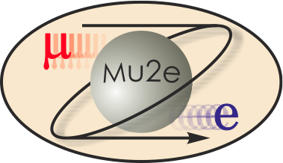
Mu2e Cosmic Ray Veto
E. Craig Dukes (University of Virginia)
Cosmic Ray Veto (CRV) Project Manager
J. Whitmore (Fermilab)
Cosmic Ray Veto (CRV) Deputy Project Manager
10/21/2014

Slide 2
Cosmic Ray Veto Team
E. Craig Dukes – L2 Manager
  30 years working at Fermilab
  Co-spokesperson: HyperCP
  L3 Manager: NOvA Power Distribution System
Julie Whitmore – Deputy L2 Manager
  Fermilab scientist for 20 years
  L2 Manager: CMS HCAL Maintenance & Operations
  L3 Manager: CMS HCAL Upgrade

Slide 3
Organization
WBS 475.8 Cosmic Ray Veto
Craig Dukes / Virginia
Julie Whitmore / Fermilab (Deputy)
475.8.1 Project Management
Craig Dukes / Virginia
CAM: Dukes
475.8.5 Photodetectors
Julie Whitmore / Fermilab
CAM: Whitmore
475.8.2 Mechanical Design
Craig Dukes / Virginia
CAM: Dukes
475.8.6 Electronics
Sten Hansen / Fermilab
CAM: Dukes → Whitmore
475.8.3 Scintillator Extrusions
Anna Pla-Dalmau / Fermilab
CAM: Pla-Dalmau
475.8.7 Module Fabrication
Craig Group / Fermilab & Virginia
CAM: Group
475.8.4 Fibers
Yuri Oksuzian / Virginia
CAM: Dukes
475.8.8 Detector Assembly & Installation
Jim Fagan / Fermilab
CAM: Dukes

Slide 4
Requirements: Fundamental
The requirements for the Cosmic Ray Veto are described in Mu2e-doc-944.
Fundamental (detector independent) requirements:
  To reduce the conversion-like electron background from cosmic rays to less than 0.1 events over the course of the run
  To provide a cosmic-ray trigger primitive to the DAQ
  Not to produce more than 10% dead time
  Not to use more than 20% of the DAQ bandwidth
Note: about 1 conversion-like electron per day is produced by cosmic-ray muons

Slide 5
Requirements: Derived
The overall inefficiency for identifying cosmic-ray muons must be no worse than 1x10⁻⁴.
The photoelectron yield of the cosmic-ray scintillation counters must be at least 14 PE/cm.
The time resolution of the cosmic ray veto should be on the order of 5 ns in order to reduce the accidental coincidence rate from counter “noise”.
The hit rate per photodetector (SiPM) should be no more than 1 MHz.
The total neutron dose to the photodetectors and front-end electronics must be less than 1×10¹⁰ n/cm², and the electronics must survive this dose with no untoward effects.
The DAQ should trigger on no more than 1/100 microbunches.
The detectors and DAQ should run during the interspill period.

Slide 6
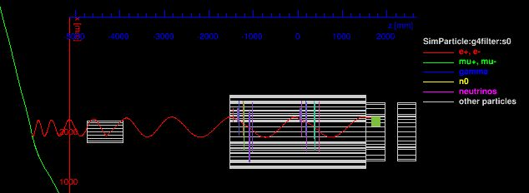
Requirement: Background Rejection
Simulations of 28 billion cosmic ray muons show that an inefficiency of no worse than10⁻⁴ is required.
These simulations have vetted the CRV coverage described in the CDR.
A targeted simulation of ~100% of the total live time show that no electron conversion-like background events come through the TS “hole”; however there are muons that mimic conversion-electron events that need to be removed by the calorimeter and tracker.

Slide 7
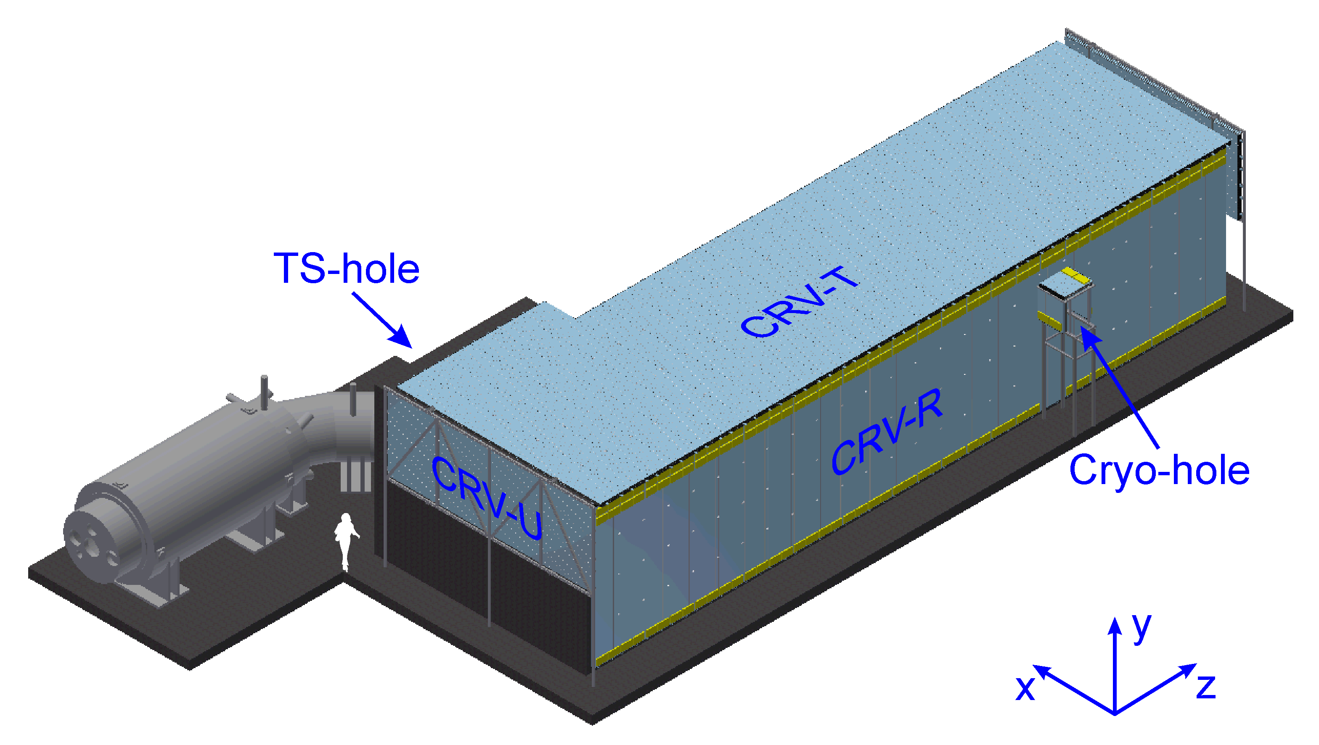
Design: Layout
Design vetted in outside CRV-Review (June 3, 2014)
Details:
Area: 323 m²
82 modules 7 sizes
5,152 counters
10,254 fibers
18,944 SiPMs
CRV identifies cosmic ray muons that produce conversion-like backgrounds.
Design driven by need for excellent efficiency, large area, small gaps, high rates, access to electronics, and constrained space.
Technology: Four layers of extruded polystyrene scintillator counters with embedded wavelength shifting fibers, read out with SiPM photodetectors.
A track stub in 3/4 layers, localized in time and space produces a veto.

Slide 8
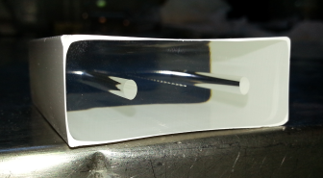
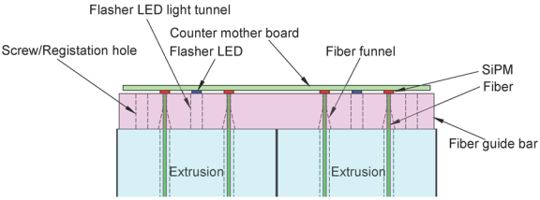
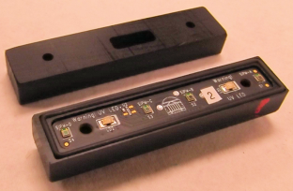
Design: Counter
Fundamental element of the CRV
50 x 20 x 900-6600 mm³
  Extruded at the FNAL-NICADD facility
  Two 1.4-mm diameter wavelength shifting fibers
  Readout: 2 x 2 mm² SiPMs on each fiber end
  Flasher LED on each end for calibration and monitoring
Glue two extrusions together to form di-counters that are served by one counter motherboard

Slide 9
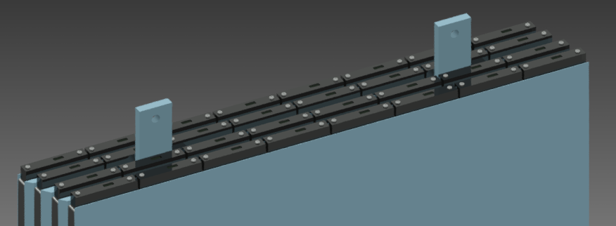
Design: Modules
Fundamental mechanical element of the CRV
4 layers of counters with 3 layers of Al absorbers sandwiched between them: 16 counters/layer (narrow module: 8)
  Layers are offset to avoid projective gaps between counters
  Total: 82; with two different widths; five different lengths

Slide 10
Design: Support Structure
Simple design that sits on top of the concrete shielding blocks.
Designed to minimized gaps between modules, to allow modules to be installed and removed without undue difficulty, and to allow access to electronics.
Design vetted by FEA.

Slide 11
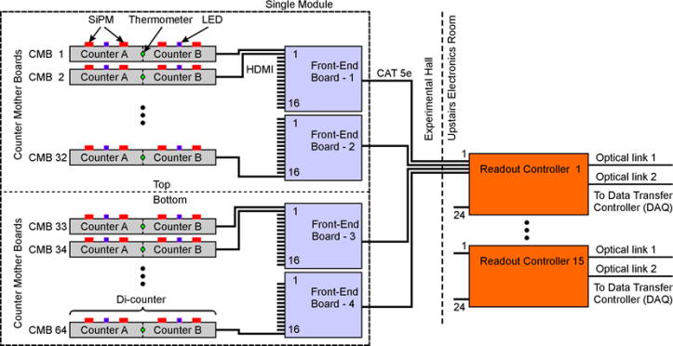
Design: Electronics
Three components: (1) Counter Motherboards (CMB: 4736), (2) Front-end Boards (FEB: 296), (3) Readout Controllers (ROC: 15)
Design based on MTB wire chamber readout
All COTS parts (80 MHz ultrasound octal amp/ADC)
Triggered system with ~1 s of buffering
Dynamic range: 2000
Max rate/SiPM: 1 MHz
Rate to DAQ: 76 MB/s
Data per run: 1.1 PB
Time resolution: ~ 1ns
Magnetic field: ~ 0.1 T
Max dose: 10¹⁰ n/cm²

Slide 12
Integration and Interfaces
Internal and external interfaces are described in docdb-1551.
External interfaces to: (1) Conventional construction, (2) the Muon Beamline, and (3) the DAQ.
We participate in the bi-weekly: electronics, muon beamline, DAQ, and integration meetings.
Formal sign-off between owners of all external interfaces as part of final design requirements.
Interfaces understood and under control.

Slide 13
Changes since CD-1
Extensive simulation work by the Neutron Working Group has shown that the rates from neutrons and gammas are higher than CD-1 estimates that were extrapolated from MECO studies.
To mitigate the higher rates we have:
  added shielding to the CD-1 design (see Muon Beamline WBS 475.5)
  added an extra layer of counters (2/3 → 3/4)
  made the Al absorber layers thicker (to kill thru-going electrons)
  moved to a triggered readout
Moved to a 50 x 20 mm² extrusion profile to increase the light yield (energy deposit) from muons traversing each layer.
The standard module width has been reduced by ~30% to ease fabrication and handling.
Whitmore added as CRV subsystem deputy and L3: Photodetectors, Fagan L3: Detector Assembly & Installation

Slide 14
Value Engineering since CD-1
We incorporate value engineering at every stage of design.
Based on studies of other projects using large numbers of SiPMs, we cut back our testing from 100% to 10%.
We are investigating using wider (60-70 mm vs 50 mm) extrusions, which will lower the counter/fiber/SiPM/electronics channel count and save costs. This is listed in the Risk Register as an opportunity.

Slide 15
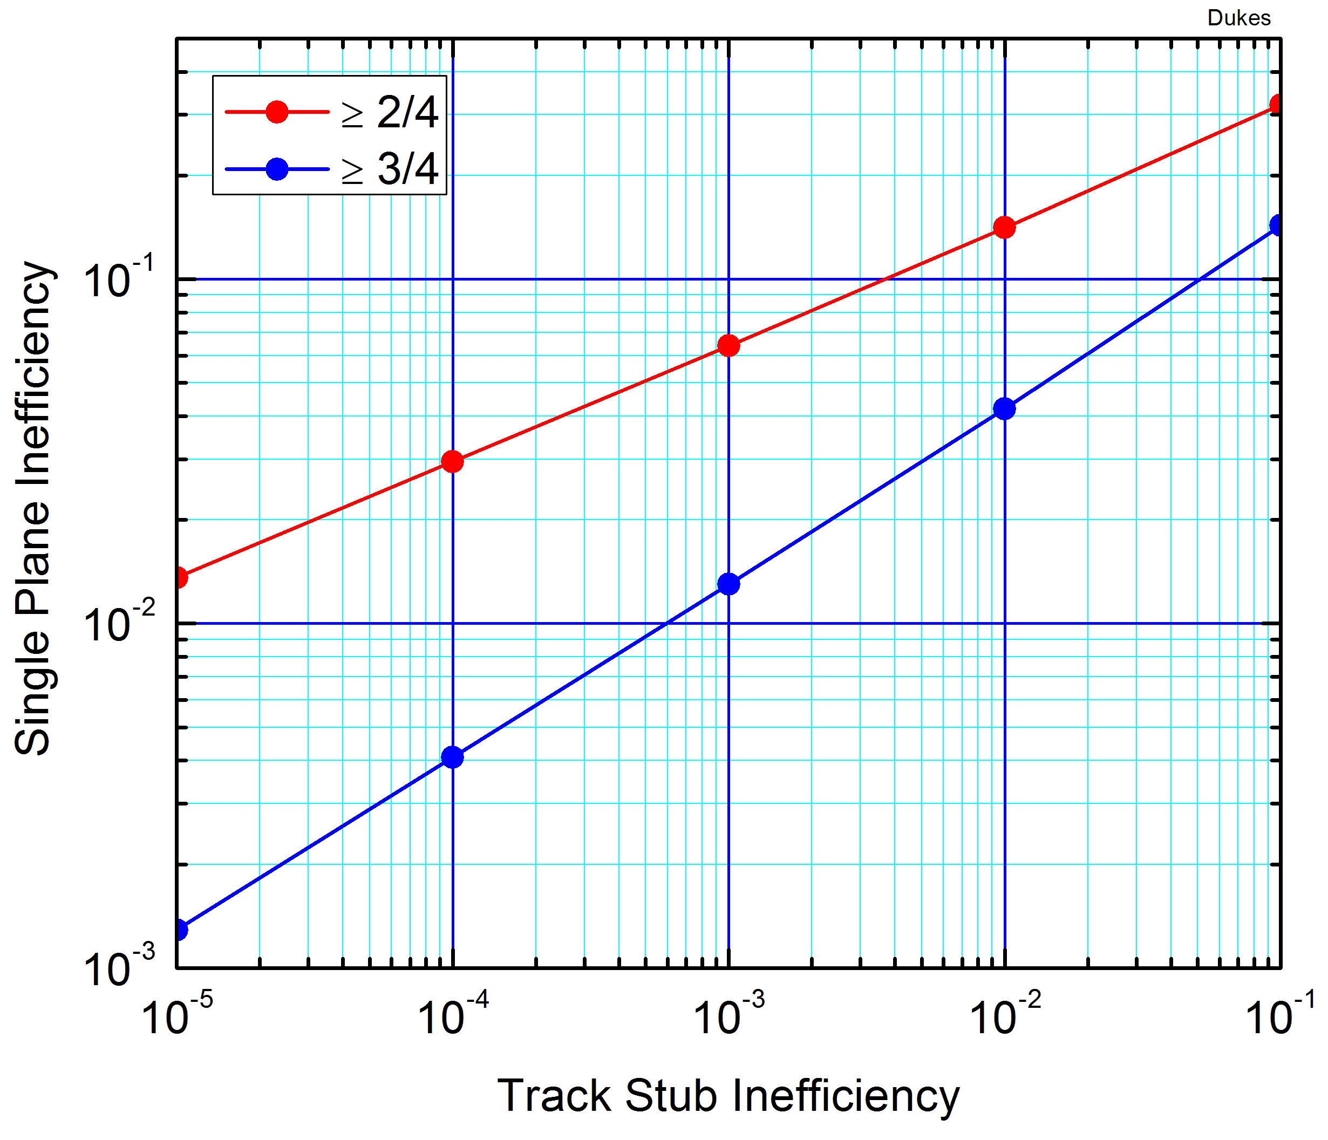
Performance: Efficiency Requirement
An inefficiency of 10⁻⁴ in finding muon track stubs with a 3/4 hit plane requirement demands a 99.6% single-plane efficiency.
The efficiency of a particular plane depends on the angles the muons make and the size of the gaps between counters.

Slide 16
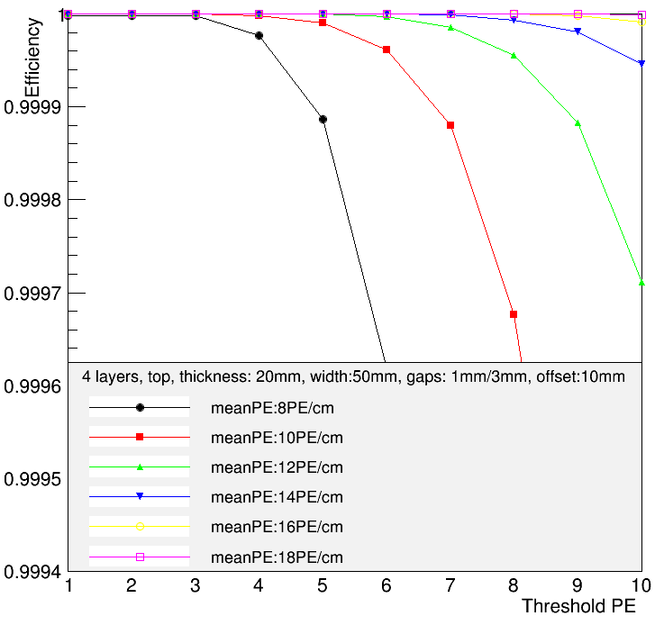
Performance: Efficiency Requirement
The single-plane efficiency requirement of 99.6% can be best couched in terms of a counter photoelectron yield requirement.
14 PE/cm
Efficiency requirement
12 PE/cm
10 PE/cm
We want an effective energy threshold of ~1 MeV, or half the light yield in PE per cm
A light yield of 14 PE/cm with a threshold of 7 PE meets requirements.
8 PE/cm
Individual SiPM noise limit
“Energy” threshold: both SiPMs at each end

Slide 17
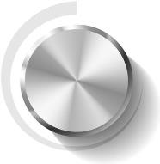
Performance: Efficiency Requirement
Important: the key parameter in meeting the efficiency requirement is the photoelectron yield.
The means by which we meet the required PE yield is through the wavelength shifting fiber diameter.
Extrapolations from test-beam data of a pre-prototype counter, and from NOvA measurements of the PE yield vs fiber diameter show that 14 PE/cm at the far end of a long counter can be achieved with a 1.4 mm diameter fiber. We will test modules with 1.4 mm and 1.8 mm fibers next spring in the Fermilab Meson Test Beam Facility and use the results to determine the appropriate diameter.
Fiber
diameter

Slide 18
Simulations: Integrated Rates & Deadtime
Simulations of the rates due to neutrons and gammas have been done using a G4beamline model of the beam, shielding, and apparatus
Rates have been checked with MARS
Factorized simulation: beam → secondary transport to CRV → rates using CRV efficiencies determined from G4beamline, GEANT4, and MCNP
A full non-factorized simulation in the Mu2e framework is underway
The PE (energy) cut will be applied offline, not in real time
The veto will be applied offline, not in real time
Threshold [MeV] | Max Instant Rate [kHz] | Average Rate [kHz] | Fractional dead time [%]
0.5 | 260 | 48 | 4.5
1.0 | 160 | 30 | 1.1
Offline SiPM threshold

Slide 19
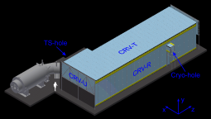
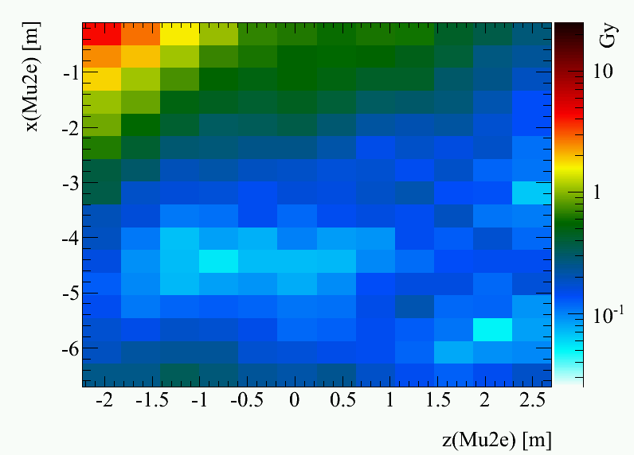
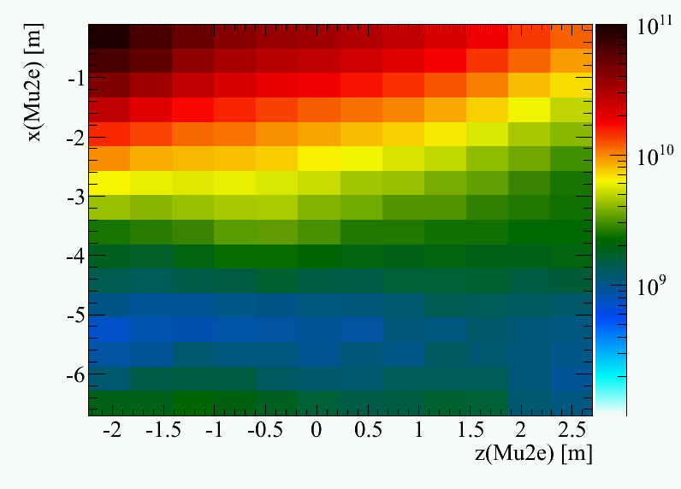
Simulations: Radiation Damage
Ionizing dose: no effect on detector or electronics – max. value ~10 Gy
Non-ionizing dose: max. rate < 10¹⁰ (1 MeV eq) n/cm² is on the edge of needing testing
Will irradiate and test SiPMs and Front-end Boards at 10¹⁰ n/cm²
y
Readout at this end only
x
z
Ionizing Radiation Dose
Neutron (1 MeV) fluence (cm⁻²)

Slide 20
Quality Assurance
We are following guidelines outlined in the project Quality Management Plan (Mu2e-doc-677).
QA/QC procedures are integrated into each component of the Cosmic Ray Veto, and in fact consume a large fraction of the resources devoted to each task.
See Level-3 breakout talks for details on QA/QC.
Example: Module Factory
  Details given in “Quality Assurance and Safety Program for Cosmic Ray Veto Module Factory” (Mu2e-doc-4150).
  Each module will have their photoelectron yield measured over their entire area to insure they meet the photoelectron yield requirement, and after shipping to Fermilab they will be tested for damage.

Slide 21
ES&H Issues
CRV has standard detector-related issues that are common at Fermilab
  Electrical hazards: low-voltage power, modest high-voltage power
  Mechanical hazards:
    CRV modules are heavy: procedures for the safe handling of them are being developed for the module factory and for installation at Fermilab.
    Compressed gas cylinders at the module factory.
  Toxic materials:
    Polystyrene is classified according to DIN4102 as a “B3” product, meaning highly flammable or easily ignited. The storage of the extrusions and fibers will take these properties into account.
    Adhesives will be used in potting the fibers and for module assembly. Appropriate measures will be taken to reduce the fumes to safe levels.
These hazards are all discussed in the Mu2e Hazard Analysis document (Mu2e-doc-675) and in the Quality Assurance and Safety Program for the Cosmic Ray Veto Module Factory (Mu2e-doc-4150)

Slide 22
Risks & Opportunities
There are no major cost or schedule risks
7 Cosmic Ray Veto risks in the registry
  Threats: 6
    5 low
    1 high
  Opportunities: 3
  Retired: 5
Detailed mitigation plans for all risks, documented in risk forms on docdb and linked from Risk Register (docdb-4320)
All risks understood and under control.
Details in breakout session.

Slide 23
Cost Breakdown by L3
Base Cost by L3 (AY $K)
Module fabrication
Scintillator
Fibers
SiPMs
Electronics

Slide 24
Cost Breakdown: Resource Type
Base Cost by L3 (AY $k)
Note: non-Fermi labor hours > Fermi

Slide 25
Quality of Estimate
91% of cost understood at the Preliminary Design level or higher

Slide 26
Labor Resources by FY

Slide 27
Labor and M&S by FY

Slide 28
Cost Table
Costs are fully burdened in AY $K
Includes actuals
Note: Labor Fermilab only; Univ. labor captured in M&S.
 | Base Cost (AY K$)
 | M&S | Labor | Total | Uncertainty (on remaining budget) | % Contingency (on remaining budget) | Total Cost
475.8.1 Project Management | 267 | 178 | 445 | 75 | 21% | 520
475.8.2 Mechanical Design | 135 | 3 | 138 | 24 | 38% | 162
475.8.3 Scintillator extrusions | 567 | 462 | 1,029 | 209 | 25% | 1,238
475.8.4 Fibers | 462 |  | 462 | 106 | 24% | 568
475.8.5 Photodetectors (SiPMs) | 464 | 305 | 769 | 190 | 41% | 959
475.8.6 Electronics | 1,314 | 407 | 1,720 | 511 | 33% | 2,231
475.8.7 Module Fabrication | 1,482 | 8 | 1,490 | 466 | 35% | 1,956
475.8.8 Detector assembly and installation | 127 | 81 | 208 | 64 | 35% | 273
475.8.9 Conceptual Design/R&D | 258 | 252 | 511 |  | 0% | 511
475.8.99 Risk Based Contingency |  |  |  | 318 | - | 318
Grand Total | 5,077 | 1,696 | 6,773 | 1,963 | 38% | 8,735

Slide 29
Major Milestones
Jun 2015: Select SiPM
Sep 2015: Final engineering design complete
Mar 2017: Wavelength shifting fiber tested and ready
Feb 2017: SiPMs tested and accepted
May 2017: Production of extrusions complete
Dec 2017: Electronics fabricated and tested
Jan 2018: Module production begins
Sep 2019: Modules received at Fermilab

Slide 30
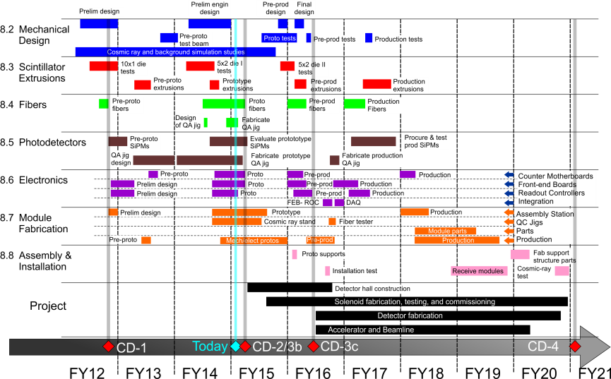
Schedule

Slide 31
Summary
We have a design that meets requirements, can be built, and is costed.
The design is simple and relies on technologies that have been proven in several recent Fermilab experiments.
Estimates for the Cosmic Ray Veto are complete
  91% of cost understood at the Preliminary Design level or higher
  Most estimates based on very similar systems, with the same personnel, that have recently been built at Fermilab.
Risks are minor and understood, mitigated where possible.
All interfaces have been identified and defined.
ES&H is embedded into all aspects of the project.
We understand exactly what has to be done to get to CD-3, and have a well-developed plan on how to get there.
The Cosmic Ray Veto sub-project is ready for approval of its performance baseline.

