Slide 1
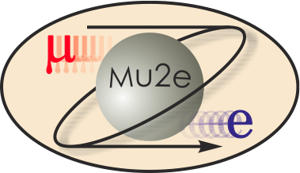
475.04 Solenoid System
Michael Lamm
L2 for Solenoids
10/21/2014

Slide 2
Solenoid Team
Michael Lamm - L2 Manager
  25 years of experience in superconducting magnet technology. Management roles in several magnet projects including USLHC and LARP. Project manager for the Superfluid Vertical Magnet Test Facility.
  Head of Magnet Department in Technical Division for 10 years where my job was to allocate resources and match skills to requirements
Tom Page – Solenoid Project Engineer since January 2010
  15 years engineering experience in magnet technology
  USLHC IR Quad cryostats, interconnects and integration
  HINS Project Engineer: overall layout, power lead design, Radio Frequency Quad Procurement Oversight
Strong local technical team on all phases of project; important collaboration with INFN Genova

Slide 3
Scope for Solenoids
Provide integrated magnetic system for Mu2e experiment included required support infrastructure and interfaces to the Muon Campus. Primary Deliverables:
Three superconducting solenoids
  Production Solenoid
  Transport Solenoid
  Detector Solenoid
…and support infrastructure
  Cryogenic Distribution System
  Power Supply System along with magnet controls and monitoring
  Magnetic Field Mapping System
  Installation and Commissioning of these deliverables

Slide 4
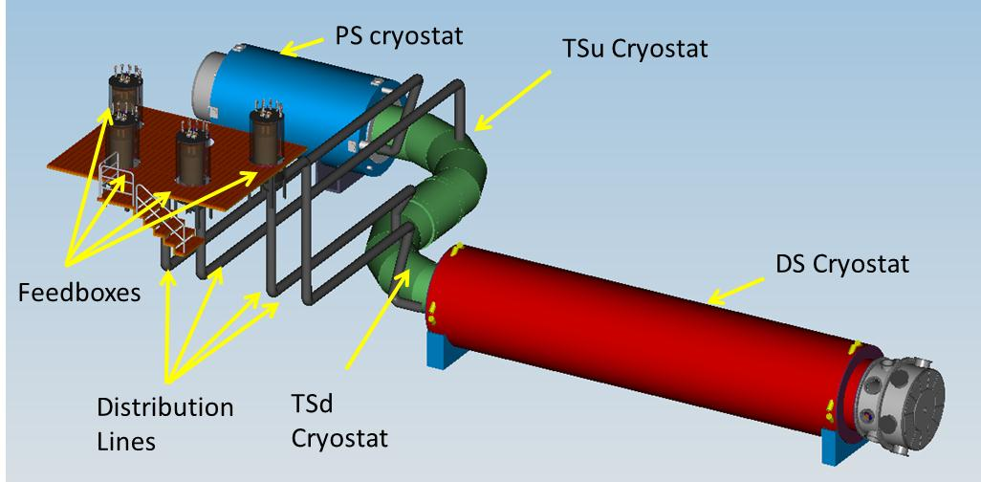
Mu2e Solenoids Scope
Production Solenoid (PS)
Transport Solenoid (TSu,TSd)
Detector Solenoid (DS)
Cryogenic Distribution
Field Mapping
Ancillary Equipment
Installation and commissioning
Cryo distribution box
Power Supply/Quench Protection

Slide 5
Procurement Strategy
PS and DS is being built in industry
  Final engineering design done by industry based on detailed requirements and specifications and reference design.
  Contract awarded after competitive bid process
    Award based on “best value”, price only one element
  QA/QC including travelers, cold test at Vendor and final acceptance at Fermilab
TS is being designed/built “in house”
  Cryostat, coil module assemblies and mechanical supports built by outside vendors
  Final assembly and test at Fermilab
Cryo Distribution components fabricated in industry
  Final design Fermilab
Recycle TeV HTS leads and Power converters
Quench protection electronics purchased from industry whenever possible

Slide 6
Requirements Overview
There are several requirement’s document covering L2 Solenoid deliverables. They are all available on review web site.
Science Driven Requirements mu2e-docdb-4381
Production Solenoid mu2e-docdb-945
Transport Solenoid mu2e-docdb-947
Detector Solenoid mu2e-docdb-946
Cryo Distribution mu2e-docdb-1244
Power Supply System mu2e-docdb-1237
Quench Protection mu2e-docdb-1238
Magnetic Field Mapping mu2e-docdb-1275

Slide 7
General Solenoid Requirements
Magnetic field requirements, described in the TDR and in supporting documents, are complex. Generally speaking field must meet the following:
  Straight Sections
    Negative monotonic axial gradient to prevent trapped particles. (potential source of backgrounds)
  Toroidal Sections
    Matched to central collimator geometry for muon momentum selection
To verify that the solenoid system meets the field performance standards
  Generate field maps within coil fabrication tolerances
  Field Maps are vetted with collaboration for muon transmission, background generation and tracking efficiency and resolution

Slide 8
Operational Requirements
Reliable superconductor operation at full field life of experiment
  Large temperature margin (>1.5K) and Jc margin (>30%) typical of detector solenoids and based on a recommendation from an early (May 2011) technical design review.
Individual operation of magnets and cryostats
  Cryostats cooled down and powered independently
  Individual magnets do not rely on mechanical support of adjacent magnets
Cryogenic operation
  Liquid helium Indirect cooling
  One Fermilab Satellite refrigerator for steady state operation
Operation due to radiation damage
  7 MGy over life of solenoid. (irreversible damage limit of epoxy)
  Conductor and stabilizer to operate for 1 year at nominal beam intensity without loss of performance, can be repaired by room temperature anneal

Slide 9
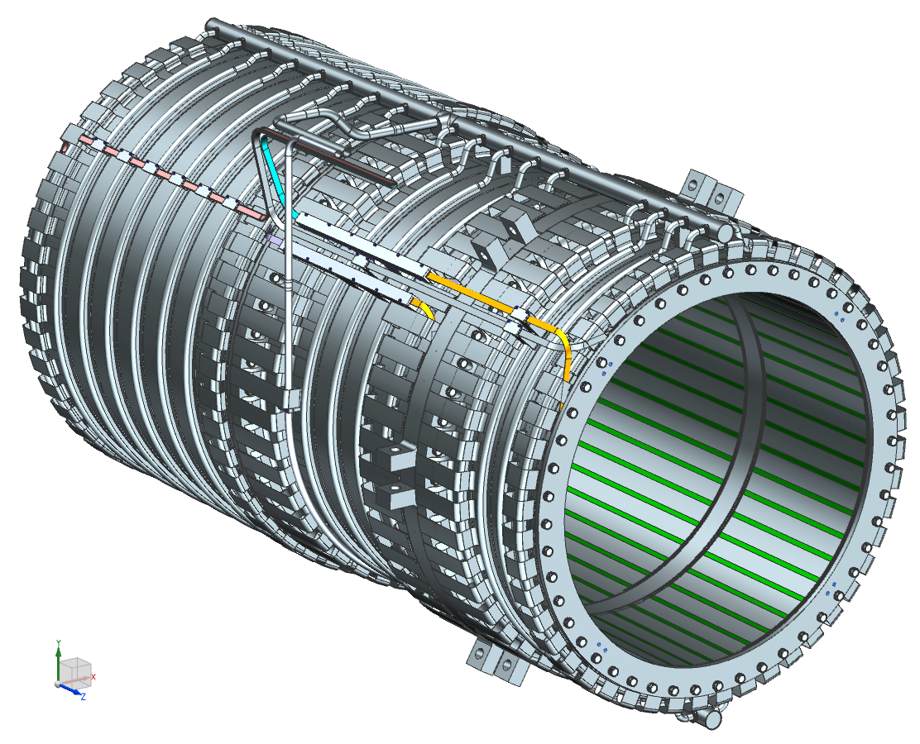
Design: Production Solenoid (PS)
1.6 m aperture
Iop =9.2 kA
Peak operating axial field 4.6T
PS consists of three coil modules with 3-2-2 layers of the same Al-stabilized cable wound in the “hard way”;
Each module has an outer support structure made of Al 5083-O to manage the forces;
The shells are bolted together to form a single cold mass assembly.
The coil modules are installed inside of cryostat using axial and transverse supports.

Slide 10
Design: Detector Solenoid (DS)
Detector Section
Gradient Section
1.8 m Aperture Operating Current ~6kA
Gradient section 2T➔ I T field
Spectrometer section 1 T field with small axial gradient superimposed to reduce backgrounds
11 Coils in total
  Axial spacers in Gradient Section
  Spectrometer section made in 3 sections to simplify fabrication and reduce cost
Fabrication technology similar to PS

Slide 11
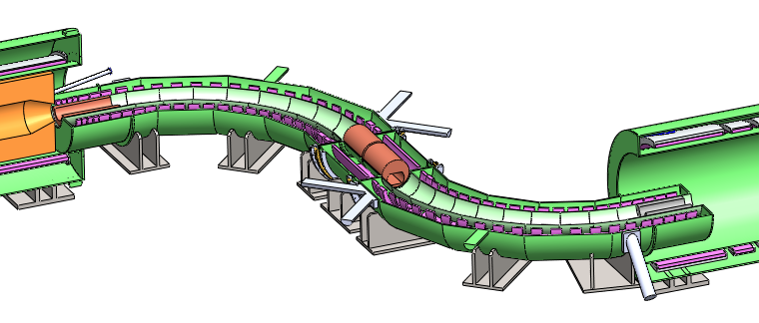
Design: Transport Solenoids (TS)
TSu
Two cryostats TSu and TSd
Separate cryogenic lines
Separate power system
TSd
52 short solenoid coils
Typically 2 coils per module
Mechanical and Magnetic interface with PS and DS
  Once bolted together defines coils placement➔magnetic field
Modules will be built in Industry

Slide 12
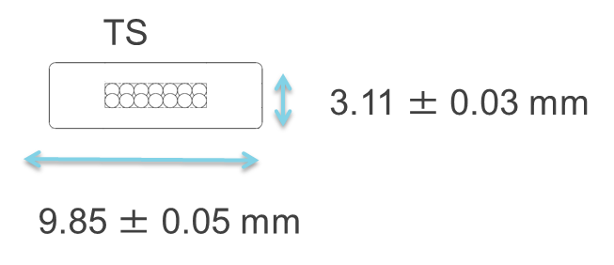
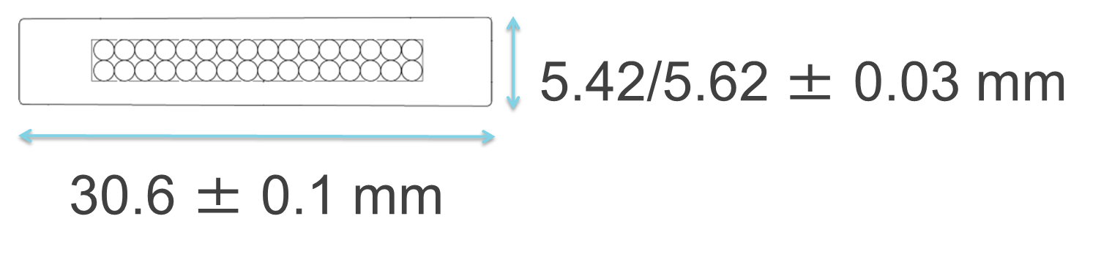
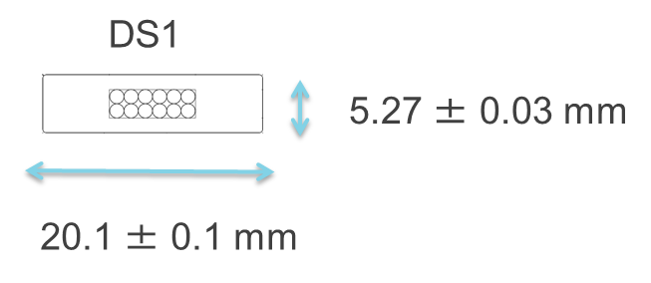
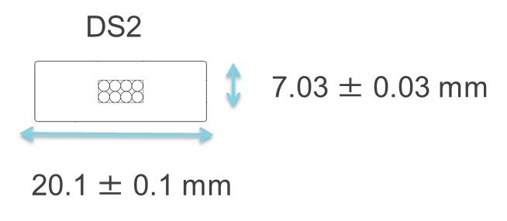
Design: PS/TS/DS1/DS2 Conductor
PS
NbTi Rutherford cable with aluminum co-extruded stabilizer
  SC content sized for Specific Magnet Requirement for Current and Temperature Margins
  TS/DS: 99.998% aluminum for high electrical and thermal conductivity
  PS: use special Ni Doped Aluminum Alloy developed for Atlas Central Solenoid, for high strength and high conductivity
  ~75 km of conductor required for project
Prototype conductor program successfully completed, production program in progress

Slide 13
Improvements since CD-1
Solenoid Designs have been stable since CD-1
  Small change to DS coil pack geometry to introduce a small axial gradient to reduced backgrounds
  Decision about cooling scheme for TS and DS
Incremental changes to Quench Protection, Power System, Cryogenics and Field Mapping
  These will be detailed in our breakout sessions

Slide 14
Value Engineering since CD-1
Several Value Engineering changes prior to CD-1
POST CD1:
Decision for DS to employ Thermal Siphon cooling is largely driven by value engineering (see next slide)
  Allows for similar coil and feedbox fabrication & design
  Allows vendors to fabricate both magnets with similar tooling
We will recycle gently used Tevatron power supplies and extraction circuit components

Slide 15
Downselects
DS and TS cooling scheme decision
Subject of an Internal review June 26-27, 2013
  Reviewers: Philippe Bredy (CEA), Bertrand Baudouy (CEA), Joel Fuerst (ANL) and Kurt Kempetz (Chairman, FNAL)
Thermal Siphon (natural convection) vs. Forced Flow
  Passive, no valves at magnet, no cryo pumps at feedbox but
  Geometry dependent, must fill from bottom, exit from top and difficult to adjust once implemented
  PS cooling scheme has always been thermal siphon
Select Thermal Siphon for DS to simplify magnet and feed box fabrication. Distribution line carrying cryogens makes a small penetration through cosmic ray wall.
Select Force Flow for TS because of the complex geometry of coils and support structure, and distribution line may have to be routed through experimental hall floor to accommodate shielding.

Slide 16
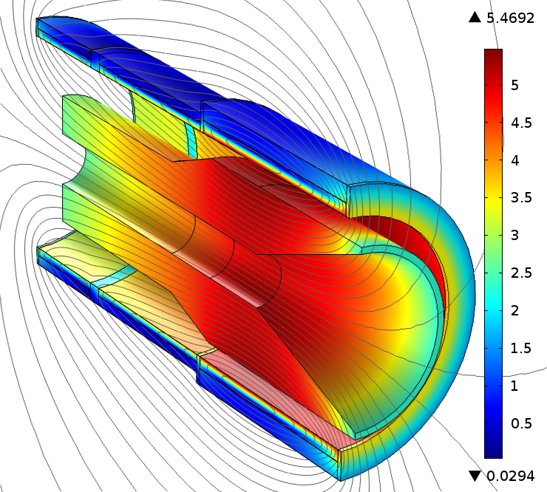
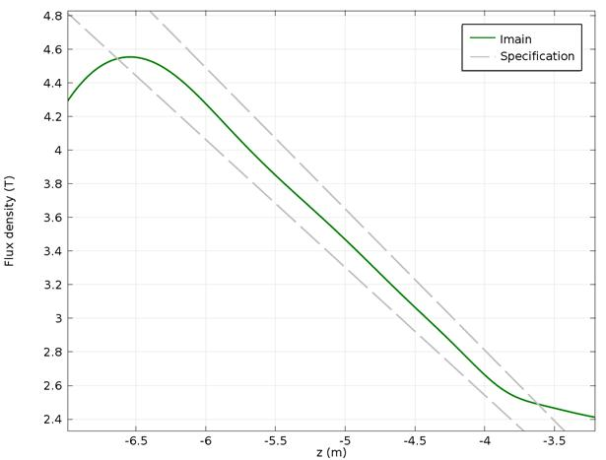
Performance: PS Magnetic field
TS region
TS region
Field analysis performed including Heat and Radiation Shield (left plot) made of high-resistivity bronze (magnetic permeability of 1.04).
Nominal field even with HRS (as shown in right plot) meets specification (dashed lines)

Slide 17
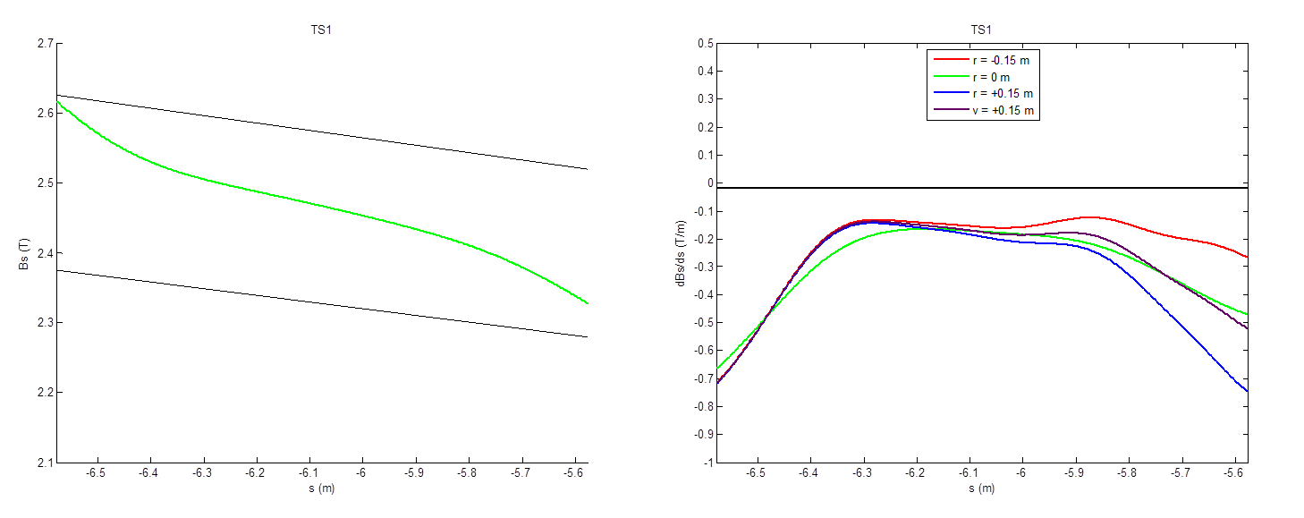
Performance TS Field Profile
Field specifications are complex
Generally speaking require:
  Negative axial gradients in straight sections to avoid trapped particles
  Absolute fields within defined limits
Meets requirements (example shown below which includes field contributions from adjacent Production Solenoid)

Slide 18
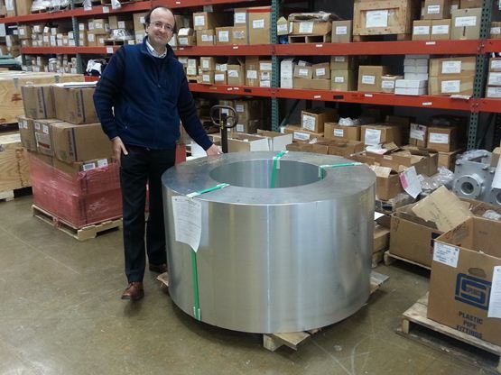
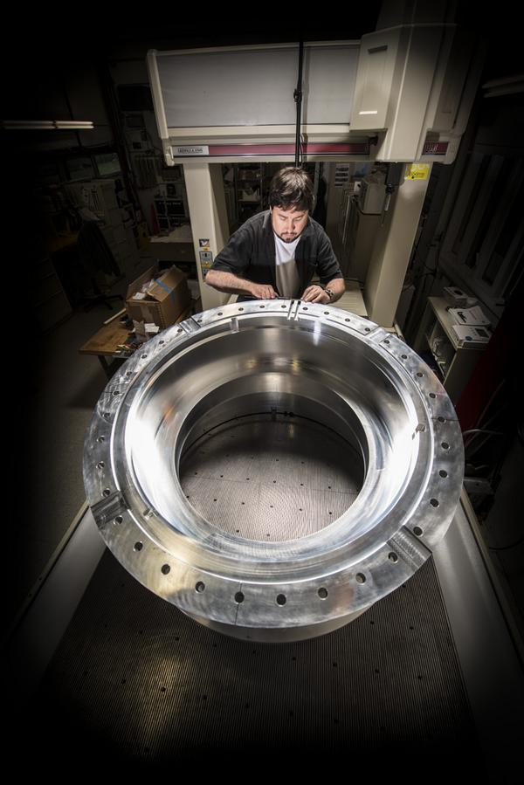
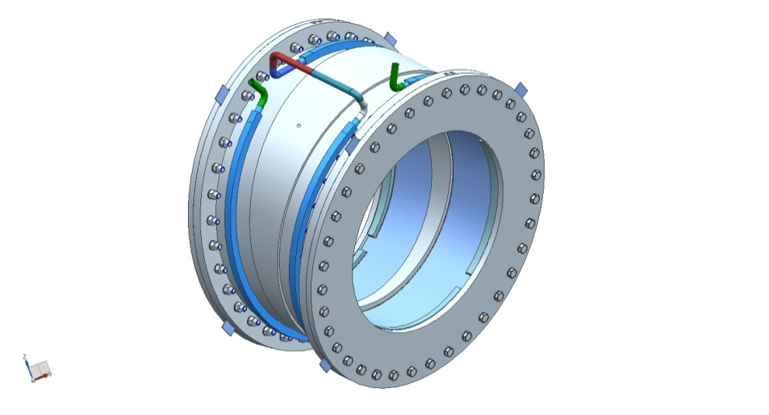
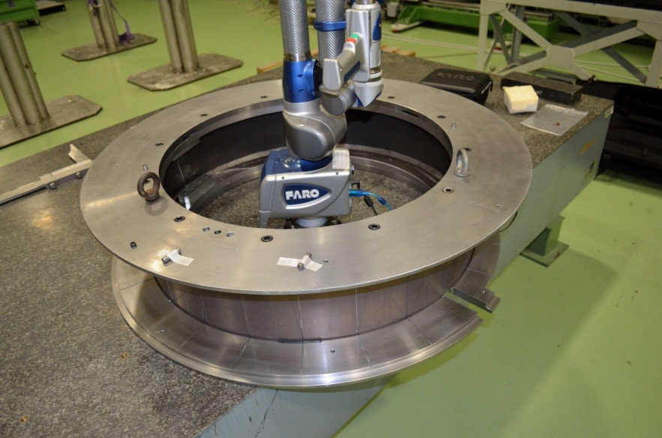
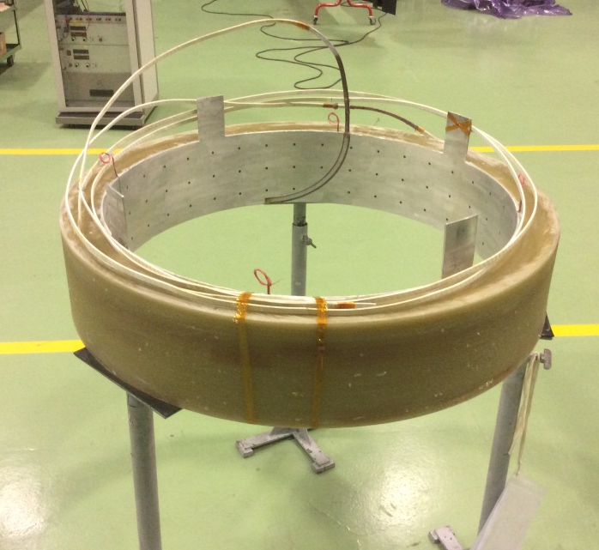
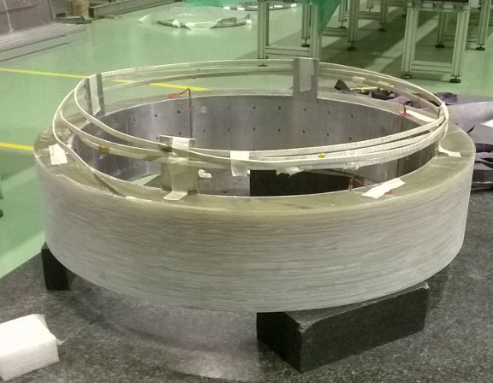
TS Prototype Coil Module Collage
Scheduled completion: October 2014
INFN GENOVA and Fermilab
Outer support cylinder casting pre-machined
Computer model of coil module
Machined shell ready for inspection
Second Completed Coil
Coil winding Mandrel
First Completed Coil
Proprietary Assembly tooling not shown!

Slide 19
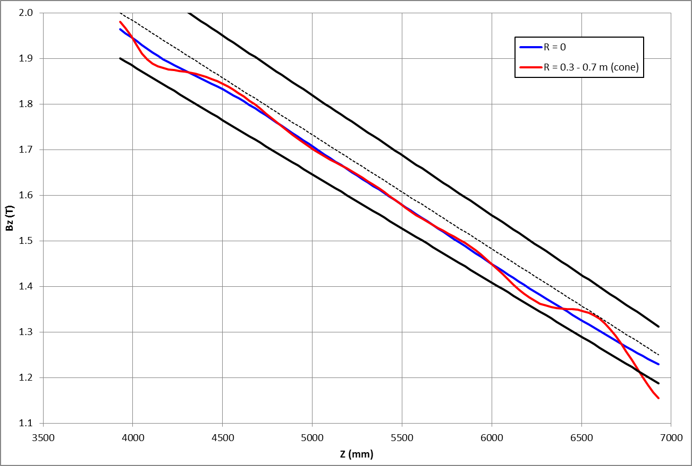
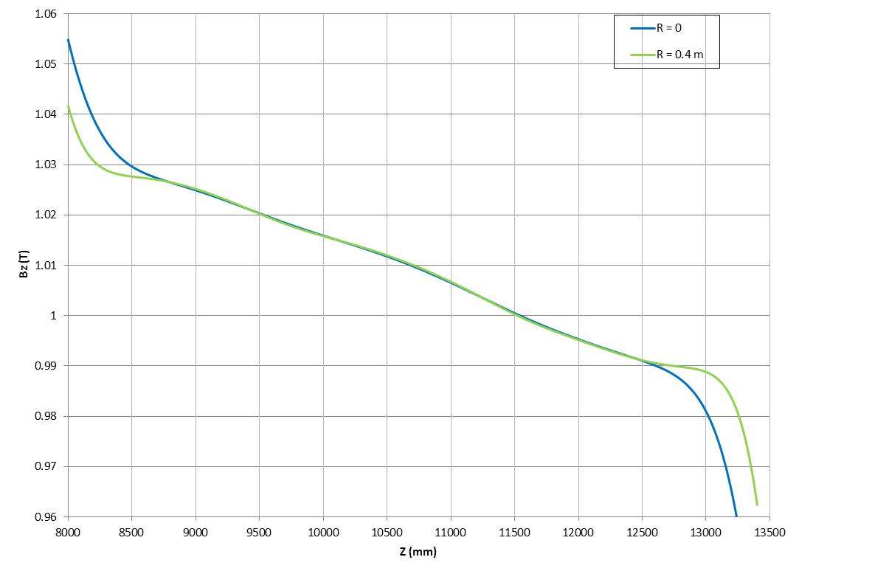
Performance: DS Magnetic Field
Gradient Region: Black lines represent the limits for the field uniformity (dB/B) using the gradient of -0.25 T/m.
Bz
Gradient Region
Tracker region
Spectrometer Region: Field distribution in detector region for different radii. Field is monotonically decreasing in tracker region for R≤ 0.4 m.
Calorimeter region
Bz
Spectrometer Region
Meets Requirements

Slide 20
Request CD3 approval for TS coil modules
TS coil modules will be fabricated in industry. There are 27 modules, with 1 or 2 (mostly) superconducting solenoid rings.
Coil module design is quite advanced, as evidence by the progress made on the TS prototype coil. Large fraction of the drawings have been completed, remaining amount of work well understood.
We would like to place a contract for production coil modules fabrication by Spring 2015. This will keep the TS fabrication on schedule and from delaying the entire project (TS is on critical path)
To do this, we need to receive CD3 approval for the coil modules during this CD2/CD3b review cycle.
In the breakout session, we will make our case to award CD3 approval
  Status of the coil module design, but also present the considerable design analysis on the TS cold mass (magnetic, thermal, mechanical) and the TS cryostat.
  Plans for final design and prototype testing

Slide 21
L2 Solenoid Organization
475.4
Solenoids
M. Lamm (FNAL)
475.4.1 Project Management
L3 – M. Lamm
CAM – M. Lamm
475.4.6 Magnet Power Systems
L3 – S. Hays
CAM - S. Hays
475.4.2 Production Solenoid
L3 – V. Kashikhin
CAM – V. Kashikhin
475.4.7 Quench Protection and Monitoring System
L3 – D. Orris
CAM – D. Orris
475.4.3 Transport Solenoid
L3 – M. Lopes
CAM – M. Lopes
475.4.8 Magnetic Field Mapping
L3 – M. Tartaglia
CAM – M. Lamm
475.4.4 Detector Solenoid
L3 – M. Buehler
CAM – M. Buehler
475.4.9 Ancillary Equipment
L3 – T. Page
CAM – T. Page
Technical Procurement Leads
-Vito Lombardo for Conductor
-Tom Page for PS/DS
475.4.5 Cryogenic Distribution
L3 – R. Schmitt
CAM – T. Page
475.4.10 System Integration, Installation and Commissioning
L3 – J. Brandt
CAM – J. Brandt

Slide 22
Quality Assurance
We have completed the prototype phase of the superconductor. Embedded into the specifications are tests and hold points to assure that the conductors meet specifications. These principals have been built into the Procurement specifications for the large solenoids as outline below:
QA Plan Essential Features
  Traveler system
  Testing embedded into fabrication process
    Outline of test plan provided in Proc. Spec.
  Hold points in fabrication at major milestones
  Regularly scheduled meetings to discuss fabrication status/issues
  Monthly EVMS-style reporting
  Acceptance tests upon delivery at Fermilab
Vendor was required to provide Preliminary QAP as part of bid package
  QAP was one of the metrics for awarding contract.
Vendor must provide full QAP at the end of “final design phase”
  Including detailed test plan
We are exercising option to perform cold full power test at Vendor facility

Slide 23
Integration and Interfaces
Solenoids have external interfaces to the Muon Beamline, Conventional Construction, Muon Campus Cryo AIP, DAQ
  Through muon beamline, interfaces with CRV and detectors
Internal interfaces between solenoids, with cryo system, power system, quench protection and slow monitoring.
Internal and external interfaces identified and described in Solenoid Interface document, available on Review site (docdb #1470).
Participation in bi-weekly integration meetings
  Jeff Brandt, our Integration L3 works closely with Mu2e integration team
  Formal sign-off between owners of all external interfaces as part of final design requirements.
Interfaces understood and under control.

Slide 24
Risks
Solenoid risks are delineated in the Mu2e Risk Register (docdb 4320). Risks cover all major deliverables; also risks associated with integration and installation. Risks are understood and under control.
Risk Statistics:
41 Solenoid risks in risk registry
  All risks mitigated to the extent possible
  32 active threats
    2 high
    9 medium
  1 opportunity
  9 retired risks
There is a breakout session talk dedicated to this important topic

Slide 25
ES&H Issues
Cryogenic fluids
Large Stored energy (~100MJ)
High Currents (up to 10kA)
Large voltages to ground during a quench (up to 600 V)
ODH (liquid helium + LN2 for 80 K shields)
Mechanical forces (>100 Tonnes of axial force between adjacent magnets, magnets are very heavy)
Large volume vacuum systems (beam line + insulating)
Stray Magnetic Fields (no return yoke)
Access issues due to radiation from 8kW proton beam
These hazards, common to Large Superconducting Magnet Systems, are discussed in the Mu2e Hazard Analysis document and Solenoid TDR chapter.

Slide 26
Solenoid Costs by L3’s
Quote in hand + change order contingency
“Request for Information” Nonbinding quotes only

Slide 27
Cost Breakdown by L3
Base Cost AY k$

Slide 28
Cost Breakdown Labor vs. Material
Base Cost AY k$

Slide 29
Quality of Estimate
Base Cost AY k$
82% of cost estimates are preliminary design or better

Slide 30
Labor Resources by FY

Slide 31
Major Milestones
Complete set of Solenoid Milestones in Milestone Dictionary (Docdb-4301).

Slide 32
Schedule
CD-3a
CD-3c
CD-2/3b
CD-4
Fabricate and QA Superconductor
KPPs Satisfied
Solenoid Design/Prototypes
Solenoid Fabrication and QA
Detector Hall Construction
Solenoid Infrastructure
Solenoid Installation and Commissioning
Detector Prototypes and Construction
Cosmic Ray System Test
Accelerator and Beamline Construction
Accelerator Commissioning (off Project)
Q3 | Q4 | Q1 | Q2 | Q3 | Q4 | Q1 | Q2 | Q3 | Q4 | Q1 | Q2 | Q3 | Q4 | Q1 | Q2 | Q3 | Q4 | Q1 | Q2 | Q3 | Q4 | Q1 | Q2 | Q3 | Q4 | Q1 | Q2 | Q3 | Q4 | Q1 | Q2 | Q3 | Q4
FY14 FY15 FY16 FY17 FY18 FY19 FY20 FY21

Slide 33
Critical Path
TS is on the critical path for most of the project, PS/DS not far behind….
TS Final Design
TS Module Procurement Activities
PO issued for TS Module Fabrication
Vendor Fabricates TS Modules
Test TS Modules
Finished Testing TS Modules
Assemble/Test TSd
Installation Activities
Solenoid Installation Complete and Ready for cooldown
Commissioning Activities
KPPs Satisfied
Q3 | Q4 | Q1 | Q2 | Q3 | Q4 | Q1 | Q2 | Q3 | Q4 | Q1 | Q2 | Q3 | Q4 | Q1 | Q2 | Q3 | Q4 | Q1 | Q2 | Q3 | Q4 | Q1 | Q2 | Q3 | Q4 | Q1 | Q2 | Q3 | Q4 | Q1 | Q2 | Q3 | Q4
FY14 FY15 FY16 FY17 FY18 FY19 FY20 FY21

Slide 34
Breakout Session Talks
In addition to having dedicated talks on each Level 3 deliverable, (PS, DS, TS, Cryo distribution….) there will be presentations on the following topics:
Solenoid Procurement Strategy
Update on Conductor Procurement since CD3a
Lessons learned from past and present magnet procurements
Solenoid Risk analysis
Expanded TS technical presentation because of the CD3 coil module request

Slide 35
Summary
Solenoid designs are well understood and meet requirements
Cost estimates for the Solenoids are complete
  Over 80% of the cost understood at the Preliminary Design level or higher
  Risk are understood, mitigated to the extent possible and are under control.
All interfaces are identified and defined
Resource needs understood
ES&H and Quality embedded into all aspects of the Project
We have responded to all recommendations from previous reviews
We are well along on the procurement of the major components of the Solenoids:
  Have initiated long lead time conductor orders
  Have selected PS and DS vendor, final stages of contract negotiations
  On track to place orders for TS coil modules
    Asking for CD3 approval for a Spring 2015 procurement
Solenoids are ready for CD-2

