Slide 1
Mu2e CD-2 – Conventional Construction- High Performance & Sustainability / Guiding Principle
Emil Huedem
10/22/2014

Slide 2
High Performance & Sustainability /Guiding Principle (GP)
Requirement – DOE order 436.1 EO 13423, Section 2(f), and EO 13514 Section 2(g), Federal agencies are required to ensure that new construction and major renovation of agency buildings comply with the Guiding Principles for Federal Leadership in High Performance and Sustainable Buildings set forth in the Federal Leadership in High Performance and Sustainable Buildings Memorandum of Understanding
Mu2e project is committed to comply with sustainability requirements. Early in the project lifecycle we looked at.
GP & LEED checklists:
other guides (ASHRAE AEDG-advanced energy design guide)
Previous proj (cmtf 2010, DOE workshop Apr 2011, OTE)
LEED-NC is not appropriate for Mu2e (DocDB# 2081, LEED Analysis Memo dated Aug 04 2011 documented the reasoning).
The identification and incorporation of GP elements that are lifecycle efficient into the design represents the project’s commitment to incorporating sustainability.

Slide 3
High Performance & Sustainability /Guiding Principle (GP)
About 60% of GP items are already met, either already in placed by current policies and procedures or are life cycle efficient. The remaining 20 of the 35 GP items are addressed by the project.
Final GP report, and various backup documentation are submitted (posted under Doc# 2081)
A number of the GP items are included in the design specifications. (Division 1 Spec and technical spec) and few are calculation documentation
Two major GP items:
Commissioning (Cx):.
Building energy efficiency:

Slide 4
High Performance & Sustainability /Guiding Principle (GP)
Commissioning (Cx):
This is included in the current project and contract has been issued for a 3rd party Cx agent (Primera Engrs). This Cx agent have successfully commissioned two recent project onsite. (Fundamental commissioning)
Due to the nature of the project schedule once the CF bldg project is completed, spaces will remain open to each other for few years. Cx will try to simulate final condition as best as possible. A re commissioning (off project) is plan later when the final experiment equipment are installed and spaces between are closed and sealed.
Scope
Review of Owners Project Requirement & Basis of Design
Maintain and Update the Commissioning Plan
CF Mech systems, lighting control and BAS will be commissioned
Review startup procedure & witness random sampling
Prepare functional test procedure
Review test and balance report (TAB)
Perform FPT (functional performance test)
Document and maintain issue log
Perform retesting
Submit final Cx report

Slide 5
High Performance & Sustainability /Guiding Principle (GP)
Energy efficiency:
Although the CF project (bldg) is not expected to meet the min requirement of “30% better than Ashrae 90.1 baseline” because of large process load, the project committed to doing the building energy model, incorporating the reasonable energy efficiency measures and just quantify where we’re at compared to Ashrae90 appendix-G baseline.
Various elements that contributed (Use of CUB chilled water, envelope, lighting, variable fan speed- Single zone VAV)
The project did due diligence to comply with the sustainability requirement and provide an energy efficient building design using the GP guidance, where it is applicable

Slide 6
High Performance & Sustainability /Guiding Principle (GP)
Back up slides

Slide 7
GP checklist (prior to design)

Slide 8
Commissioning

Slide 9
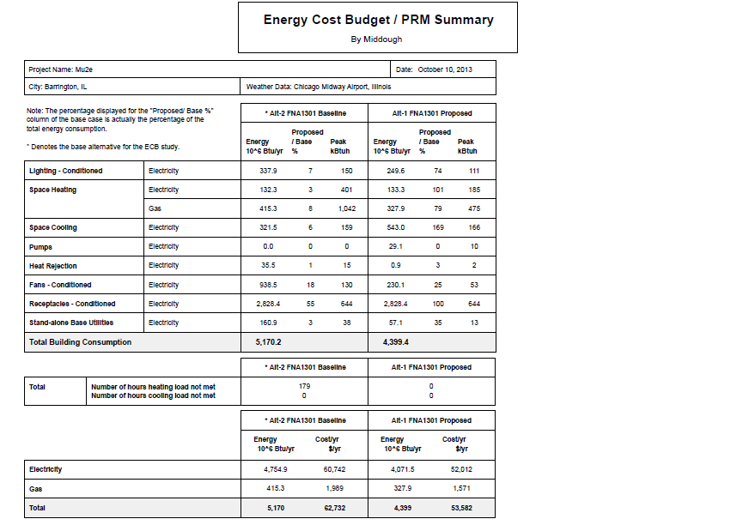
Energy Model result
Energy Model Result

Slide 10
Some excerpt from GP report
Item 5 Commissioning
Building commissioning is covered in the bid documents from an overview level through detailed commissioning checklists for each system used in the building.
Item 6 / 7 Energy Efficiency
Building energy efficiency has been checked utilizing Trane Trace modeling software with input according to ASHRAE 90.1 – 2007, Appendix G. The current Trace output indicates a 15% savings relative to ASHRAE 90.1. A significant issue that is limiting the energy savings of this building is the high energy consumption of the experimental equipment
Item 10 / 11 Measurement and Verification
Metering has been provided for natural gas, electricity and domestic water. Metering is being monitored by the building automation system.
Item 13 Indoor Water - Water Savings Calculations
Plumbing fixtures have been selected to achieve 31.2% water savings following LEED Version 3 calculation methodology. Savings have exceeded the 20% goal
Item 14 Indoor Water - Measurement and Verification
Domestic water meter is being provided and is monitored by the building automation system.
Item 21 / 22 Water Efficient Products
Products and services that have earned the WaterSense label have been certified to be at least 20 percent more efficient without sacrificing performance.” Applicable products for the Mu2e project are toilets and facuets
Item 23 Ventilation and Thermal Control - ASHRAE 55-2004 Data
Chart and Calc
Item 24 Ventilation and Thermal Control - ASHRAE 62-2007 Calculations
Chart and Calc
FULL GP REPORT Docdb 2081

