Slide 1
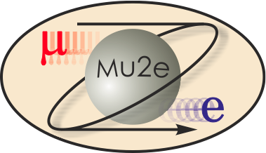
Charge Review WBS 3.0
T. Lackowski
L2 Manager
10/22/2014

Slide 2
Review Charge

Slide 3
Charge # 1
1. Do the proposed technical design and associated implantation approach satisfy the performance requirements? How has the project team ensured that the subsystems will be fully integrated? Are the CD-4 goals reasonable and well defined.
The physical design is well understood by the stakeholders and much effort has been expended to insure that the technical apparatus will fit, and be serviced and operated safely. Mechanical and electrical requirements are well known and are satisfied, with reasonable margin.
Requirements and Interface documents are approved by stakeholders.
The following link take you to the Fermi Project Management Policies and procedures. http://www.fnal.gov/directorate/OPMO/PolProc/home.htm

Slide 4
Charge #2
Is the cost estimate and schedule consistent with the plan to deliver the technical scope? Is contingency adequate for the risk?
ICE was within .4% for the remaining work scope. The apparent successful proposal for the major construction package is 4% less than the engineers estimate.
The schedule was based on the experience Fermilab has had with small business subcontractors based on the MC-1 construction progress.
All of my major risks have been mitigated, transferred, retired or accepted. There are still a number of “standard” construction risks which are being monitored.

Slide 5
Charge #3
3. Are the management structure and resources adequate to deliver the proposed technical scope within the baseline budget and schedule as specified in the PEP?
From the sub-project management level the PM has communicated the need to stay within the cost and schedule baseline. The tools and personnel to monitor and analyze the work status exists.

Slide 6
Charge #4
4. Is the documentation structure by DOE Order 413.3b for CD-2 complete?
While many of the documents have been completed by the Level One project manager WBS 475.03 has:
Contributed to a number of the documents such as the HA and TDR.
Have read, not memorized, all of the management documents such a PEP, PMP, and Acquisition Strategy. Know where to find what I need to manage my subproject.
Addressed and completed those items unique to my sub-project.

Slide 7
Charge # 5
Are ES&H aspects being addressed given the project’s current stage of development?
ES&H was considered and addressed in the design.
Aisles for installation, maintenance
Life safety
NEPA
Construction Safety
Building on the established ISM program
Separate superintendent and safety representative
Subcontractor’s corporate ES&H involvement
Consultant ES&H

Slide 8
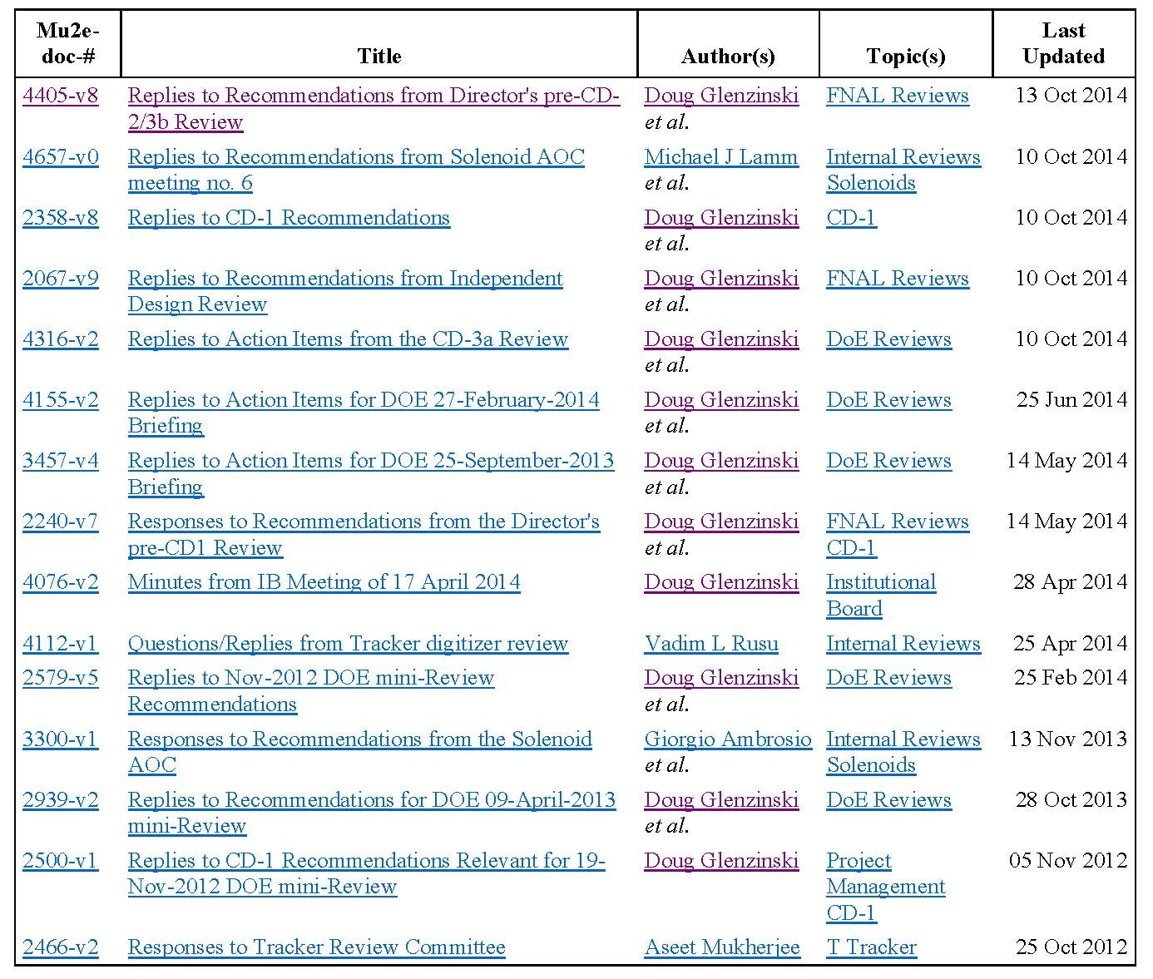
Charge # 6
6. Has the project responded satisfactorily to the recommendations from the previous independent project review?
Responses from past
reviews.

Slide 9
Responses from Director’s CD-2/3b review

Slide 10
Responses from Director’s CD-2/3b review

Slide 11
Charge # 7
7. Is the detailed design sufficiently mature so that the project can continue with procurement and fabrication? Has there been adequate progress on the long-lead procurement activities approved under CD-3a?
There are contract documents that are complete and buildable for the Mu2e Conventional Facilities.
The Delivery Ring Upgrade and the procured items are either substantially complete or off the shelf specifications. None are schedule critical.

Slide 12
Charge # 8
8. Is the documentation required by DOE Order 413.3b for CD-3b complete?
The WBS 475.03 documents / actions are complete.
Some of project level documents (such as PEP, PMP) may have minor updates by CD-3c but are now complete.

Slide 13
Review Summary
We have met the requirements for CD-2/3b approval by:
Project Management
Strong, experienced team in place with a history of success of similar Fermilab projects;
Actively managing the project using a properly tailored DOE 413.3B approach.
Well matured front-end planning, cost, scope and schedule.
Conventional Facilities subproject fully integrated with the rest of the Project and lab certified system. (i.e. WBS, risks, milestones, tools)
Construction Documents:
Based on known technical requirements and interfaces;
Completed a fixed price subcontractor solicitation;
Proposals in hand, ready to award
Within the budgeted cost and schedule.
Required permitting in place.
.

