Slide 1
Introduction WBS 3.0
T. Lackowski
L2 Manager
10/21/2014

Slide 2
Emergencies Notification
Voice alarm will describe type of emergency and action to be taken.
Exit the building through the south stairways, do not use north stairs unless voice command states differently.
Leave all belongings and walk steadily towards the exit.
Stay in area of refuge until given the all clear.

Slide 3
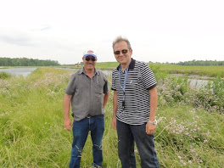
Coordinators
Construction Coordinator Tim Trout
Design Coordinator
Ron Jedziniak

Slide 4
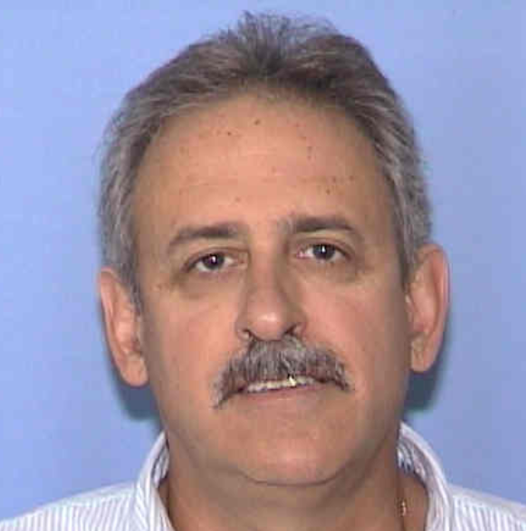
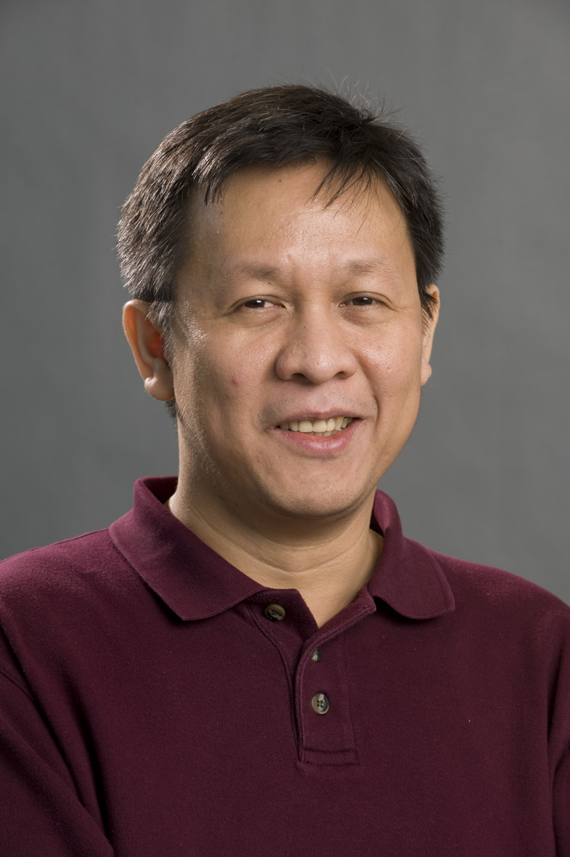
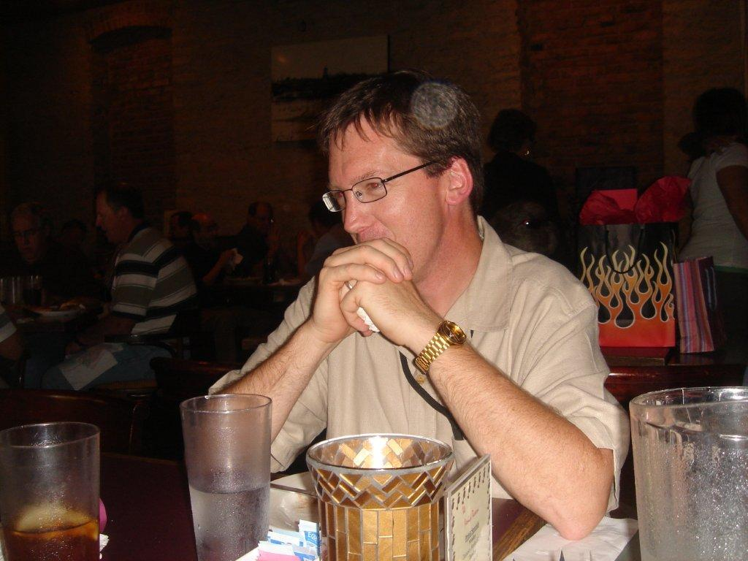
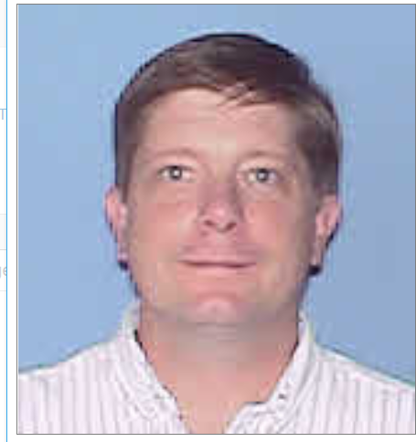
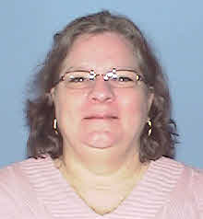
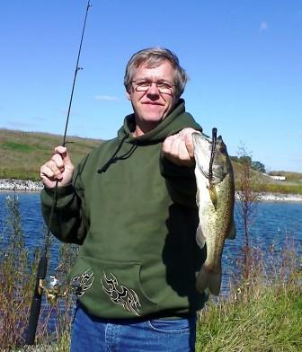
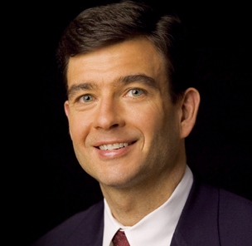
Fermi Conventional Support Team
Chuck Federowicz - Civil
Lee Hammond –VE Coordinator
Jim Niehoff –Life Safety / Fire Protection detection
Emil Huedem – HVAC, Process Water Sustainability
Steve Dixon Architect
Randy Wielgos Electrical
Sandra Efstathiou – Procurement Officer
Mike Gardner–Project Controls

Slide 5
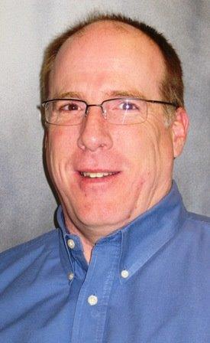
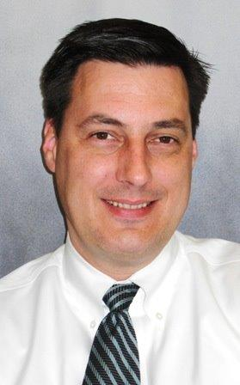
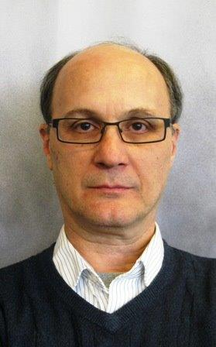
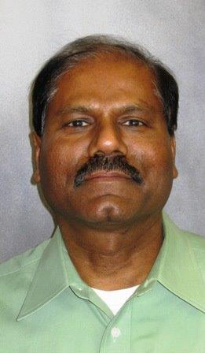
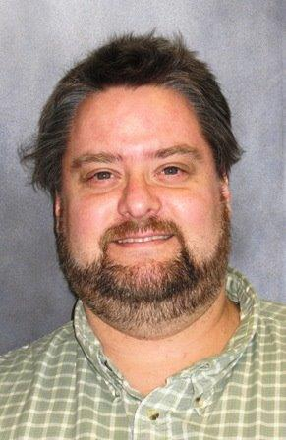
Consultants Team Members
Steve Ejnik Senior Manager
Michael Shrader Project Manager
Fritz Hengge Architectural Manager
William Sonna Structural
Thomas Soukup Architect
Sukdev Sinha Electrical

Slide 6
AD Team Members
Brian Drendel is level 3 for the purchase and installation of site communications wiring to the building.
In order to take Beneficial Occupancy there needs to be connections to site communications. FIRUS (Fire Incident Reporting and Utility System) and Metasys panel connected to the site communications system. The fire panel, sump pump monitoring, generator status, and security systems are connected to FIRUS. Metasys, the building management system for HVAC control is connected to the site backbone via a communication cable.
For economy all of the required communication wiring will be pulled at the same time.
Rick Coleman is level 3 for fabricating the steel plates (existing steel in railyard) that make up the Beam Absorber core. The best way to install these plates is to have the building subcontractor install with heavy equipment. The installation of the plates is in the subcontract.

Slide 7
Proposed Breakout Talk Schedule

Slide 8
Review Charge

