Slide 1
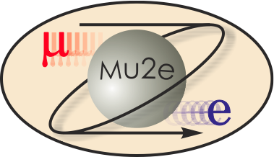
Requirements and Interfaces
T. Lackowski
L2 Manager
10/21/2014

Slide 2
Communications
Face to face discussions with stakeholders was the primary tool used to establish requirements and interfaces.
These face to face interactions were held in various meetings, with both large and small groups.
The design is a direct result of these communications.
Weekly Conventional Construction Meetings
Every other week integration meetings.
Weekly Tech Board meetings
Project Management Group meetings
The requirements and interfaces are documented and approved.
For convention construction items approval is commonly at the L2 Manager level, but can be with any stakeholders.

Slide 3
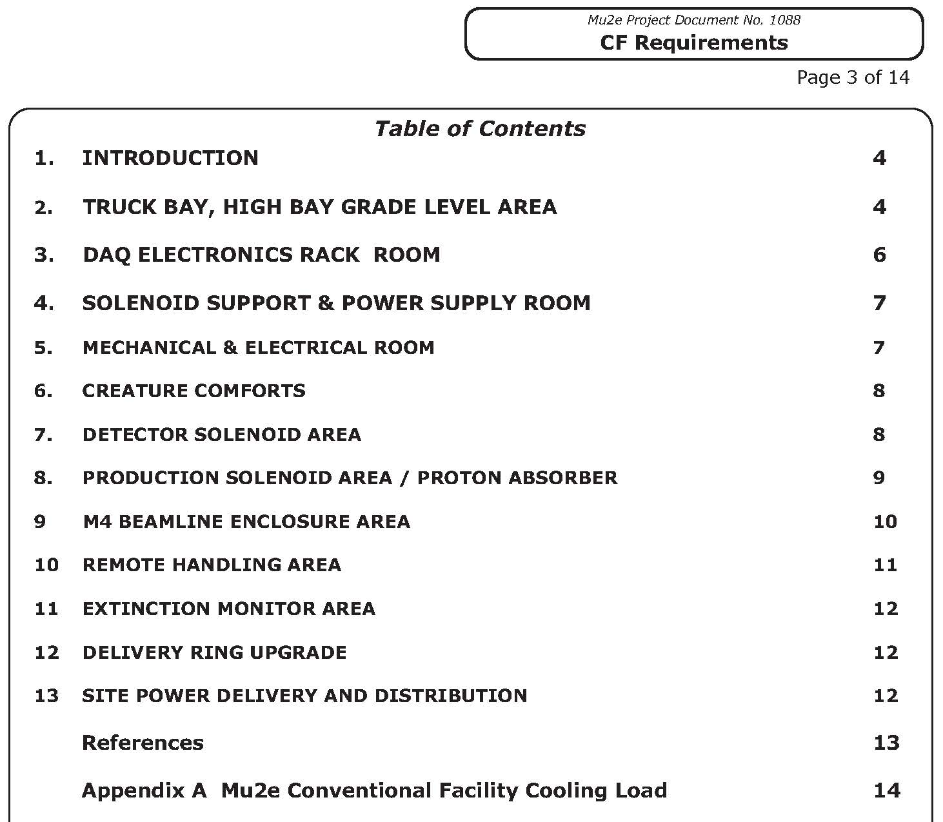
Requirements
Requirements are in approved DocDb 1088
Requirements are
organized geographically.
Document has been review
and signed-off by L2
subproject managers
and approved by L1
managers.

Slide 4
Interface Document
The CF Interface document is posted in DocDB 1537
There are two internal interfaces to conventional disciplines.
There are forty interfaces with stakeholders external to conventional construction, normally the L2 manager accept/approve the agreement.
Where possible, drawings are used to show the interface requirements.
Approvals are at the interface level between the effected stakeholders.
In addition to the mu2e interface document there is also an Muon Campus Interface document

Slide 5
Example: Magnetic Fields
A somewhat unusual requirement for Mu2e is a strong magnetic stray field developed by the solenoids. This field is calculated at 600 gauss 5 feet from solenoid and 5 gauss at the extremes of the building.
The impacts of this magnetic field on the structure, motors, lighting, sprinkler heads and many other systems was discussed relative both to the requirement and interface discussions.
The locations of potentially affected equipment such as the elevator, HVAC equipment and DAQ lead to the final arrangement of spaces.

