Slide 1
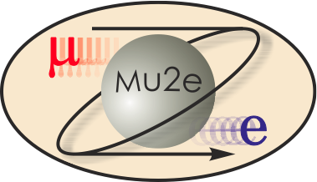
CD-2 & CD-3 DOE Checklists Conventional Construction
T. Lackowski
L2 Manager
10/22/2014

Slide 2
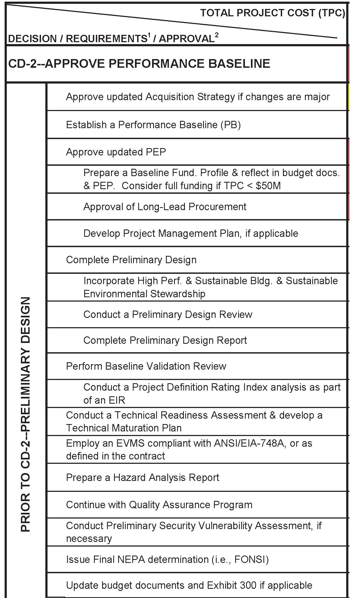
CD-2 Checklist
AS Mu2e-doc 1074 AAP 4127
Baseline Cost /Schedule
PEP Mu2e-doc 1172
NA
4317 3a for conductor purchase
PMP Mu2e-doc 508
Drawings 2956
GP Mu2e-doc 2081
Dir. Review 4404 Replies 4405
T D R Mu2e-Doc 4299
Ice Review 8/26-28/2014
NA
NA
Certification Letter
HA Mu2e –Doc 4229
QMP Mu2e-doc 677
SVA Mu2e-doc 676
NEPA 2274
NA

Slide 3
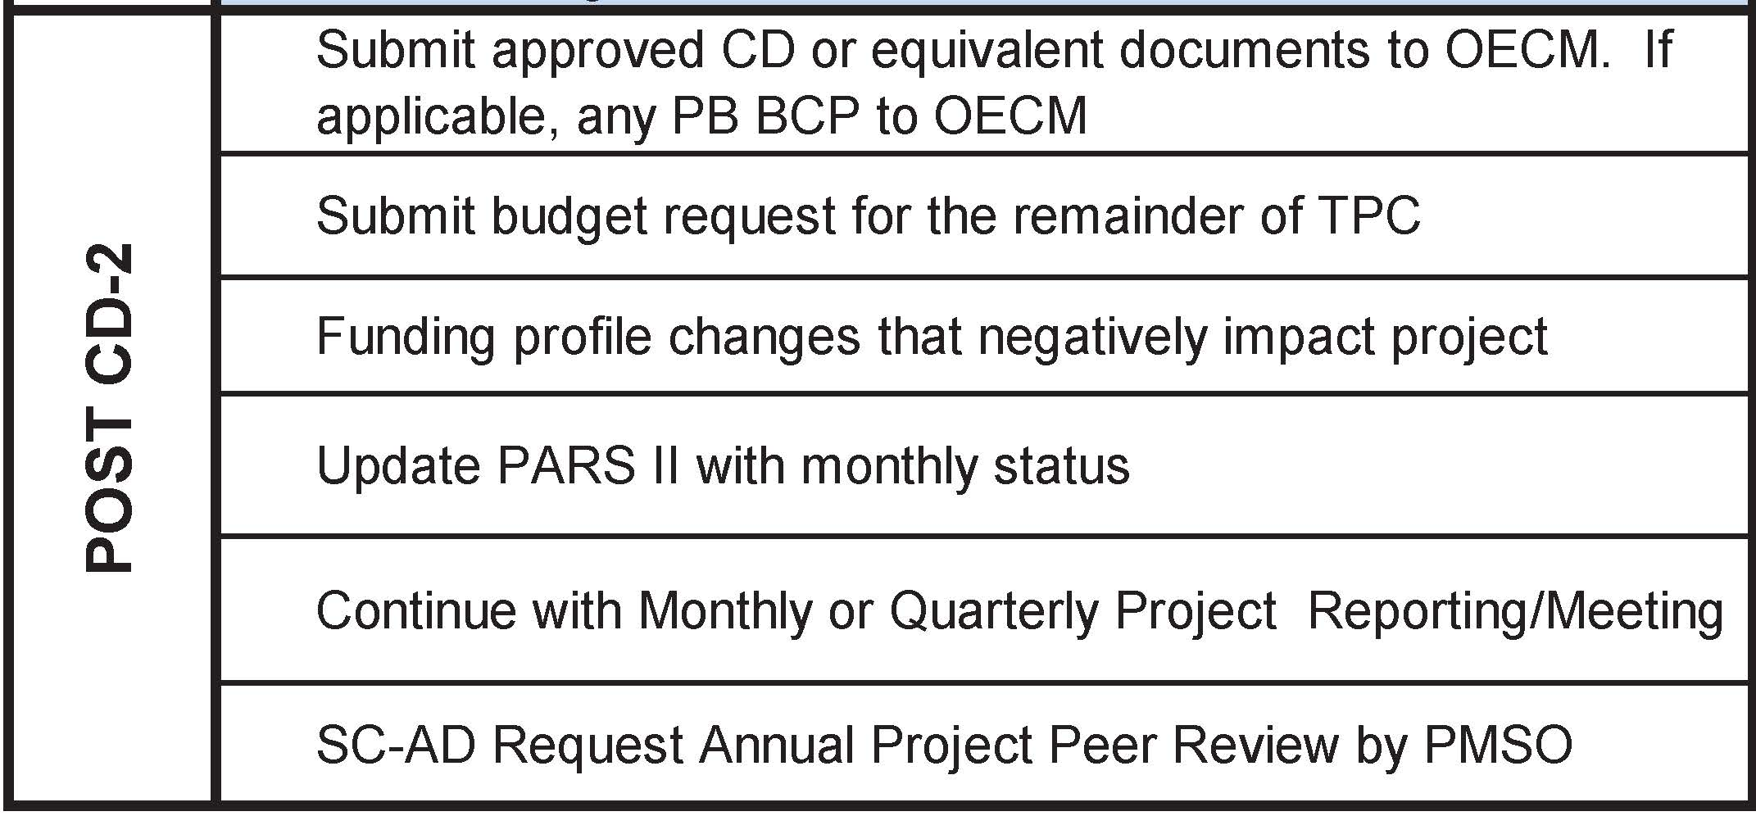
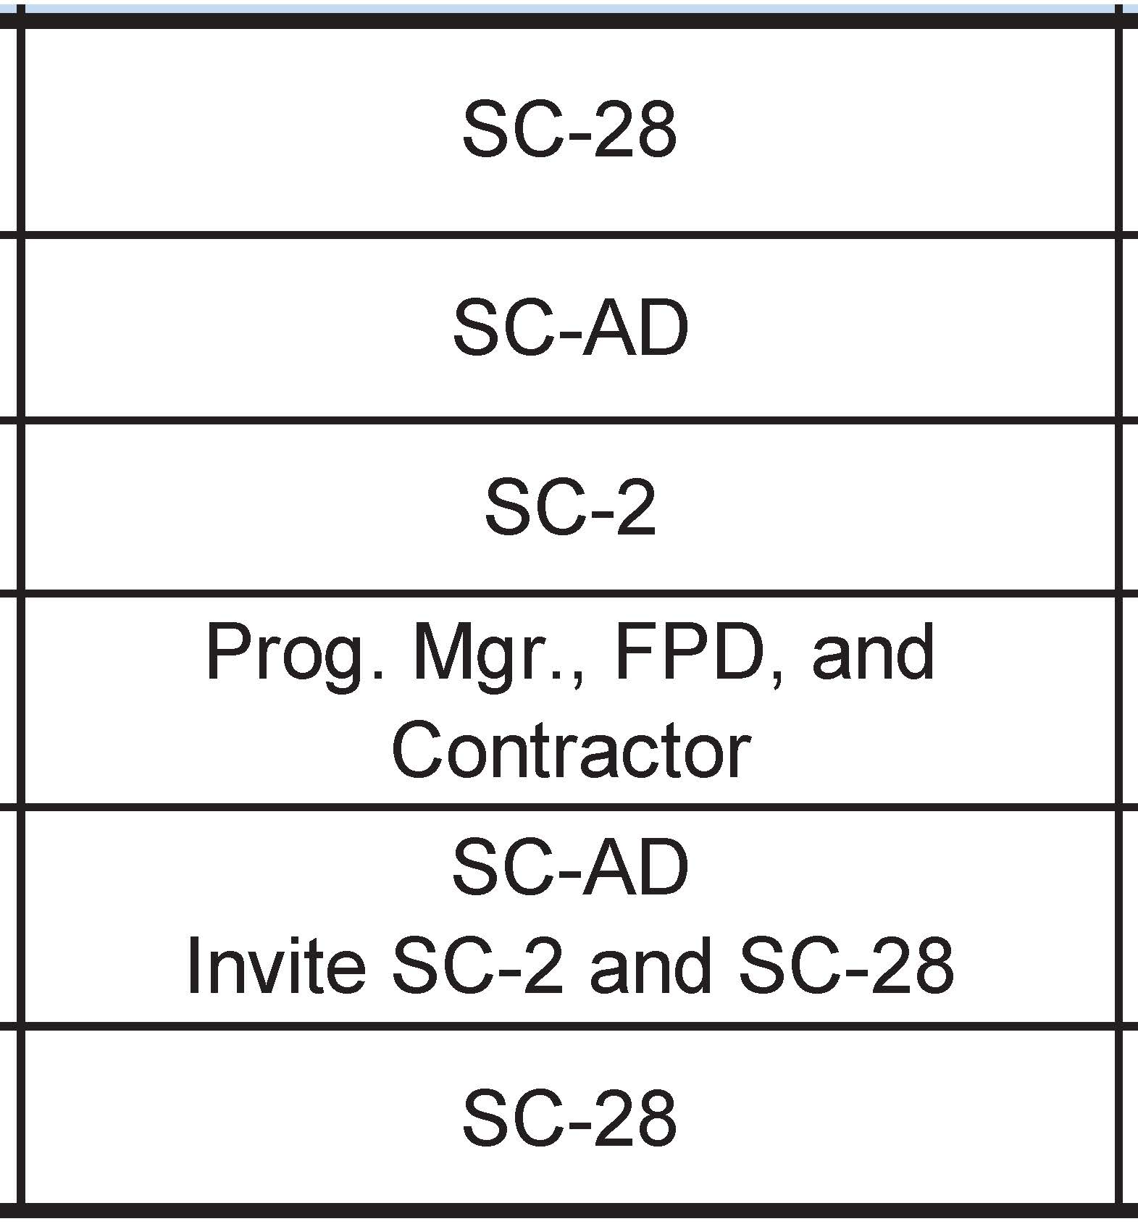
Post CD-2 Checklist
PM as needed.

Slide 4
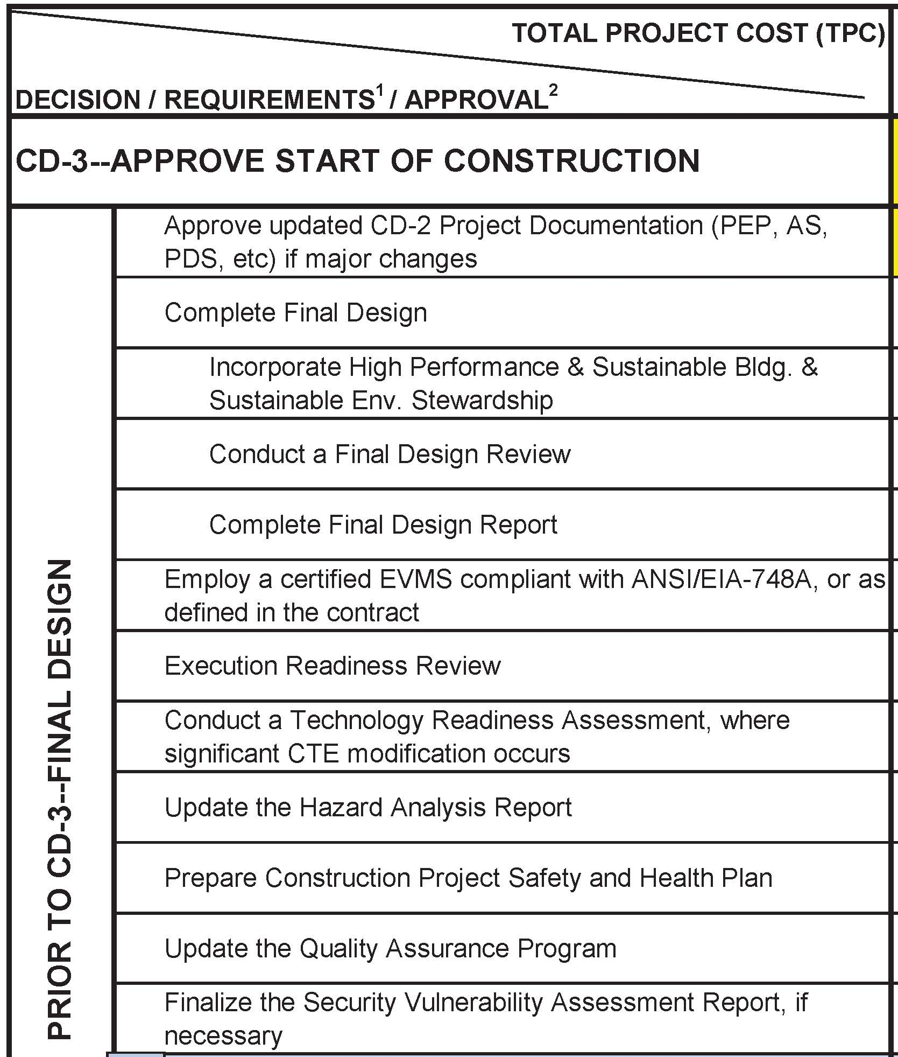
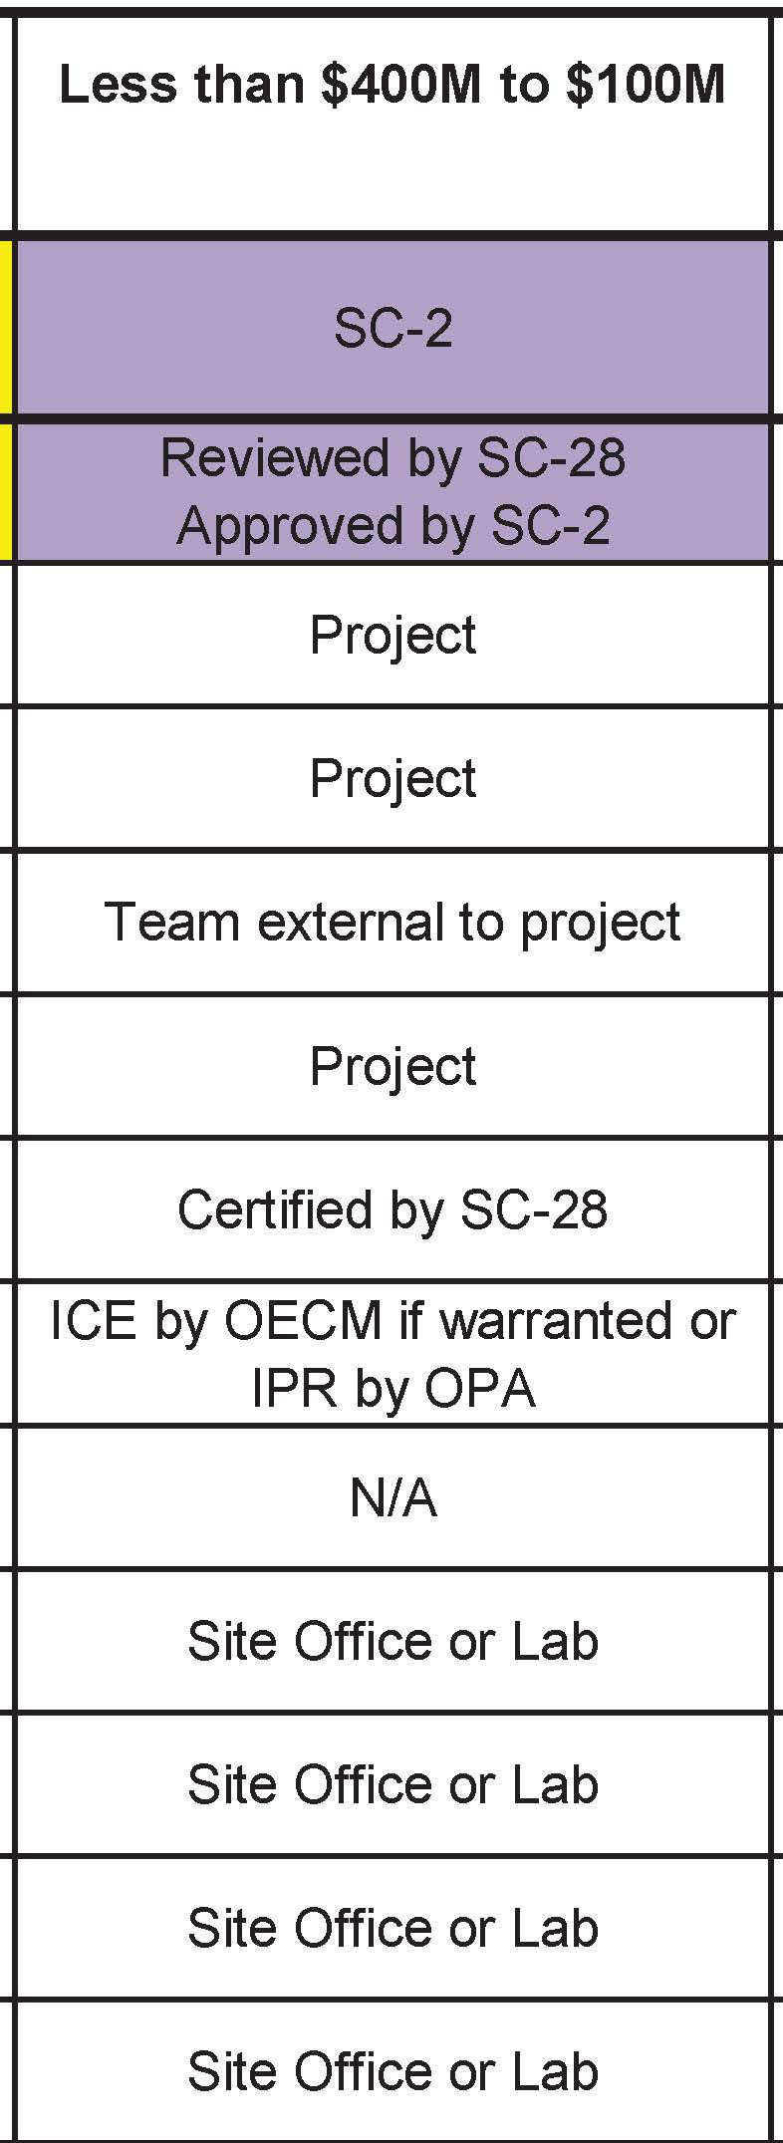
CD-3 Checklist
1074, 1172
RFP Contract Doc. 3494 3620
GP Mu2e-doc 2081
* See below
RFP Contract Doc. 3494
Certification Letter
Ice backup data 4487
NA
Mu2e –Doc 4229
Conventional Const. 4432
Mu2e-doc 677
Mu2e-doc 676
* AON 1314; Comment and Compliance Review 4416; Mu2e Experimental Area Preliminary Shielding
Assessment approval 4313; Middough Cleveland Office Review 4506;
Dir. Review 4404; Dir. Review Replies 4405; This review

Slide 5
Preliminary Design
Complete Preliminary Design
Incorporate High Performance & Sustainable Environmental Stewardship
Mu2e-doc-2081
Conduct a Preliminary Design Review
30% drawing issued to project team for review
30% technical review by Middough Cleveland Office
CD2/3b Directors Review
Report Mu2e-doc 4404; Response Mu2e-doc 4405
Complete Preliminary Design Report
Technical Design Report

Slide 6
ES&H
Prepare a Hazard Analysis Report
Mu2e-doc-4229 , dated July 16, 2014, signed.
CFS Contributed to Mu2e Hazard Analysis mainly mechanical, fire, environmental, and construction.
Design also responded to hazards identified by others such as ODH and Radiation.
Update final NEPA determination -Approved Nepa on 6/8/2012 with an approved CX (B1.15,B3.10)

Slide 7
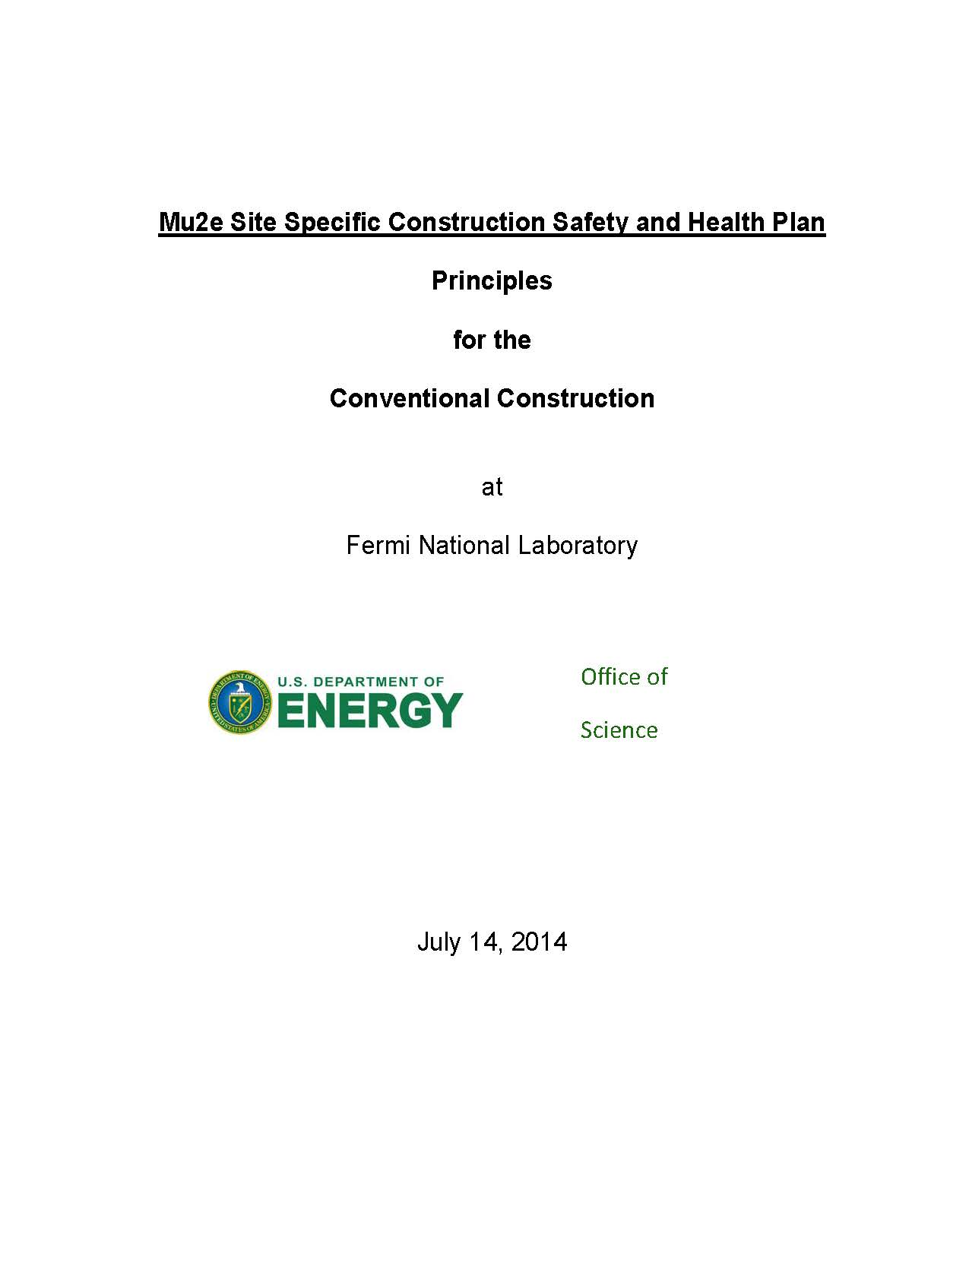
ES&H
Prepare Construction Project Safety and Health Plan
Project Document posted in DocDB 4432
Developed with input from Conventional Construction
Exhibit A defines to the subcontractor, Fermilab’s expectation and requirements, for their Safety and Health Plan

Slide 8
ICE Review
The ICE team developed and estimate that was within 2% of the engineer’s estimate for the Mu2e Conventional Faculties contract.
Several differences were noted that would reduce the difference
Example: Engineer’s estimate for concrete unit cost was higher to account for the robust forming and more difficult placement than the standard RS Means costs used by the ICE team.
There were larger differences at the CSI division level. This was due to packaging.
Example: ICE Team including concrete duct bank in Div. 16, electrical: Engineer’s estimate included the duct bank in Div. 2 Site.
The ICE and project estimates were .4% different on the remaining work, including EDIA and procured items.

Slide 9
From Draft Report of Independent Cost Estimate
For the conventional facilities, the ICE was performed using a bottom-up technique—a DOE Type V-ICE as defined in reference (a). The CF ICE is structured using the same WBS developed by the Project Team, for ease of comparison. In addition, the major assumptions used by the Project Team were reviewed and adopted, as appropriate, by the ICE Team, again for consistency and to ensure an accurate comparison. The ICE Team identified no concerns with the WBS structure or assumptions that needed to be reconciled before starting the estimate process.
The escalation rates used for the project estimate are reasonable, based on comparison with other DOE projects and independent studies
The ICE for conventional facilities is within 0.4% of the project estimate, so there is excellent agreement.
The results of the CF portion of this ICE have been provided to the Project Team for review. Because the difference between the CF estimates is negligible, DOE-APM determined that a formal reconciliation between the two parties is not needed. This decision was also supported by the fact that the project has received bids for the CF portion.

Slide 10
Complete Final Deign
Complete Final Design
Mu2e Conventional Facilities
Contract documents complete, RFP issued and proposals received.
Delivery Ring Upgrade
Drawings complete and shelved.
Most procured items are ordered using standard specifications or model numbers. The specification for the 30 ton cranes are 90% complete.

Slide 11
Conduct a Final Design Review
The design has been reviewed by various entities in order to insure that the final product meet or exceed the environmental and organizational requirements.
Life safety – Rick Glen of AON reviewed the final drawings for compliance with the applicable fire protection/life safety requirements of the 2009 International Building Code (IBC), the 2009 Life Safety Code, NFPA 101 and for compliance with the mu2e Fire Protection/ Life Safety Assessment dated June 12, 2013.
The Fermilab Radiological Control Manual requires the approval of the a shielding assessment prior to issuing an RFP. The AD/ESH Department reviewed and approved on June 9, 2014 the Mu2e Experimental Area Preliminary Shielding Assessment.

Slide 12
Conduct a Final Design Review
Middough Inc., the entity responsible for the design of the Mu2e Conventional Facilities, employed State of Illinois licensed professional which have affixed their seal to the documents. Civil, Architectural, Structural Mechanical , Plumbing and Electrical disciplines are covered. At the 30%, 60% and final design levels the home office of Middough in Cleveland Ohio used senior design architects and engineers to accomplish an independent review. These reviews were technical, focusing on the adherence and compliance with applicable material codes, building codes, corporate standards and good design standard of practice. This review included spot checks of calculations.
Middough is liable for the adequacy of the design to meet or exceed building and material codes.

Slide 13
Conduct a Final Design Review
Director’s Independent Design and CD-2/3 Review of the Mu2e Project, July 8-10, 2014. Reviewed contract documents for completeness and appropriateness. Review the status of the required permits required to proceed with construction. Provided recommendation to the “requirements, responsibilities, and expectation” of the construction contractor staff.
Comment and Compliance Review is distributed to a broad spectrum of Fermilab personnel including ESH&Q, Fermilab section and division management, FESS Operations, FESS Roads and Grounds and FESS Engineering. These groups are independent from the project team and review the project for organizational requirements.

Slide 14
Conduct a Final Design Review
Within the project but separate from the Conventional Construction team the technical team used the 30, 60, 90, and final drawings to input and maintain a 3D model in NX software. This is also the software used for the technical components, allowing for physical checks with the technical equipment to be made.
This review.

