Slide 1
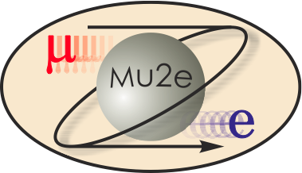
Risk Management Conventional Construction
T. Lackowski
L2 Manager
10/22/2014

Slide 2
RISK MANAGEMENT DURING CD PHASES
Critical Decision Phases with continuous and iterative risk management.
Initiation Definition Execution Transition/Closeout
CD-0 CD-1 CD-2 CD-3 CD-4
Approve Mission Approve Performance Approve Start of Approve Start of
Need Requirements Baseline Construction/ Operation or
& Alternative Authorization Project/Transition
Selection to Complete Completion
And Cost Range Implementation
Risk Planning
Risk Management Documentation
Qualitative Analysis Process
Risk Communications
Closeout
Lessons Learned

Slide 3
KEY ELEMENTS OF RISK MANAGEMENT
Risk Planning
Risk Identification
Qualitative Risk Analysis
Quantitative Risk Analysis
Risk Handling and Mitigation Strategies
Risk Monitoring

Slide 4
Risk Identification
Identified and documented Risk items.
Clearly state the risk event and impact to the Project.
Note the interdependencies within the Project.
Compile and review risks at the subproject level, then submit to Project Office.
Project Manager determines which risks are above threshold that will be held in the Project Risk Registry”
Currently, Mu2e Risk Register contains two Conventional Construction risks that are held by the L2 and one risks that are held by the Project Manager.
Lower level risks are held by the Conventional Construction L2.

Slide 5
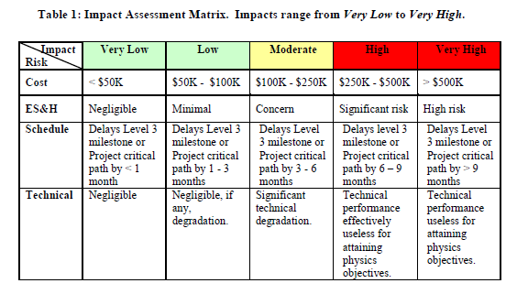
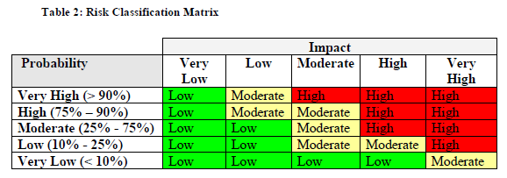
Risk Analysis Tools Qualitative

Slide 6
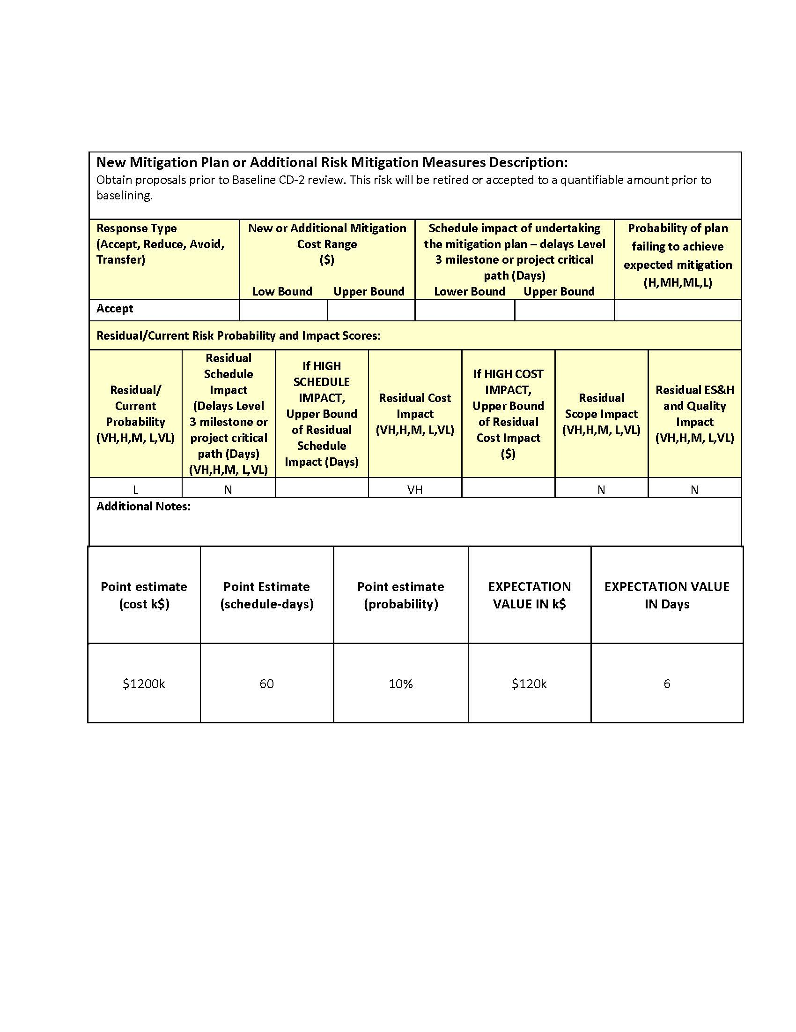
Project Risk Form

Slide 7
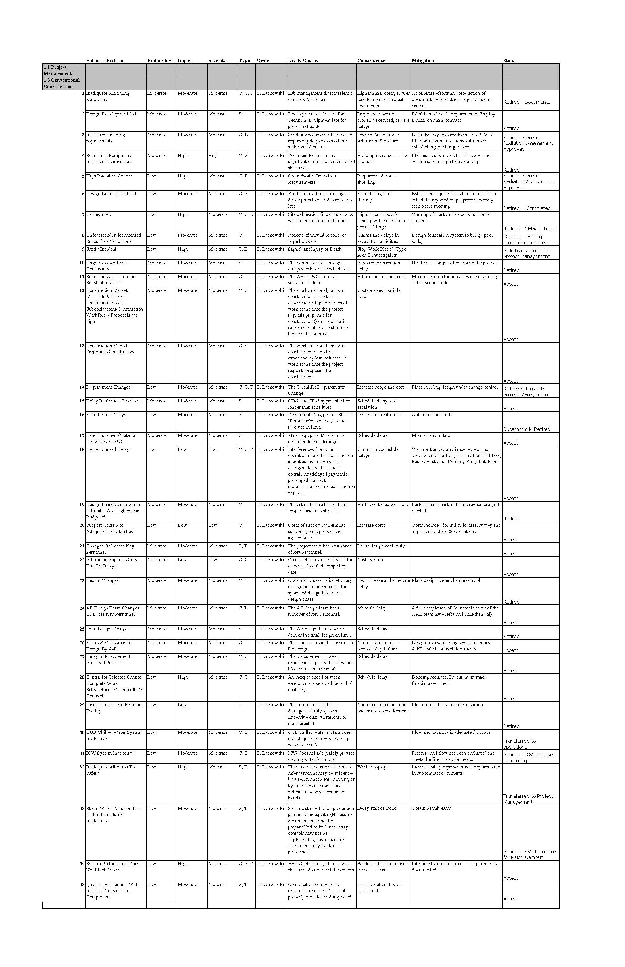
Lower Level Risks
Project level risks were generated from the sub-project risk registry.
Lower level risks are reviewed monthly at the sub-project level.

Slide 8
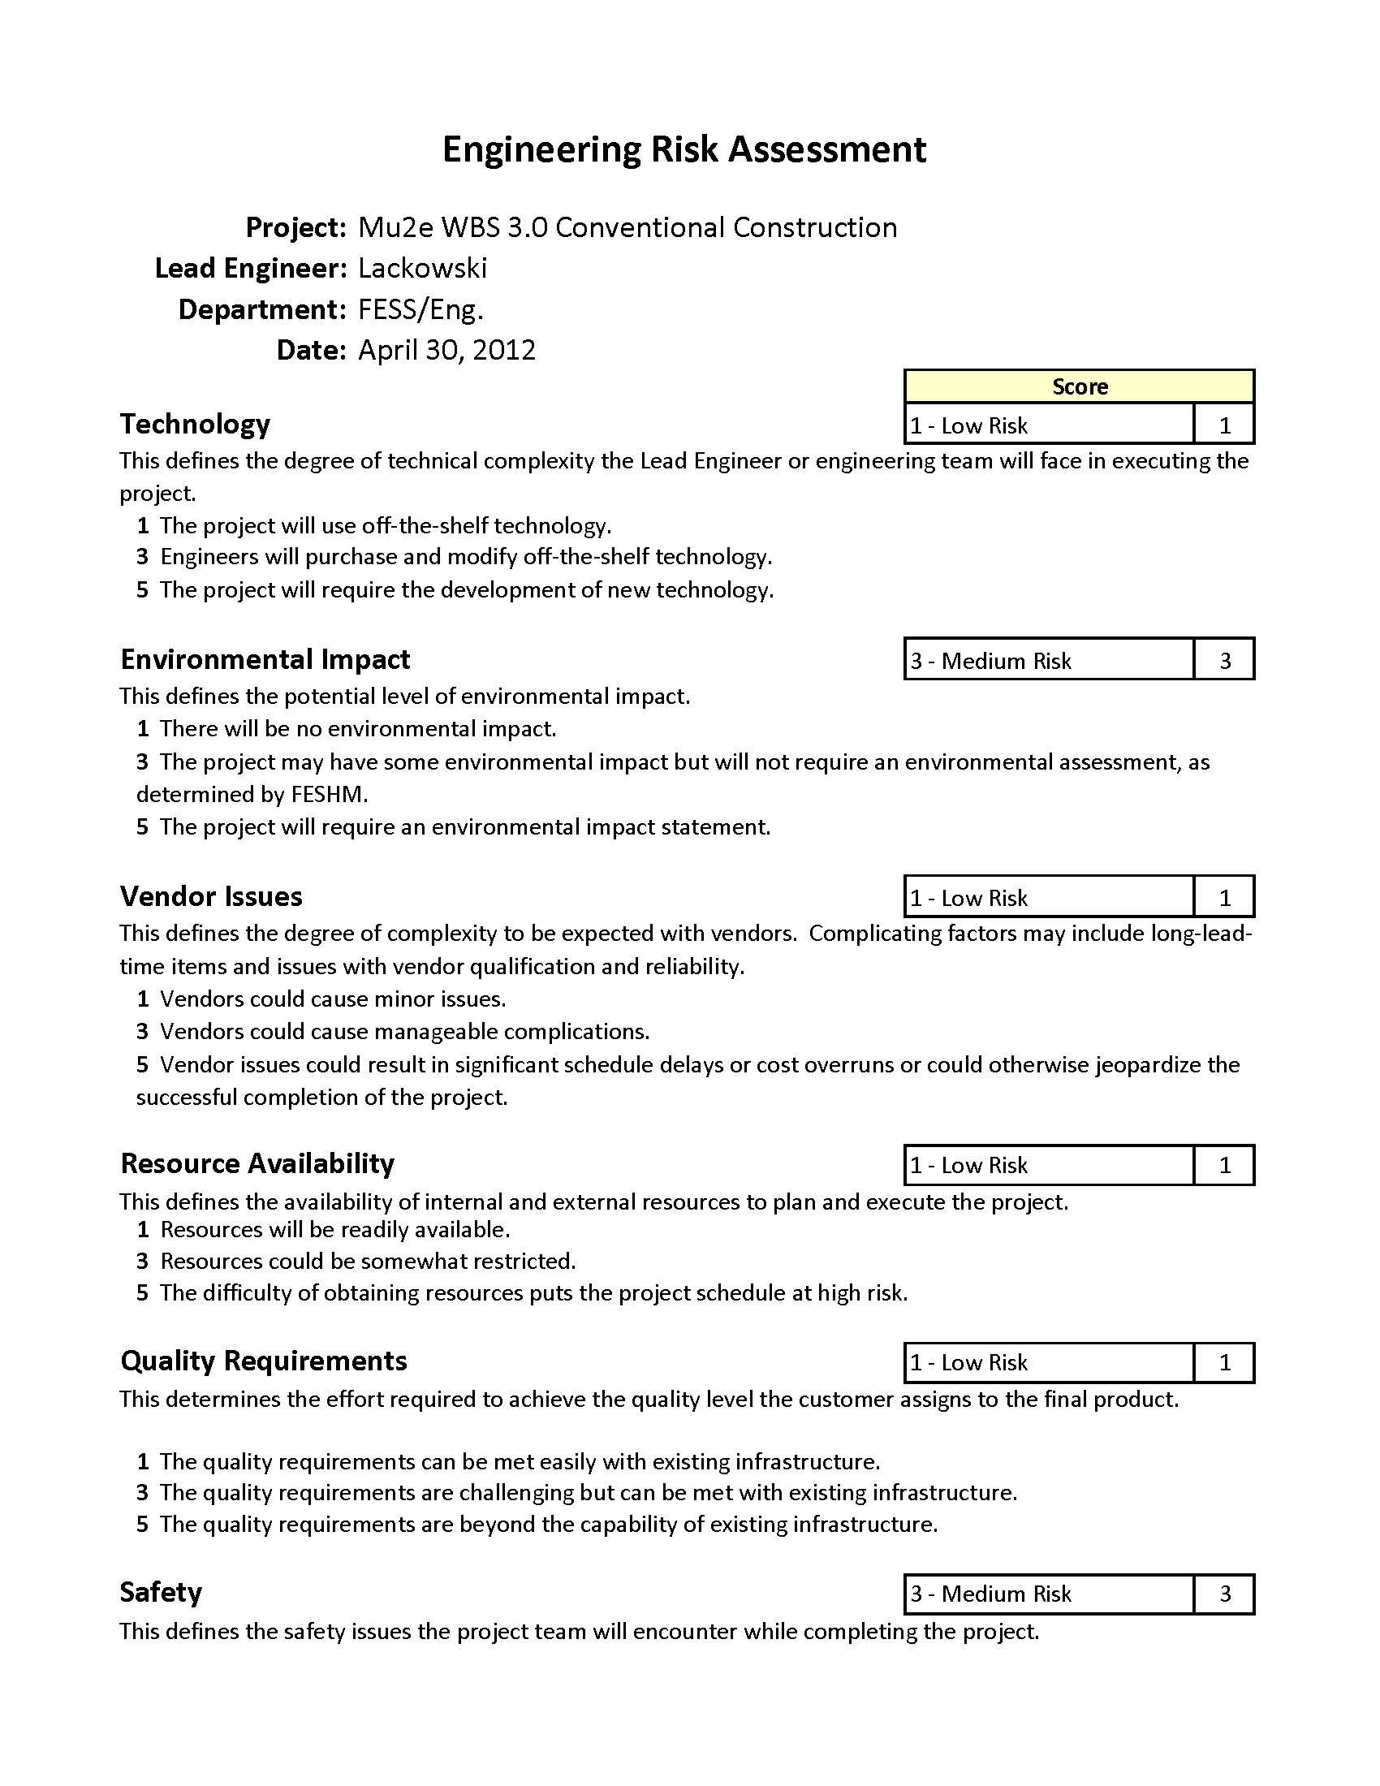
Engineering Risk Assessment
Assessments were completed by each sub-project.
2225

Slide 9
Mitigations and Monitoring
Mitigation plans are developed by the risk owner and implemented into the project plan
The risk owner has a significant role in risk monitoring.
The risk owner will update information on the risk item’s form promptly following recognition.
After CD-2, the Risk Manager will prepare a monthly report that identifies any and all changes to the Risk Register in the previous month.
The lower conventional construction risks are reviewed monthly by the owner.

Slide 10
Summary
Mu2e has a solid foundation of risk entries that all members have agreed on.
A Risk Management Plan has been developed by the project.
Mu2e has determined that the Project’s Risk Program is acceptable and ready for a CD-2/3b approval.
Iterative process will continue throughout the life cycle of the Project.
Both project level risks and sub-project level risks are tracked, and monitored.

