Slide 1
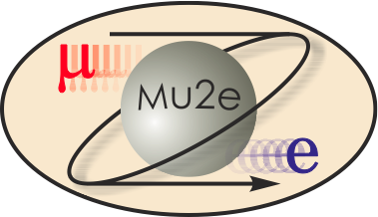
Value Engineering WBS 3.0
T. Lackowski
L2 Manager
10/22/2014

Slide 2
VE Study
Using the Advanced Conceptual Design drawing as the basis a Value Engineering workshop was held on February 14-15, 2013.
The workshop followed the Corp of Engineer’s OVEST format.
The A&E disciple leads participated in the workshop as independent experts. The workshop doubled as an informational kickoff meeting and as a team building.

Slide 3
Planning, Agenda and Participant List

Slide 4
Information and Functional Analysis Phases
Understand the background and decisions that have influenced the development of the design through a formal presentation by the designers.
Analyze the key functional issues governing the Project. The functions of any facility or system are the controlling elements in the overall VE approach. This procedure forces the participants to think in terms of function, and the cost and impacts associated with that function.
Define Project objectives and key criteria governing the project.
Determine Project’s definition of Value.

Slide 5
Information and Functional Analysis Phases
Talks were given by major project stakeholders, describing the physics, the scientific equipment, installation and operational requirements.
Talks also were given by in-house FESS disciplines describing the facilities design as of the Advanced Conceptual.

Slide 6
Speculation Phase
The VE Team thinks of as many ways as possible to provide the necessary function within the project areas at a lesser initial or Life-Cycle Cost which represent improved value to the project.
Judgment of the ideas is prohibited.
The VE Team is looking for quantity and association of ideas, which will be screened in the next phase of the study.
Many of the ideas brought forth in the creative phase are a result of work done in the function analysis. This list may include ideas that can be further evaluated and used in the design.

Slide 7
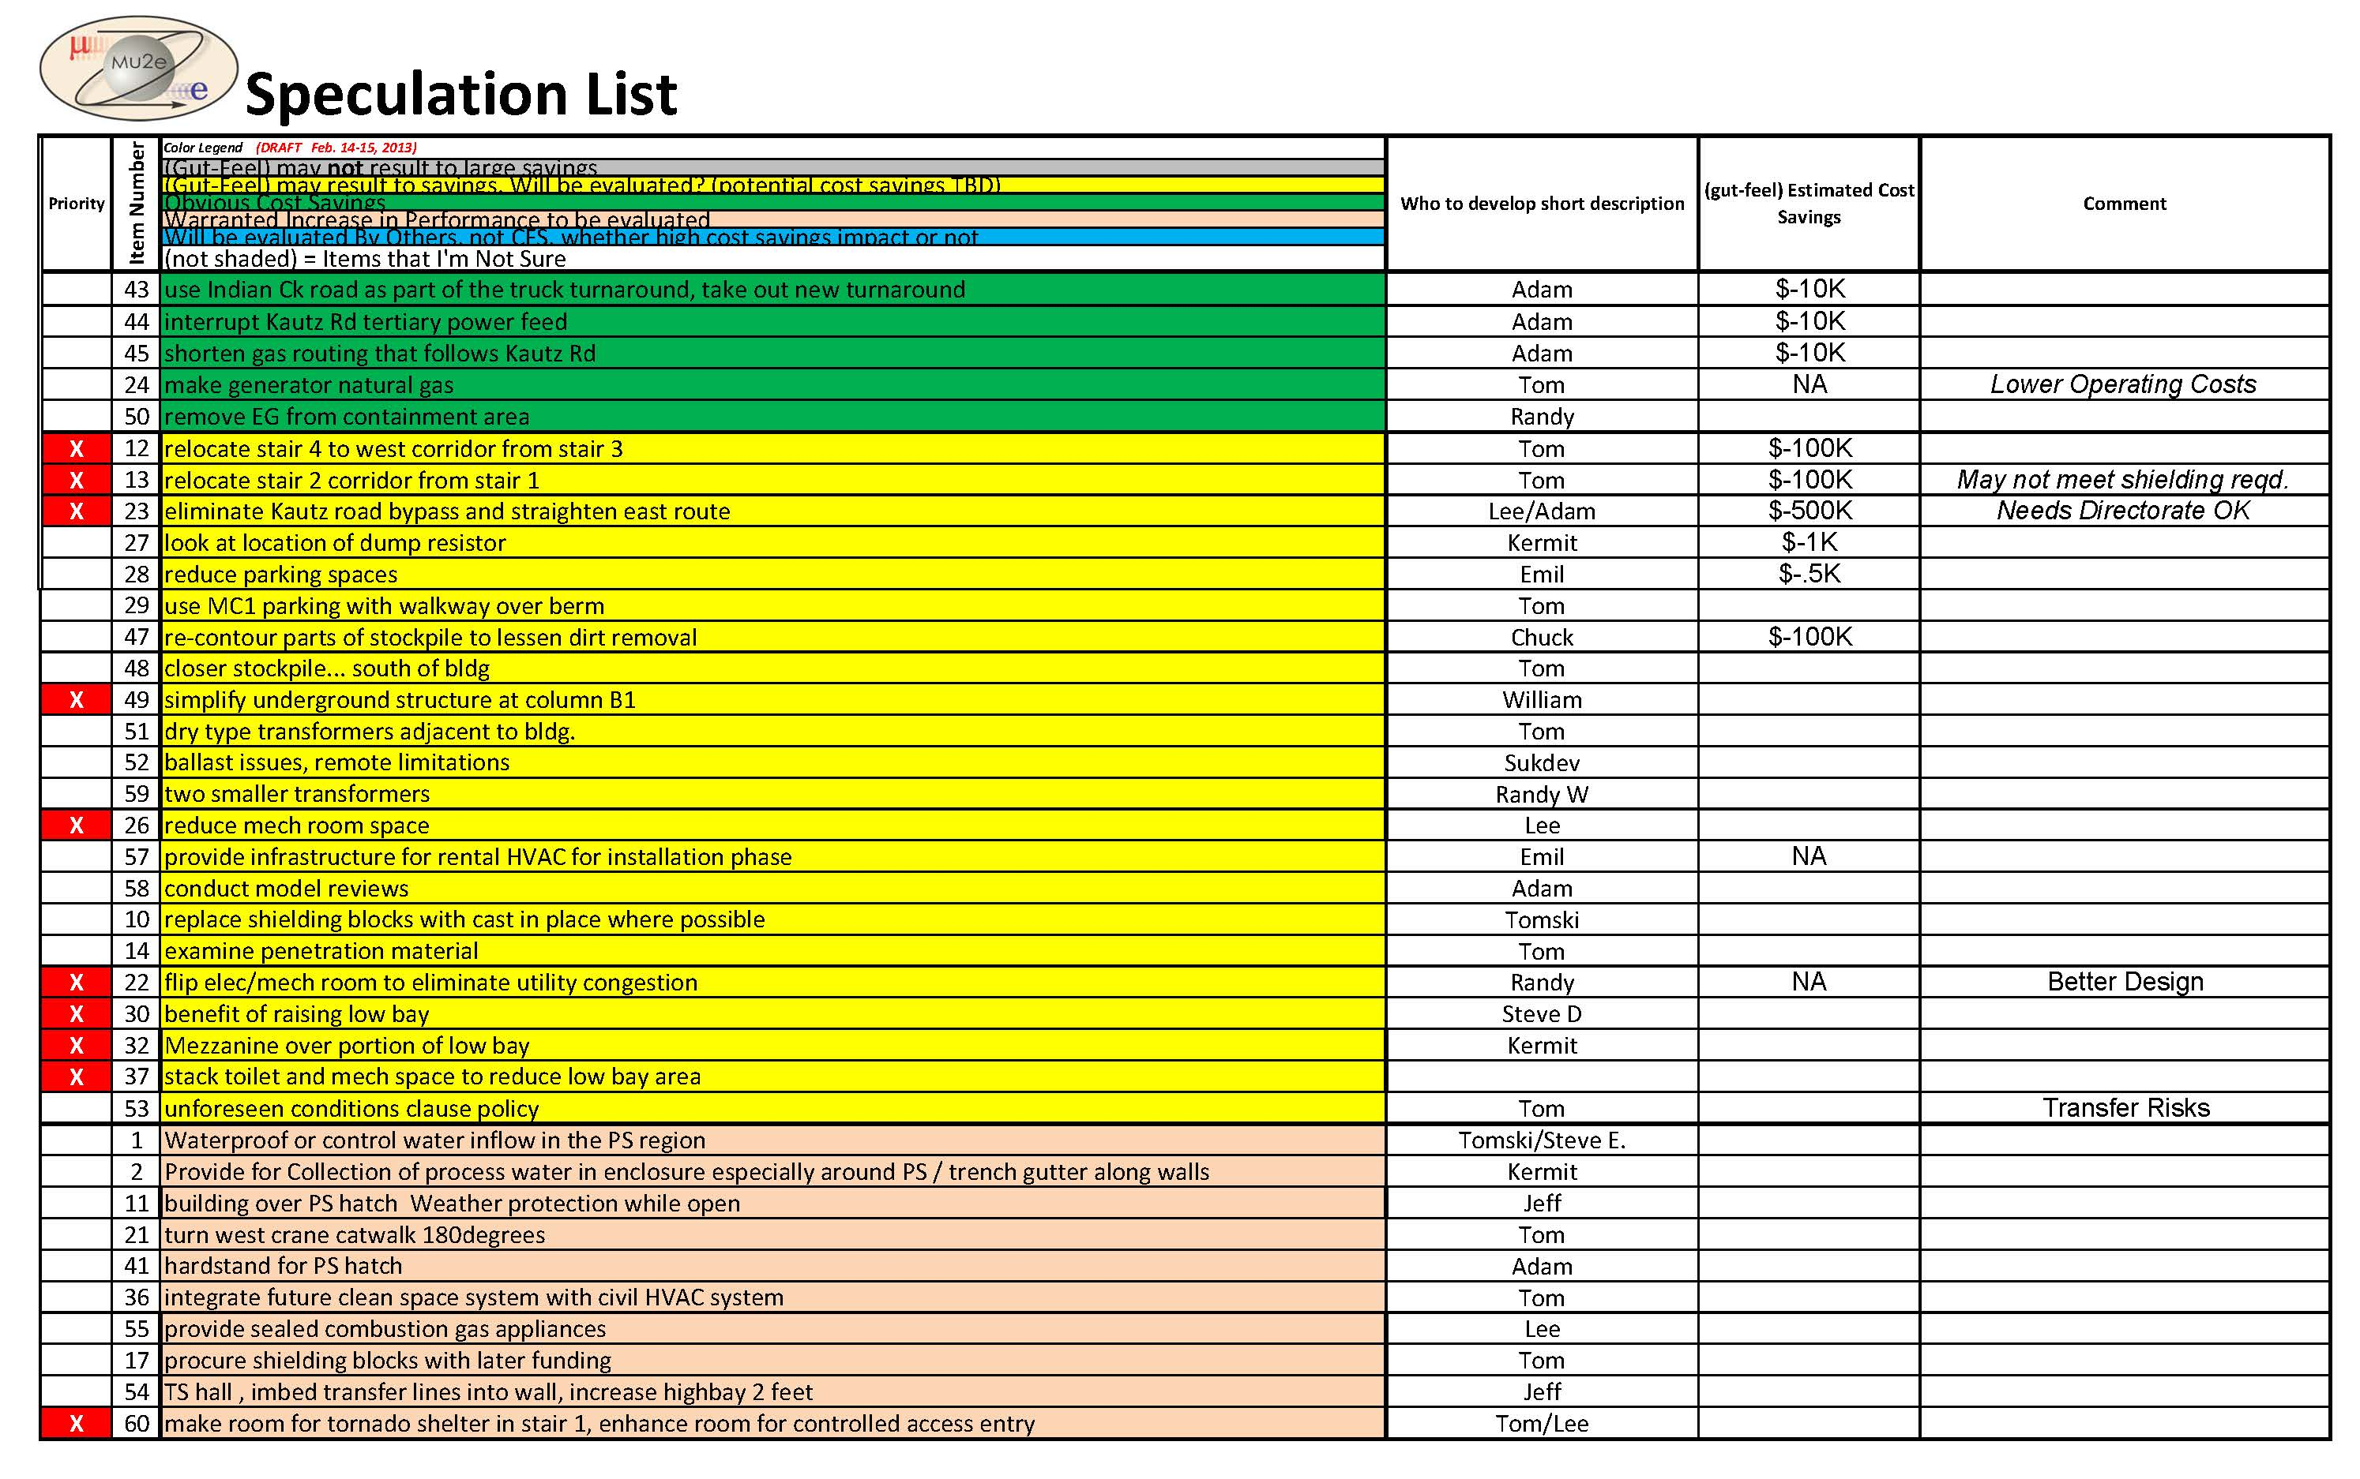
Speculation Phase

Slide 8
Speculation Phase

Slide 9
Evaluation
Defines the criteria to be used for evaluation.
Analyzes and judges the ideas resulting from the creative session. Ideas found to be impractical or not worthy of additional study are discarded. Those ideas that represent the greatest potential for cost savings and value improvement are developed further. A weighted evaluation is applied in some cases to account for impacts other than costs (such as schedule impacts, aesthetics, etc.).

Slide 10
Building over PS Hatch

Slide 11
Mechanical Room Layout

Slide 12
Eliminate Kautz Road

Slide 13
Diesel to Gas Generator

Slide 14
Development Phase
During the development phase of the VE study, many of the ideas are expanded into workable solutions. The development consists of:
Description of the recommended design change.
Descriptive evaluation of the advantages and disadvantages of the proposed recommendation.
Cost comparison and LCC calculations.
Each recommendation is presented with a brief narrative to compare the original design method to the proposed change.
Sketches and design calculations, where appropriate, are also included in this part of the study.

Slide 15
Site Plan, eliminated Kautz Road.

Slide 16
Presentation
The presentation is the compilation of the recommendations in the form of a written report. The recommendations, the rationale that went into the development of each proposal, and a summary of key cost impacts are presented at that time so that a decision can be made as to which Value Management proposals will be accepted.
In addition to the monetary benefits, the VE Workshop provides a valuable opportunity for key project participants to come together, then step aside and view the project from a different perspective. The VE process therefore produces the following benefits:
Opportunity to explore all possible alternatives
Forces project participants to address "value" and "function"
Helps clarify project objectives
Identifies and prioritizes Client's value objectives
Implements accepted proposals into design
Provides feedback on results of the study

Slide 17
See Mu2e Doc Db 2742 for full report
2742

