Slide 1
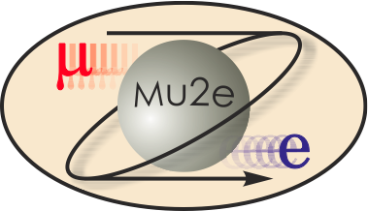
Conventional Facility RFP, Cost and Schedule
T. Lackowski
L2 Manager
10/22/2014

Slide 2
RFP
The Mu2e Conventional Facilities, project # 6-10-2 was issued with the GPP, MC Beamline Enclosure, Project # 6-10-22, to be awarded to a single proposer.
RFP issued on 6/18/2014.
Initial proposals received on 8/12/2014.
Final proposals received 9/18/2014
Evaluation team finalized their choice on 9/22/2014
Provisions have been added to keep the reporting of progress separate between the two scopes.

Slide 3
RFP Constraints
Issuing the RFP was contingent on DOE’s consent to the Acquisition Plan and RFP for mu2e Conventional Facilities and the MC Beamline Enclosure, received on 6/17/2014.
RFP also contingent on the Accelerator Div. ES&H approval of the Preliminary Radiation Assessment, received 6/16/2014.
NEPA approved 6/12/2012.

Slide 4
Cost Estimate
The cost estimate was developed by Middough Inc.
Estimates and schedules were prepared at the 60% and 90% design level.
Discipline engineers and estimator worked together developing the estimates.
Fermilab engineers reviewed the estimates and took ownership of scope and costs.
This was useful not only as a check of the estimate but also brought to light a number of material issues that were able to be resolved.
Estimate performed using RS Means and Middough’s Cost data.
Middough’s estimate was adjusted for additions and changes made after receipt of final drawings from the A&E.
$11,966,300 (Middough) + $344,127 (Fermi) = $12,310,427

Slide 5
Management and Engineering Estimate
The estimate for Management and engineering costs was developed using a percent of the estimated construction cost.
Subdivided by:
Preliminary / Final Design
Construction Phase
Project Close
Subdivided by:
In-house labor (hours)
Travel, Equipment and in-house consultants (M&S)
Consultants (M&S)
Subdivided by year
Costs and scope not included in % of construction such as survey and JULIE, which used to be provided by Fermilab at no cost to projects, have been added in as activities w/ budget.

Slide 6
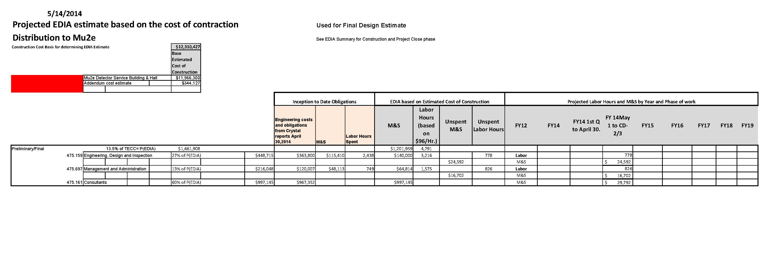
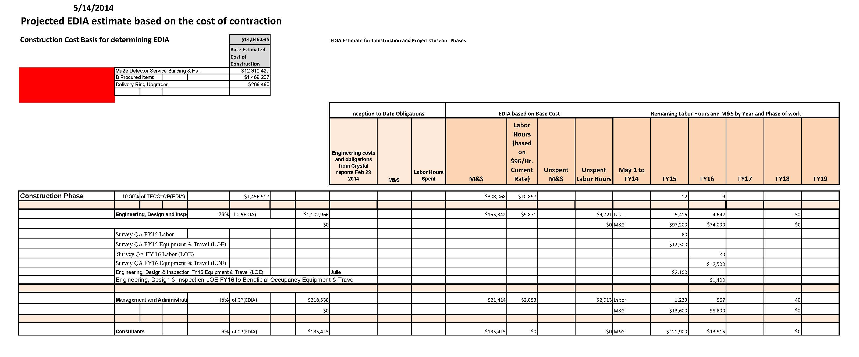
Example showing Final Design Costs

Slide 7
Independent Cost Estimate (ICE)
DOE Washington is managing the ICE for Conventional Construction.
Civil Construction – ICE within ~2% (lower) of project estimate. ICE review was held at Fermilab on 8/26-28/2014
Differences at the CSI division was discussed
Packaging accounted for much of the difference
Project estimate included duct bank cost in Div. 2, civil while independent estimator place these costs in Div 16, electrical.
Some user items included in electrical
Ice estimator used straight RS Means for concrete; Project estimate accounted for difficult placement methods and heavier formwork/falsework due to configuration.
DOE determined no further effort was needed to resolve the small differences.

Slide 8
Schedule
Primavera P6 used as scheduling tool
Planning package for fixed price construction packages
FY 14 Base costs in schedule
BOE assigns contingencies, Resource type
Cobra delivers the total numbers, transforms labor hours to dollars, adds escalation, contingency and indirects.
Number of Activities – 298
Number of Completed Activities - 111
Number of Milestones – 73
22 Level of Effort
79 labor Activities
0 Critical Activities

Slide 9
Schedule
Middough generated two schedules
One based on a sophisticated subcontractor, multi-tasking and;
One based on a less sophisticated, one trade at a time, type subcontractor.
I independently generated a schedule that is in between the two Middough schedules
The Fermi schedule (my schedule) is used for the baseline planning package durations and has an 85% confidence.
The Fermi schedule (my schedule) was used to generate durations and subcontract milestones.

