Slide 1
Mu2e Conventional Facilities Life Safety
Jim Niehoff
ES&H (Fire Protection) Safety Specialist
10/2014

Slide 2
Objectives
Provide successful evacuation
Provide effective fire fighting and rescue operation
Limit spread of fire and smoke by:
Fire suppression systems
Fire alarm systems
Smoke abatement

Slide 3
Requirements (Determined)
AON’s recommendations (Mu2e Doc DB- 1314) are based on codes/orders/standards that Fermi has stipulated:
DOE Order 420.2C Safety of Accelerator Facilities
IBC (International Building Code)
IFC (International Fire Code)
NFPA (National Fire Protection Association)
Aim of Life Safety
Get the occupants out (egress)
Get the fire fighters personnel in (ingress)
Fire Protection approach is based on experience from previous projects at the laboratory

Slide 4
Salient Design Features
Less than 30 feet below level of exit discharge, omitting the requirements for smoke control and stairway pressurization
Two Exit stairways enclosed by 2 hour fire rated construction
Means to separate Enclosure from Detector Hall
Maximum travel distance 300 feet
Minimum aisle width 36 inches
Automatic fire sprinkler system, preaction type (Detector Hall)
Linear heat type detection
Beam Type Smoke Detection & Spot Type Detection
Air sampling smoke detection
Manual pull stations

Slide 5
Salient Design Features , Continued
Fire Alarm will have Emergency Voice Alarm system enable to interface with Fermilab’s Site-wide Emergency Warning System
Emergency and exit signage
Emergency/Standby power systems for
Fire alarm system
Exit sign Illumination
Emergency Lighting
Elevator & Elevator Car Lighting
Sump System

Slide 6
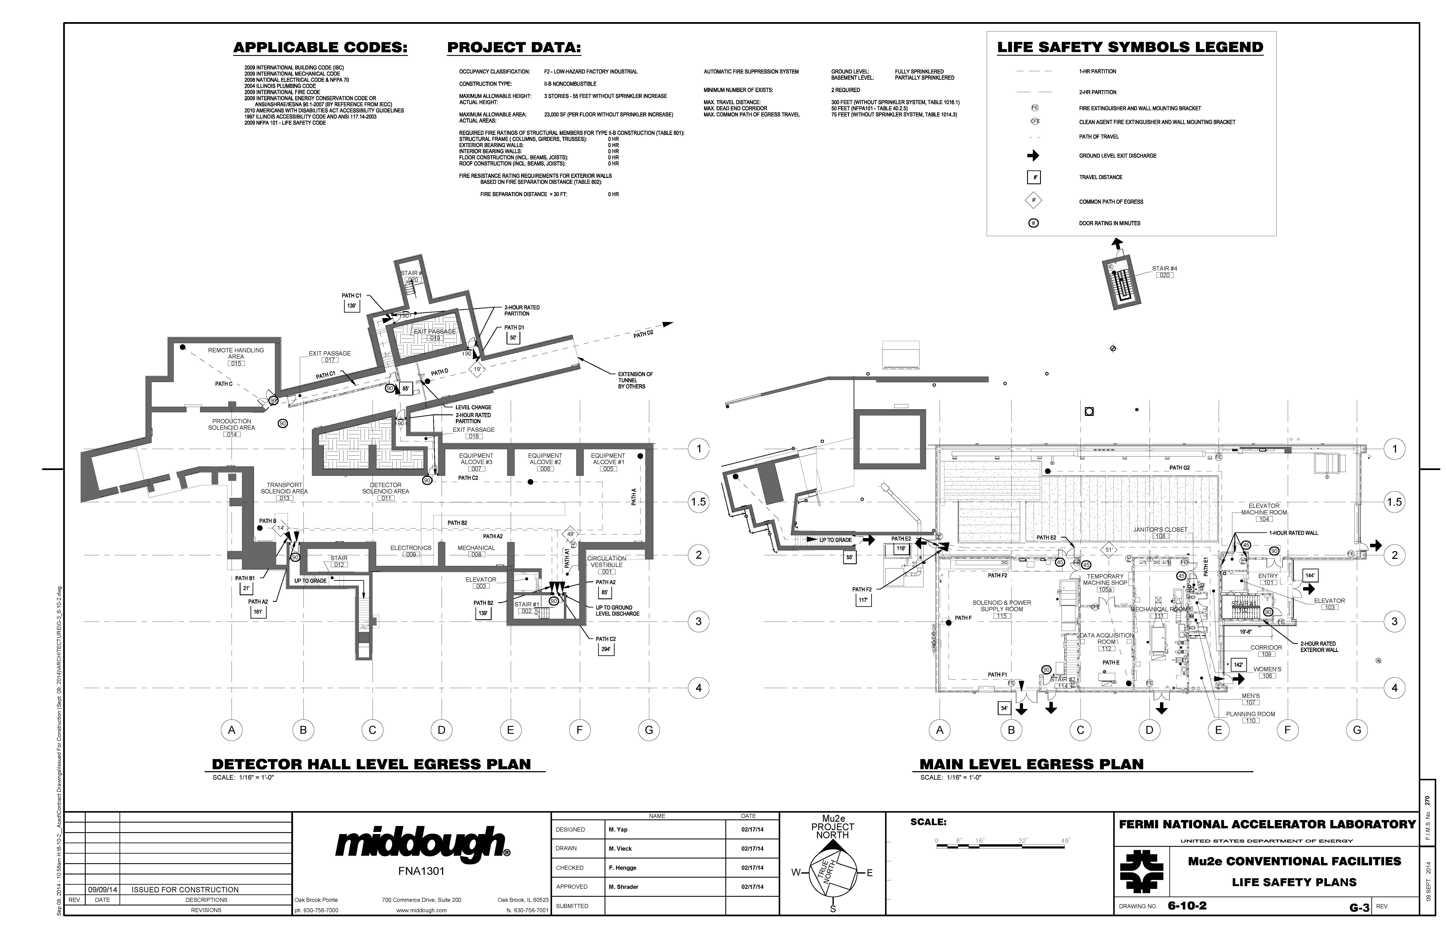
A&E Independent Code Review
Middough performed their own independent code and life safety analysis and developed a Life Safety drawing summarizing :
Required codes,
Occupancy Classification
Type of Construction
Building Area
Building Height
Means of egress

Slide 7
Final Review
The completed contract documents were forwarded to Rick Glen of AON to perform a “Building Department” style document life safety review.
Mu2e Doc db- 1314 contains the letter indicating compliance with the applicable fire protection/life safety requirements of the 2009 International Building Code (IBC), the 2009 Life Safety Code, NFPA 101, and for compliance with the mu2e Fire Protection/Life Safety Assessment dated June 12, 2013

Slide 8
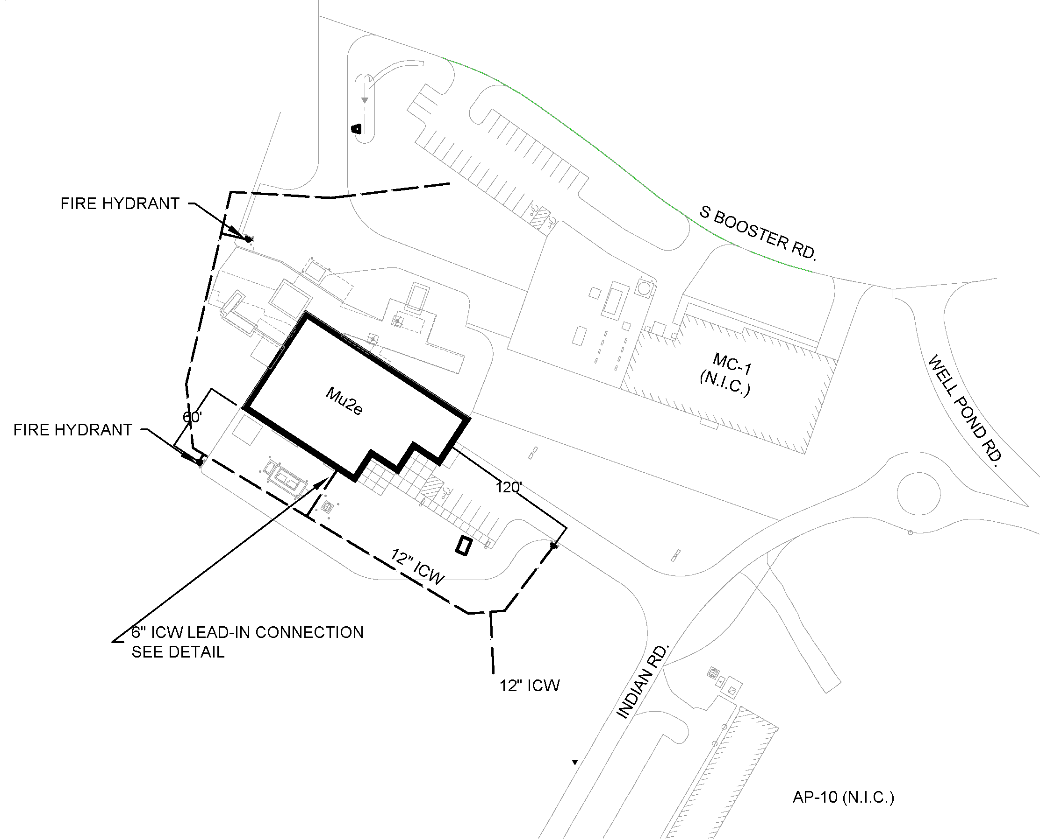
DESIGN (Site Plan)

Slide 9
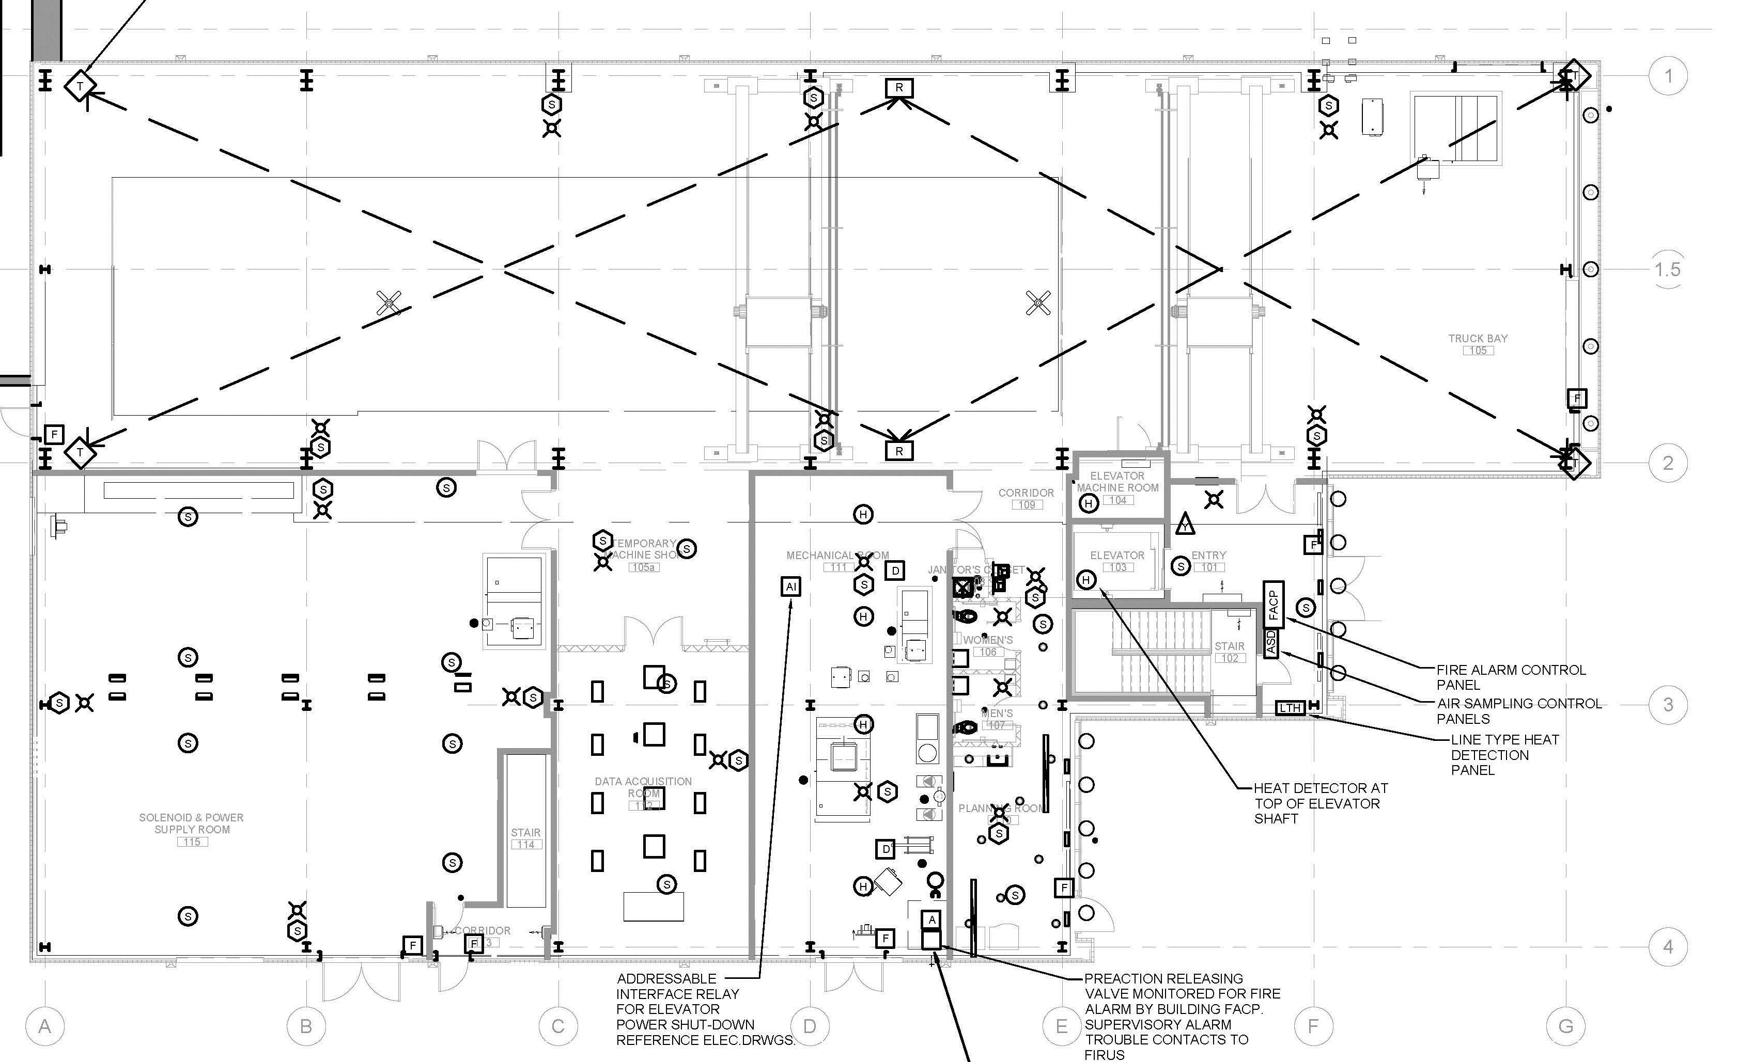
Fire Detection – Main Level
Beam Type Smoke Detection
Manual Pull Station
Combination Speaker and Strobe
Spot Type Smoke Detection

Slide 10
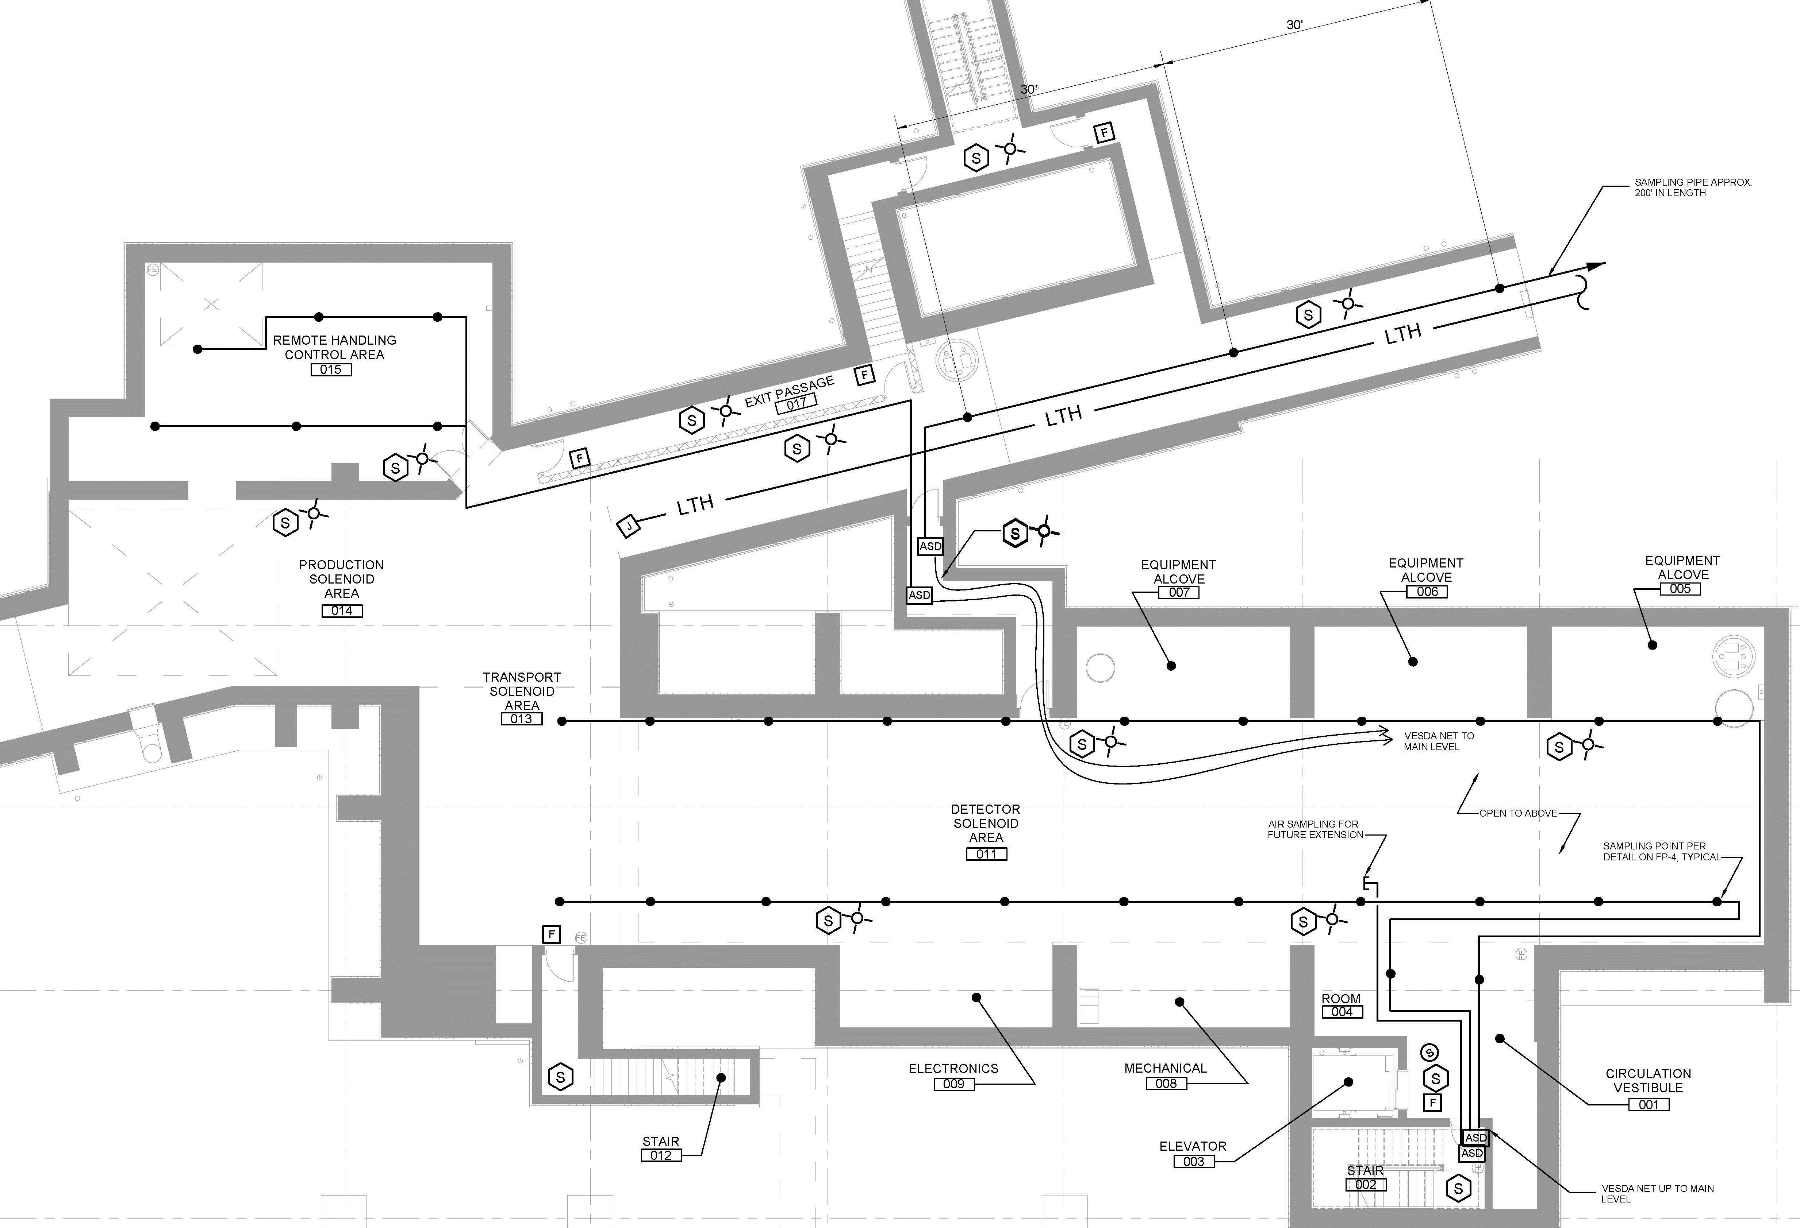
Fire Detection – Lower Level
Line Type Heat Detection
Air Sampling Smoke Detection

Slide 11
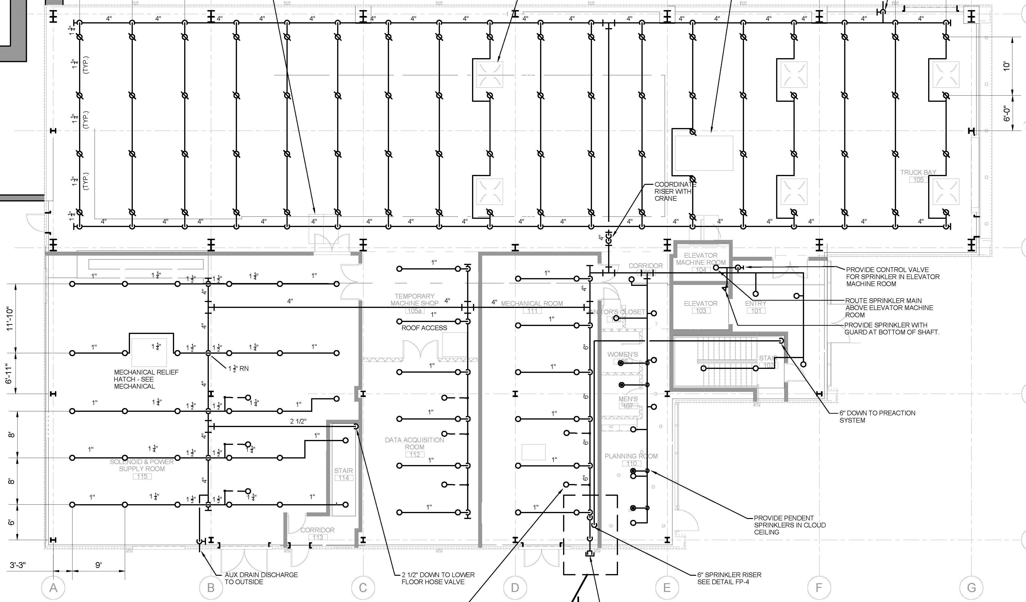
Fire Suppression – Main Level
Wet Type Automatic Sprinkler System – Ordinary Hazard Throughout

Slide 12
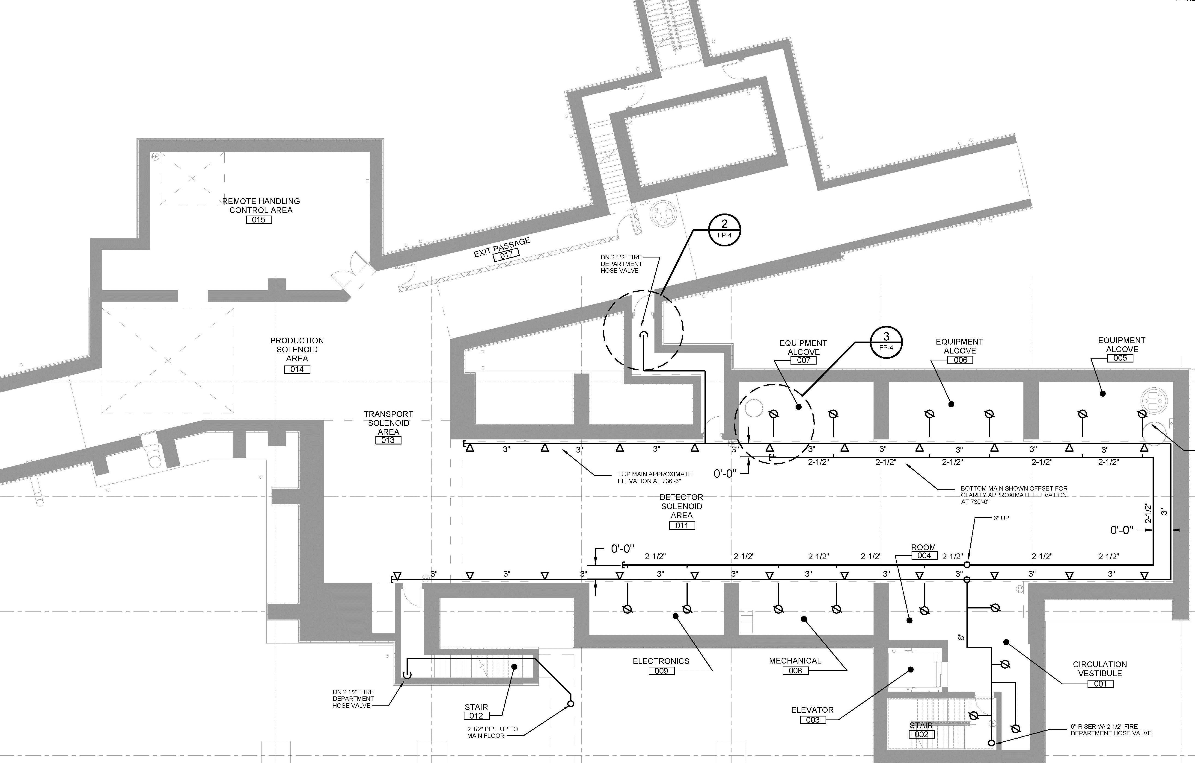
Fire Suppression – Lower Level
Pre-Action (Dry Type) Automatic Sprinkler System

Slide 13
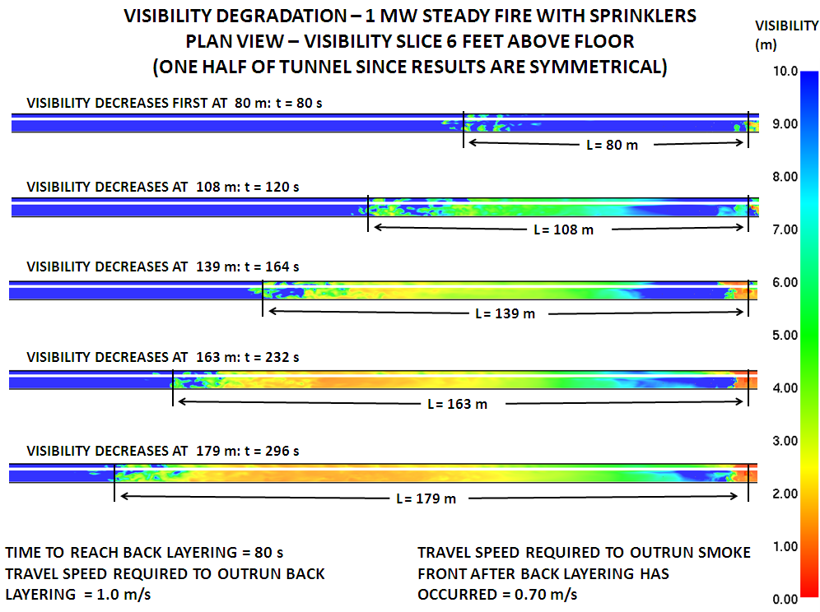
Validation of Exiting Distances
Code required exiting distances for a beam enclosure was verified to insure safe evacuation with a smoke model that concluded that an able bodied person can reach an exit prior to being overcome by smoke.
Egress Analysis
Required Safe Egress Time (RSET)
Available Safe Egress Time (ASET)
If ASET is greater than RSET, occupants have enough time to evacuate safely.
Study concluded that NFPA standards/Codes is a feasible approach in single tunnel / enclosure design.

Slide 14
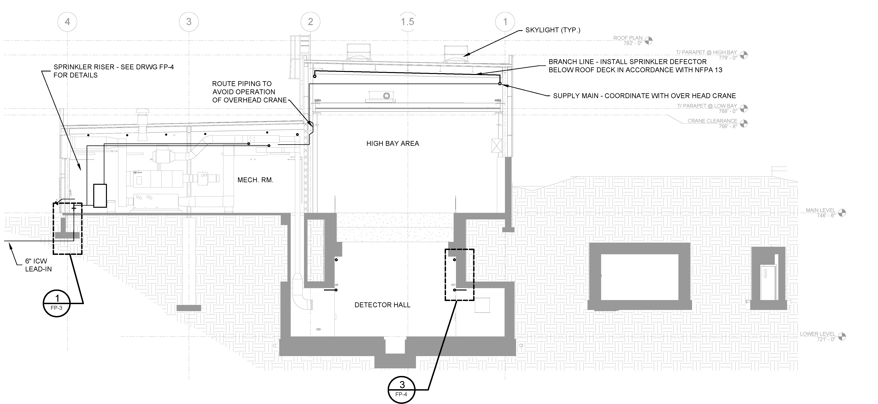
Design (Building Section View)

Slide 15
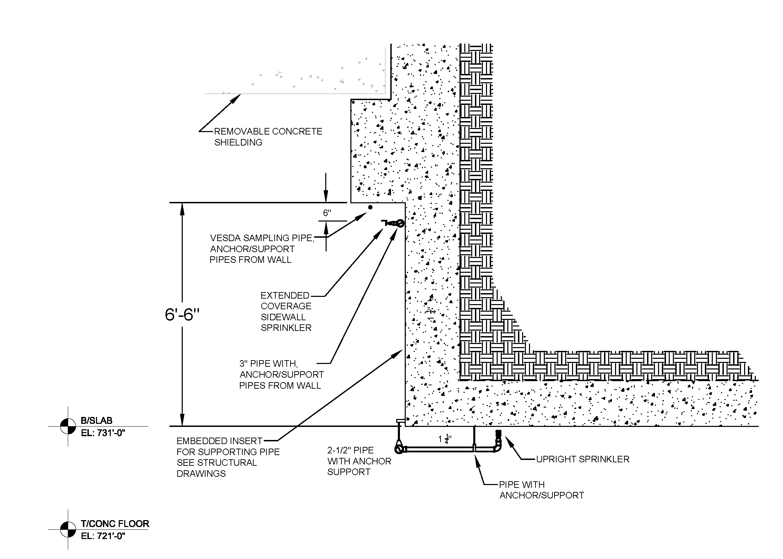
Design (Detector Hall Section under hatch)

