Slide 1
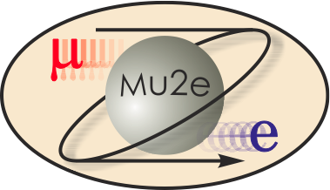
Mu2e Tracker Straws
Chiho Wang
Straws L3 Manager
10/22/2014

Slide 2
Outline
Straw requirements
Straw property measurements
Straw assembly components and procedures
Cost

Slide 3
Straw requirements
5 mm ID metalized Mylar tube cathode.
Minimal material
6 μm Mylar + 3 μm adhesive + 6 μm Mylar double helical wrap
Inner wall coating: 500Å Al + 200Å Au
Outer wall coating: 500Å Al
Operates in vacuum
Sustains > 1 atm pressure difference
Leak rate < 7 ccm / detector volume
Stability
Straw straightness: max. transverse deviation/sagging < 300 μm for HV stability.
Longitudinal tension is applied to keep straw straight.
Initial tension need to be higher to counter for material relaxation over time (creep).
Sustains radiation over the life time of operation.

Slide 4
Straw properties
Destructive tests:
Pressure: sustained 60 psi (10 min.). Destroyed ≥ 70 psi
Stretch: sustained 1.6 kg (2 yrs.). Destroyed ≥ 2.9 kg
Mechanical:
Linear density: 0.34±0.01 g/100cm
Wall thickness: 15 μm
Derived from linear density, assuming Mylar density 1.39 g/cm³, and same for the polyester based adhesive.
Spring constant: 0.891 cm/kg/100cm
Electrical:
Cathode resistance: 120 Ω/100cm

Slide 5
Straw leak measurement 1
Duke C. Wang, S. Oh
Pressurize to ~ 1 atm and measure the pressure drop

Slide 6
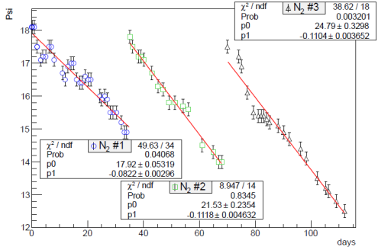
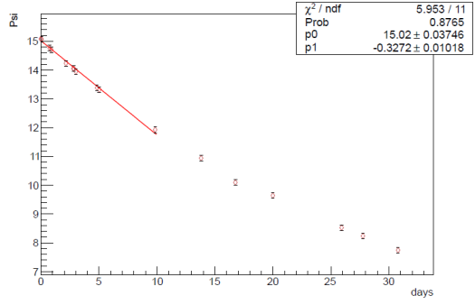
Straw leak measurement 1
Duke C. Wang, S. Oh
N₂
CO₂
N₂ leak rate =0.095±0.026 psi/day
CO₂ leak rate =0.36±0.06 psi/day
Assume Ar leak rate similar to N₂ , and straw volume ~ 0.3 m³, estimated Ar(80%)CO(20%) leak rate ~ 2 ccm / tracker volume

Slide 7
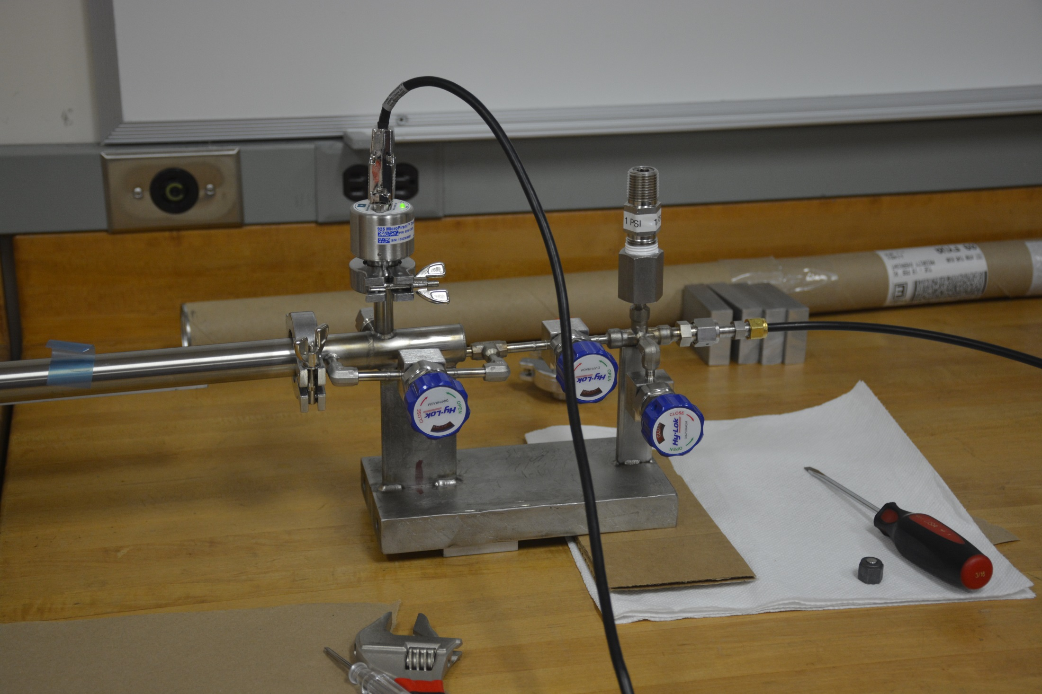
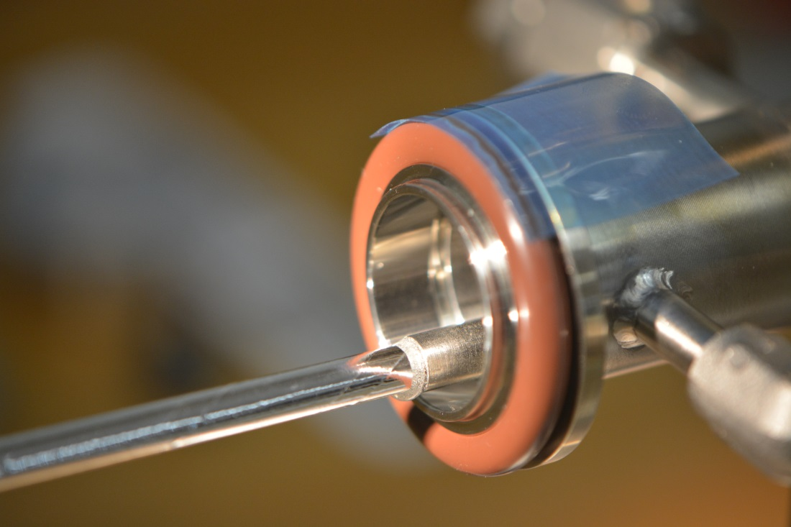
Straw leak measurement 2
York J. Popp, K. Lynch
Fill straw with ArCO₂ and place in vacuum,
Measure pressure rise
Gas inlet
To straw
Straw
1 psi
Pressure relief
Vacuum
gauge
Feed through
Tested 10×129cm straws
Early results ≲ 4 ccm / tracker volume
Improvements underway
Vacuum pump

Slide 8
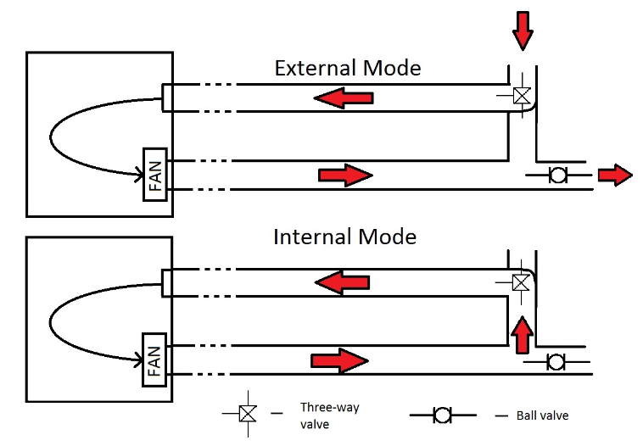
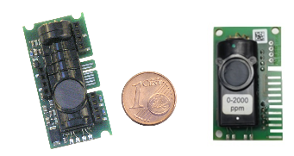
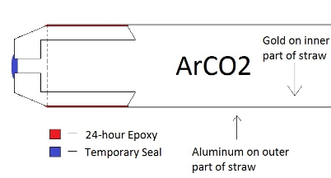
Straw leak measurement 3
Rice D. Rivera, M. Corcoran
Fill straw with ArCO₂ and place in vacuum,
Measure pressure rise
EE891 and EE892 CO2 sensor
Tested 119 ×129cm straws
Averaged leak rate = 5·10⁻⁵ ccm/straw
~1 ccm for tracker volume

Slide 9
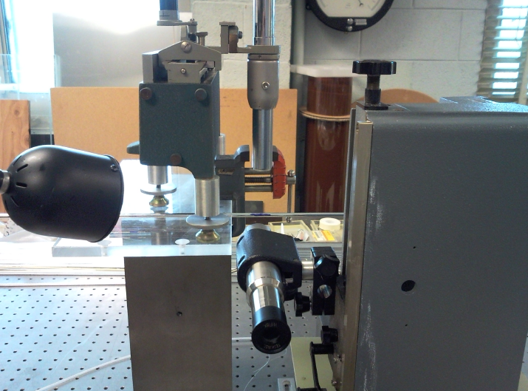
Straw straightness measurement To determine the required straw tension
Horizontal Traveling Microscope (X)
Duke C. Wang, S. Oh
Straw
Straw deviation measured for different straw length and tension.
Vertical Traveling Microscope (Y)

Slide 10
Straw straightness measurement
Duke C. Wang, S. Oh
$$ΔR=\sqrt{Δx2+Δy2}$$
ΔR (cm)
g
Mid point deviation, relative to the highest tension (500g)

Slide 11
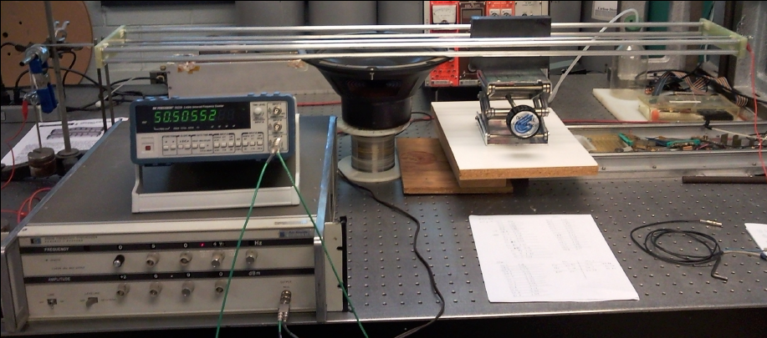
Straw creep measurement
Duke C. Wang, S. Oh
Glue straws on a support frame (120 cm) with tensions:
300 g, 400 g, 500 g, 600 g.
Measure straw tension by resonant frequency as a function of time.
Magnet
Frequency Counter
Straw
Weight
Precision
Function
generator
Support Frame
Speaker
Chiho Wang, Seog Oh, Wes Johnson
11

Slide 12
Straw creep measurement
Duke C. Wang, S. Oh
300 g
400 g
500 g
600 g
Corrected for temperature & humidity variation

Slide 13
Straw creep measurement
Duke C. Wang, S. Oh
Fractional tension shows scaling effect, giving prediction power to other initial tensions.
Assume T(t)/T(0)=(c0*e^{-c1*t}+c2), with c2=0
6-year extrapolation → T(t)/T(0) ~ 43%
700 g initial tension is sufficient to keep tension > 250 g after 6 years.

Slide 14
Radiation aging study
Fermilab R. Wagner
A single straw detector, constructed with relevant components, was operated under Sr⁹⁰ irradiation.
Expected total dose (including beam flash) of 0.9 C/cm was irradiated.
Gain change monitored by Fe⁵⁵ peak amplitude.
Observed no measurable degradation in gain or cathode resistivity
Fractional gain change over 3 irradiation periods. Measured at 3 locations from downstream. Referenced to un-irradiated point at 110 cm:
Gas flow rate = 2 vol/hr/m
20±0.02% CO₂ with balance Ar
Airgas “primary standard” grade. Purity 99.99% with individual impurities below:
Period | Charge (mC/cm) | Current (nA/cm) | Gain(x)/Gain(110 cm)
 |  |  | p1 (7cm) | p2 (37cm) | p3 (67cm)
1 | 120 | 18 | 0.979 | 0.982 | 0.994
2 | 120 | 36 | 1.010 | 1.009 | 1.002
3 | 670 | 70 | 0.994 | 0.990 | 0.983
Total | 910 |  | ±2%

Slide 15
Straw property summary
Straw is robust and has no problem operating in vacuum. The burst pressure exceeds 60 psi and is well above 14 psi.
Straw leak rate of ≲4 ccm is within acceptable range of 7 ccm
700 g initial tension is needed to keep straw tension above 250 g after 6 years, which is needed to keep straw straightness within ±0.3 mm for HV stability.
Straw can sustain tension > 1.6 Kg and is well above the needed 700 g initial tension.
No measurable degradation in gain after expected dosage of radiation.

Slide 16
Straw assembly
After a straw is received from manufacturer it needs to go through QC procedures and get assembled into a straw sub-assembly. These procedures include:
Visual inspection
Continuity check (measure resistance)
Leak test
Cut to length
Assemble/Attach end pieces
A QA/QC data base is being developed to track/link component data.

Slide 17
Straw cutter
Fermilab R. Wagner

Slide 18
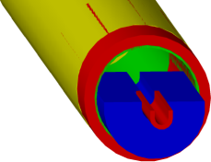
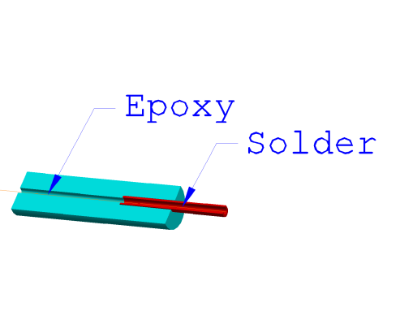
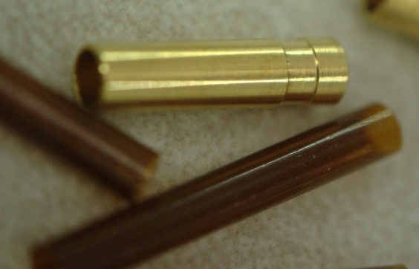
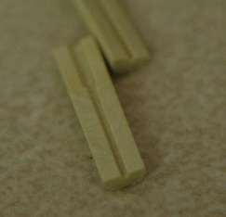
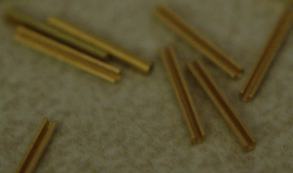
Straw sub-assembly
Fermilab R. Wagner, A. Mukherjee
Wire fixation
Sense wire is aligned by external precision fixture (PAAS), not by straw components)

Slide 19
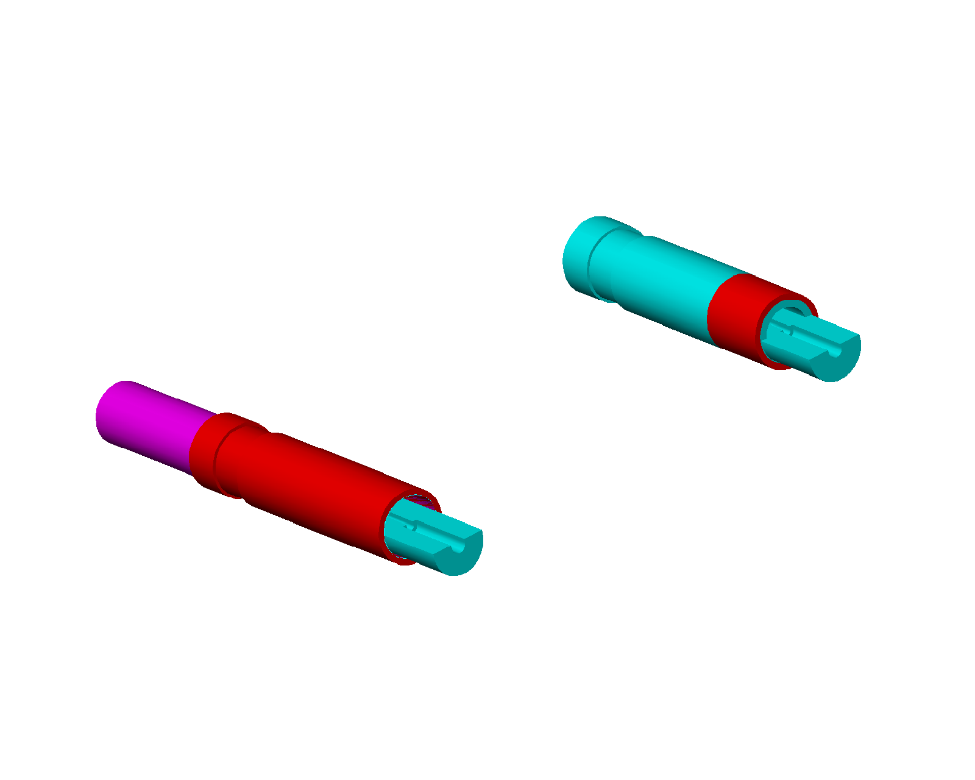
Straw Termination
Fermilab R. Wagner, A. Mukherjee
Simulation studies show it is not necessary to deaden straws near gas manifold
New
3piece construction
Mostly plastic Lighter & cheaper
Old
4 piece construction
Kapton sleeve trimmed to deaden ~1 cm past manifold
Mostly brass

Slide 20
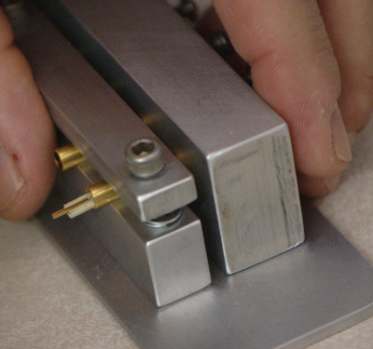
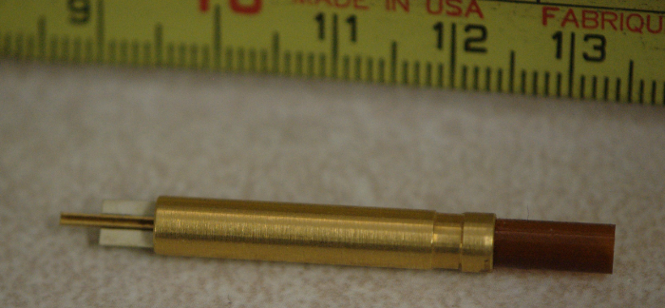
Assembly jigs for assembling end pieces
Fermilab R. Wagner

Slide 21
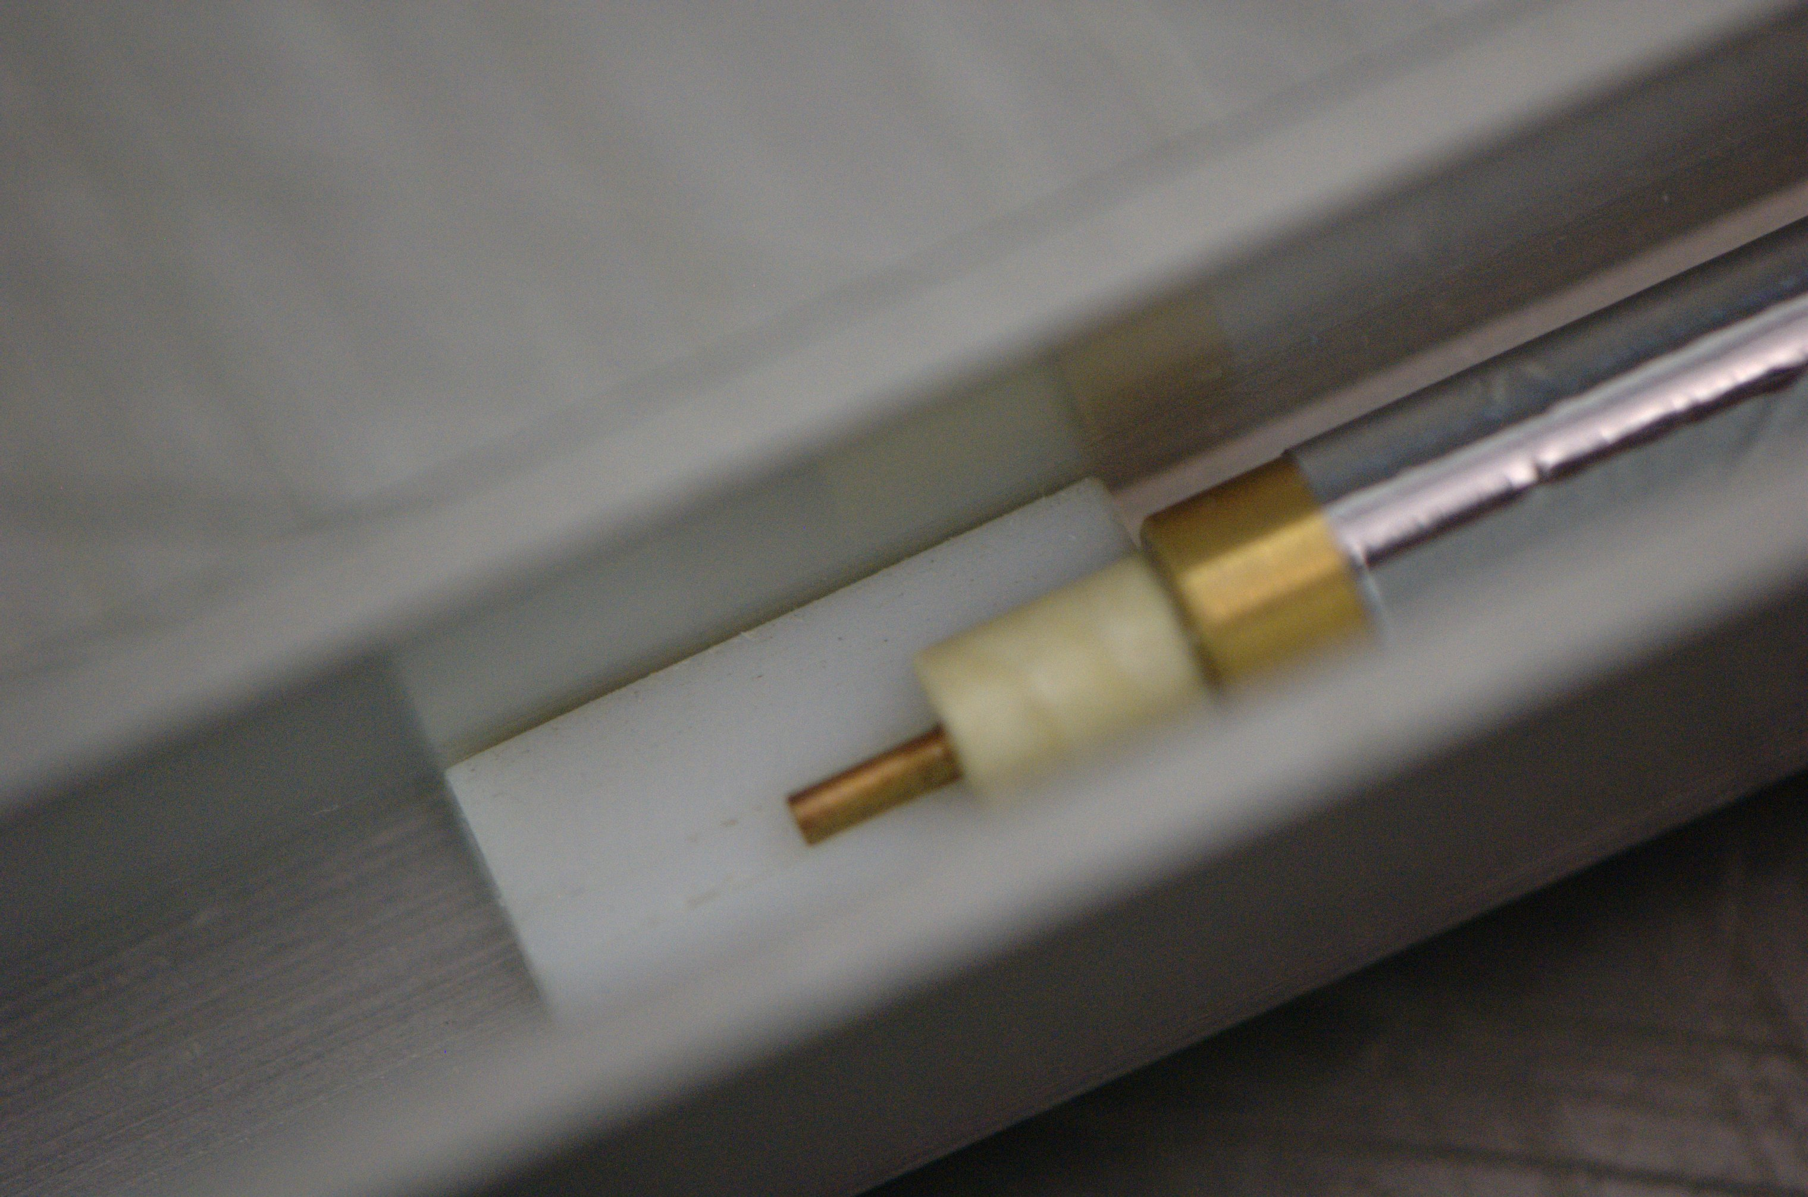
Assembly jigs for gluing end pieces to straw
Orient end pieces on two ends
Glue to straw with conductive glue
Fermilab R. Wagner

Slide 22
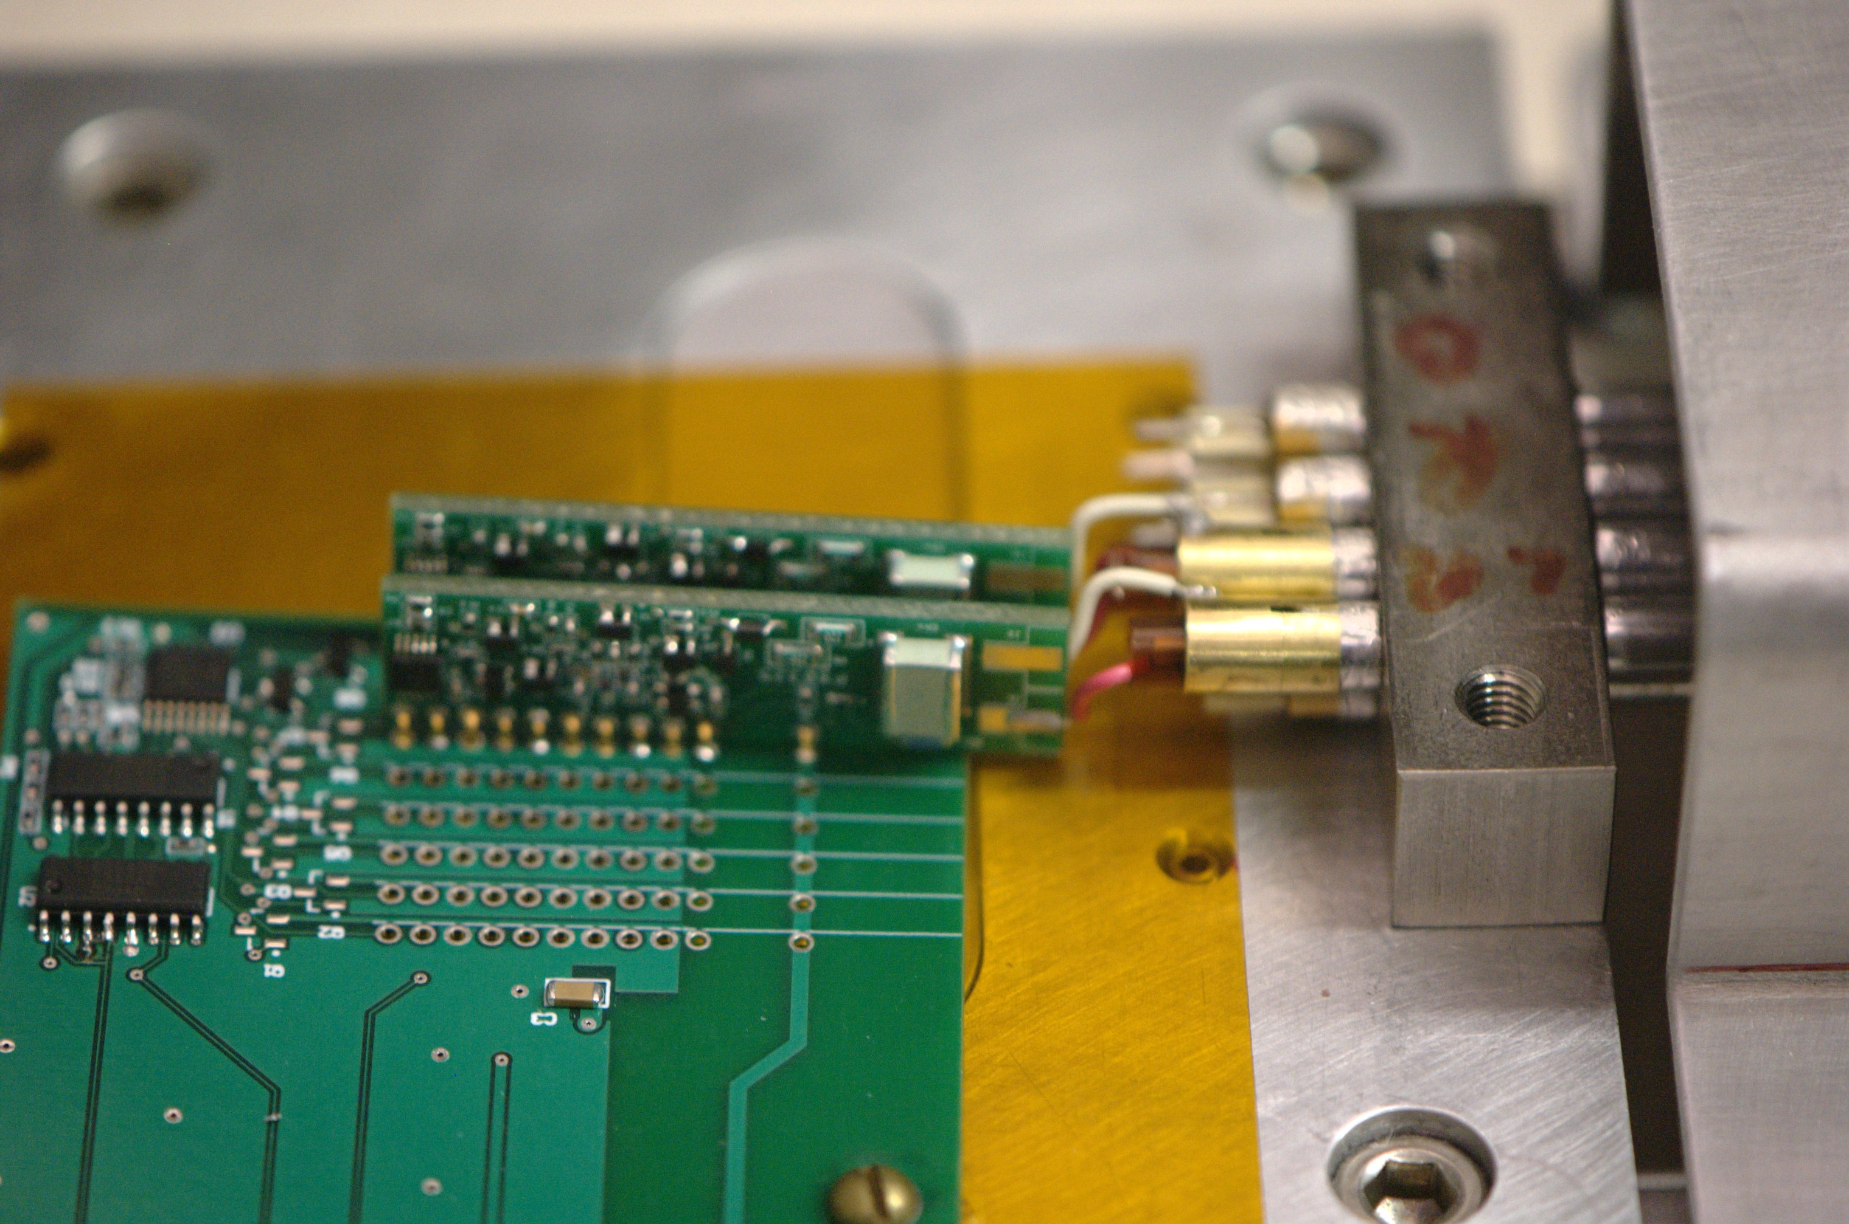
A 2x4 prototype
Fermilab R. Wagner, V. Rusu
Front end electronics attached

Slide 23
QA/QC data base
Rice M. Corcoran
York K. Lynch
Use a RDBMS FNAL supports PostgreSQL
Barcode users & most parts Straws via their storage tubes
QC and construction steps recorded in DB
Leverage NOvA software experience and barcode readers, but write new software interface
GUI

Slide 24
Straw assembly summary
Straw end components had been manufactured and tested.
Assembly tools and test equipment for straw assembly procedures were developed and functional.
Using the material and tools developed, a 2×4 prototype is completed with front end electronics attached.
A QA/QC data base is being implemented for production process.

Slide 25
Cost Table
 | Base Cost (AY K$) |  |  | Estimate Uncertainty (on remaining costs) | % Contingency on ETC | Total Cost
 | M&S | Labor | Total
475.06 Tracker
475.06.02 Straws
475.06.02.01 Straw Tubes | 1,170 | 67 | 1,237 | 425 | 38% | 1,662
475.06.02.03 Wire Stringing | 29 | 2 | 31 | 4 | 21% | 35
Grand Total | 1,200 | 69 | 1,268 | 429 | 38% | 1,697

Slide 26
Cost Breakdown
Base Cost (AY K$)

Slide 27
Quality of Estimate
Base Cost (AY K$)

Slide 28
Labor & Material by FY
Base Cost (AY K$)

Slide 29
Labor Resources by FY
FTEs by Discipline

Slide 30
Conclusion
Detecting elements of the tracker: straws and straw-end components are manufactured and tested.
Straw tube is robust and leak tight, and exceeds the requirements to operate in vacuum for 6 years.
Assembly procedures and assembly tooling are realized and exercised.
A QA/QC data base is being implemented.
Ready for CD-2

