Slide 1
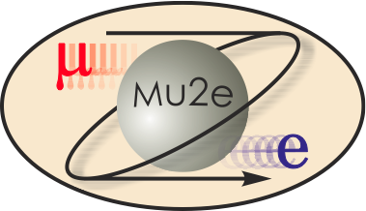
Mu2e Tracker Infrastructure
A. Mukherjee
Tracker L2 Manger Acting Infrastructure L3 manager
22 Oct 14

Slide 2
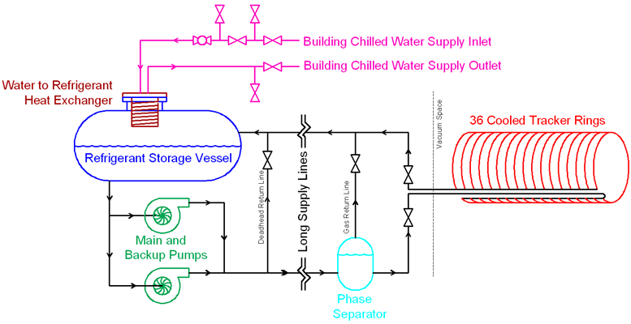
Cooling
10kW tracker + 5kW calorimeter → 15kW SUVA system
Passive distribution by equalizing line lengths
Tap points for calorimeter cooling not shown

Slide 3
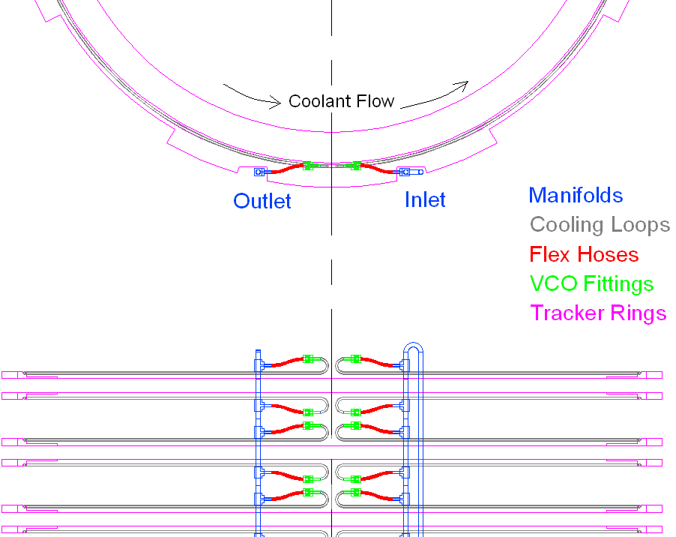
Cooling
One ring per plane
VCO disconnect for removing planes
±2ºC at OD

Slide 4
Cooling
Temperature gradient with full electronics load
+5C

Slide 5
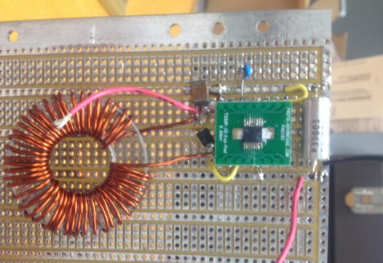
Power
Reduce magnetic field perturbations and power loss in lines by sending power at 48V
Buck DC-DC convertor with air-core toroid
Tested to 36V with hand-wound toroid
Developing 48V version with toroid manufactured on PCB

Slide 6
Alignment Monitoring: Hall Probe
Not for absolute alignment: monitor variation over time
2-axis Hall probe aligned perpendicular to magnetic field
20 µradian resolution with B_{z}=1Tesla field

Slide 7
Cabling
Horizontal beams support cabling, gas lines on tracker
Cables run past calorimeter and beam stop to IFB
Azimuthal position set to minimize interference with calorimeter electronics
Leave room to sight panel survey monuments
High Voltage
Communication
Power
Gas

Slide 8
Cabling
Gas
One pair per plane
IFB penetration: Standard welded feedthroughs
Panel penetration: stainless steel compression fitting with epoxy
Low voltage
One pair per plane
In vacuum: Nomex® covered ~2.5mm square magnet wire Similar to that used by CDF
Outside vacuum: THHN (flexible) wire
IFB penetrations: standard electric vacuum feedthroughs
Panel penetrations: Copper with Kapton® sleeve

Slide 9
Cabling
High Voltage
One line per panel
Silicone insulated, 0.05” pitch ribbon cable
IFB penetration: Vacuum rated DB25
Note all lines are at the same voltage
Panel penetrations: Copper with ceramic sleeve
Copper communication
Two coax per panel
IFB and Panel Penetration: Standard vacuum rated SMA

Slide 10
Cabling
Optical Communication
One pair per panel
Jacket but no fiber reinforcement
Reinforcement traps air and forms a virtual leak
IFB penetration: standard vacuum rated fiber feedthrough
Panel penetration: individual fibers with epoxy seal

Slide 11
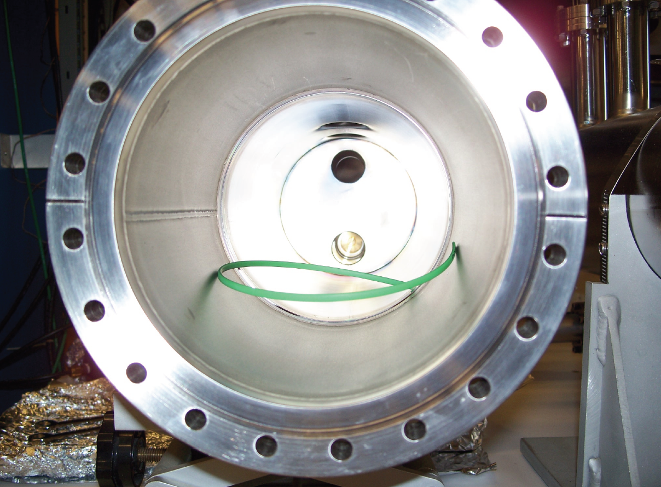
Outgassing from Cables
Optical fibers tested for outgassing
Reinforcing fibers normally used trap too much air
CERN’s unreinforced optical cable gives acceptable results
~8·10⁻⁴ ccm/370mm for 12-fiber ribbon after pumping for 48 hours
<4·10⁻⁴ ccm/370mm after pumping ~1 week
Worst case extrapolation (linear in length)
<1.0 ccm in 2 days
<0.5 ccm in a week

Slide 12
Electrical Breakdown (Townsend Effect)
Our residual gas is (probably) mostly water absorbed into plastics… not air
Tested for breakdown with just water
Standard solder tail DB25 (female) connector, being considered for HV penetration at IFB
Coat solder connections with acrylic (nailpolish)
Connector side left open
Withstands 1.8kV up to ~0.1 Torr
No problem operating at nominal DS pressure of 10⁻⁴ Torr

Slide 13
Cost Table
 | Base Cost (AY K$) |  |  | Estimate Uncertainty (on remaining costs) | % Contingency on ETC | Total Cost
 | M&S | Labor | Total
475.06 Tracker
475.06.05 Tracker Infrastructure
475.06.05.01 Gas System | 8 | 85 | 93 | 44 | 51% | 137
475.06.05.02 High Voltage System | 12 | 64 | 76 | 33 | 43% | 109
475.06.05.03 Low Voltage System | 65 | 91 | 156 | 70 | 45% | 226
475.06.05.04 Cooling | 129 | 222 | 351 | 142 | 41% | 493
475.06.05.05 Cabling & Control | 160 | 104 | 265 | 63 | 25% | 327
Grand Total | 374 | 567 | 941 | 352 | 38% | 1,293

Slide 14
Cost Breakdown
Base Cost (AY K$)

Slide 15
Quality of Estimate
Base Cost (AY K$)

Slide 16
Labor & Material by FY
Base Cost (AY K$)

Slide 17
Labor Resources by FY
FTEs by Discipline

Slide 18
Summary
Preliminary design exists for key subsystems: cooling, power
Conceptual design exists for all other subsystems
Outgassing studies in progress
Vacuum penetration design will be done at York
Vacuum equipment and expertise available
Fermilab engineering becomes available as other L3s move into production

