Slide 1

Mu2e Tracker Electronics
Vadim Rusu
Front End Electronics L3 Manager
10/22/2014

Slide 2
Outline
Requirements
Design and Implementation
Prototypes
Cost

Slide 3
Electronics requirements
Amplification and digitization of the straw signals
Transmit the digitized data to DAQ
Record both ends of the straw (time division – 3cm resolution)
Measure pulse height for dE/dx
Supply HV to anode wires (and HV disconnect)
Run triggerless mode (soft trigger may be implemented at the DAQ level)
B field perturbation <1G in the active region
Rad hard (2×10¹² n/cm²)
10kW power
<12×96 dead channels in 5 years at 90% CL

Slide 4
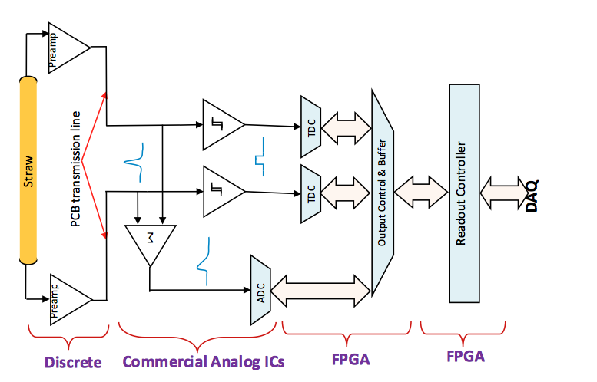
Tracker Front End Scheme

Slide 5
Tracker Front End Scheme
Preamp
475.06.04.01
Digitizer
475.06.04.02
ROC
475.06.04.03

Slide 6
Implementation
Entire electronics chain implemented in commercially available components
  Reduced risk
  Reliable cost estimates (manufacturer quotes and catalog)
  Upgradeable (ride technology wave)
  Flexibility
    All key functionalities implemented in FPGAs
    Reconfigurable

Slide 7
Preamp requirements
Bandwidth 100-300MHz
Typical electron pulse >5x noise floor
Dynamic range x10 typical electron pulse
  Clip larger pulses to avoid x-talk downstream from large proton pulses
Shaping – return to baseline <200ns
  >50% efficiency for typical electron pulse after a typical proton pulse
>100kOhm R from the HV bus
  <1nA leakage through blocking capacitor
  HV remote disconnect
Doc-db 3879

Slide 8
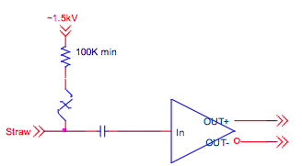
Preamp implementation
Mukherjee/V. Rusu
FNAL
41472 preamps (2x straws)
Small/simple PCBs at the end of the straw
Low power (~15mW)
Configurable gain and threshold
Input stage
  Low noise/high f_{T} SiGe technology discrete BJT
  Active 300Ohm termination to avoid reflections
  ESD Transient protection
Output stage
  Differential output (good CMRR avoids ground loops)
  Termination and pull-up at digitizer input
Advanced stage of prototyping

Slide 9
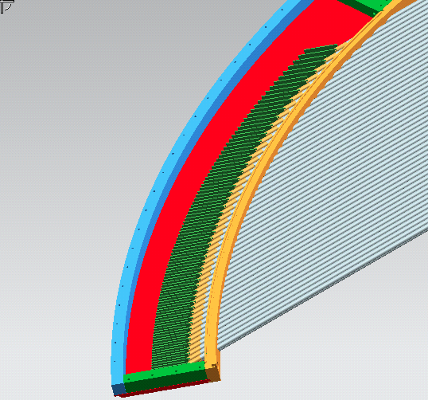
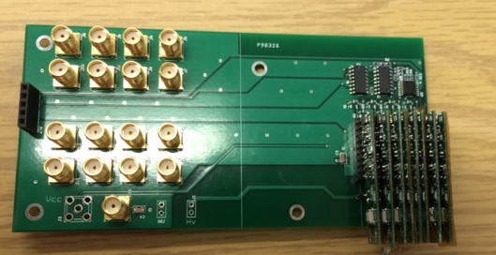
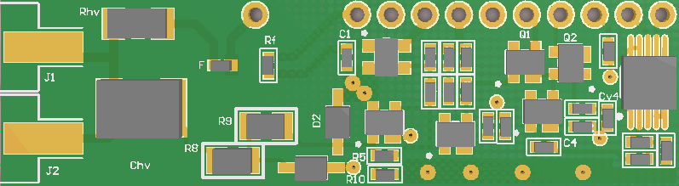
Preamp performance
250MHz -3dB point
2mV RMS output noise
10mV typical electron pulse response
Dynamic range 150mV
~50ns shaping time

Slide 10
Digitizer requirements
<70ps ΔT resolution (time division)
1ns drift time resolution
  1700ns range (at least a microbunch)
7 bits ADC resolution
  X10 typical electron pulse range
50MS/s sampling rate
LVDS data to ROC (200Mb/s line)
  Data to ROC
    Header, 2x TDC, 8 ADC samples
150mW/straw
Doc-db 3879

Slide 11
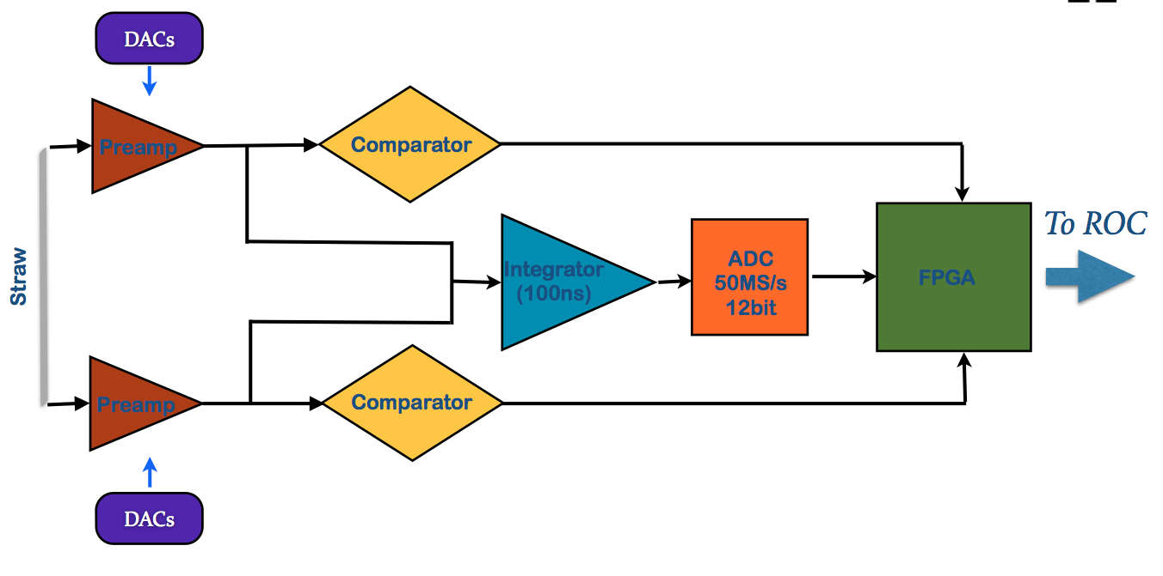
Digitizer scheme
Doc-db 4085
J. Wu/V. Rusu
FNAL

Slide 12
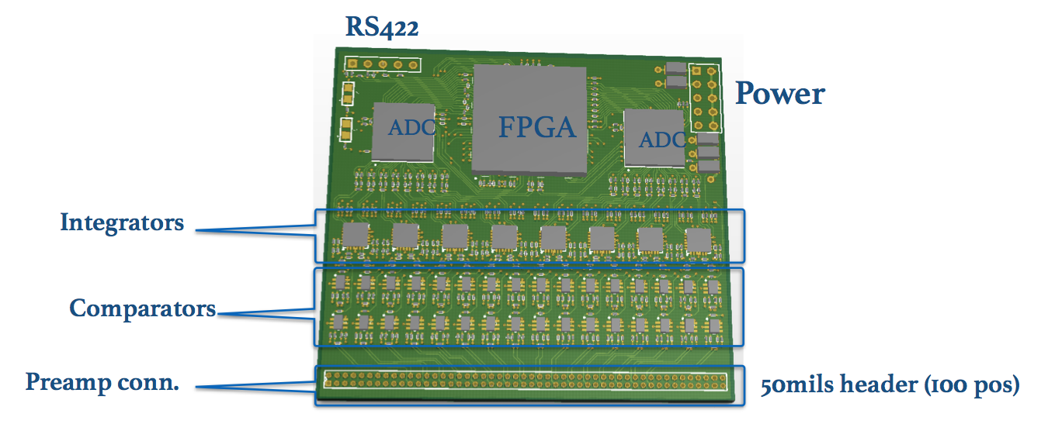
Digitizer implementation
41472 TDC channels and 20736 ADC channels
Commercial off-the-shelf components
  Fast comparator and shaper
  ADC (Maxim19527)
  “TDC in FPGA”
Digitizer PCB
  16 straws/digitizer
Advanced Prototype
Doc-db 4085

Slide 13
Digitizer performance
Test bench measurements
Doc-db 4085

Slide 14
Readout Controller Requirements
Received data from Digitizers
Buffering
  Continue data transfer in inter-spill time
Transmits to DAQ
  230Mbps each ROC to DAQ
Relies slow controls to front-end
  Preamp settings
  HV control (fuses)
  Monitor environmental variables
Doc-db 3973

Slide 15
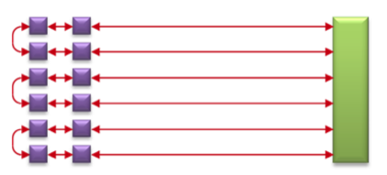
ROC Implementation
SmartFusion FPGA (rad hard line from Microsemi)
DDR3 on board for buffering
2.5 Gbps full-duplex fiber optics
  Ring architecture
Advanced prototype
Doc-db 3973
U of Houston – E. Hungerford
FNAL - G. Deuerling

Slide 16
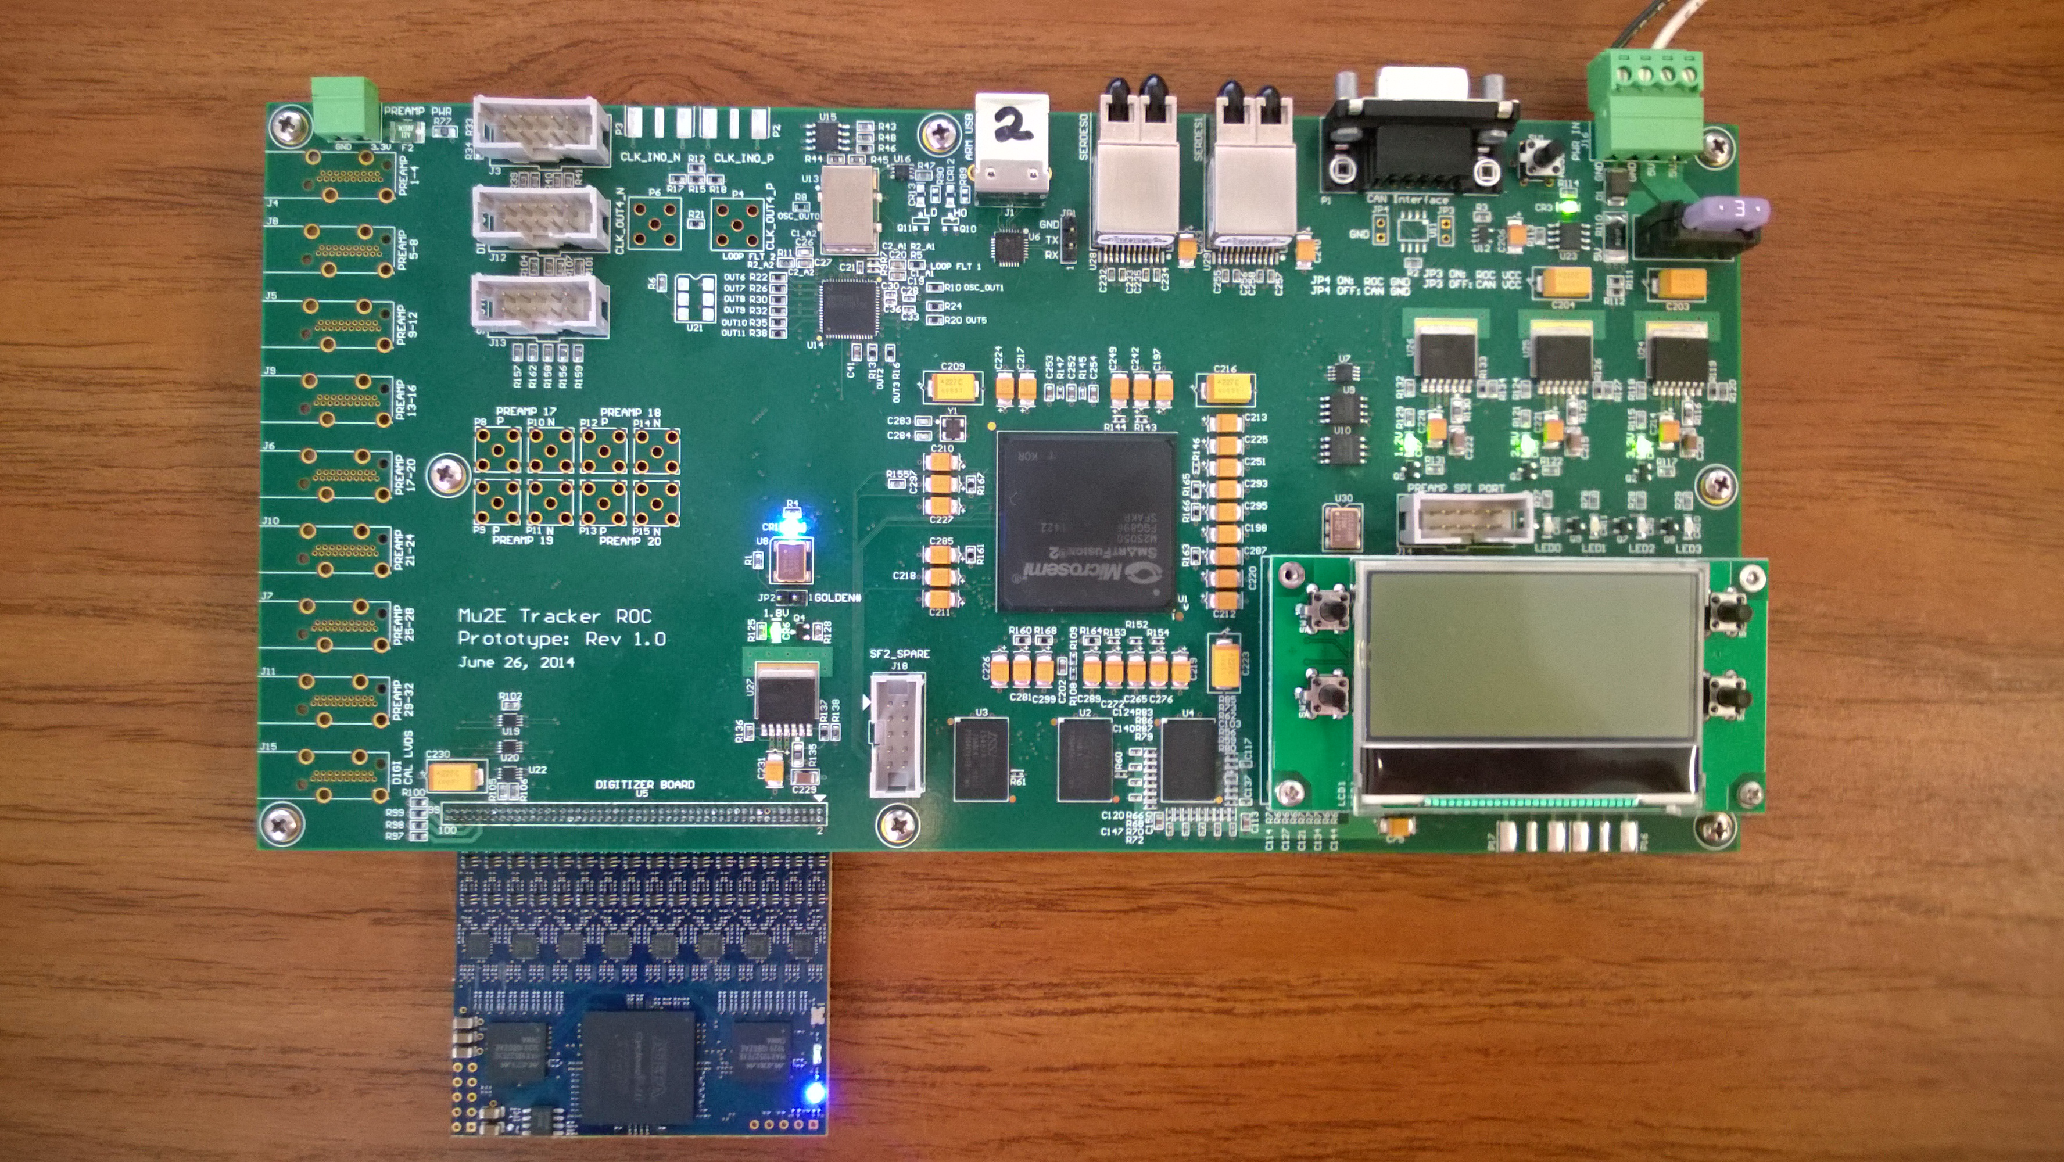
ROC/Digi Prototype
Successfully established comm between ROC and digi
LVDS data received on the ROC FPGA
  USB readout – almost ready to try optical fiber

Slide 17
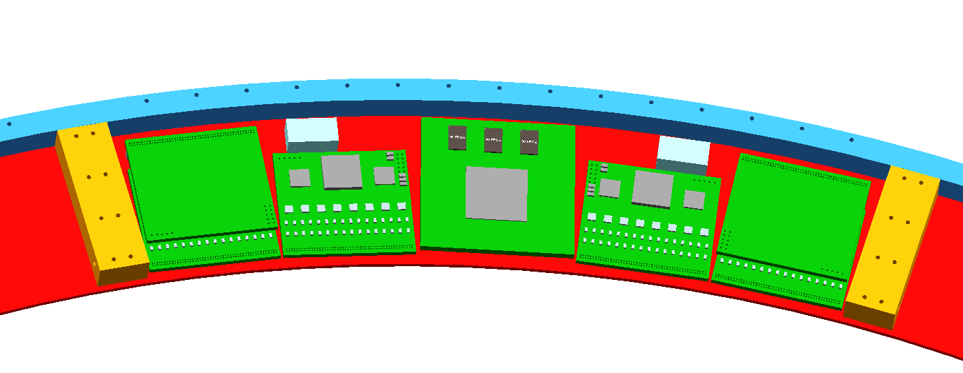
Assembly
Tight fit, but it does fit.
TRANSCEIVERS
ROC
DIGITIZERS

Slide 18
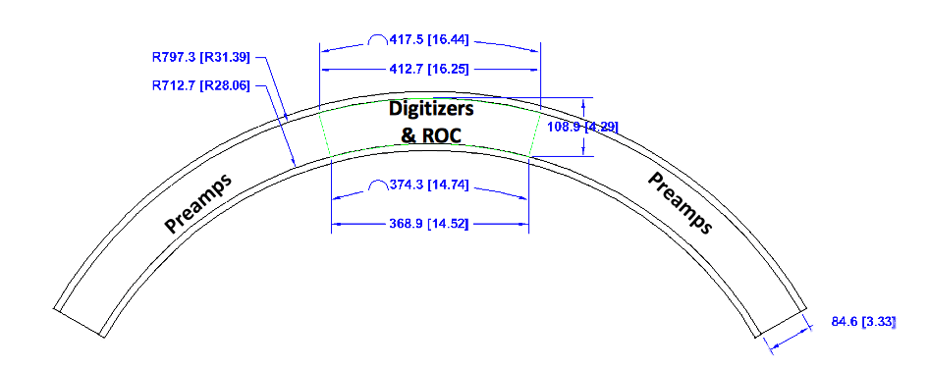
Infrastructure (Signal transmission)
Investigated a long (55’’) motherboard
  Recommendation from Digitizer Review (April 2014)
  Cost ineffective (+high assembly costs)
Preamp mobo + ROC mobo
  Effectively a transmission line board(s)
    All components (preamp, digi, ROC) mezzanines
    HV, slow controls on board

Slide 19
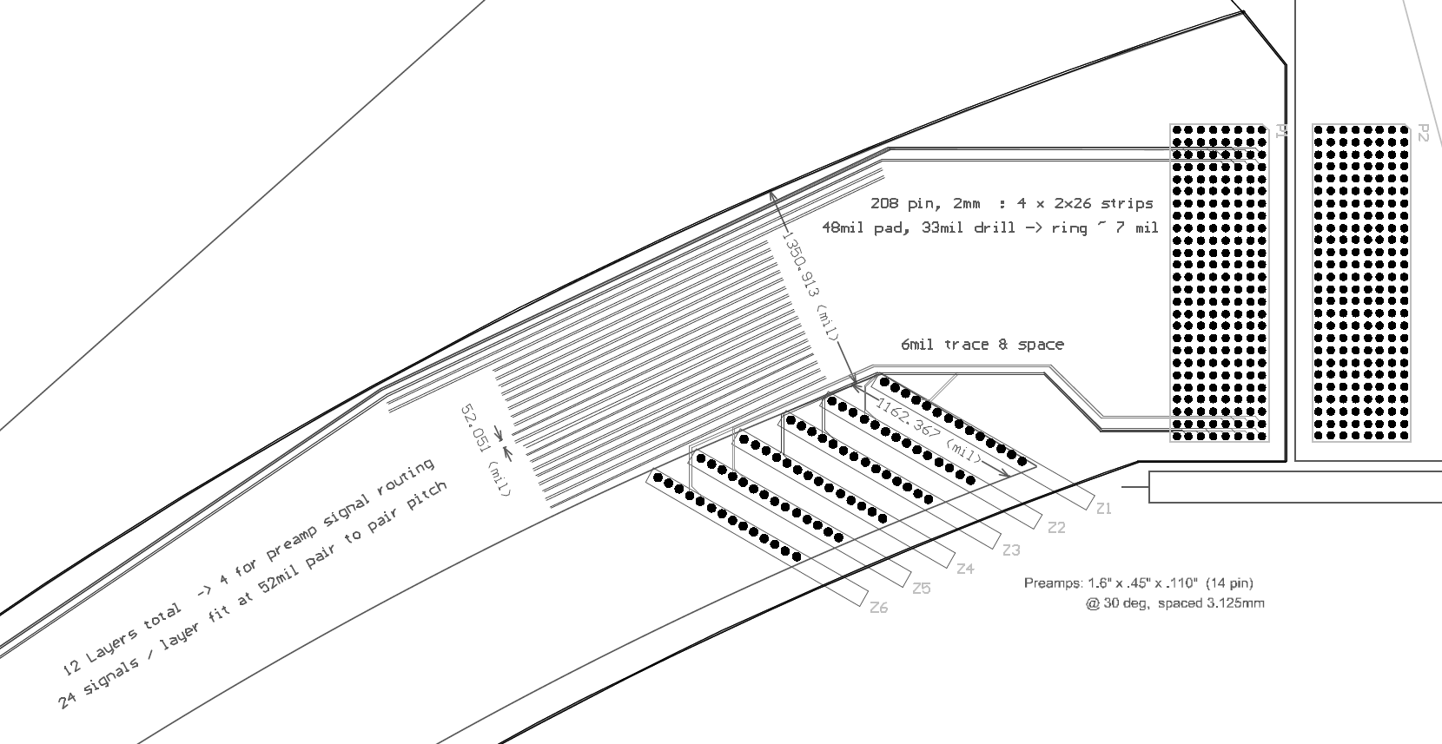
Transmission boards
Rice U.
M. Corcoran
T. Nussbaum

Slide 20
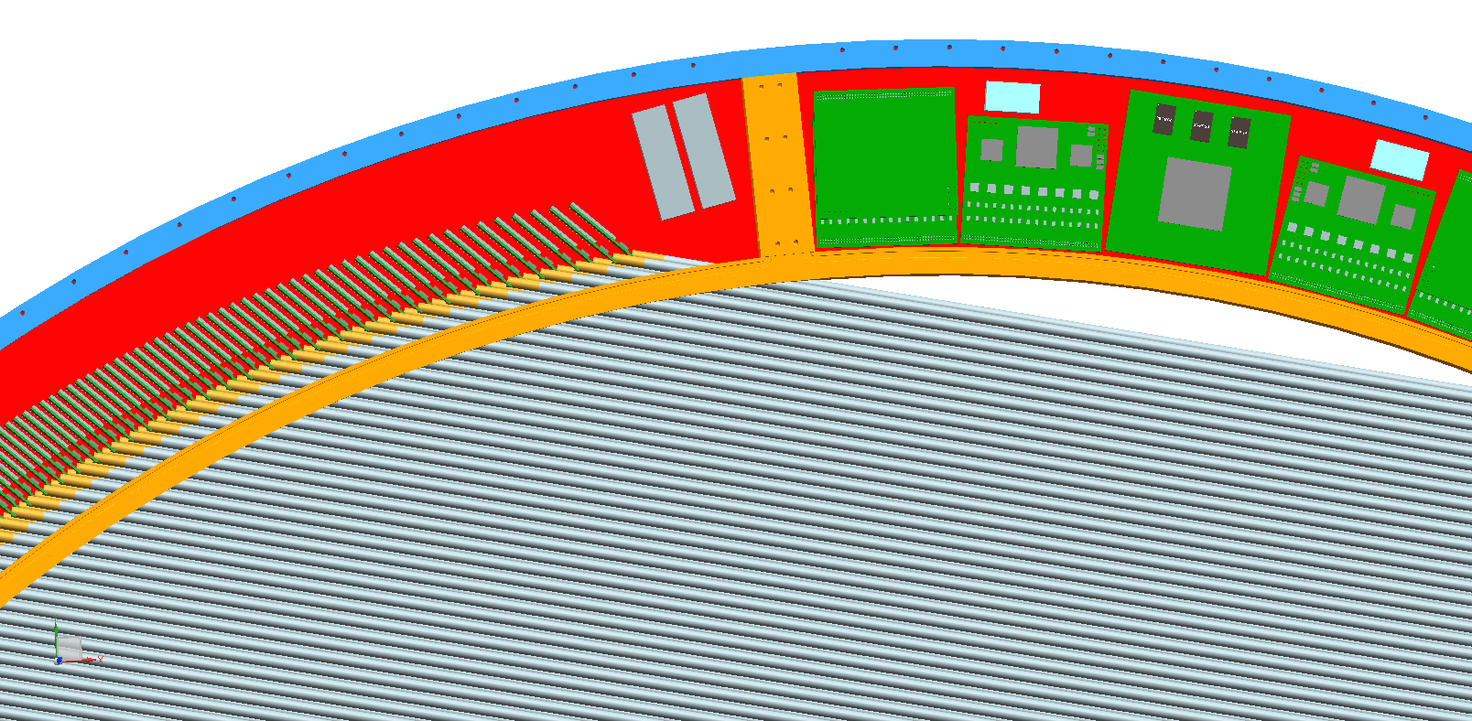
Assembly

Slide 21
Infrastructure (Power distribution)
Five low voltage levels needed (<5V)
48V power line from outside the cryostat
  Allows for lower current (B field)
DC-DC converters outside the stations step down to a suitable voltage
Regulators inside the gas volume for actual distribution

Slide 22
ES&H
  High voltage is moderate by Fermilab standards
  1500V, <1mA and ~10mJ stored energy on any one line
  Power is from 48V supplies which have passive (limited capacity) and active (monitor and trip) current limit

Slide 23
Cost Table
 | Base Cost (AY K$) |  |  | Estimate Uncertainty (on remaining costs) | % Contingency on ETC | Total Cost
 | M&S | Labor | Total
475.06 Tracker
475.06.04 Tracker Front End Electronics
475.06.04.01 Preamp | 563 | 98 | 661 | 216 | 35% | 877
475.06.04.02 Digitizer | 793 | 387 | 1,180 | 255 | 26% | 1,435
475.06.04.03 Readout Controller | 316 | 88 | 403 | 161 | 42% | 564
475.06.04.04 Test Stands | 4 | 19 | 23 | 11 | 145% | 34
Grand Total | 1,676 | 591 | 2,267 | 643 | 32% | 2,910

Slide 24
Cost Breakdown
Base Cost (AY K$)

Slide 25
Quality of Estimate
Base Cost (AY K$)

Slide 26
Labor & Material by FY
Base Cost (AY K$)

Slide 27
Labor Resources by FY
FTEs by Discipline

Slide 28
Conclusion
Design of front end electronics meets the requirements
Advanced prototypes on all sub-systems
Initial integration pass under way
Solid cost estimate based mostly on quotes

Slide 29
Backup

Slide 30
TDC Using FPGA Logic Chain Delay
This scheme uses current FPGA technology
Low cost chip family can be used. (e.g. EP2C8T144C6 $31.68)
Fine TDC precision can be implemented in slow devices (e.g., 25 ps (RMS) in a 400 MHz chip).
IN
CLK

Slide 31
Autocalibration using histogram method
It provides a bin-by-bin calibration at certain temperature.
It is a turn-key solution (bin in, ps out)
It is semi-continuous (auto update LUT every 16K events)
16K
Events
DNL
Histogram
Σ
LUT
In (bin)
Out (ps)

