Slide 1
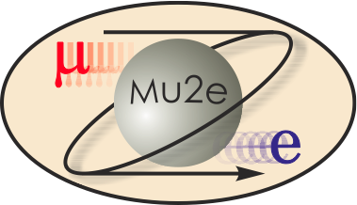
Mu2e Tracker University Roles in Construction
Marj Corcoran
L3 manager for Straw Assemblies
October 22, 2014

Slide 2
Institutions and faculty/scientists
York College at CUNY—Jim Popp and Kevin Lynch
University of Minnesota—Dan Cronin-Hennessy
Rice University—Marj Corcoran
University of Houston—Ed Hungerford and Kwong Lau
Duke University—Seog Oh and Chiho Wang
Fermilab—Aseet Mukherjee, Bob Wagner, Vadim Rusu

Slide 3
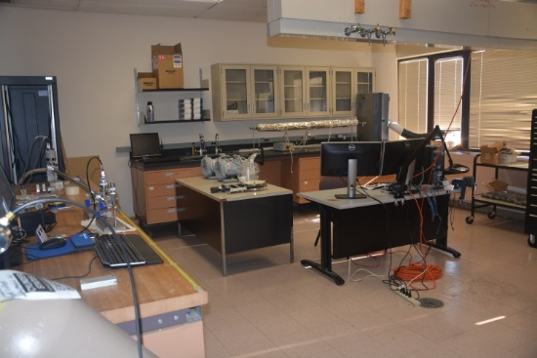
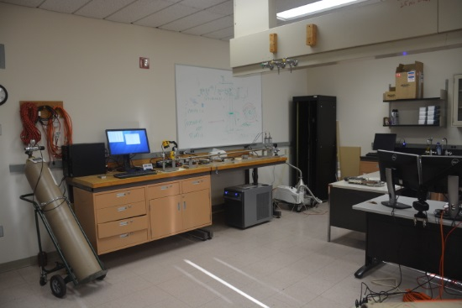
York College at CUNY
York will
prepare all straw end pieces (50K with spares)
leak test in vacuum a few % of all straws as validation of the CO₂ leak tests
develop QA/QC database with Minnesota
design and fabricate vacuum feedthroughs
Vacuum setup and lab space at York

Slide 4
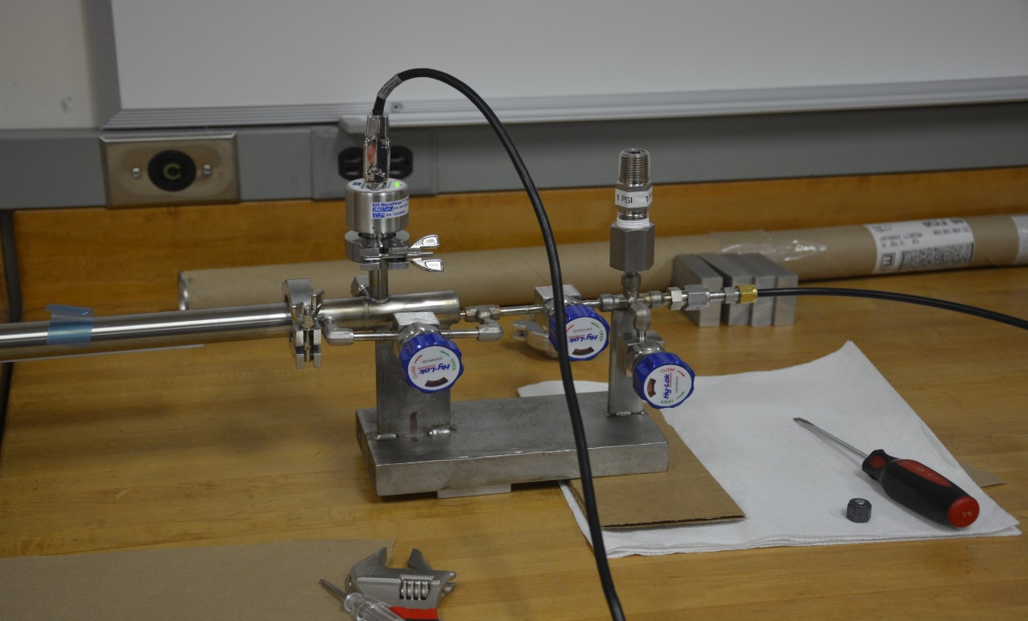
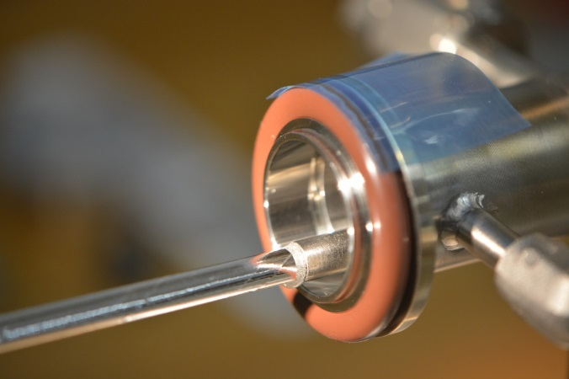
York vacuum setup
Straws are tested in vacuum with 1atm ArCO₂ gas. A few percent of all straws will be tested in vacuum to validate the CO₂ leak tests (discussed later).

Slide 5
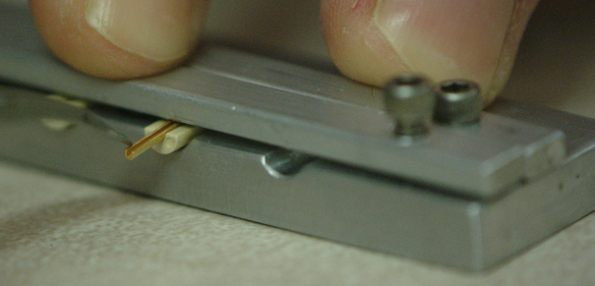
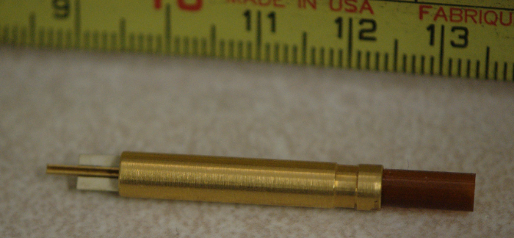
York – straw end piece assembly
York will also assemble the end straw pieces. The fixturing for this work has been developed at Fermilab.

Slide 6
York QA database
York is developing the QA database, drawing on the expertise at Minnesota.

Slide 7
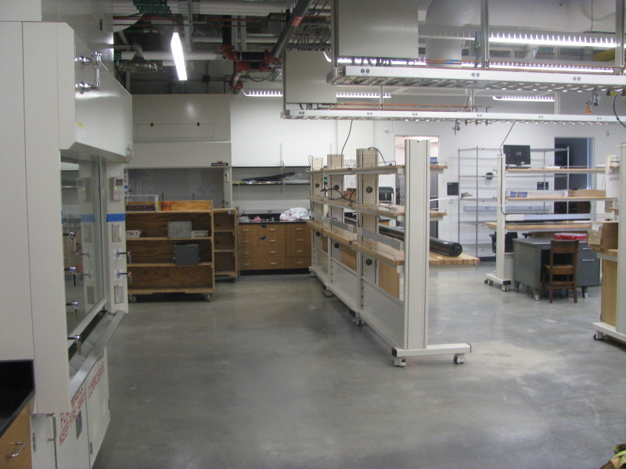
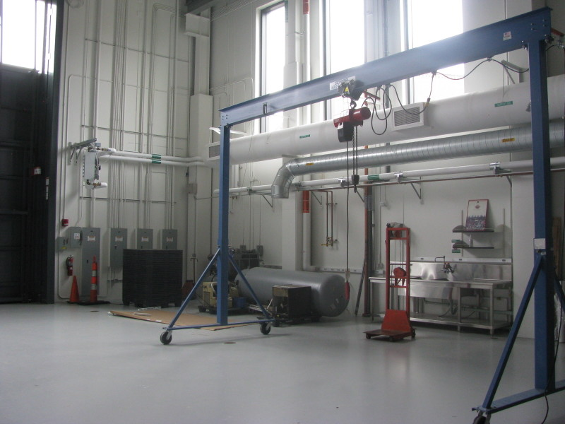
University of Minnesota
Minnesota will
Leak test all straws (25K including spares)
Cut straws to length and insert straw terminations
Work with York on QA database
Some of the available lab space at Minnesota

Slide 8
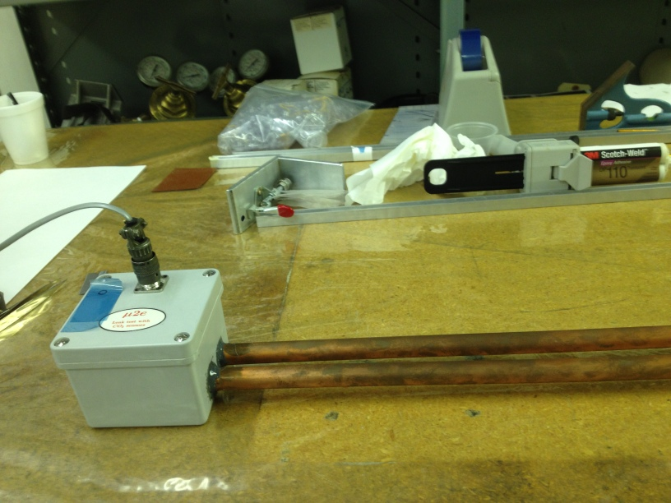
CO₂ Straw Leak Tests
Since the straws operate in vacuum, it is important to ensure that all straws have
leak rates below our limit of 30 x 10⁻⁵ ccm. We will test 100% of the straws
using a technique we developed using CO₂ sensors with Ar/CO₂ gas in the straws.
This is the CO₂ test chamber, currently at Lab 3 in the Village.

Slide 9
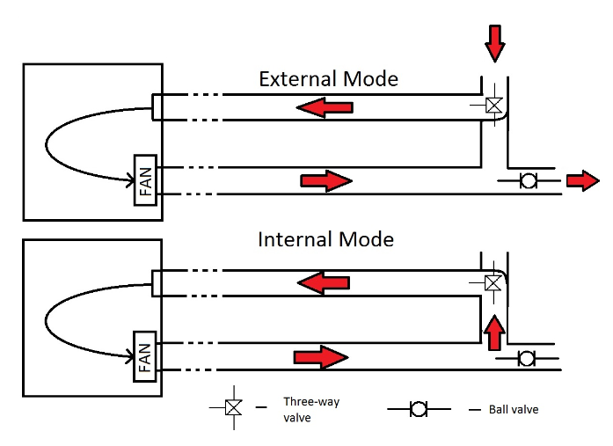
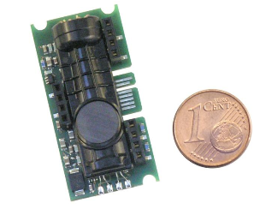
CO₂ straw leak tests
We flush the chamber with N₂, pressurize the straw with Ar/CO₂ to 1atm above ambient, insert it in the chamber, and wait about an hour. The sensor reads the CO₂ levels in ppm, providing a 10-15% measurement of the leak rate.

Slide 10
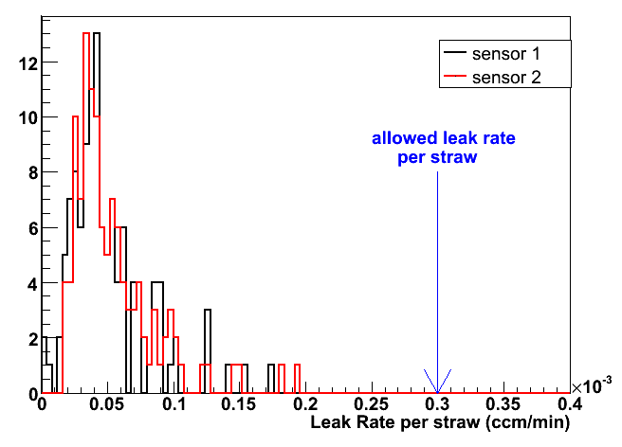
CO₂ leak test—first 100 straws
We tested 119 straws over this past summer, here are the measured leak rates.

Slide 11
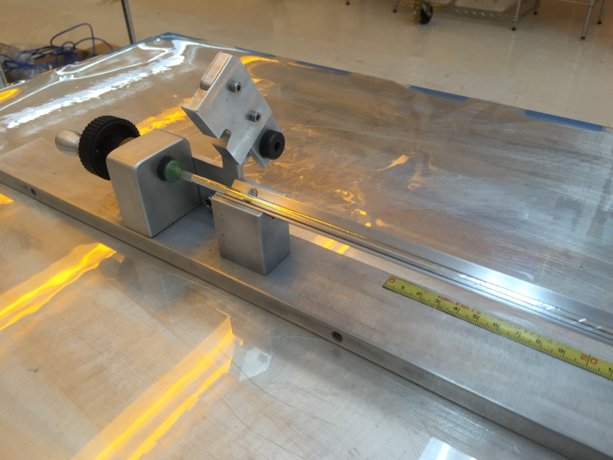
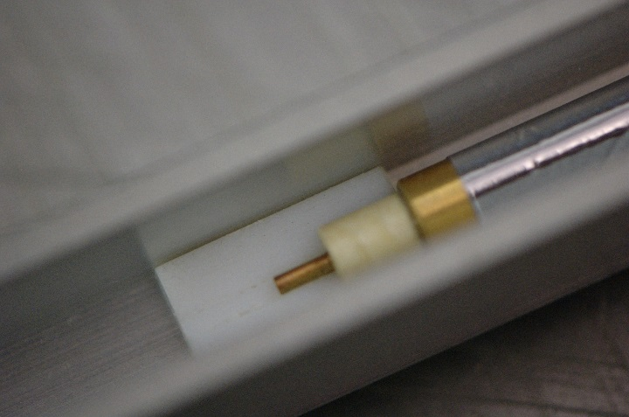
Minnesota--Straw preparation
Minnesota will cut the straws to length and glue in the end pieces. Minnesota post doc Dan Ambrose already has experience with these tasks.

Slide 12
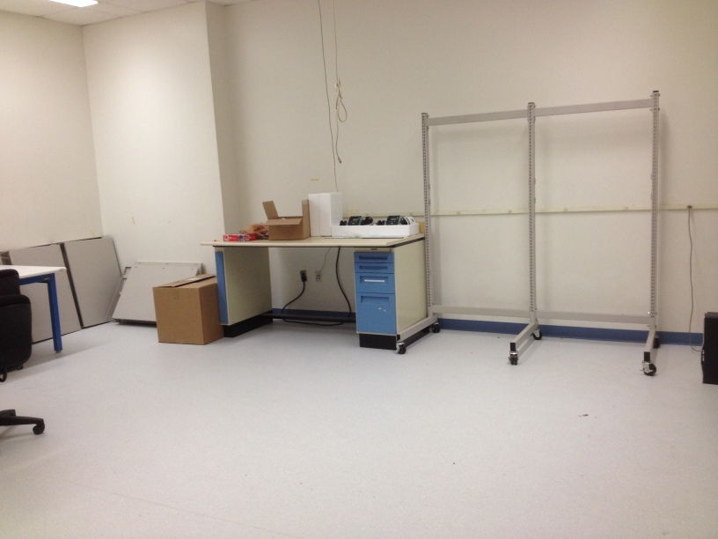
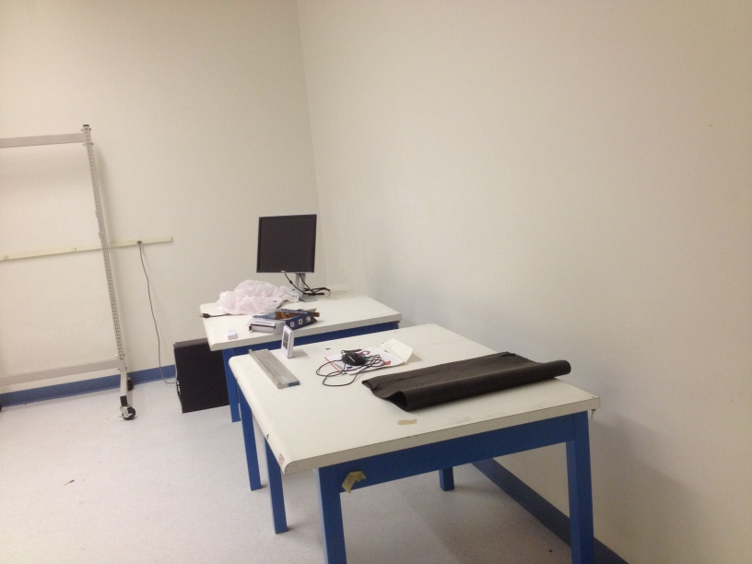
Rice University
Rice will
Construct 96-straw panels (220 including spares)
Run some preliminary tests
Rice clean room

Slide 13
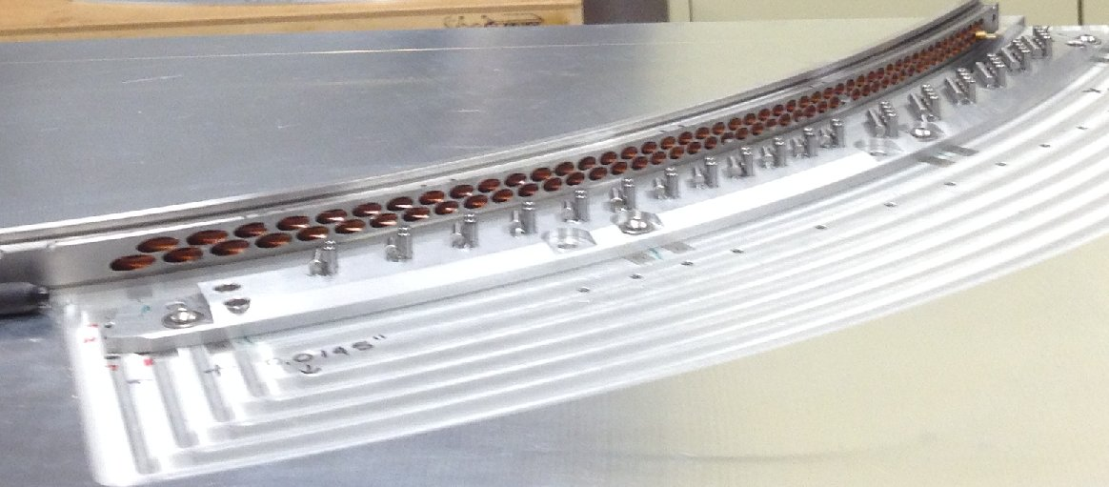
Panel assembly
This is the Panel Assembly and Alignment Structure (PAAS). This is the configuration for stringing sense wires.

Slide 14
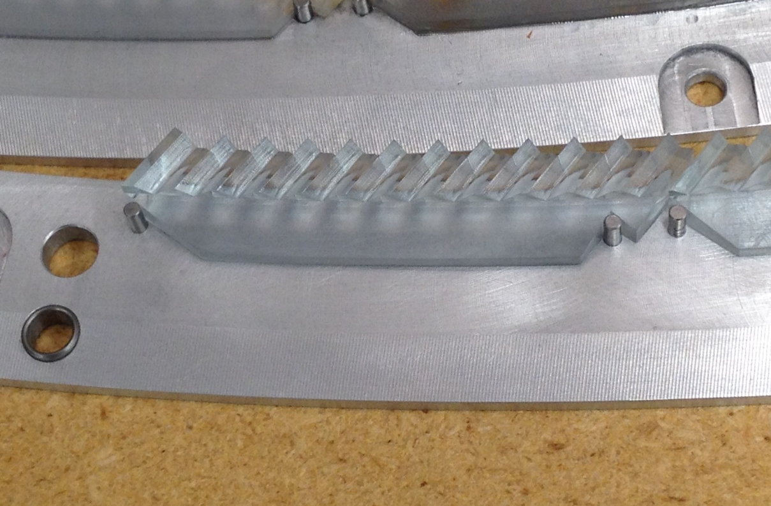
Panel assembly
This is an example of the 3D printed piece that will be used to position the straws. The dowel pins in the previous picture are replaced with these pieces.

Slide 15
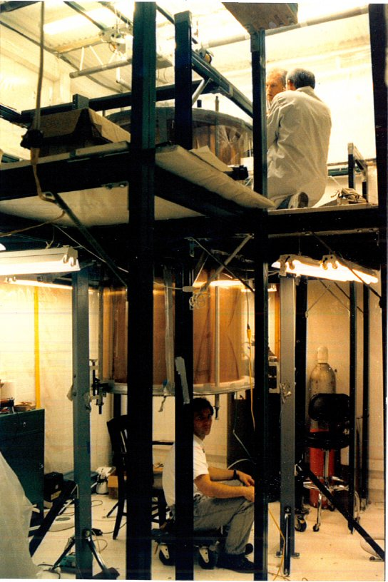
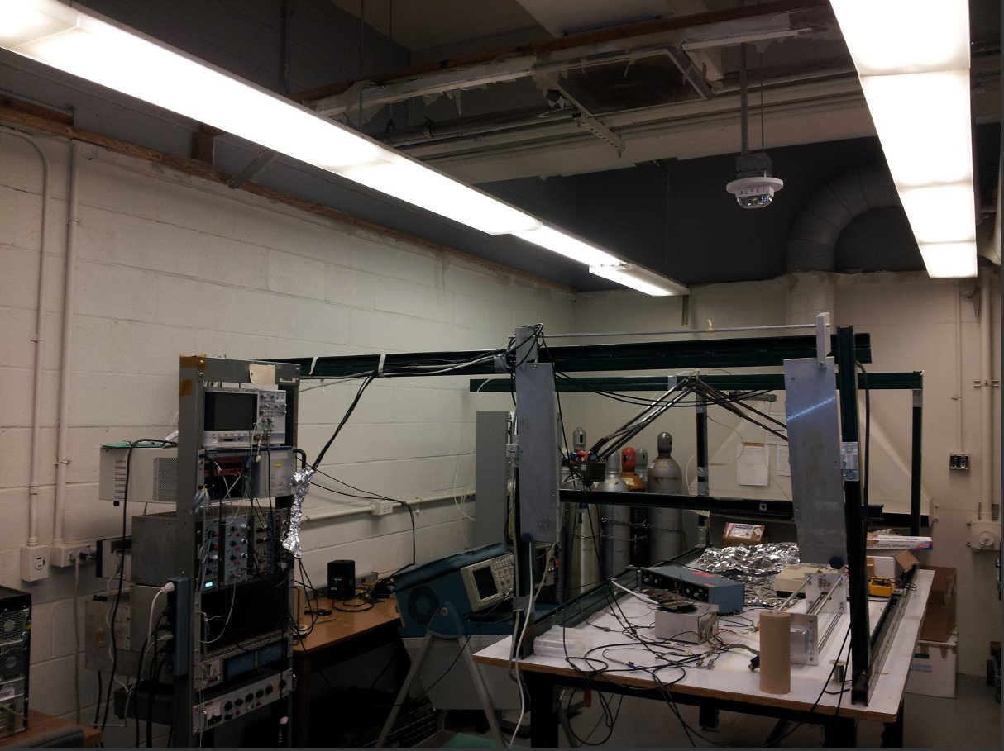
University of Houston
University of Houston will
Test all panels including HV tests, continuity, signal readout
Check all tensions in both straws and wires
UH is prepared to help with leak tests if needed
Constructing the MEGA drift chamber and some of the UH lab space.

Slide 16
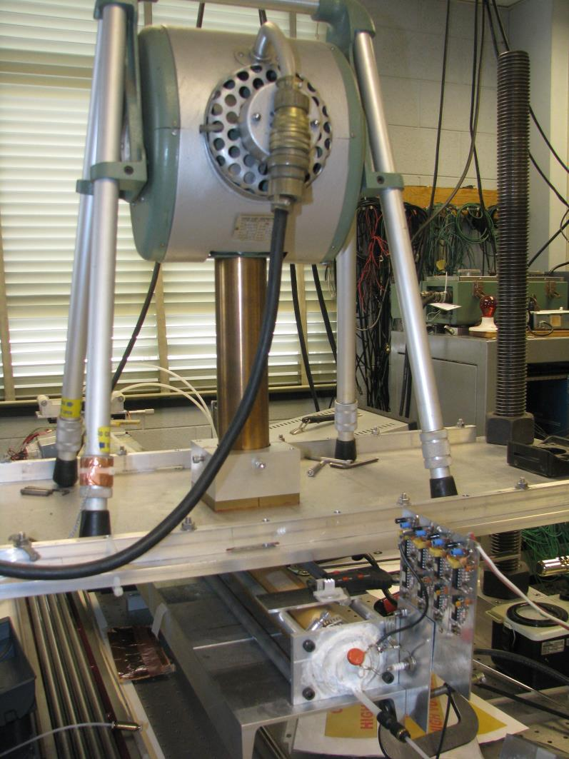
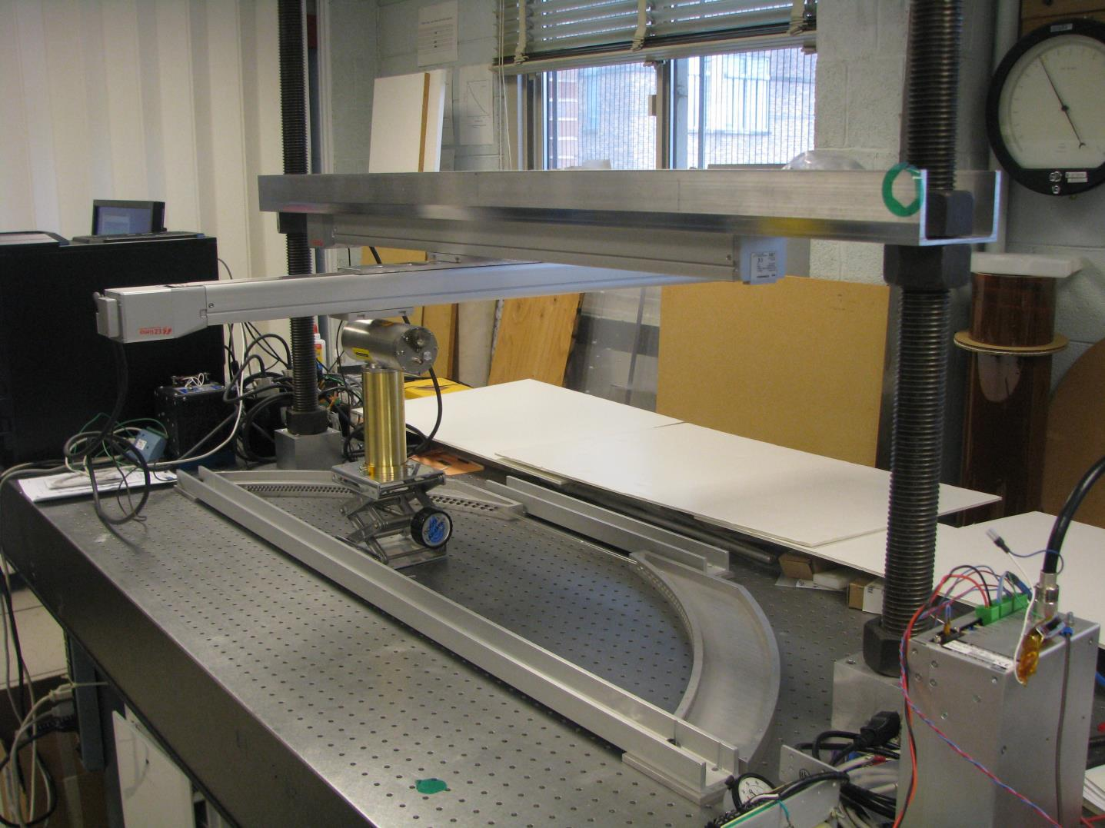
Duke University
Duke will
Procure the straws from PPG and perform several tests
Use X-ray machine from the Atlas TRT construction to locate each wire
X-ray setup at Duke

Slide 17
Duke X-ray wire location
Taken from a talk by Chiho Wang last year

Slide 18
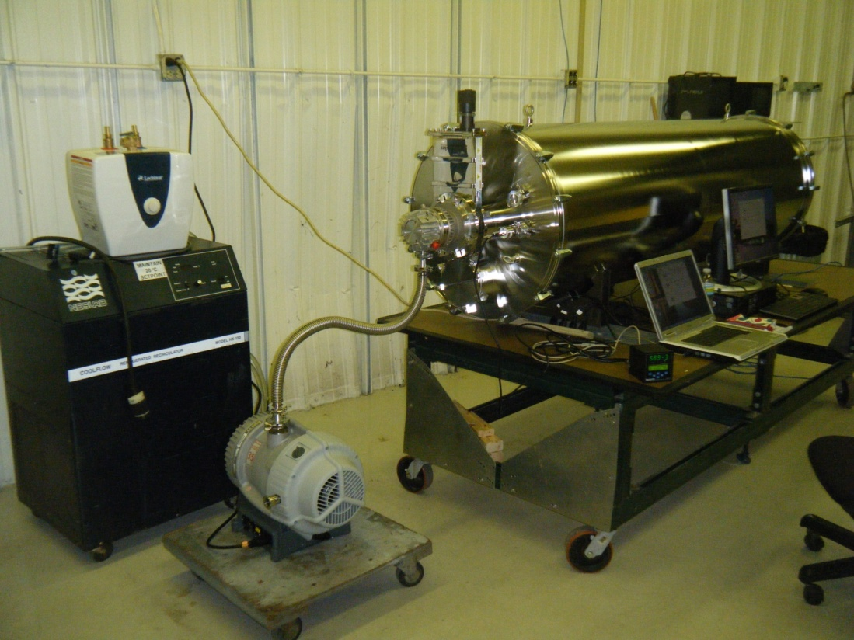
Fermilab
Fermilab will
Leak test each panel in vacuum
Assemble panels into planes and construct the full tracker
Vacuum tank in Lab 3 at Fermilab

Slide 19
ES&H considerations
Each university has its own ES&H department, and each group will have to abide
by the regulations of its university.
That said, each institution should
Have a written safety document for the work done there
Have a one-on-one safety discussion with each person working there
Have periodic safety inspections.
There are not a lot of hazards:
Compressed gas
Soldering irons and solder
Epoxy and other chemicals
X-rays

Slide 20
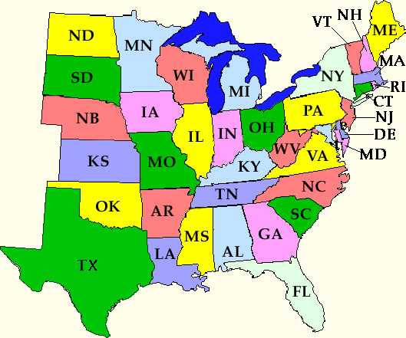
Parts flow
York assembles end pieces, ships to MN
MN leak tests straws, inserts end pieces, ships to Rice
Rice assembles panels, takes to UH
UH runs extensive test on all panels, ships to Duke
Duke measures wire positions, ships to Fermilab
U. Minnesota
York
PPG
Duke
Rice U. Houston
Straws
Termination
Vacuum Feedthroughs
Panels
Vender Oversight

Slide 21
Cost Table
 | Base Cost (AY K$) |  |  | Estimate Uncertainty (on remaining costs) | % Contingency on ETC | Total Cost
 | M&S | Labor | Total
475.06 Tracker
475.06.03 Straw Assemblies
475.06.03.01 Panels | 648 | 269 | 917 | 443 | 57% | 1,361
475.06.03.02 Single Plane | 145 | 98 | 243 | 67 | 39% | 310
475.06.03.03 Gas Manifold | 1,722 | 151 | 1,873 | 749 | 42% | 2,623
475.06.03.04 Full Tracker Support and Assembly | 193 | 292 | 485 | 234 | 51% | 718
Grand Total | 2,708 | 811 | 3,519 | 1,493 | 47% | 5,012

Slide 22
Cost Breakdown
Base Cost (AY K$)

Slide 23
Quality of Estimate
Base Cost (AY K$)

Slide 24
Labor & Material by FY
Base Cost (AY K$)

Slide 25
Labor Resources by FY
FTEs by Discipline

Slide 26
Summary
All groups are on-board with this work breakdown. We can make adjustments if needed as the work progresses.
York—straw terminations, vacuum leak tests, vacuum feedthroughs, possibly help with leak tests
Minnesota—CO₂ leak tests, cut straws to length and terminate
Rice—insert straws and sense wires, complete panels
Houston—test all panels including HV tests in air and in gas, ensure that all channels see signals
Duke—procure straws, measure and document the locations of all sense wires and straws in each panel
Fermilab—leak test all panels, assemble panels into planes and planes into stations, construct full tracker
See Docdb4635 for more detail on university groups’ experience and facilities.

