Slide 1
Mu2e Cosmic Ray Veto: 8.7: CRV Module Fabrication “Follow up” on fabrication hours
Craig Group
L3 Manager and CAM for CRV Fabrication
10/22/2014

Slide 2
Content
Review of factory labor estimate.
Include breakdown of task estimates.
Clarify a few points we failed to mention on Tuesday.
Discussion of factory lifetime
Extended support for lead technician

Slide 3
Personnel at the Module Factory
Technician Leader: Factory design, prototyping, factory management (QA/safety), documentation, fabrication, …
Mechanical Technician: Assist in moving into factory, building assembly stations, and fabrication efforts.
Undergraduates: tedious tasks in the module factory: cleaning/de-burring components, spreading epoxy, QA checklists, …
Uncosted graduate students, postdocs, and faculty: commission the QA tools, establish metrics, analyze data from QA measurements, and fill in where ever they are needed at the factory.

Slide 4
Personnel at the Module Factory
About 7300 total hours of effort to fabricate 91 modules to Fermilab.
~80 hours of fabrication effort per module.
~54 hours of tech effort per module for fabrication.
With full-time effort, about 6 modules per month can be produced in the module factory.
40% LOE in additional to hours above
20% maintain factory
20% administrative: inventory, QA data, …
40% contingency in additional to hours above
Separate task for packing modules & loading truck:
2 tech hours/models (20 hours per shipment)
Separate task for managing module parts:
1 hour per module

Slide 5
Primary steps for fabrication
Assemble di-counters: 4 tech hours
-- epoxy 32 pairs of counters together. < 10 min per counter pair.
-- spread epoxy on pairs and clamp full layer at once.
-- undergrad student could prep counters.
Fiber and fiber guide bar: 6 tech hours
-- apply epoxy to 64 FGB and fix in place with jig (~10 per hour).
-- undergrad student could thread 128 fibers.
Flycut: 8 tech hours
-- time consuming step with almost constant attention.
-- fiber imaging done during fly cut process.
4) Fiber QA: 4 hours
-- fiber transmission test of 32 di-counters.
-- < 10 min per di-counter, run test & record results

Slide 6
Primary steps for fabrication (cont…)
5) Counter manifold: 4 tech hours
-- insert counter motherboard and attach jig
(can be prepped in advance by U-grad)
-- simple install – 2 screws per manifold
6) Epoxy module: 6 tech hours
-- 32 di-counters, 5 AL sheets, lots of epoxy
-- requires two people for efficiency (tech + U-grad)
Module QA: 2 tech hours
-- techs move modules
-- post-doc performs QA
8) Crate: ~1 tech hour per module
-- Crates fabricated at local job shop

Slide 7
Summary: tech hours for fabrication
Assemble di-counters: 4 hours
Fiber and fiber guide bar: 6 hours
Flycut: 8 hours
Fiber QA: 4 hours
Counter manifold: 4 hours
Epoxy module: 6 hours
Module QA: 2 hours
Crate: 1 hour
Total: ~ 35 hours per module
additional 19 available: basic QA, prep, and surprises
also 20% FTE to maintain factory
also 20% for administrative effort
also 40% contingency

Slide 8
Work flow at module factory
Month 1
(DocDB 4197)

Slide 9
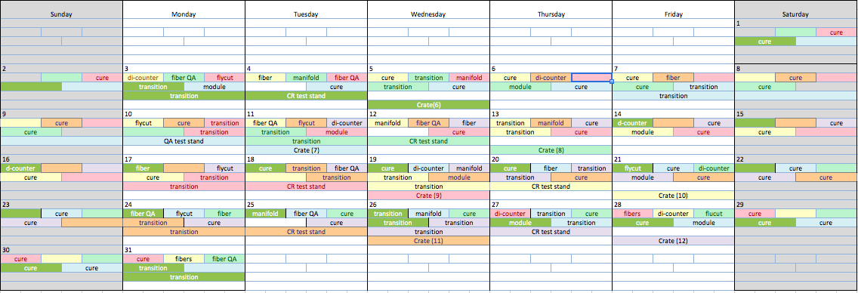
Work flow at module factory
Module 12 crated in less than 2 months!
Month 2

Slide 10
Lag time in work flow
7 days are “free” on the counter assembly table over 2 month period
This work space is a bottleneck
(this drove design of 4-layer table)
Fly-cutting a module is a full day of effort
(but not a big deal if it bleeds into fiber QA)
Many days free on the module assembly table
Many days free on the cosmic ray test stand
Crating only takes small effort per module
(crates to be produced at local job shop)
There is a day or two of flexibility on transitions between work spaces except for the counter assembly table.

Slide 11
Optimizations
We have presented the baseline fabrication plan
The factory schedule was a planning exercise as a proof of principle that activities can occur in the planned factory at the estimated rate.
There will be ample opportunity to streamline the plan based on what we learn from prototypes and the pilot phase. Examples:
Staggered work days for technicians
Evening prep by undergraduates or post docs
Optimizations of activity combinations in a work day
Which work days benefit most from a third person
Preparing several modules worth of di-counter in advance of production
…

Slide 12
Tech vacation and unexpected absence
We plan to have two post docs stationed at UVA during the fabrication effort. (also two faculty)
Post docs will maintain the CSC test stand and perform module QA.
Group members will be trained in all steps of the fabrication and available to fill in for tech absence and if production falls behind schedule.

Slide 13
Prototyping was an important part of designing our plan and will be critical for for fine tuning of the plan!
We have built dozens of counter prototypes and a module prototype and have plans to build 5 more module prototypes.

Slide 14
Prototype Plan
Mechanical prototype (early FY15):
4.7 m long; No electronics
Time and motion studies; handling modules
Test/practice epoxy application
Two “short” (cryo-length) electronics prototypes (FY15):
Outfitted with electronics
Study mounting techniques
Test bed for electronics
Two “pre-production” prototypes (FY16):
Outfitted with electronics
Production scintillation and fiber
Shipped to Fermilab to test installation and mounting procedures

Slide 15
Factory Lifetime
Extending the factory life beyond planned production was suggested.
The factory, as designed, is optimized for large-scale production.
The fly-cutter and QA devices and some jigs are the primary custom tooling required to make an extra module or two. These will be kept at UVA.
It will be possible to produce a module or two at UVA if this need is discovered after factory breakdown.
If there were some catastrophic event and a large fraction of the CRV needed to be replaced a new factory would be required.
Given the costs involved, we don’t think extending the life of the production factory beyond production is reasonable.

Slide 16
Lead Technician
It was suggested the it would be best to keep the lead technician on staff through installation.
We would love to keep him if we can find work on other projects during that time.
That being said, we believe that the scientific staff will be experts on all steps of fabrication by the end of the production period.
All production steps will be well documented and we are confident that in an emergency we will be able to build additional modules without the lead technician.
We will look for oportunities to keep the tech on staff, however given the costs involved, we don’t think supporting the tech through instillation should be the baseline plan.

Slide 17
Summary
The labor plan for the module fabrication factory is well defined and most steps have been (or will be) confirmed with prototype fabrication experience.
The counter assembly table space is a bottleneck due to several fabrication steps and epoxy cure time. There is flexibility in scheduling daily activities at the other stations.
U-grad and uncosted scientific effort will be available to fill in when needed during fabrication: tech vacation, illness, schedule variations…
There is a 40% FTE in addition to fabrication labor for maintaining the factory and administration tasks.
In addition, there is a 40% contingency on the labor estimate.
We think the estimate is defensible.

