Slide 1

Mu2e CD-2 Review
Trigger & DAQ
10/21/2014

Slide 2
Topics
475.9.1 Management
  Organization, Schedule, Cost Estimates, QA, Risks, ES&H
475.9.2 System Design & Test
  Requirements, System Architecture, System Test
475.9.3 Data Acquisition
  Data Readout, Timing System
475.9.4 Data Processing
  Online Computing and Data Filters
475.9.5 Controls & Networking
  General-purpose Networking, Slow Controls, Control Room

Slide 3
Management

Slide 4
Management
475.9
Trigger & DAQ
M. Bowden (FNAL)
475.9.1 Project Management
L3 – M. Bowden
CAM – M. Bowden
475.9.3 Data Acquisition
L3 – K. Biery
CAM – K. Biery
475.9.2 System Design & Test
L3 – M. Bowden
CAM – M. Bowden
475.9.4 Data Processing
L3 – R. Rivera
CAM – R. Rivera
475.9.5 Controls & Networking
L3 – R. Rivera
CAM – R. Rivera

Slide 5
Management
Basis of Estimate
  85% of DAQ costs are labor, mainly related to software and firmware development
  software is always difficult to estimate
  labor estimates use a top-down approach and are based on a recent project (NOvA) of similar scope and complexity
    significant overlap in labor resources and software
    NOvA effort involved both hardware and firmware development, Mu2e is firmware only (reduced engineering cost)
    Mu2e makes greater use of existing software developed for NOvA and other experiments (reduced software development cost)
  M&S estimates are based on current catalog pricing

Slide 6
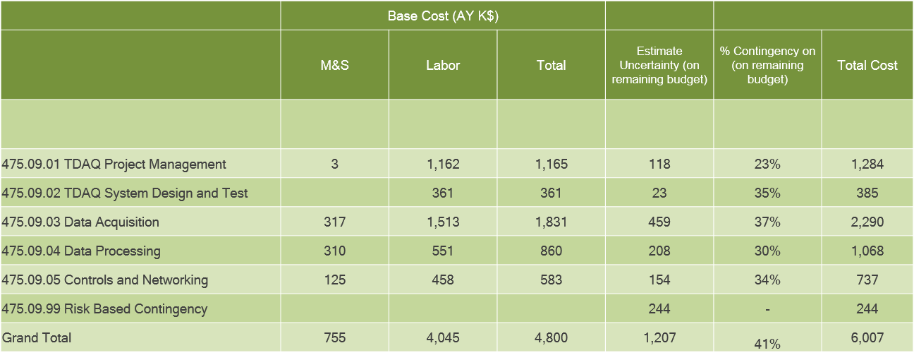
Management
WBS 9 Trigger & DAQ
Costs are fully burdened in AY $k

Slide 7
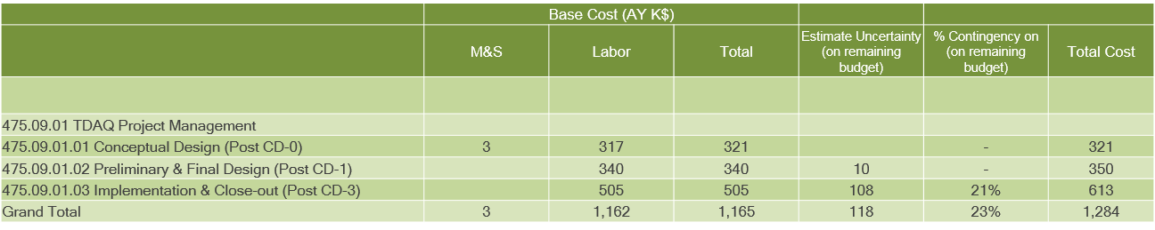
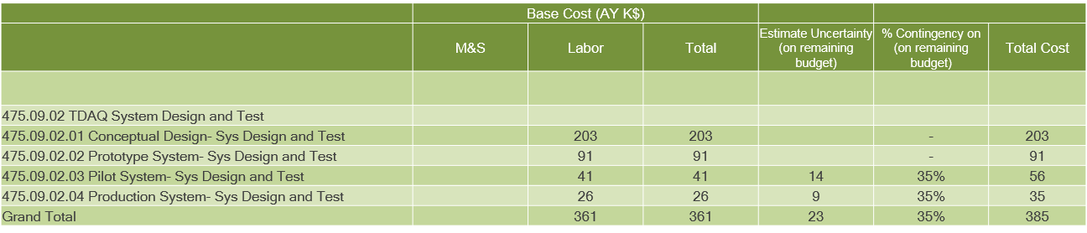
Management

Slide 8
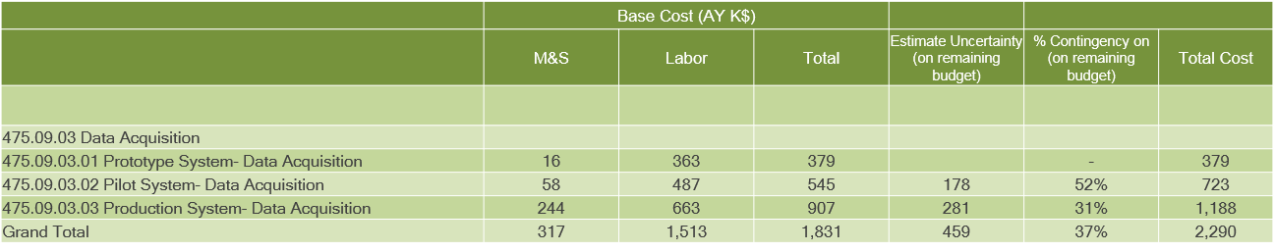
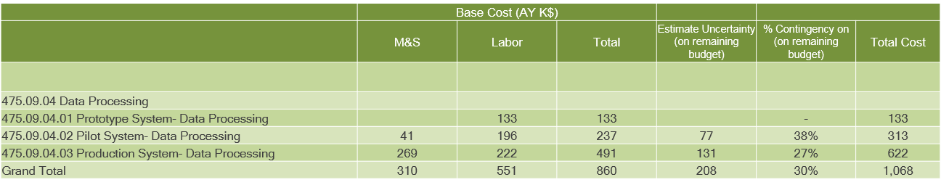
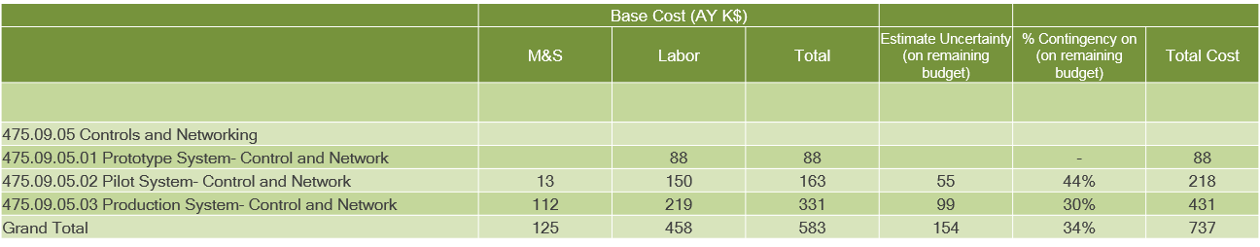
Management

Slide 9
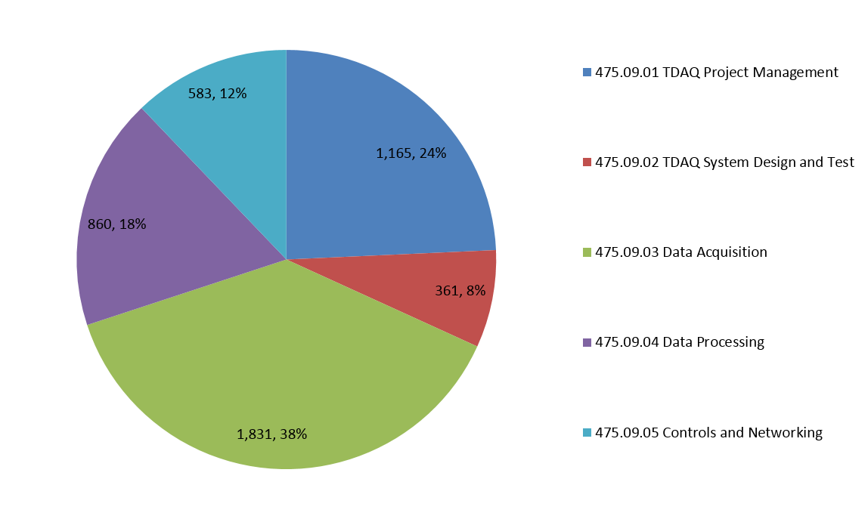
Management
Cost Breakdown

Slide 10
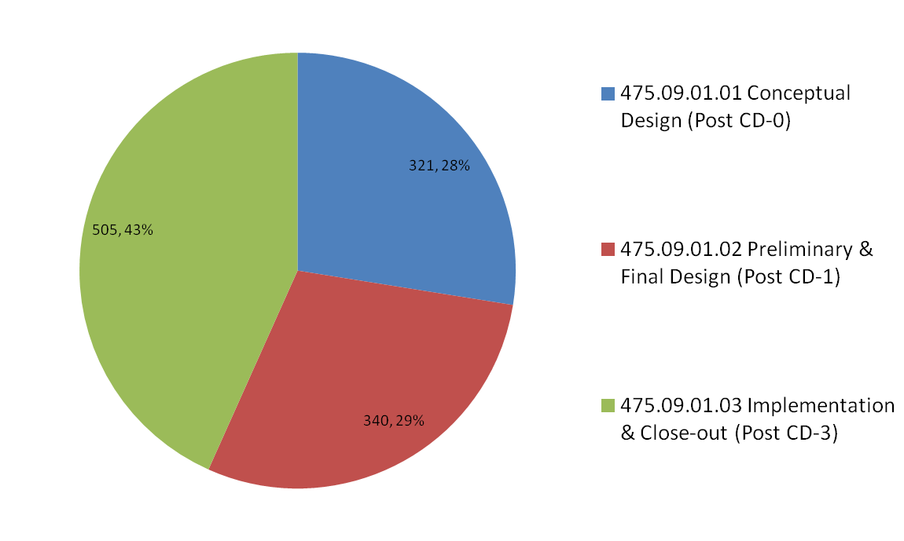
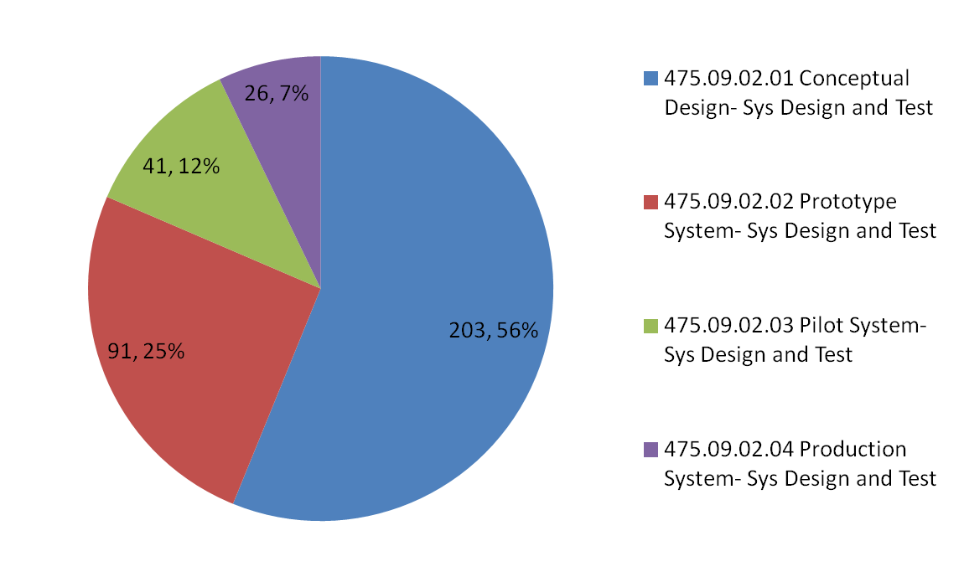
Management
Cost Breakdown (by L3 Activity)

Slide 11
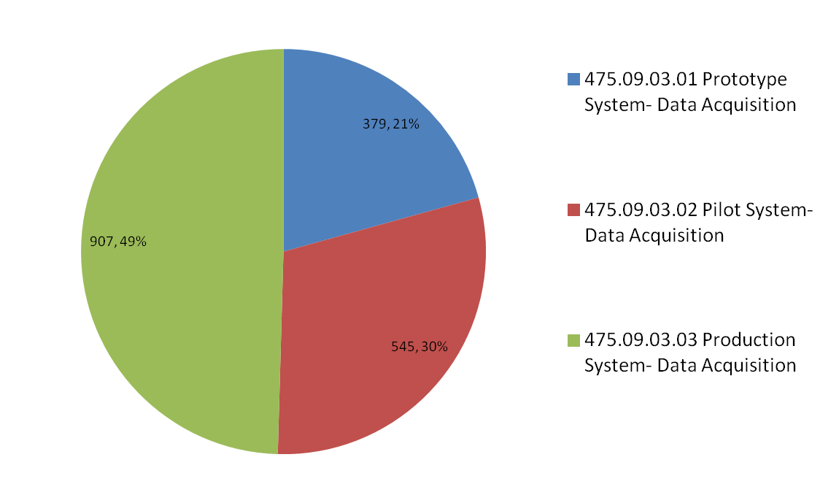
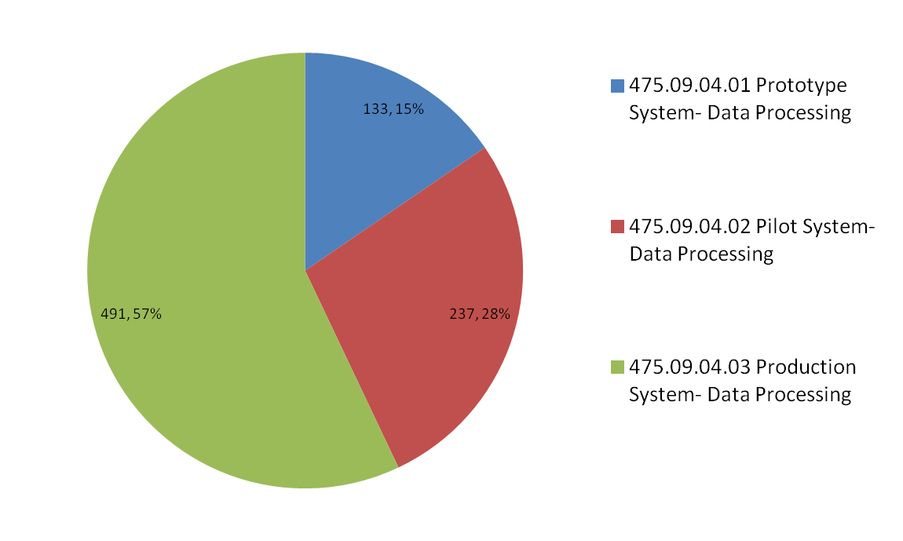
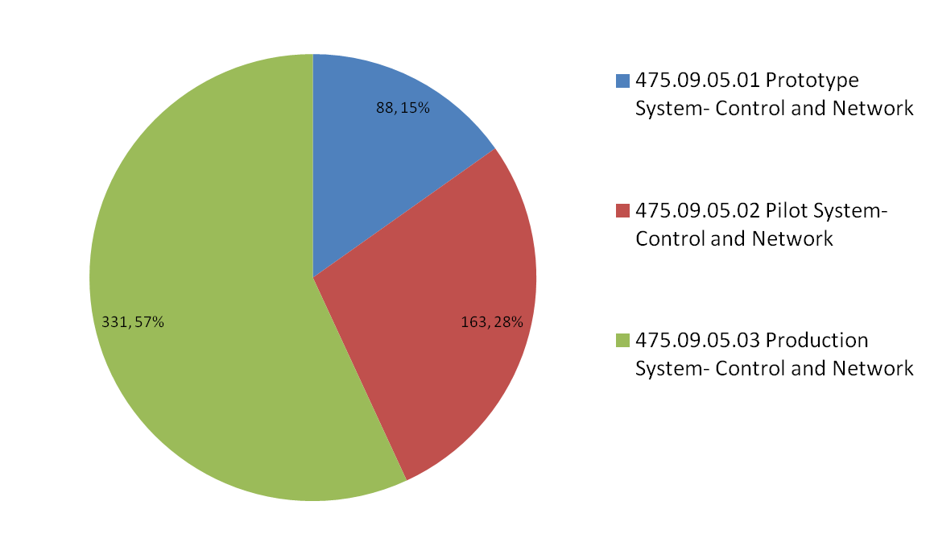
Management
Cost Breakdown (by L3 Activity)

Slide 12
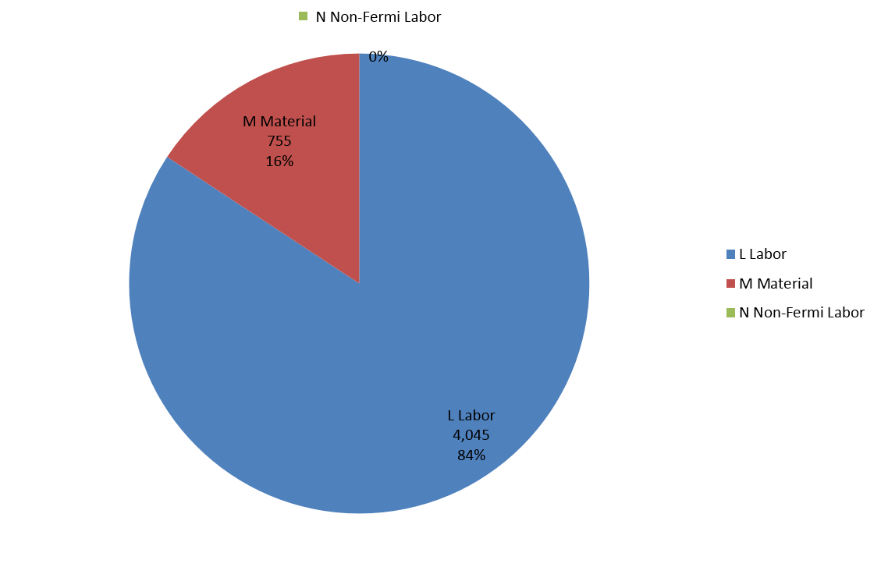
Management
Cost Breakdown

Slide 13
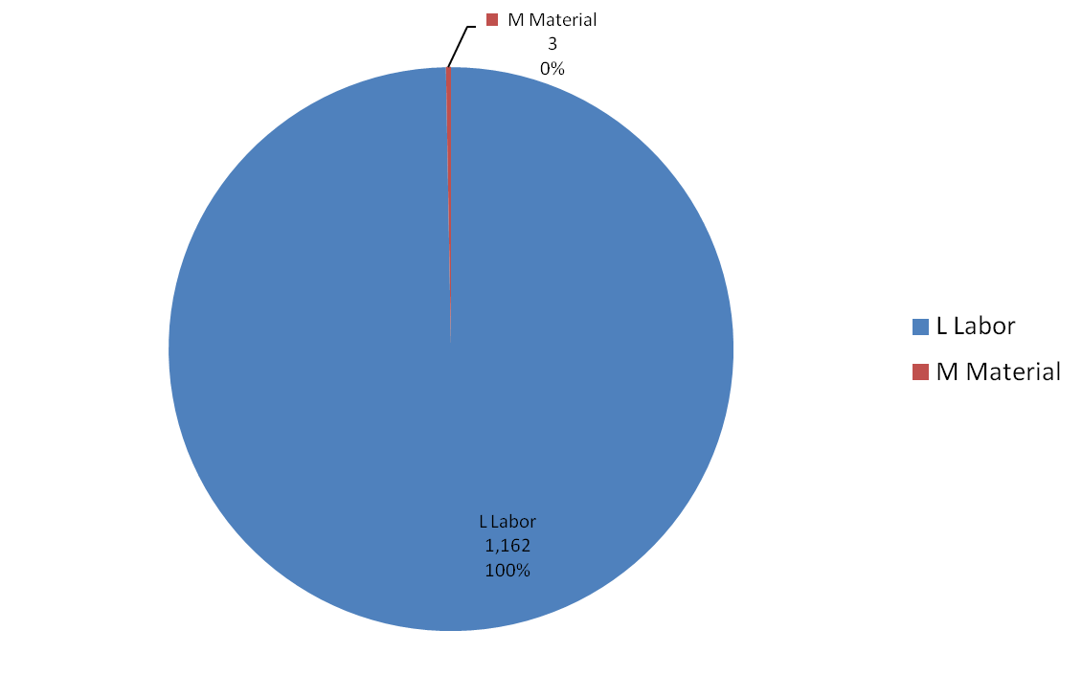
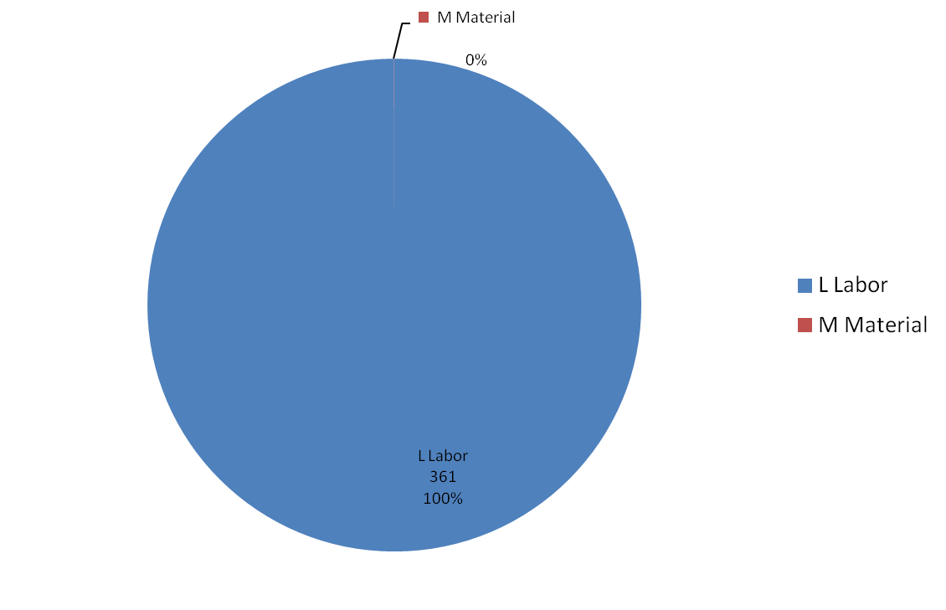
Management
Cost Breakdown (by L3 Activity)
475.09.01
475.09.02

Slide 14
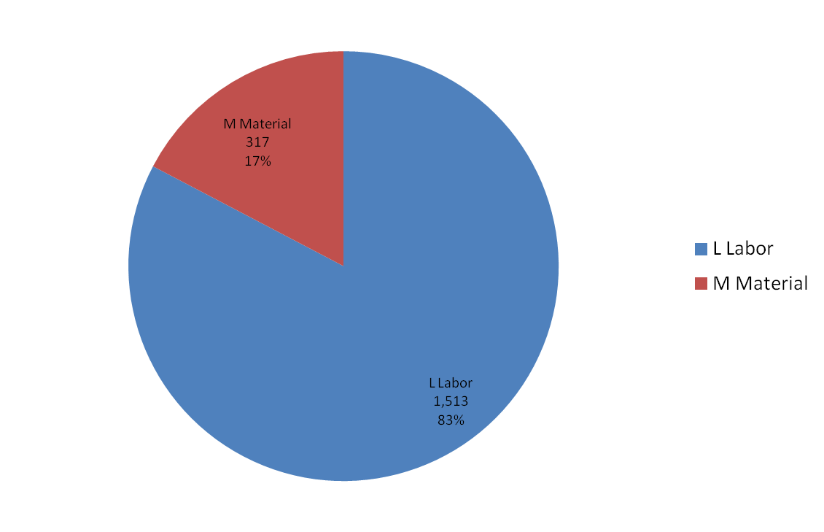
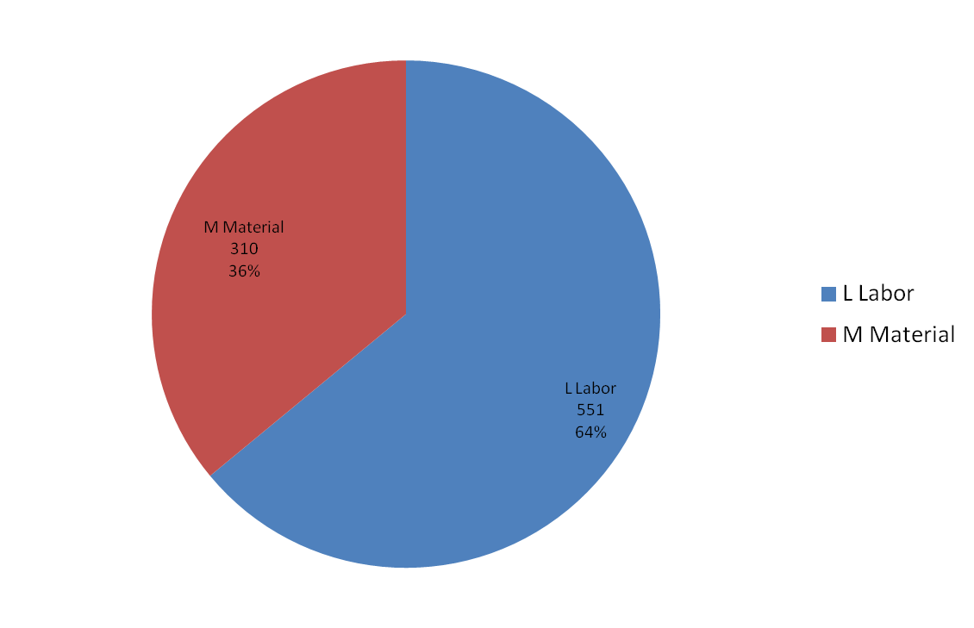
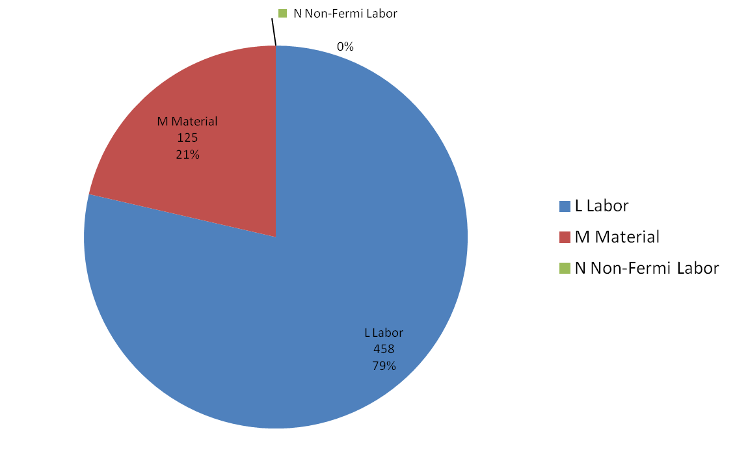
Management
Cost Breakdown (by L3 Activity)
475.09.03
475.09.04
475.09.05

Slide 15
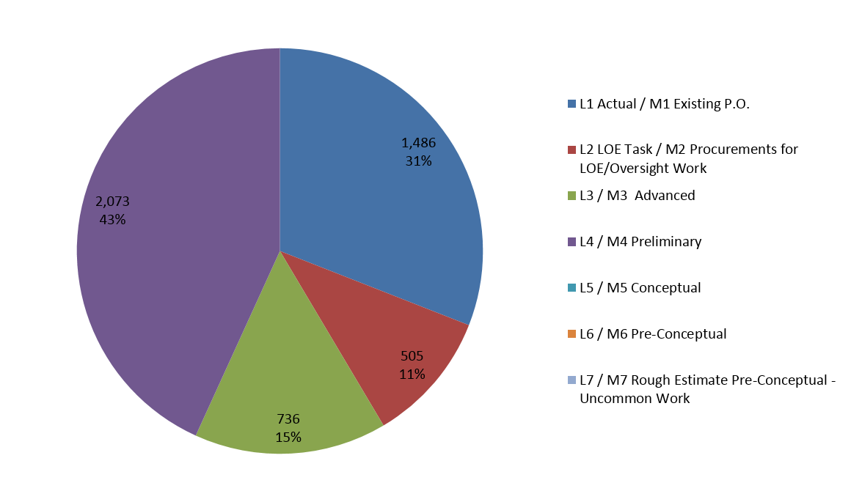
Management
Quality of Estimate

Slide 16
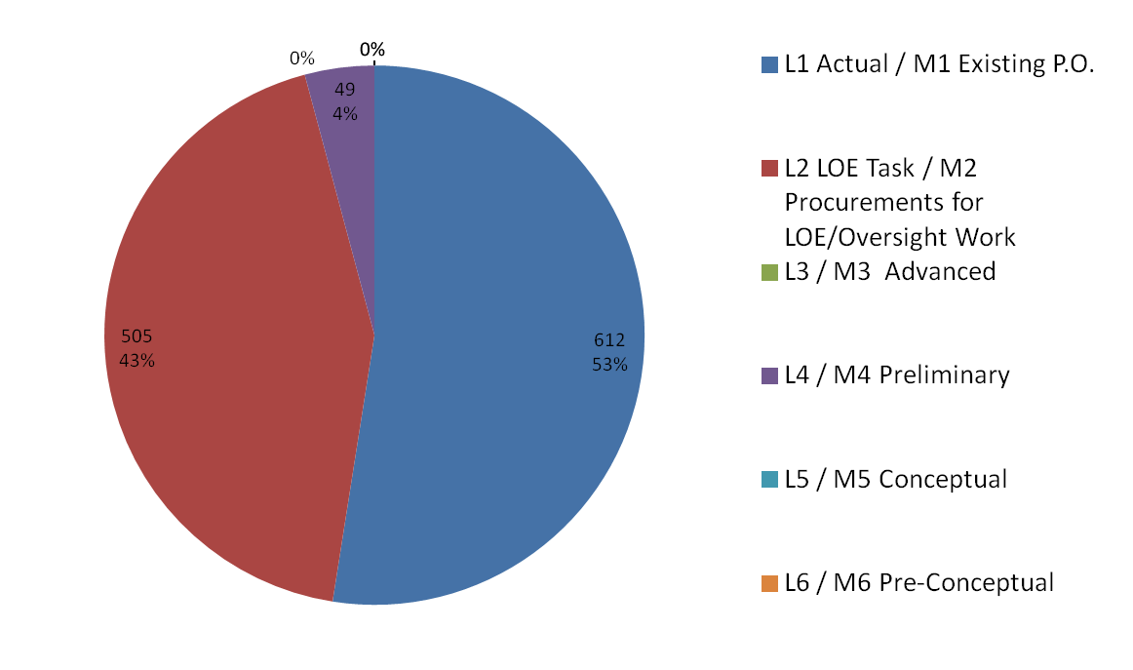
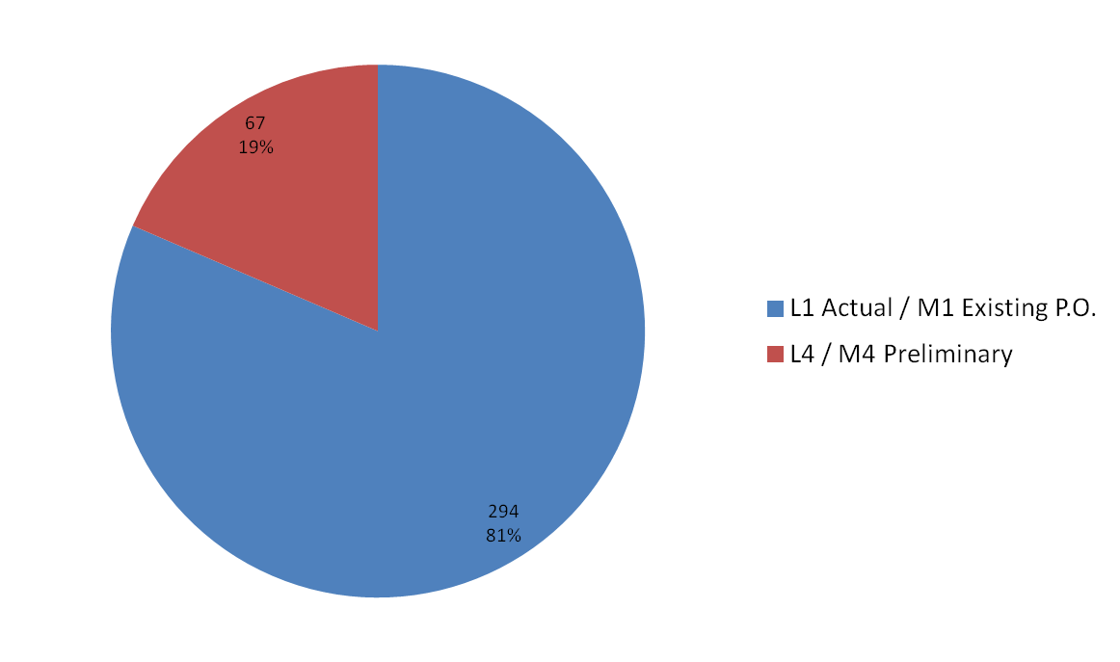
Management
Quality of Estimate (by L3 Activity)
475.09.01
475.09.02

Slide 17
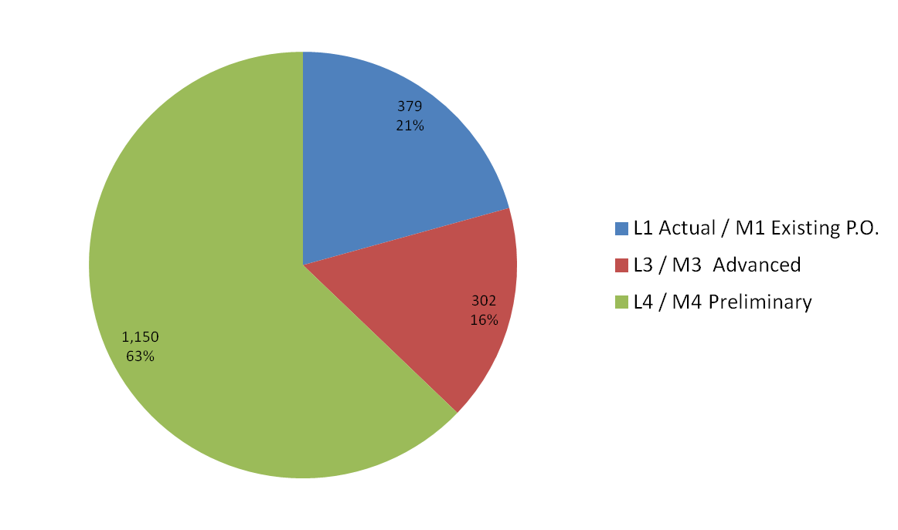
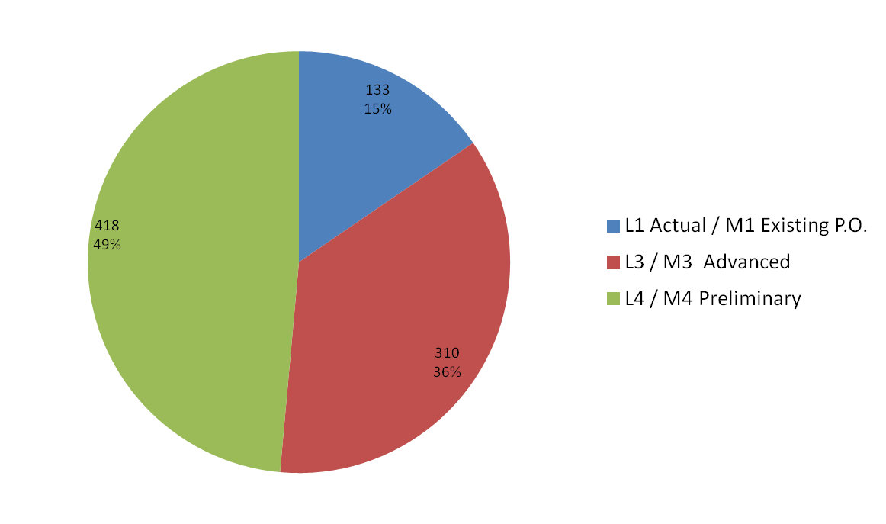
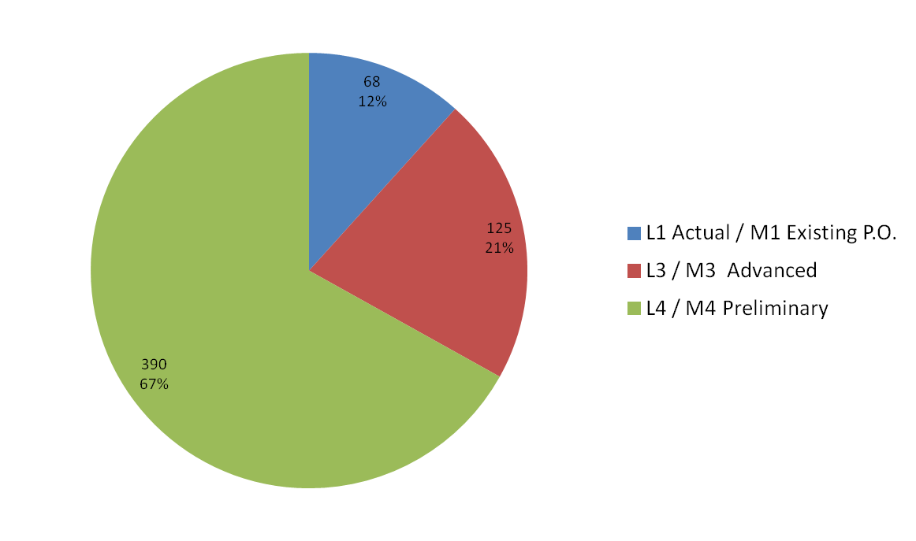
Management
Quality of Estimate (by L3 Activity)
475.09.03
475.09.04
475.09.05

Slide 18
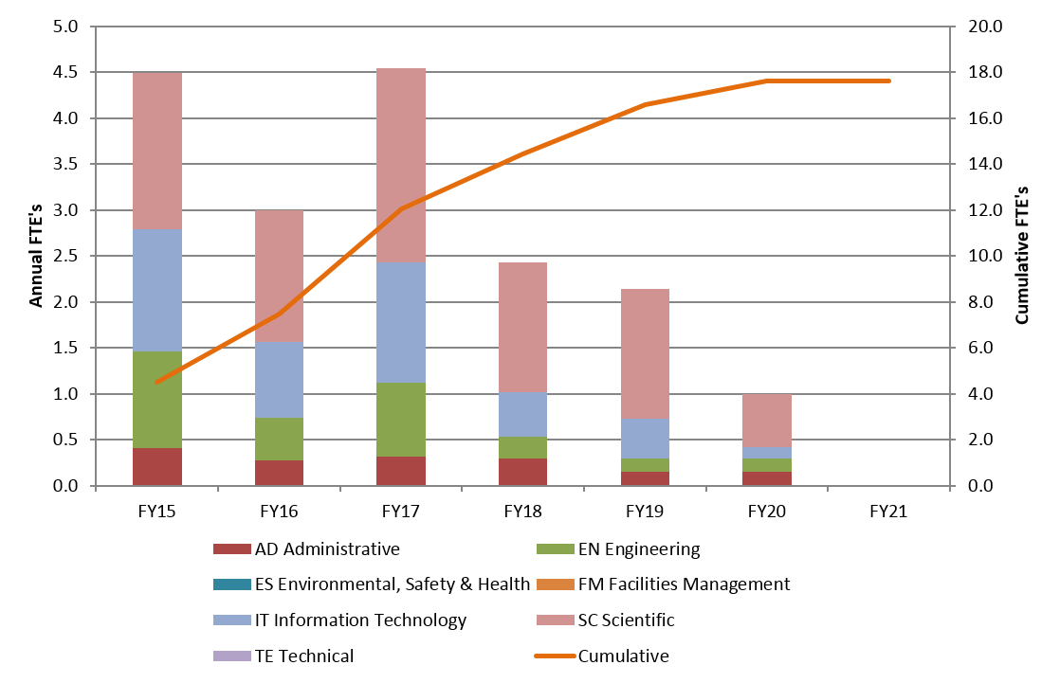
Management
Resources by FY

Slide 19
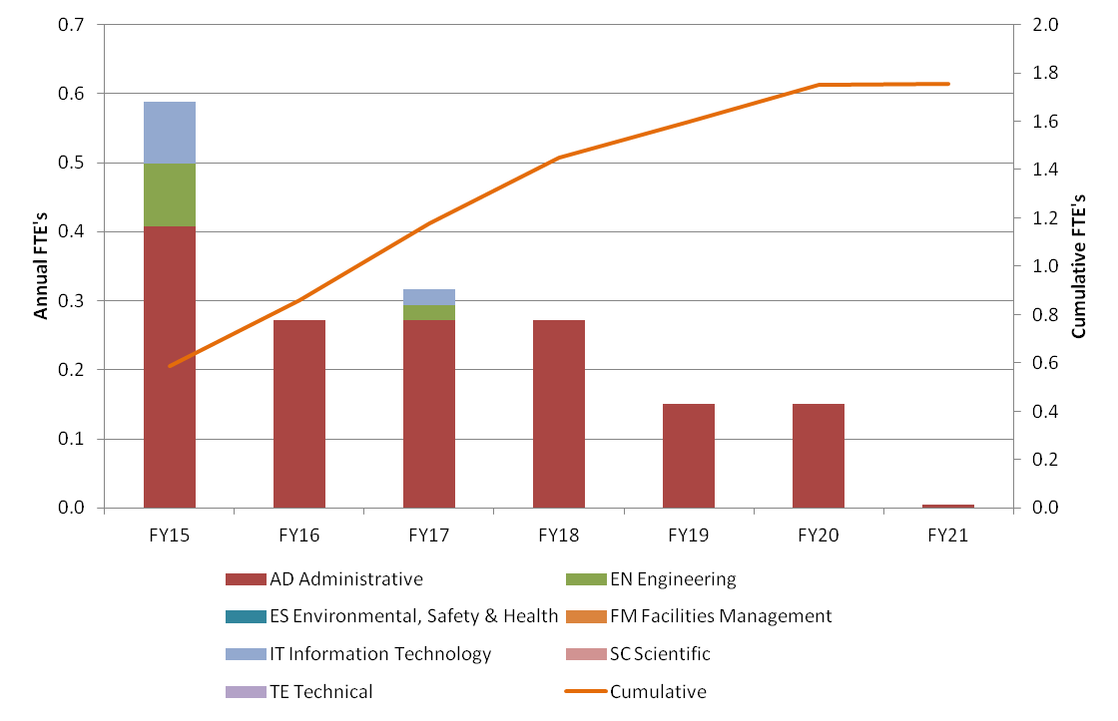
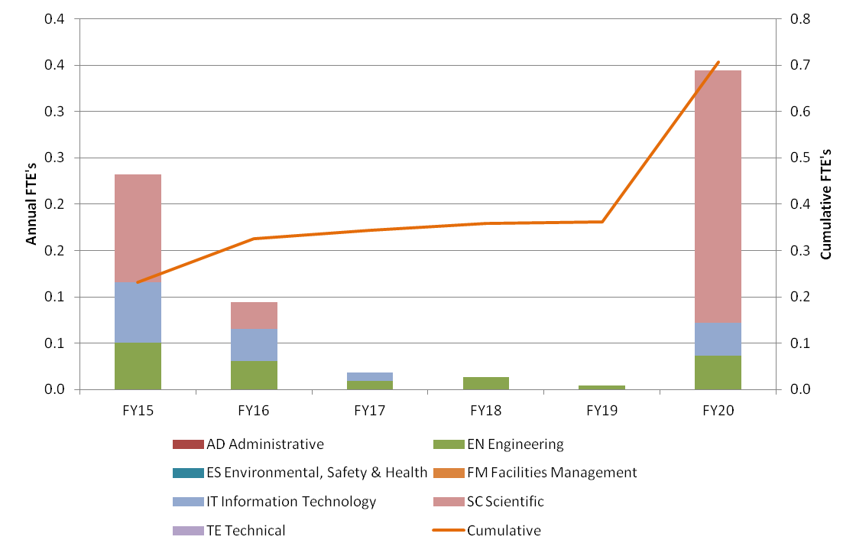
Management
Resources by FY (by L3 Activity)
475.09.01
475.09.02

Slide 20
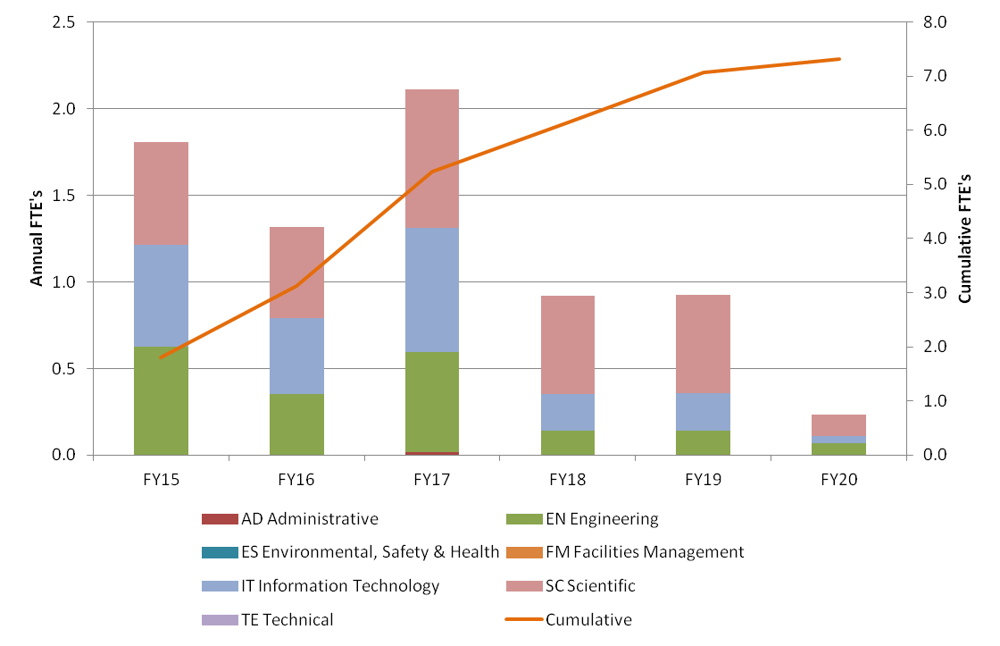
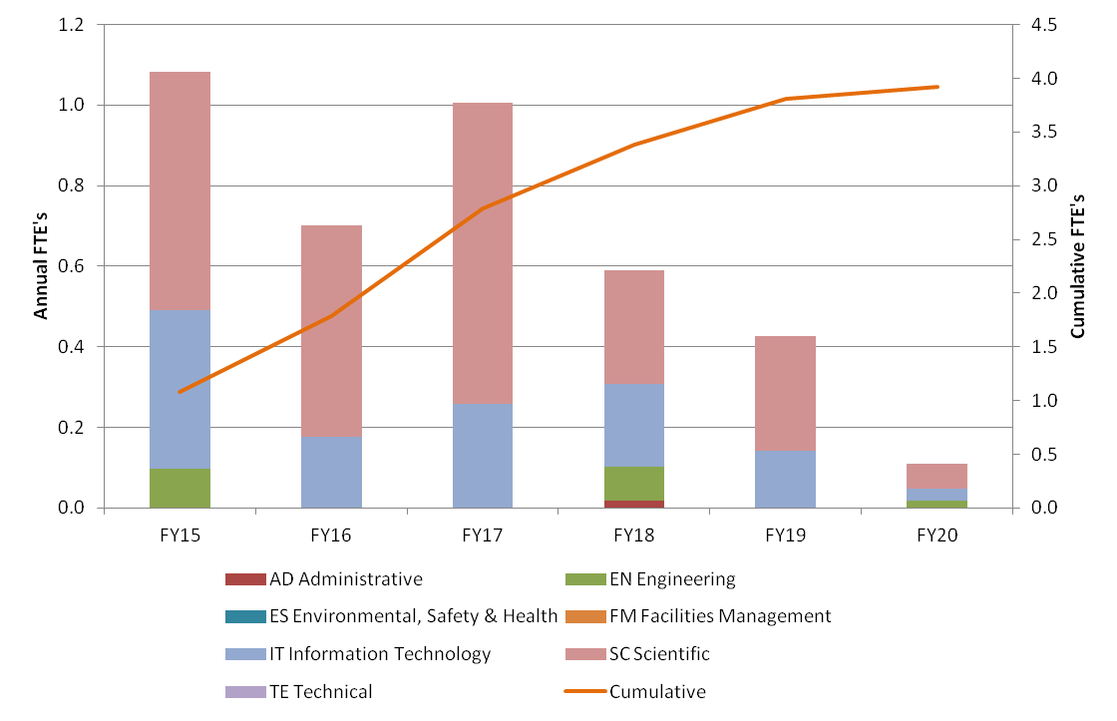
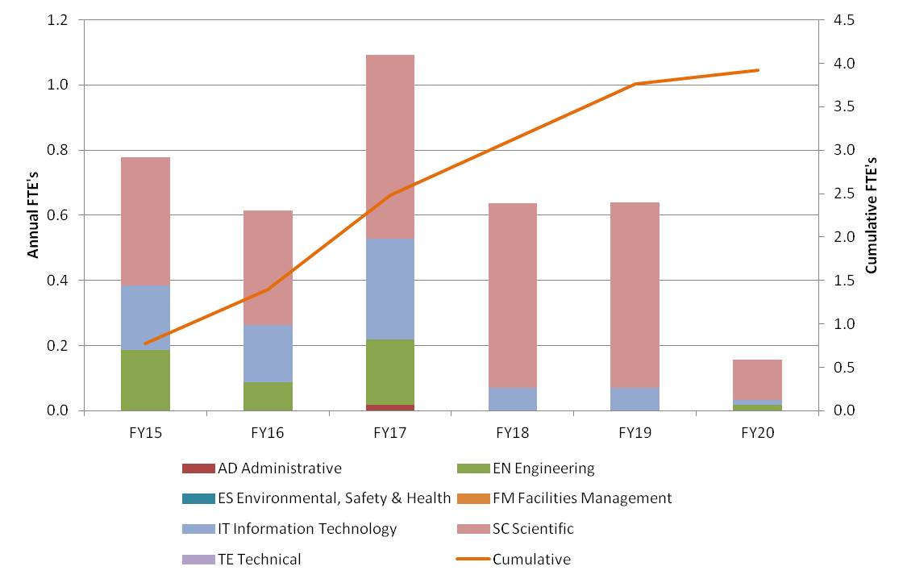
Management
Resources by FY (by L3 Activity)
475.09.03
475.09.04
475.09.05

Slide 21
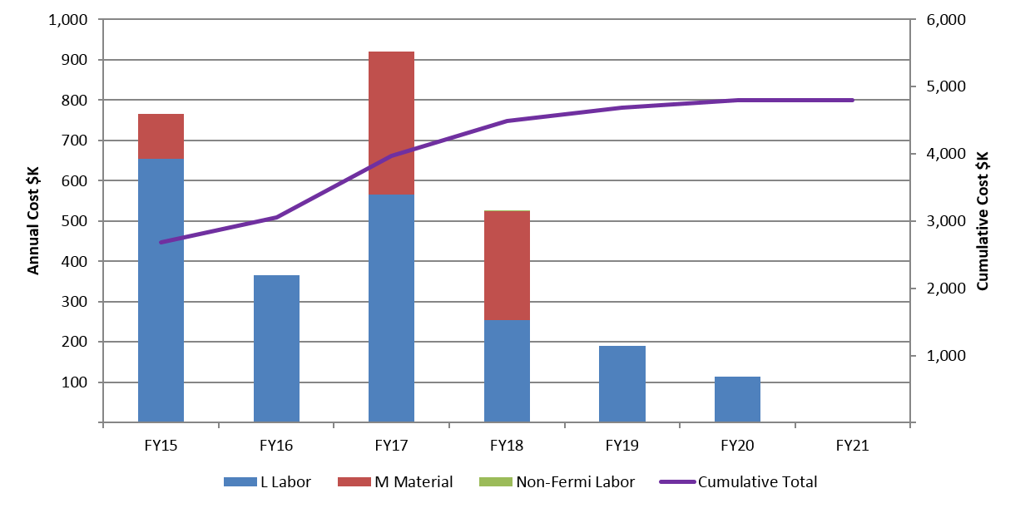
Management
Resources by FY

Slide 22
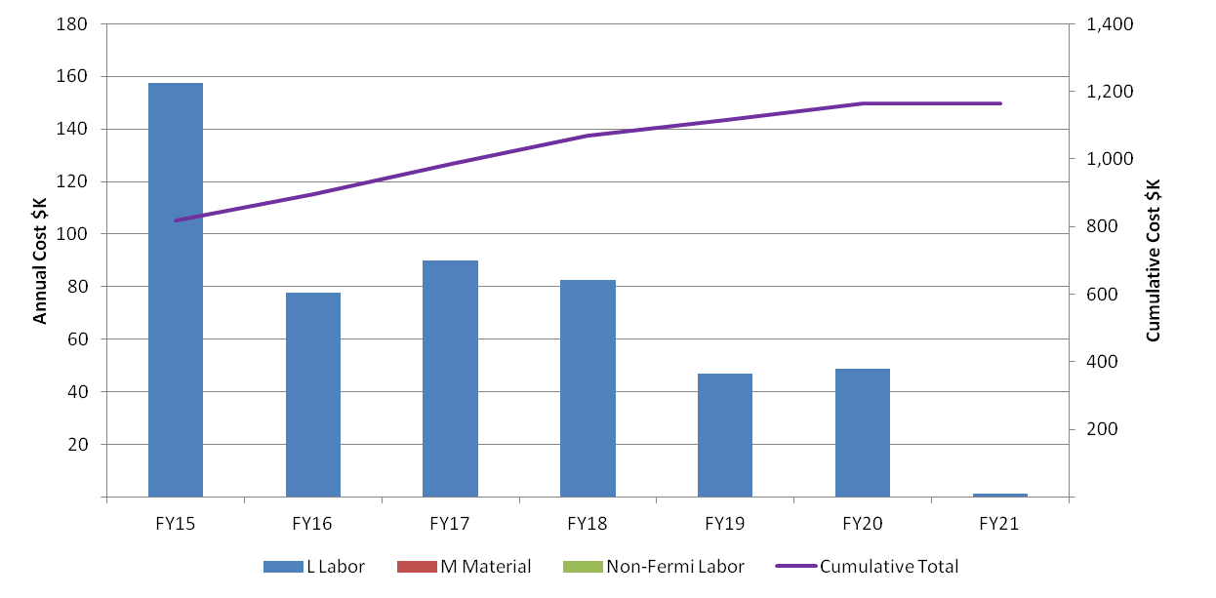
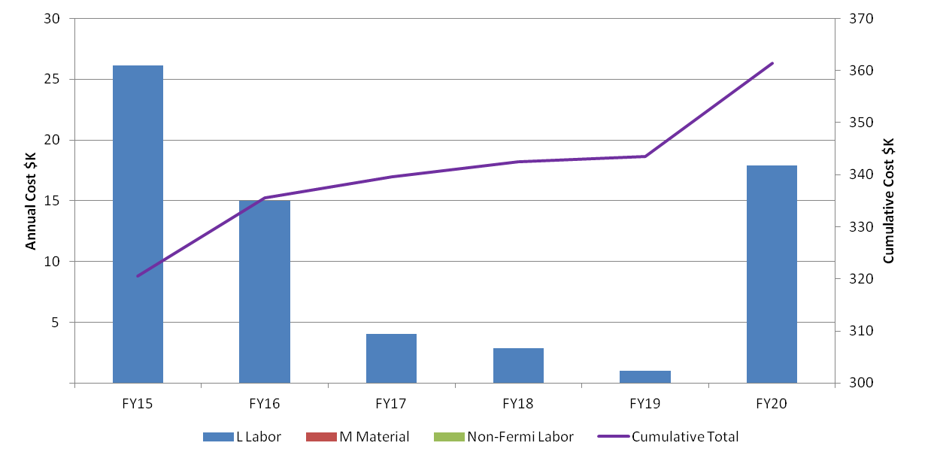
Management
Resources by FY (by L3 Activity)
475.09.01
475.09.02

Slide 23
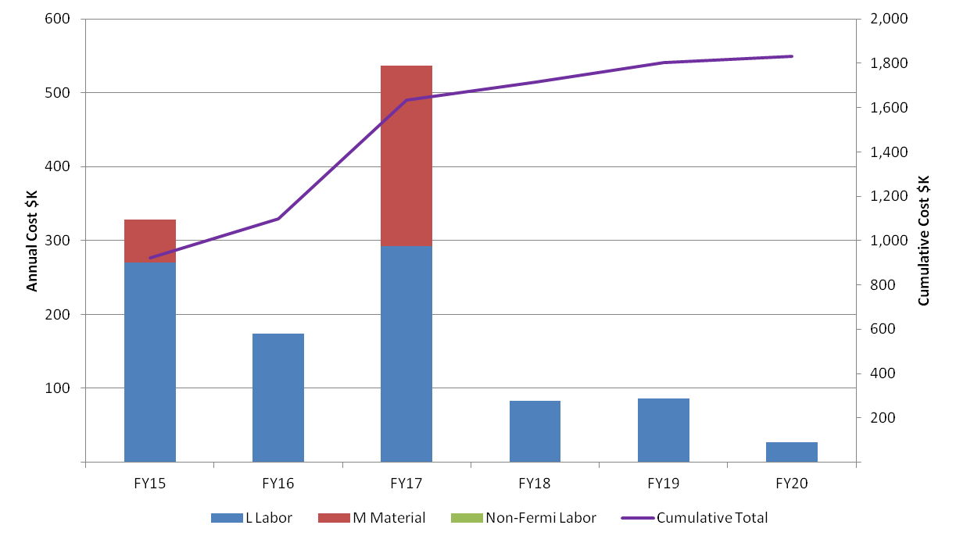
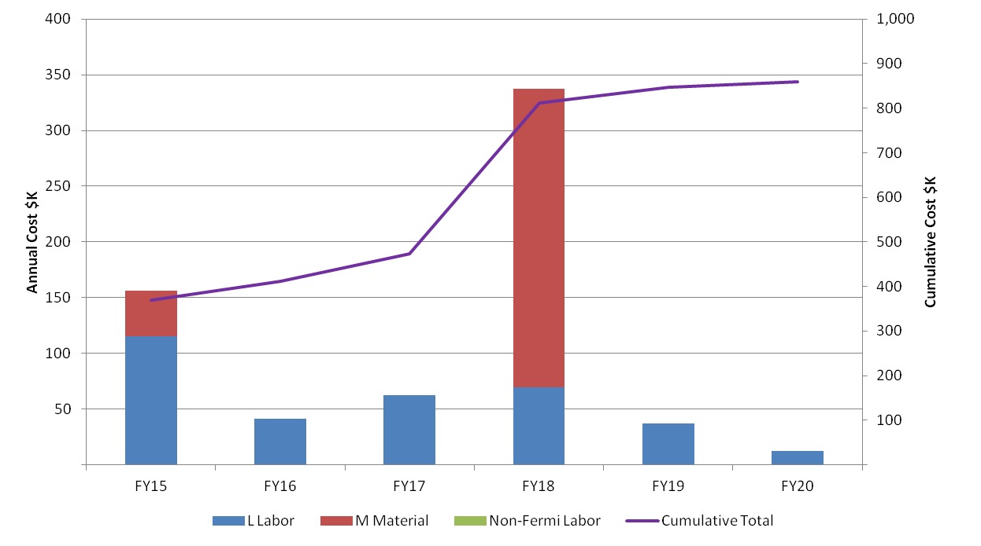
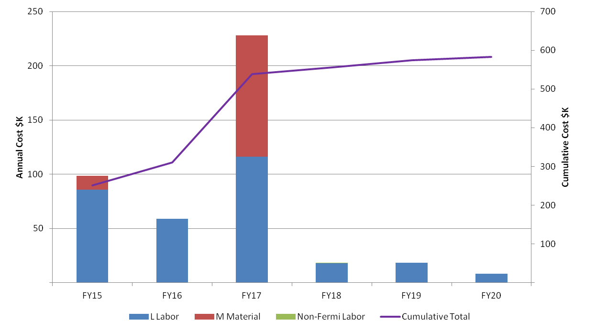
Management
Resources by FY (by L3 Activity)
475.09.03
475.09.04
475.09.05

Slide 24
Management
CD-3a
CD-3c
CD-2/3b
CD-4
Data Acquisition
Pilot System
Data Acquisition
Production System
KPPs Satisfied
Data Processing
Pilot System
Data Processing
Production System
Controls & Network
Pilot System
Controls & Networking
Production System
Optimization & Debug
Detector Hall Construction
DAQ, Controls, Networking Purchases
Computer
Purchases
Detector Prototypes and Construction
Cosmic Ray System Test
Accelerator and Beamline Construction
Accelerator Commissioning (off Project)
Q3 | Q4 | Q1 | Q2 | Q3 | Q4 | Q1 | Q2 | Q3 | Q4 | Q1 | Q2 | Q3 | Q4 | Q1 | Q2 | Q3 | Q4 | Q1 | Q2 | Q3 | Q4 | Q1 | Q2 | Q3 | Q4 | Q1 | Q2 | Q3 | Q4 | Q1 | Q2 | Q3 | Q4
FY14 FY15 FY16 FY17 FY18 FY19 FY20 FY21

Slide 25
Management
Major Milestones
Completion of Pilot System development for Data Acquisition, Data Processing, and Controls and Networking tasks (July 2015)
Completion of Production System development for Data Acquisition, Data Processing, and Controls and Networking tasks (January 2020)
  last two years are optimization & debug at reduced level of effort
Cosmic Ray Test (final integration with detectors and full readout test) (June 2020)

Slide 26
Management
Improvements since CD-1
better data rate estimates due to improved background simulations
switch to a triggered CRV readout to accommodate higher background rates and lower thresholds (CRV data not needed for online analysis)
rejection rate reduced from 99.8% to 99.0% to allow independent Calorimeter filters

Slide 27
Management
  Performance
  Tests have been performed on the primary DAQ interfaces -
  digitizer to readout controller (LVDS), readout controller to data transfer controller (optical link), and data transfer controller to DAQ server (PCIe) to verify bandwidth requirements
  Optimized version of the online Tracker filter meets processing requirement

Slide 28
Management
Remaining work before CD-3
Development and test of a small (15%) DAQ Pilot system
  end-to-end data transfer test
  DAQ and detector Readout Controller (ROC) interface tests
  preliminary Calorimeter filter benchmarks

Slide 29
Management
Quality Assurance
DAQ system can be tested to a high level of confidence using simulated data, prior to Cosmic Ray test
Full DAQ system is a scaled version of the Pilot system
In-situ testing - diagnostic features include monitoring of data link bit-error rate and optical power levels, memory and processor tests using large simulated data sets

Slide 30
Management
Risks
Insufficient manpower for DAQ software (TRIG-128)
  Cause: uncosted labor resources are not available for scheduled tasks
  Mitigation strategy: use additional costed labor (~$500k)
Insufficient DAQ online processing (TRIG-130)
  Cause: improvements in processor performance and filter optimization are less than expected
  Mitigation strategy: add DAQ servers (~$75k)

Slide 31
Management
ES&H
ES&H issues are minimal
  High voltage (208 VAC, no exposed connections)
  Class 1 lasers (eye safe)
  no radiation or magnetic field issues

Slide 32
System Design & Test

Slide 33
System Design & Test
Requirements
Requirements for the DAQ are described in mu2e-docdb 1150.
Collect and assemble data from the Tracker (~13 GBytes/sec) and Calorimeter (~8 GBytes/sec) for online analysis.
Provide online filtering to reduce data Tracker & Calorimeter data volume by ≥ 99%.
Combine with data from CRV, Extinction and Target Monitors for transfer to offline storage.

Slide 34
System Design & Test
Requirements
Provide global timing synchronization
Provide fast and slow control networks
Provide connections to offline storage and site networking
Provide control room/operator interfaces

Slide 35
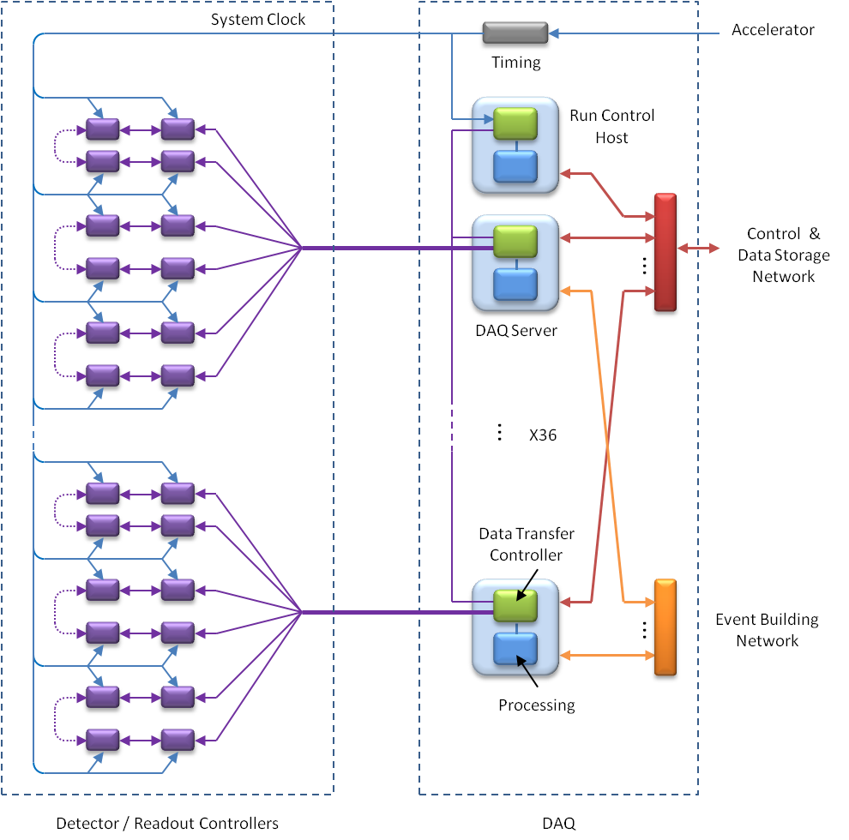
System Design & Test
architecture supports both streaming (Tracker, Calorimeter) and triggered (CRV) readout
DAQ Servers handle data readout, event building and processing
bidirectional front-end interface for fast control and readout
large front-end buffers for uniform data transfer
all commercial DAQ hardware
scalable… 1 GByte/sec per DAQ server

Slide 36
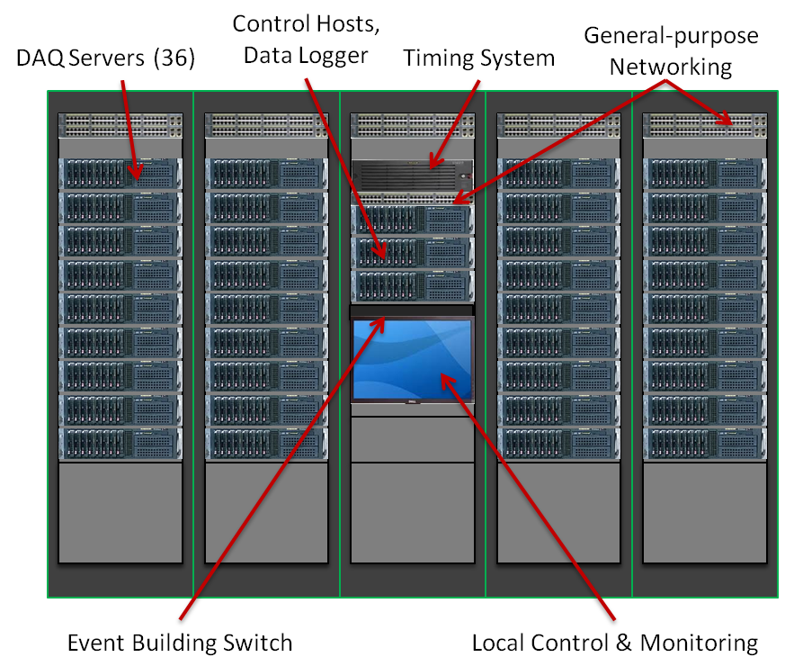
System Design & Test

Slide 37
System Design & Test
Tracker
36 DAQ Servers
216 optical data Links
Multiple Readout Controllers per link to balance load
240 Tracker ROCs (2 per link)
240 Calorimeter ROCs (3 or 4 per link)
15 CRV ROCs (1 per link)
Links are bidirectional (control & data)
Redundant paths to mitigate any single-point failure
20 DAQ Servers
12 ROCs/Server
Calorimeter
12 DAQ Servers
20 ROCs/Server
CRV
3 DAQ Servers
5 ROCs/Server
ROCs
DAQ Server

Slide 38
System Design & Test
ROC
Link Failure
DTC
ROC Failure
Redundant Readout Paths

Slide 39
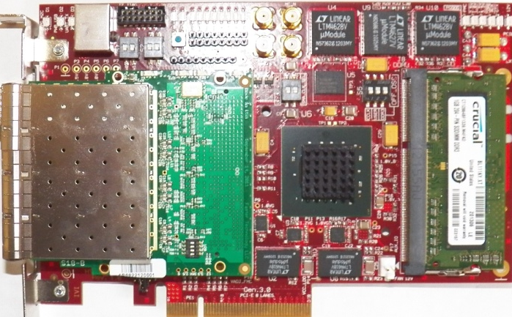
System Design & Test
Control Fanout
(CFO)
The Run Control Host transmits a global timestamp/readout control packet to synchronize all DTCs and ROCs.
X 6
…
Run Control Host
DTC Control Ring
(1 of 6)
Readout Controllers (ROC)
ROC Links
Data Transfer
Controller (DTC)
DAQ Server
…
X 6
Data Transfer
Controller (DTC)
DAQ Server

Slide 40
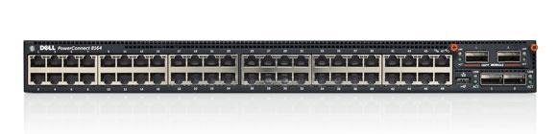
System Design & Test
In
Out
Server 0
0
0
In Out
0
0
1
0
1
0
The Event Building (EVB) function is performed by the DAQ Servers over a 10G Ethernet network.
Mu2e uses a folded network which reduces switch size and allows all EVB buffering to be done in server memory.
…
…
…
…
35
0
35
0
In
Out
Server 1
0
1
In Out
0
1
1
1
1
1
…
…
…
…
35
1
35
1
…
…
…
In
Out
Server 47
In Out
10G Ethernet Switch
0
35
0
35
1
35
1
35
…
…
…
…
35
35
35
35
Logical Operation
Physical Implementation

Slide 41
Data Acquisition

Slide 42
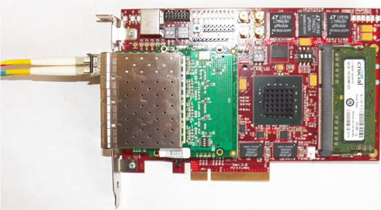
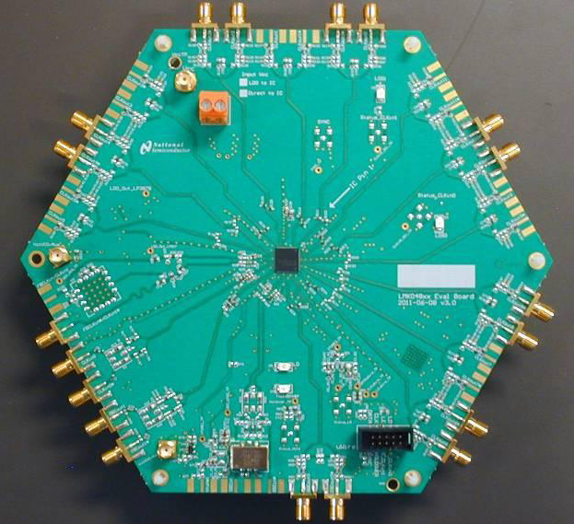
Data Acquisition
Scope
Data Transfer Controllers (DTCs) and firmware
Optical Links connecting DTCs to Detector
Event Building Network (EVB)
Timing System
Data Acquisition software running on DAQ Servers and Run Control Host
Infrastructure (racks, cable trays)
Detector
DTC
Processing
EVB
…
DTC
Processing
DAQ Servers (36)
Timing System

Slide 43
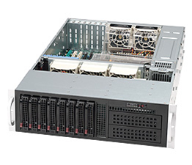
Data Acquisition
Commercial (off-the-shelf) hardware
DAQ server
  - 3U rack-mount computer
  - integrated DAQ and online processing
Data Transfer Controller (DTC)
  PCIe card with FPGA, memory,
  and an 8-port SFP+ optical interface
- 1 GByte/sec readout bandwidth
Event Building network
  48 port 10G Ethernet switch

Slide 44
Data Acquisition
DAQ
36 MTP Cables (432 fibers)
Detector to DAQ cable distance is approximately 60 meters.
Upper Level
Detector
Detector Staging Area
Lower Level
Cable Trench

Slide 45
Data Acquisition
digitizer clocks (~50 MHz)
Clock Generator
/n
PLL
∆
System Clock
(590 kHz)
Local Timestamp
µController
Program Memory
Control
CANbus
Digitizers
SerDes
Optical
XCVR
Optical Link 0
Data
Router
SerDes
Optical
XCVR
Optical Link 1
FPGA
Data Buffer
(512 MB, ECC)
Generic Readout Controller (ROC) Architecture

Slide 46
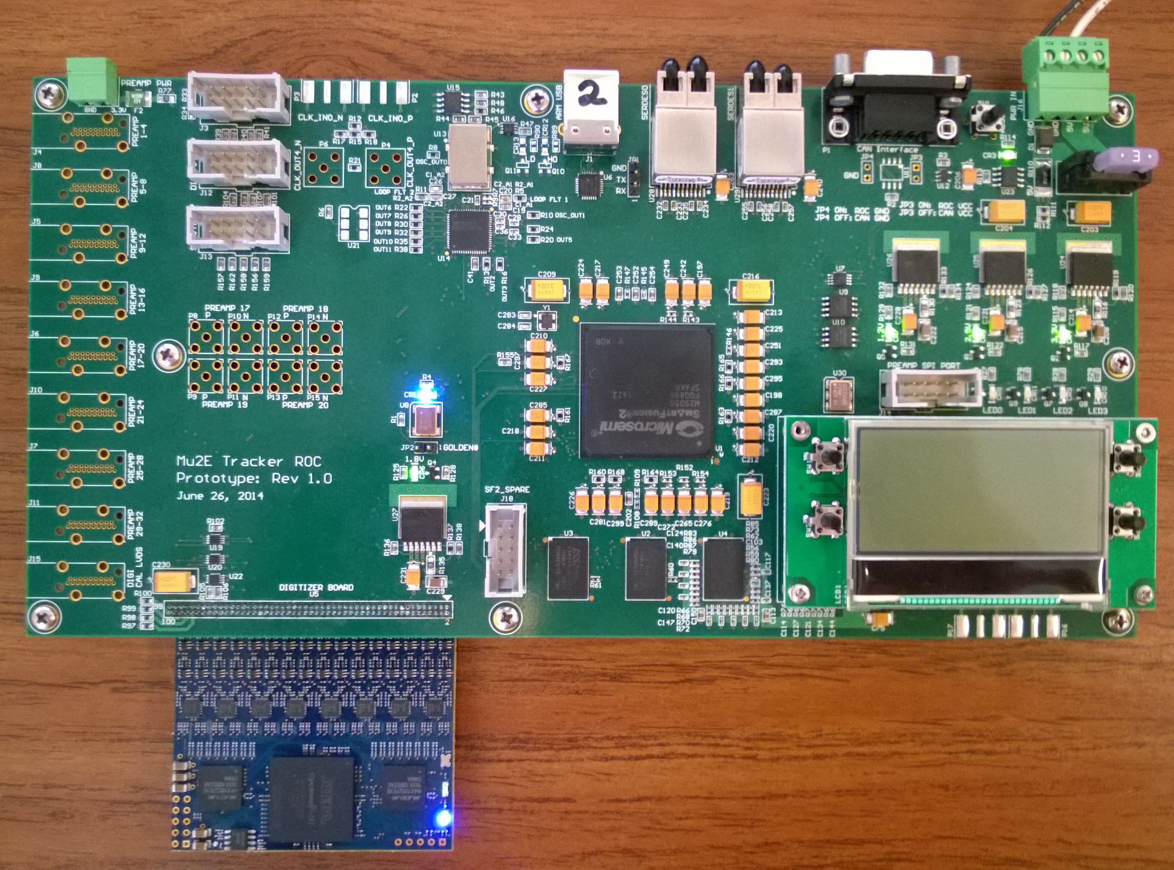
Data Acquisition
Optical Links
CANbus (redundant slow control link)
Timing System Interface
FPGA
Preamp
Inputs
ECC Memory
(1 second buffer)
Tracker Digitizer
Tracker Readout Controller (ROC) Prototype

Slide 47
Data Acquisition
Optical Interface (FMC card with 8
SFP transceivers)
Memory
PCIe Interface
FPGA
Data Transfer Controller (DTC)

Slide 48
Data Acquisition
CFO Ring
CFO Packet Controller
Message Controller
ROC Link 0
ROC Link 1
ROC Link 2
Link Output Controller
ROC Link 3
ROC Link 4
Link Input Controller
Data Controller
PCIe Controller
ROC Link 5
EVB Port
EVB Packet Controller
DTC FPGA
SERDES
DRAM Controller
Buffer

Slide 49
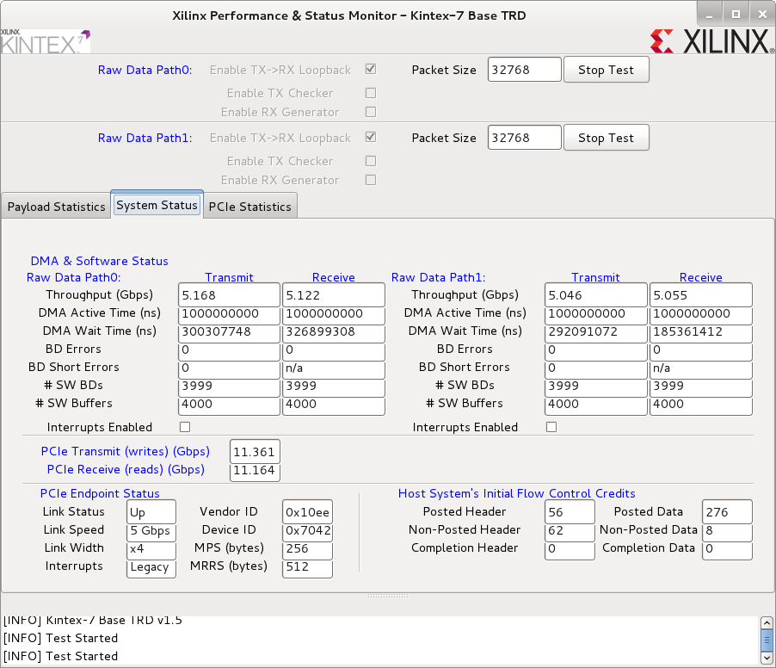
Data Acquisition
DTC Bandwidth Tests (PCIe x4, gen2, 1 GByte/sec transmit and receive)

Slide 50
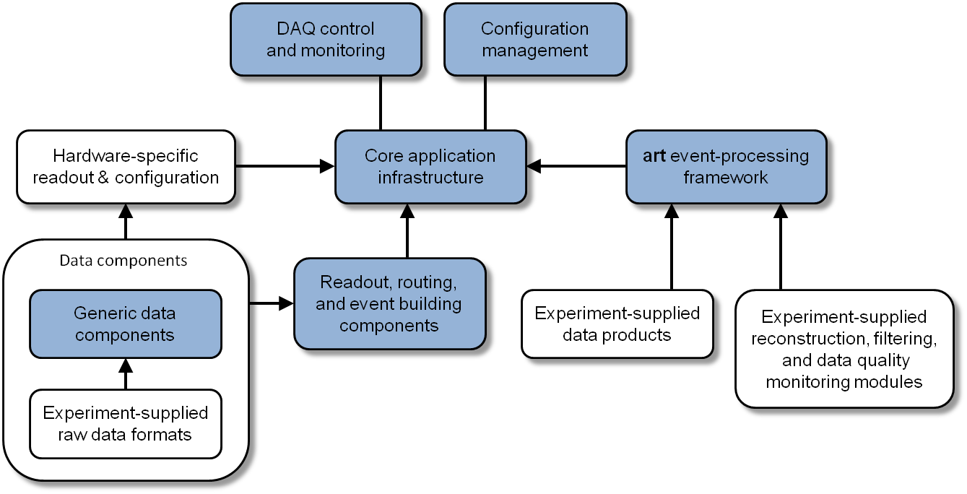
Data Acquisition
Software based on art and artdaq
(a common DAQ & Online Processing framework developed for Mu2e and other current/future experiments)

Slide 51
Data Acquisition
Process
Management
Tool
Message
Viewing &
Logging
System Control
(Run Control)
Run History
Configuration Management
Format
Software CFG params
XMLRPC,
Standard commands
Distribution scheme
Hardware CFG params
syslog-ng
Storage, management
tools, archiving
BoardReader
EventBuilder
Aggregator
Control messages
Message logging
Control messages
Message logging
Control messages
Message logging
Hardware readout
and configuration
Fragment sending
Fragment receiving
& event building
art
Event transfer
and ordering
art
Mu2e
Online Filters
Data sorting &
online monitoring
algorithms
DTC Interface
State machine
State machine
State machine
common artdaq features
Mu2e specific features
combination of artdaq and Mu2e
data flow
DAQ
Monitoring
Data
Storage
DQM

Slide 52
Data Acquisition
stop
Run Control
+initialize(pset : ParameterSet &) : boolean
+start(id : art::RunID) : boolean
+stop() : boolean
+pause() : boolean
+resume() : boolean
+report(which : string) : Report_ptr
+bootedEnter()
+shutdown()
initialize
start
pause
xmlrpc
Booted
Ready
Running
Paused
StateMachine
shutdown
shutdown
initialize
stop
resume

Slide 53
Data Acquisition
supercycle (1.33 seconds)
beam ON (492 msec)
beam OFF (836 msec)
spill (54 msec beam, 5 msec gap)
(36 msec gap)
Readout Controllers capture data during the 492 msec beam ON period and transmit data to the DAQ over the full 1.33 second supercycle.
Beam Structure

Slide 54
Data Acquisition
Beam Pickup or Supercycle Start
Fast Control Links to DAQ Servers
2.4 MHz
X12
Accelerator
Controls
590 kHz
CFO
System Clocks to Tracker & Calorimeter
ROCs
…
X10
590 kHz
590 kHz
X12
X 8
X 8
System Clocks to CRV ROCs
System Clock Fanout

Slide 55
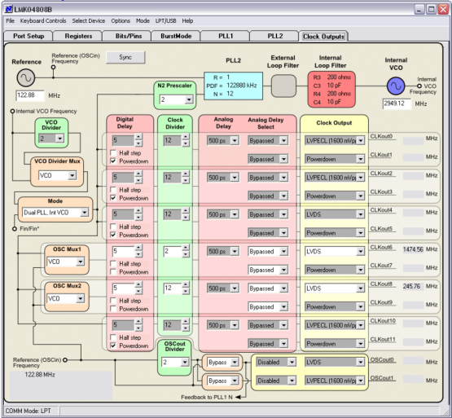
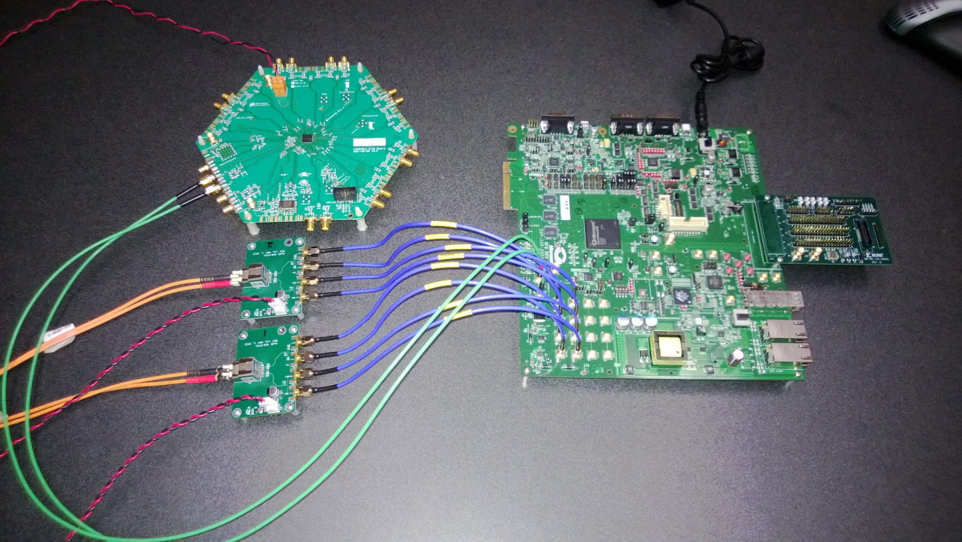
Data Acquisition
clock generator on ROC provides final System Clock alignment and acquisition clock multiplier
clock phase alignment is programmable in 25 psec steps
Timing System

Slide 56
Data Acquisition
t₀
System Clock - 1695 ns (590 KHz), phase-locked to accelerator. Leading edge of System clock is t-zero reference for Readout Controller Internal Timestamp counters.
Control/Data Link - 2.5 Gbps (DAQ ↔ Readout Controllers). A control packet is sent for each System Clock period to specify Readout Controller operation during the next System Clock (µBunch) . The control packet includes the µBunch Timestamp.
Readout Controller acquisition clocks - ~50 MHz (varies with detector), phase-locked to System Clock, drives Readout Controller Internal Timestamp counter and ADCs/TDCs.
Timing System

Slide 57
Data Processing

Slide 58
Data Processing
Scope
DAQ Servers
Data Logger, DCS Host & Run Control Host
Data Processing software running on DAQ Servers
Online data filters and analysis
Detector
DTC
Processing
EVB
…
DTC
Processing
DAQ Servers (36)
Timing System

Slide 59
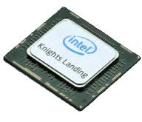
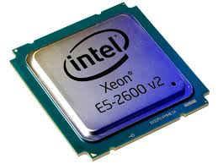
Data Processing
36 DAQ Servers
192k events/sec
using XEON-PHI processor
64 cores X 36 servers → 2,304 total cores
Available processing time/event: 12 ms
using dual XEON processors
20 cores X 36 servers → 720 total cores
Available processing time/event: 3.75 ms
DAQ Servers
Processing Requirements

Slide 60
Data Processing
Several algorithmic and compiler optimizations were applied to the reference Tracking filter to achieve a speedup of almost 30X.
Optimization stage for MakeStereoHits | Compiler | Execution Time (ms)
 |  | Xeon (speedup) | Xeon Phi (speedup)
Reference | gcc 4.4.7 | 132 | -
Modified algorithm | gcc 4.4.7 | 6.67 (19.8x) | -
Modified algorithm | icc 14.0.1 | 2.04 (3.33x) | -
Additional optimizations | icc 14.0.1 | 1.88 (1.08x) | 30.4
Optimization stage for FlagBkgHits | Compiler | Execution Time (ms)
 |  | Xeon (speedup) | Xeon Phi (speedup)
Reference | gcc 4.4.7 | 14.2 | -
Reference | icc 14.0.1 | 8.03 (1.77x) | 123
Optimizations (mem align/layout) | icc 14.0.1 | 5.01 (1.60x) | 37.7 (3.26x)
Optimizations (single precision) | icc 14.0.1 | 3.37 (1.49x) | 24 (1.57x)
Note : Speedup factors in parentheses are relative to previous stage

Slide 61
Data Processing
Trigger stage | Execution time (ms) | Scaled times (ms)
MakeStereoHits | 1.88 | 1.18
FlagStrawHits | 0.12 | 0.07
FlagBkgHits | 3.37 | 2.12
TrkPatRec | 0.71 | 0.45
TriggerResults | 0.03 | 0.02
Total | 6.11 | 3.84
Execution times were measured on a XEON E5-2630 and scaled for the E5-2687w.
Estimate of 3.84 ms/event using current generation processors is very close to the requirement of 3.75 ms/event (not including overheads). We expect an additional 2-3X improvement in processing performance between now and server purchases in 2018.

Slide 62

Data Processing
Near-term processing roadmap (XEON PHI)
  3X performance over 5110P

Slide 63
Controls & Networking

Slide 64
Controls & Networking
Scope
Control Room
General-purpose Networking
Detector Control System (DCS) (lower speed data acquisition and control for environmental data, power supplies, accelerator status, etc)
accelerator controls
DAQ Server
Run Control Host
Control & Data Network
Local Control Room
…
DAQ Server
Access Switch
Data Logger
Remote Control Room
Offline Storage
DCS & Management Network
DCS Host
DCS
Endpoints

Slide 65
Controls & Networking
accelerator controls
DAQ Server
Run Control Host
Control & Data Network
Local Control Room
EVB Network
…
Access Switch
Remote Control Room
DAQ Server
Data Logger
Offline Storage
DCS & Management Network
DCS Host
DCS Endpoint Controllers, PDUs
…
System Architecture - Networking Perspective

Slide 66

Controls & Networking
The Detector Control System (DCS) software will incorporate development work done for NOvA, along with current web based interface technology.
Screenshot from EPICS/CSS based DCS used in NOvA.

Slide 67

Controls & Networking
Mu2e Remote Control Room - Wilson Hall, 1st floor West
(shared use - LBNF, MicroBooNE, MINERvA, MiniBooNE, MINOS, Muon g-2, Mu2e, NOvA)

Slide 68
Summary
Based on initial testing of DAQ components, we are confident that the system bandwidth and processing will meet requirements.
Currently in the Pilot System development phase, expected to take approximately 1 year.
Pilot phase goal is a small (6 server) functioning DAQ system, with the basic features necessary to communicate with detector readout controllers, buffer and exchange event data between servers, and measure online filter performance.
75% of effort is in firmware/software development. Estimates are based on a top-down approach using recent experiments of similar complexity.
Costs are reduced through the use of commercial hardware and a common software framework.

Slide 69
Summary
We have a design that fully satisfies the requirements
Cost estimates for the DAQ are complete
  100% of the cost understood at the Preliminary Design level or higher
  Risks are understood, mitigated to the extent possible and are under control.
All interfaces are identified and defined
Resource needs understood
ES&H embedded into all aspects of the Project
Responded to all recommendations from previous reviews
DAQ is ready for CD-2

