Slide 1
HEPAP Accelerator R&D Subpanel Progress Report
Don Hartill on behalf of the Subpanel
SLAC Seminar 12/5/2014

Slide 2
Outline
Subpanel was formed in response to P5 recommendations (follows three previous Subpanels on Accelerator R&D
Summary of Charge to the Subpanel
Members of the Subpanel
Meetings
GARD thrust areas
Information gathering process
Community input for resources needed
Sticker shock
Results of preliminary discussions
Challenges
Gathering further information for advanced acceleration
Developing a priority map for the GARD program
Paying attention to workforce needs
Support for fundamental accelerator science
Next steps to a final report by late March 2015

Slide 3
History
First HEPAP Subpanel on Accelerator R&D was the “Tigner” Panel in 1980
Main recommendation was that support should be 4% of the HEP
operating budget.
Second HEPAP Subpanel on Accelerator R&D was the first “Marx” Panel in
1996 which endorsed the 4% support level and added further justification
for this level of support and pointed out that accelerators were useful
in a number of areas outside of high energy physics.
Third HEPAP Subpanel on Accelerator R&D was the second “Marx” Panel in
2006 suggested that the level of support should be 4 % for the coming year with 5% the next year and increasing to 6% smoothly over the next ten years remaining at that level afterword. Another recommendation was that the NSF begin a program in Accelerator Science. The concept that HEP should
be the “steward of accelerator R&D” that would support accelerator needs in other branches of the Office of Science and that these branches should provide some support for these activities.
Four members of the second “Marx” Panel are members of our panel.

Slide 4
Subpanel Members
Bill Barletta MIT Young-Kee Kim U of Chicago
Ilan Ben-Zvi BNL& Stonybrook Tadashi Koseki KEK/J-PARC
Marty Breidenbach SLAC Geoff Kraft (NP) JLAB
Oliver Bruning CERN Andy Lankford UC Irvine
Bruce Carlsten Los Alamos Lia Merminga Triumf
Roger Dixon Fermilab Jamie Rosenzweig UCLA
Steve Gourlay LBNL Mike Syphers MSU
Don Hartill (Chair) Cornell Bob Tschirhart Fermilab
Georg Hoffstaetter Cornell Rik Yoshida Argonne
Zhirong Huang (BES) SLAC

Slide 5
Charge Summary
National Goals: Appropriate goals in broad terms for medium ( < 10 years ) and long term ( < 20 years ) U. S. Accelerator R&D for a world leading future program in accelerator based particle physics consistent with P5
Current Effort: Examine the scope of the current effort and evaluate how well these address the HEP mission as expressed by P5
Impediments: Describe any impediments that may exist in achieving these goals

Slide 6
Charge Summary
Training: Accelerator R&D efforts play a major role in training future accelerator scientists and technologists. How are we doing?
Balance: How do we maintain a healthy and appropriately balanced national program? Provide further guidance for a plan based on the science and technology case for increased investment in HEP Accelerator R&D called for in P5’s Scenario C
Preliminary report by end of November with final report by March 2015

Slide 7
Guidance from P5
Science Drivers
Use the Higgs boson as a new tool for discovery
Pursue the physics associated with neutrino mass
Identify the new physics of dark matter
Explore the unknown: new particles, interactions, and physical principles
Projected startup dates for existing projects
LHC: Phase 1 upgrade 2020
HL-LHC 2025
LBNF 2028
ILC 2030
Possible future projects
Multi-MW proton source
1 TeV e+e- collider
100 TeV pp collider
> 3 TeV lepton collider
Neutrino factory
Assuming ~ 10 year new physics discovery era for each the “existing” projects then sets the time scale for the construction start of future projects
Assuming ~ 10 year R&D phase to develop the needed technologies to produce a credible conceptual design report sets the start date of a significant R&D program

Slide 8
Information Gathering
Meetings were held at BNL, Fermilab, Argonne, SLAC and LBNL on a road trip the last week in August
Subpanel Website: http://www.usparticlephysics.org/p5/ards
Website has the agendas and the talks for the lab visits.
Town Hall meetings were held at each of the lab visits.
An additional virtual Town Hall meeting was held on Oct. 10

Slide 9
Meetings
First Meeting (Organizational) at SLAC July 7 & 8.
Road Trip to BNL, Fermilab & Argonne, and SLAC & LBNL week of August 25 to 30.
Two Day Meeting Newport Beach, CA Nov. 6 & 7
Second Two Day Meeting Chicago, IL Dec. 3 & 4
Final Two Day Meeting on the West Coast Early Jan. 2015

Slide 10
Road Trip
Energy frontier was the focus at BNL.
Intensity frontier was the topic at Fermilab.
Novel Particle Acceleration was the theme at SLAC/LBNL.
Two hour executive session at LBNL followed by a two page report by each subpanel member on their impressions from the road trip.

Slide 11
Current GARD Program
In FY 14 the current General Accelerator Research and Development budget is 85.5 M$.
Since the P5 report, ~ 26 M$ of SRF R&D at Fermilab has been redirected to the PIP II project and test facility operation support.
Also included in the GARD program is 12 M$ for wakefield acceleration operations and 6 M$ for superconducting magnet facility operating costs.
This leaves a net of ~ 42.5 M$ for GARD base programs and is divided among the seven GARD thrusts and is illustrated by the following chart:

Slide 12
Current GARD Program

Slide 13
NSF Program in Accelerator Science
In addition to the DOE GARD program, NSF has started their new program in Accelerator Science with a total funding level of 9.8 M$ this year.
Fourteen awards have been made covering a broad range of topics in Accelerator Science.
Of the 9.8 M$ ~ 1.2 M$ is for SRF research
It is a very welcome addition to the NSF portfolio.

Slide 14
LHC Upgrades
The LARP program to construct the high field quadrupoles and dipoles based on NbSn₃ has been moved from GARD to LHC Hi-Lumi directed R&D. Crab SRF cavities are also part of this program and are being developed by BNL and Old Dominion University.
The schedule for these upgrades is to begin installation in 2023 with a 2.5 year duration and then run until 2035 integrating ~ 3000 fb⁻¹. 1.2 km of the LHC will be replaced in the upgrade. Total cost ~ 800 MCHF for the LHC.
Pileup will be the principal experimental challenge with the potential of up to several hundred interactions per bunch crossing.

Slide 15
Future Collider Options
The construction of the ILC in Japan is under study.
Muon colliders were not endorsed by P5.
Andy and I were at the Future Circular Collider collaboration meeting at CERN in early September. The URL for all the talks is https://indico.cern.ch/event/333236/other-view?view=standard
FCC R&D is now part of the CERN medium term plan and they have applied for H2020 funding to support some of the R&D. More than 25 institutions have signed MOU’s to carry out different parts of the needed R&D. The FCC could be initially an ~ 200 GeV e+e- collider or an ~ 100 TeV pp collider with a circumference between 80 and 100 km.

Slide 16
Future Collider Options
The high energy physics community in China is pressing forward with a proposal for a 50 to 80 km ring. It would first be a ~ 200 GeV e+e- collider with a proposed construction start in early 2020’s followed by a pp collider in the mid 2030’s.
In addition, there is a 150 MEuro EU initiative spread over ten years in laser plasma acceleration with a focus on developing compact synchrotron radiation sources based on FELs.

Slide 17
US GARD Opportunities
For the Intensity Frontier, the measure is MW•Ktons•beamtime
/yr so accommodating higher beam power has significant leverage. Beam stability at synchrotron injection energies combined with higher power targets could have large benefits.
Future high energy colliders are expensive and complex. Optimization studies will be key in lowering the cost and maximizing operating efficiency. Optimized superconducting magnet design both in field and manufacturability will require R&D. For e+e-, more efficient RF would lower operating costs.
Advanced acceleration technology potentially has the promise of dramatically increasing the accelerating gradient and thereby significantly reducing the cost of a very high energy e+e- collider.

Slide 18
Challenges
Limited funding for the GARD program
Time scales for the possible construction starts for the next generation of accelerator facilities are long
Next generation of either multi-MW proton sources, 100 TeV pp colliders, 1 TeV e+e- colliders, and > 3 TeV lepton colliders are complex machines
The current sketch designs for these accelerators have a broad spectrum of maturity
The very high stored energy of both the beams and the magnet systems of a 100 TeV pp collider provide interesting design challenges
Intense synchrotron radiation from the beams in a 100 TeV pp collider presents very significant challenges for both the vacuum system design and the needed cryogenic cooling capacity
The applicability of the advanced acceleration technologies to HEP colliders is at an early stage of understanding
The cost of using known technologies for these machines is high
A key driver for the GARD program is to understand and develop strategies to significantly reduce the costs of construction and operation for future facilities

Slide 19
Further Challenges
The Accelerator R&D Subpanel is not a project review panel. Our task is to recommend a balanced program in accelerator R&D to OHEP to provide the US with a world leading program in accelerator based particle physics. And, parenthetically developing an exciting program that will attract additional funding to the program.
We were briefed on several initiatives each with a price tag of ~ 25 M$ per year including capital investment, operations, and experiments. One on-going program will stop at the end of FY16 unless a significant investment is made to reconfigure a portion of the SLAC linac because of the LCLS II construction project.
The current funding level (FY2015) for the entire GARD program is 71 M$.
The sum of all the requests for support by the GARD program sums to ~ 100 M$ so we have a 30% or so problem. P5 had roughly a factor of 3 to 4 problem as they began their deliberations. Their report has been a great help in managing expectations

Slide 20
Further Challenges
To make a contribution to future high energy colliders, the superconducting magnet program will need increased investment both in going to higher magnetic fields and in developing manufacturing techniques that significantly reduce the magnet assembly labor costs.
For the LCLS II cryomodules, the cost of Nb for the cavities is only 10% of the cost so improved manufacturing techniques have the potential of significantly reducing the cost of the completed cryomodules for a high energy SRF based collider.

Slide 21
Process
After the Road Trip we have set up the following five accelerator R&D areas to study in more detail:
Accelerator physics and instrumentation:
Beam dynamics, simulation, computation, beam loss monitoring, etc
Advanced acceleration:
Normal conducting RF structures and sources
Wakefield accelerators
Beam driven plasma wakefield acceleration
Laser driven plasma wakefield acceleration
Dielectric laser acceleration
Fundamental aspects of muon acceleration
Issues with 100 TeV pp collider

Slide 22
Process
Particle Sources and Targets:
High power beams, horns, targets, and collimators
Beam dumps
Superconducting Magnets and Materials:
Superconducting RF:

Slide 23
Process
The R&D needs for future very high energy colliders will be covered in the five areas mentioned previously rather than setting up a separate area.
High field superconducting magnets, beam dynamics and instrumentation, along with efficient RF acceleration are the key areas.
To make sure everything is included, a separate list of needed R&D will be maintained for these very high energy colliders.

Slide 24
Process
Each area has at least two subpanel members assessing the information provided to the subpanel and developing appropriate guidance and recommendations.
Good progress is being made by each of these subgroups and preliminary draft reports are being written by each subgroup. One subgroup has already has already produced a first draft.
Discussion between the subgroups takes place during our weekly telecoms (twice weekly lately). These were key in preparation for our meeting on Nov. 6 and 7. At that meeting it was clear that we needed more information for the advanced acceleration trust area.
In addition, we plan to hold a virtual town hall meeting like P5 did on October 10 at 11 EDT. Five presentations were heard with one giving the subpanel a quiz at the end.

Slide 25
Process
The goal of the meeting on December 3 and 4 was to develop the final set of recommendations and comments that will form the draft report. It was to be presented next Monday at the December HEPAP meeting. We failed but did make a serious start at setting up a process to prioritize the accelerator R&D programs as guidance to OHEP to manage the GARD program.

Slide 26
Driver Trust Area Matrix
First part:
On the vertical axis are the physics drivers and the horizontal axis are the accelerator projects
Second part:
On the vertical axis are the accelerator projects
and the horizontal axis are the GARD trust areas
Insert a number from 0 to 10 to indicate the correlated need with 10 indicating the strongest

Slide 27
Results of the preliminary discussions
Five possible new accelerator facilities are the focus of our discussions
100 TeV pp collider
1 TeV e+e- collider
Multi-MW proton source
and at a later stage
neutrino factory
> 3 TeV lepton collider
More information was needed to assess the viability of advanced acceleration technologies in these possible facilities
Requests for more specific information was requested from both of the plasma wakefield acceleration facilities along with the DLA scheme and the muon collider proponents with a deadline of Dec. 1
The information provided was discussed at our meeting in Chicago these past two days.
One item of note was the lowering of the proposed accelerating gradient for the plasma wakefield approach to ~ 1 GeV/m
The subcommittee focusing on advanced acceleration techniques is continuing to assess the information provided

Slide 28
Steps to the Final Report
Continue information gathering in the advanced accelerator arena – this is likely to involve further requests for more detailed information with respect to likely beam quality, etc.
Continue drafting report sections for each of the GARD thrust areas
Meet again in January which may include a session where advanced accelerator proponents are asked appropriate questions
At that meeting agree on the final set of recommendations
Transform the final draft sections into a final report via basecamp and teleconferences during late January and February
Finish the final report by mid to late March
Present the final report to HEPAP at its early April meeting

Slide 29
Conclusions
A healthy program in accelerator R&D is key to insuring that the US accelerator based high energy particle physics program is world leading.
Training of the next generation of accelerator scientists and technologists is a very important element of this R&D program. See the HEPAP Subpanel report on personnel needs published this past spring.
Our hope is that our report will provide useful guidance to DOE OHEP in charting the future of accelerator R&D in the US.

Slide 30
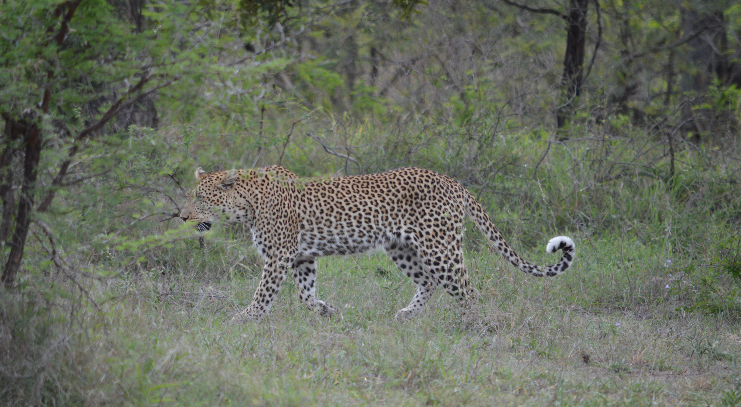
After the Report Submission

Slide 31

After the Report Submission

Slide 32
Thank you

