Slide 1
Status of MICE RF for Step V’
(at LBNL)
Derun Li
Lawrence Berkeley National Laboratory
December 6, 2014

Slide 2
Outline
Introduction
  MICE Step V’
Status and plans of RFA module
  RF cavities
  RF couplers
  RF tuners and actuator
  Beryllium windows
  RF vacuum vessel
  Module assembly and fixtures
Summary

Slide 3
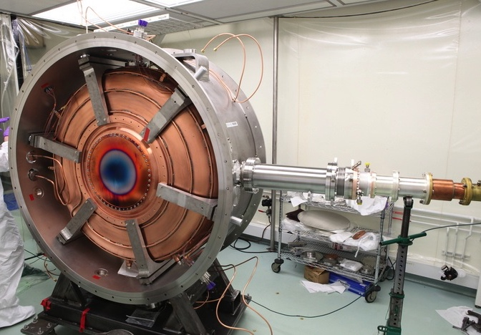
Expedited MICE (Step V’)
Plan developed in response
to P5 recommendations
Legend:
-SS = Spectrometer Solenoid-
-FC = Focus Coil-
-AFC = Absorber-Focus Coil Module-
-RFA = RF-Absorber Module-
Operational 2015
-Absorber-
-Tracker1-
-FC-
-Tracker2-
Represents reduced cost and technical risk relative to MICE Step V
-SS1-
-AFC-
-SS2-
Operational
2017
Secondary
-Absorber1-
Secondary
-Absorber2-
Primary
-Absorber-
NEW
Expedited
MICE Final
Configuration
-Tracker1-
-FC1-
-FC2-
-Tracker2-
-SS1-
RFA1-
-AFC1-
-AFC2-
RFA2-
-SS2-

Slide 4
Reference and Alternative
Reference Design
RFA
RFA
Alternative Design
RFA
RFA
Two single cavity modules, like the one in operation in the MTA：10 MV/m; nominal 12 MV/m from two 2MW amplifiers； Our responsibility is to deliver two RFA modules to RAL by mid-May 2016

Slide 5
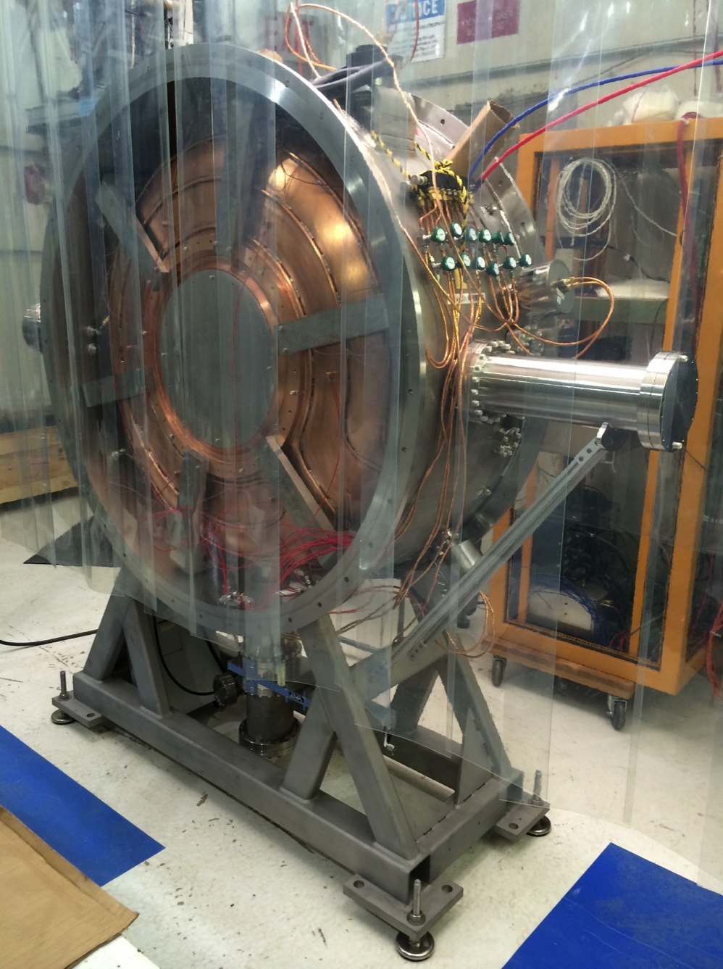
Status of the MICE RFA Module
  The MICE RFA module is very similar/identical to the MTA single cavity vessel
    RF cavities
    RF couplers
    Cavity support struts
    RF tuners forks
    Actuator and controls
    Beryllium windows
    RF vacuum vessel
    Support stand
    Assembly fixtures and procedures
  Vacuum system
Single cavity vessel at MTA

Slide 6
RF Cavities
Select four best cavities (two spares) from nine cavity bodies based on inner surface finish, frequency measurement and water cooling pipe location
  Four cavities have been measured previously
  Two cavities are eliminated due to un-acceptable surface finish
  Pairing of beryllium windows with cavity bodies by measuring resonant frequency
Electro-polishing (EP) of the selected four cavity bodies

Slide 7
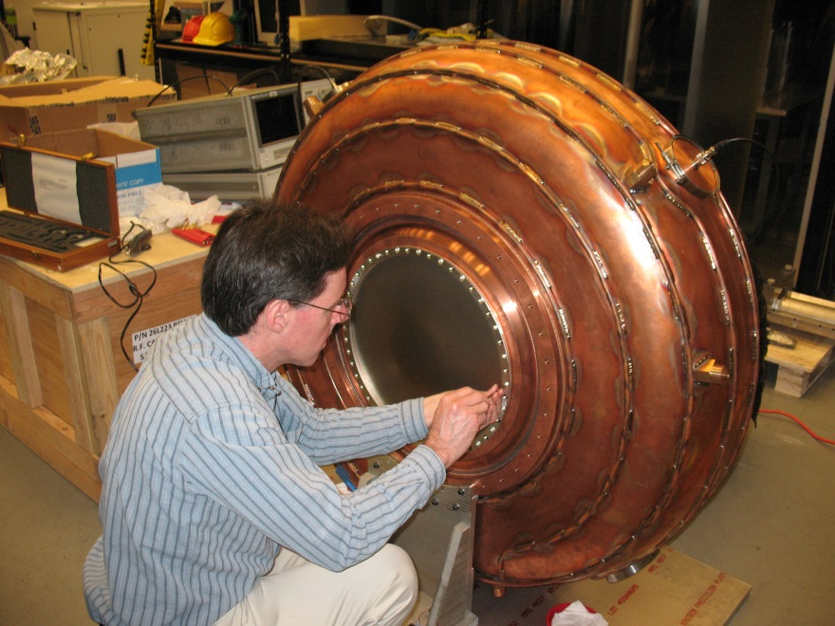
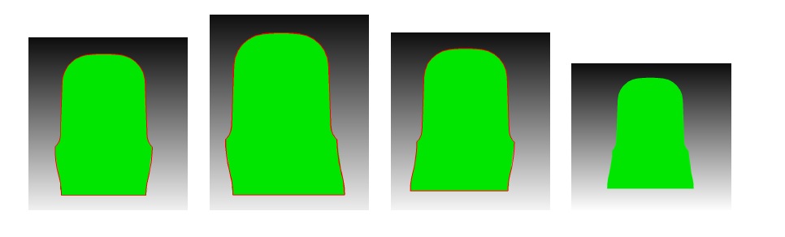
Frequency Measurement
Cavity body frequency f_{b}
Be window frequencies, f_{w1}, f_{w2} perturbations, compared with previous CMM measurement
and RF simulations
Measurements already started

Slide 8
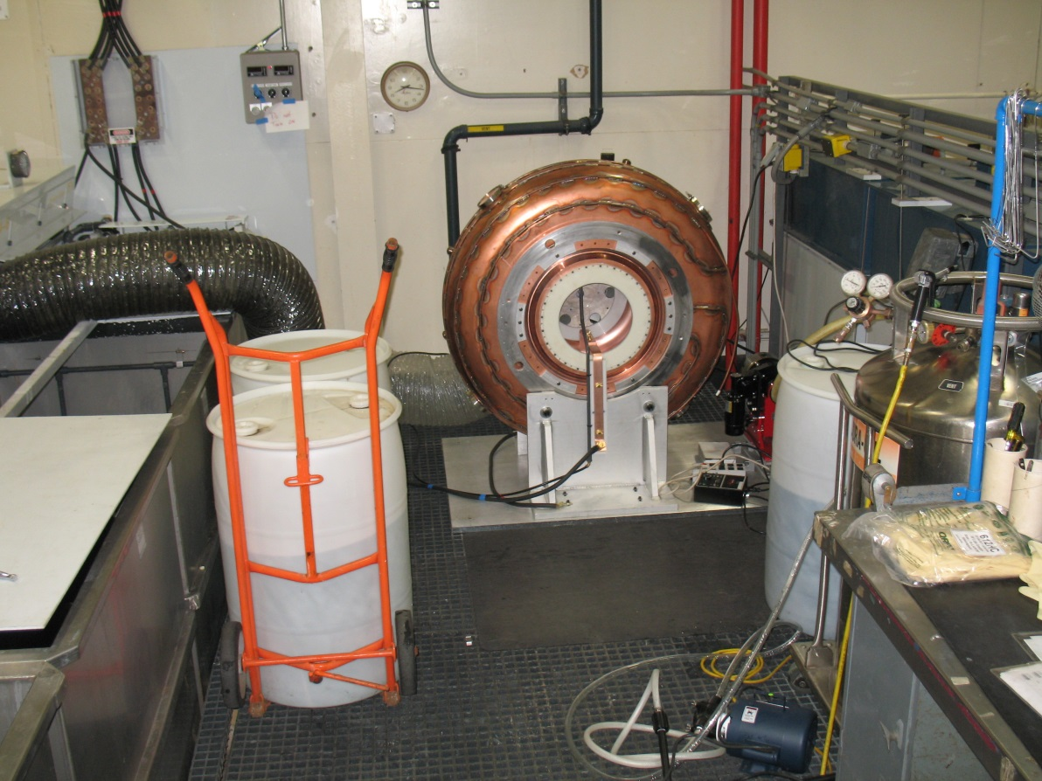
Electro-Polishing
Valid ES&H approval of EP at LBNL
EP of four selected cavity bodies, following the same procedure we developed for MICE prototype cavity in
2012
A few minor
improvements for
the EP fixture
EP plan/schedule
developed

Slide 9
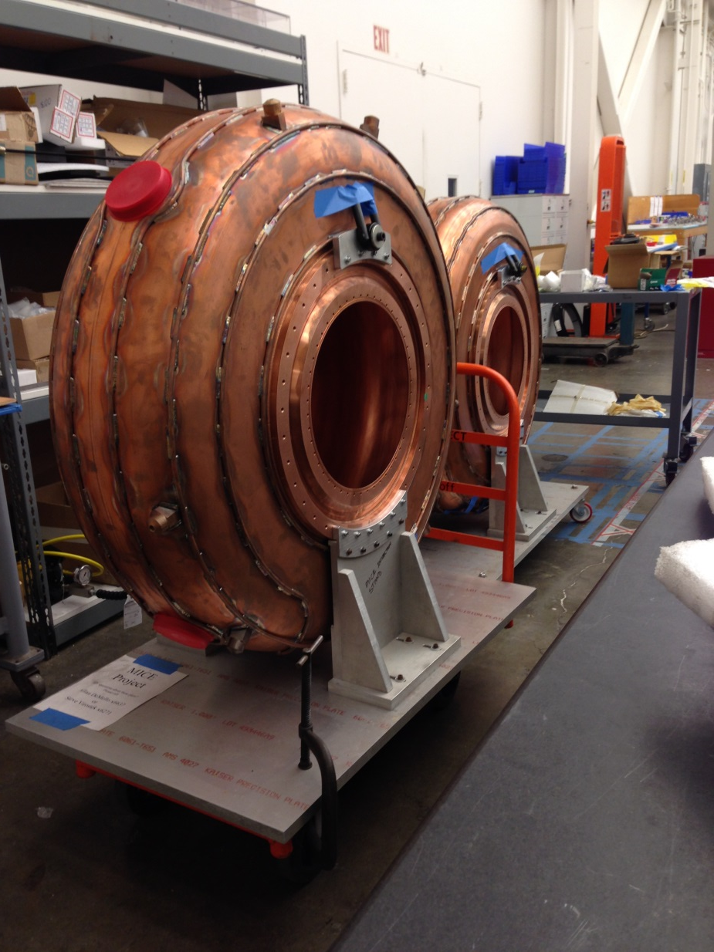
Current Status of Cavities
Seven cavity bodies have been moved out of storage container
Two cavity bodies are moved out of box and installed on inspection stands
Installation of beryllium windows soon
RF cavity frequency measurement setup in progress
Assembly Shop at LBNL
December 2, 2014

Slide 10
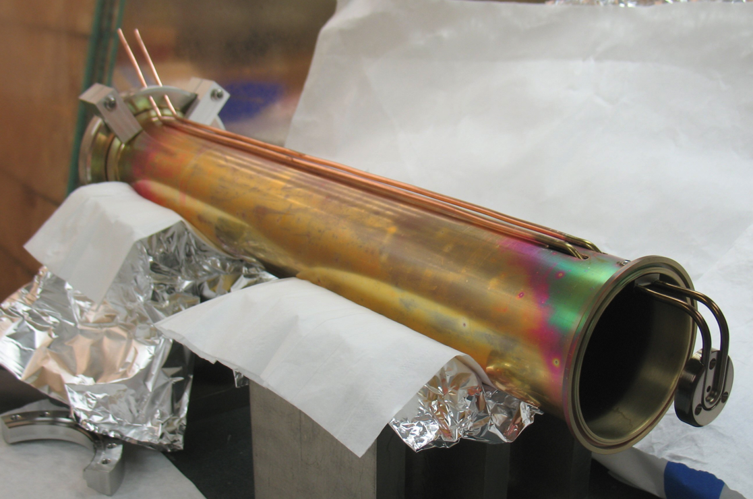
RF Coupler
Two RF power couplers for MICE prototype cavity currently under high power testing at MTA
Installation and testing experience/results to be incorporated
  Improve new coupler design, and possibly post-processing of the coupler surface if needed
Proposed changes
  Vacuum issues at RF ports
  RF coupler flange for easer
  Installation and adjustment
Post-processing
  TiN-coating of RF windows
  (copper region)
  EP and TiN-coating on inner
  coaxial line and loop

Slide 11
Cavity Tuners
25 tuner folks available (at UMissi now)
New actuator design complete, prototyping of the new design in progress
  Experience from assembly and testing of the single cavity vessel at MTA
    Vacuum leak
    Complexity and hard to
    fabricate ➔expensive and
    long lead time
  New design greatly
  reduce fab. complexity,
  and offer more reliable
  operation

Slide 12
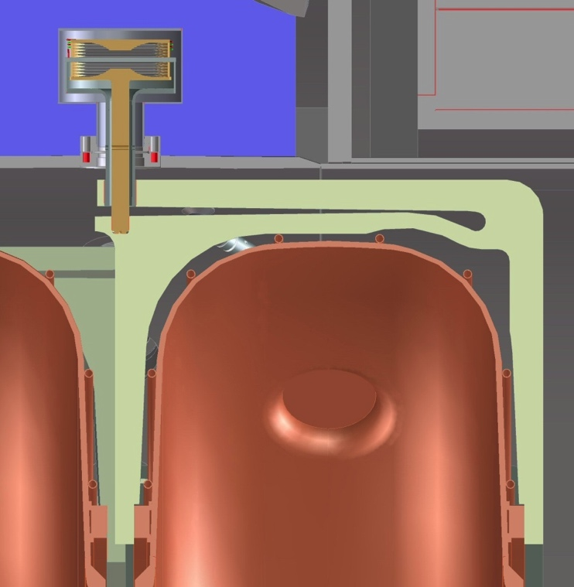
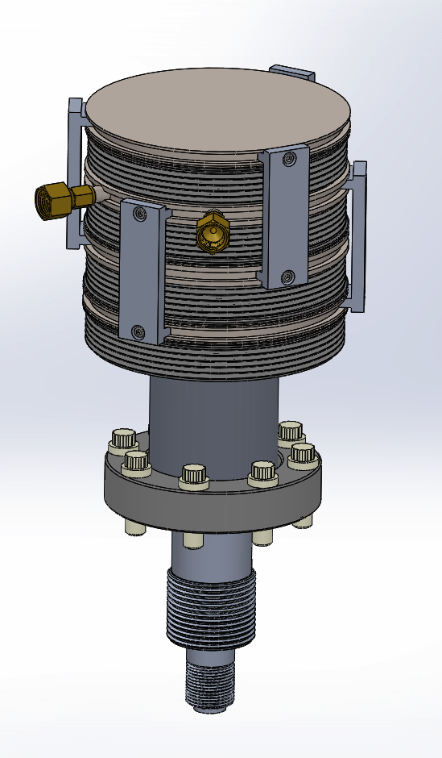
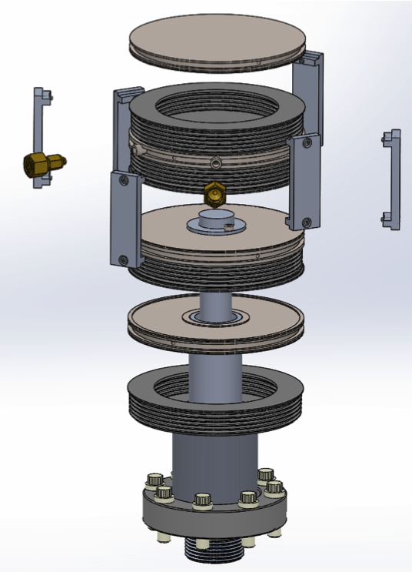
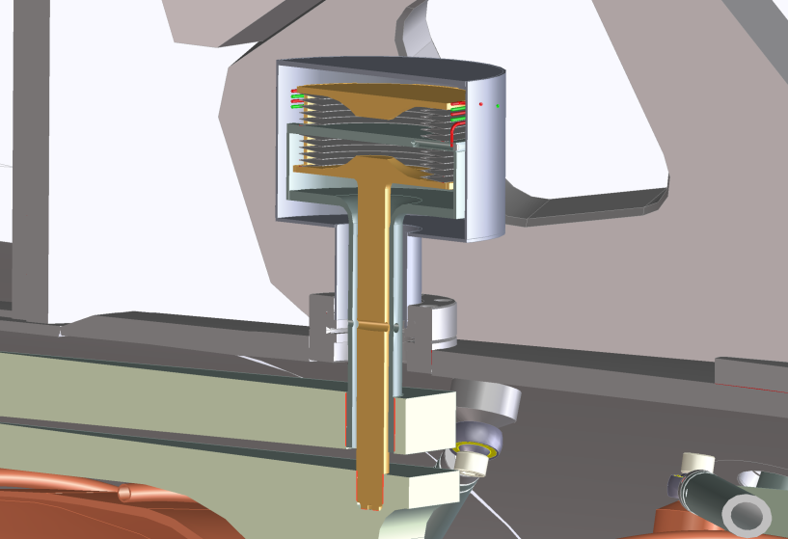
Actuator Design Improvement
Re-use bellows we already have
(Thanks to D. Summers)
Simpler parts to make
Old design

Slide 13
New Actuator Design
International design review complete
Prototyping:
  Prototype fabrication drawings complete
  PO of materials next week
  Fabrication starts Mid-Dec. 2014
  Development of fabrication procedures and techniques
  Quality control and check
  Functional test January-Feb. 2015
  Test setup for single actuator test already received from Fermilab

Slide 14
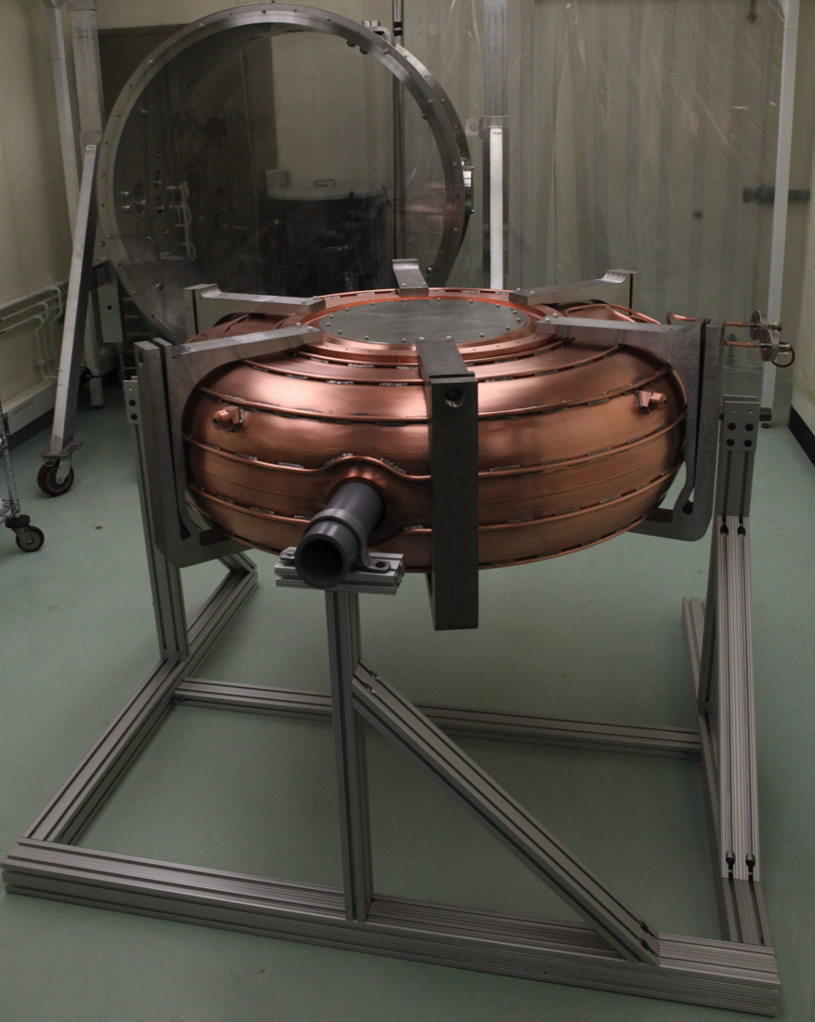
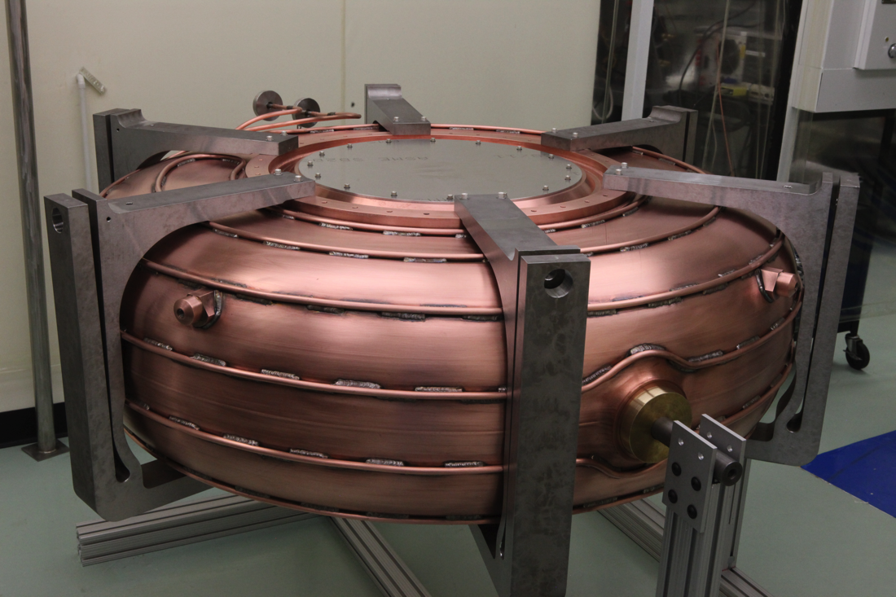
Integration
Using fixtures and procedures developed for the MICE prototype cavity
  Support stand shipped
  Making missing pieces
Testing of tuners at LBNL

Slide 15
RFA Vessel
Waiting for final confirmation of dimensions
  December 24, 2014
Very similar/identical to the single cavity vessel at MTA, Fermilab
Vacuum conceptual design
  RF cavity/coupler vacuum
  Exterior vacuum connecting to the rest of MICE cooling channel (collaboration with RAL)
Proposed RF vacuum system design review
  Mid-January 2015

Slide 16
Proposed RFA Schedule
Delivery date of two RFA modules to RAL
  Mid-May 2016 (details in MICE WBS)
  Full characterization tests of tuners after assembly
  RFA module assembly starts in the fall of 2015
  All hardware components ready by Oct. 2015
  RFA vessel fabrication readiness review
    Mid-April 2015
  RF coupler final review (experience from MTA)
    May 2015
  Cavity (with beryllium windows) selection and EP
    Mid-June 2015
  Production of actuators
    Starts March 2015

Slide 17
Summary
MICE Step V’ represents reduced cost and technical risk relative to MICE Step V
Experience/procedures/fixtures developed for MICE prototype cavity and the single cavity vessel can be directly applied to RFA
Improvement to hardware design & fabrication only to incorporate lessons learned from MTA
Schedule and resources for design/fabrication/assembly/delivery developed under MAP
LBNL team committed to meet the schedule

